Slide 1
THIS PRESENTATION MUST BE UPLOADED BEFORE THE PRESENTATION TIME (14:15)
Galactic Speed Project
Gaetan Jenni and Axel Juaneda
EE-390(a) TP de conception de systems numériques

Slide 2
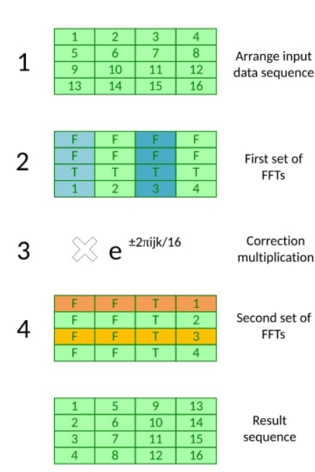
The Bailey algorithm
Variation of the Cooley–Tukey FFT algorithm originally designed for systems with hierarchical memory
Could provide a good starting point for optimizations
Lots of parallelization
Cache efficiency
Row/Col major alternance very efficient in hardware (BRAM)
Off-core computation, multiple small FFT that can be loaded in memory
‹#›

Slide 3
Fixed Point
Goal:
Reduce resource usage
Improve SNR since FXP is computed the same way on the pynq and on the core i9
How:
Normalized the FFT by nfft to stay in the same range for all configurations and stages
Issue:
We implemented the FXP only in our FFT so we do lots of FXP/FP conversion

Slide 4
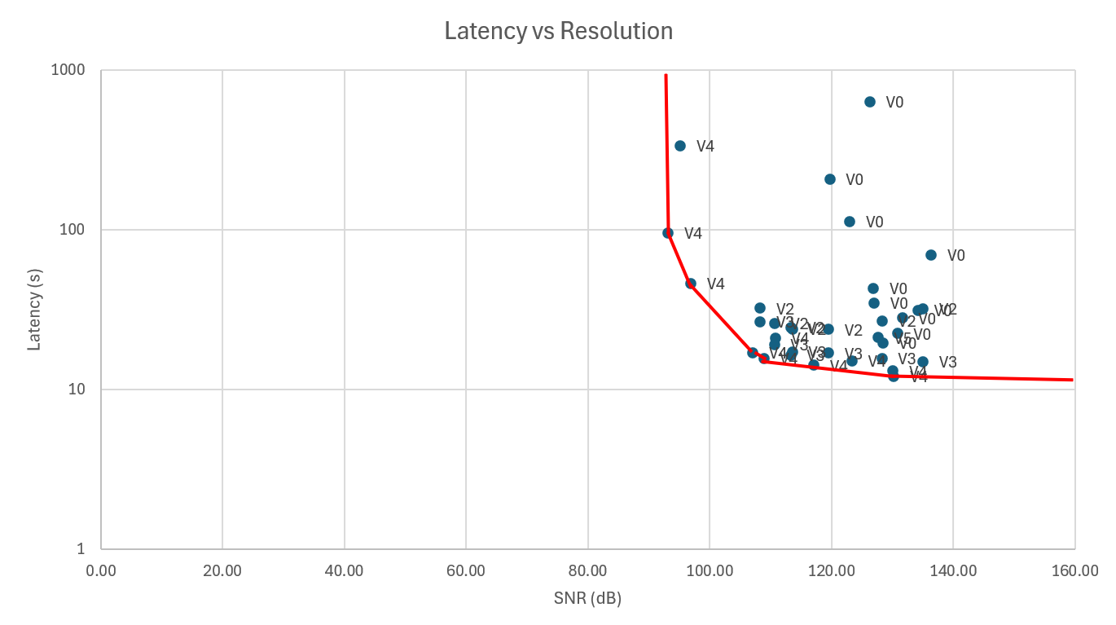
Summary of the project
Number of solutions generated: 4
V2: Bailey software-hardware
V3: Bailey software-hardware opti
V4: Bailey full software
V5: Bailey full hardware
‹#›

Slide 5
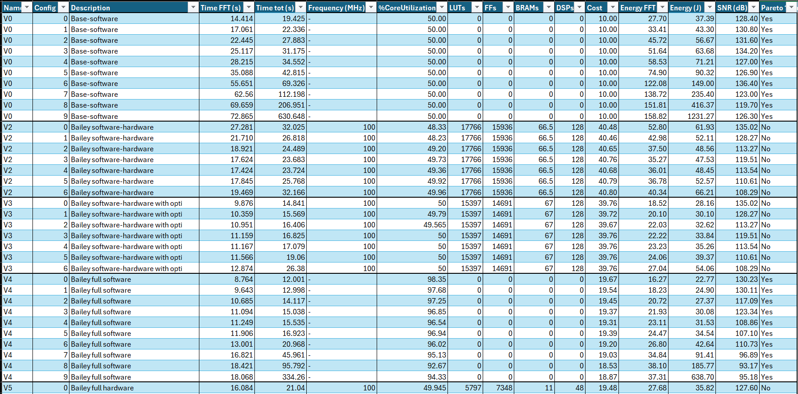
Solutions
‹#›

Slide 6
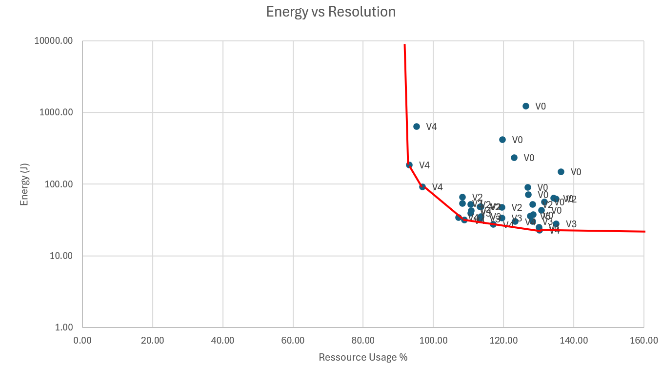
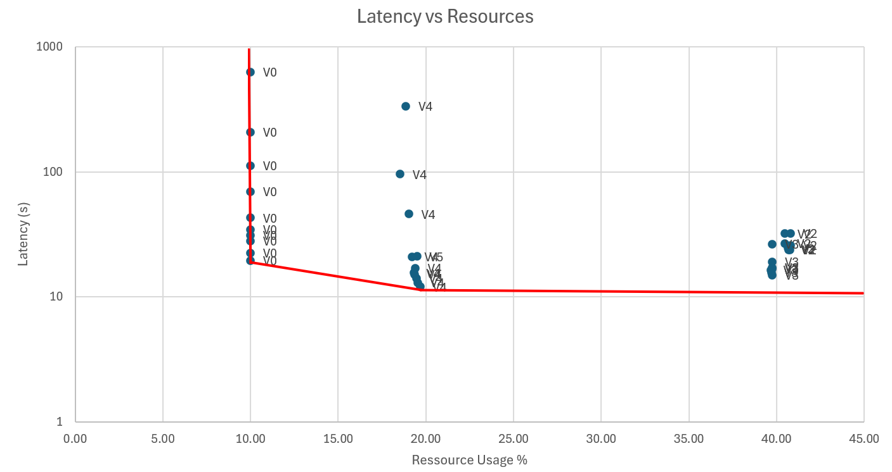
Summary of the project
‹#›

Slide 7
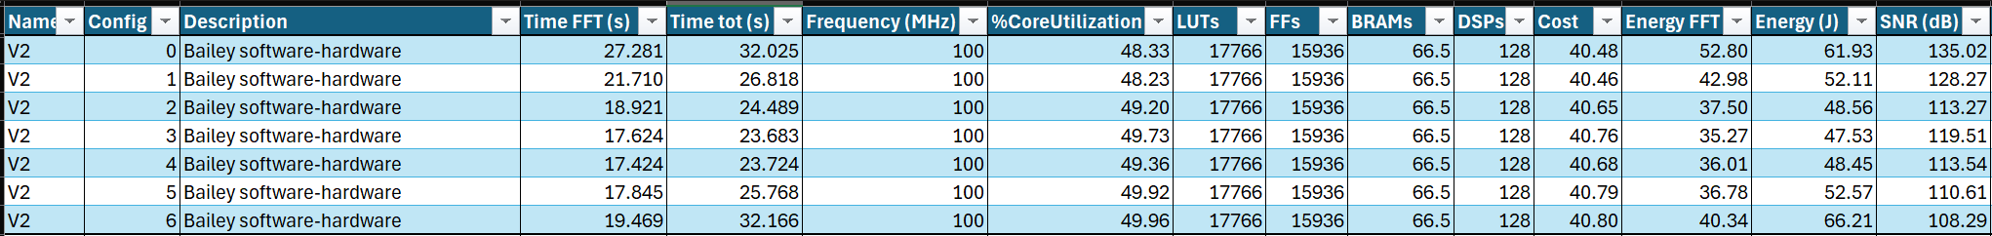
Solution V2: First Bailey software-hardware
Only the FFT inside hardware -> 2^10 NFFT maximum
Use of caching with ACP port
Twiddles in LUT
Ping pong buffer
Dataflow with 8 workers
Test with kernel -> slower because the switch between user-space and kernel-space is costly
‹#›

Slide 8
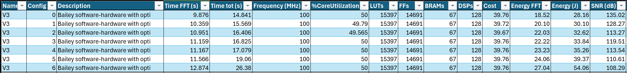
Solution V3: Bailey software-hardware optimized
2 AXI bus to burst real + imag
Software optimizations
‹#›

Slide 9
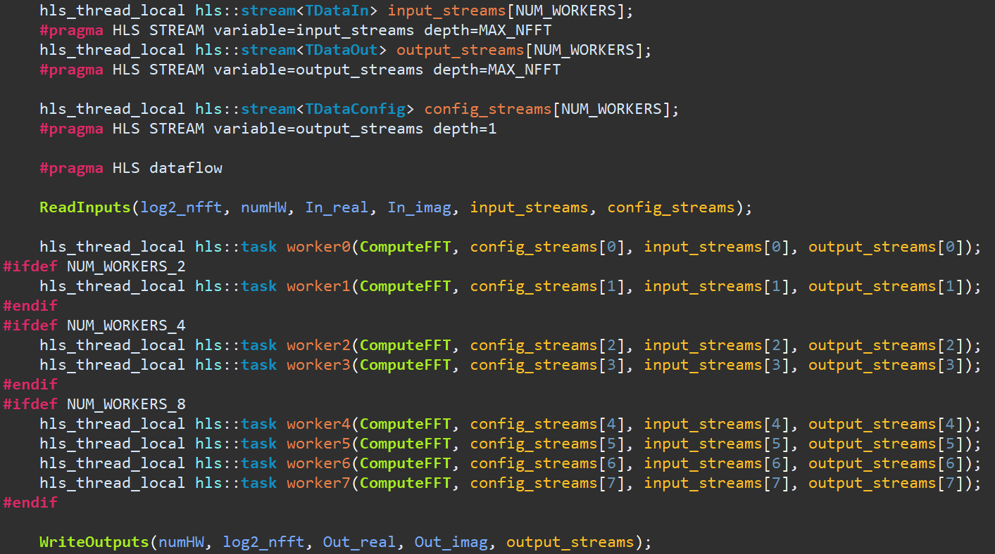
Solution V3: Bailey software-hardware optimized
‹#›

Slide 10
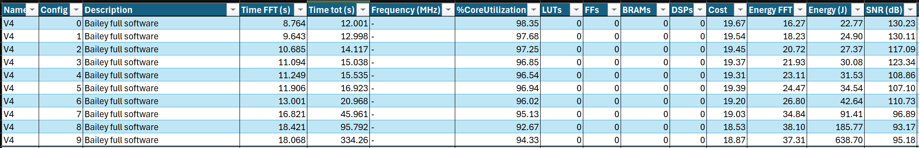
Solution V4: Bailey full software
Usage of OpenMP to parallelize with 2 threads
‹#›

Slide 11
Solution V5: Bailey full hardware
Use ap_uint to reduce resource usage
Highly specific to config 0
Did not had time to optimize it (no unrolling, poor burst…)
‹#›

Slide 12
Conclusions
Major achievements of your project
Dataflow
Bailey FFT implementation
Cache optimization
Good scaling
“High flexibility”
Hurdles encountered during the project
Cache decoherence
Kernel crash
Strategic bottlenecks
Final words about the project and the course
Exploring many technical options and being highly creative is exciting, but it also makes it easy to head in the wrong direction.
Incredibly time-consuming but super interesting.
‹#›

