Slide 1
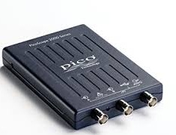
Class
BufferMan
Class
picoConfig
acquireData
BMregister
picoIni
manageDataBuffer
BMregister_mpQ
Consumer
thread
. . .
acquirePicoData
getEvent
deque
mpQueue
Consumer
sub-process
start
run
getStatus
pause
reportStatus
end

