Slide 1
GODIVA Simulink Building Blocks

Slide 2
GODIVA Simulink Building Blocks
Introduction: Plan cells and Choice cells

Slide 3
Plan cells
input
Plan cells
output
Group of cells/neurons. Excitatory inputs form an “input pattern”. Cell activations for an “output pattern”

Slide 4
Plan cells
input
output
input
Plan cells
output
time
Behavior: Output cells simply hold pattern of activation observed in input pattern

Slide 5
Plan cells
Inhibitory input
Inhibitory input
output
input
Plan cells
output
time
Behavior: Inhibitory inputs inhibit activation in individual Plan cells

Slide 6
Choice cells
input
Choice cells
output
Like Plan cells: group of cells/neurons. Excitatory inputs form an “input pattern”. Cell activations for an “output pattern”. But behavior is different compared to Plan cells

Slide 7
Choice cells
input
output
input
Choice cells
output
time
Behavior: Output cells keep only activation in cell with highest activation (winner takes all)

Slide 8
Choice cells
input
Inhibitory input
output
input
Choice cells
output
time
Behavior: Output cells keep only activation in cell with highest activation (winner takes all). But now, output pattern is maintained and input is disregarded (until choice cells are inhibited, which would initiate a new winner-takes-all competition)

Slide 9
GODIVA Simulink Building Blocks
Main building block in goDIVA
(phonological and frame representations)
inhibition
input
Plan cells
output
Choice cells
gate

Slide 10
Main building block in goDIVA
input
Plan cells
output
Choice cells
Behavior: Plan cells keep copy of input pattern. Choice cells select cell with highest activation
e.g. Speech Sound Map

Slide 11
Main building block in goDIVA
input
Plan cells
output
Choice cells
Behavior: When choice cells select cell with highest activation, that cell is inhibited/deleted in the original Plan cells pattern. Then the choice cells would select the cell with second-highest (now highest) activation, and this process would repeat, sequentially selecting and “deleting” the next highest activation until all cells are inactive

Slide 12
Main building block in goDIVA
input
Plan cells
output
Choice cells
gate
Behavior: When choice cells select cell with highest activation, that cell is inhibited/deleted in the original Plan cells pattern. But now choice cells activation will not change unless gate signal is received (this allows control timing of sequence read-out)

Slide 13
Main building block in goDIVA
inhibition
input
Plan cells
output
Choice cells
gate
Behavior: feedback from other layers can now directly modulate choice cell activation (e.g. goDIVA uses this for sequential read-out of stack of choice cells in phonological representation)
e.g. phonological representation

Slide 14
Main building block in goDIVA
inhibition
input
Plan cells
output
Choice cells
gate
Behavior: additional control of timing of sequence read-out. Choice cells activation will not change unless gate signal is received AND output is explicitly inhibited or cells are already inactive;
e.g. frame representation

Slide 15
Main building block in goDIVA
inhibition
input
Plan cells
output
Plan cells
Choice cells
Plan cells
Choice cells
Choice cells
gate
Note: stack of Plan and Choice cells are used in goDIVA to represent different channels/slots in phonological representation (encoding relative position of phonemes within syllable, see below)

Slide 16
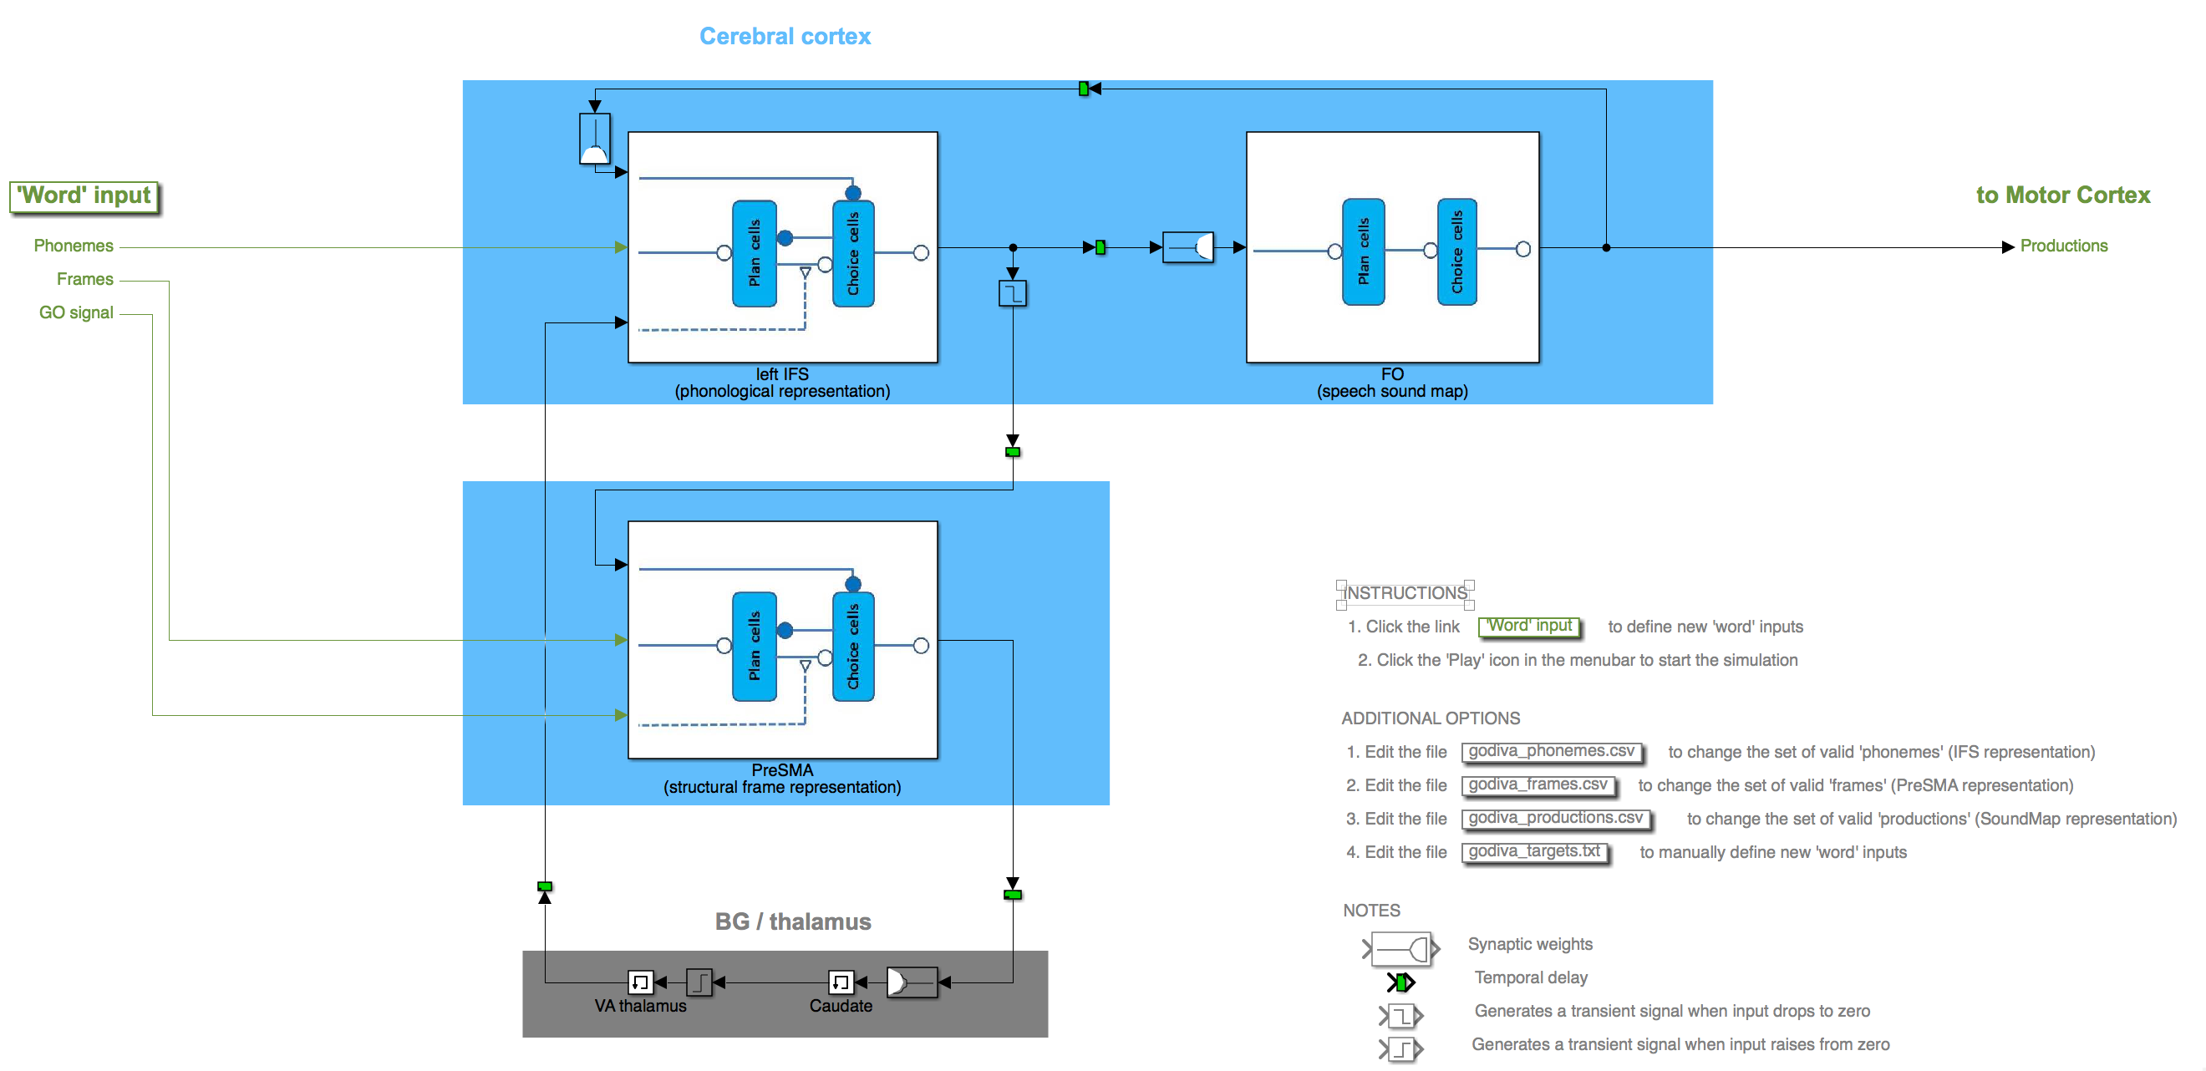
GODIVA Simulink Building Blocks
godiva model (Simulink)

Slide 17
GODIVA Simulink Building Blocks
godiva model (Simulink)
Phonological representation
Speech Sound Map
Main building blocks
Frame representation

Slide 18
GODIVA Simulink Building Blocks
godiva model (Simulink)
Phonological representation
Speech Sound Map
3: hh l
4: ae ow
5: s
#phonemes
1
2
3 hh l
4 ae ow
5 s
6
7
#frames
1 CV CVC
CV
CVC
Behavior:
Target phonological & frame representations stored in IFS&preSMA Plan cells. (note: activation strength represents relative order; phonemic representation contains 7 channels/slots for different positions of phonemes within each syllable)
Frame representation

Slide 19
GODIVA Simulink Building Blocks
godiva model (Simulink)
Phonological representation
Speech Sound Map
#phonemes
1
2
3 hh l
4 ae ow
5 s
6
7
#frames
1 CV CVC
CV CV
CVC
Behavior:
2) GO signal activates transfer in preSMA of first frame (most active) to Choice cells
Frame representation

Slide 20
GODIVA Simulink Building Blocks
godiva model (Simulink)
Phonological representation
Speech Sound Map
3: hh l
4: ae ow
5: s
3: hh
4: ae
#phonemes
1
2
3 hh l
4 ae ow
5 s
6
7
#frames
1 CV CVC
Behavior:
3) This, in turn, activates transfer in IFS of first phonemes (most active in each channel/slot) to Choice cells
Frame representation

Slide 21
GODIVA Simulink Building Blocks
godiva model (Simulink)
Phonological representation
Speech Sound Map
3: hh
4: ae
hh-ae
#phonemes
1
2
3 hh l
4 ae ow
5 s
6
7
#frames
1 CV CVC
Behavior:
4) Speech Sound Map matches a portion (or all) of the IFS pattern (learned sequences). SSM sends the corresponding motor command to motor cortex. It also sequentially inhibits/deletes the identified/read-out portions of IFS choice cells, until all choice cells in IFS are inactive
Frame representation

Slide 22
GODIVA Simulink Building Blocks
godiva model (Simulink)
Phonological representation
Speech Sound Map
#phonemes
1
2
3 hh l
4 ae ow
5 s
6
7
#frames
1 CV CVC
CV CVC
CVC
Behavior:
5) All IFS choice cells inactive triggers the inhibition of preSMA choice cells, which enables the transfer of the next frame stored in preSMA plan cells to preSMA choice cells
This in turn activates the transfer in IFS of the associated phonemes stored in IFS plan cells to IFS choice cells (same as step 3), so the entire process is repeated (steps 3-5)
Frame representation

Slide 23
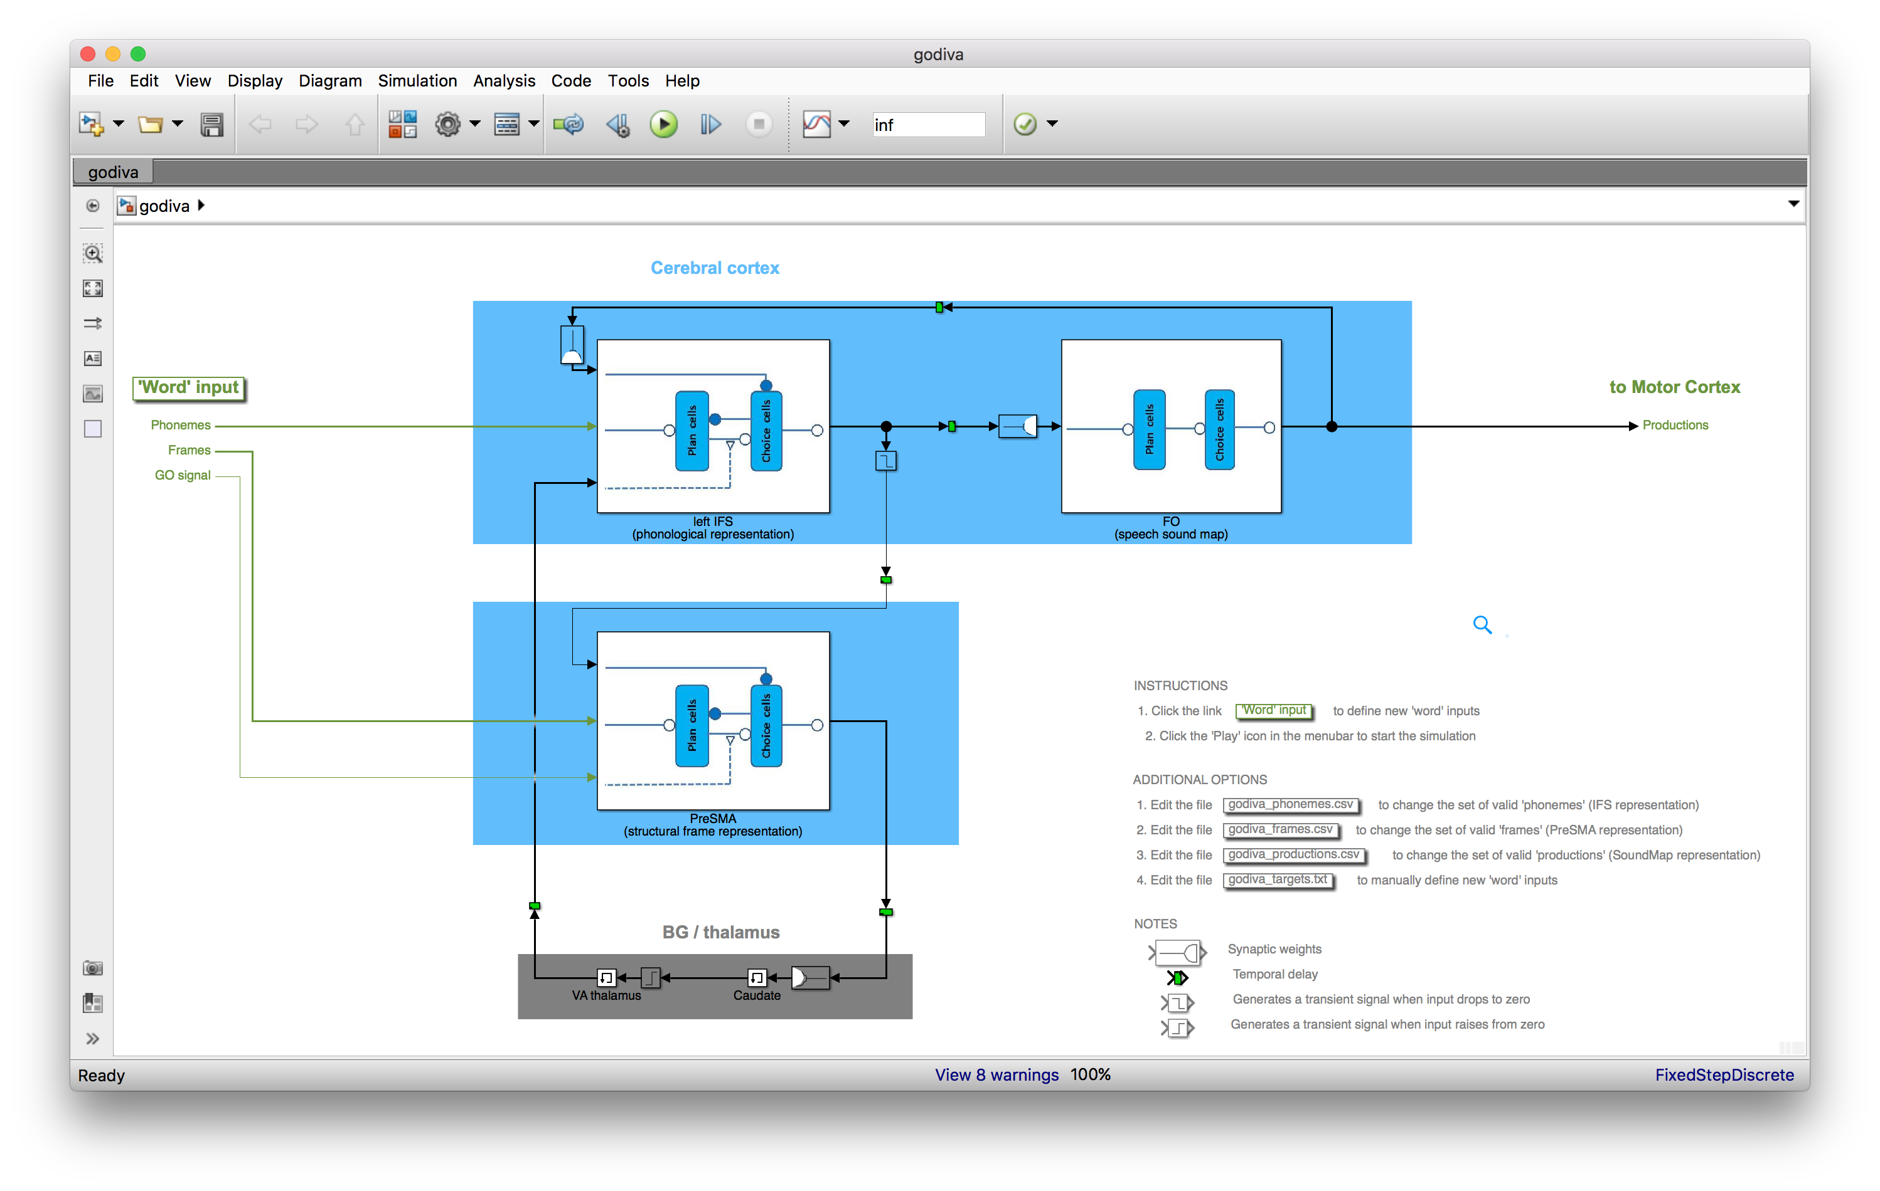
GODIVA Simulink implementation
2. Start simulation
1. Define word target

Slide 24
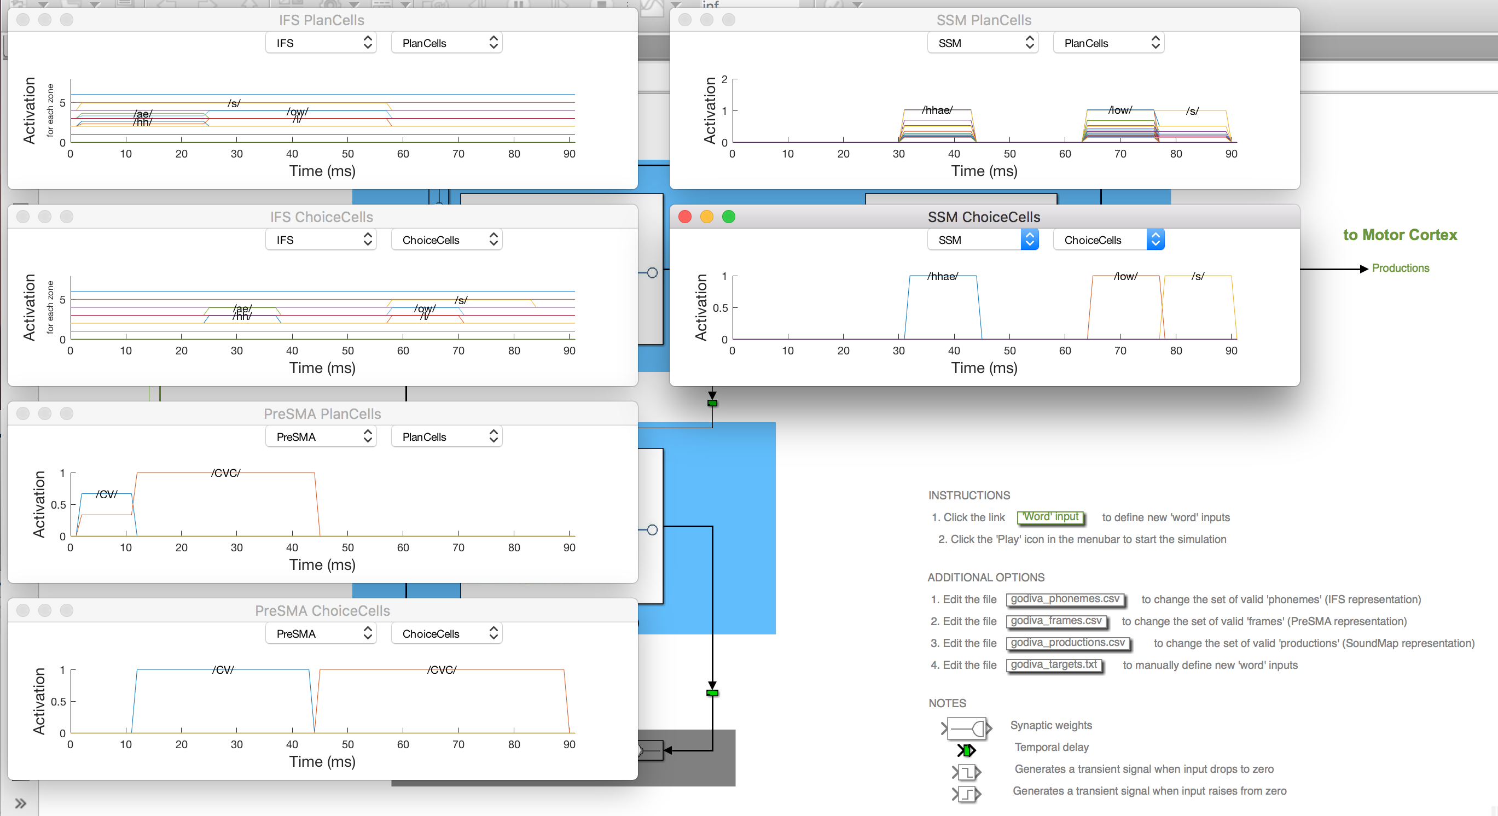
GODIVA Simulink implementation
Activation timeseries (IFS, SSM and preSMA plan and choice cells)

Slide 25
GODIVA post-presentation homework:
Simulate production of word “tictac”. Explain activation timeseries
Add word ‘tac’ to soundmap representation and repeat simulation (1)
3) What possible change(s) to the learned representations or to the model connections could cause the simulation above to repeat only the first half of the production (tic) over and over (e.g. tic tic tic …)?

Slide 26
Plan cells

Slide 27
Plan cells
Choice cells

