Slide 2
Computational approaches for the therapeutic target discovery to ame-liorate muscle wasting during aging and disease
Msc Karen Guerrero Vazquez
Dr. Katarzyna Whysall
Dr. Pilib O Broin

Slide 3
Recap
Diff express genes and Gene Graphs

Slide 4






Slide 5
~3 – 8 %
Loss of muscle mass per decade
Brocklehurst, 1976
Notes:
. From the time you are born to around the time you turn 30, your muscles grow larger and stronger. But at some point in your 30s, you start to lose muscle mass and function. No matter the lifestyle, everybody is going to loss between 3 to 8% of muscle mass per decade after age 30, and this rate of decline is even higher after the age of 60. Sarcopenia is associated with detrimental clinical outcomes, such as a reduced quality of life, frailty, an increased risk of falls, fractures, hospitalization, and mortality.

Slide 6
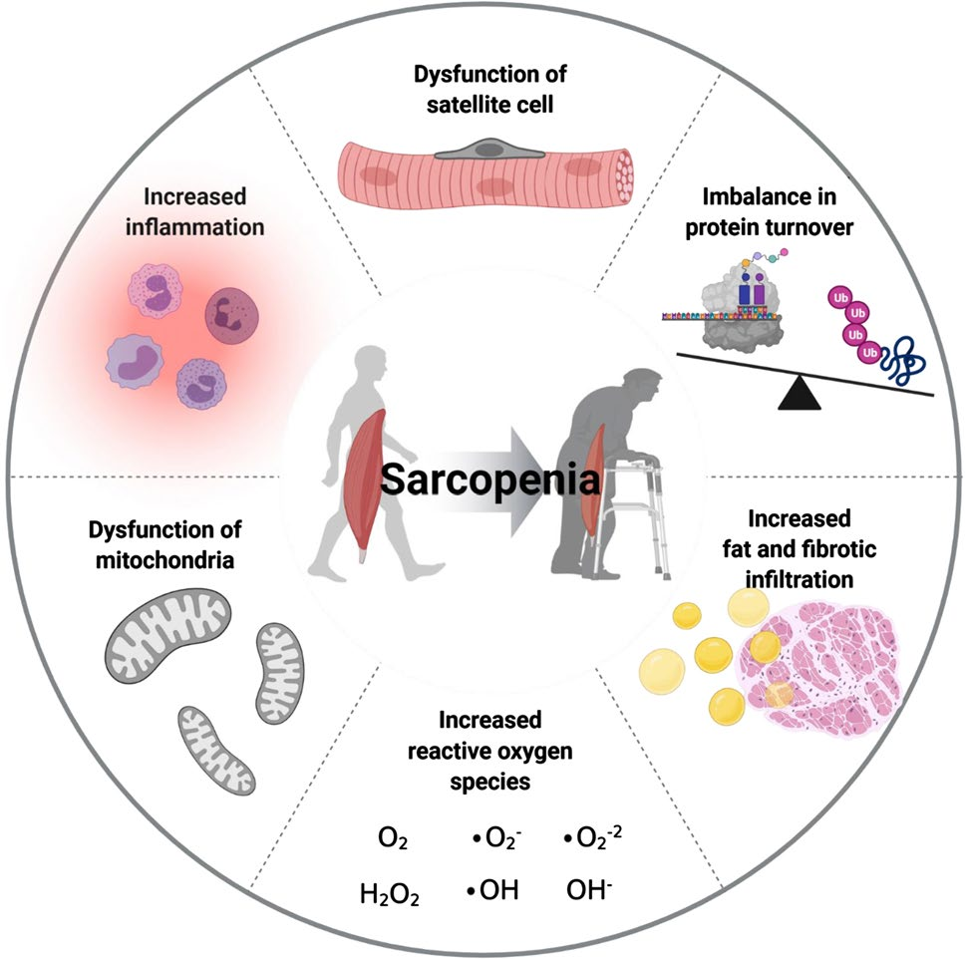
Aging and sarcopenia

Slide 7

MicroRNA (miRNAs)
MicroRNAs (miRNAs) are small single-stranded RNAs that play an important role in the regulation of gene expression. Their simultaneous regulation of multiple genes and pathways and ability to deliver miRNAs into most tissues without inducing systemic immune response, makes them attractive therapeutic candidates.

Slide 8
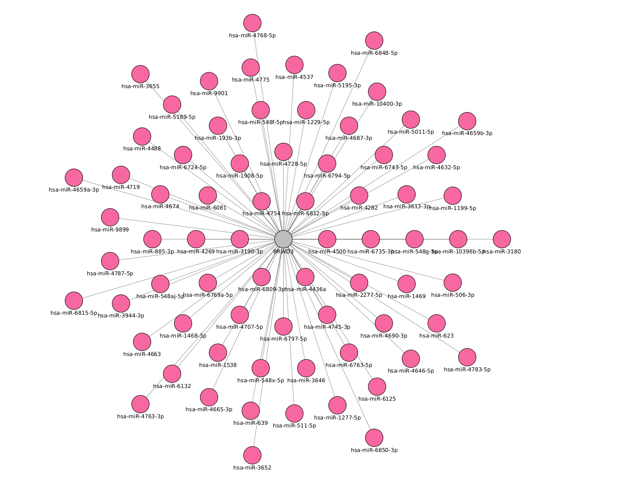
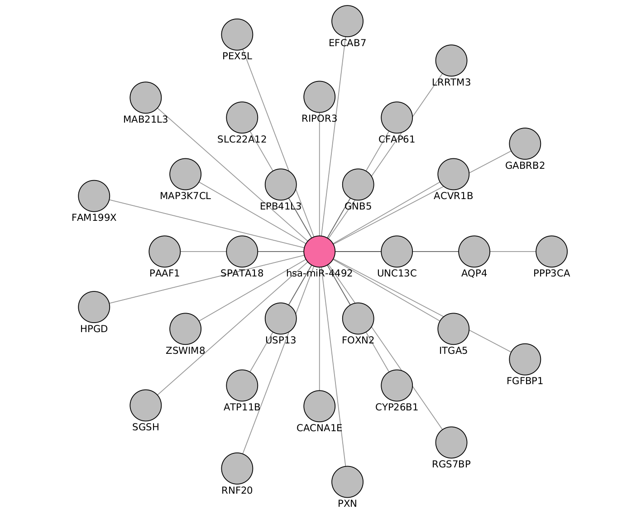
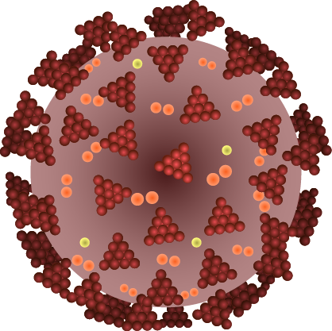
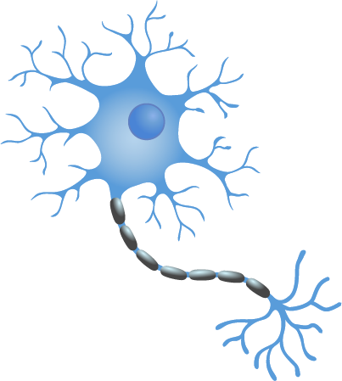
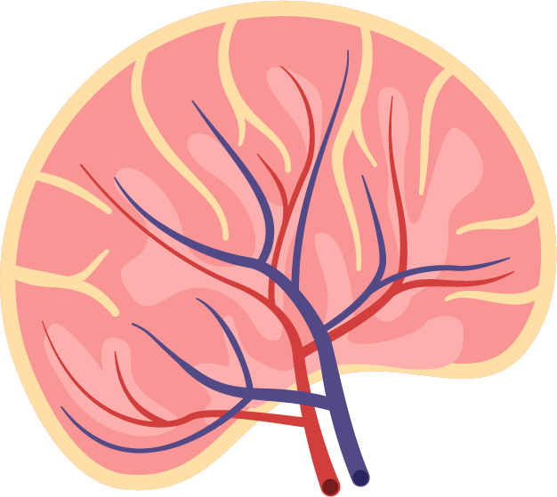
MicroRNA (miRNAs)
miRNAs are often ubiquitously expressed, have overlapping functions and can regulate multiple genes. Also, not all miRNAs are functionally relevant in a given cell type.

Slide 9
Objective
Create independent models and a common model of miR:target interactions in muscle loss during ageing and critical illness based on differentially expressed (DE) miRs and genes
Fine-tune
Test

Slide 10






Tools to analyze miRNAs

Slide 11
Tools to analyze miRNAs

Slide 12



Tools to analyze miRNAs

Slide 13
Tools to analyze miRNAs

Slide 14
Tools to analyze miRNAs

Slide 15
Tools to analyze miRNAs

Slide 16
Tools to analyze miRNAs

Slide 17
Tools to analyze miRNAs

Slide 18
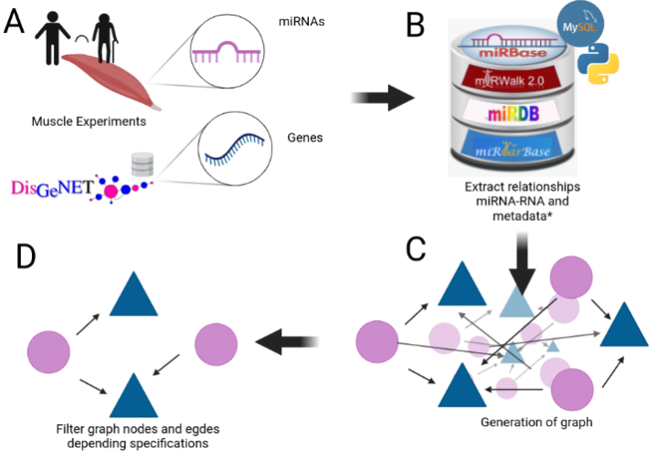
Notes:
We mentioned that aging have a lot of factors attached to it, in the specific case of Sarcopenia we can include chronic inflammation, increased reactive oxidative species, and increased fibrosis of muscle, among others have been reported to contribute to development of sarcopenia

Slide 19
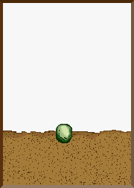
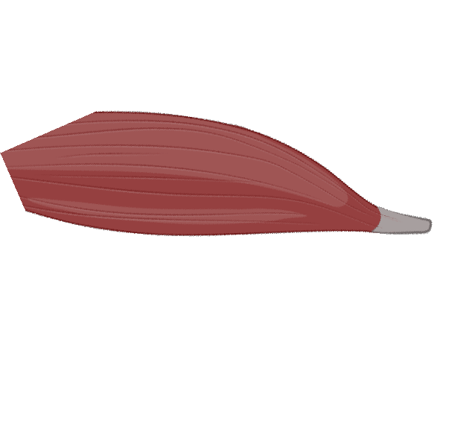

How to start

Slide 20
My Experiments
Target | Type | N. Experiments | Healthy | Non healthy
mRNA | RNAseq | 3 | 3 | 0
 | MicroArray | 4 | 2 | 2
miRNA | MicroArray | 2 | 2 | 0
 | miRSeq | 1 | 0 | 1
Proteomics | - | 1 | 1 | 0

Slide 21

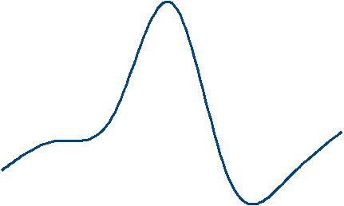
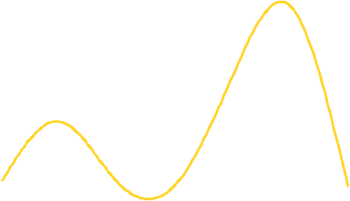
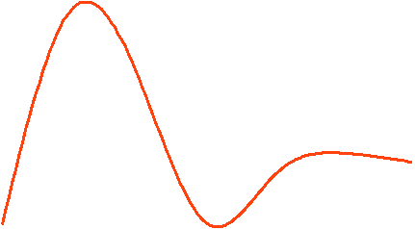
Expression during age
max
Expression
min
20
25
30
35
40
45
50
55
60
65
70
75
80
Age
Figure 2: change of gene expression by age

Slide 22
Expression during age
max
Expression
min
20
25
30
35
40
45
50
55
60
65
70
75
80
Age
Figure 2: change of gene expression by age

Slide 23
Expression during age
Middle age
Old
Young
Y
<35>
MA
<65>
O
Figure 2: change of gene expression by age

Slide 24
Experiments
GEO number | Samples | Min Age | Max Age | Reference
GSE152558 | 5 | 41 | 85 | Tharakan, R., Ubaida-Mohien, C., Piao, Y., Gorospe, M., & Ferrucci, L. (2021).
GSE164471 | 53 | 34 | 80 | Tumasian III, R. A., Harish, A., Kundu, G., Yang, J. H., Ubaida-Mohien, C., Gonzalez-Freire, M., ... & Ferrucci, L. (2021).
GSE157585 | 136 | 19 | >65 | Kulkarni, A. S., Peck, B. D., Walton, R. G., Kern, P. A., Mar, J. C., Windham, S. T., ... & Peterson, C. A. (2020).
GSE87105 | 16 | 30 | 78 | Mercken, E. M., Capri, M., Carboneau, B. A., Conte, M., Heidler, J., Santoro, A., ... & de Cabo, R. (2017)..
GSE23527 | 36 | 29 | 76 | Drummond, M. J., McCarthy, J. J., Sinha, M., Spratt, H. M., Volpi, E., Esser, K. A., & Rasmussen, B. B. (2011)

Slide 25
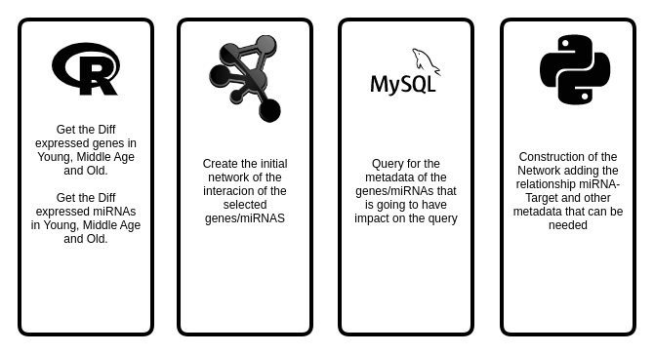
Tools that

Slide 26
Experiment | Evaluation | Regulation | Genes
GSE152558 | MO | UP | 8
GSE152558 | MO | Down | 9
GSE157585 | YO | UP | 9
GSE157585 | YO | Down | 73
GSE164471 | YO | UP | 5
GSE164471 | YM | UP | 2
GSE164471 | MO | UP | 6
GSE164471 | YO | Down | 8
GSE164471 | YM | Down | 2
GSE164471 | MO | Down | 11
GSE23527 | YO | Up | 1
GSE23527 | YO | Down | 5
GSE875105 | OY | Down | 88
GSE875105 | MO | Up | 6
GSE875105 | OY | Up | 18
Notes:
We mentioned that aging have a lot of factors attached to it, in the specific case of Sarcopenia we can include chronic inflammation, increased reactive oxidative species, and increased fibrosis of muscle, among others have been reported to contribute to development of sarcopenia

Slide 27

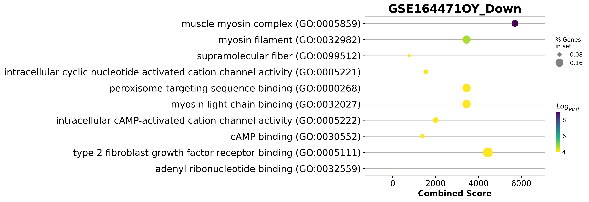
GSE164471 Dotplot

Slide 28
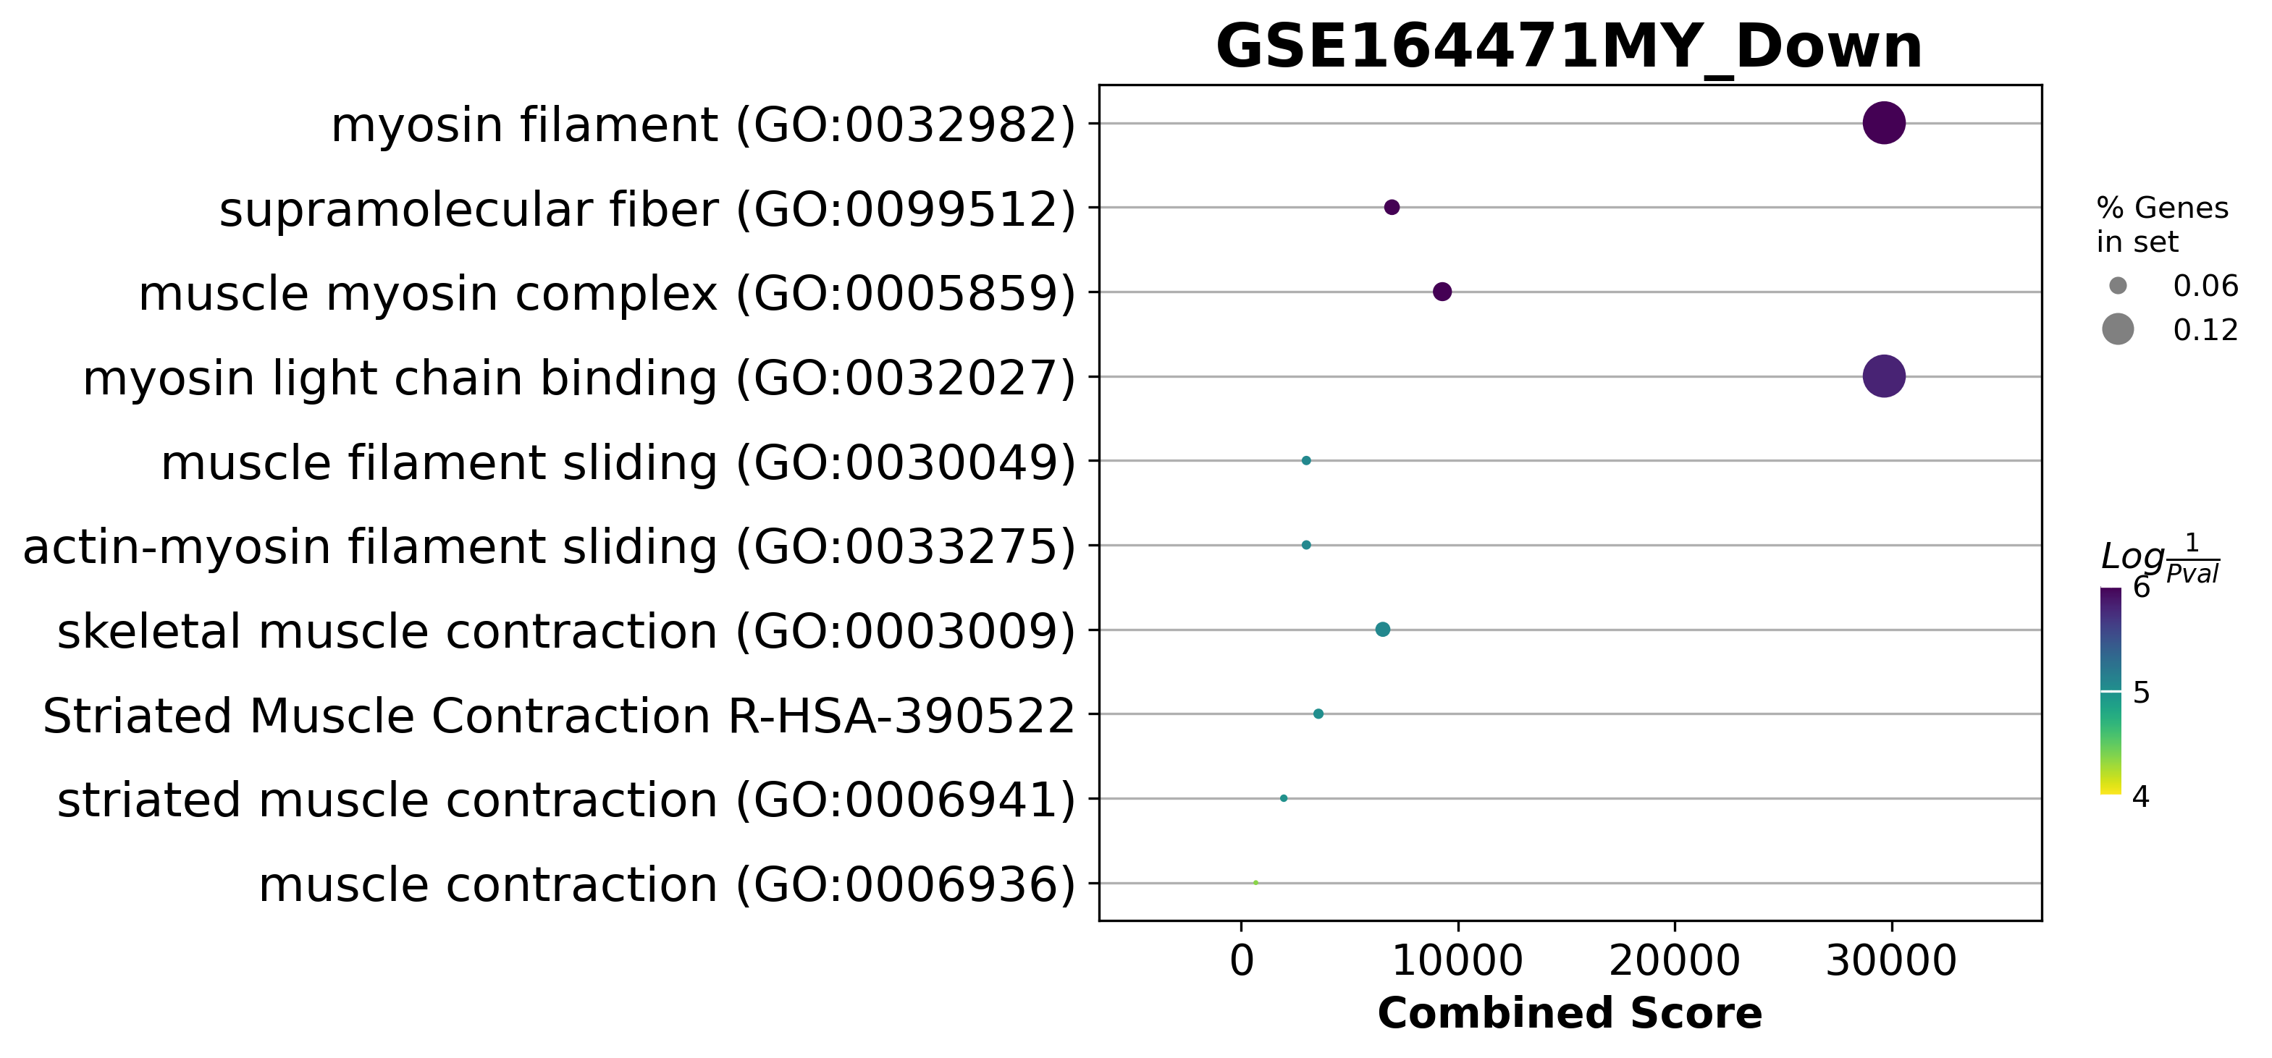
GSE164471Dotplot

Slide 29
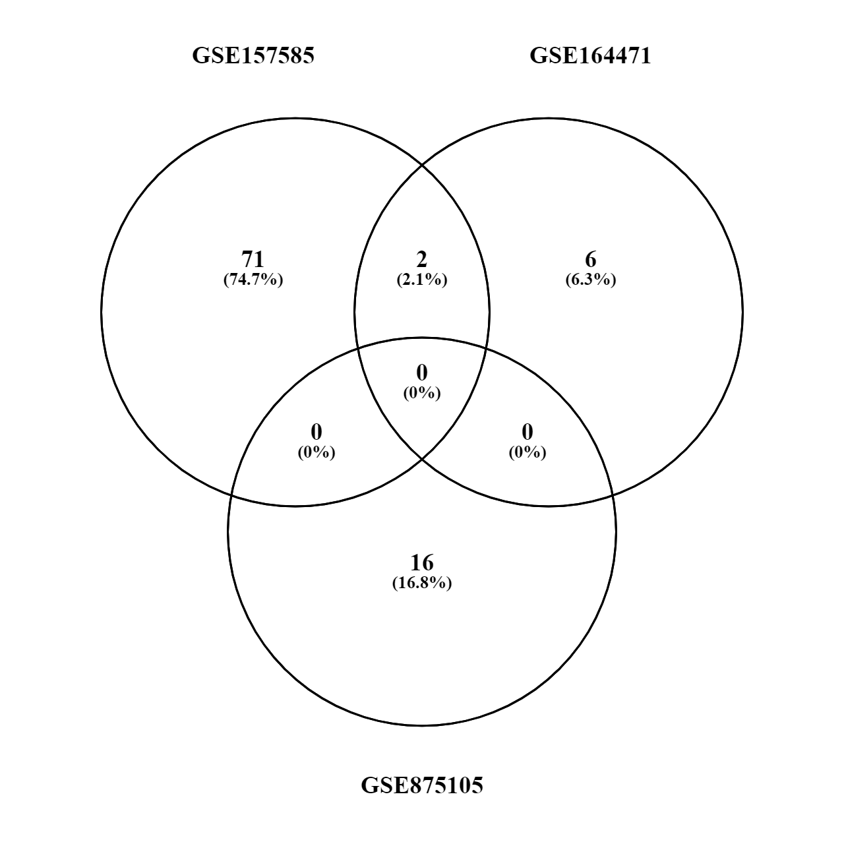
Old vs Young (up or down)
MYH8
HCN1

Slide 30
All comparisons (up or down)
MYH8
Young to Old
Young to Middle Age
2
1
8
0
1
MTCO1P12
4
MTND6P4
AC093809.1
12
MTND4P24
RPL10P9
Middle Age to Old

Slide 31
All comparisons (up)
Young to Old
Young to Middle Age
2
0
93
0
0
5
FAM96A
PAQR4
CISD1
FH
AIFM1
15
Middle Age to Old

Slide 32
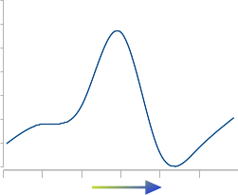
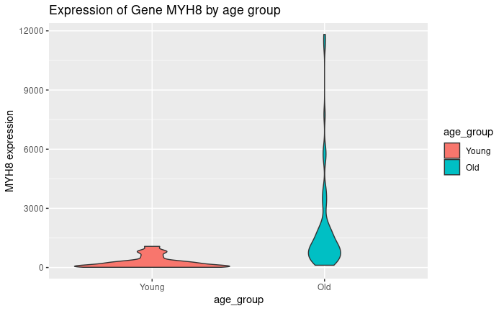
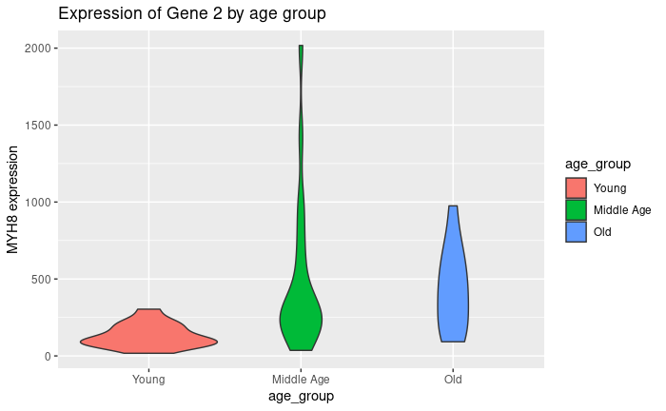
MYH8 raw count over age
Age
GSE157585
GSE164471

Slide 33
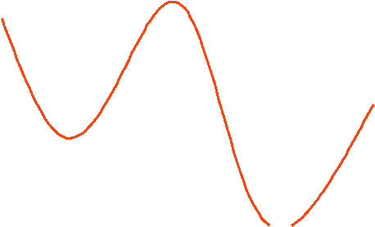
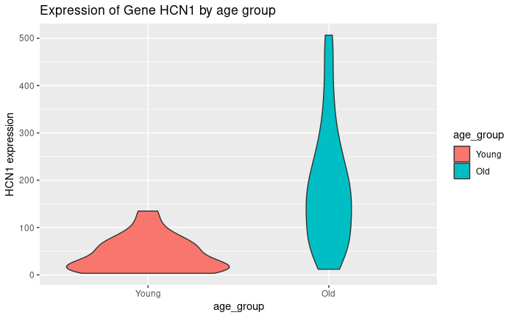
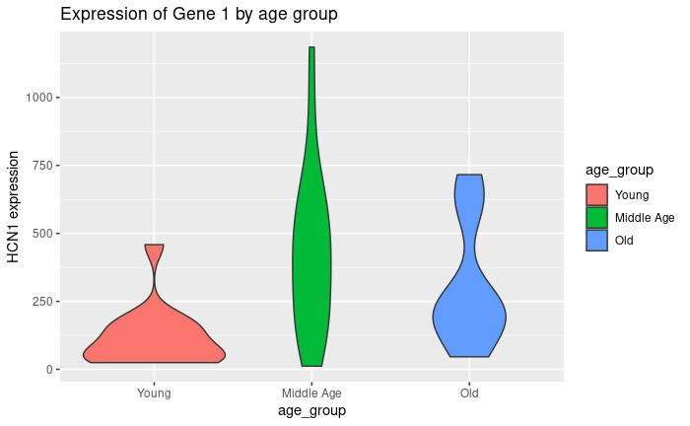
HCN1 raw count over age
GSE157585
GSE164471

Slide 34
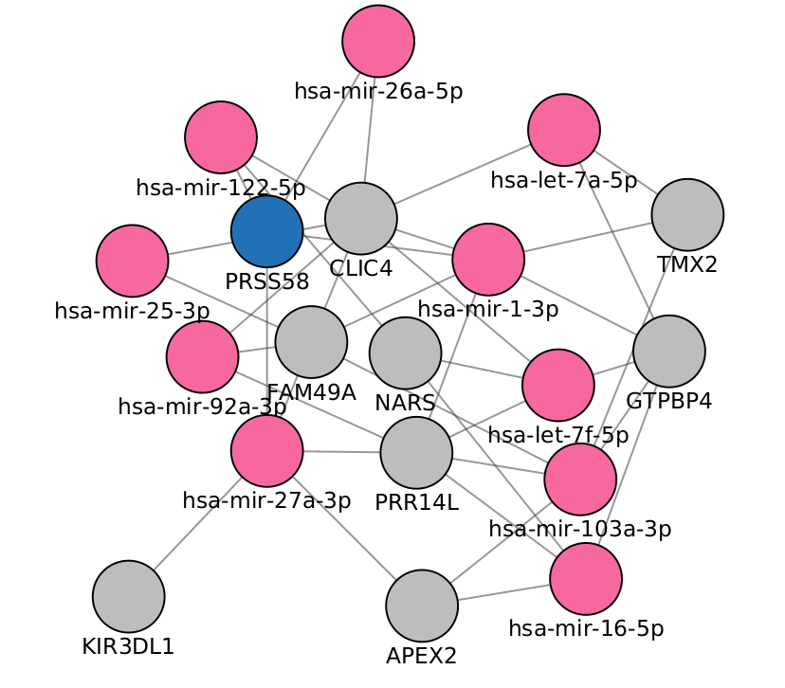

Slide 35
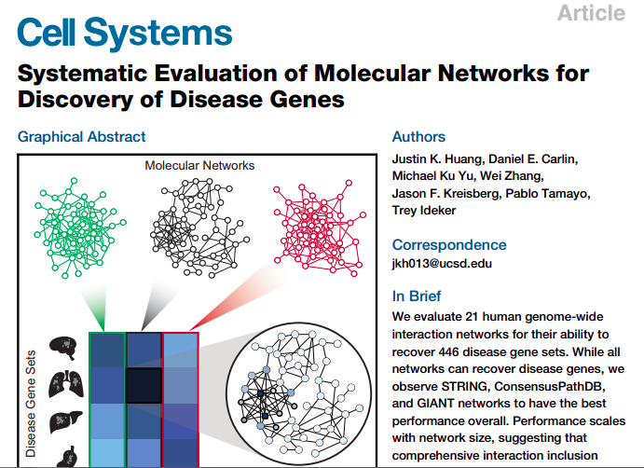

Slide 36
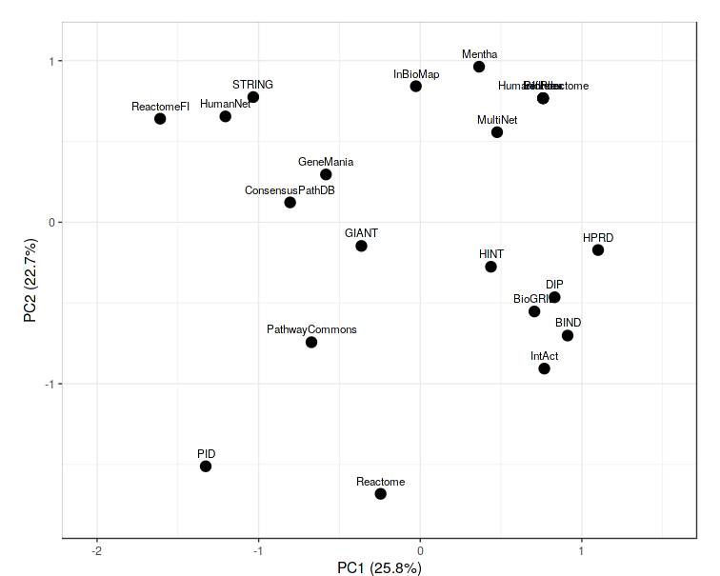



Slide 38



Slide 39
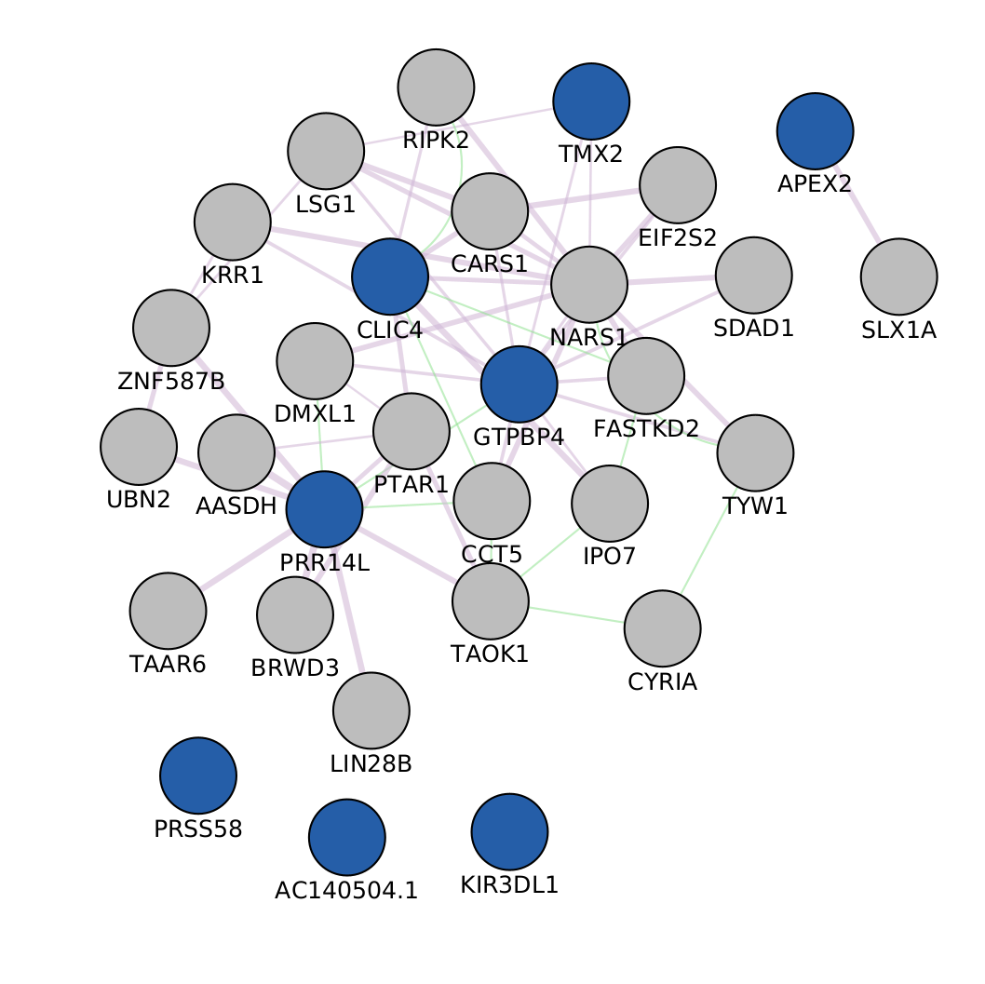



Slide 40
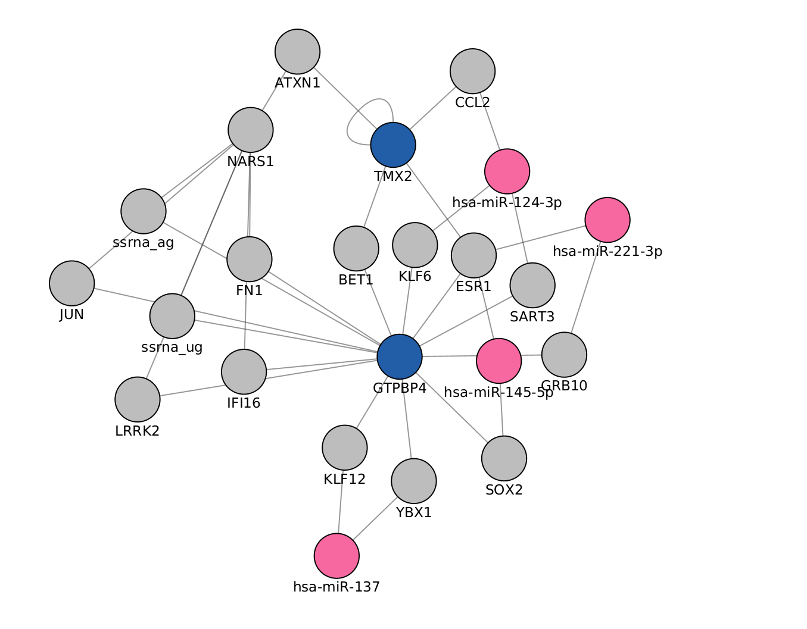
Known and recognizable miRNAs

Slide 41
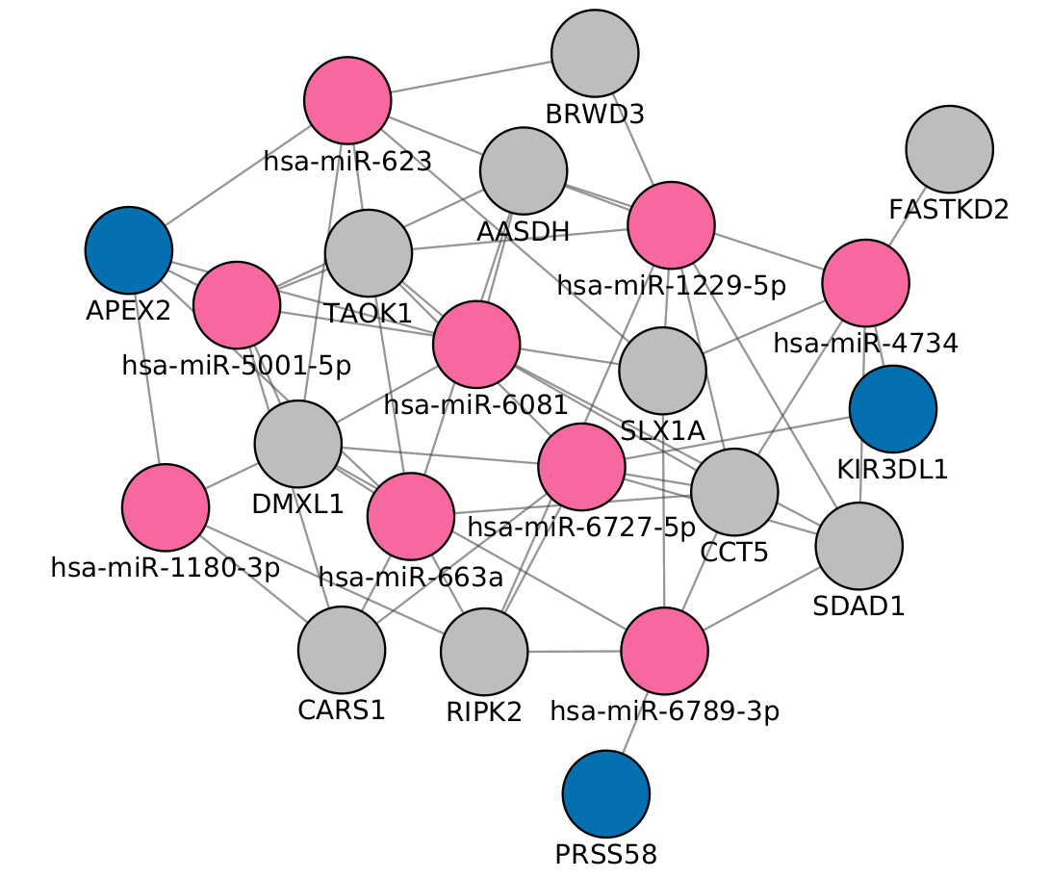

Slide 42
Measuring and evaluating
Identify a gene set of interest on the molecular interaction network.
Sub-sample a proportion of the gene set of interest.
Propagate using the random walk model across the molecular interaction network.
Sort all genes in the network by propagation score and then sweep this list to calculate a precision-recall curve of the list for recovering genes from (1) not contained in (2).
Calculate the area under the precision-recall curve (AUPRC) from (4).
Repeat (2-5) for 50 different sub-samples of the gene set of interest and average these values. This averaged AUPRC is the raw measure of performance for a given molecular network on clustering a gene set of interest.
Repeat steps 1-6 for 50 degree-preserved shuffles of the network on the same gene set of interest to construct a null distribution of average AUPRC values.
Calculate the robust Z-statistic (Rousseeuw and Croux, 1993) using the null distribution of average AUPRC values from (7) of the actual network’s performance on the gene set of interest. This is the performance score of a network for a particular gene se

Slide 43


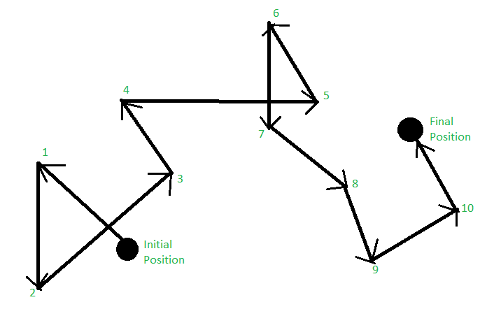
AUPRC

Slide 44
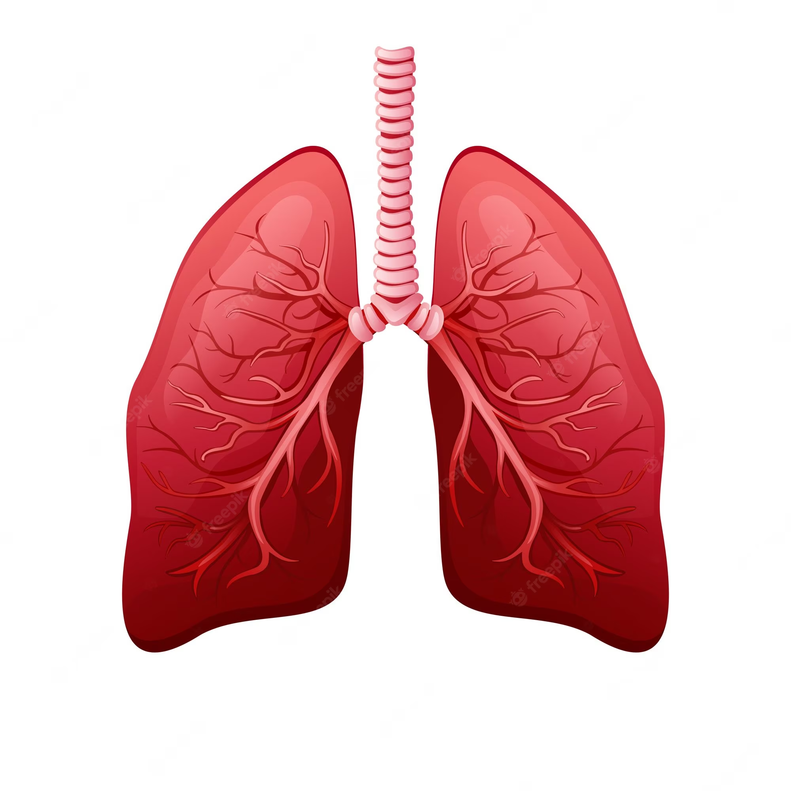

Slide 45
50% IntAct + Closeness centrality
20% mirNet
23%
GeneMania + PageRank
Differentialy expressed?

Slide 46
Next steps
Clean up the evaluation system
Define criteria for microRNA and gene selection
Select the microRNAs to send to the lab
Re run different configurations to find the best output
Work on the database

Slide 47




Conferences
20-21 April 2023
12 May 2023
22 May 2023
8-11 June 2023

Slide 48
Questions?
?

Slide 49
Thank You

Slide 50
Acknowledgements
This presentation has emanated from research conducted with the financial support of Science Foundation Ireland under Grant number [18/CRT/6214 ]

