Slide 1


Slide 2
Ribosome profiling analysis of human skeletal muscle identifies reduced translation of mitochondrial proteins with age

Slide 3
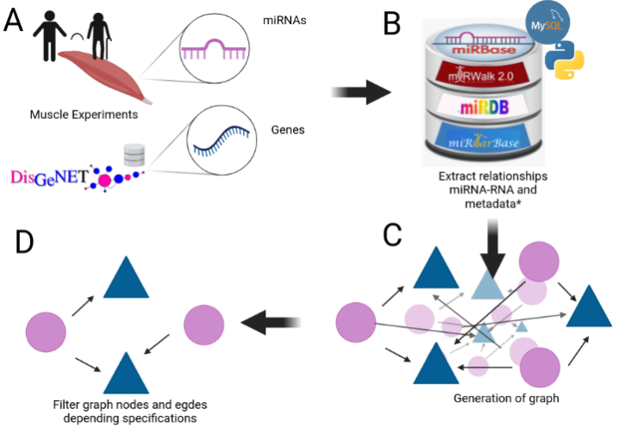
Why this paper?

Slide 4


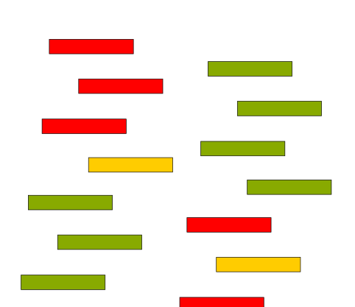


MicroArray
miRNAs
NGS
Genes
Proteins

Slide 5

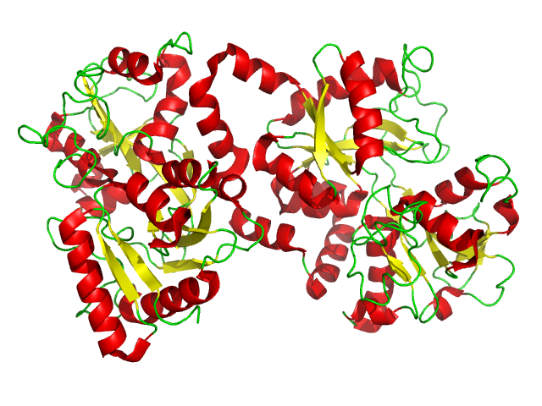

Skeletal muscle shows an age-dependent decline in the levels of different proteins, but whether such decline is associated with reduced translation has not been studied.

Slide 6
Background
protein translation is important for human longevity
Treatment with the drug rapamycin, a caloric restriction mimetic that prolongs life span in animal models, functions at least in part by reducing protein translation

Slide 7
Background
The mechanisms whereby lowering translation promotes longevity are not understood, and it is unknown whether modifications of translation occur during human ageing.

Slide 8
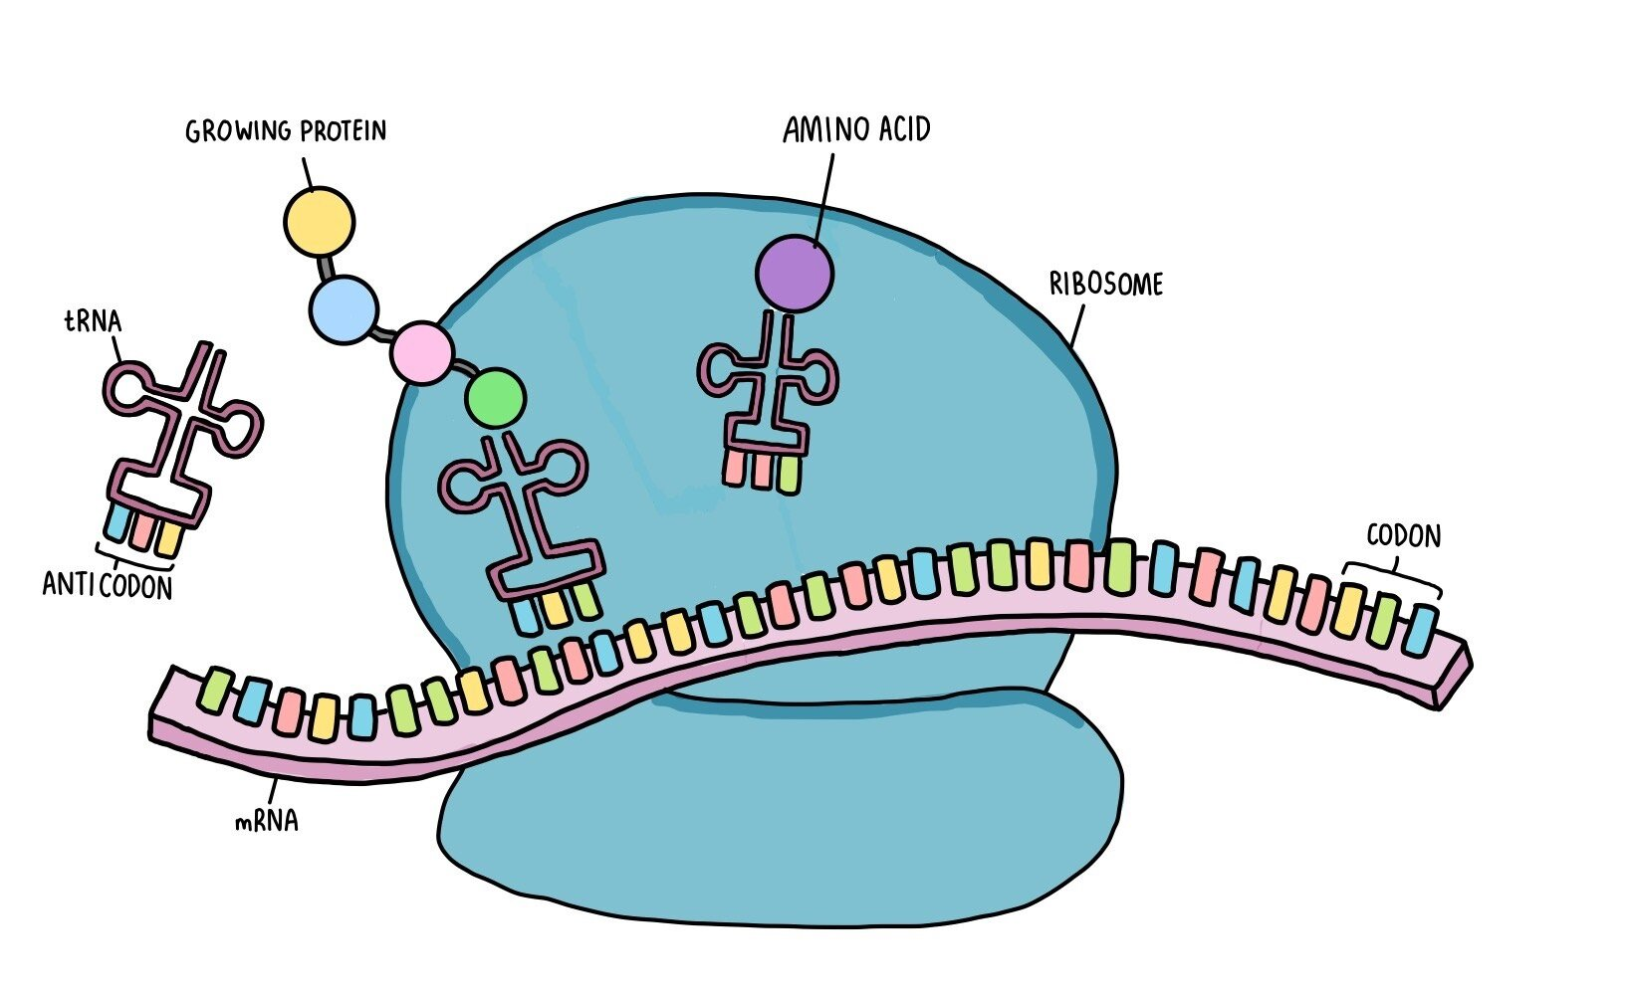
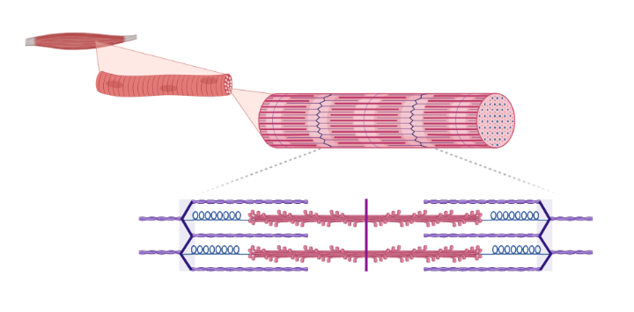
Analysed the translational profiles of skeletal muscle biopsies

Slide 9
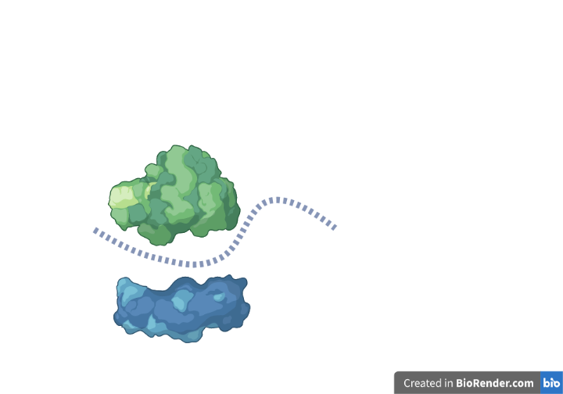

Transcript-specific translation was globally evaluated by ribosome profiling.

Slide 10
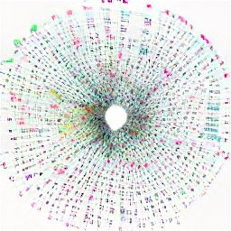
RNASeq to estimate for each transcript the ratio of translating mRNAs with overall mRNAs present in the tissue.

Slide 11





Subjects
Middle Age
Old
43
46
41
83
85

Slide 12
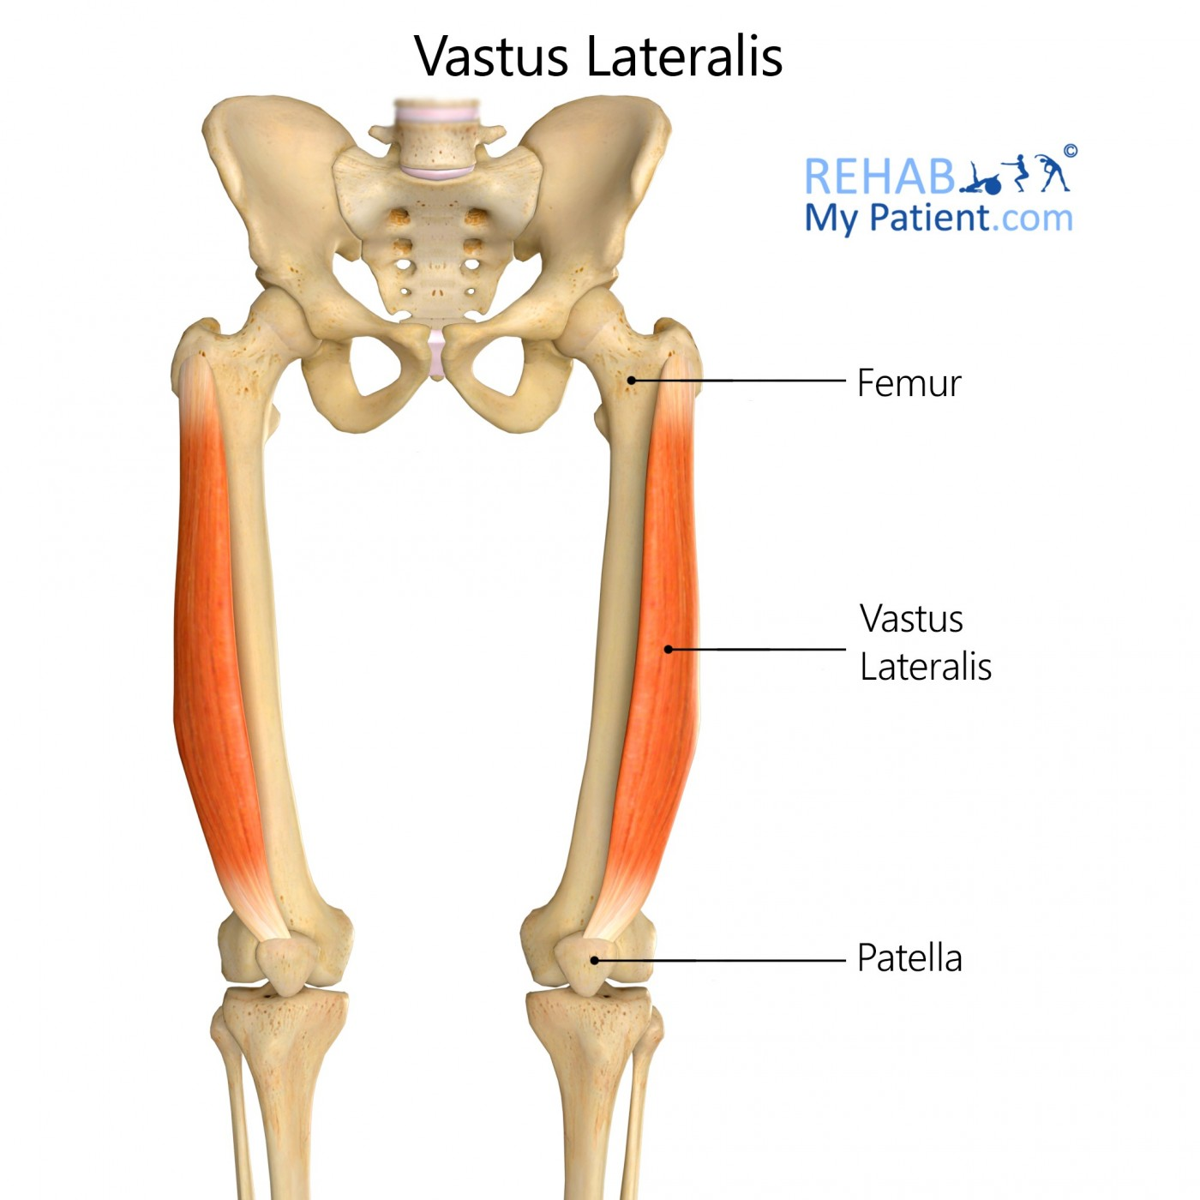

Bergström needle biopsies from vastus lateralis muscles

Slide 13
For ribosome profiling
Muscle was immersed into a polysome preparation buffer containing cycloheximide to fix ribosomes in place before digestion with RNase I.
Protected ribosome footprints were then extracted in Trizol, purified using a Qiagen RNA kit, and finally isolated on a denaturing gel

Slide 14
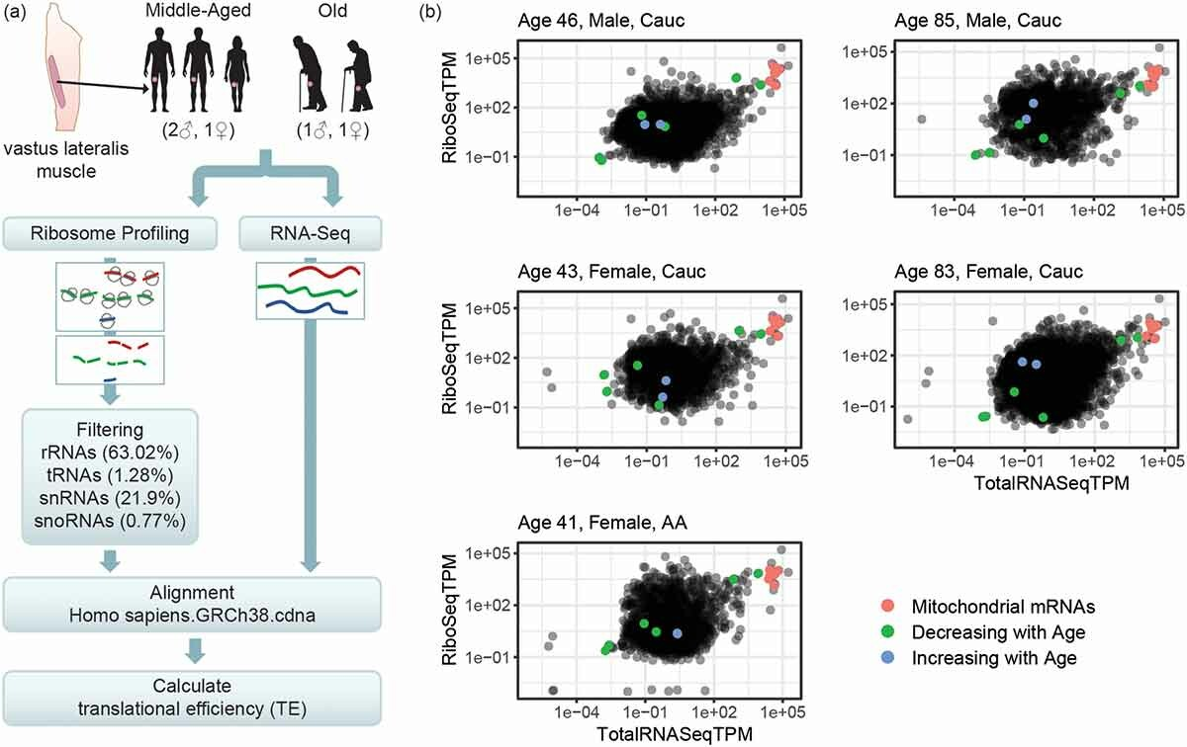

Slide 15
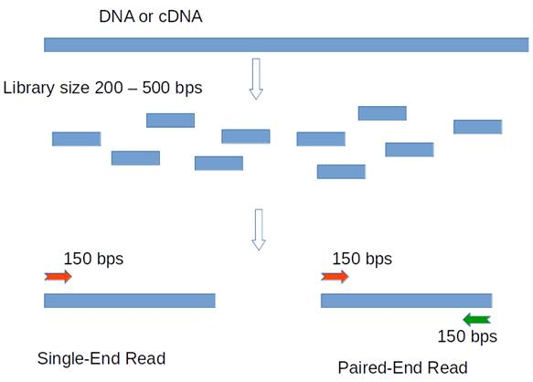
For ribosome profiling
Ribosome profiling (RiboSeq) libraries were single-end sequenced
Depth of 150 to 250 million reads

Slide 16



Filter out contaminating non-coding RNA sequences
aligned to a database of known human rRNAs, tRNAs, snRNAs and snoRNAs
rRNAs (63%)
tRNAs (1%)
snRNAs (22%)
snoRNAs (1%)
1

Slide 17
For RNASeq
Total RNASeq libraries were paired-end sequenced on a NextSeq
Depth of 600 to 800 million reads.

Slide 18

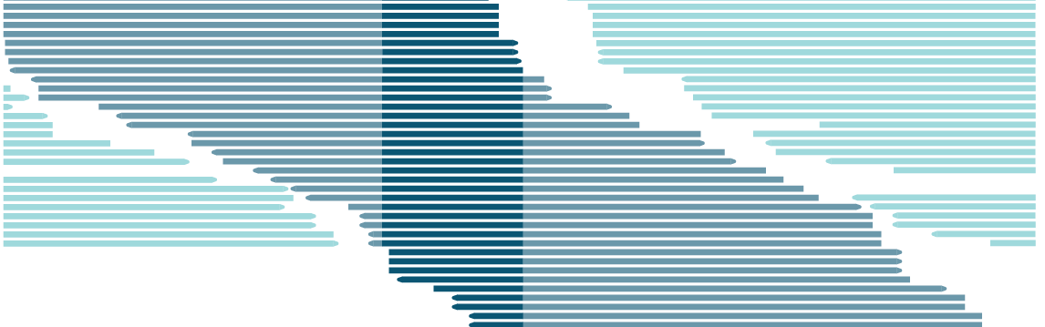
Alignment
All reads were then aligned to the known protein-coding gene transcriptome using Ensembl hg38 (Homo_sapiens.GRCh38.cdna) with Salmon

Slide 19
Ribosome profiling libraries were processed by clipping the cloning linker sequence CTGTAGGCACCATCAAT.

Slide 20

Two age groups were compared using RiboRex

Slide 21
RiboRex
We combine RNA-seq and Ribo-seq read counts by constructing a specific design matrix
RNA-seq
Ribo-seq
TPM transcripts per million

Slide 22
Two age groups were compared using RiboRex
Transcripts were included if;
  they were detected in all five samples
  TPM > 0.001 in RiboSeq
Upstream ORF and untranslated region lengths genome annotations
2
2.5

Slide 23
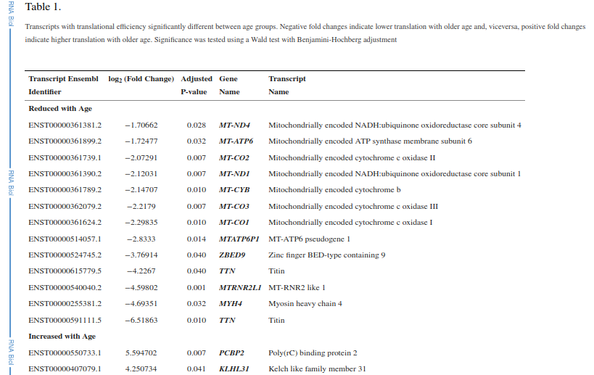

Slide 24

Mitoribosome expression analysis
Results of Salmon alignment were analysed for differential expression with DESeq2

Slide 25
RiboRex
Computational tool for mapping genome-wide differences in translation efficiency. Riborex shares a similar mathematical structure with existing methods, but has a simplified implementation. Riborex directly leverages established RNA-seq analysis frameworks for all parameter estimation

Slide 26
Finally, the translational efficiency of each transcript was determined by taking the ratio of the ribosome profiling reads to the Total RNA reads for each transcript, and the two age groups were compared using RiboRex

Slide 27
Transcripts were included in the analysis only if they were detected in all five samples and above a minimum TPM of 0.001 in RiboSeq.
Upstream open reading frames and untranslated region lengths were determined using Ensembl Human (GRCh38.p13) genome annotations.
For mitoribosome expression analysis, results of Salmon alignment were analysed for differential expression with DESeq2

Slide 28
3

Slide 29
each dot represents normalized read counts for ribosome profiling (y-axis, RiboSeqTPM) and their relationship with normalized read counts for Total RNA (y-axis, RNASeqTPM) for each transcript isoform, and shows the extent to which RNA expression and translation are related.

Slide 30
Transcripts differentially translated
7 of the mRNAs displaying reduced ribosome engagement in old muscle were encoded by the mitochondrial genome (mtDNA)
DT
Less translated
15
13

Slide 31
mtDNA
Protein coding
less translated
37
13
7
7 of the mRNAs displaying reduced ribosome engagement in old muscle were encoded by the mitochondrial genome (mtDNA)
OXPHOS complex
suggest that mitochondrial transcripts are poorly translated in older human skeletal muscle

Slide 32
mtDNA
Protein coding
37
13
6
OXPHOS complex
also decreased in translation with age, although not an extent to reach statistical significance

Slide 33
Transcripts differentially translated
KLHL31 mRNA
  contains an internal ribosome entry site (IRES)
PCBP2 mRNA
  encodes an IRES trans-activating factor
DT
More translated
15
suggesting cap-independent translation might increase overall
2

Slide 34
The ratio between ribosome profiling reads and Total RNA reads is an estimate of the probability of ribosome binding to a given transcript and represents the translational efficiency (TE) of that transcript.

Slide 35
Looking across all transcripts and all samples, we observed a general correlation between mRNA levels and levels of ribosome occupancy, but also some transcripts which had substantially higher or lower ribosome binding than others.

Slide 36
Consistent with previous reports of decreased overall skeletal muscle translation with age [8], we found that 13 of these 15 transcripts were less translated in muscle from older participants.

Slide 37
Interestingly, 7 of the mRNAs displaying reduced ribosome engagement in old muscle were encoded by the mitochondrial genome (mtDNA).
The mtDNA contains only 37 genes, of which 13 are protein-coding; all 13 proteins are components of oxidative phosphorylation complexes [9]. Since 7 out of these 13 mRNAs appeared less translated, our data suggest that mitochondrial transcripts are poorly translated in older human skeletal muscle. The remaining six mitochondrial mRNAs also decreased in translation with age, although not an extent to reach statistical significance (Table S1)

Slide 39
mitochondrial transcripts, which are translated by mitochondrial ribosomes, were abundantly recovered

Slide 40
Conclusion
Using ribosome occupancy as a measure of translation status, several mRNAs showed differential translation with age.
Older age was associated with lower translation of myosin and titin isoforms and more broadly with the translation of proteins involved in oxidative phosphorylation encoded by the mitochondrial genome.

Slide 41
Conclusion
Suggest that mitochondrial biogenesis in skeletal muscle decreases with age at least in part through a decline in mitochondrial translation.

Slide 42
“everybody's a critic”
Strengths
  Combine techniques to get added value
  Samples characterized individually
Weaknesses
  All the DE analysis was cramped on a low quality picture with no detailed infromation
  There are no parameters in the software that they used
  A lot of material left beside

