Slide 1


Slide 2
Computational approaches for the therapeutic target discovery to ame-liorate muscle wasting during aging and disease

Slide 3
There’s a computer representation of the microRNAs and their interaction that allows the identification of micro RNA for the treatment of Sarcopenia.

Slide 4
Objective
Given a set of microRNA, their targets and their Differential Expression, get a subset of microRNA with great “influence” on Sarcopenia.
The graph should be clear enough to create a “simple” model from it.

Slide 5
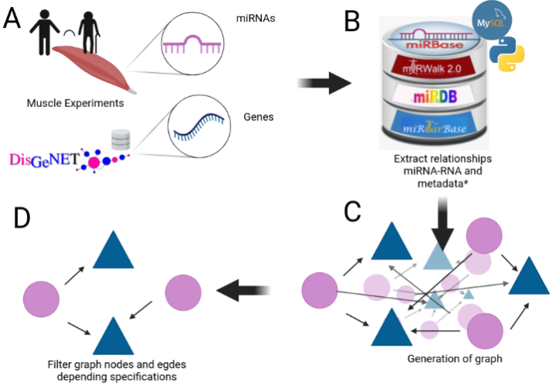

Slide 6
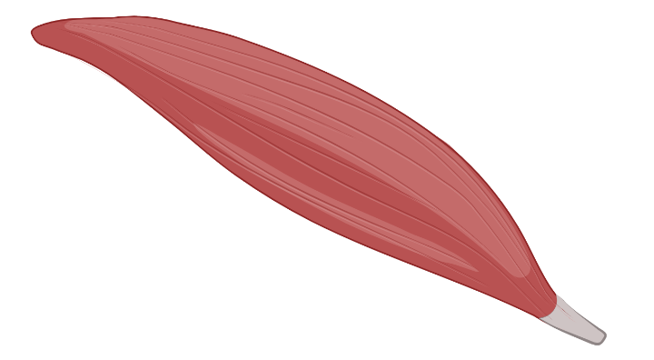


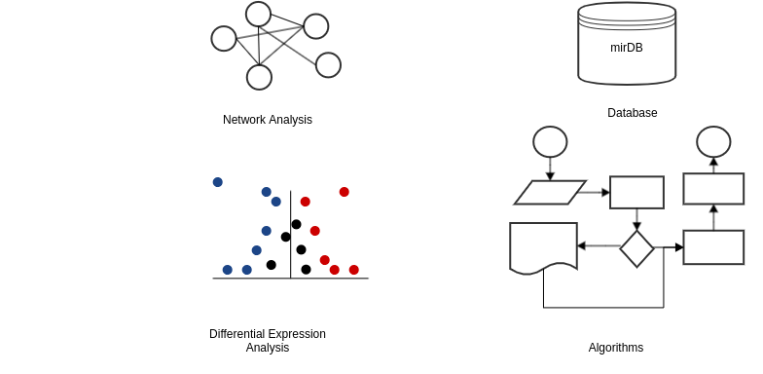

Abundance
Proteins
Targets
miRNAs
Diff Exp Y/O

Slide 7
Key points

Slide 8
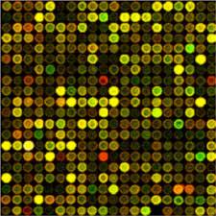
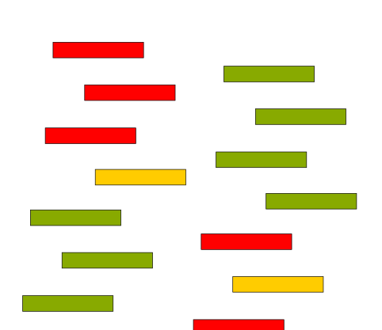
Use Diff Exp Data to select Mirnas of interest
miRNAs
Diff Exp Y/O
Proteins

Slide 9


Use Cytoscape’s App Intact to select proteins of interest and build the graph scalfold
Proteins
miRNAs

Slide 10
Use Databases to get the realtionship miRNA-Target
Targets

Slide 11
Add the differential expression Y/O and the abundance in muslce to the network
Abundance
Diff Exp Y/O

Slide 12
Select most important nodes
Proteins
miRNAs

Slide 13
Evaluate and tune the model
Proteins
miRNAs

Slide 14
Data Bases

Slide 15






Characterization
Target mRNA
Expression Tissue
HMDD v3.2

Slide 16
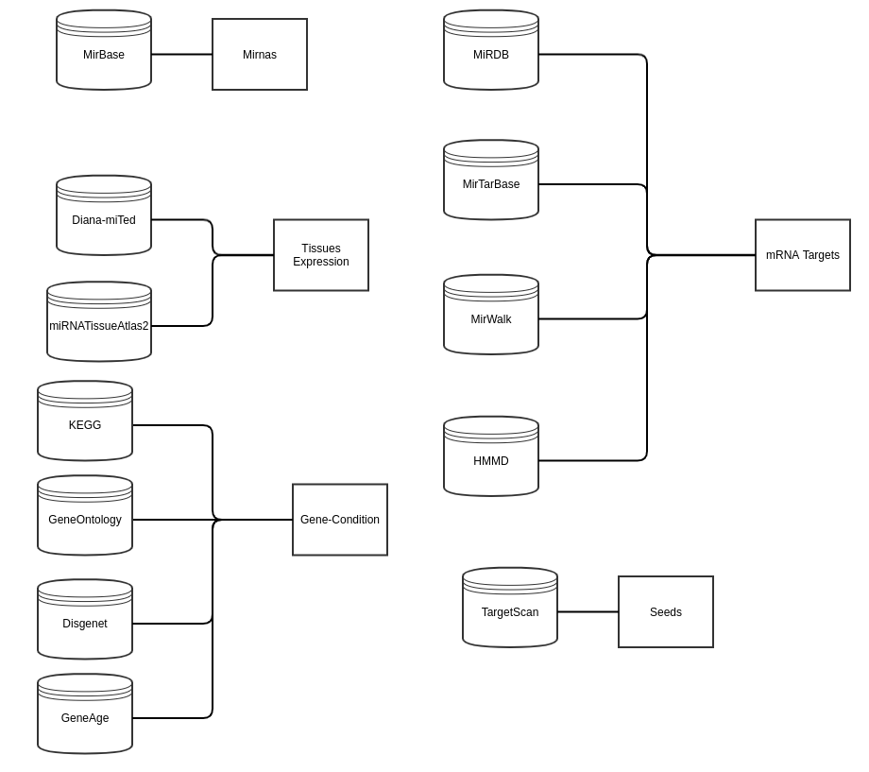

mysql -u mirna -h 185.175.171.169 -p
Password_123

Slide 17
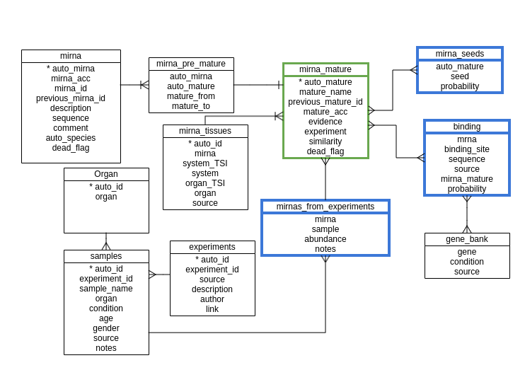
mysql -u mirna -h 185.175.171.169 -p
Password_123

Slide 18
Network Analysis

Slide 19

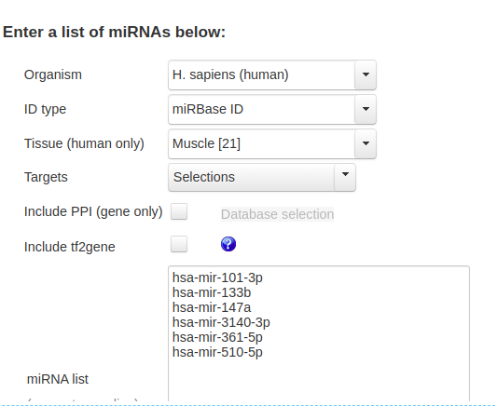
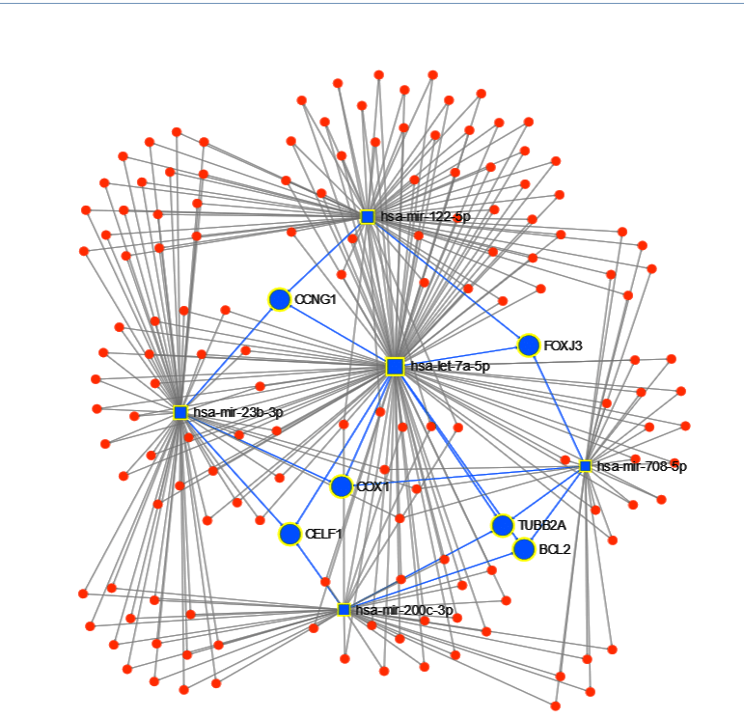
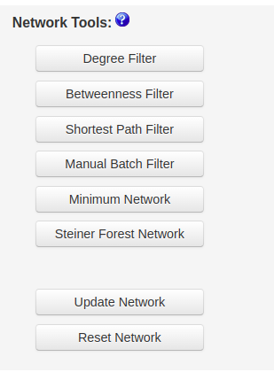
miRNet - a miRNA-centric network visual analytics platform

Slide 20
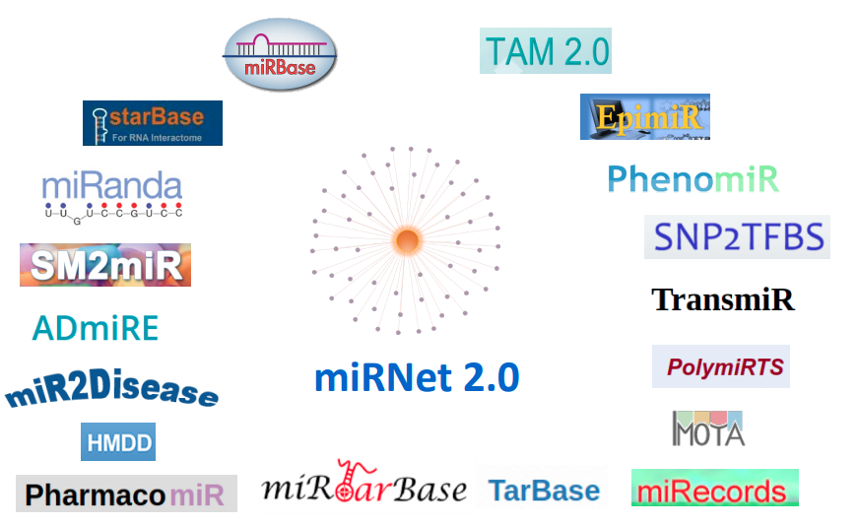
MiRNet

Slide 21
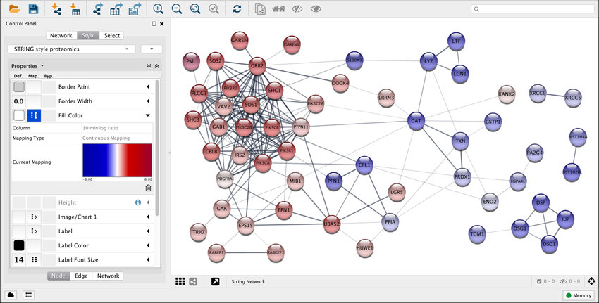
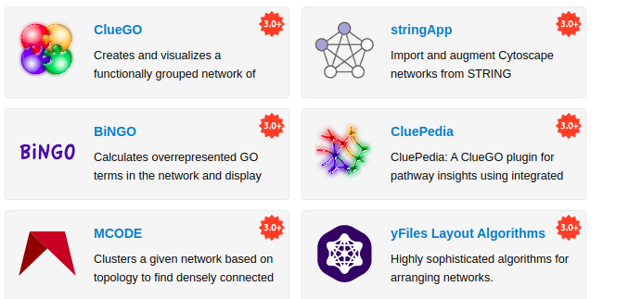
+400 APPS

Slide 22
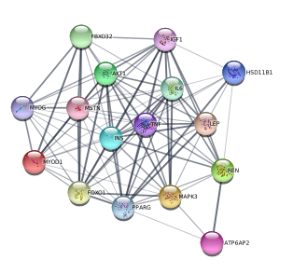
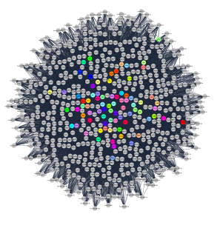
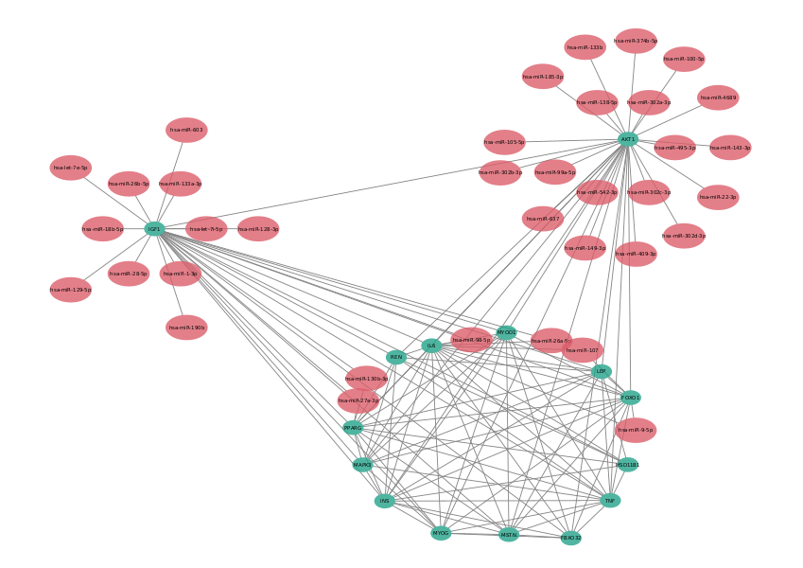

Slide 23
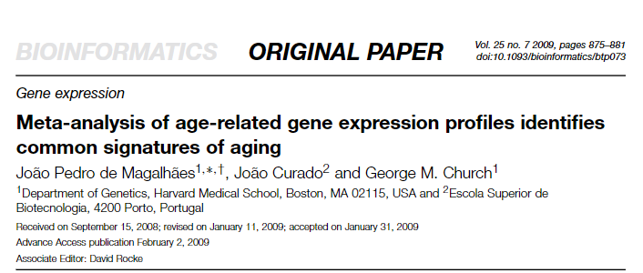
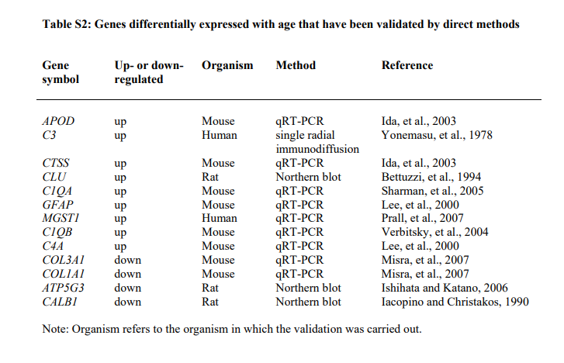
miRNA | Target selected genes | Seed | Occurrences
hsa-miR-10400-5p | 2 | AAGGCAG | 1
hsa-miR-1233-3p | 2 | AGAGAGG | 1
hsa-miR-3150a-3p | 2 | AGCCGCC | 1
hsa-miR-365a-5p | 3 | AGGGCUG | 1
hsa-miR-3714 | 3 | AGGGGGA | 1
hsa-miR-423-5p | 3 | CAGGGAG | 1
hsa-miR-4446-3p | 2 | CGGGGCU | 1
hsa-miR-4508 | 2 | CUGGGGA | 1
hsa-miR-4537 | 2 | GAGCCCU | 1
hsa-miR-4746-3p | 2 | GAGCCGA | 1
hsa-miR-6746-3p | 3 | GAGGGGC | 1
hsa-miR-6751-5p | 3 | GCGGUGC | 1
hsa-miR-6754-5p | 2 | GGGACUU | 1
hsa-miR-6763-5p | 4 | UGGGGAG | 2
hsa-miR-6794-5p | 3 | UGGGGGU | 1
hsa-miR-6856-5p | 3
hsa-miR-8089 | 3

Slide 24
Algorithms

Slide 25
Algorithms
Chapter One: Calculate importance of a node

Slide 26
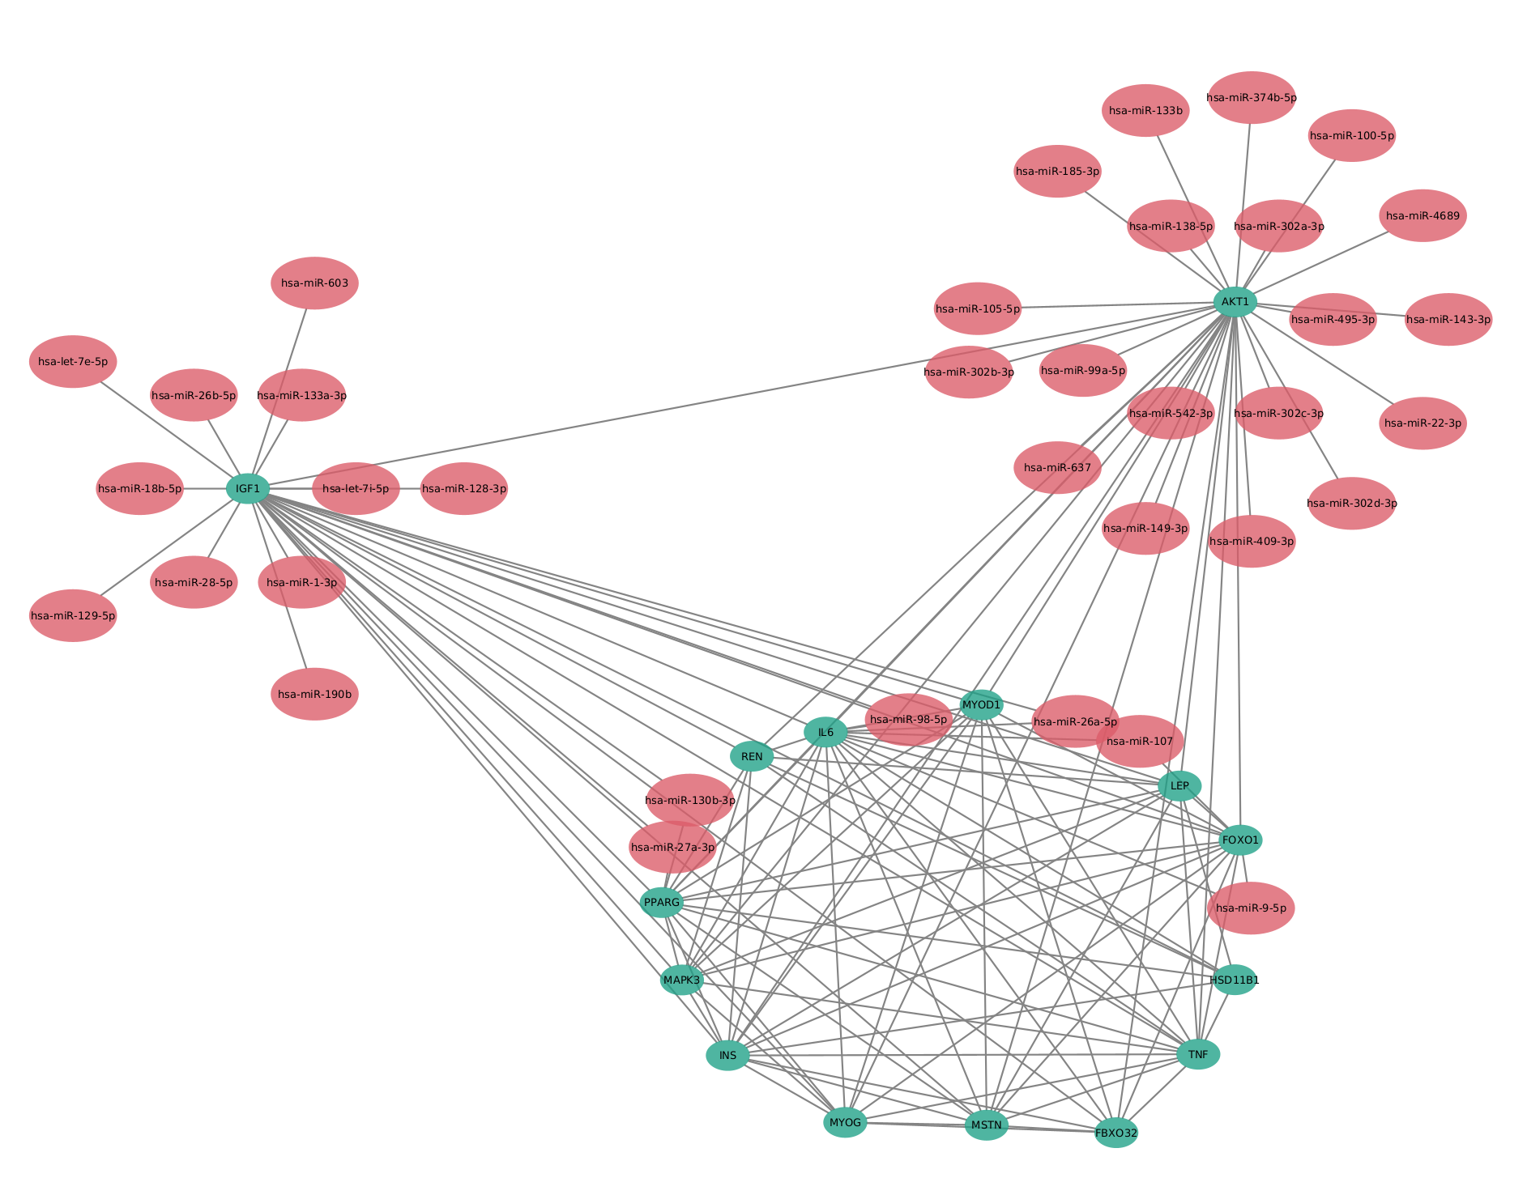

Slide 27
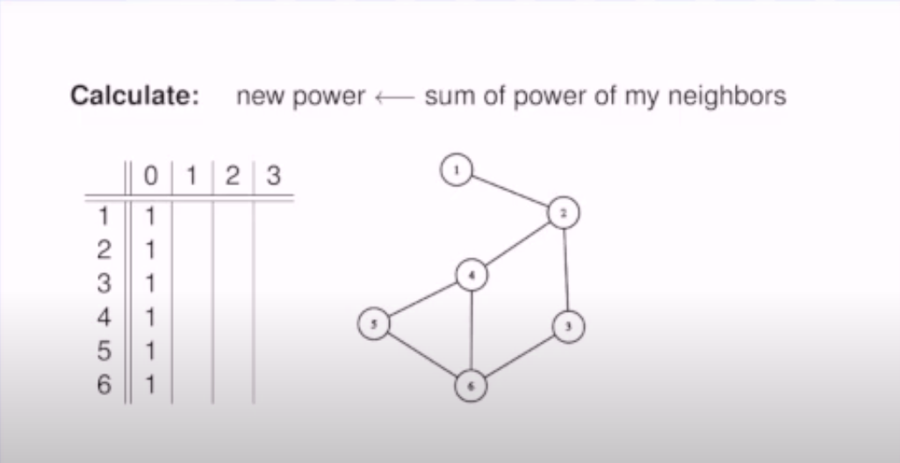
https://youtu.be/9xX4Z5Sfk7g?t=167

Slide 28
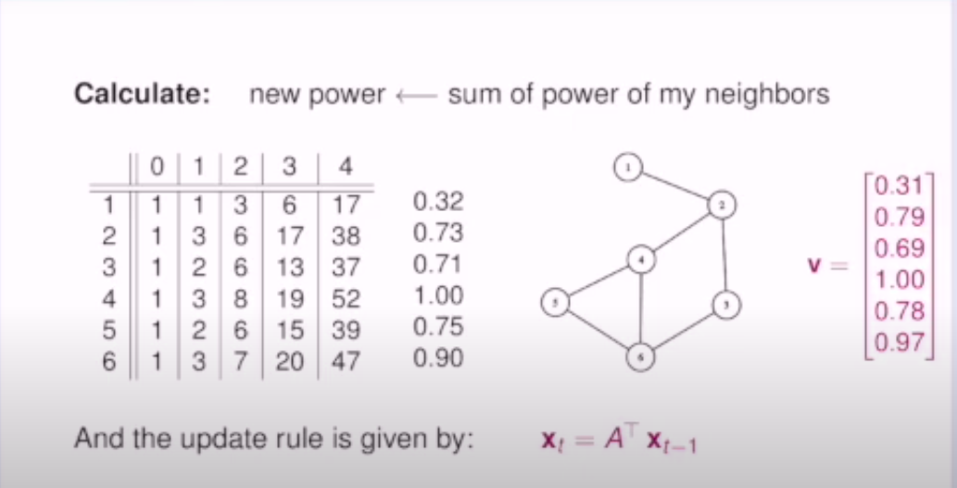
https://youtu.be/9xX4Z5Sfk7g?t=167

Slide 29
PageRank Centrality

Slide 30
My elements
Nodes
  miRNAS mRNA
Edges
  miRNA:mRNA
  mRNA:mRNA
  miRNA:miRNA
Differential Expression
  Tissues

Slide 31
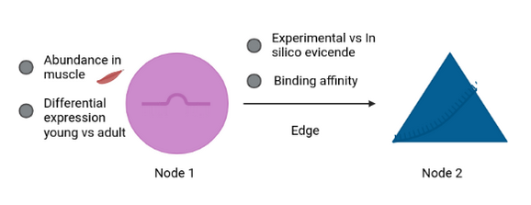
My elements
Nodes
  Diff Expression y/o
  Abundance in muscle
miRNA:mRNA; mRNA:mRNA
  Proability
  Binding affinity
Differential Expression / Abundance
  miRNATissueAtlas2
  Diana-miTED
  Local

Slide 32
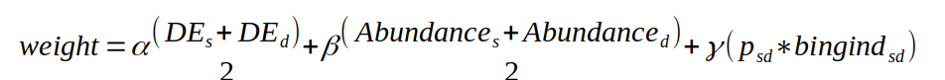
Evaluation (maybe)

Slide 33
Differential Expression

Slide 34
My Experiments
Target | Type | N. Experiments
mRNA | RNASeq | 3
 | MicroArray | 4
miRNA | MicroArray | 1
 | miRSeq | 2
Proteomics | - | 1

Slide 35
RNA Seq
Experiment | n. S | Age range |  | Title | Library
GSE152558 | 5 | 41 | 85 | Ribosome profiling analysis of aging human skeletal muscle | TruSeq
GSE164471 | 53 | 34 | 80 | Skeletal Muscle Transcriptome in Healthy Aging | TruSeq
GSE157585 | 136 | 19 | >65 | Metformin Alters Skeletal Muscle Transcriptome Adaptations to Resistance Training in Older Adults | ?

Slide 36
MicroArray Seq
Experiment | n.S | Age range |  | Title
GSE53702 | 13 | 18 | 78 | Inflammation-induced acute phase response in skeletal muscle and critical illness myopathy
GSE87105 | 16 | 30 | 78 | Conserved and species specific molecular denominators in mammalian aging [human]
GSE21497 | 20 | 18 | 25 | Common Gene Transcriptional Patterns Following Immobilization, Spinal Cord Injury, and Unloading in Human Skeletal Muscle
GSE13205 | 21 | 46 | 77 | Skeletal muscle transcriptome in ICU patients suffering from sepsis induced multiple organ failure

Slide 37
MiRSeq
Experiment | n.S | Age range |  | Title
GSE23527 | 36 | 29 | 76 | Aging and MicroRNA Expression in Human Skeletal Muscle
DunHill
“Tamirna”

Slide 38
Plan
Download files
  fasterq-dump
Quality control
  fastqc
Trimining
  cutadapt
Pseudo Aligment
  kalisto
Analysis
  DESeq2
Omics Comparison
Enrichment Analysis

Slide 39
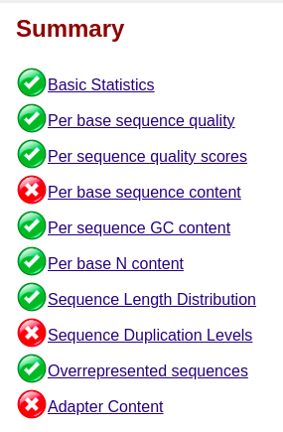
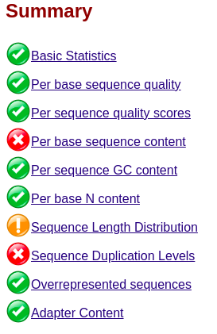
GSE152558

Slide 40
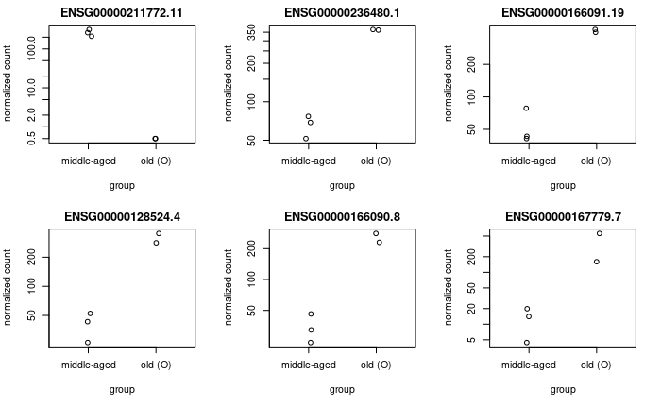
Top 6 diff expressed genes

Slide 41
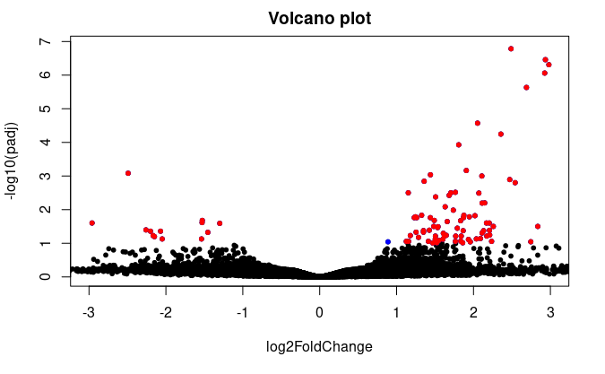
Volcano plot

Slide 42
Link to results
https://toppgene.cchmc.org/output.jsp?userdata_id=5556ff02-8d03-40ec-a81f-e9c25508ed20
http://cbl-gorilla.cs.technion.ac.il/GOrilla/wufiecui/GOResults.html

Slide 43
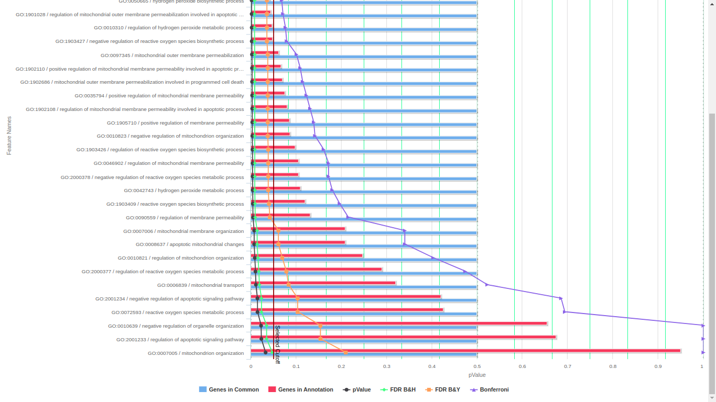

Slide 44
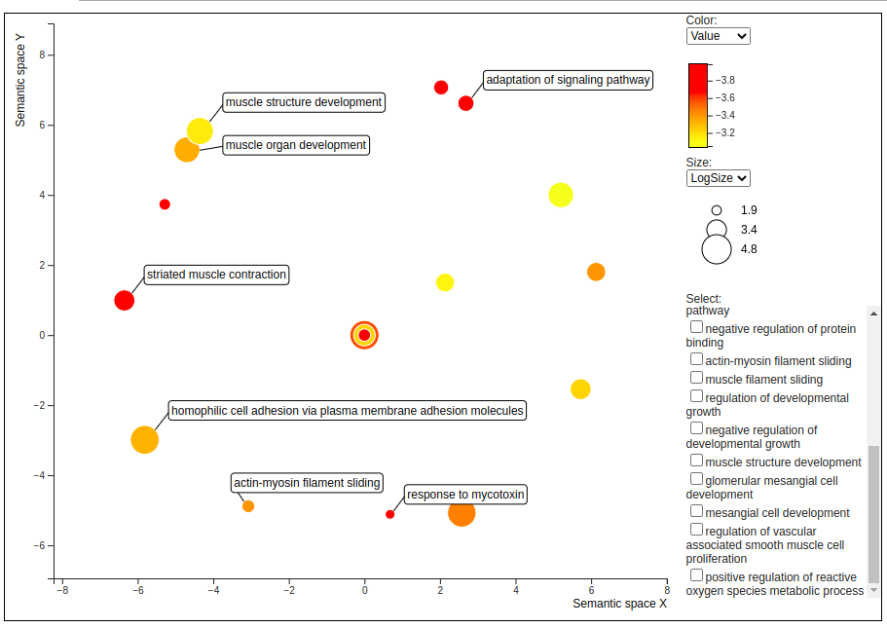

Slide 45
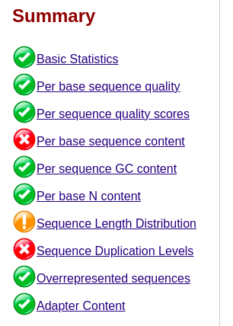
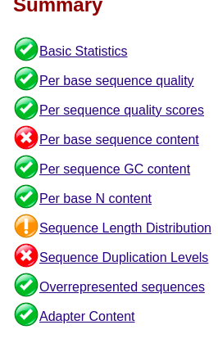
GSE164471

Slide 46
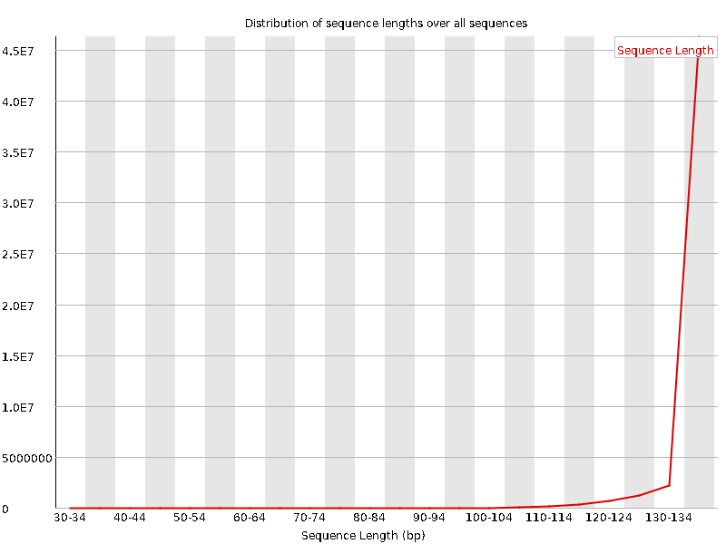
Sequence length BEFORE cut
Sequence length: 35-138

Slide 47
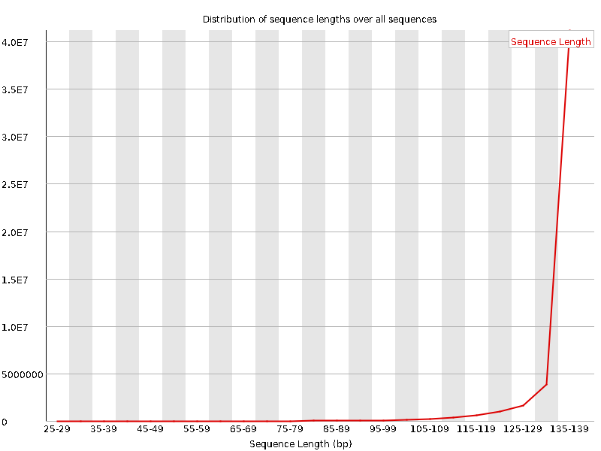
Sequence length AFTER cut
Sequence length: 30-138

Slide 48
Some warning
Library : TruSeq
Single-end – Am I using the right adapter to cut?
Aligner needs the average sequence length and sd

Slide 49
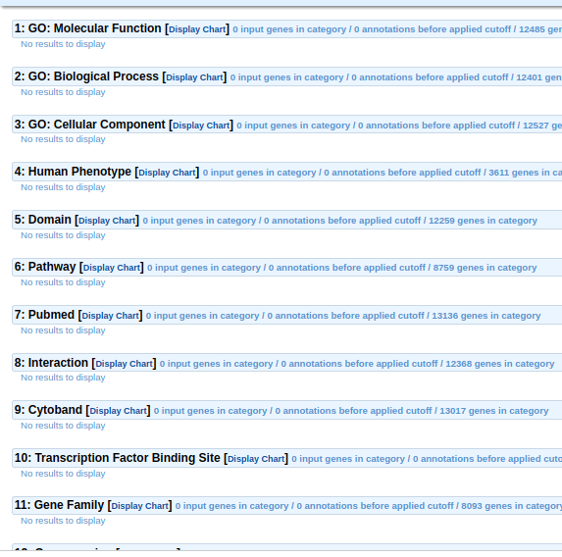
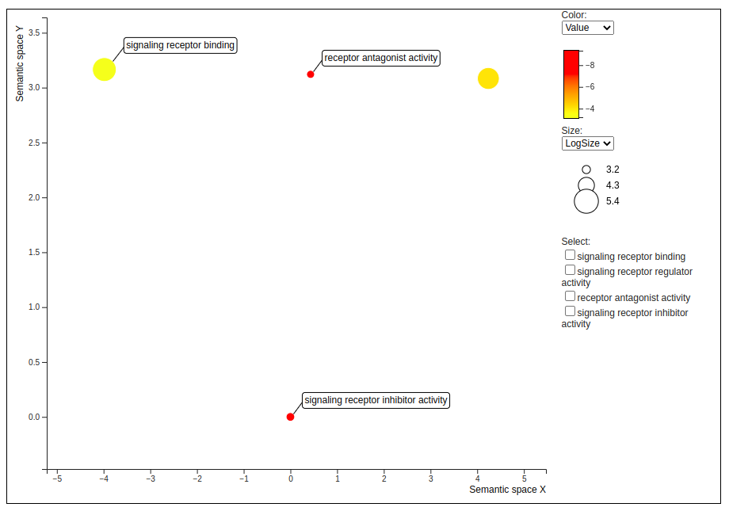
http://cbl-gorilla.cs.technion.ac.il/GOrilla/iwkr1ykk/GOResults.html

Slide 50
Future plans

Slide 51
Milestones
DEA on the different omic data
  Probably biggest one of aging muscle
Integration Database of microRNA data
  ACTUAL database that allows freedom on the selection of data
Algorithm for the selection of microRNAs
  Proably a new pluginn for Cytoscape that can complement MiRNet

Slide 52
To Do
DATABASE: Include Dif Exp Data
Diff Expr:
  Finish process RNASeq
  Desing process for microArray
  Desing process for miRSeq
  Integration of omic data
Enrrichment Analysis: Everything
NETWORK: Compare with Enrrichment Analysis
Algorithms: Many iterations

Slide 53
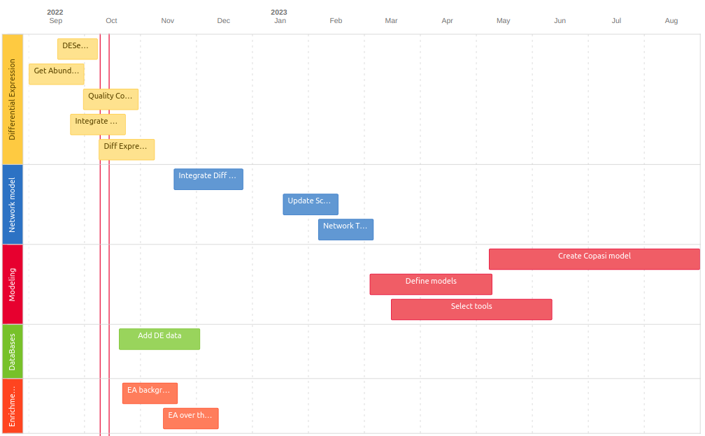

Slide 54
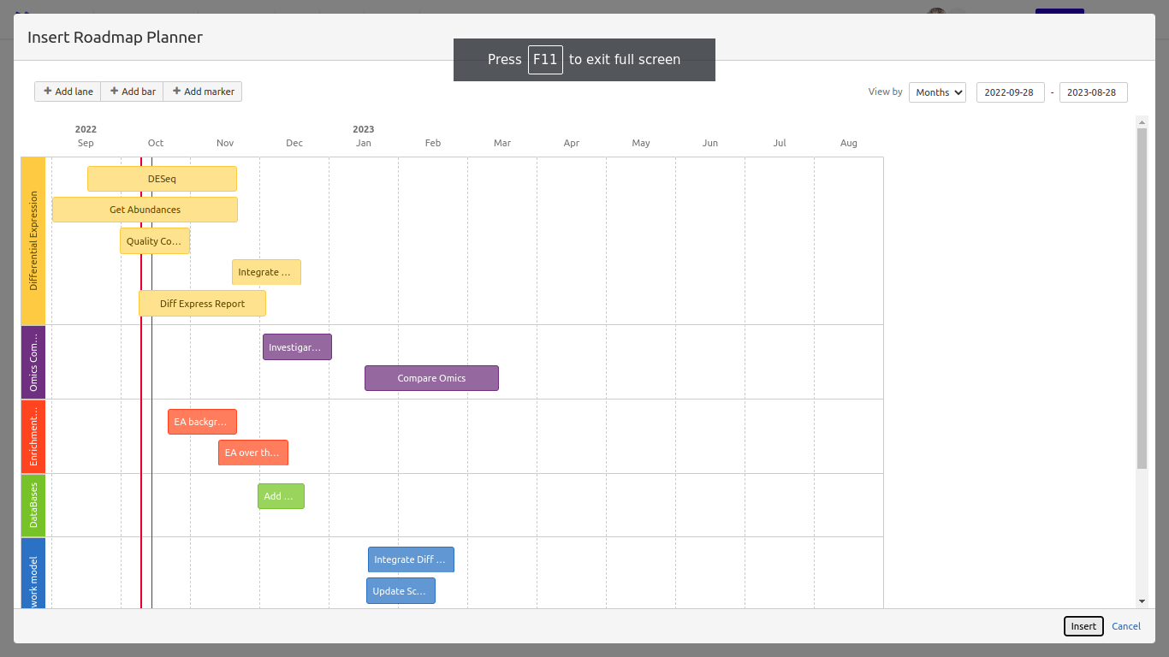
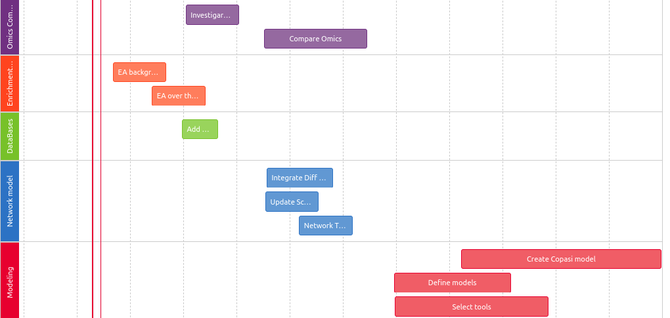

Slide 55

Thank you

