Slide 1
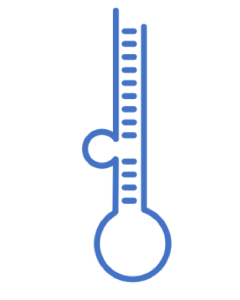
miRNA Data
Analysis of the selected datasets
V 1.5 Presented on February 25, 2022

Slide 2
Download data
Database | year | Cites | Website | down | avail | PubmedID | Content | Prediction Algorithm | API | API alternative
miRBase | 2014 | 2368 | mirbase.org/ | Yes | Yes | 24275495 | General | NA | NA | NA
miRWalk | 2011 | 830 | mirwalk.umm.uni-heidelberg.de/search_mirnas/ | Yes | Yes | 21605702 | Predicted miRNA | Yes | NA | NA
miRTarBase | 2010 | 563 | mirtarbase.mbc.nctu.edu.tw/ | Yes | Yes | 21071411 | General | NA | NA | NA
miRDB | 2020 | 374 | mirdb.org/ | Yes | Yes | 31504780 | Expression | Yes | NO | Yes
mirDIP | 2017 | 111 | ophid.utoronto.ca/mirDIP/ | Yes | Yes | 21364759 |  | NA | NA | NA
Rfam | 2021 | 49 | rfam.org | Yes | Yes | 33211869 | Family | NA | Yes | NA
miRNASNP | 2021 | 13 | bioinfo.life.hust.edu.cn/miRNASNP/ | Yes | Yes | 32990748 | Single nuclotide | Yes | No | Yes
mirtronDB | 2019 | 5 | mirtrondb.cp.utfpr.edu.br/ | Yes | Yes | 30874795 | mirtrons | Yes | NA | NA
DIANAmiTED | 2022 | 0 | dianalab.e-ce.uth.gr/mited/#/ | Yes | Yes | 34469540 | Expression | NA | NA | NA

Slide 3
Download data
Database | year | Cites | PubmedID | Content | Prediction Algorithm | API | API alternative
miRBase | 2014 | 2368 | 24275495 | General | NA | NA | NA
miRWalk | 2011 | 830 | 21605702 | Predicted miRNA | Yes | NA | NA
miRTarBase | 2010 | 563 | 21071411 | General | NA | NA | NA
miRDB | 2020 | 374 | 31504780 | Expression | Yes | NO | Yes
DIANAmiTED | 2022 | 0 | 34469540 | Expression | NA | NA | NA

Slide 4

2022
Diana had been on since 2011 (6)
estimates of microRNAs
querying of the expression of one or many miRNAs

Slide 5
Diana miTED columns
S.No
Sample_ID
Collection
Project_ID
Tissue_or_organ_of_origin
Tissue_subregion
Cell_Line
Disease
Organism
Gender
Health_state
Tissue_definition
ALL MIRNAS (2464)

Slide 6
HMDD v3.2
8 publication from 2007 to 2019
the Human microRNA Disease Database
curated experiment-supported evidence for human microRNA

Slide 7
HMDD colums
category
mir
disease
pmid
description

Slide 8

13 papers from 2003 to 2021 including one for R client and 4 usage
Rfam is a collection of multiple sequence alignments and covariance models representing non-coding RNA families.
2021 synchronising microRNA families between rfam and miRBase v22
manually curated an initial set of 1678 multiple sequence alignments. Second phase in wating
rfaRm: R client-side interface for Rfam database of RNA families analysis

Slide 9

2015, 2021
miRNA target binding sites

Slide 10




Characterization
Target mRNA
Expression Tissue
HMDD v3.2

Slide 11


miRBase local database in mySQL
www.mirbase.org/ftp/CURRENT/database_files/

Slide 12


Operating system
Notes:
Ubuntu 20.04.3 LTS (Focal Fossa)

Slide 13
Process to create mySQL database
CREATE USER 'karen'@'localhost' IDENTIFIED BY '123';
GRANT ALL PRIVILEGES ON *.* TO 'karen'@'localhost' WITH GRANT OPTION;
CREATE DATABASE mirnadbs;
To run the load into file I need to run the sql as
sudo mysql --local-infile=1 -u karen –p
LOAD DATA LOCAL INFILE 'confidence_score.txt' INTO TABLE confidence_score ;

Slide 14
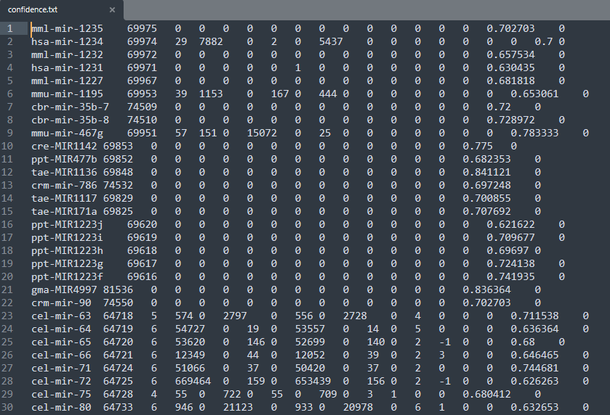
Process to create mySQL database

Slide 15
Process for python processing of data
General objective: Get all datasets together for evaluation
Specific Objectives
Recompile all the datasets
Distinguish the differences and similarities
Design the model with compatibility for all datasets
Separate the txt datasets in order to run a LOAD DATA LOCAL INFILE

Slide 16
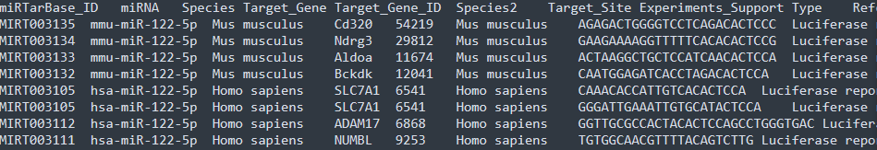
-

Slide 17
Python processing of data
Methodology:
- Create a virtual enviroment to get control of the versions that I am ussing
python3 -m venv /home/karen/Documents/phd/mirnadbs
- Activate enviroment
source /home/karen/Documents/phd/mirnadbs/bin/activate
- Clone my own repo
For this I download the desktop version because it rocks (from https://gist.github.com/berkorbay/6feda478a00b0432d13f1fc0a50467f1)
sudo wget https://github.com/shiftkey/desktop/releases/download/release-2.9.3-linux3/GitHubDesktop-linux-2.9.3-linux3.deb
### Uncomment below line if you have not installed gdebi-core before
# sudo apt-get install gdebi-core
sudo gdebi GitHubDesktop-linux-2.9.3-linux3.deb

Slide 18
What’s next
Week 5:
Finish to build database
Python script
Design queries for analysis
Include mirnaSNIP and rFAM or discard
Week 6:
Compare seed-gene relationship among different databases(?) (MML48)

Slide 19
