Slide 2
Menu
GSE152558
GSE157585
GSE164471
Genral wordcloud
Genral wordcloud
Genral wordcloud
General dotplots
General dotplots
General dotplots
Word Up/Down
Word Up/Down
Word Up/Down
Dotplot Up/Down
Dotplot Up/Down
Dotplot Up/Down

Slide 3
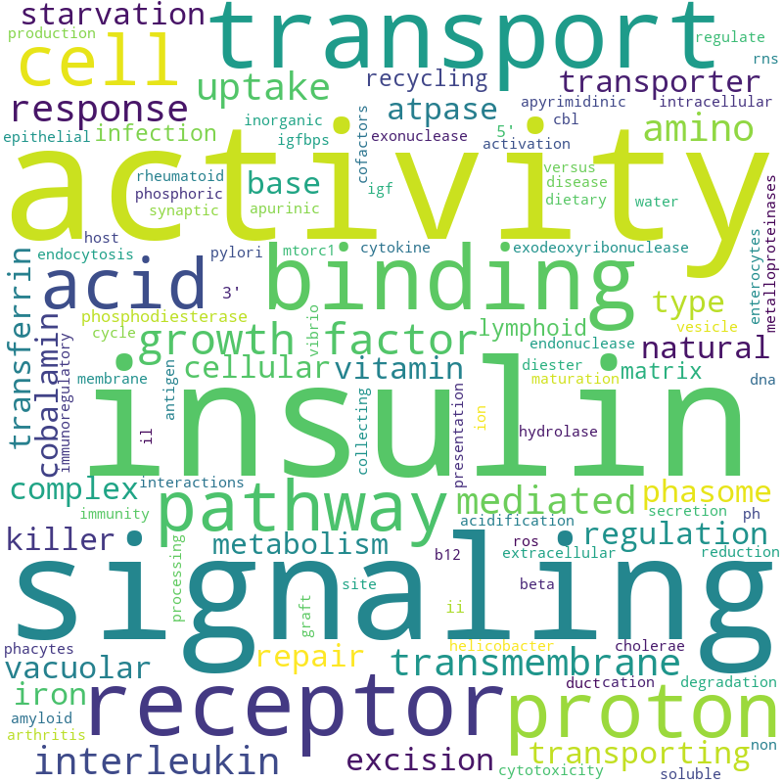
GSE152558 WordCloud
GSE157585
GSE164471(YO)
GSE164471(YM)
GSE164471(MO)

Slide 4
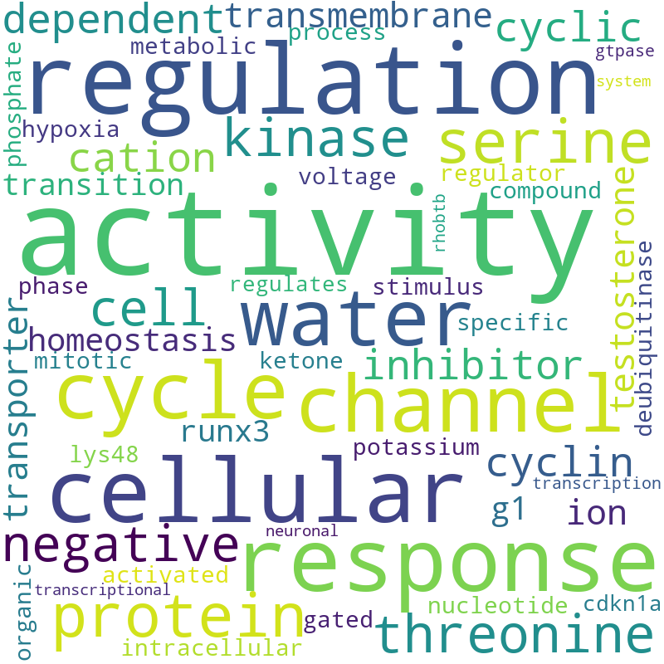
GSE157585 WordCloud
GSE152558
GSE164471(YO)
GSE164471(YM)
GSE164471(MO)

Slide 5
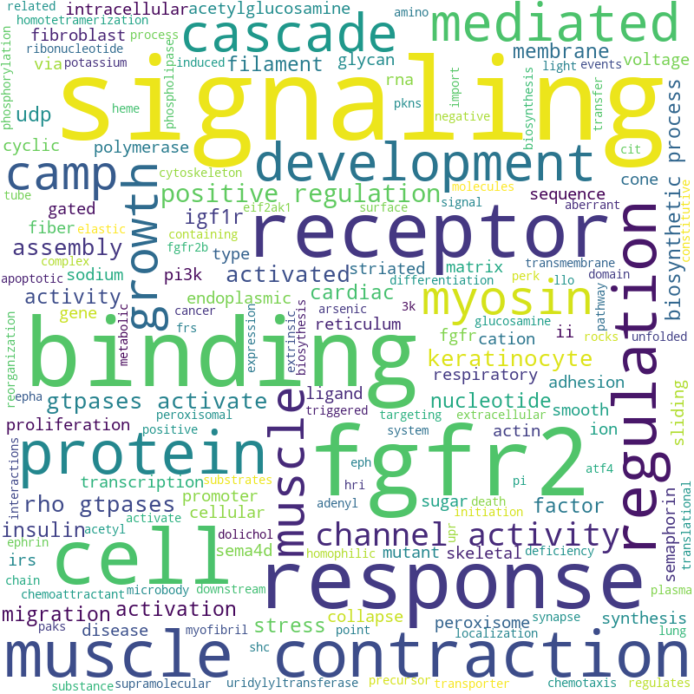
GSE164471(YO) WordCloud
GSE152558
GSE157585
GSE164471(YM)
GSE164471(MO)

Slide 6
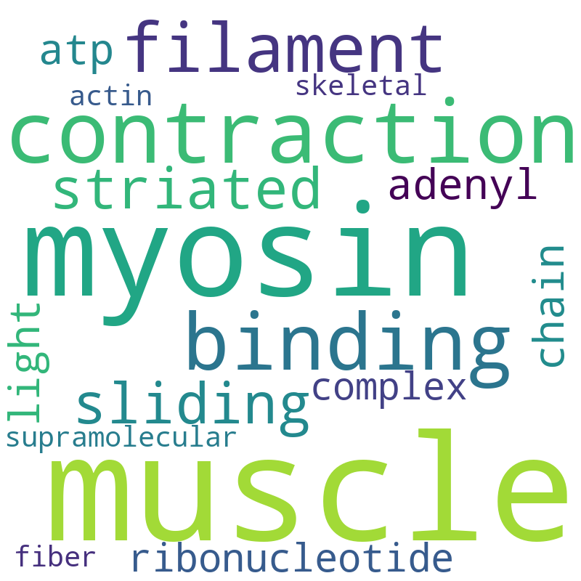
GSE164471(YM) WordCloud
GSE152558
GSE157585
GSE164471(YO)
GSE164471(MO)

Slide 7
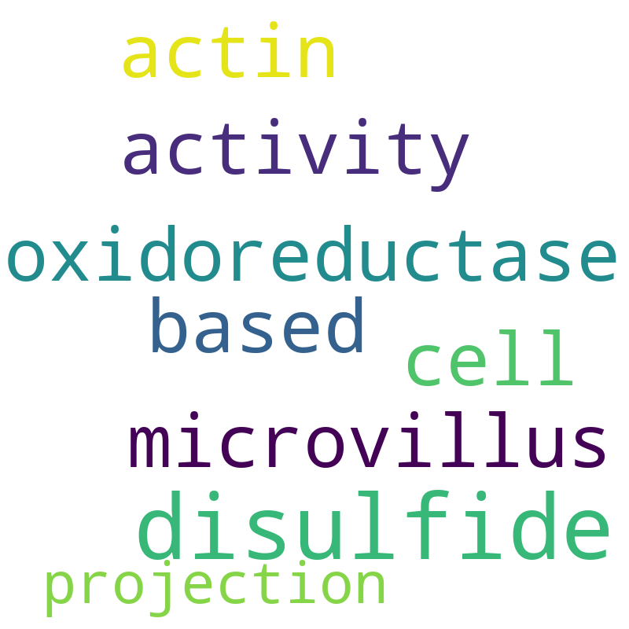
GSE164471(MO) WordCloud
GSE152558
GSE157585
GSE164471(YO)
GSE164471(YM)

Slide 8
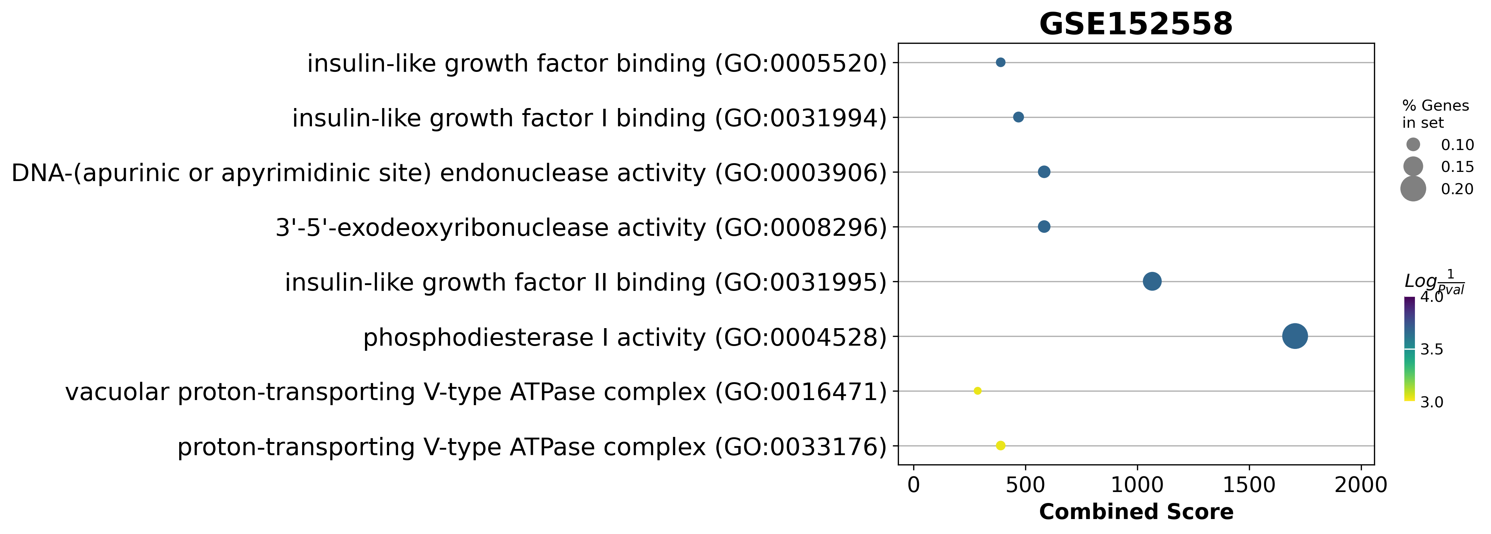
GSE152558 Dotplot
GSE152558
GSE157585
GSE164471(YO)
GSE164471(YM)
GSE164471(MO)

Slide 9
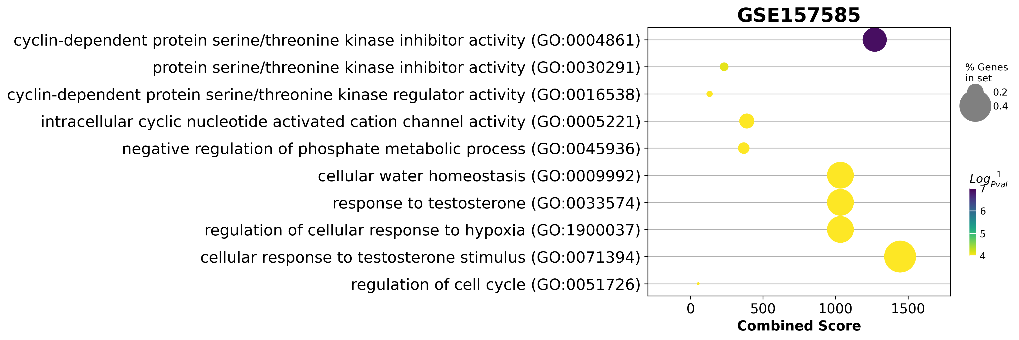
GSE157585 Dotplot
GSE152558
GSE157585
GSE164471(YO)
GSE164471(YM)
GSE164471(MO)

Slide 10
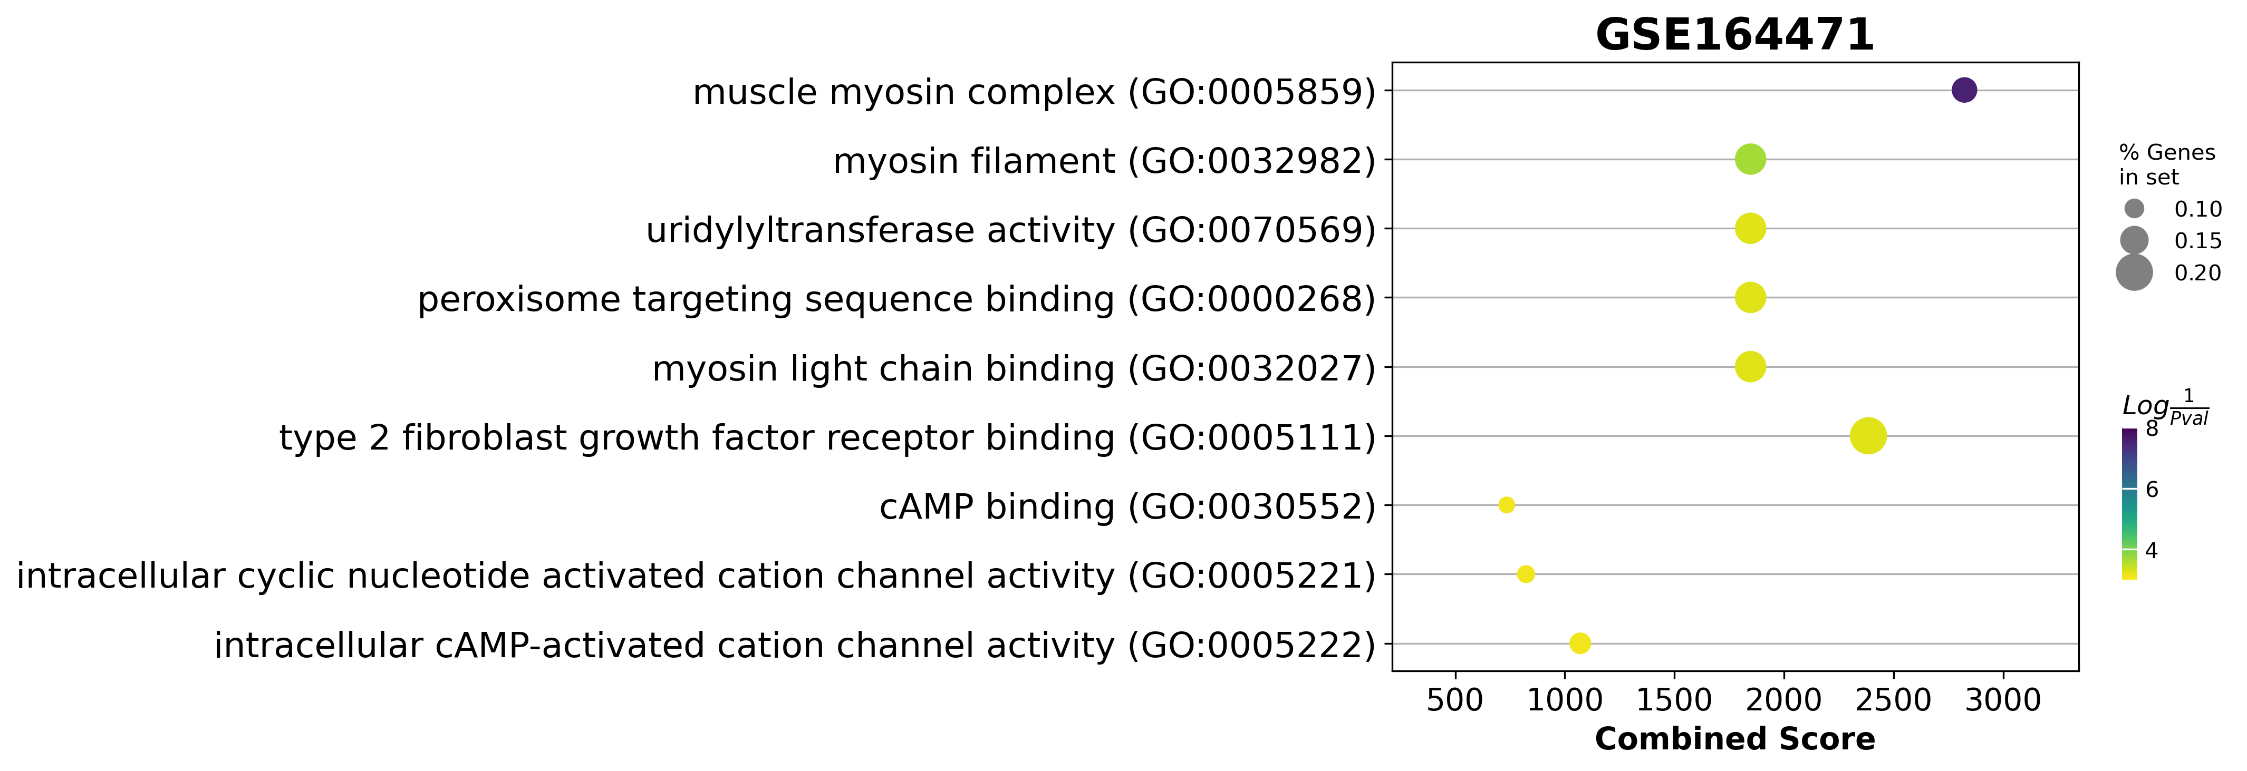
GSE164471(YO) Dotplot
GSE152558
GSE157585
GSE164471(YO)
GSE164471(YM)
GSE164471(MO)

Slide 11
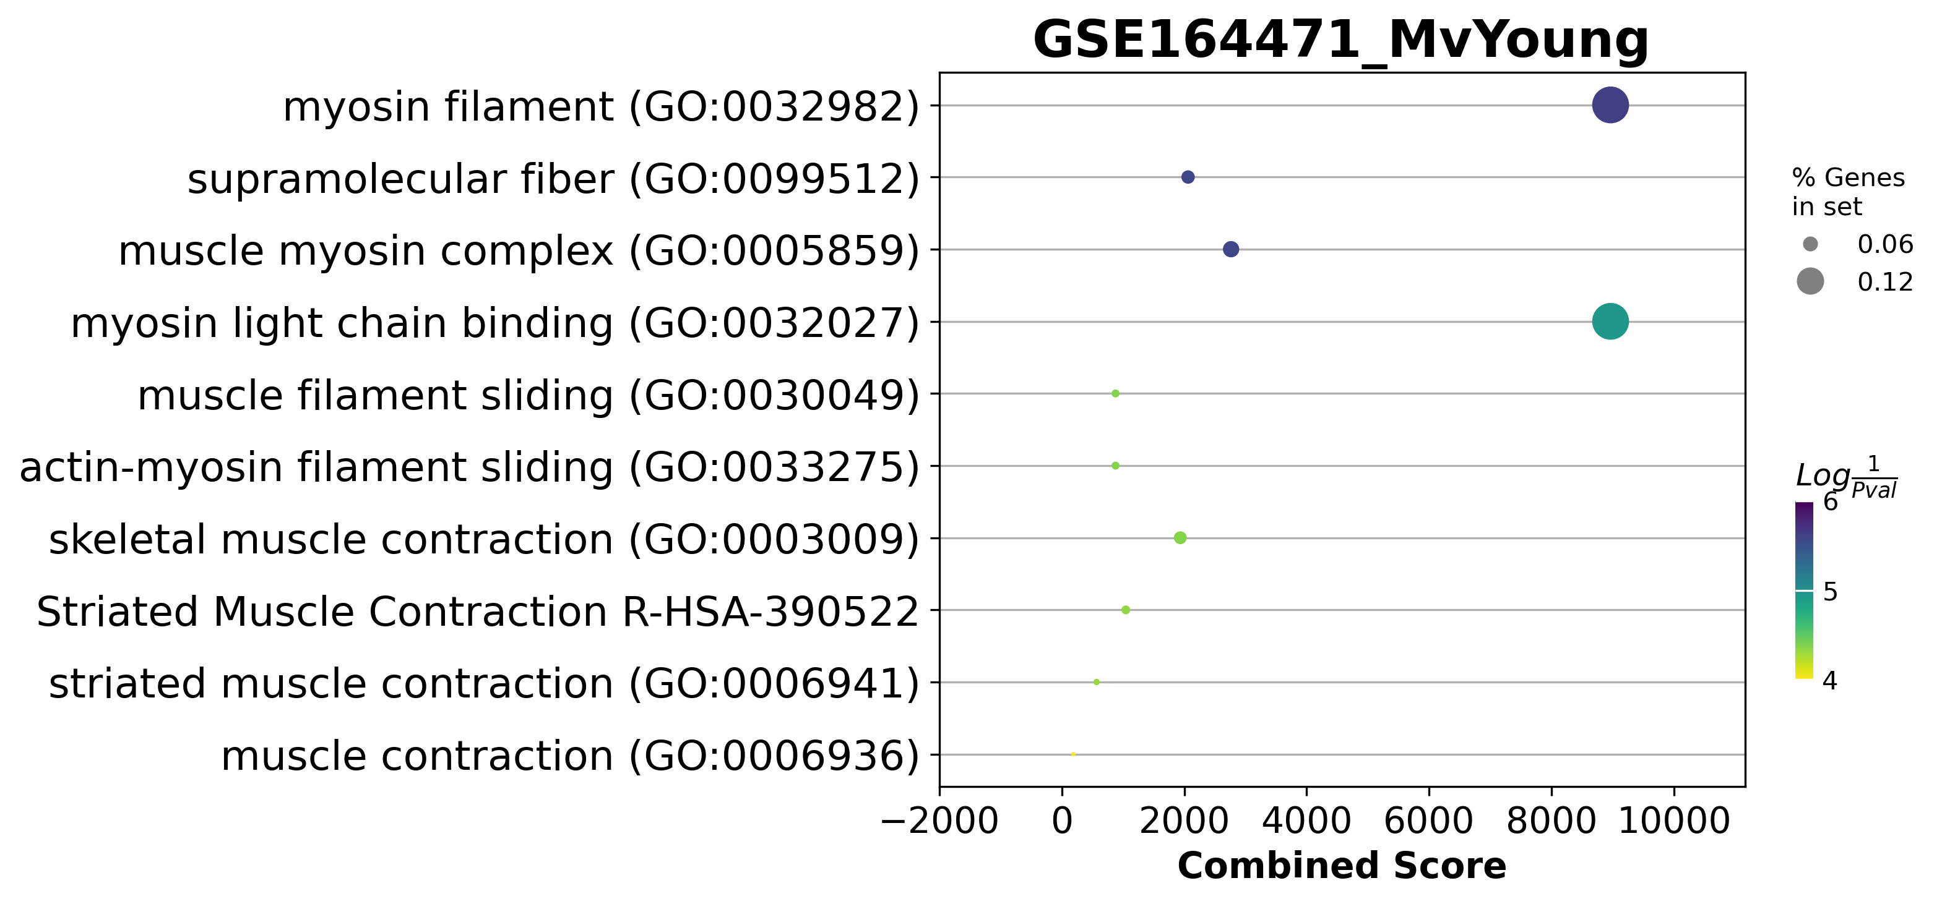
GSE164471(YM) Dotplot
GSE152558
GSE157585
GSE164471(YO)
GSE164471(YM)
GSE164471(MO)

Slide 12
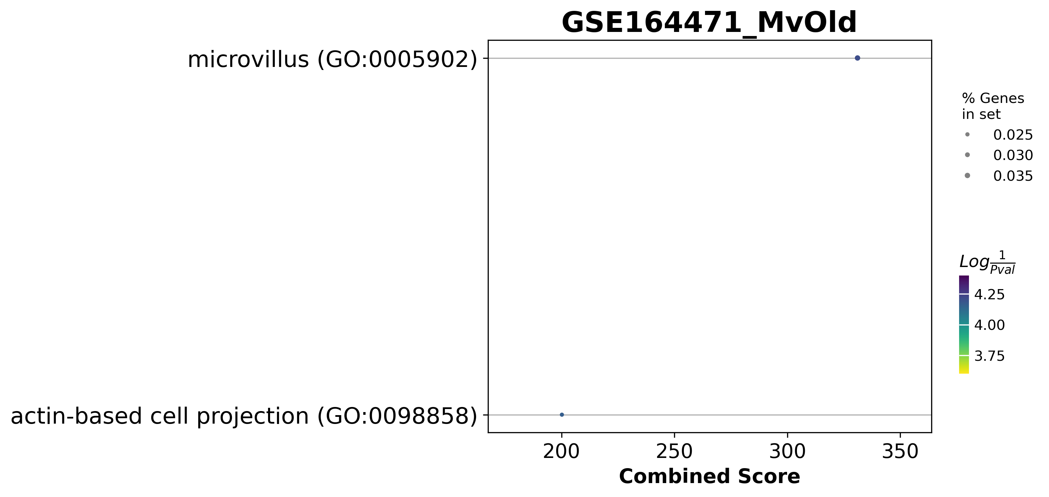
GSE164471(MO) WordCloud
GSE152558
GSE157585
GSE164471(YO)
GSE164471(YM)
GSE164471(MO)

Slide 13
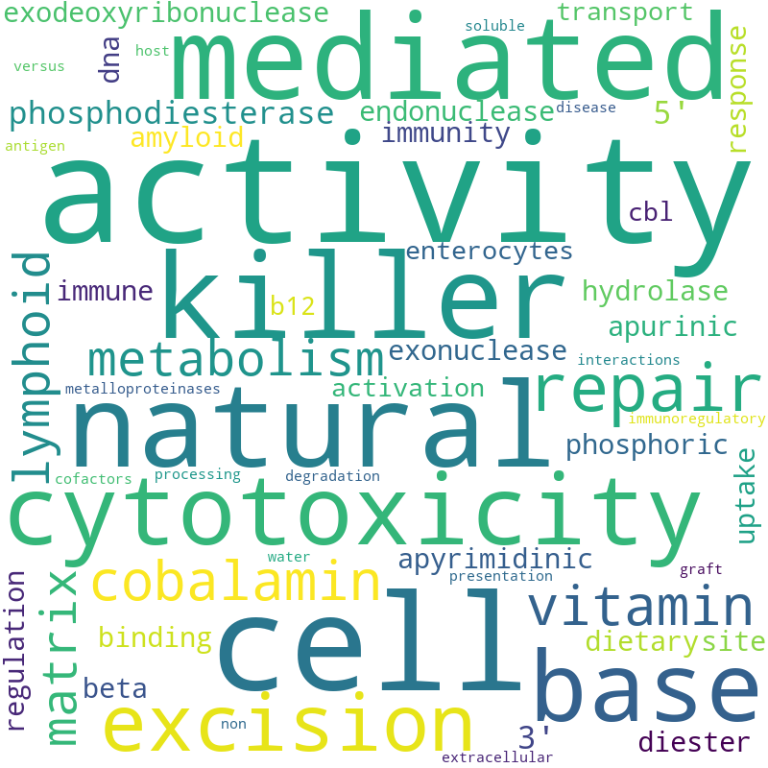
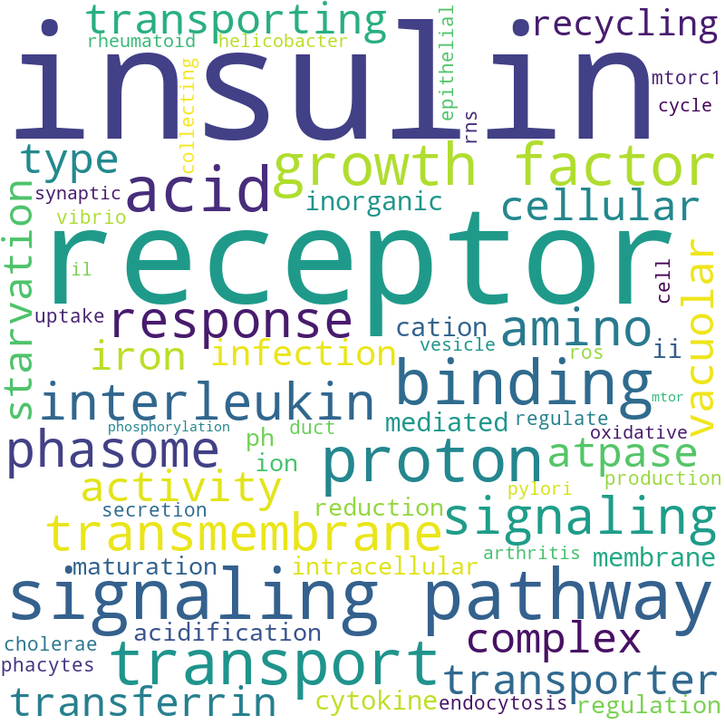
GSE152558 WordCloud
UP regulated
DOWN regulated
GSE152558
GSE157585
GSE164471(YO)
GSE164471(YM)
GSE164471(MO)

Slide 14
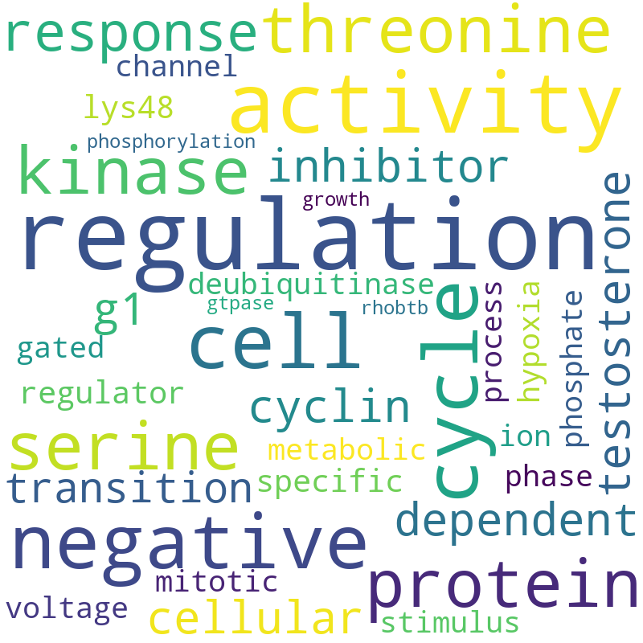
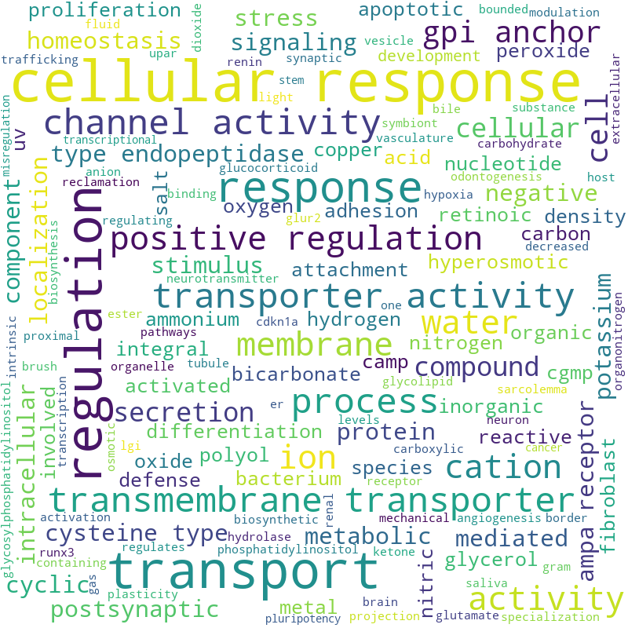
GSE157585 WordCloud
UP regulated
DOWN regulated
GSE152558
GSE157585
GSE164471(YO)
GSE164471(YM)
GSE164471(MO)

Slide 15
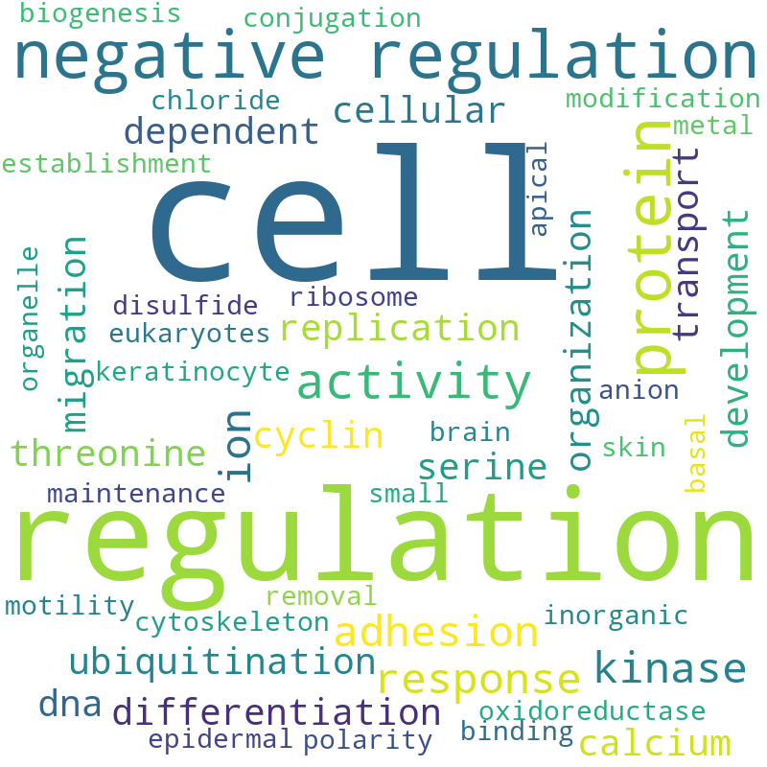
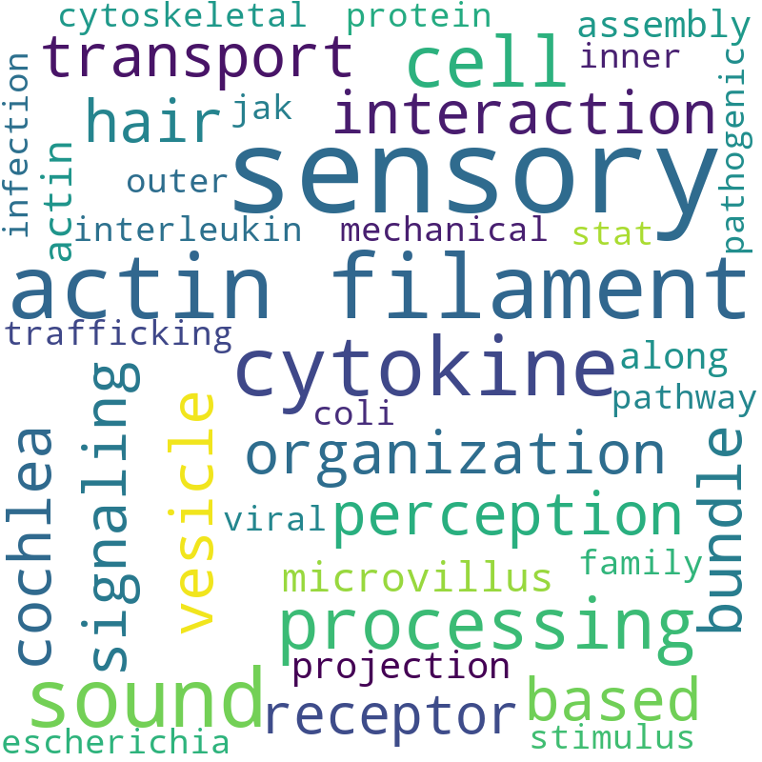
GSE164471(YO) WordCloud
UP regulated
DOWN regulated
GSE152558
GSE157585
GSE164471(YO)
GSE164471(YM)
GSE164471(MO)

Slide 16
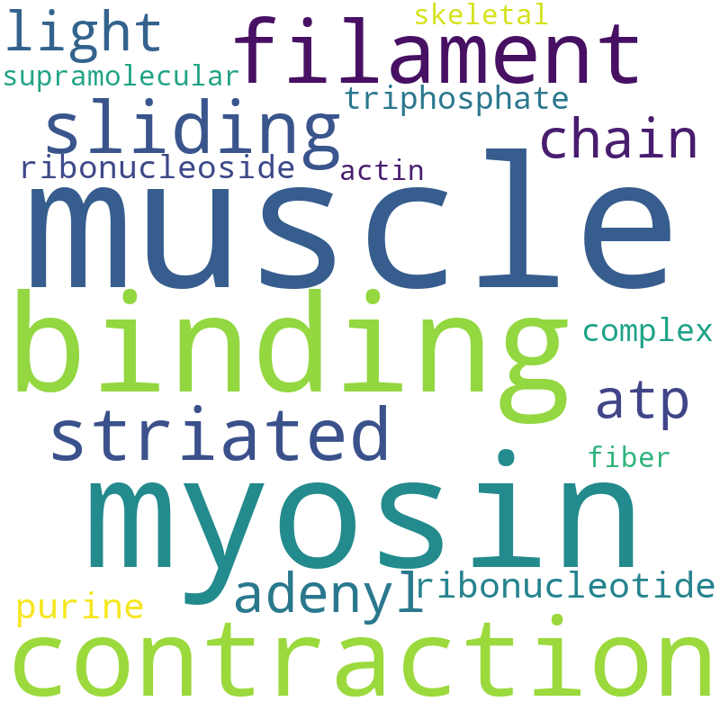
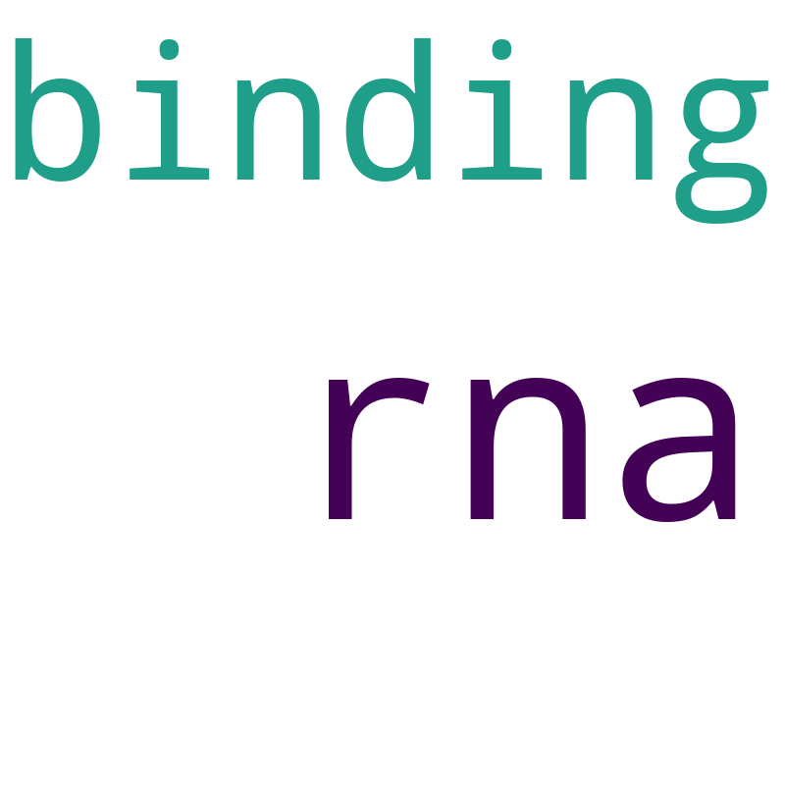
GSE164471(YM) WordCloud
UP regulated
DOWN regulated
GSE152558
GSE157585
GSE164471(YO)
GSE164471(YM)
GSE164471(MO)

Slide 17
GSE164471(MO) WordCloud
UP regulated
DOWN regulated
GSE152558
GSE157585
GSE164471(YO)
GSE164471(YM)
GSE164471(MO)

Slide 18
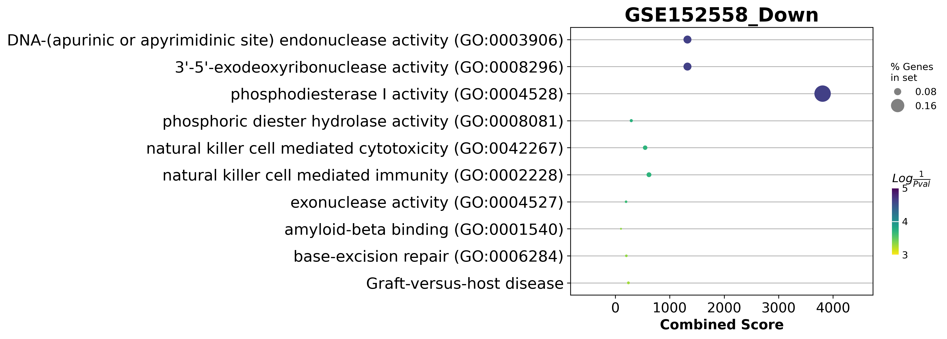
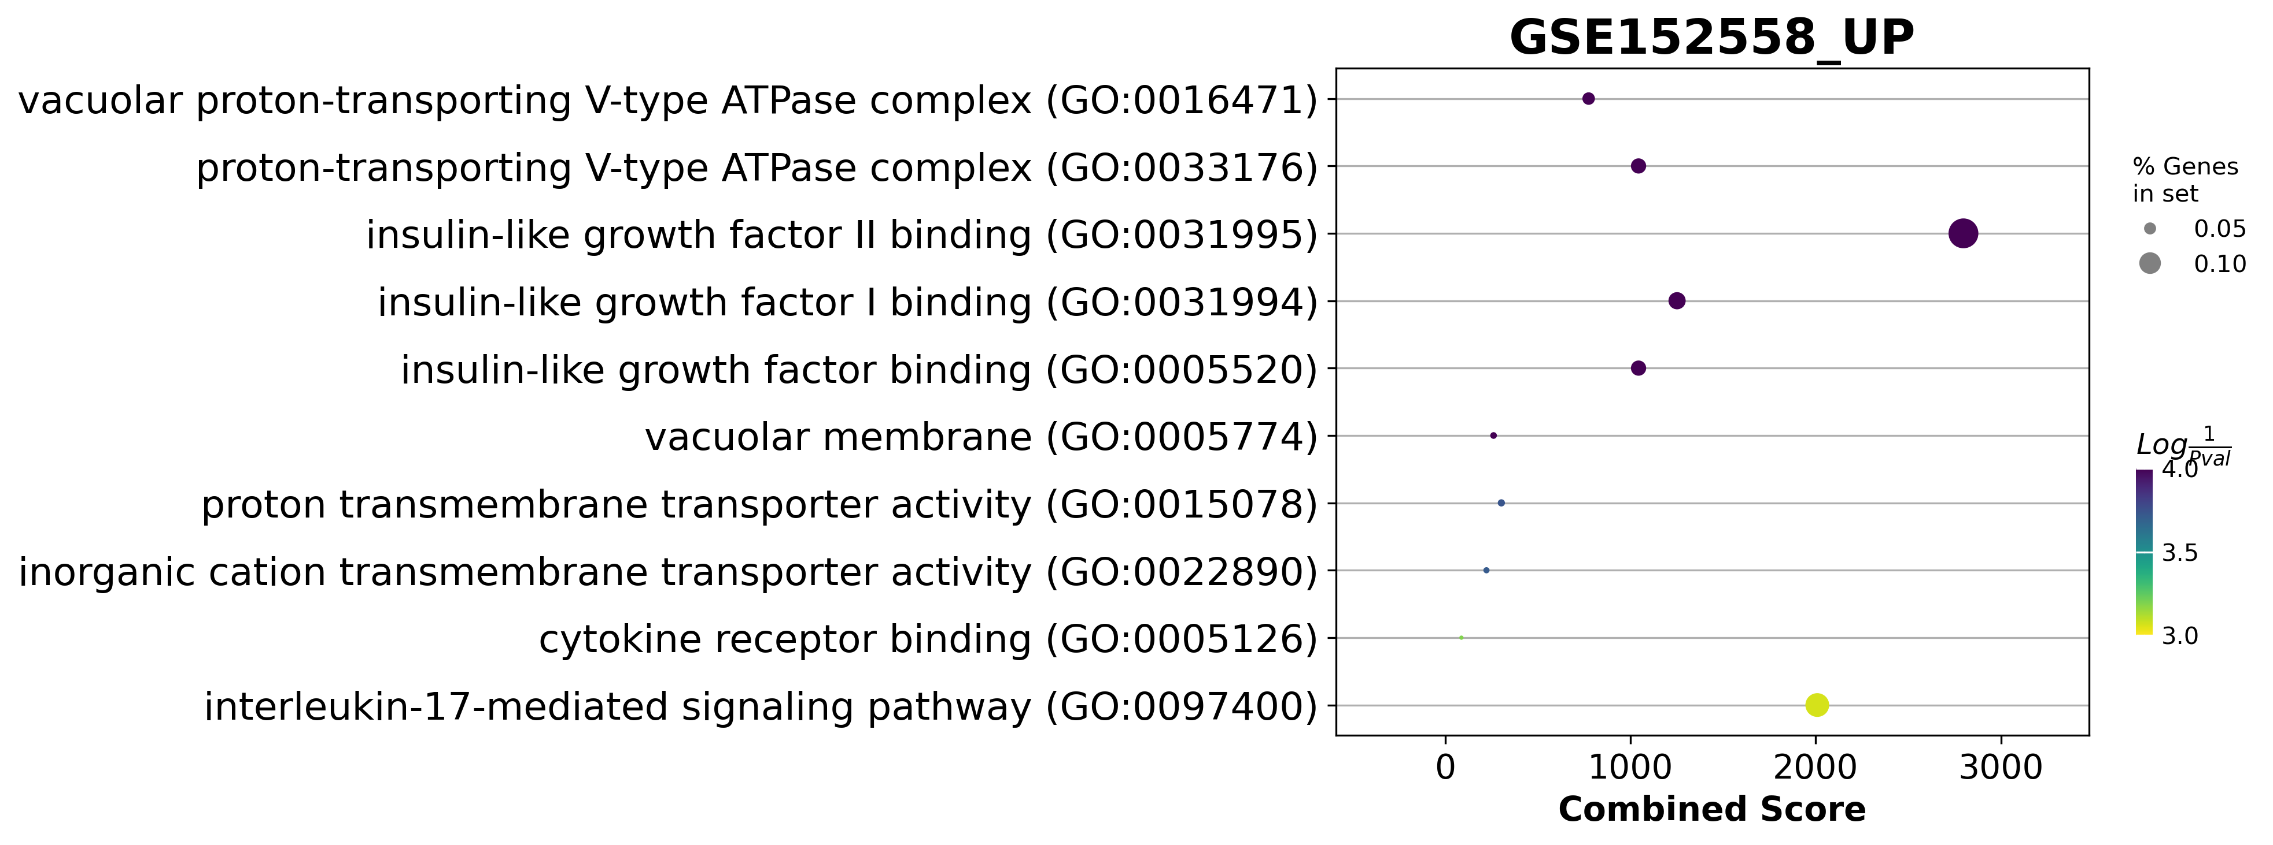
GSE152558 Dotplot
UP regulated
DOWN regulated
GSE152558
GSE157585
GSE164471(YO)
GSE164471(YM)
GSE164471(MO)

Slide 19
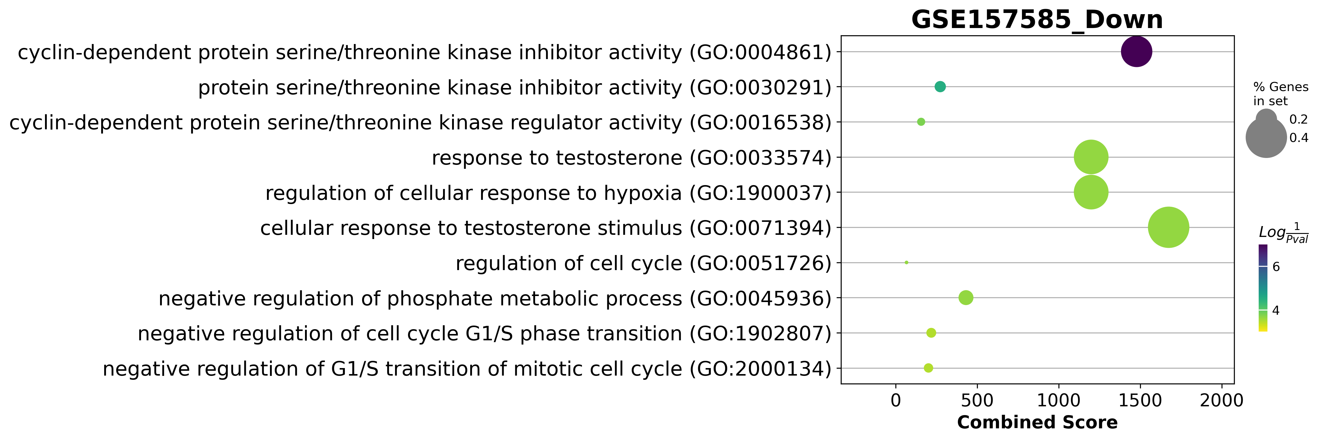

Slide 20
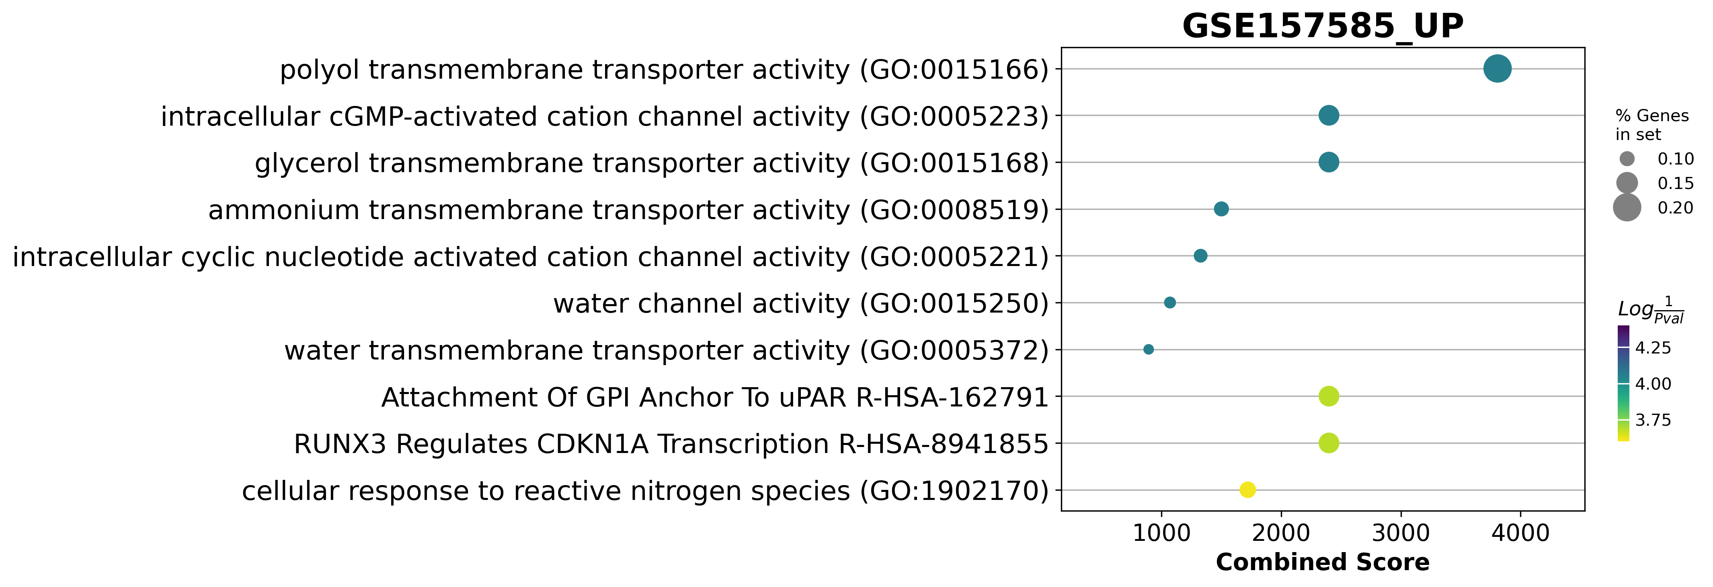

Slide 21
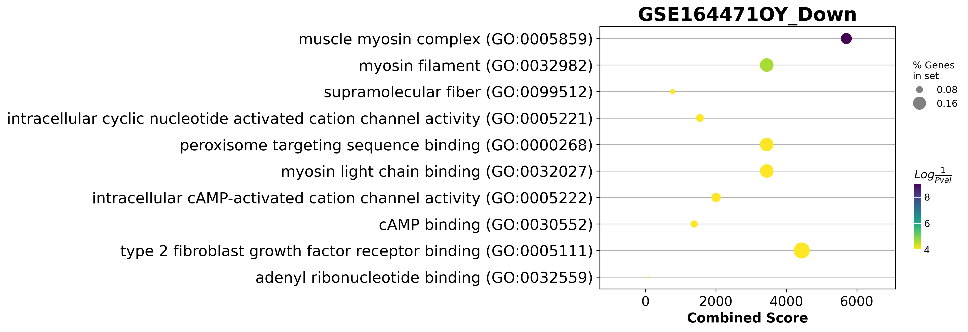
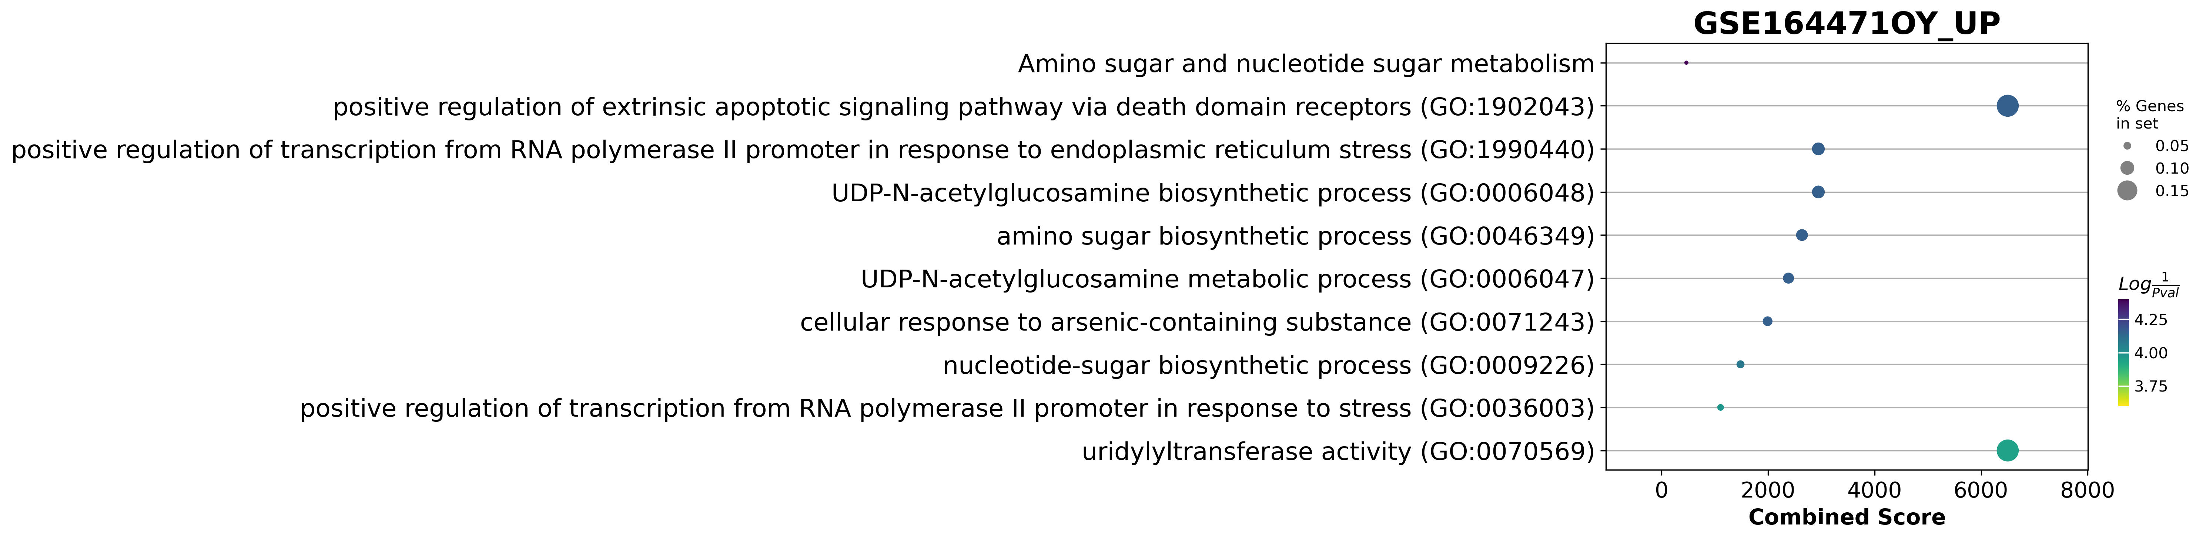
GSE164471(YO) Dotplot
UP regulated
DOWN regulated

Slide 24
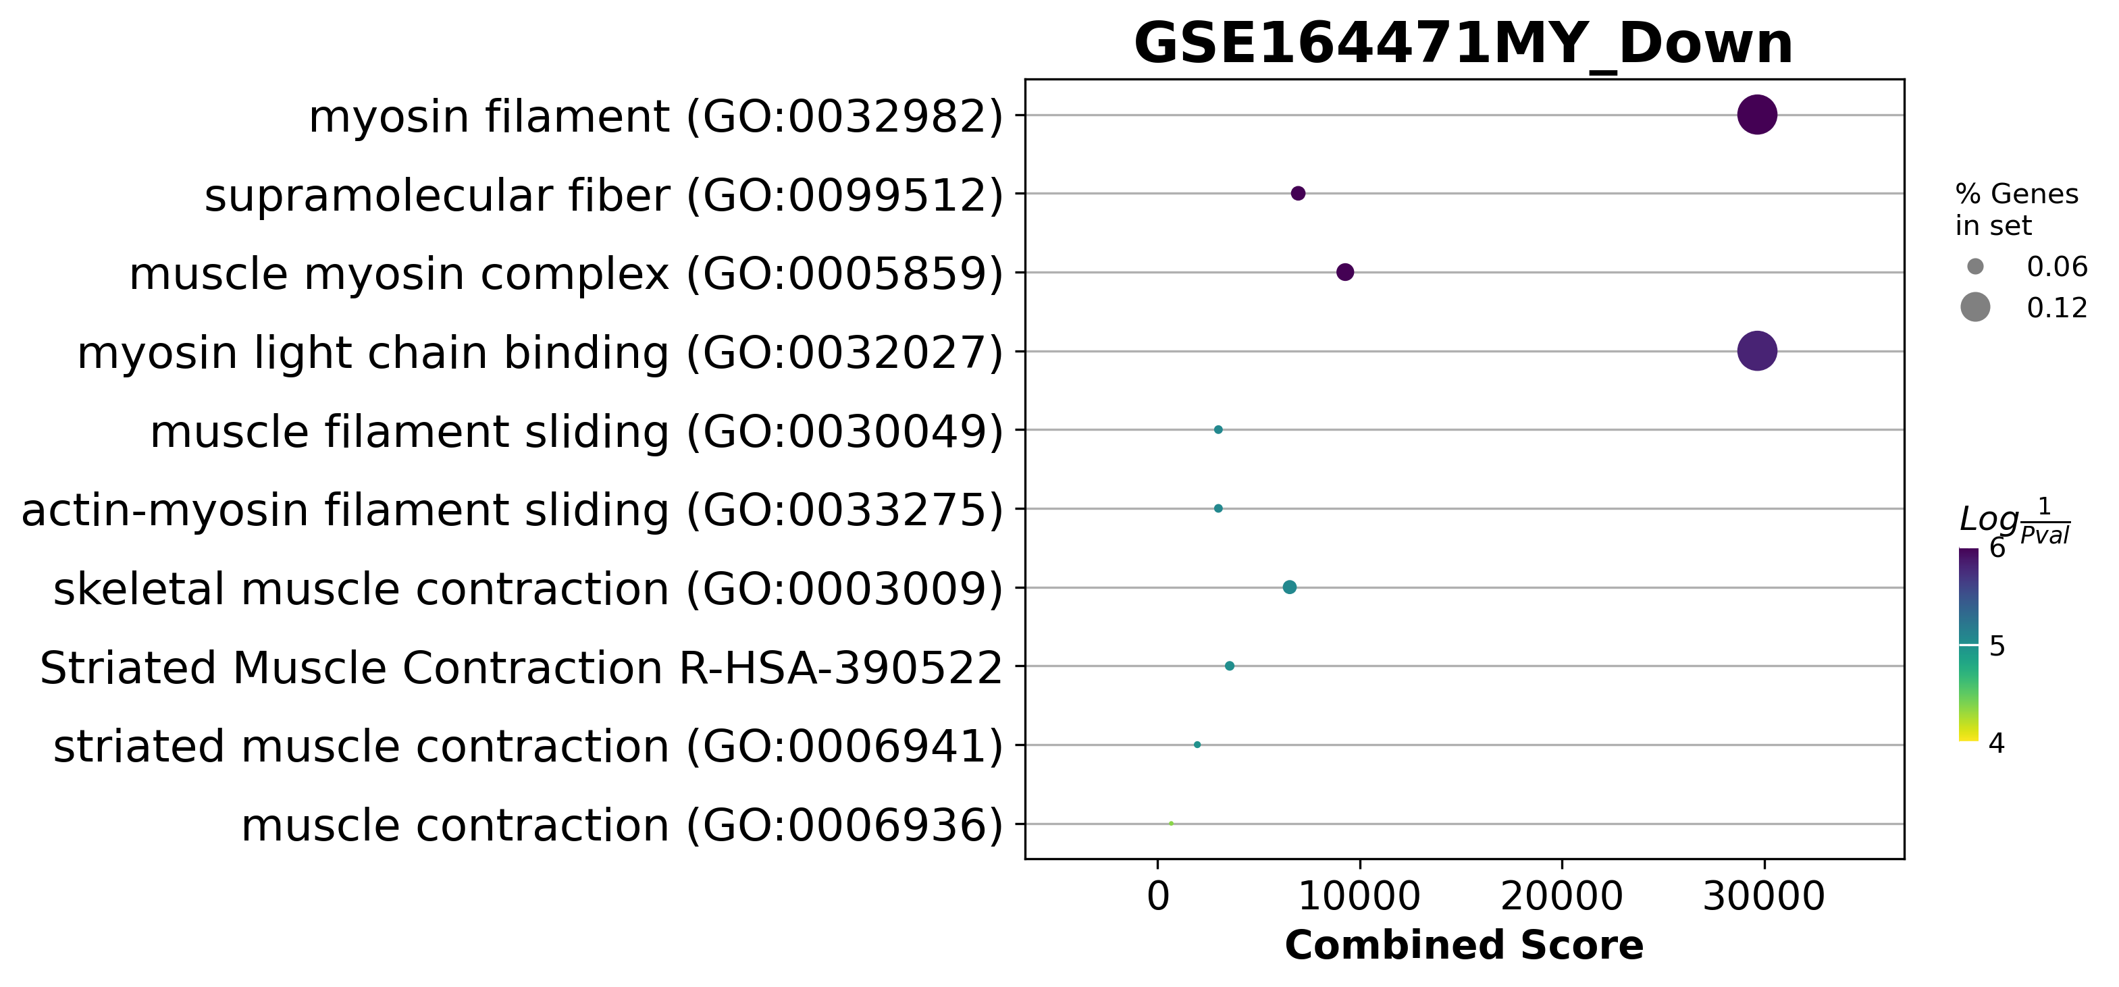
GSE164471(YM) Dotplot
UP regulated
DOWN regulated

Slide 26
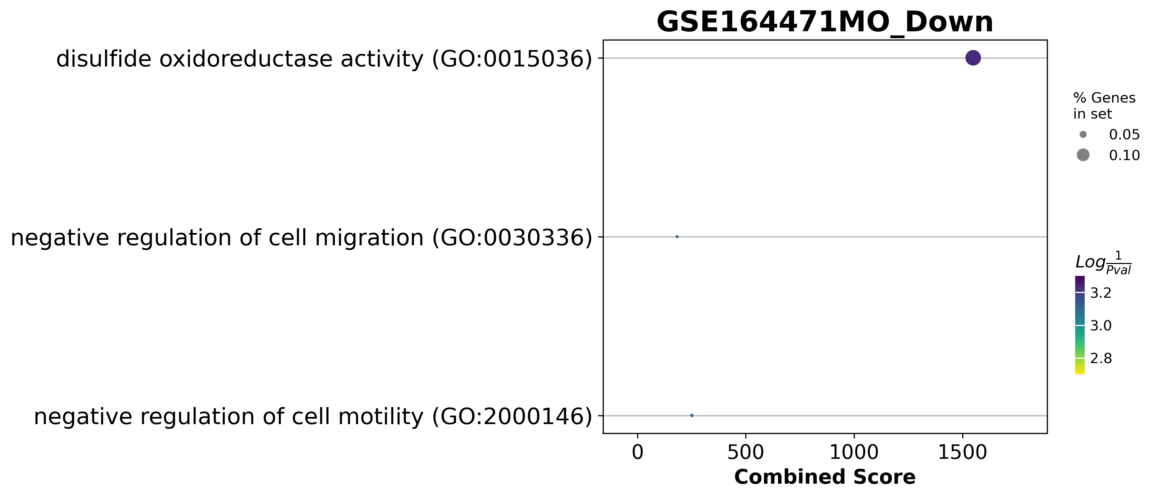
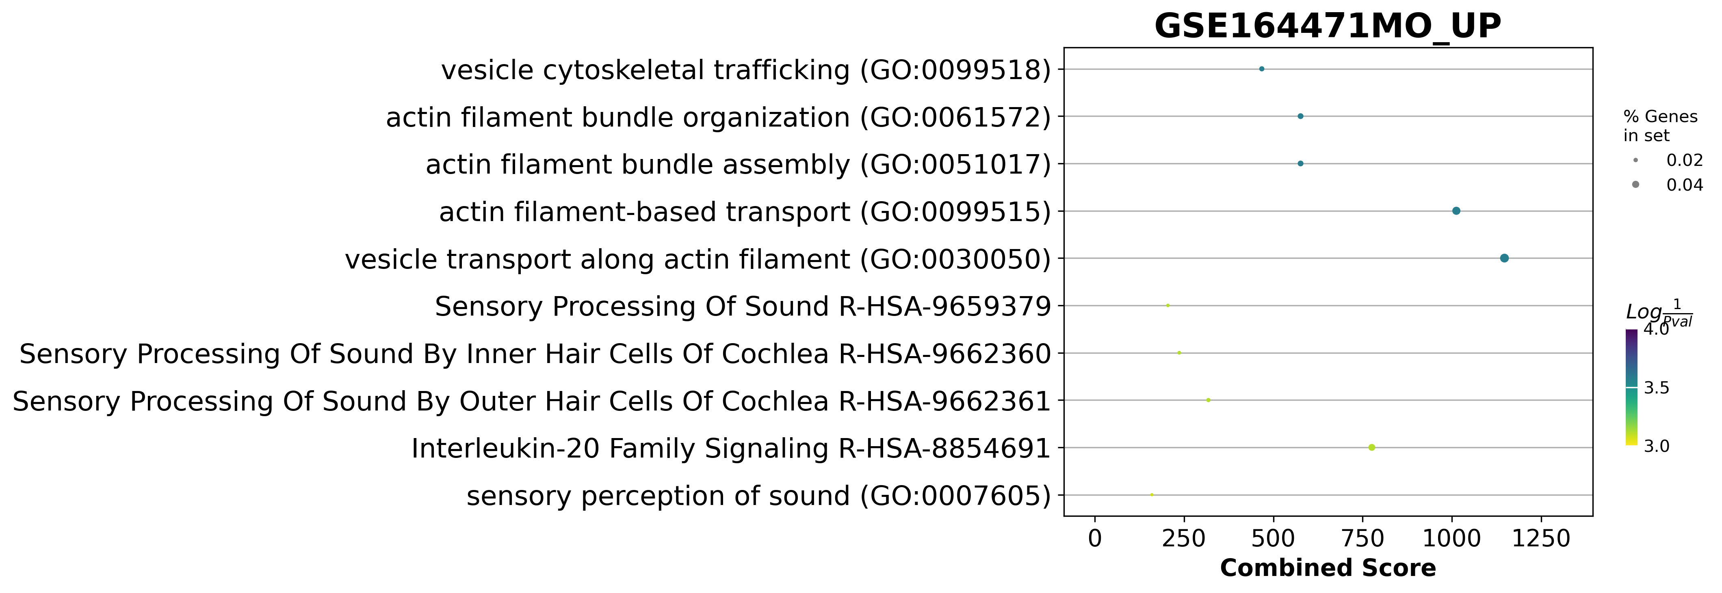
GSE164471(MO) Dotplot
UP regulated
DOWN regulated

Slide 29
General data

Slide 30
GSE152558
5 samples
Middle age vs Old
17 diff express genes
AC018635.1
OR7E154P
TRBV7-3
IGFBP6
ATP6V1F
CMTM5
IL25
PKMP1
KIR3DL1
FAM3C2
AC140504.1
APEX2
RBPJP5
TRBC2
AL136455.1
CDY8P
PRSS58

Slide 31
GSE157585
130 samples
Young vs Old
83 diff express genes
CYP26B1 USP13 ATP11B EPB41L3 CFAP61 ST13 EEF1A2 IK KAT2B SPP1 TRIM67 INHBA FAM199X CDKN1A MINDY2 PLVAP MYH8 SLC38A2 ROCK2 RPSAP36 KRTAP19-3 | UNC13C PPIG ZFHX3 FBXO15 GABRB2 PHIP ARHGAP36 CDKN2A ARID5B DDAH1 RNF20 TSPAN7 SPATA18 HPGD HCN1 SLC30A8 DACT1 SLFN5 GSG1L FOXN2 | FEZ2 AQP4 SPTLC3 DMRT2 NR1D2 ZNF25 NHLH2 FAM133CP CYP4X1 RGS7BP OSTN NELFB PGAP1 SLC22A12 RPS15AP6 AC017007.2 TATDN2P3 H3F3AP4 SLC9A3P2 AQP1 AC091429.1 | PA2G4P3 AC116565.1 AC139491.7 CACNA1E LRRTM3 EFCAB7 RPL11P3 FER1L6 RPL21P16 SMPD4P1 MROH5 MYL12BP2 BTF3L4P4 AC097376.1 NCAPGP1 AC122718.1 RNA5-8SP6 ZBED6 AC089984.2 CR383656.13

Slide 32
GSE164471
53 samples
Young, Middle age, Old
YO
  13 diff express genes
YM
  5 diff express genes
MO
  17 diff express genes
YO | YM | MO
MTND4P24 RPL10P9 IGFN1 ATF3 UAP1 PEX5L FGF7 HCN1 MAB21L3 MYH11 MYH8 MTND6P4 AC093809.1 | DQX1 MTND4P12 MYH8 MTCO1P12 | AC093809.1 ESPNL IL24 MTND6P4 METTL25 MYO1H PRR14L FAM49A TMX2 NARS PRSS44 GTPBP4 MTCO1P12 CLIC4 RPL10P9 MTCO3P22 MTND4P24

