Slide 1
Meeting Nov 11 2022
Meeting Nov 11 2022

Slide 2
Code ran

Slide 3
Fastqdump
fasterq-dump $sample -o $sample -O fastq/$experiment/$sample -S --include-technical |tee -a fasterq-dump_$sample.LOG

Slide 4
Cutadapt
cutadapt -q 28 -m 30 -a AGATCGGAAGAGCACACGTCTGAACTCCAGTCA -A AGATCGGAAGAGCGTCGTGTAGGGAAAGAGTGT ${sample}_1.fastq ${sample}_2.fastq -o cutadapted/${sample}_1.fastq -p cutadapted/${sample}_2.fastq >> cutadapt_${sample}.out 2> cutadapt_${sample}.err

Slide 5
Cutadapt
cutadapt -q 28 -m 30 -a AGATCGGAAGAGCACACGTCTGAACTCCAGTCA ${sample}.fastq -o cutadapted/${sample}.fastq > cutadapt_${sample}.out 2> cutadapt_${sample}.err

Slide 6
Kalisto
singularity exec kallistito_0.1.sif kallisto quant -i reference/homo_sapiens/transcriptome.idx -o outputKallisto/${sample} -t 12 cutadapted/${sample}_1.fastq cutadapted/${sample}_2.fastq --verbose | tee -a Kallisto_quant_${sample}.LOG

Slide 7
Quality
file:///run/user/1000/gvfs/sftp:host=10.80.222.10,user=kGuerreroVazquez/home/kGuerreroVazquez/diff_exp_adventure/fastqc/GSE152558/SRR12021926/SRR12021926_1_fastqc.html

Slide 8
Samples
GSE152558: 5/5
GSE157585: 84/84
GSE164471: 46/53

Slide 9
Differential Expression

Slide 10
GSE152558

Slide 11
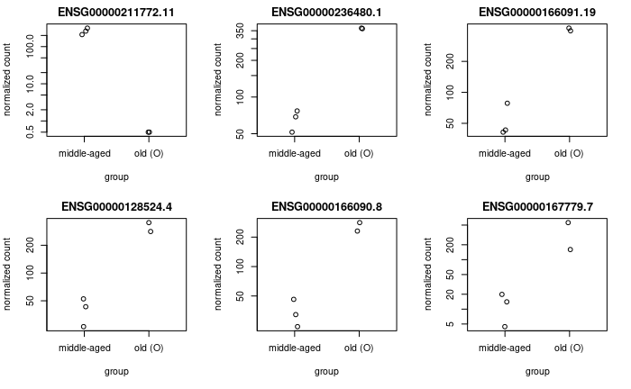
GSE152558

Slide 12
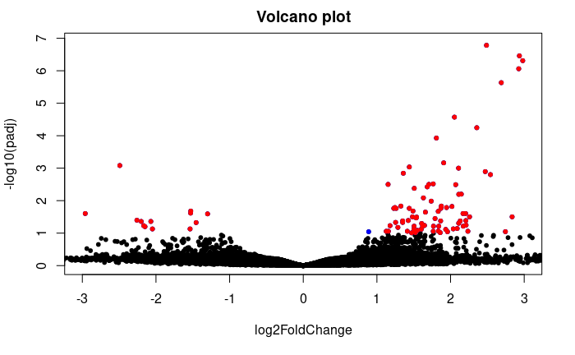
GSE152558

Slide 13
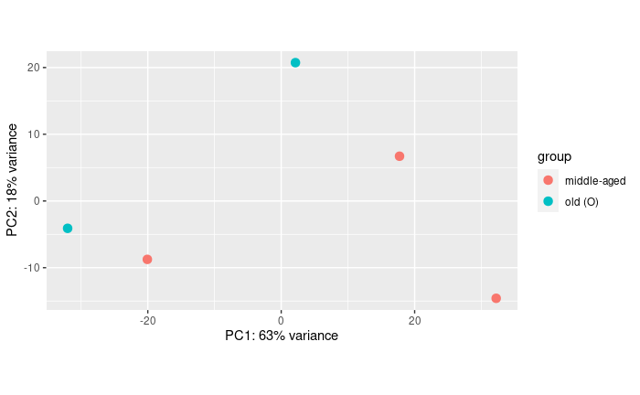
GSE152558

Slide 14
GSE157585

Slide 15
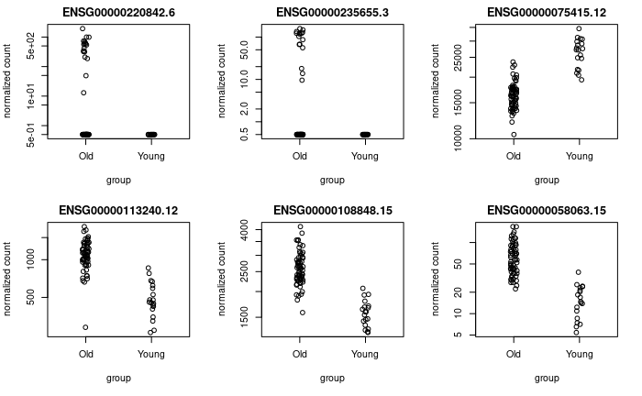
GSE157585

Slide 16
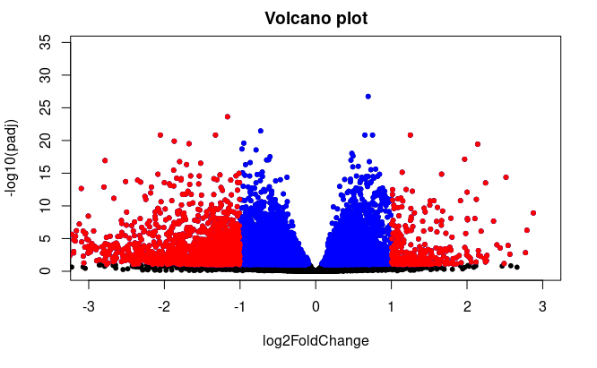
GSE157585

Slide 17
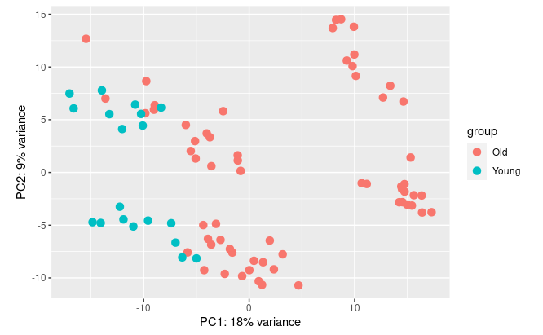
GSE157585

Slide 18
GSE164471

Slide 19
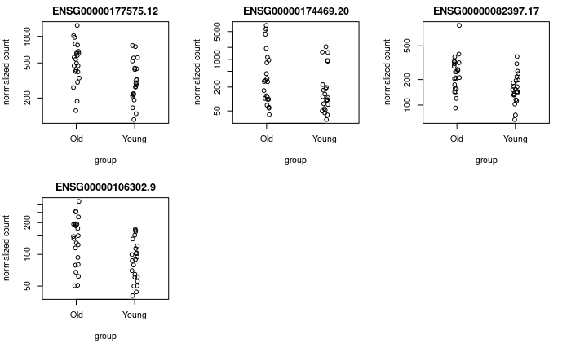
GSE164471

Slide 20
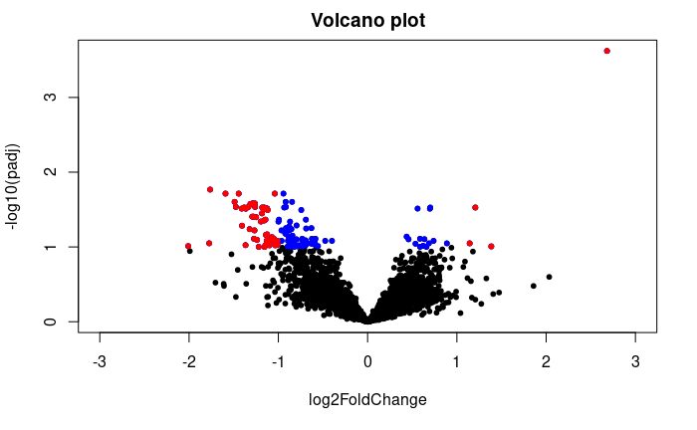
GSE164471

Slide 21
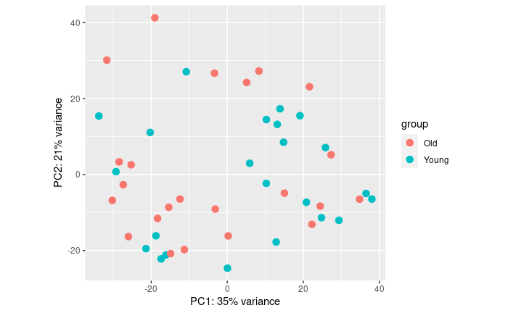
GSE164471

Slide 22
Findings
GSE152558 (5)
130 diff expressed genes
GSE157585 (84)
8649 diiff express genes
GSE164471 (2)
170 diff express genes.

Slide 23
Shared genes
GSE152558nGSE157585': 46
'GSE152558uGSE157585': 8180
'GSE152558nGSE164471': 0
'GSE152558uGSE164471': 129
'GSE157585nGSE164471': 105,
'GSE157585uGSE164471': 129
'GSE152558nGSE157585nGSE164471': 0
'GSE152558uGSE157585uGSE164471': 129

Slide 24
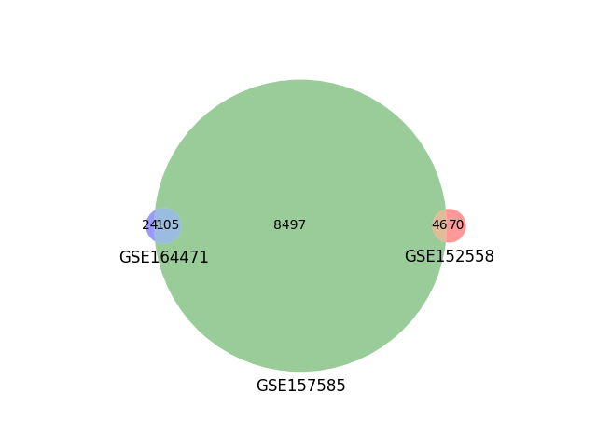

Slide 25
Enrrichment analysis

Slide 26
Gorilla
Ensmbl with version
Ensmbl without version
Convert to gene name
Convert to entrez
Prevously it worked http://cbl-gorilla.cs.technion.ac.il/GOrilla/wufiecui/GOResults.html

Slide 27
TopGene/TopFun
Worked with Ensembl but low infomation

Slide 28
David
Claims to work with ensembl
Removed the version
Covnerted to Entrez
Now it works...

Slide 29
http://www.pantherdb.org/

Slide 30
David
It worked just with no version

