Slide 1
Results DEA and PEA

Slide 3
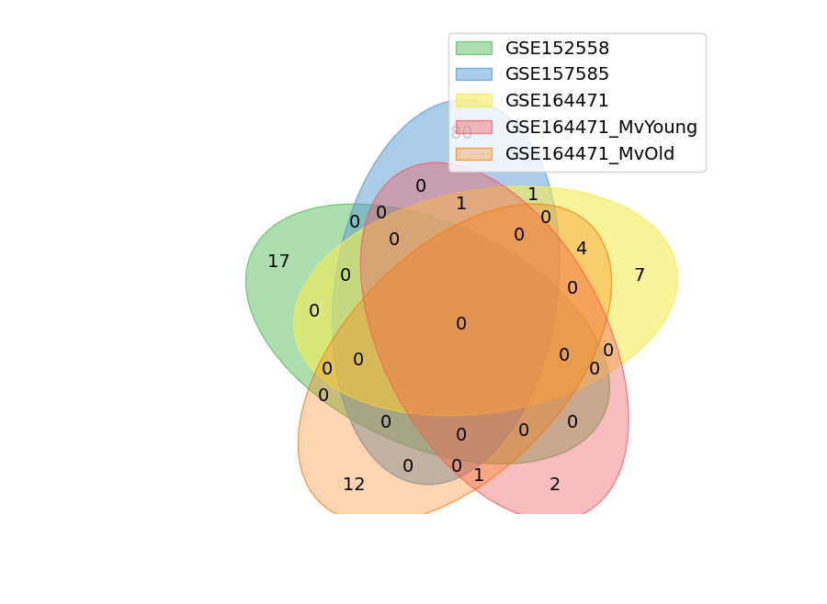

Slide 4
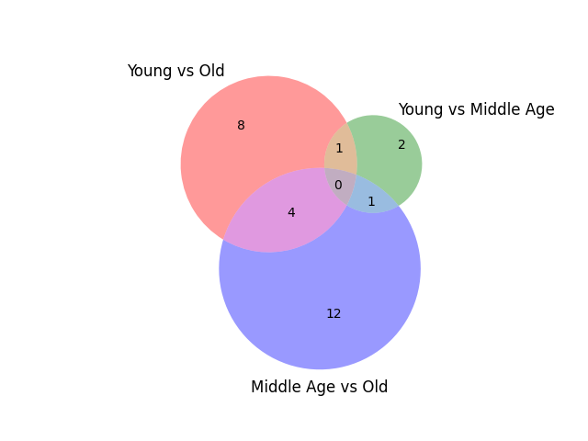
GSE164471

Slide 5
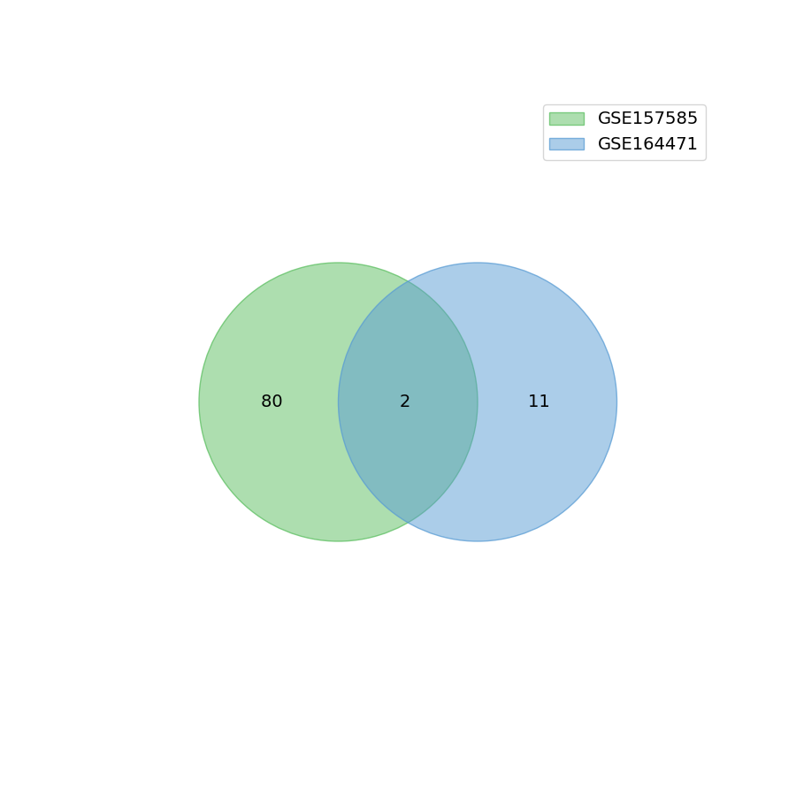
Old vs Young

Slide 6
Old vs Young
MYH8
HCN1

Slide 7

Old/Ma Vs Young

Slide 8
ENSG00000133020.4
GSE157585
  Old vs Young
GSE164471
  Old vs Young
  Middle Age vs Young
MYH8

Slide 9
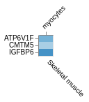
GSE152558: Molecular function
1 binding (GO:0005488)
1 catalytic activity (GO:0003824)
https://toppgene.cchmc.org/output.jsp?userdata_id=db93fb95-8f10-4f5c-ad53-bf8c56441688

Slide 10
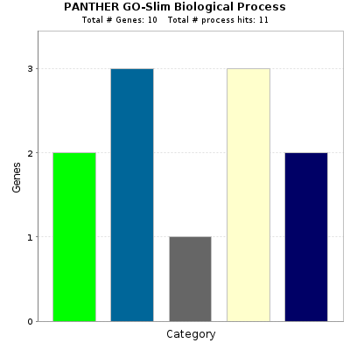
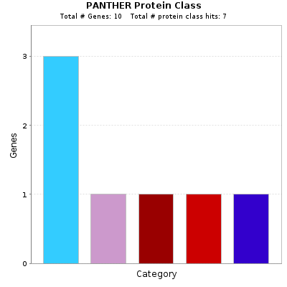
GSE152558

Slide 11
GSE152558:Biological process
3 response to stimulus (GO:0050896)
2 signaling (GO:0023052)
3 cellular process (GO:0009987)
1 metabolic process (GO:0008152)
2 biological regulation (GO:0065007)

Slide 12
GSE152558: Cellular Component
5 cellular anatomical entity

Slide 13
GSE152558: Protein
3 defense/immunity protein (PC00090)
1 transporter (PC00227)
1 scaffold/adaptor protein (PC00226)
1 protein-binding activity modulator (PC00095)
1 protein modifying enzyme (PC00260)

Slide 14
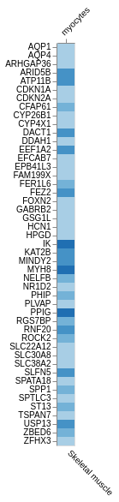
GSE157585
https://toppgene.cchmc.org/output.jsp?userdata_id=3d46405d-4932-4c7d-8f32-95ddf7062bc7

Slide 15
GSE157585
Negative regulation cyclin-dependent protein serine/threonine kinase inhibitor activity (3) pvaue = 2.64e-2
Transcriptional regulation by RUNX3 (3) pvalue = 1.68e-3
replicative senescence (2) pvalue = 4.17e-2

Slide 16
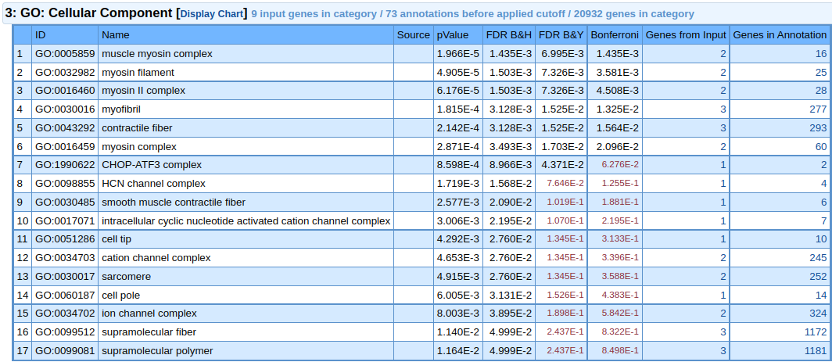
GSE164471 Young vs Old
https://toppgene.cchmc.org/output.jsp?userdata_id=e55eb74c-230c-42bb-9860-ff4e67ba0632

Slide 17
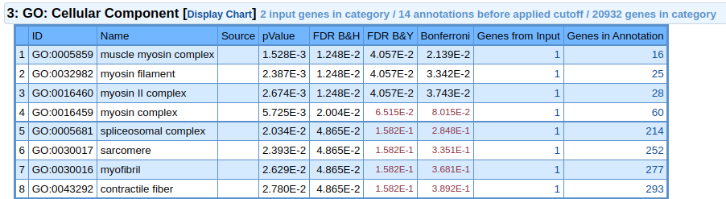

GSE164471 Young vs Middle Age
https://toppgene.cchmc.org/output.jsp?userdata_id=8cf3a125-35bf-489f-b01f-9c338a2617e4

