Slide 1
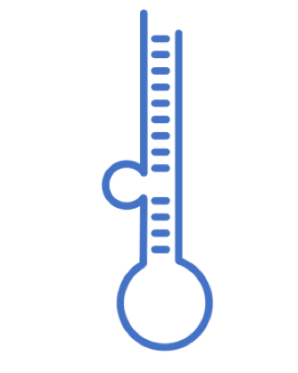
miRNA-genes network
V 1.1 Presented on April 7, 2022

Slide 2
Update on our data…
Adding miRDB
# Mirnas | # Genes | # sources
2674 | 59131 | 3 | Only human
7591 | 177910 | 4 | All

Slide 3
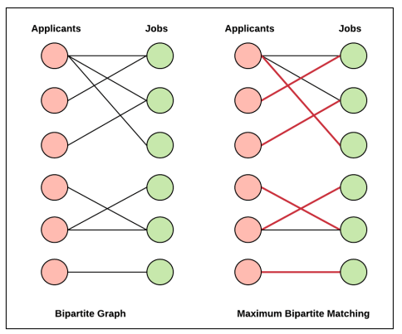
Bipartite graph

Slide 4
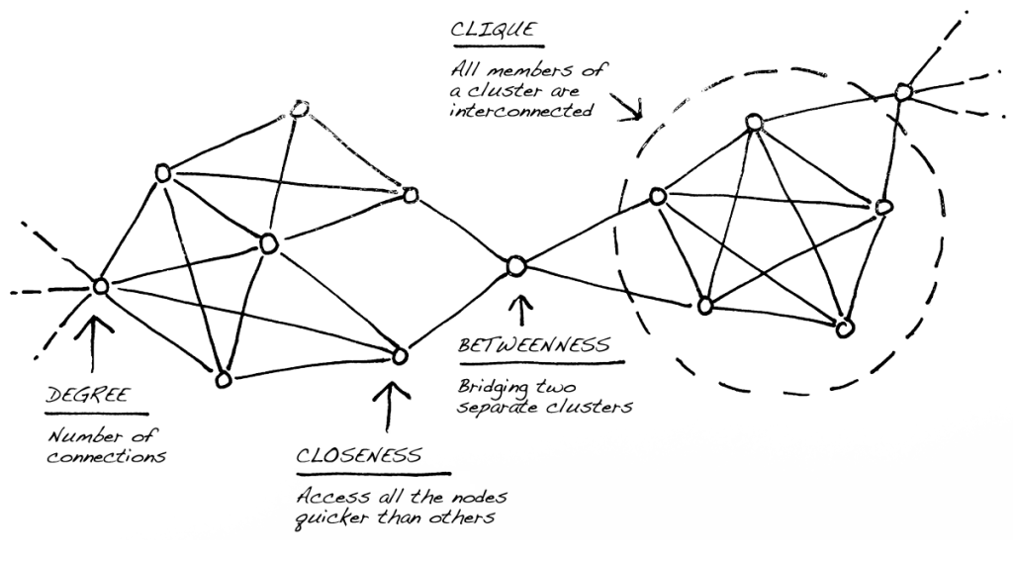

Slide 5
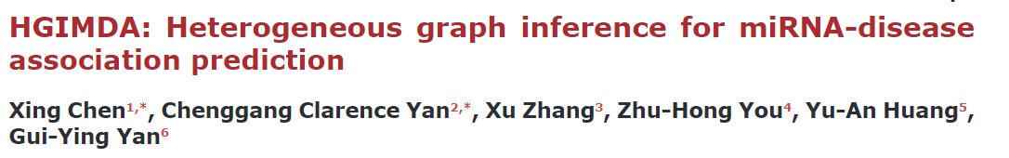
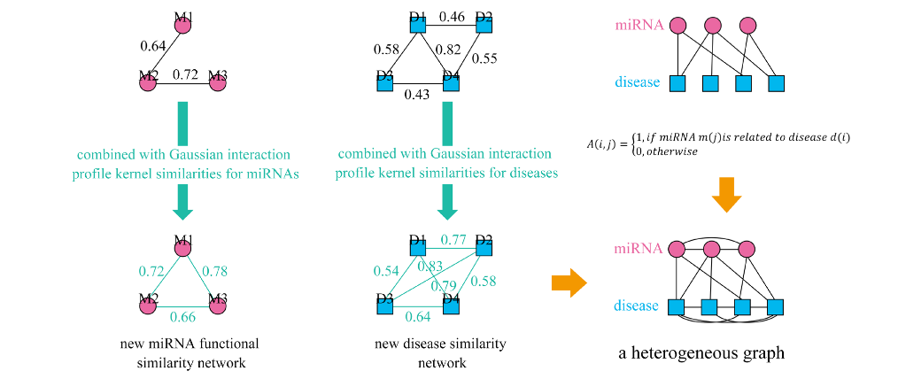

Slide 6
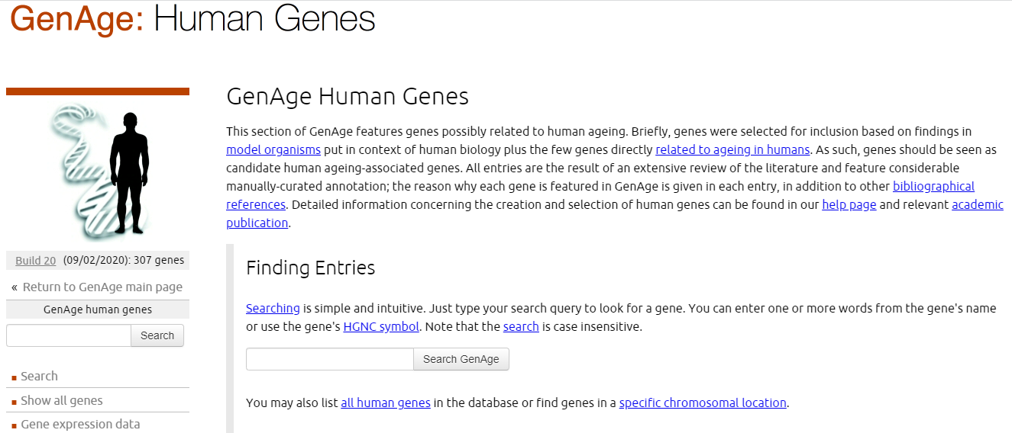
Aging

Slide 7
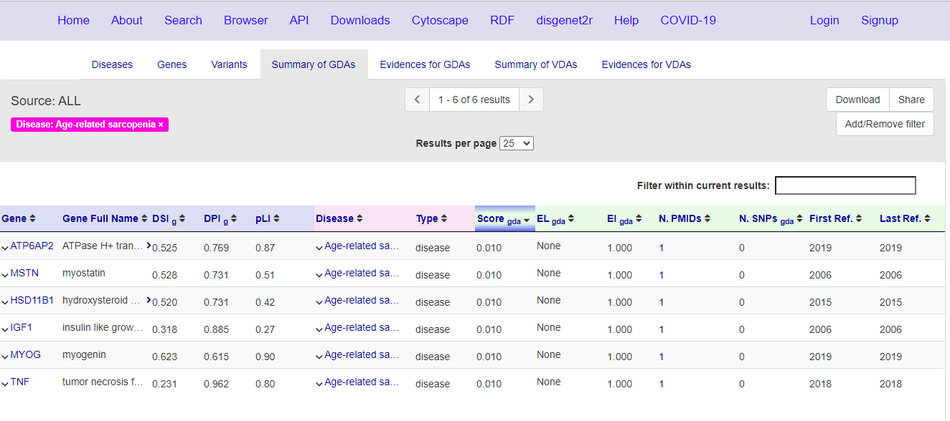
Sarcopenia

Slide 8
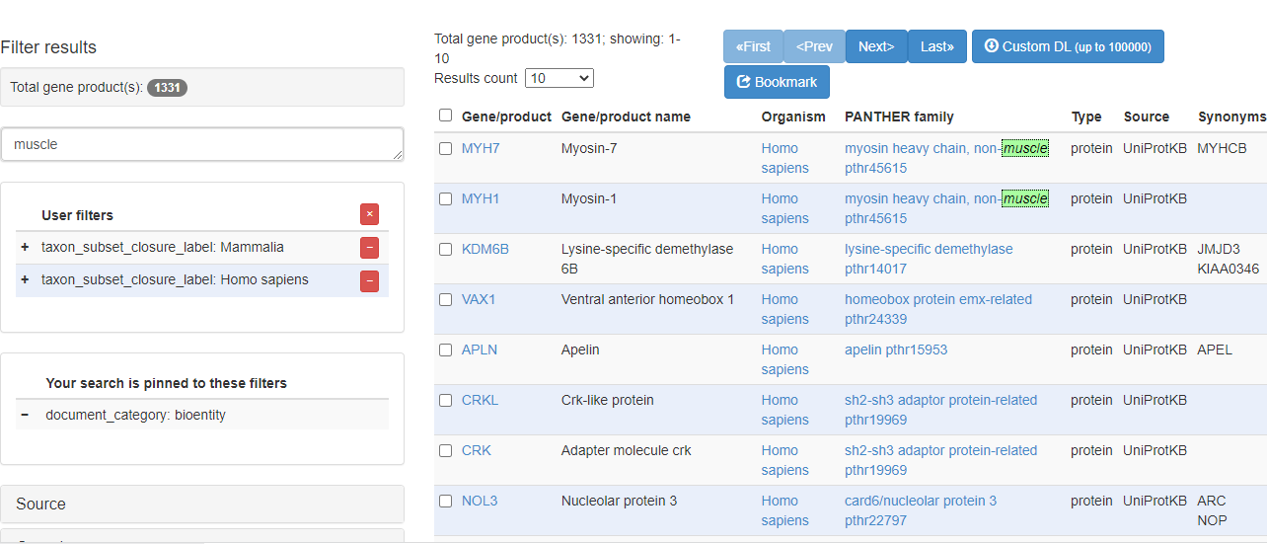
Muscle

Slide 9
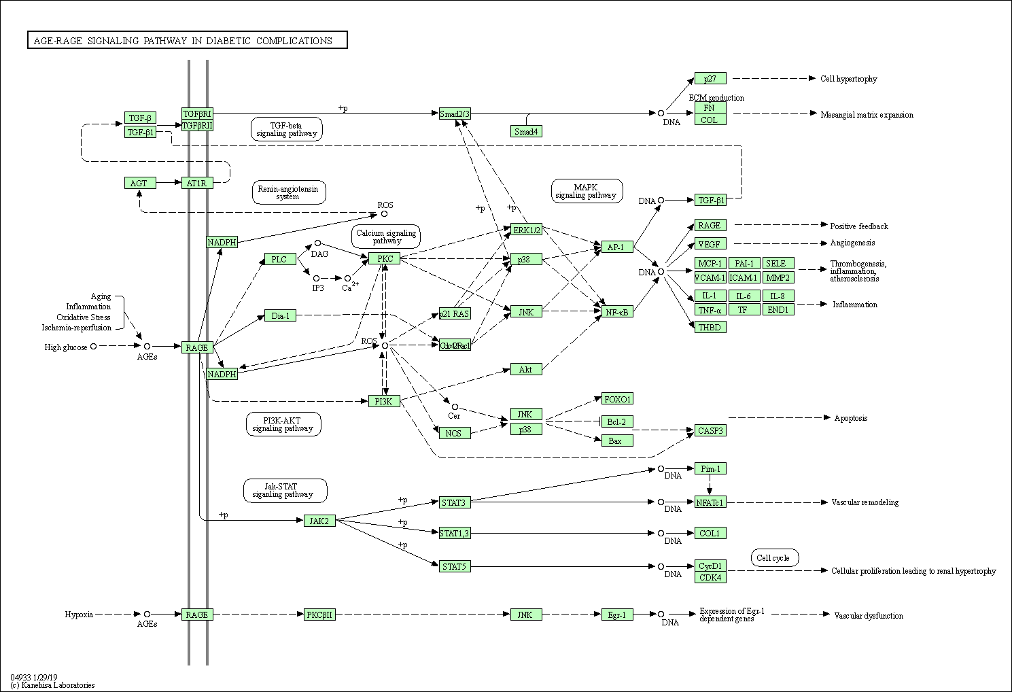
Kegg Path

Slide 10
Collecting genes (Playing around)
Source | Type | Total genes | Genes with HUMAN mirs | Mirs involved
GenAge | Aging | 307 | 304 | 2615
Gene Ontology | Muscle | 50 | 46 | 2285
Disgenet | Sarcopenia | 6 | 6 | 1058
KEGG | AGE-RAGE signalling pathway in diabetic complications | 359 | 58 | 2435
ALL |  | 722 | 393 | 2625
Notes:
www.jbc.org/article/S00219258(20)428662/fulltext

Slide 11
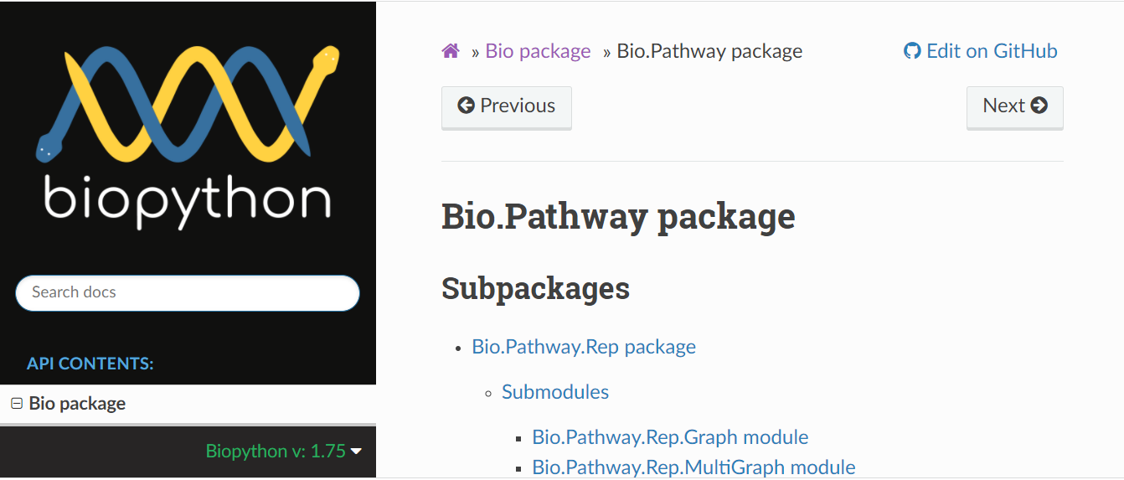
Using Biopython

Slide 12
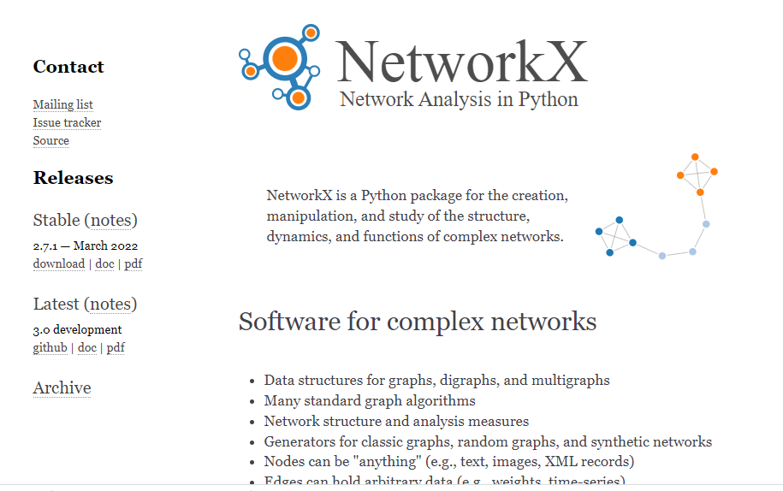
NetworkX

Slide 13
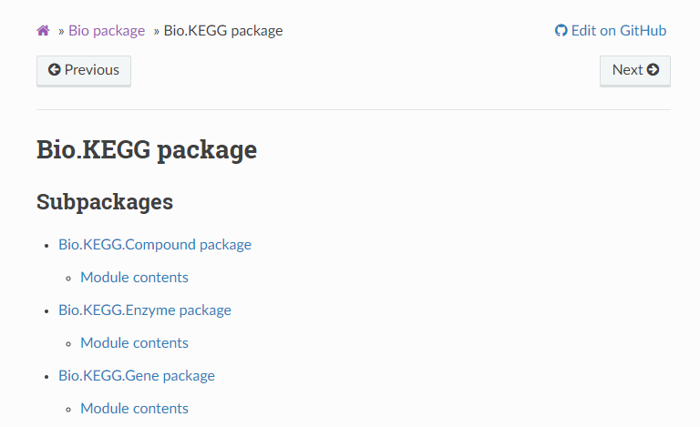
Biopython already includes KEGG

Slide 14
To do (?)
Look for similar applications
Include seeds instead of the mirnas
Clean code, create exec files
Biopython course
Construct network from cero

Slide 15
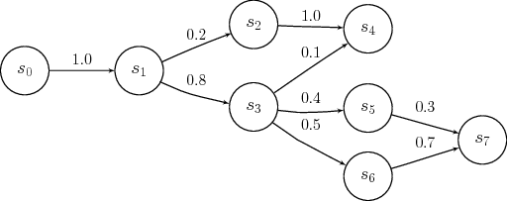
Markov hidden model

