Slide 1

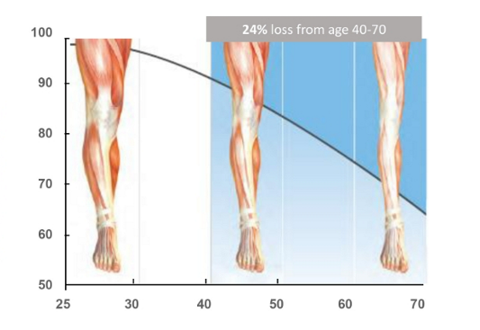
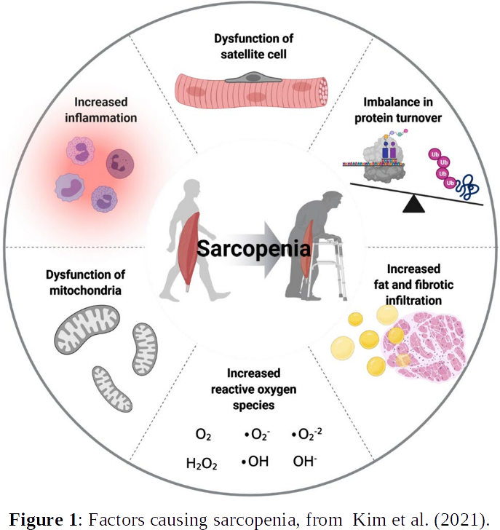


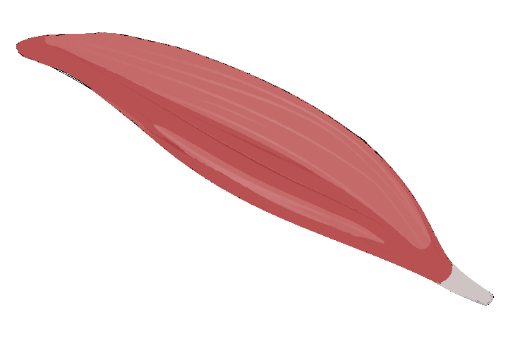



Strategies for the selection of miRNA candidates for the treatment of Sarcopenia using network-based analysis and differential expression scoring
Karen Guerrero Vazquez
Dr. Katarzyna Goljanek-Whysall
Dr. Pilib Ó Broin

