Slide 1
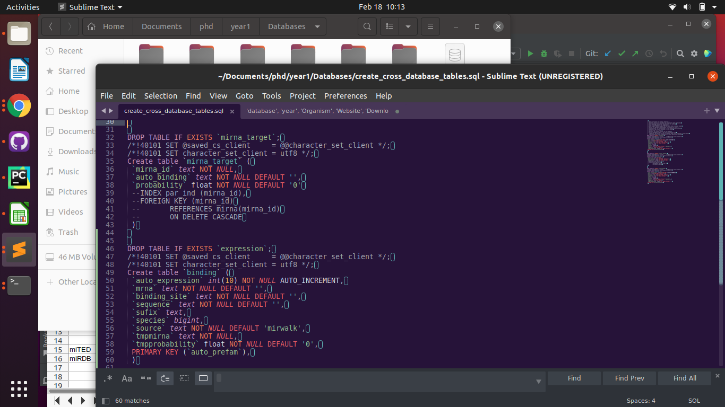

Slide 2
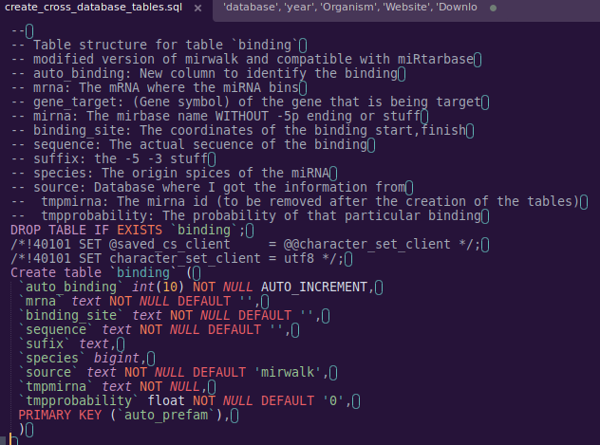

Slide 3
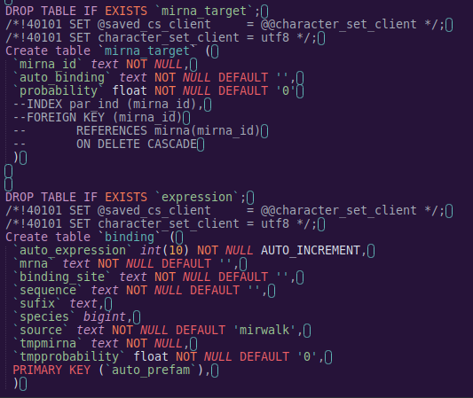

Slide 4
mirWalk
miRNA
mRNA
Gene symbol
Binding site
duplex
Binding probability

Slide 5
mirTarBase
miRTarBase_ID
miRNA
Species
Target_Gene
Target_Gene_ID
Species2
Target_Site
Experiments_Support Type
References

Slide 6
HMDD
category
mir
disease
pmid
description

Slide 7
Diana mirTed
S.No
Sample_ID
Collection
Project_ID
Tissue_or_organ_of_origin
Tissue_subregion
Cell_Line
Disease
Organism
Gender
Health_state
Tissue_definition
ALL MIRNAS (2464)

Slide 8
miRDB
miRNA
mRNA
Prediction probability percentage

Slide 10
Process for python processing of data
Objective: Separate the txt datasets in order to run a LOAD DATA LOCAL INFILE
-

Slide 11
Process for python processing of data
Methodology:
- Create a virtual enviroment to get control of the versions that I am ussing
python3 -m venv /home/karen/Documents/phd/mirnadbs
- Activate enviroment
source /home/karen/Documents/phd/mirnadbs/bin/activate
- Clone my own repo
For this I download the desktop version because it rocks (from https://gist.github.com/berkorbay/6feda478a00b0432d13f1fc0a50467f1)
sudo wget https://github.com/shiftkey/desktop/releases/download/release-2.9.3-linux3/GitHubDesktop-linux-2.9.3-linux3.deb
### Uncomment below line if you have not installed gdebi-core before
# sudo apt-get install gdebi-core
sudo gdebi GitHubDesktop-linux-2.9.3-linux3.deb
-

Slide 12
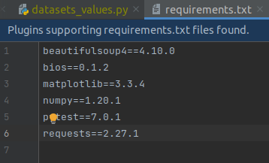
Process for python processing of data
Install the requerements
pip install pipreqs
pipreqs /home/project/location
pip install -r requirements.txt
From https://stackoverflow.com/questions/35796968/get-all-modules-packages-used-by-a-python-project
- Create script that convert the code to a dataframe (before it was a dictionary)
-

Slide 13
SQL
Process to create my database with mysql
CREATE USER 'karen'@'localhost' IDENTIFIED BY '123';
GRANT ALL PRIVILEGES ON *.* TO 'karen'@'localhost' WITH GRANT OPTION;
CREATE DATABASE mirnadbs;
To run the load into file I need to run the sql as
sudo mysql --local-infile=1 -u karen -p

