Slide 1
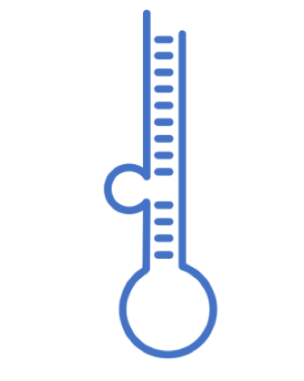
miRNA Data
Analysis of the selected datasets
V 1.1 Presented on February 18, 2022

Slide 2
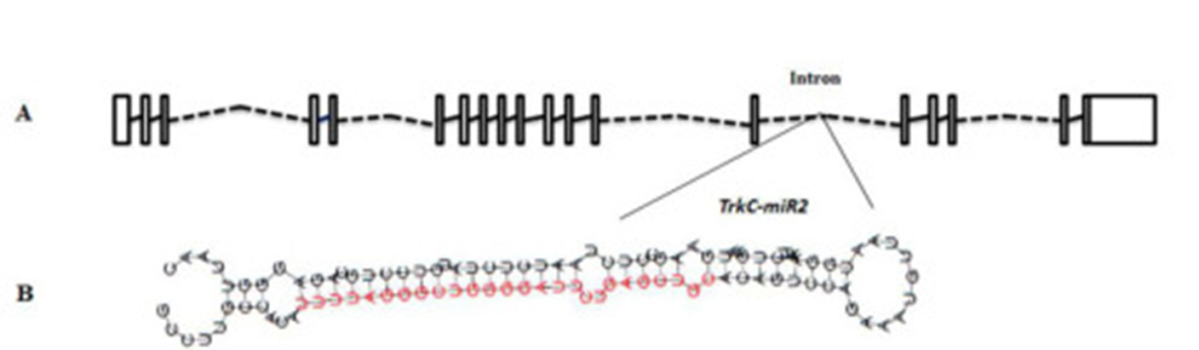
miRNA
18 - 25 nt single stranded
conserved small noncoding RNAs
regulate almost all cellular functions including cell proliferation, growth, differentiation and apoptosis, have been implicated in controlling the fate and behaviour of stem cells
Notes:
www.jbc.org/article/S00219258(20)428662/fulltext

Slide 3
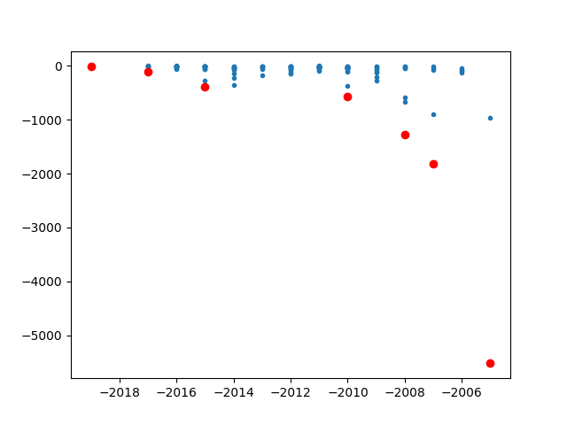
Pareto front

Slide 4

Database | year | Cites | Organism | Website | down | avail | PubmedID | Content | information
miRBase | 2014 | 2368 | Miscellaneous | www.mirbase.org/ | Yes | Yes | 24275495 | General Information | miRNA/Target interactions
smiRNAdb | 2007 | 1817 | Miscellaneous | www.mirz.unibas.ch/cloningprofiles/ | No | No | 17604727 | Expression datasets | Expression profiles
microRNA.org | 2008 | 1270 | Miscellaneous | www.microrna.org/ | No | No | 18158296 | Predicted miRNA | Expression profiles miRNA/Target interactions Phylogeny
miRWalk | 2011 | 830 | NA | NA | NA | NA | 21605702 | Predicted miRNA | Target gene
miRBase | 2019 | 809 | Miscellaneous | www.mirbase.org | Yes | Yes | 30423142 | General Information | miRNA/Target interactions
miRTarBase | 2010 | 563 | Miscellaneous | mirtarbase.mbc.nctu.edu.tw/ | Yes | Yes | 21071411 | General Information | miRNA/Target interactions Phylogeny
miRTarBase | 2016 | 523 | Miscellaneous | mirtarbase.mbc.nctu.edu.tw | Yes | Yes | 26590260 | General Information | miRNA/Target interactions Phylogeny
HMDD | 2015 | 389 | Homo sapiens | 202.38.126.151/hmdd/mirna/md/ | No | No | 18923704 | Association to diseases | Disease
miRDB | 2020 | 374 | NA | NA | NA | NA | 31504780 | Expression datasets | Target gene
mirDIP | 2017 | 111 | Miscellaneous | ophid.utoronto.ca/mirDIP/ | Yes | Yes | 21364759 |  | miRNA/Target interactions
Rfam | 2021 | 49 | NA | NA | NA | NA | 33211869 |  | NA
miRNASNP | 2021 | 13 | NA | NA | NA | NA | 32990748 | Single nuclotide | Expression profiles miRNA/Target interactions SNPs
mirtronDB | 2019 | 5 | Plants | mirtrondb.cp.utfpr.edu.br/ | Yes | Yes | 30874795 |  | NA
CSCD2 | 2022 | 3 | NA | NA | NA | NA | 34551437 |  | NA
DIANAmiTED | 2022 | 0 | NA | NA | NA | NA | 34469540 |  | NA

Slide 5
Database | year | Cites | Website | down | avail | PubmedID | Content | Prediction Algorithm | API | API alternative
miRBase | 2014 | 2368 | mirbase.org/ | Yes | Yes | 24275495 | General | NA | NA | NA
smiRNAdb | 2007 | 1817 | mirz.unibas.ch/cloningprofiles/ | No | No | 17604727 | Expression | NA | NA | NA
microRNA.org | 2008 | 1270 | microrna.org/ | No | No | 18158296 | Predicted miRNA | NA | NA | NA
miRWalk | 2011 | 830 | mirwalk.umm.uni-heidelberg.de/search_mirnas/ | Yes | Yes | 21605702 | Predicted miRNA | Yes | NA | NA
miRTarBase | 2010 | 563 | mirtarbase.mbc.nctu.edu.tw/ | Yes | Yes | 21071411 | General | NA | NA | NA
HMDD | 2015 | 389 | 202.38.126.151/hmdd/mirna/md/ | No | No | 18923704 | Diseases | NA | NA | NA
miRDB | 2020 | 374 | mirdb.org/ | Yes | Yes | 31504780 | Expression | Yes | NO | Yes
mirDIP | 2017 | 111 | ophid.utoronto.ca/mirDIP/ | Yes | Yes | 21364759 |  | NA | NA | NA
Rfam | 2021 | 49 | rfam.org | NA | NA | 33211869 | Family | NA | Yes | NA
miRNASNP | 2021 | 13 | bioinfo.life.hust.edu.cn/miRNASNP/ | Yes | Yes | 32990748 | Single nuclotide | Yes | No | Yes
mirtronDB | 2019 | 5 | mirtrondb.cp.utfpr.edu.br/ | Yes | Yes | 30874795 | mirtrons | Yes | NA | NA
DIANAmiTED | 2022 | 0 | dianalab.e-ce.uth.gr/mited/#/ | NA | Yes | 34469540 | Expression | NA | NA | NA

Slide 6
Download data
Database | year | Cites | Website | down | avail | PubmedID | Content | Prediction Algorithm | API | API alternative
miRBase | 2014 | 2368 | mirbase.org/ | Yes | Yes | 24275495 | General | NA | NA | NA
miRWalk | 2011 | 830 | mirwalk.umm.uni-heidelberg.de/search_mirnas/ | Yes | Yes | 21605702 | Predicted miRNA | Yes | NA | NA
miRTarBase | 2010 | 563 | mirtarbase.mbc.nctu.edu.tw/ | Yes | Yes | 21071411 | General | NA | NA | NA
miRDB | 2020 | 374 | mirdb.org/ | Yes | Yes | 31504780 | Expression | Yes | NO | Yes
mirDIP | 2017 | 111 | ophid.utoronto.ca/mirDIP/ | Yes | Yes | 21364759 |  | NA | NA | NA
Rfam | 2021 | 49 | rfam.org | Yes | Yes | 33211869 | Family | NA | Yes | NA
miRNASNP | 2021 | 13 | bioinfo.life.hust.edu.cn/miRNASNP/ | Yes | Yes | 32990748 | Single nuclotide | Yes | No | Yes
mirtronDB | 2019 | 5 | mirtrondb.cp.utfpr.edu.br/ | Yes | Yes | 30874795 | mirtrons | Yes | NA | NA
DIANAmiTED | 2022 | 0 | dianalab.e-ce.uth.gr/mited/#/ | Yes | Yes | 34469540 | Expression | NA | NA | NA

Slide 7

First publication 2002 (then called the microRNA Registry)
Names and distributes microRNA gene sequences.
Author submission
Current release v22
17 tables:
confidence | mature_database_url | mirna_database_links | mirna_prefam
mirna_species | mature_database_links | mirna_database_url | mirna_mature
dead_mirna | mirna_2_prefam | mirna_literature_references
mirna_context | mirna_chromosome_build | Confidence_score
mirna | literature_references | mirna_pre_mature

Slide 8
miRBase mirna columns
auto_mirna
mirna_acc
mirna_id
previous_mirna_id
description
sequence
comment
auto_species
dead_flag

Slide 9

2011, 2014, 2018
Compilation of the genes and miRNA dictionaries for human, mouse and rat from several databases:
HUGO Gene NomenclatureCommittee (HGNC)
Mouse Genome Database (MGD)
Rat Genome Database (RGD)
NCBI (Entrez Gene)
Targetscan
miRBase
Synonym dictionaries
Watson–Crick complementary subsequences between miRNA and gene sequences
Compares the identified miRNA binding sites with the results obtained from eight established miRNA-tar-get prediction programs

Slide 10
mirWalk columns
miRNA
mRNA
Gene symbol
Binding site
duplex
Binding probability

Slide 11

2011, 2014, 2016, 2018, 2020, 2022
miRNA-target interactions
manually surveying literature
4,630 miRNAs (2656 miRNAS in miRBase)

Slide 12
mirTarBase columns
miRTarBase_ID
miRNA
Species
Target_Gene
Target_Gene_ID
Species2
Target_Site
Experiments_Support Type
References

Slide 13

2008, 2015, 2020
wiki model
afunctional catalogue whose pages are organized by mature miRNAs
MirTarget algorithm (SVM)
miRBase were imported and linked to other tables in miRDB

Slide 14
miRDB columns
miRNA
mRNA
Prediction probability percentage

Slide 15

2022
Diana had been on since 2011 (6)
estimates of microRNAs
querying of the expression of one or many miRNAs

Slide 16
Diana miTED columns
S.No
Sample_ID
Collection
Project_ID
Tissue_or_organ_of_origin
Tissue_subregion
Cell_Line
Disease
Organism
Gender
Health_state
Tissue_definition
ALL MIRNAS (2464)

Slide 17
HMDD v3.2
8 publication from 2007 to 2019
the Human microRNA Disease Database
curated experiment-supported evidence for human microRNA

Slide 18
HMDD colums
category
mir
disease
pmid
description

Slide 19

13 papers from 2003 to 2021 including one for R client and 4 usage
Rfam is a collection of multiple sequence alignments and covariance models representing non-coding RNA families.
2021 synchronising microRNA families between rfam and miRBase v22
manually curated an initial set of 1678 multiple sequence alignments. Second phase in wating
rfaRm: R client-side interface for Rfam database of RNA families analysis

Slide 20

2015, 2021
miRNA target binding sites

Slide 21
Characterization
Target mRNA
Expression Tissue
HMDD v3.2

Slide 22


miRBase local database in mySQL
www.mirbase.org/ftp/CURRENT/database_files/

Slide 23

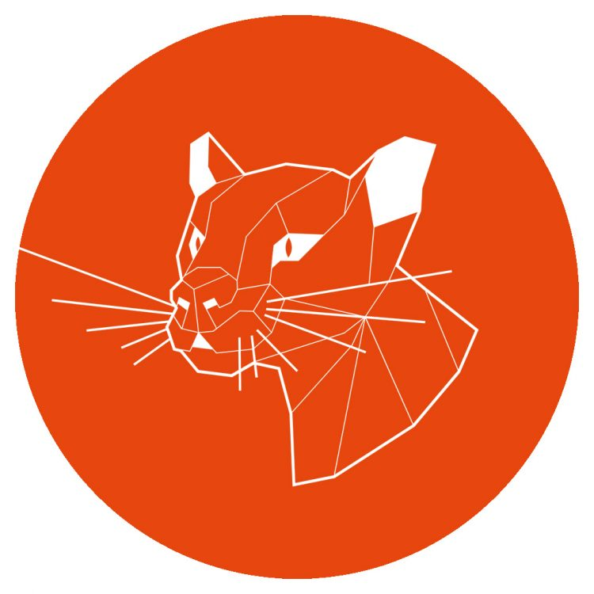
Operating system
Notes:
Ubuntu 20.04.3 LTS (Focal Fossa)

Slide 24
Process to create mySQL database
CREATE USER 'karen'@'localhost' IDENTIFIED BY '123';
GRANT ALL PRIVILEGES ON *.* TO 'karen'@'localhost' WITH GRANT OPTION;
CREATE DATABASE mirnadbs;
To run the load into file I need to run the sql as
sudo mysql --local-infile=1 -u karen –p
LOAD DATA LOCAL INFILE 'confidence_score.txt' INTO TABLE confidence_score ;

Slide 25
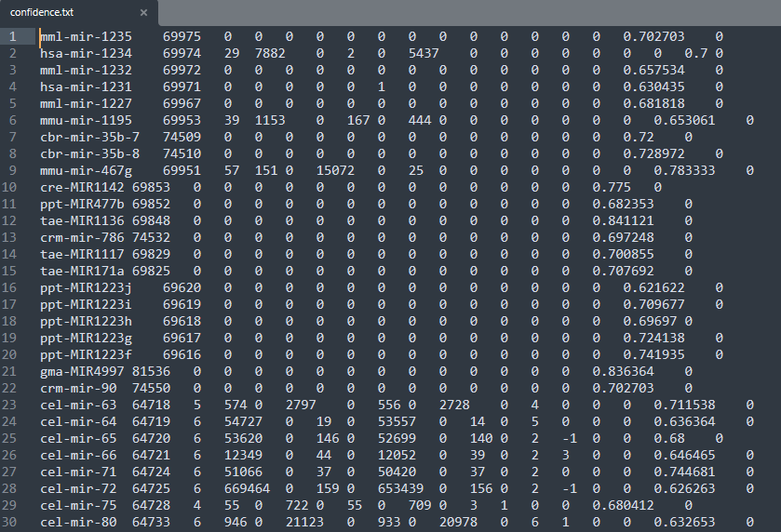
Process to create mySQL database

Slide 26
Process for python processing of data
General objective: Get all datasets together for evaluation
Specific Objectives
Recompile all the datasets
Distinguish the differences and similarities
Design the model with compatibility for all datasets
Separate the txt datasets in order to run a LOAD DATA LOCAL INFILE

Slide 27
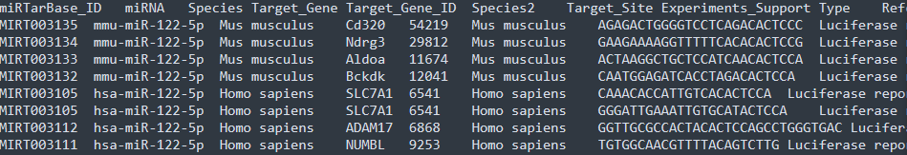
-

Slide 28
Python processing of data
Methodology:
- Create a virtual enviroment to get control of the versions that I am ussing
python3 -m venv /home/karen/Documents/phd/mirnadbs
- Activate enviroment
source /home/karen/Documents/phd/mirnadbs/bin/activate
- Clone my own repo
For this I download the desktop version because it rocks (from https://gist.github.com/berkorbay/6feda478a00b0432d13f1fc0a50467f1)
sudo wget https://github.com/shiftkey/desktop/releases/download/release-2.9.3-linux3/GitHubDesktop-linux-2.9.3-linux3.deb
### Uncomment below line if you have not installed gdebi-core before
# sudo apt-get install gdebi-core
sudo gdebi GitHubDesktop-linux-2.9.3-linux3.deb

Slide 29
What’s next
Week 5:
Finish to build database
Python script
Design queries for analysis
Include mirnaSNIP and rFAM or discard
Week 6:
Compare seed-gene relationship among different databases(?) (MML48)

Slide 30
