Slide 1
Yanai, 2020
Notes:
Mircro RNA or miRNA are conserved small non-coding RNAs that play an important role in the regulation of gene expression, they are short nucleotide single stranded RNAs (ssRNAs), between 14 and 33, with an average of 20 as MirBase suggest today.

Slide 2
Inferring the human microRNA functional similarity and functional network based on microRNA-associated diseases
Evolution of a single approach…
2010-2021

Slide 3
MicroRNA
non-coding RNAs
regulation of gene expression
14 and 33 nucleotides

Slide 4
School of Information and Control Engineering, China University of Mining and Technology, Xuzhou, China
Business Analytics Centre, National University of Singapore, Singapore

Slide 5
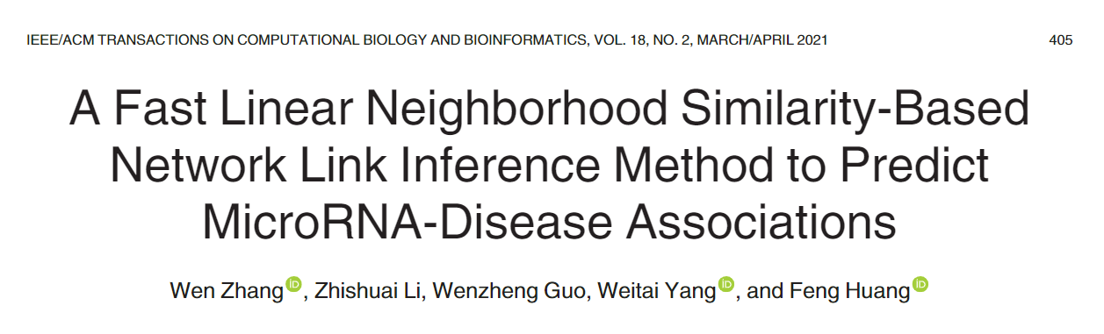

Slide 6
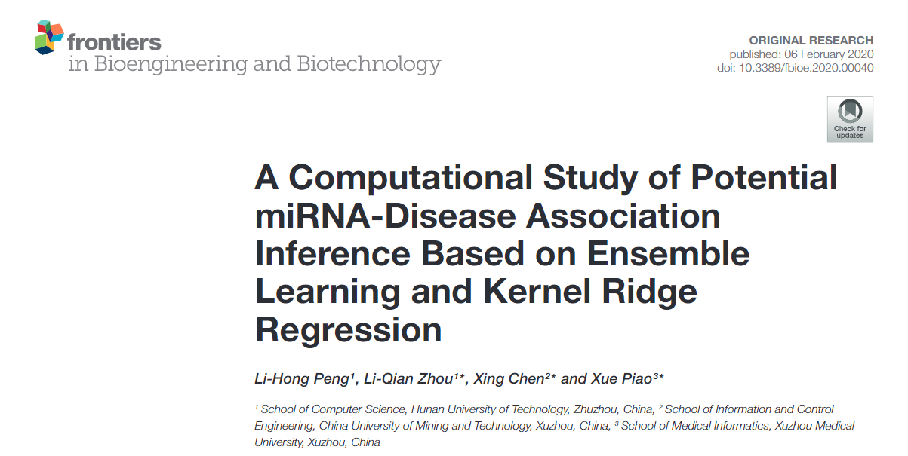

Slide 7
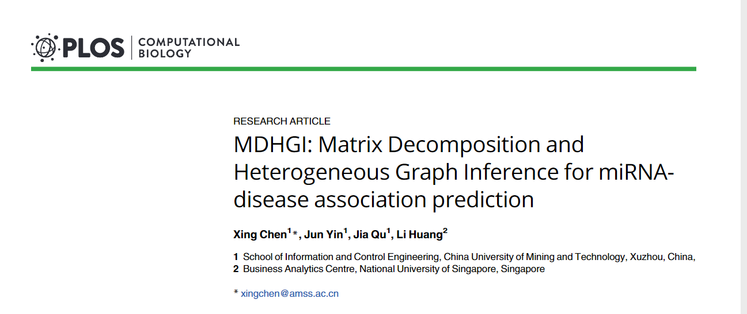
2018

Slide 8
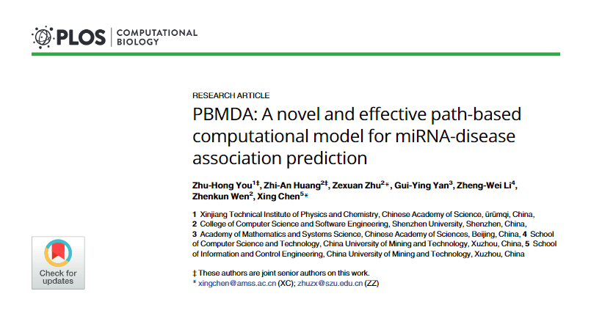
2017

Slide 9
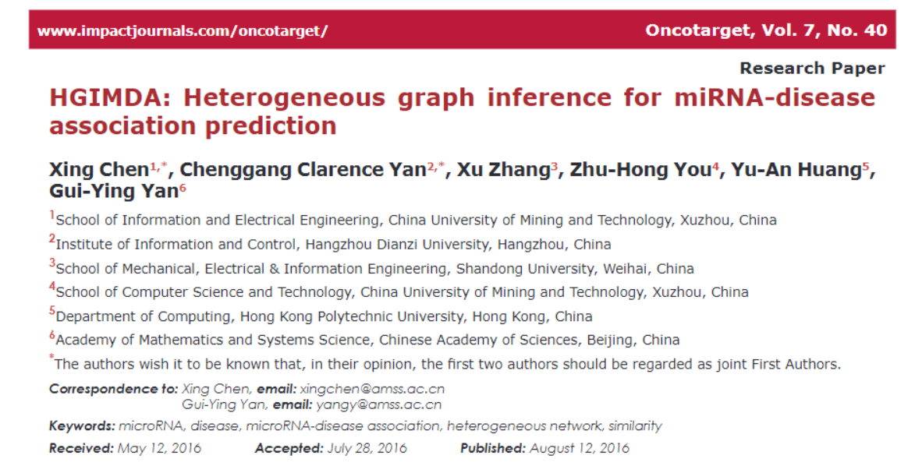

Slide 10
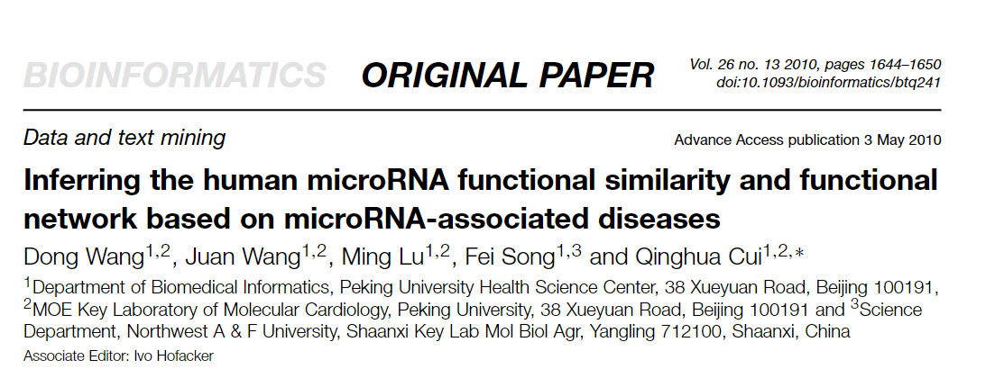

Slide 11
Association of mirna:disease
Genes with similar functions are often associated with similar diseases.
The relationship of different diseases can be represented by a structure of directed acyclic graph(DAG)
miRNA-associated disease data available

Slide 12
Similarity function among miRNAs
Part 1

Slide 13
HMDDV2.0
5430 validated associations
495 miRNAs
383 diseases
Associations miRNA - Diseases

Slide 14

 | Disease 1 | Disease 2 | Disease 3 | … | Disease n
miRNA 1 | 1 | 0 | 1 | … | 0
miRNA 2 | 0 | 0 | 0 | … | 1
… | … | … | … | … | …
miRNA m | 0 | 1 | 0 | … | 1

Slide 15
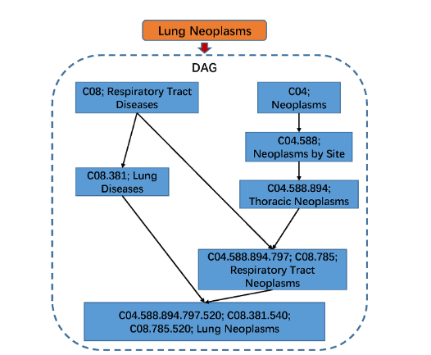



Disease similarity (MeSH)

Slide 16

Disease similarity (MeSH)

Slide 17
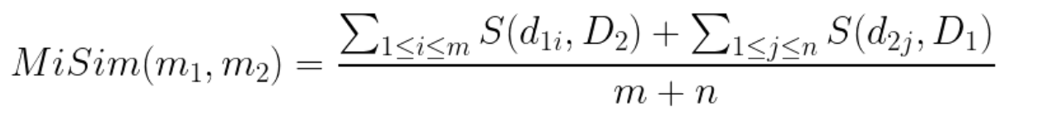
Similarity
miRNAs with similar functions tend to have similar expression profile

Slide 18
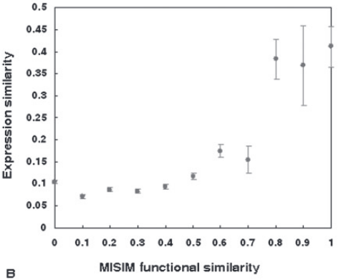
MiSim similarity and expression similarity
miRNA expression data from 40 normal tissues
grouped miRNA pairs into different groups according to functional similarity by a step of 0.1 and calculated the average functional similarity and expression similarity of each group.
miRNA functional similarity is positively correlatedwith expression similarity

Slide 19
miRNAs family and MISIM similarity
A family of miRNAs incorporates similar mature miRNA sequences and complete identical seed regions
miRNAs of the same family tend to show high functional similarity
compared the functional similarity of miRNAs in the same family to miRNAs that are not from the same family.

Slide 20
MiSim and Distance in the Chromosome
A cluster of miRNAs is usually transcribed and expressed synchronously and functions coordinately
The correlation of expression profiles decreases sharply for miRNAs whose distances are more than 50 kb, while miRNAs whose distances are within 50 kb usually show high expression similarity.

Slide 21
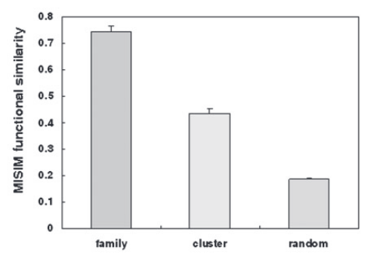
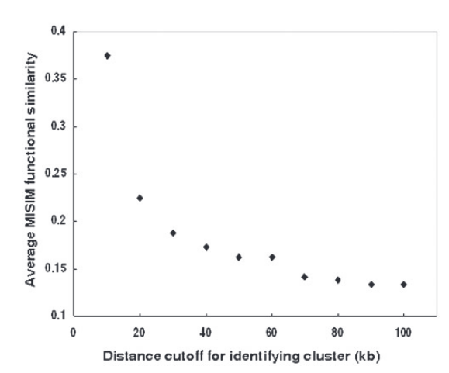

Slide 22
Using the similarity to find new targets
Part 2

Slide 23
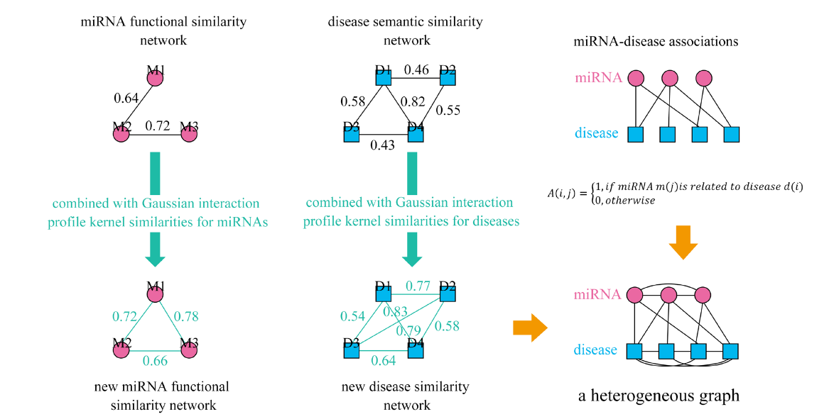

Slide 24
probability of each predicted link was calculated
erformedanalysis of correlation between the probability of predicted linksand the MISIM functional similarity of miRNAs connected bythe corresponding links
This indicated that the predicted novellinks with high probability tend to be real links

Slide 25
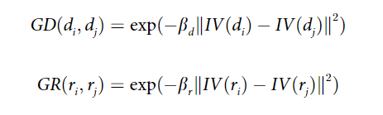
Gaussian interaction profile kernels

