Slide 1
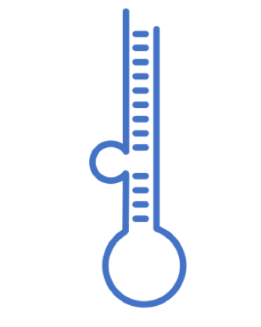
Computational approaches for the therapeutic target discovery to ameliorate muscle wasting during aging and disease
Dr. Katarzyna Whysall
Dr. Pilib O Broin
V 1 Presented on March 21, 2022

Slide 2
Objective
Create independent models and a common model of miR-Target interactions in muscle loss during aging and critical illness based on differentially expressed (DE) miRs and genes.

Slide 3
Aging

Slide 4
Muscle

Slide 5
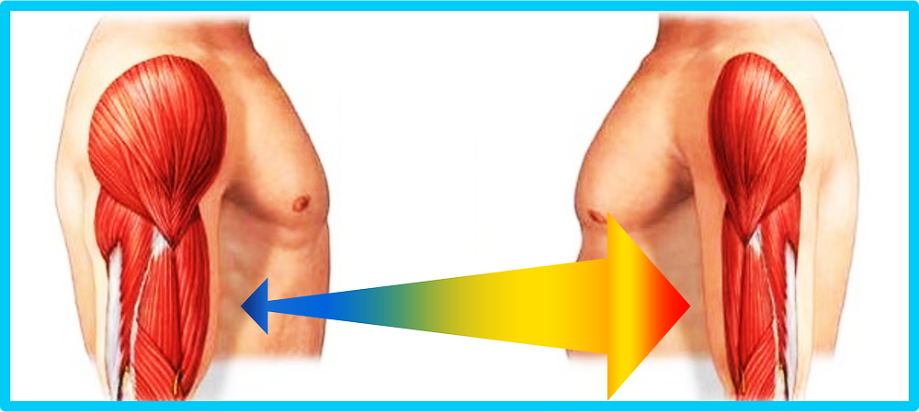
Sarcopenia
Notes:
Although the exact rate of decline varies, a person may lose 3 to 8 percent of muscle mass per decade.

Slide 6
Sarcopenia Genes

Slide 8
Garbage in, garbage out (GIGO)
Garbage data
Most amazing Data Science project ever
Garbage results

Slide 10
General values
Total binding registers: 15,436,301
mirTarBase 7,694
mirWalk 15,428,606
hsa 12,526,887
mmu 2,018,527
dre 890,399
Targets: 29,951
miRNAs: 5,277
22 different species
hsa 2673
mmu 1978
dre 374
Combinations miRNAs-Target: 8,800,625

Slide 11
MiRNA-Target
miRNas 5277
Min amount of Genes 1
Max amount of Genes 7214
Sum 8800625
median 950
mean 1668
SE.mean 22
1st Quartile 538
3rd Quartile 2644

Slide 12
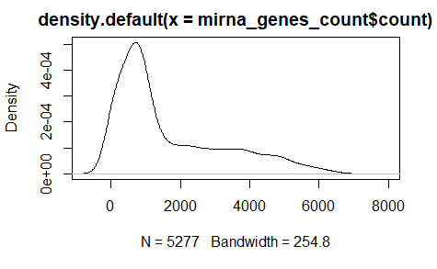
# of target genes

Slide 13
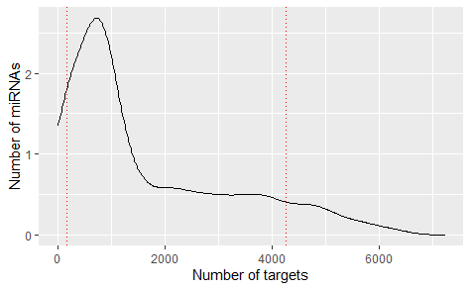
163 One target
2761 Few targets (<1000)
638 Many targets (>4000)
Total: 5277

Slide 15
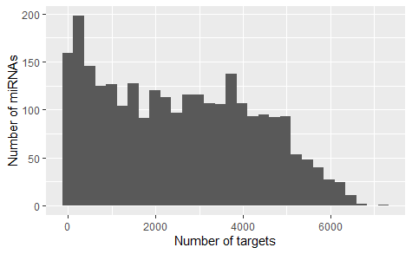
Only Human

Slide 16
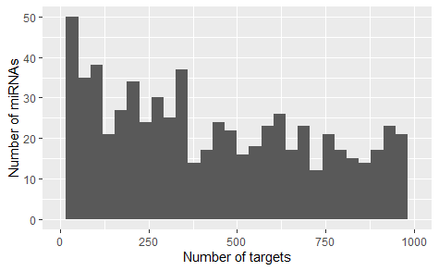
Only Human; few targets

Slide 17
New tools
- Eutils (NCBI calls)
- Gene corrector
Unified source of targets
Tools to quickly integrate more NCBI data

Slide 18
Plans for next week (or two)
Read and get familiarize with:
TargetScan
miRNet
Enrichr
Cytoscape
PathVisio
Ingenuity Pathway Analysis
Complex Pathway Simulator
GENE Expression Omnibus
Xpress

Slide 19
Plans for following weeks
Integrate tools for the efficient clustering of microRNAs and the pathways in order to select potential microRNAs

Slide 20
22 different species
'ath'
'bmo'
'bta'
'cel'
'cfa'
'cgr'
'dme'
'dre‘
'ebv'
'gga'
'hcm'
'hsa'
'ksh'
'mdv'
'mml'
'mmu'
'ola'
'ptr'
'rno'
'ssc'
'tgu'

Slide 21
Download data
Database | year | Cites | PubmedID | Content | Prediction Algorithm | API | API alternative
miRBase | 2014 | 2368 | 24275495 | General | NA | NA | NA
miRWalk | 2011 | 830 | 21605702 | Predicted miRNA | Yes | NA | NA
miRTarBase | 2010 | 563 | 21071411 | General | NA | NA | NA
miRDB | 2020 | 374 | 31504780 | Expression | Yes | NO | Yes
DIANAmiTED | 2022 | 0 | 34469540 | Expression | NA | NA | NA

Slide 22

2022
Diana had been on since 2011 (6)
estimates of microRNAs
querying of the expression of one or many miRNAs

Slide 23
Diana miTED columns
S.No
Sample_ID
Collection
Project_ID
Tissue_or_organ_of_origin
Tissue_subregion
Cell_Line
Disease
Organism
Gender
Health_state
Tissue_definition
ALL MIRNAS (2464)

Slide 24
HMDD v3.2
8 publication from 2007 to 2019
the Human microRNA Disease Database
curated experiment-supported evidence for human microRNA

Slide 25
HMDD colums
category
mir
disease
pmid
description

Slide 26

13 papers from 2003 to 2021 including one for R client and 4 usage
Rfam is a collection of multiple sequence alignments and covariance models representing non-coding RNA families.
2021 synchronising microRNA families between rfam and miRBase v22
manually curated an initial set of 1678 multiple sequence alignments. Second phase in wating
rfaRm: R client-side interface for Rfam database of RNA families analysis

Slide 27

2015, 2021
miRNA target binding sites

Slide 28


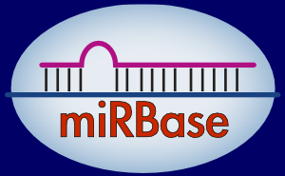

Characterization
Target mRNA
Expression Tissue
HMDD v3.2

Slide 29


miRBase local database in mySQL
www.mirbase.org/ftp/CURRENT/database_files/

Slide 30


Operating system
Notes:
Ubuntu 20.04.3 LTS (Focal Fossa)

Slide 31
Process to create mySQL database
CREATE USER 'karen'@'localhost' IDENTIFIED BY '123';
GRANT ALL PRIVILEGES ON *.* TO 'karen'@'localhost' WITH GRANT OPTION;
CREATE DATABASE mirnadbs;
To run the load into file I need to run the sql as
sudo mysql --local-infile=1 -u karen –p
LOAD DATA LOCAL INFILE 'confidence_score.txt' INTO TABLE confidence_score ;

Slide 32
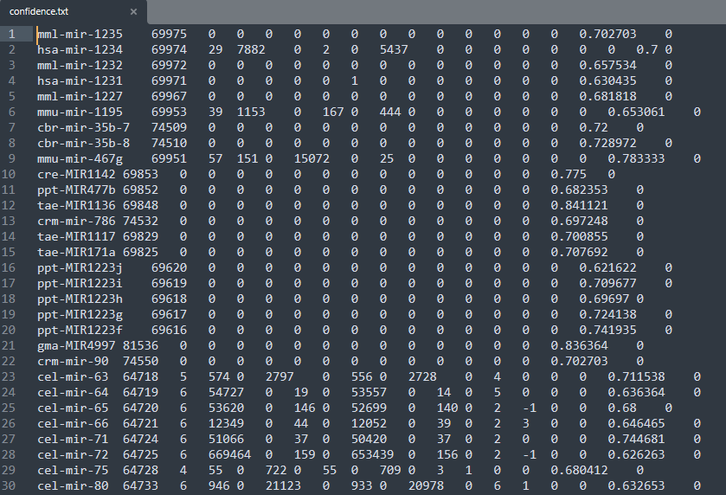
Process to create mySQL database

Slide 33
Process for python processing of data
General objective: Get all datasets together for evaluation
Specific Objectives
Recompile all the datasets
Distinguish the differences and similarities
Design the model with compatibility for all datasets
Separate the txt datasets in order to run a LOAD DATA LOCAL INFILE

Slide 34
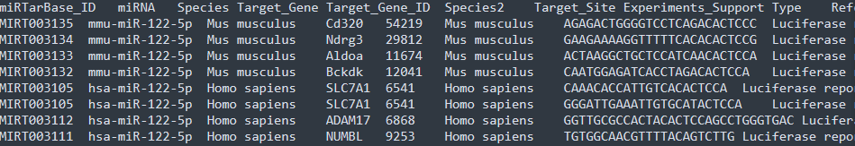
-

Slide 35
Python processing of data
Methodology:
- Create a virtual enviroment to get control of the versions that I am ussing
python3 -m venv /home/karen/Documents/phd/mirnadbs
- Activate enviroment
source /home/karen/Documents/phd/mirnadbs/bin/activate
- Clone my own repo
For this I download the desktop version because it rocks (from https://gist.github.com/berkorbay/6feda478a00b0432d13f1fc0a50467f1)
sudo wget https://github.com/shiftkey/desktop/releases/download/release-2.9.3-linux3/GitHubDesktop-linux-2.9.3-linux3.deb
### Uncomment below line if you have not installed gdebi-core before
# sudo apt-get install gdebi-core
sudo gdebi GitHubDesktop-linux-2.9.3-linux3.deb

Slide 36
What’s next
Week 5:
Finish to build database
Python script
Design queries for analysis
Include mirnaSNIP and rFAM or discard
Week 6:
Compare seed-gene relationship among different databases(?) (MML48)

Slide 37
