Slide 1
microRNA-diseases association and similarity
Evolution of a single approach…
2010-2021

Slide 2
Association of mirna:disease
Genes with similar functions are often associated with similar diseases.
The relationship of different diseases can be represented by a structure of directed acyclic graph(DAG) (MeSH)
miRNA-associated disease data available (HMDD)

Slide 3
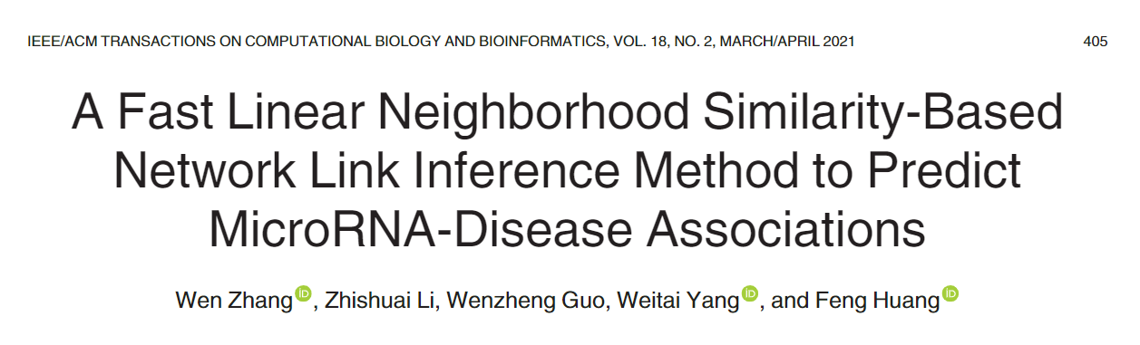

Slide 4
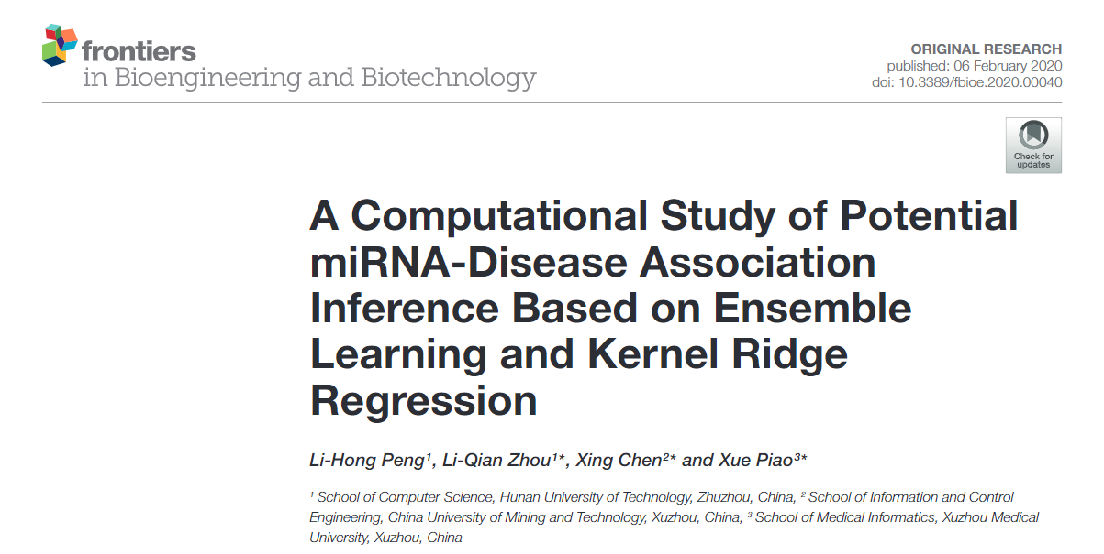

Slide 5
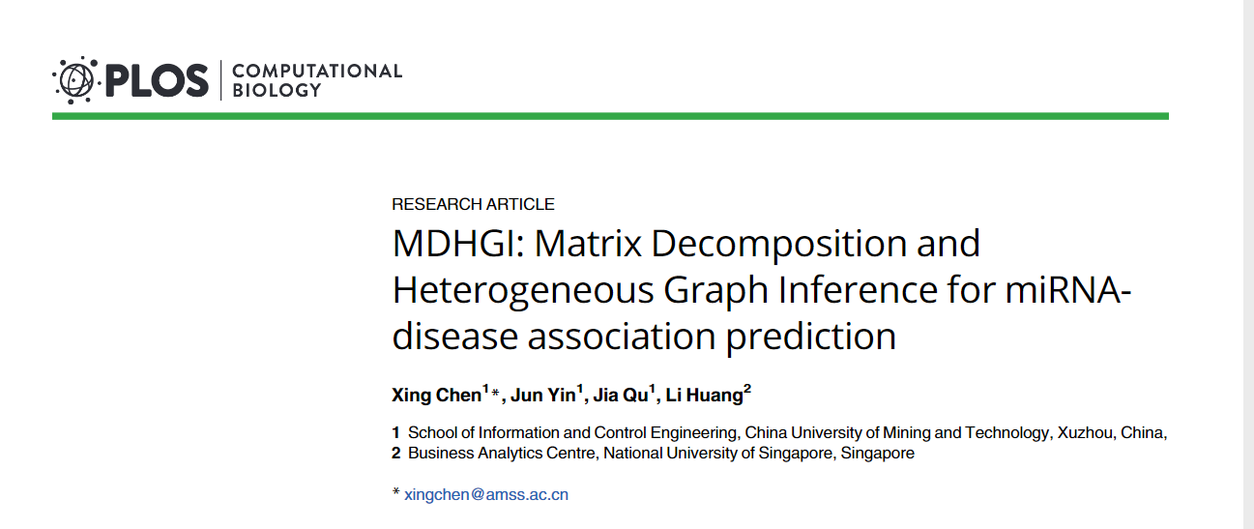
2018

Slide 6
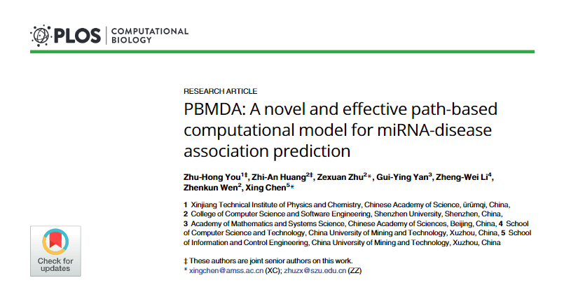
2017

Slide 7
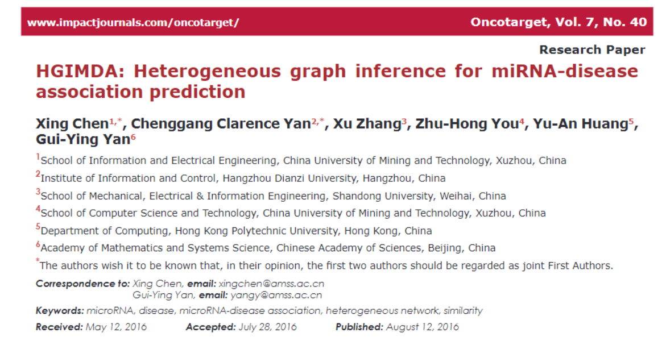

Slide 8
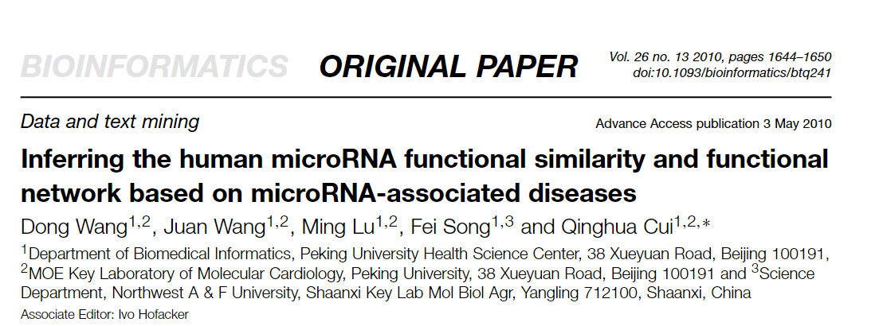

Slide 9
School of Information and Control Engineering, China University of Mining and Technology, Xuzhou, China
Business Analytics Centre, National University of Singapore, Singapore
Xing Chen

Slide 10
Similarity function among miRNAs
Part 1

Slide 11
>hsa-mir-1-1
UGGGAAACAUACUUCUUUAUAUGCCCAUAUGGACCUGCUAAGCUAUGGAAUGUAAAGAAGUAUGUAUCUCA
>hsa-mir-133a-1
ACAAUGCUUUGCUAGAGCUGGUAAAAUGGAACCAAAUCGCCUCUUCAAUGGAUUUGGUCCCCUUCAACCAG
CUGUAGCUAUGCAUUGA
Levenshtein Distance
47
Families
MioMirs
Expression under certain condition
Associated diseases
Notes:
How to define how similar 2 miRnas are

Slide 12
HMDDV2.0
5430 validated associations
495 miRNAs
383 diseases
Associations miRNA - Diseases

Slide 13

 | Disease 1 | Disease 2 | Disease 3 | … | Disease n
miRNA 1 | 1 | 0 | 1 | … | 0
miRNA 2 | 0 | 0 | 0 | … | 1
… | … | … | … | … | …
miRNA m | 0 | 1 | 0 | … | 1

Slide 14
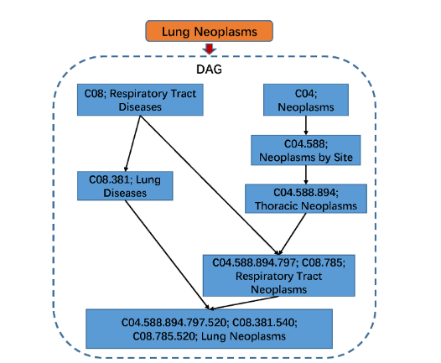



Disease similarity (MeSH)

Slide 15

Disease similarity (MeSH)

Slide 16
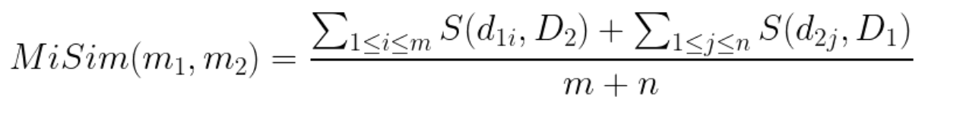
Similarity
miRNAs with similar functions tend to have similar expression profile

Slide 17
MiSim similarity and expression similarity
miRNA expression data from 40 normal tissues
grouped miRNA pairs into different groups according to functional similarity by a step of 0.1 and calculated the average functional similarity and expression similarity of each group.
miRNA functional similarity is positively correlated with expression similarity

Slide 18
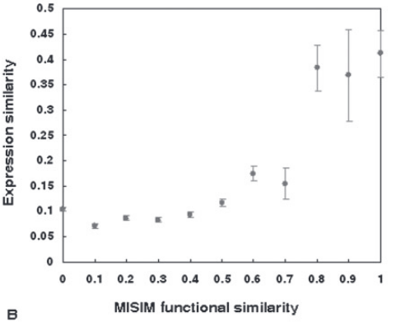

Slide 19
miRNAs family and MISIM similarity
A family of miRNAs incorporates similar mature miRNA sequences and complete identical seed regions
miRNAs of the same family tend to show high functional similarity
compared the functional similarity of miRNAs in the same family to miRNAs that are not from the same family.

Slide 20
MiSim and Distance in the Chromosome
A cluster of miRNAs is usually transcribed and expressed synchronously and functions coordinately
The correlation of expression profiles decreases sharply for miRNAs whose distances are more than 50 kb, while miRNAs whose distances are within 50 kb usually show high expression similarity.

Slide 21
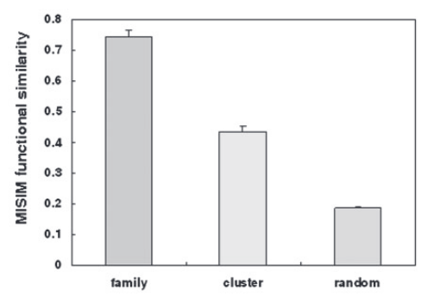
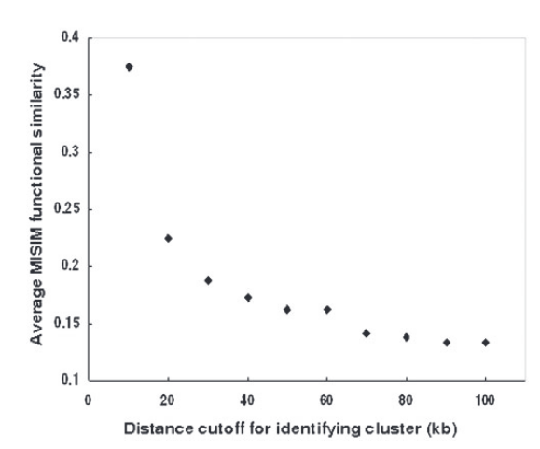

Slide 22
Using the similarity to find new targets
Part 2

Slide 23
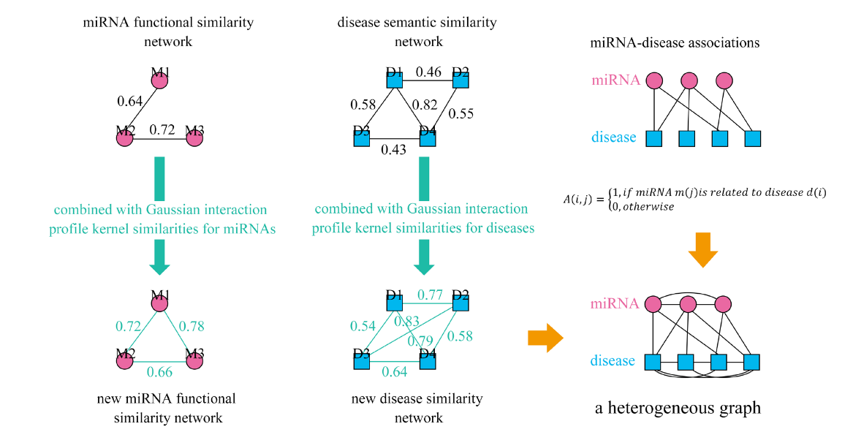

Slide 24
probability of each predicted link was calculated
performed analysis of correlation between the probability of predicted links and the MISIM functional similarity of miRNAs connected by the corresponding links
This indicated that the predicted novel links with high probability tend to be real links
0.7 and 0.9

Slide 25
Pajek
Fast Linear Neighborhood Similarity
Notes:
The linear neighborhood similarity assumes thateach data point can be reconstructed by the linear weightedsum of other data points.

Slide 26
Case studies
Breast Neoplasms
Prostatic Neoplasms
Lung Neoplasm

Slide 27
Updating the method
Part 3

Slide 28
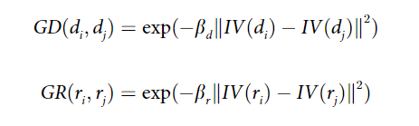
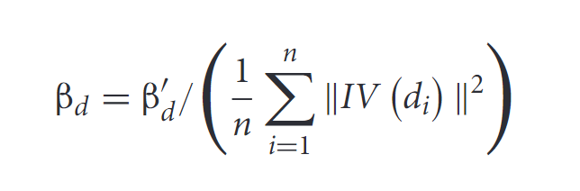

Gaussian interaction profile kernels
binary vector IV($m_{i}$) was defined to represent the interaction profiles of miRNA $m_{i}$

Slide 30
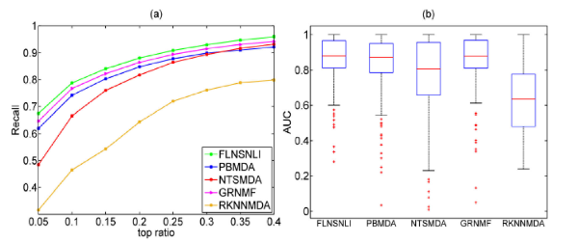

Slide 31
Overview
Part 4

Slide 32
Strengths
Weaknesses
Evolution of one idea
Each unit can be read independently
Explained the process behind the calculation
Experiments validate the quality of the similarity
The changes among them are minimal
Feel like the same paper
A lot of time explaining formulas explained in previous papers

Slide 33
Thank you!!

