Slide 2



Slide 3
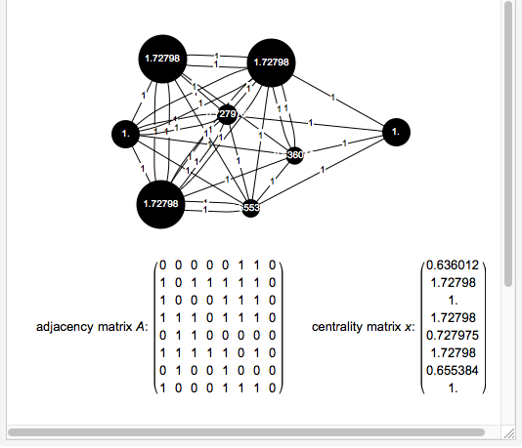

Slide 4
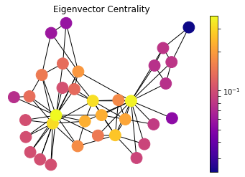
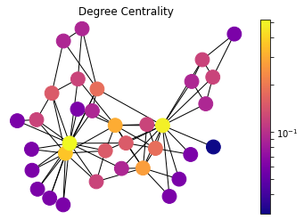
Centralities

Slide 5
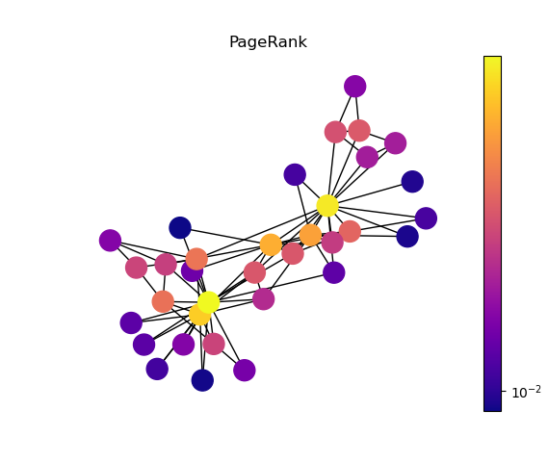
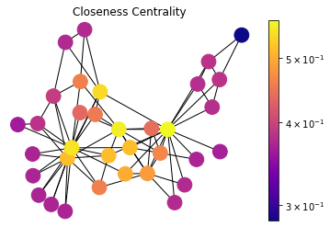
Centralities

Slide 6


Slide 7

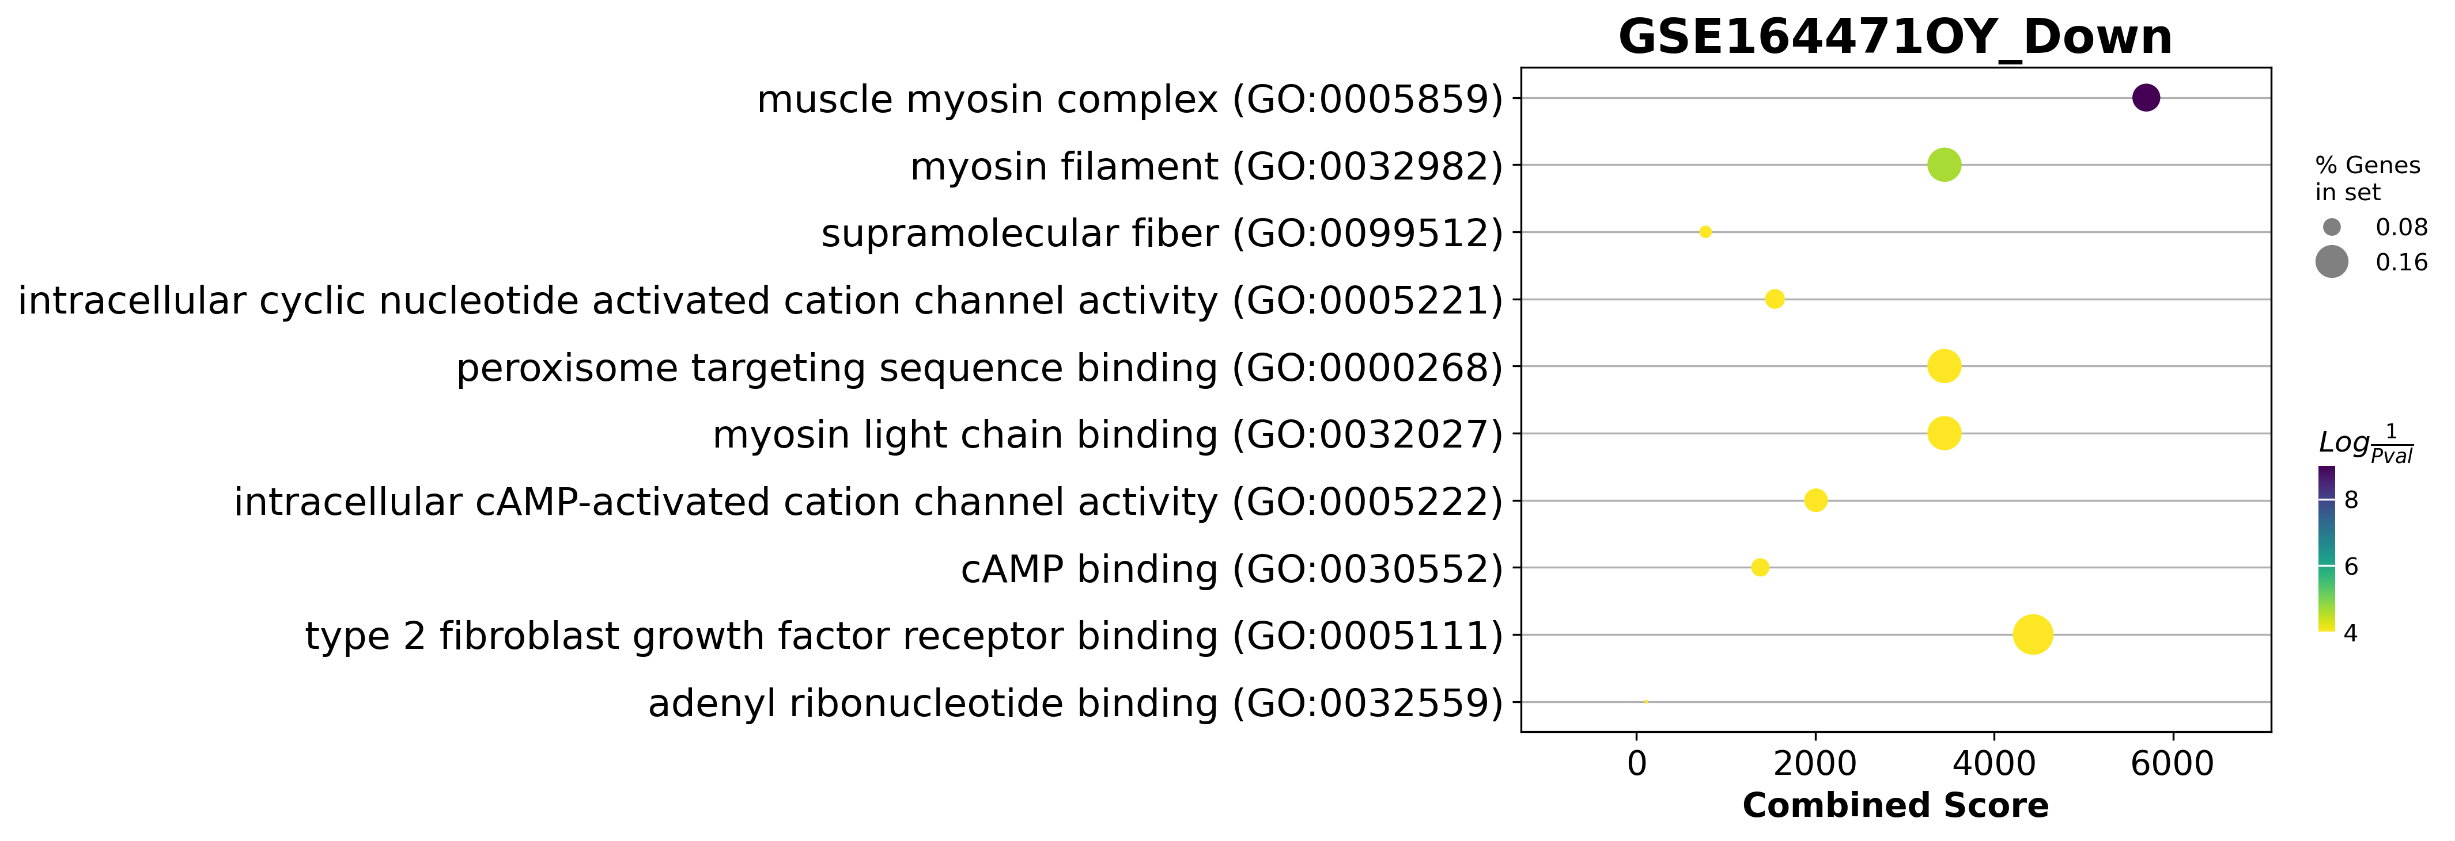
GSE164471 Dotplot

Slide 8
All comparisons (up or down)
MYH8
Young to Old
Young to Middle Age
2
1
8
0
1
MTCO1P12
4
MTND6P4
AC093809.1
12
MTND4P24
RPL10P9
Middle Age to Old

Slide 9
All comparisons (up)
Young to Old
Young to Middle Age
2
0
93
0
0
5
FAM96A
PAQR4
CISD1
FH
AIFM1
15
Middle Age to Old

Slide 10
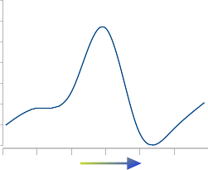
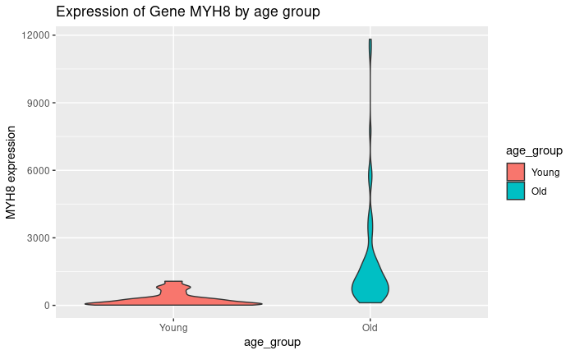
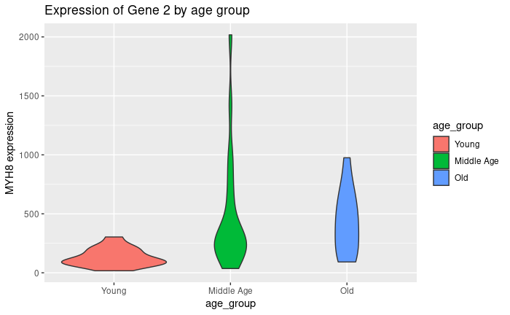
MYH8 raw count over age
Age
GSE157585
GSE164471

Slide 11
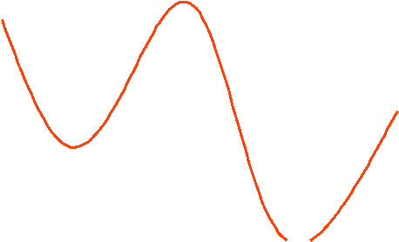
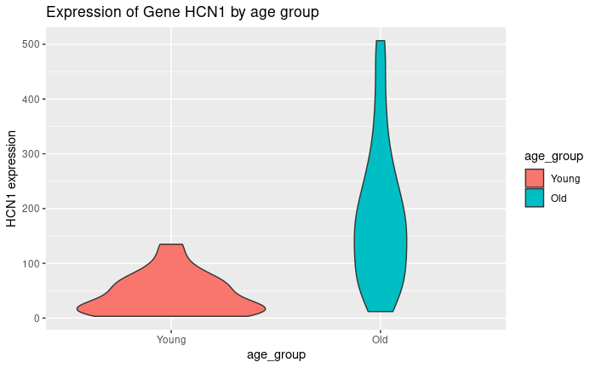
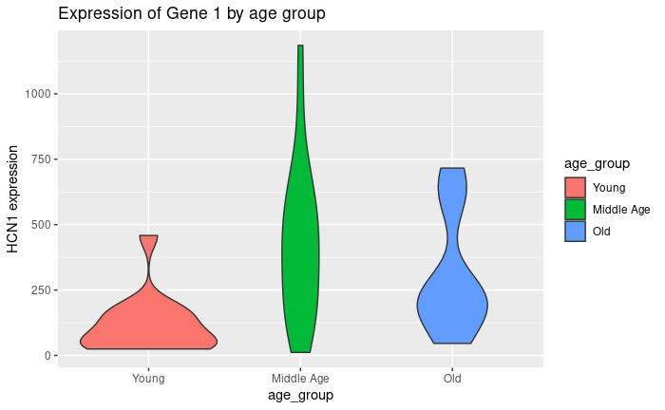
HCN1 raw count over age
GSE157585
GSE164471

Slide 12
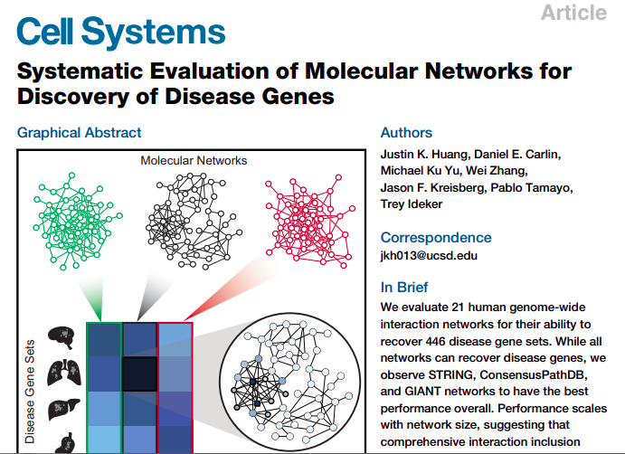

Slide 13
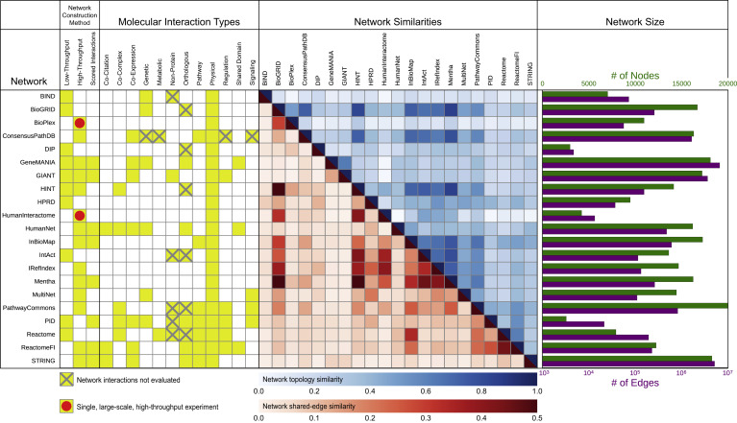

Slide 14
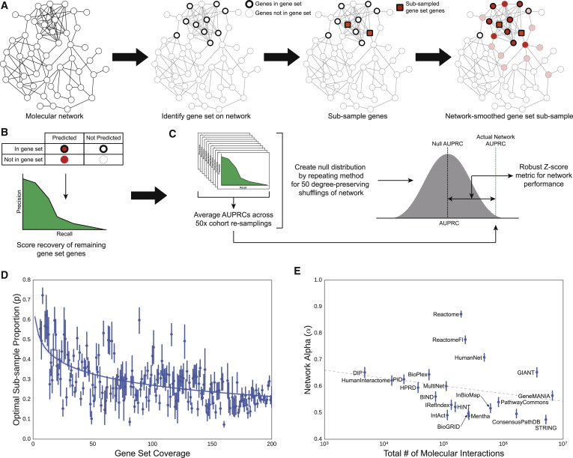

Slide 15



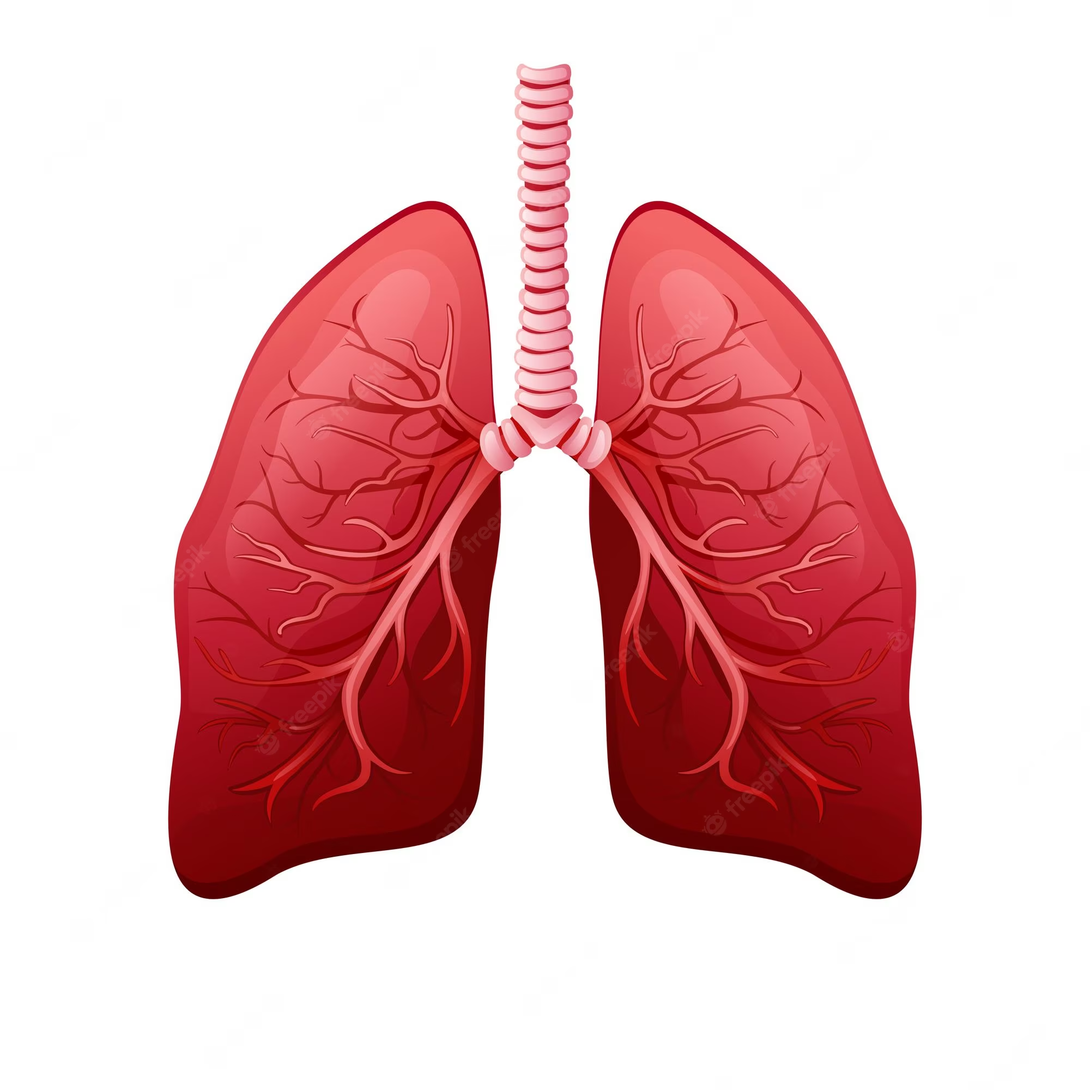

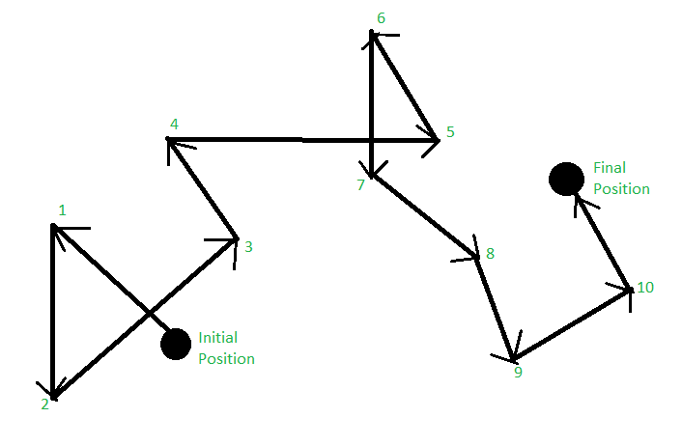
AUPRC

Slide 16
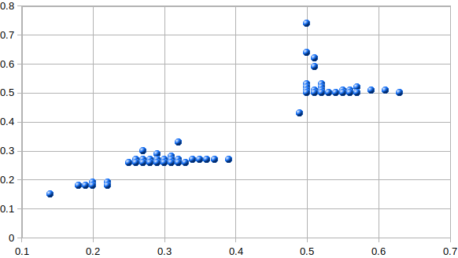
447 Diseases from DisGenNet
Edge Score
Hamman-Rich syndrome
Muscle related
Microcephaly
Node Score

Slide 17






Tools to analyze miRNAs

Slide 18
Tools to analyze miRNAs

Slide 19



Tools to analyze miRNAs

Slide 20
Tools to analyze miRNAs

Slide 21
Tools to analyze miRNAs

Slide 22
Tools to analyze miRNAs

Slide 23
Tools to analyze miRNAs

Slide 24
Tools to analyze miRNAs

Slide 25
Measuring and evaluating
Identify a gene set of interest on the molecular interaction network.
Sub-sample a proportion of the gene set of interest.
Propagate using the random walk model across the molecular interaction network.
Sort all genes in the network by propagation score and then sweep this list to calculate a precision-recall curve of the list for recovering genes from (1) not contained in (2).
Calculate the area under the precision-recall curve (AUPRC) from (4).
Repeat (2-5) for 50 different sub-samples of the gene set of interest and average these values. This averaged AUPRC is the raw measure of performance for a given molecular network on clustering a gene set of interest.
Repeat steps 1-6 for 50 degree-preserved shuffles of the network on the same gene set of interest to construct a null distribution of average AUPRC values.
Calculate the robust Z-statistic (Rousseeuw and Croux, 1993) using the null distribution of average AUPRC values from (7) of the actual network’s performance on the gene set of interest. This is the performance score of a network for a particular gene se

Slide 26
Next steps
Clean up the evaluation system
Define criteria for microRNA and gene selection
Select the microRNAs to send to the lab
Re run different configurations to find the best output
Work on the database

