Slide 1
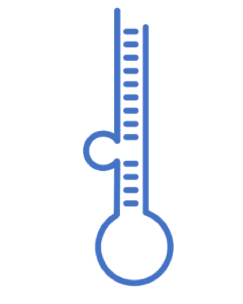
miRNA
What is
Genesis
Databases
V 1.1 Presented on February 4, 2022

Slide 2
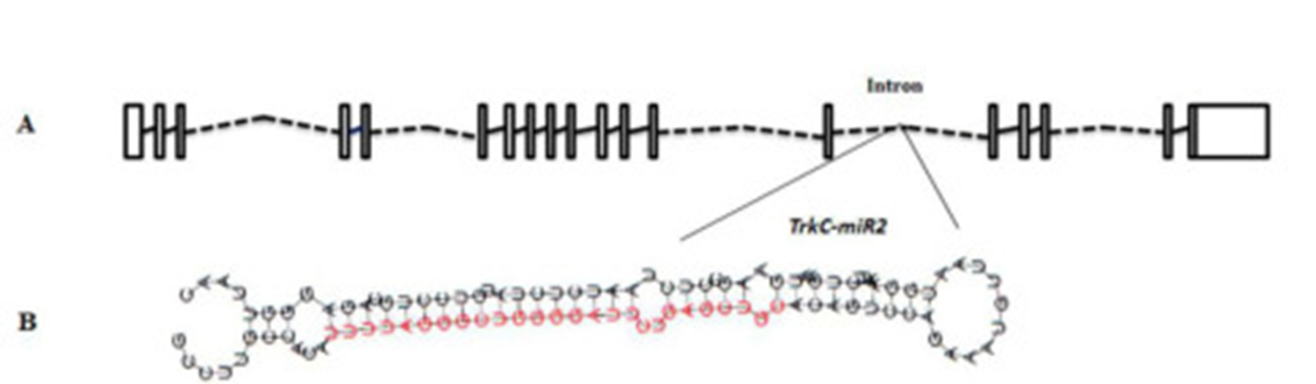
miRNA
1825 nt single stranded
conserved small noncoding RNAs
regulate almost all cellular functions including cell proliferation, growth, differentiation and apoptosis, have been implicated in controlling the fate and behaviour of stem cells
Notes:
www.jbc.org/article/S00219258(20)428662/fulltext

Slide 3
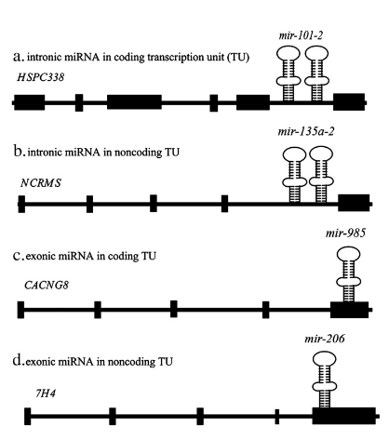
Where to find them?
Half are intragenic and processed mostly from introns and relatively few exons of protein coding genes.
The remaining are intergenic, transcribed independently of a host gene and regulated by their own promoters
Normally, they are close proximity to other miRNAs
Notes:
Wahid F, Shehzad A et al, 2010 MicroRNAs: synthesis, mechanism, function, and recent clinical trials

Slide 4
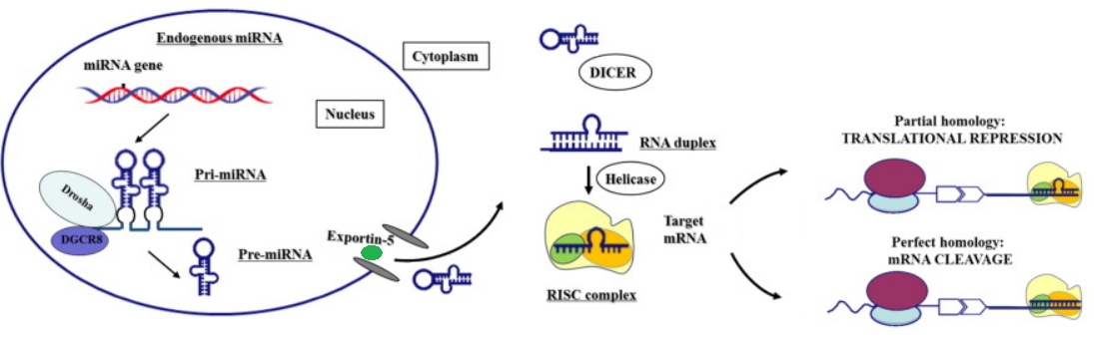
miRNA genesis
Notes:
Modified from www.thelancet.com/article/S23523964(16)304236/fulltext

Slide 5
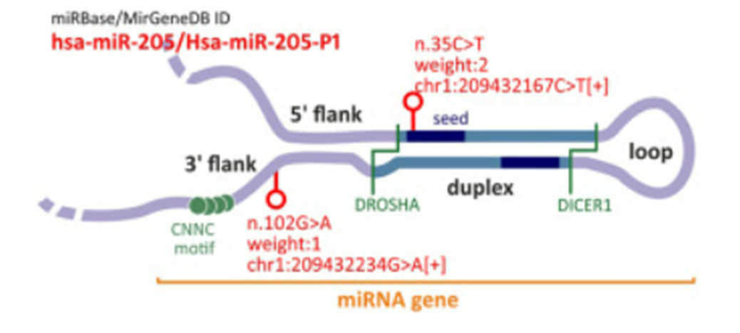
Notes:
www.sciencedirect.com/science/article/pii/S2666166721007292

Slide 6
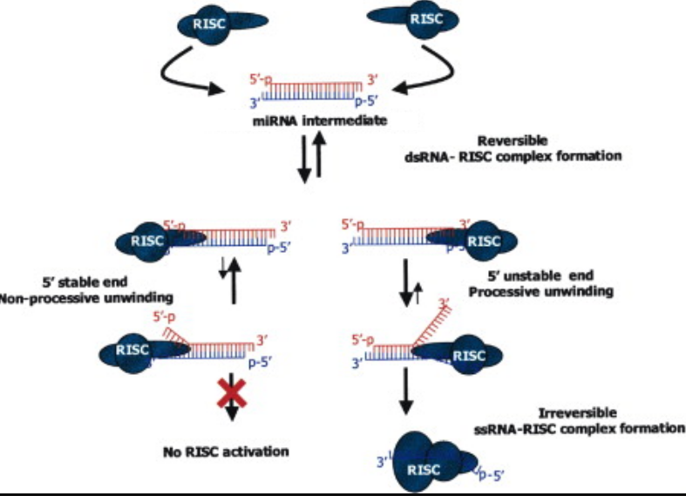
miRNA duplex
Notes:
Edited from www.cell.com/fulltext/S00928674(03)008018

Slide 7
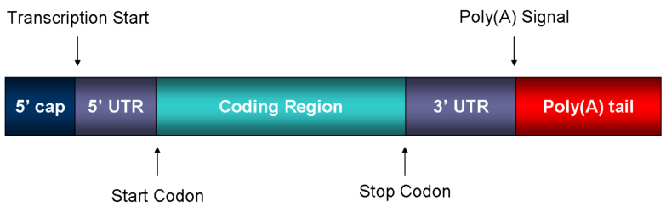
How does it work?
One is miRNA compete with eIF4E for binding to the mRNA 5' cap which results in the failure of the translation initiation process.
miRISC prevents the mRNA from circularizing, resulting in translation inhibition
miRISC may inhibit the assembly of the 60s ribosomal subunit with the 40s preinitiation complex, resulting in translation repression. miRNA/RISC may mediate translation repression through accumulation of target mRNA in processing bodies.
When the binding complementarity is perfect, miRNAs induce mRNA degradation
Notes:
miRNAs guide miRisc to specifically recognize messenger RNA and downregulate gene expression by one of the two posttranscriptional mechanisms by base pairing
The binding between the miRNA seed sequence (nucleotides 28 at the 5'end of the miRNA sequence) and the miRNA regulatory element (MRE) at of a target gene determines the specific type of regulation;
miRNAs act as inhibitors of translation when the binding at the 3'UTR of target genes is only partially complementary. When the binding complementarity is perfect, miRNAs induce mRNA degradation
they can activate translation by binding non canonical sites in the 5'UTR of target genes

Slide 8
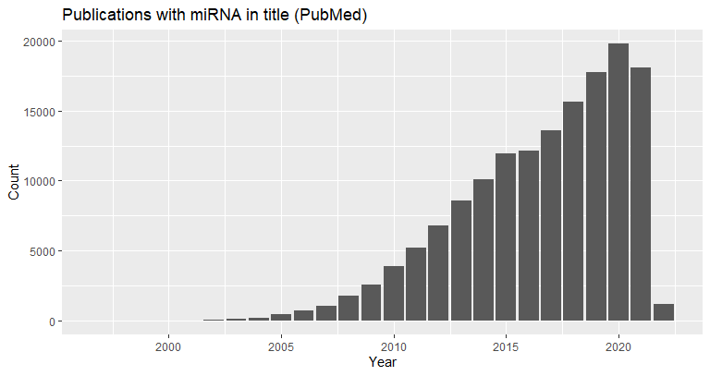
Evolution of miRNA study/importance
miRNAs fall into the class of RNAibased therapeutics
1,120,000 Academic Google
134,677 in PubMed

Slide 9
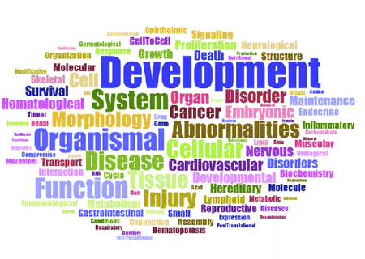
Notes:
www.researchgate.net/publication/315121855_Chronically_dysregulated_NOTCH1_interactome_in_the_dentate_gyrus_after_traumatic_brain_injury

Slide 10
Principal databases (the sources)
TarBase (DIANATarBase)
miRBase
Dimitra Karagkouni, et al 2018
Greece and USA
Artemis G Hatzigeorgiou and Theodore Dalamagas,
>33 experimental methodologiesExperimentally verified
13, 404 validated MITs
Ana Kozomara, et al 2019
England
Sam GriffithsJones
38, 589 precursors
48 860 mature microRNAs
Text mining
Sentence analysis

Slide 11
Principal databases (state of the art)
miRTarBase
miRBase
HsiYuan Huang, et al 2020
China and Taiwan
TzongYi Lee1, FengXiang Wei, and HsienDa Huang
miRNATarget interactions (MTIs)
Experimentally verified
13, 404 validated MITs
Ana Kozomara, et al 2019
England
Sam GriffithsJones
38, 589 precursors
48 860 mature microRNAs
Text mining
Sentence analysis

Slide 12
Databases
1993 – Discover
2001 – First use of the term miRNA
2004 – The microRNA Registry
2006 – TarBase
2006 – miRBase
.
.
.
2020 – Over 45 different databases only with data accessible to download

Slide 13
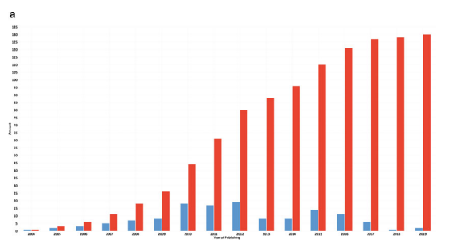
Number of databases during time

Slide 14
Overview of databases
microRNAs Databases: Developmental Methodologies, Structural and Functional Annotations
Nagendra Kumar Singh
2015
MicroRNA Databases and Tool
Tharcísio Soares de Amorim, Daniel Longhi Fernandes Pedro, and Alexandre Rossi Paschoal
2019

Slide 15
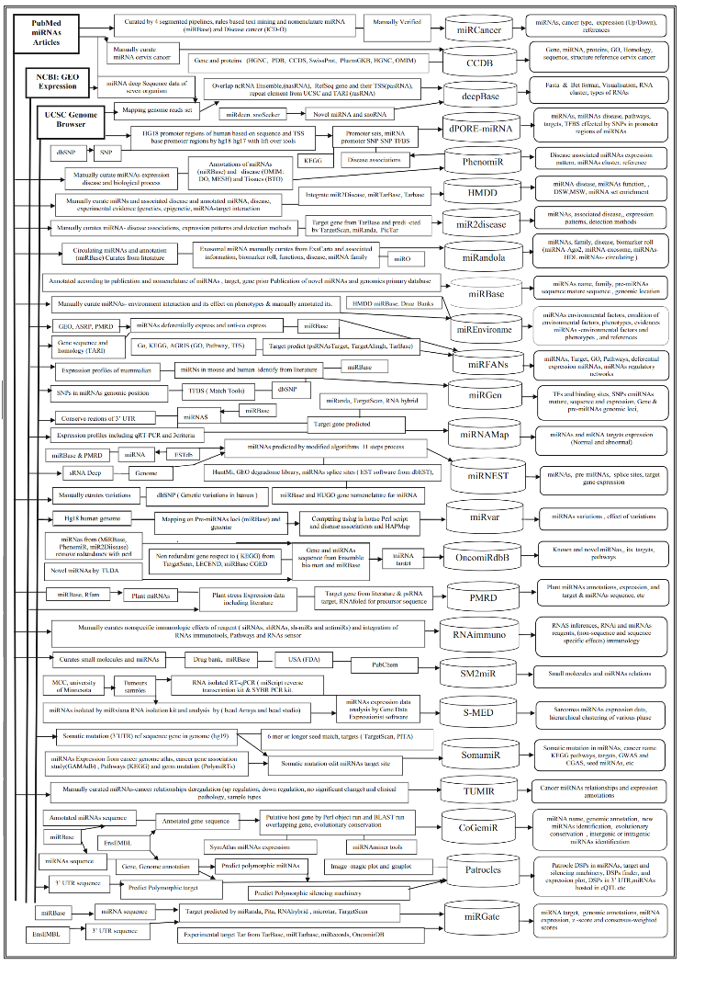

Slide 16
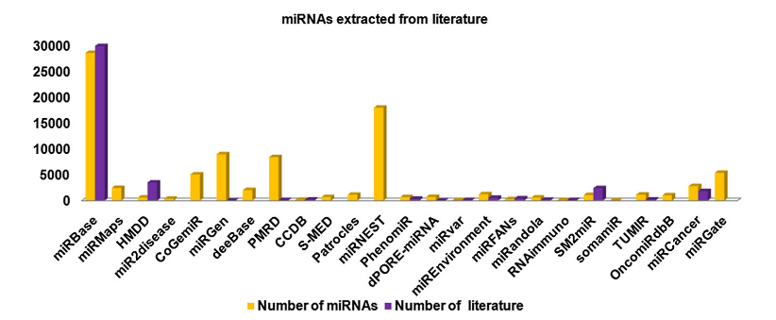
Number of miRNA in some DB

Slide 17
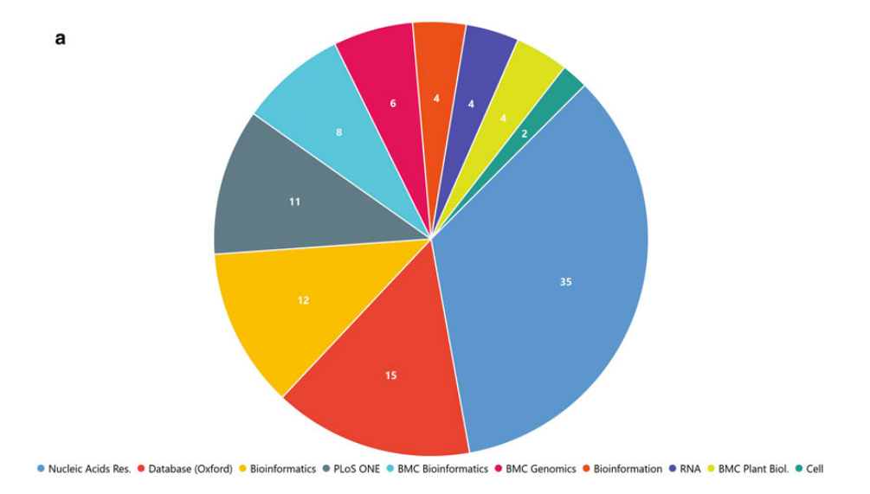
Where databases are publicated

Slide 18
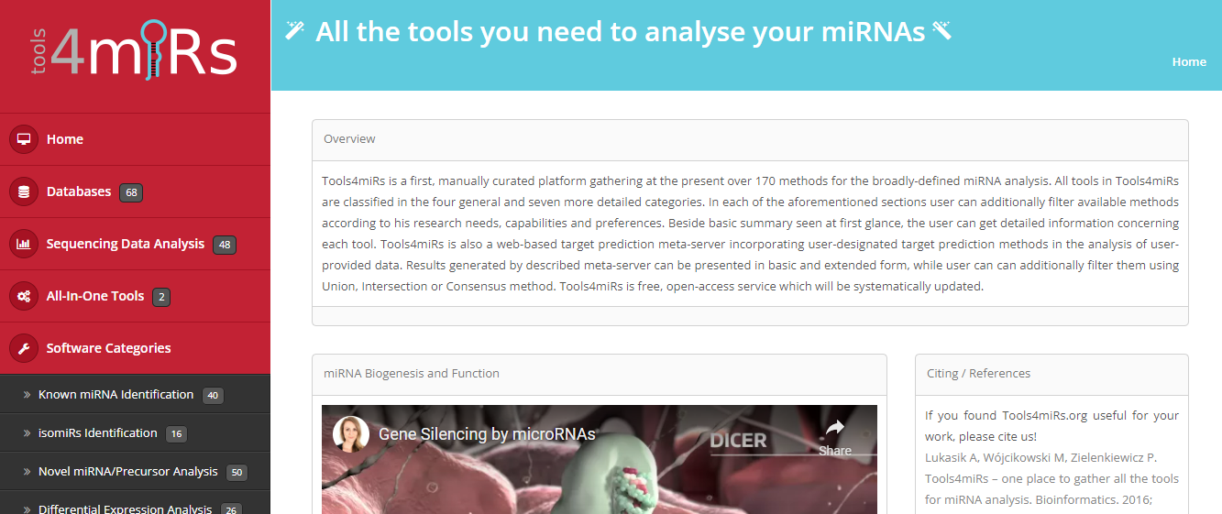
Tools4miRNA

Slide 19
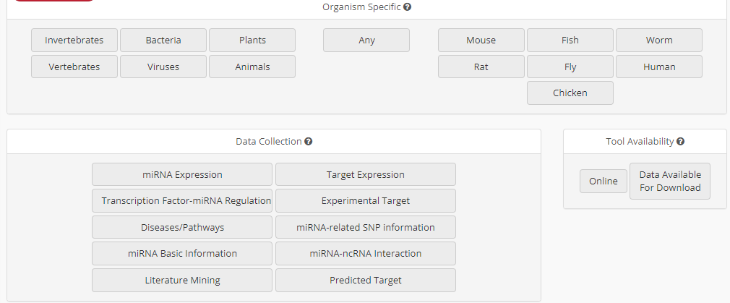
Tools4miRNA Search filters

Slide 20
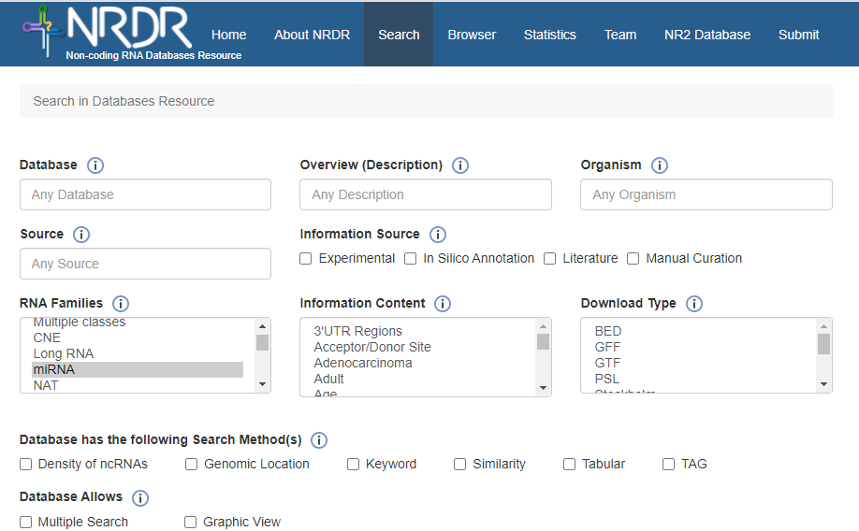
Noncoding RNA Database Resource

Slide 21
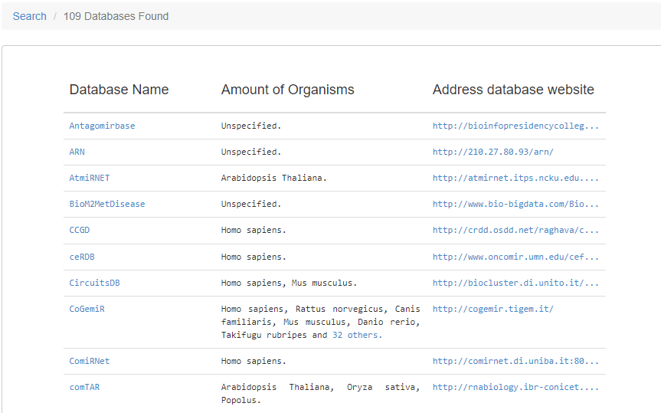
NRDR result for miRNA

Slide 22
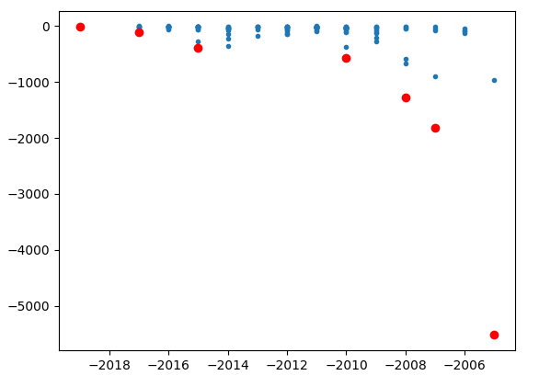
Filtering the databases
Pareto front
Parameters
Number of cites
Year of publication
Pubmed
("database"[Title] OR
"repository"[Title]
OR "dataset"[Title])
AND
("miRNA"[Title] OR
"microRNA"[Title] OR
"micro RNA"[Title])

Slide 23
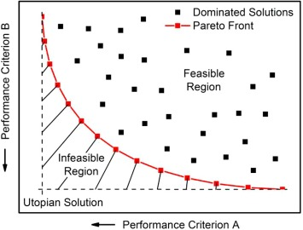
Pareto front

Slide 24
Database | year | Cites | Organism | Website | down | avail | PubmedID | Content | information
miRBase | 2014 | 2368 | Miscellaneous | www.mirbase.org/ | Yes | Yes | 24275495 | General Information | miRNA/Target interactions
smiRNAdb | 2007 | 1817 | Miscellaneous | www.mirz.unibas.ch/cloningprofiles/ | No | No | 17604727 | Expression datasets | Expression profiles
microRNA.org | 2008 | 1270 | Miscellaneous | www.microrna.org/ | No | No | 18158296 | Predicted miRNA | Expression profiles miRNA/Target interactions Phylogeny
miRWalk | 2011 | 830 | NA | NA | NA | NA | 21605702 | Predicted miRNA | Target gene
miRBase | 2019 | 809 | Miscellaneous | www.mirbase.org | Yes | Yes | 30423142 | General Information | miRNA/Target interactions
miRTarBase | 2010 | 563 | Miscellaneous | mirtarbase.mbc.nctu.edu.tw/ | Yes | Yes | 21071411 | General Information | miRNA/Target interactions Phylogeny
miRTarBase | 2016 | 523 | Miscellaneous | mirtarbase.mbc.nctu.edu.tw | Yes | Yes | 26590260 | General Information | miRNA/Target interactions Phylogeny
HMDD | 2015 | 389 | Homo sapiens | 202.38.126.151/hmdd/mirna/md/ | No | No | 18923704 | Association to diseases | Disease
miRDB | 2020 | 374 | NA | NA | NA | NA | 31504780 | Expression datasets | Target gene
mirDIP | 2017 | 111 | Miscellaneous | ophid.utoronto.ca/mirDIP/ | Yes | Yes | 21364759 |  | miRNA/Target interactions
Rfam | 2021 | 49 | NA | NA | NA | NA | 33211869 |  | NA
miRNASNP | 2021 | 13 | NA | NA | NA | NA | 32990748 | Single nuclotide | Expression profiles miRNA/Target interactions SNPs
mirtronDB | 2019 | 5 | Plants | mirtrondb.cp.utfpr.edu.br/ | Yes | Yes | 30874795 |  | NA
CSCD2 | 2022 | 3 | NA | NA | NA | NA | 34551437 |  | NA
DIANAmiTED | 2022 | 0 | NA | NA | NA | NA | 34469540 |  | NA

Slide 25
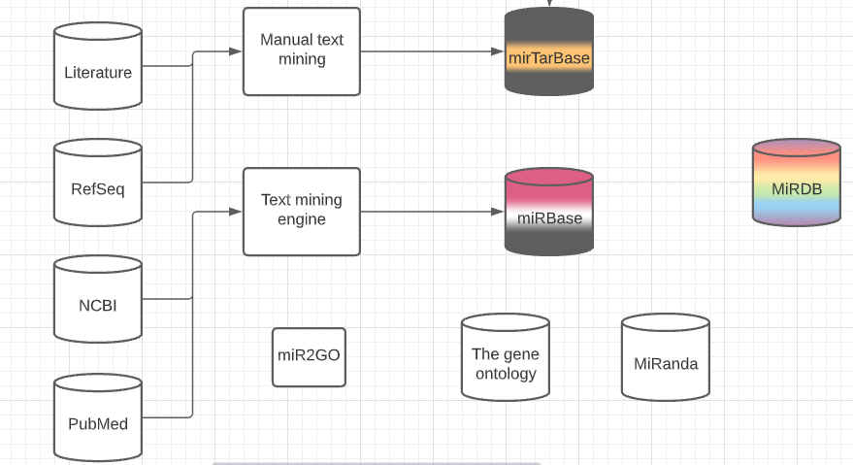
Databases (work in progress)

