Slide 1
Dryrun
Cardiovascular cancer

Slide 2
Objectives of last session
Define the methodology to follow
Continue understanding of aging-mirnas-muscle
Create prototype
Define how to evaluate the mirnas

Slide 3
Objective of the meeting
Methodology
Potential of techniques
Routes to take

Slide 4
APPs

Slide 5
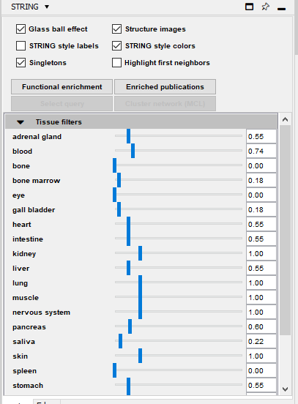
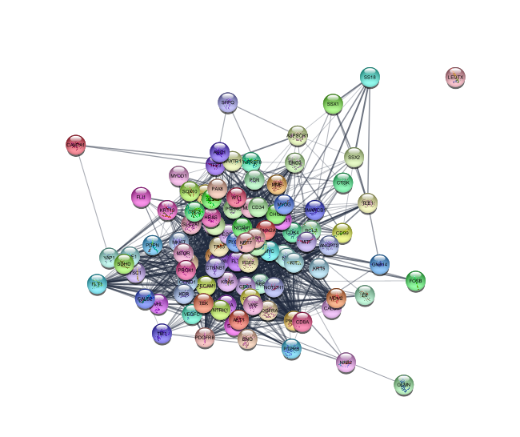
String
100 proteins
1634 edges

Slide 6

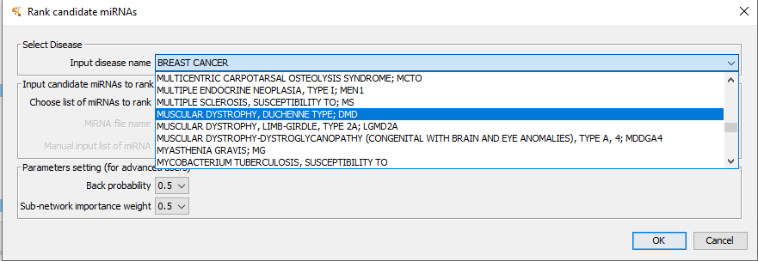
RWRMTN

Slide 7
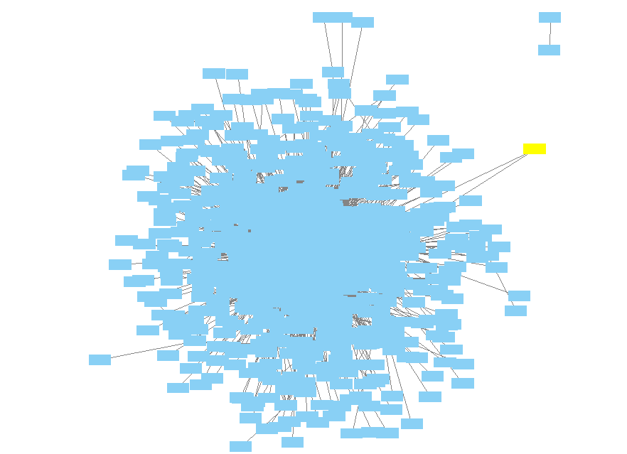


Slide 8
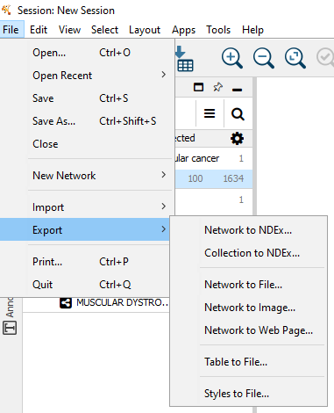

Slide 9
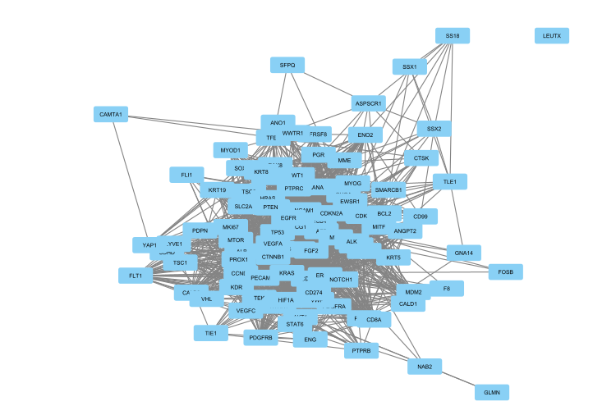
Original network from String
100 nodes
1634 edges

Slide 10
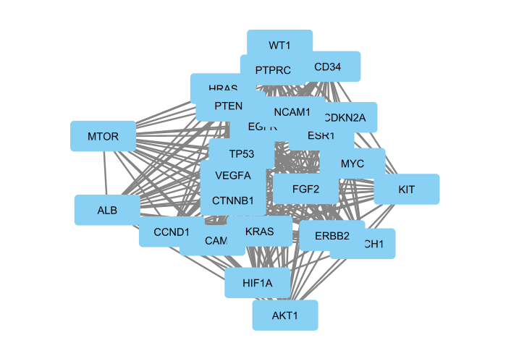
25% top connected nodes
25 nodes
287 edges

Slide 11
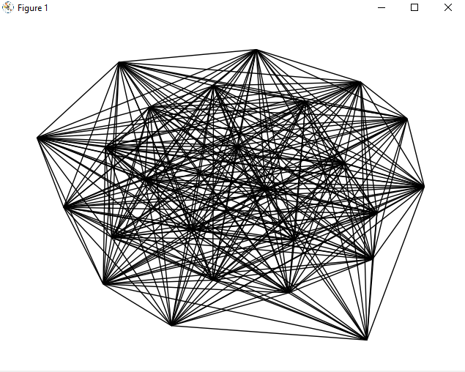

Slide 12
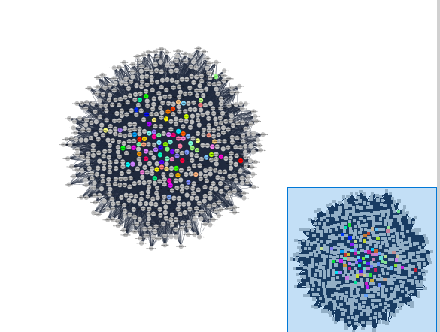
All proteins, all mirnas
662 nodes
16406 edges

Slide 13
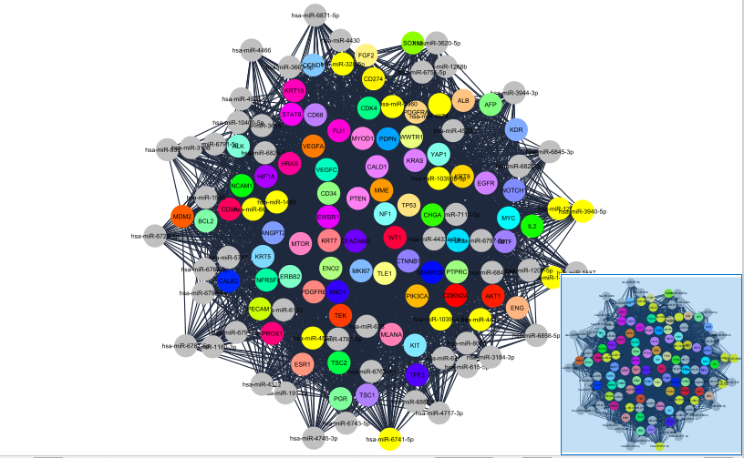
25% top connected nodes
133 nodes
3181 edges

Slide 14
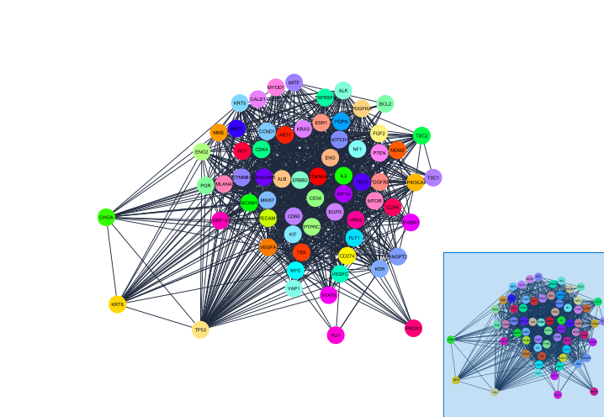
1% top connected nodes with the mirnas (no mirnas)
66 nodes
1119 edges

Slide 15
Let’s practice

Slide 16
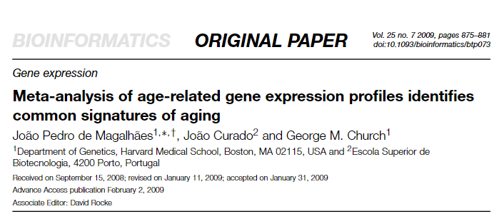
De Magalhaes 2009

Slide 17
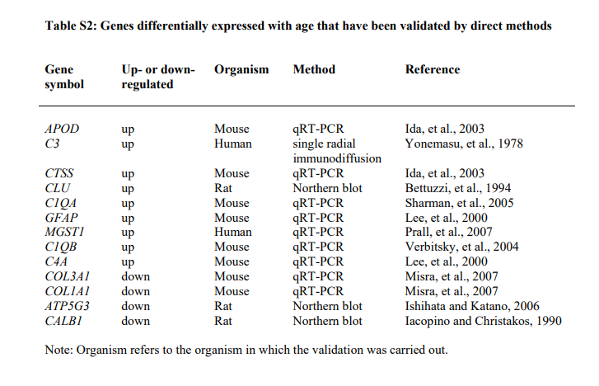

Slide 18
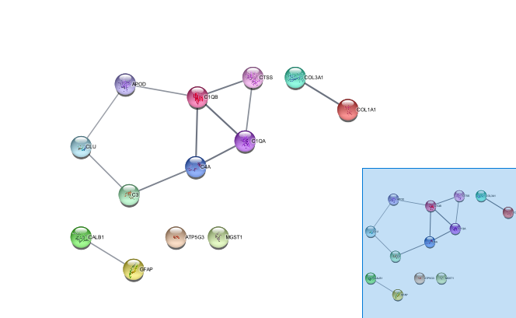
Original String network

Slide 19
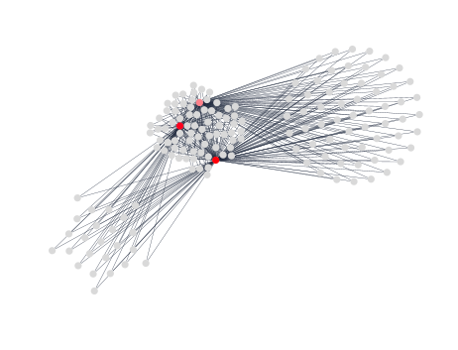
10% top connected nodes
161 nodes
390 edges
3 genes

Slide 20
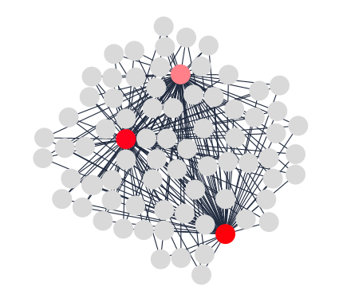
Degree > 3
76 nodes
390 edges

Slide 21
Proteins
MGST1:
Microsomal Glutathione S-Transferase 1
Involved in the production of leukotrienes and prostaglandin E, important mediators of inflammation.
C1QB and C1QA
Complement C1q B chain ; complement C1q A chain
protein complex involved in the complement system, which is part of the innate immune system

Slide 22
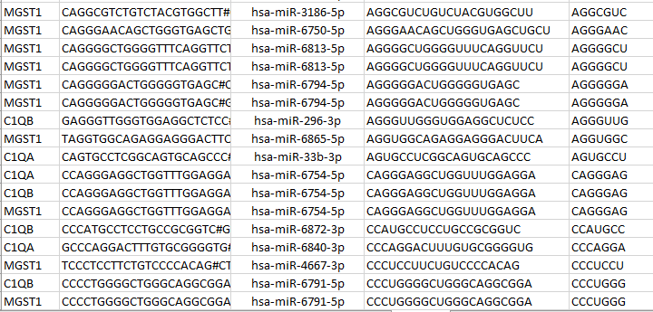
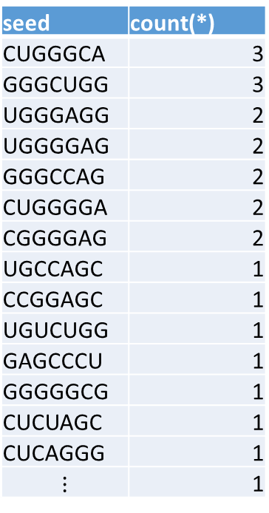
Mirna seeds
143 different seeds
seed | count(*)
CUGGGCA | 3
GGGCUGG | 3
UGGGAGG | 2
UGGGGAG | 2
GGGCCAG | 2
CUGGGGA | 2
CGGGGAG | 2
UGCCAGC | 1
CCGGAGC | 1
UGUCUGG | 1
GAGCCCU | 1
GGGGGCG | 1
CUCUAGC | 1
CUCAGGG | 1
$$⋮$$ | 1

Slide 23
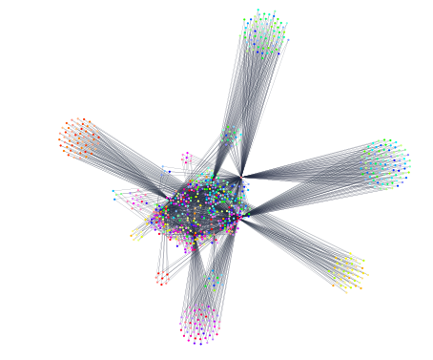
50% top connectivity
975 nodes
2066 edges
6 genes

Slide 24
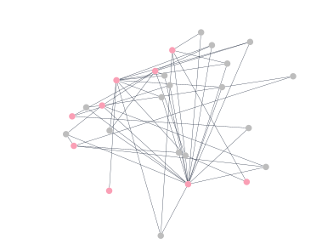
miRNAs with target to 5 or more genes
26 nodes
17 mirnas
2066 edges

Slide 25
Genes and miRNAs selected
Genes
Mirnas
APOD
C3
C4A
CALB1
CLU
COL1A1
COL3A1
CTSS
GFAP
hsa-miR-10400-5p
hsa-miR-1233-3p
hsa-miR-3150a-3p
hsa-miR-365a-5p
hsa-miR-3714
hsa-miR-423-5p
hsa-miR-4446-3p
hsa-miR-4508
hsa-miR-4537
hsa-miR-4746-3p
hsa-miR-6746-3p
hsa-miR-6751-5p
hsa-miR-6754-5p
hsa-miR-6763-5p
hsa-miR-6794-5p
hsa-miR-6856-5p
hsa-miR-8089

Slide 26
miRNA | Target selected genes | Seed | Occurrences
hsa-miR-10400-5p | 2 | AAGGCAG | 1
hsa-miR-1233-3p | 2 | AGAGAGG | 1
hsa-miR-3150a-3p | 2 | AGCCGCC | 1
hsa-miR-365a-5p | 3 | AGGGCUG | 1
hsa-miR-3714 | 3 | AGGGGGA | 1
hsa-miR-423-5p | 3 | CAGGGAG | 1
hsa-miR-4446-3p | 2 | CGGGGCU | 1
hsa-miR-4508 | 2 | CUGGGGA | 1
hsa-miR-4537 | 2 | GAGCCCU | 1
hsa-miR-4746-3p | 2 | GAGCCGA | 1
hsa-miR-6746-3p | 3 | GAGGGGC | 1
hsa-miR-6751-5p | 3 | GCGGUGC | 1
hsa-miR-6754-5p | 2 | GGGACUU | 1
hsa-miR-6763-5p | 4 | UGGGGAG | 2
hsa-miR-6794-5p | 3 | UGGGGGU | 1
hsa-miR-6856-5p | 3
hsa-miR-8089 | 3
https://www.mirbase.org/cgi-bin/mirna_entry.pl?acc=MI0022608

Slide 27
Genes that hsa-miR-6763-5p binds
APOD
C1QB
C3
CALB1
COL1A1
MGST1
PMID:22955976"Discovery of hundreds of mirtrons in mouse and human small RNA data"Ladewig E, Okamura K, Flynt AS, Westholm JO, Lai ECGenome Res. 22:1634-1645(2012).

Slide 28
Genes that hsa-miR-3150a-3p binds
APOD
C1QA
C1QB
C4A
MGST1
PMID:20300190"Characterization of the Melanoma miRNAome by Deep Sequencing"Stark MS, Tyagi S, Nancarrow DJ, Boyle GM, Cook AL, Whiteman DC, Parsons PG, Schmidt C, Sturm RA, Hayward NKPLoS One. 5:e9685(2010).
PMID:21199797"Identification of new microRNAs in paired normal and tumor breast tissue suggests a dual role for the ERBB2/Her2 gene"Persson H, Kvist A, Rego N, Staaf J, Vallon-Christersson J, Luts L, Loman N, Jonsson G, Naya H, Hoglund M, Borg A, Rovira CCancer Res. 71:78-86(2011).

Slide 29
APOD
Encodes a component of high density lipoprotein.
Homology to plasma retinol-binding protein and other lipocalins.
This glycoprotein is closely associated with an enzyme involved in lipoprotein metabolism. [provided by RefSeq, Aug 2008]
C3
Central role in the activation of complement system
The C3a peptide, also known as the C3a anaphylatoxin, modulates inflammation and possesses antimicrobial activity.
Mutations in this gene are associated with atypical hemolytic uremic syndrome and age-related macular degeneration in human patients. [provided by RefSeq, Nov 2015]
CALB1
Calcium binding capability.
Depletion of this protein was noted in patients with Huntington disease. [provided by RefSeq, Jan 2015]
COL1A1
Encodes the pro-alpha1 chains of type I collagen.
Associated with dermatofibrosarcoma protuberans, resulting from unregulated expression of the growth factor [provided by R. Dalgleish, Feb 2008]

Slide 30
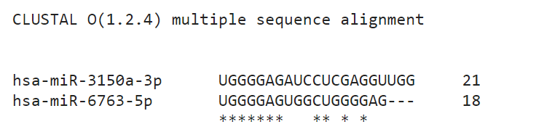
Playing a bit with them…
7 mismatches
3 insertion/deletions

Slide 31
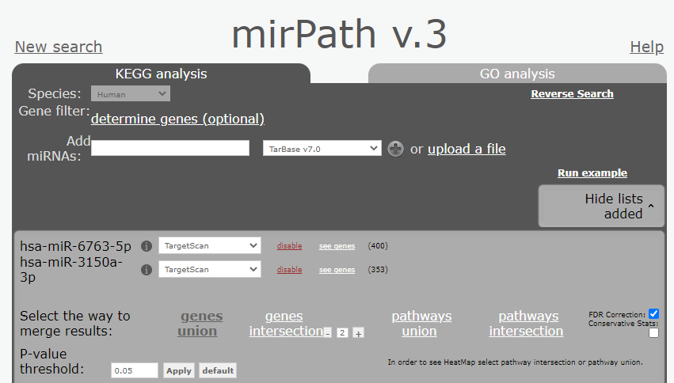

Slide 32
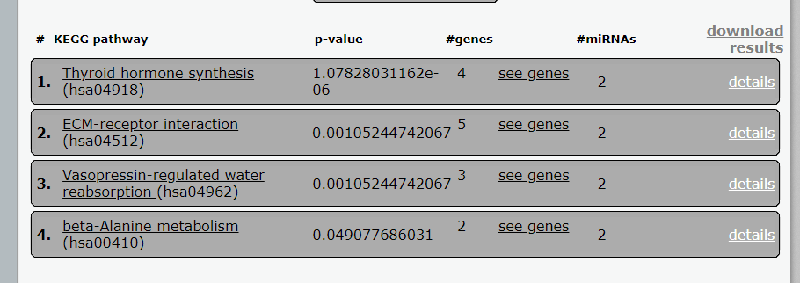



Slide 33
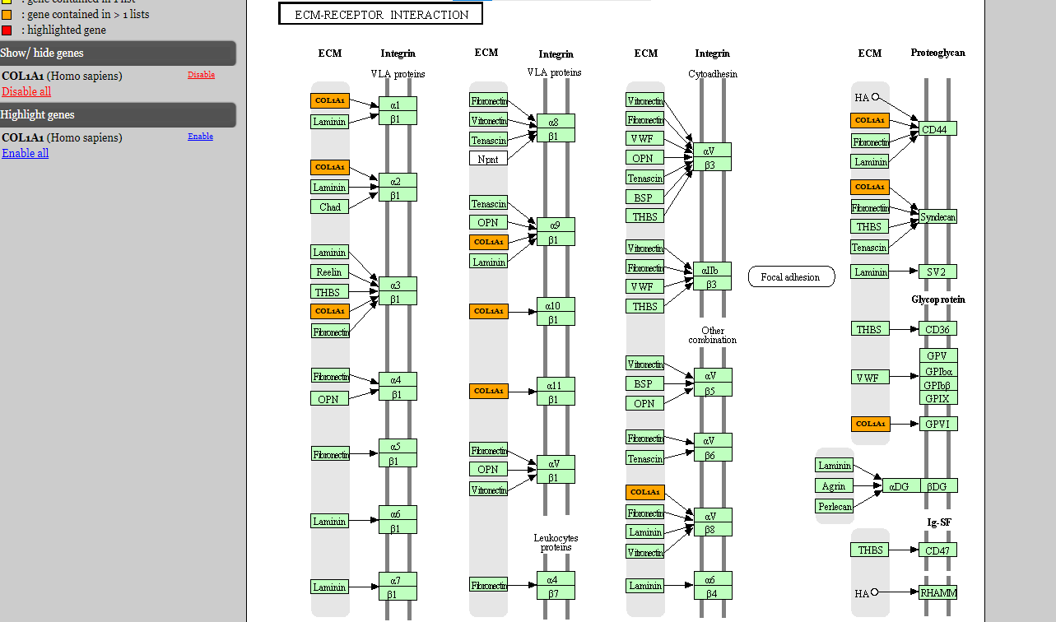

Slide 34
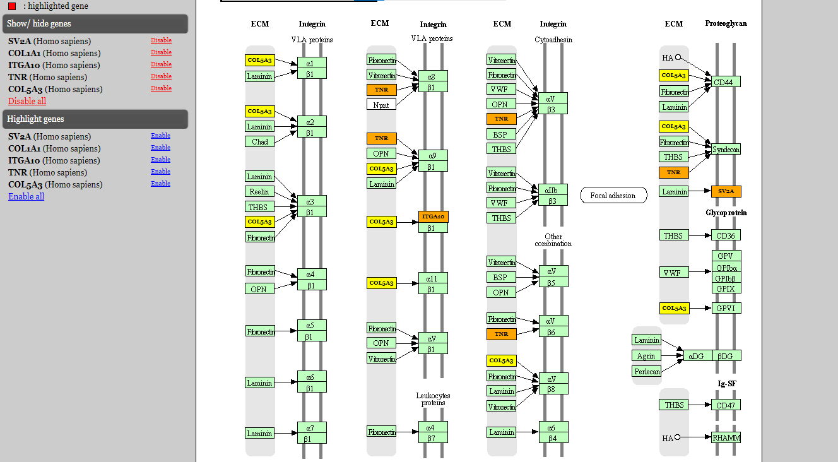

Slide 35
How relevant is that they match the pathway?
Mirna | # of target genes
hsa-miR-10400-5p | 7270
hsa-miR-1233-3p | 4759
hsa-miR-3150a-3p | 5712
hsa-miR-365a-5p | 4817
hsa-miR-3714 | 6322
hsa-miR-423-5p | 6132
hsa-miR-4446-3p | 5320
hsa-miR-4508 | 6382
hsa-miR-4537 | 3639
hsa-miR-4746-3p | 6047
hsa-miR-6746-3p | 5722
hsa-miR-6751-5p | 6572
hsa-miR-6754-5p | 6411
hsa-miR-6763-5p | 7561
hsa-miR-6794-5p | 6439
hsa-miR-6856-5p | 6175
hsa-miR-8089 | 6658
There are in total 177,910 genes with at least 1 mirna associated.
.
.
.
Let’s keep playing

Slide 36
miRNA | All genes | Selected genes | Ratio | Percentage | Random percentage | % difference
hsa-miR-10400-5p | 7270 | 2 | 2.75E-04 | 0.03 | 4.09 | -4.06
hsa-miR-1233-3p | 4759 | 2 | 4.20E-04 | 0.04 | 2.67 | -2.63
hsa-miR-3150a-3p | 5712 | 2 | 3.50E-04 | 0.04 | 3.21 | -3.18
hsa-miR-365a-5p | 4817 | 3 | 6.23E-04 | 0.06 | 2.71 | -2.65
hsa-miR-3714 | 6322 | 3 | 4.75E-04 | 0.05 | 3.55 | -3.51
hsa-miR-423-5p | 6132 | 3 | 4.89E-04 | 0.05 | 3.45 | -3.40
hsa-miR-4446-3p | 5320 | 2 | 3.76E-04 | 0.04 | 2.99 | -2.95
hsa-miR-4508 | 6382 | 2 | 3.13E-04 | 0.03 | 3.59 | -3.56
hsa-miR-4537 | 3639 | 2 | 5.50E-04 | 0.05 | 2.05 | -1.99
hsa-miR-4746-3p | 6047 | 2 | 3.31E-04 | 0.03 | 3.40 | -3.37
hsa-miR-6746-3p | 5722 | 3 | 5.24E-04 | 0.05 | 3.22 | -3.16
hsa-miR-6751-5p | 6572 | 3 | 4.56E-04 | 0.05 | 3.69 | -3.65
hsa-miR-6754-5p | 6411 | 2 | 3.12E-04 | 0.03 | 3.60 | -3.57
hsa-miR-6763-5p | 7561 | 4 | 5.29E-04 | 0.05 | 4.25 | -4.20
hsa-miR-6794-5p | 6439 | 3 | 4.66E-04 | 0.05 | 3.62 | -3.57
hsa-miR-6856-5p | 6175 | 3 | 4.86E-04 | 0.05 | 3.47 | -3.42
hsa-miR-8089 | 6658 | 3 | 4.51E-04 | 0.05 | 3.74 | -3.70

Slide 37
We need more information

Slide 38
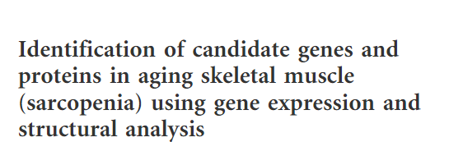
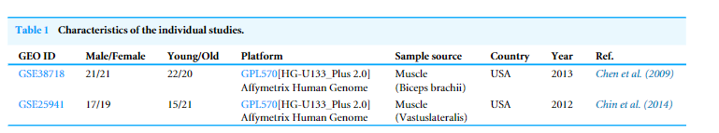
Let’s add the differential expression
(Ugly paper)

Slide 39
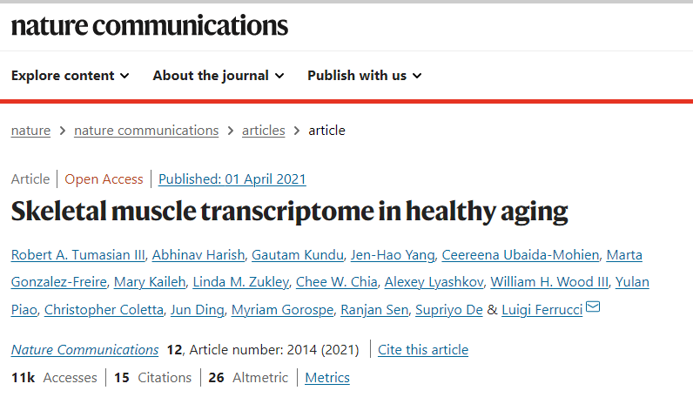
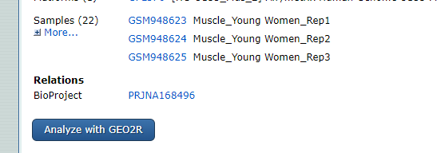

Slide 40
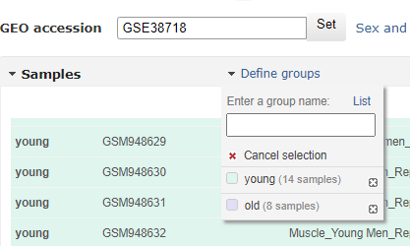

Slide 41


Slide 42
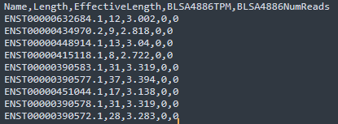
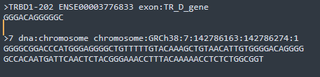
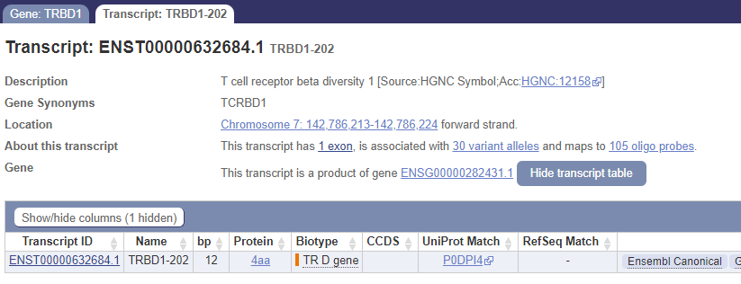

Slide 44
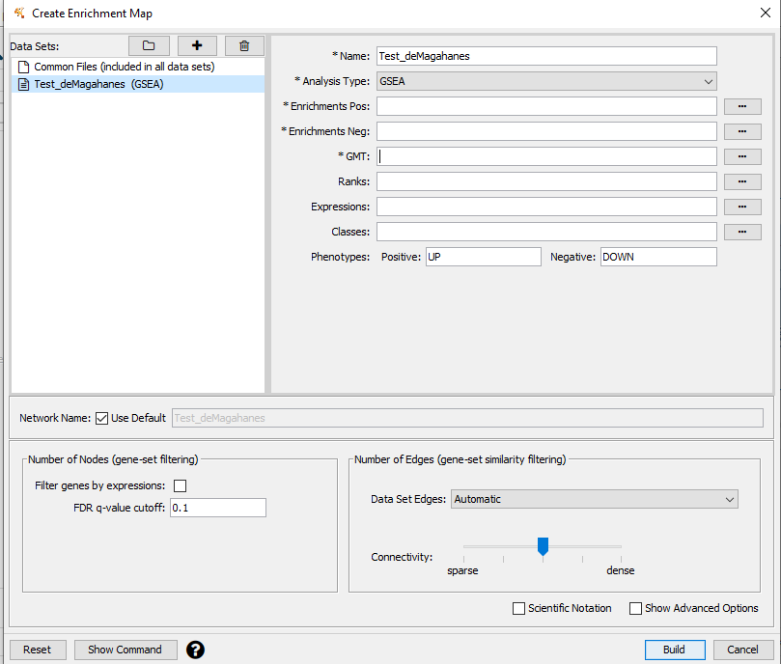

Slide 45
Aging =
genomic instability +
telomere attrition +
epigenetic alterations +
loss of proteostasis +
deregulated nutrient sensing +
mitochondrial dysfunction +
cellular senescence +
stem cell exhaustion +
altered intercellular communication

