Slide 1
Journal club
Bias in miRNA enrichment analysis related to gene functional annotations
June 02, 2023
Karen Guerrero Vazquez

Slide 2




Bias in miRNA enrichment analysis related to gene functional annotations
Konstantinos Zagganas
Thanasis Vergoulis
Georgios K. Georgakilas
Spiros Skiadopoulos
Theodore Dalamagas
doi: https://doi.org/10.1101/2021.08.16.456527

Slide 3
Intoruction

Slide 4
Predcited miRNA:target interactions
most miRNA target prediction algorithms have been trained on seed-enriched data sets with features extracted from the sequence surrounding the seed, even though recent evidence shows that non-seed-based interactions are common in miRNA-mediated gene expression regulation. This limited training data and focus on seed-based interactions can introduce bias into the predicted miRNA:target interactions.

Slide 5

The “recent” evidence
However, it is unclear to what extent miRNAs target sites without seed matches. Here, we performed a transcriptome-wide identification of the endogenous targets of a single miRNA-miR-155-in a genetically controlled manner. We found that approximately 40% of miR-155-dependent Argonaute binding occurs at sites without perfect seed matches

Slide 6
mRNA
~1200 nt
~22 nt
miRNA
seed
~5 nt
91%
Random miRNA hit random mRNA

Slide 7
False Positive Rate (self delcared)
TargetScan: 49%
mirTarBase: 9%
MiRDB: 25%
B3GLCT predictions made by multiple algorithms in miRWalk have a high false positive rate (>96%),

Slide 8
in 2015, it was demonstrated by Bleazard et al. [3], that the standard method of miRNA functional enrichment analysis is not suitable for such analyses, since it provides highly unspecific results. Briefly, Bleazard et al. illustrated that miRNA functional enrichment analysis based on target prediction algorithms is strongly biased and leads to the identification of unrelated biological processes.

Slide 9
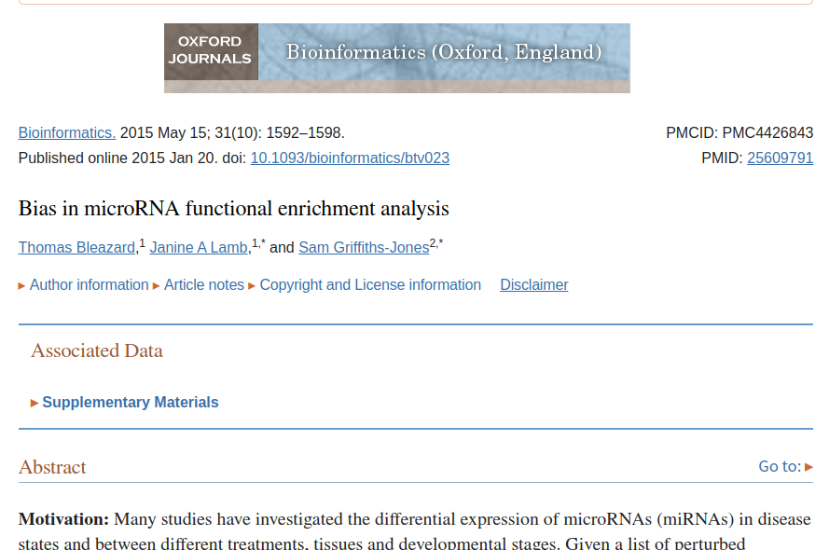
We show that the most commonly used functional enrichment test is inappropriate for the analysis of sets of genes targeted by miRNAs. The hypergeometric distribution used by the standard method consistently results in significant P-values for functional enrichment for targets of randomly selected miRNAs, reflecting an underlying bias in the predicted gene targets of miRNAs as a whole.
certain functional categories are preferentially targeted by miRNAs, regardless of whether those miRNAs are differentially expressed in a biological state or not. It is not helpful to report a GO term as enriched for targets of differentially expressed miRNAs if an equally strong enrichment would be obtained for randomly picked miRNAs.

Slide 10
Who uses hypergeometic districubution?
DIANA-miRPath
miEAA
miRPathDB
MAGIA
Gene Set Enrichment Analysis (GSEA)

Slide 11
The mechanics responsible for this bias are not yet fully understood due to the fact that miRNA target prediction is far from being a solved problem in Bioinformatics [15, 1]. Moreover, Bleazard et al. proposed a new method for unbiased enrichment analysis that accounts for the bias introduced by target prediction.

Slide 12
In this paper we demonstrate that when this bias is removed, by using experimentally val-
idated miRNA targets, then a new bias, related to gene annotations, is made visible. Addi-
tionally, we illustrate that this occurs due to a bias affecting the gene-to-biological-function
annotations and is not accounted for by the unbiased enrichment analysis proposed by Bleazard
et al., resulting in reduced sensitivity. To alleviate this issue, we introduce a new statistical mea-
sure that increases the sensitivity of the unbiased enrichment analysis. This measure accounts
for both sources of bias (predicted interactions and gene annotations) and is more sensitive
when predicted or experimentally validated targets are used.

Slide 13
a gene class refers to a group of genes that share a common biological function or process, as defined by the Gene Ontology (GO) database.

Slide 14
Methodology

Slide 15
New proposed method
Given a miRNA group of interest (query) calculate a statistical measure relevant to the problem
Create 1 million randomly assembled miRNA groups with the same size as the query and for each of them calculate the same statistical measure.
The empirical p-value is then defined as the proportion of randomly assembled miRNA groups that present a better statistical behaviour compared to the behaviour of the query

Slide 16
GO term overlap [3] and it is defined as the proportion of genes targeted by a group of miRNAs, that are also members of a specific GO category.
lef t-sided-overlap =

Slide 17
bias affecting miRNA functional enrichment analysis still persists even when experimentally validated miRNA targets are used, instead of predicted targets
the empirical distribution of the overlaps does not match with the expected hypergeometric distribution

Slide 18
Collection
we selected miRNAs dysregulated in multiple sclerosis and gene ontology (GO) annotations from Ensembl
we retrieved disease-to-gene associations from DisGeNET v7 [17], as well as pathway data from KEGG
Moreover, we used the latest version of miRTarBase [4] at the time this article is written, in order to get a list of experimentally validated miRNA targets.
We selected 14 of the dysregulated miRNAs that exist in the data set.

Slide 19
we randomized at the miRNA level, by creating 1 million randomly assembled miRNA groups containing 14 miRNAs each
For each of these groups, we calculated the gene members of each GO category in the data set, that are also targeted by the miRNAs in the group and created a histogram.

Slide 20
On the same graph, we plotted the expected hypergeometric distribution for the overlaps, given the number of targeted/non-targeted genes and the number of genes belonging/not-belonging to the same GO term. The results indicate that the analysis still suffers from a bias related to the size of each gene class

Slide 21
Source of Bias
Based on the definition of the left-sided overlap, we can see that it essenially is the percentage (and not the absolute number) of targets that also belong to the gene class. Intuitively, this suggests that the left sided overlap is designed to remove the bias stemming from target prediction, because the intersection is normalized using the total number of genes being targeted by the miRNA group. In the next section we introduce a new metric, which is expected to account for both sources of bias

Slide 22
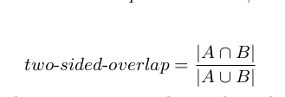
Two-sided overlap
Jaccard coefficient:

Slide 23
BUFET2
Two p-values for the same randomization test that are produced using the left- and two-sided overlap as a statistical measure, respectively
reverse search module that allows researchers to discover statistically significant microRNAs associated with a gene class (GO term, disease, pathway, etc), in almost real time

Slide 24
The module takes a gene class as input and
randomizes at the miRNA level; using an exhaustive approach, but rather an exhaustive one

Slide 25

Checking it out

Slide 26


Slide 27
python3 bufet2.py -miRNA /data/datasets/inputs/alzheimers_mirnas.txt -interactions /data/datasets/interactions/mirtarbase.txt -annotations /data/datasets/annotations/kegg.csv -iterations 1000000 -output /data/outputs/output_alz.txt --no-synonyms

Slide 28
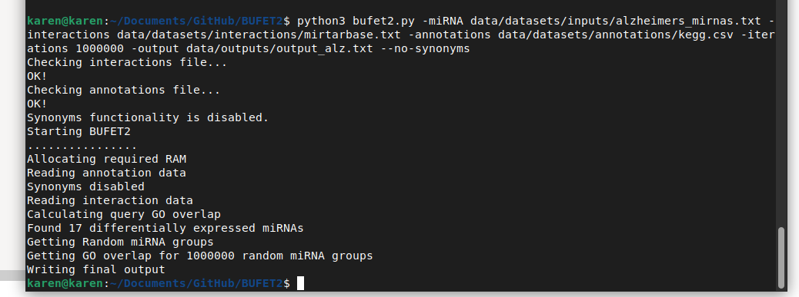

Slide 29
Output
#GO-term-ID | GO-term-size | Observed-Target-Left-Sided... | Mean-Random-Simulated-Left... | Left-sided-empirical-p-value | Observed-Target-Two-Sided... | Mean-Random-Simulated-Two... | Two-sided-empirical-p-value
hsa04974~Protein digestion and absorption | 103 | 0.00326141 | 0.00414247 | 0.739577 | 0.0031894 | 0.00394574 | 0.715527
hsa04971~Gastric acid secretion | 76 | 0.00401405 | 0.00520281 | 0.800503 | 0.00395452 | 0.00502885 | 0.782733
hsa04966~Collecting duct acid secretion | 27 | 0.00175615 | 0.00166664 | 0.429571 | 0.00174738 | 0.00164686 | 0.424004

Slide 30
it seems that the mismatch is indeed more prominent as the
size of the category increases. In order to quantify and investigate this effect, we designed
the following experiment. First, we define as distance between the distributions the horizontal
distance (number of genes in common with the GO category) between the maximum values of
each distribution. Then, using this definition, for all GO categories in the data set, we evaluate
the distance between the two distributions in relation to the category size

Slide 31
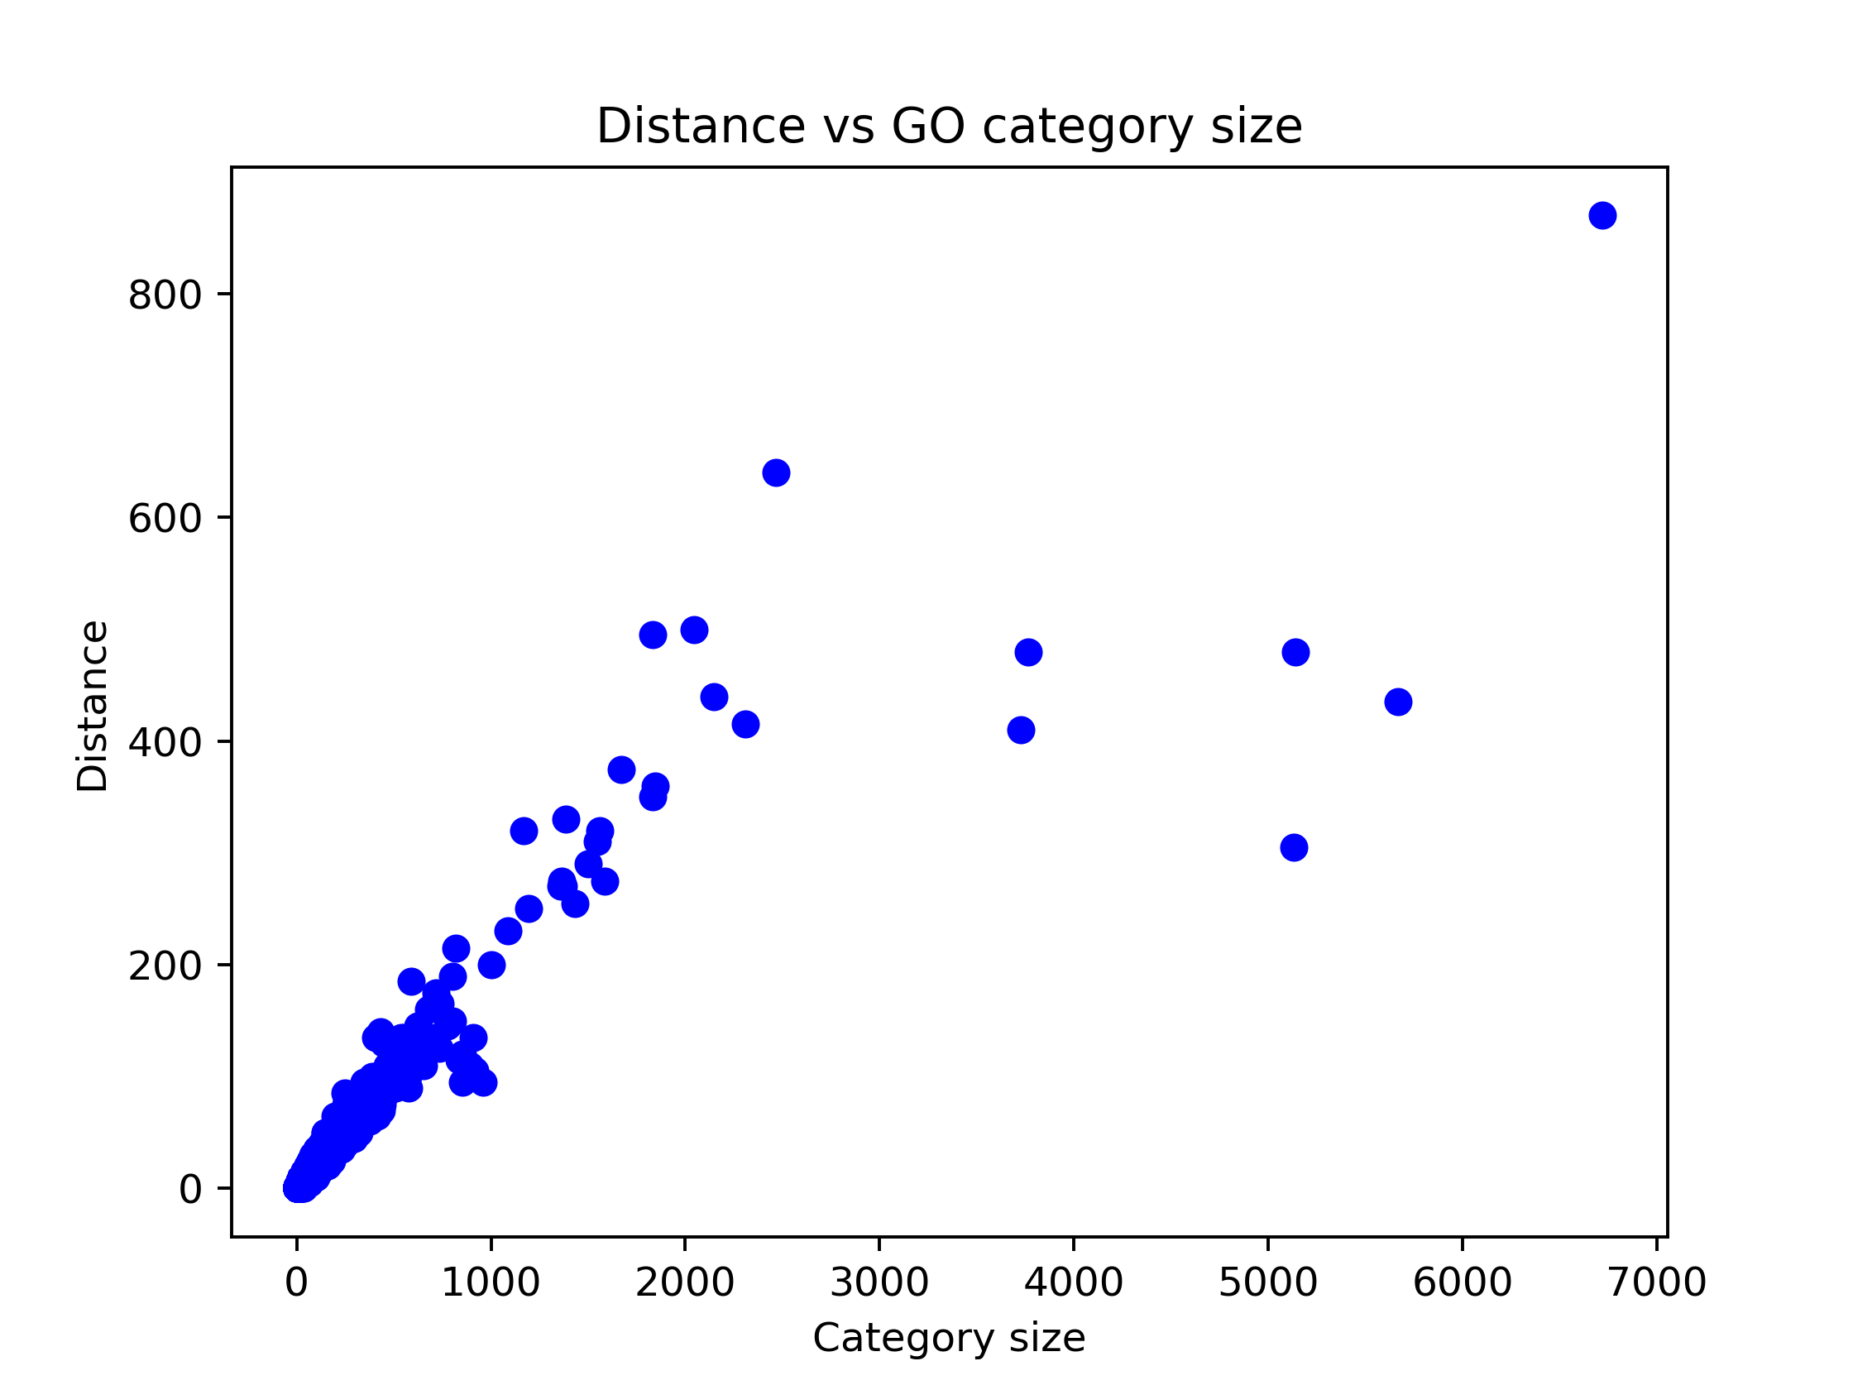

Slide 32
the genes in a GO category are also contained in a category which
is higher in the hierarchy (e.g. neuron projection, cell projection and cellular component) and
this means that the genes in a category higher in the tree are not picked uniformly for each
category and thus they do not satisfy the assumptions of the hypergeometric distribution. This,
essentially introduces a bias that is more prominent, the higher up from the branches of the
tree one goes. To check whether this effect can also be observed with DisGeNET and KEGG,
we performed the same experiment using these data sets.

Slide 33
Thus, the hierarchy existing between the diseases introduces
the same bias as seen for GO. Regarding KEGG, the same effect is also observed. This could
be attributed to complex interactions between genes in pathways that are not specified in the
data set. An example of this could be gene co-expression or other more complex effects that
lead to genes being included in a pathway.
In conclusion, we showed that for all three data sets there is a bias, which is clearly a product
of the gene annotation structure, affecting the miRNA functional enrichment analysis.

Slide 34
Left-sided vs two-sided overlap
left-sided overlap, which measures the proportion of genes targeted by a group of miRNAs that are also members of a specific GO category, does not account for the bias introduced by target prediction algorithms. Therefore, they propose using a more sensitive metric called two-sided overlap, which measures the proportion of genes targeted by a group of miRNAs that are both members of a specific GO category and have predicted binding sites for those miRNAs. The authors compare the performance of these two metrics using four published lists of miRNAs associated with different types of cancer.

Slide 35
PATHWAY and
DISEASE
using the two-sided overlap as a metric increases
the sensitivity of the test and leads to more accurate results. This is particularly evident with
Alzheimer’s disease, where the “Alzheimer’s disease” pathway is not marked as statistically
significant by the left-sided p-value. Moreover, even when both methods suggest that a pathway
is significant, the two-sided p-value is smaller, denoting a stronger association of the miRNA
group with the pathway.

Slide 36
Randomization test metric vs type of type of miRNA targets
They demonstrate that using predicted miRNA targets introduces bias into the analysis, which can lead to false positive results. Therefore, they recommend using experimentally validated miRNA targets whenever possible to improve the accuracy and reliability of miRNA functional enrichment analysis. The authors use microT-8, a widely used algorithm for predicting miRNA targets, as an example of a prediction algorithm that may introduce bias into the analysis. They also note that their findings have important implications for future studies of miRNA function and regulation.

Slide 37
Issues regarding overrepresentation analysis and the hierarchy of Gene Ontology annotations
have been mentioned as far back as 2003 [5, 24]. Bleazard et al. also point out that there may
be underlying correlations between targeting of processes and the hierarchical GO structure. In
Section 3.1 we demonstrated that there is a definite bias related to the hierarchical structure of
the GO and that this bias also affects other gene annotation data sets like KEGG PATHWAY
and DisGeNET. This suggests that Fisher’s exact test does not present enough robustness for
miRNA functional enrichment analyses, even when the bias from miRNA prediction algorithms
is eliminated through the utilization of experimentally validated miRNA targets. Despite its
drawbacks, however, the standard method is still very popular in published studies

Slide 38
This denotes that the same bias
affects the analysis regardless of the type of interactions used.

