Slide 1
Dryrun
Cardiovascular cancer

Slide 3
APPs

Slide 4
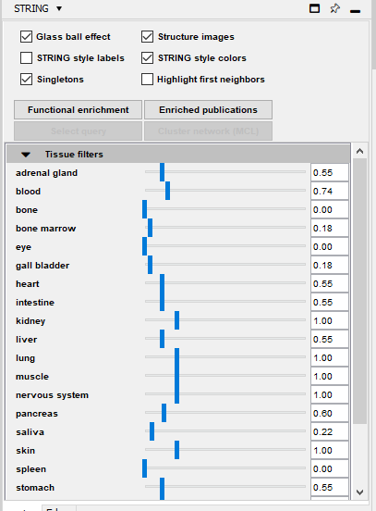
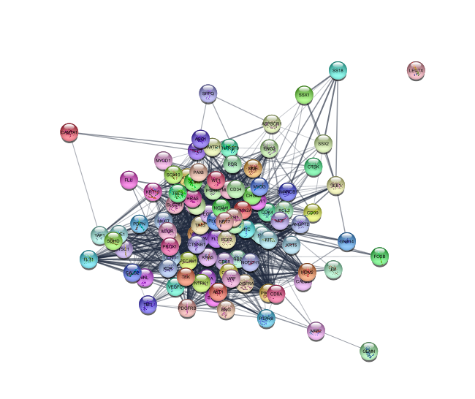
String
100 proteins
1634 edges

Slide 5

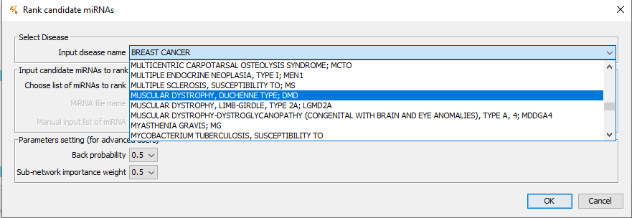
RWRMTN

Slide 6
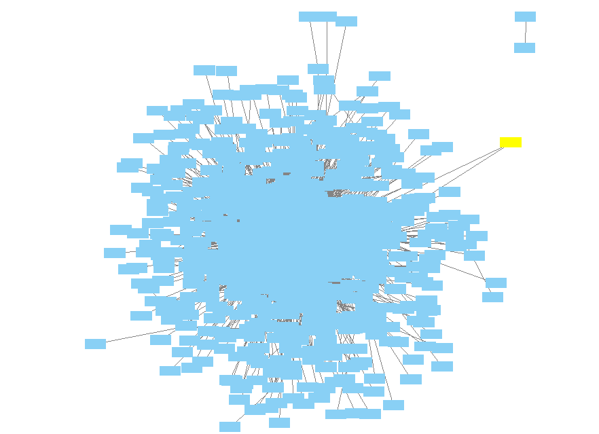


Slide 7
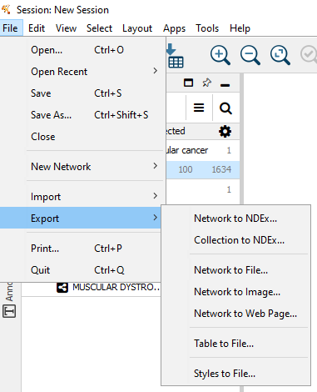

Slide 8
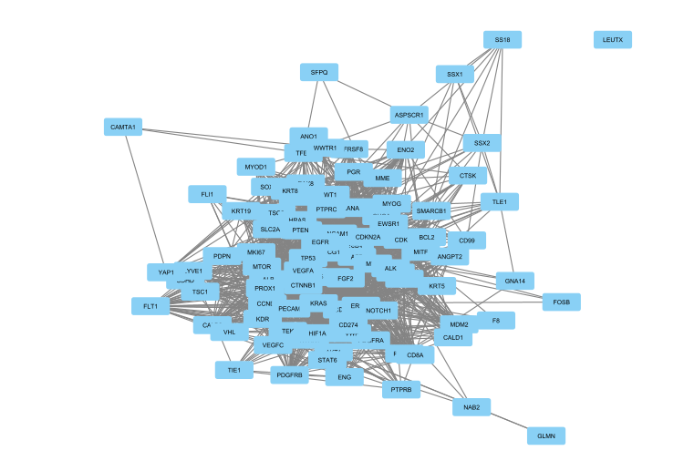
Original network from String
100 nodes
1634 edges

Slide 9
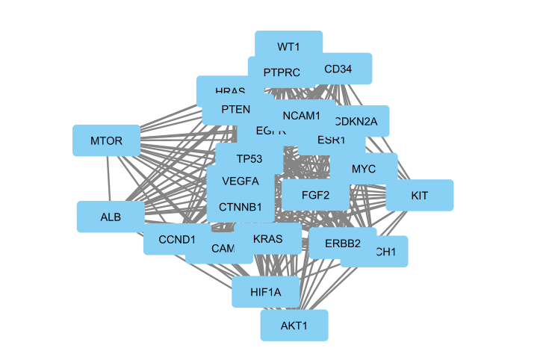
25% top connected nodes
25 nodes
287 edges

Slide 10
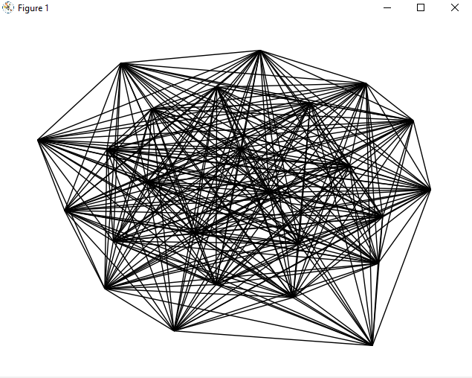

Slide 11
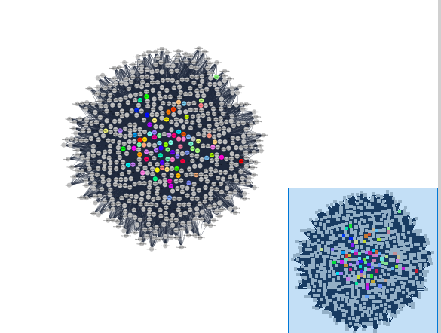
All proteins, all mirnas
662 nodes
16406 edges

Slide 12
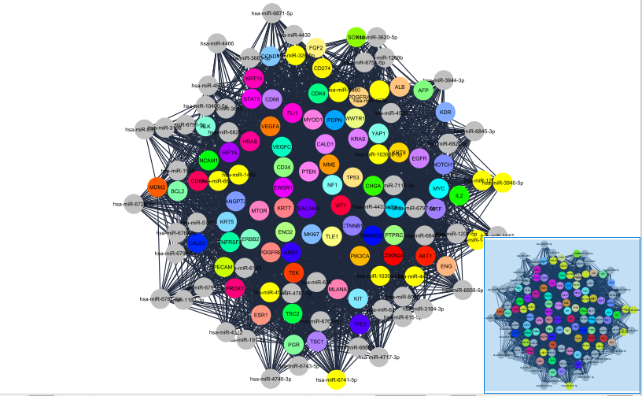
25% top connected nodes
133 nodes
3181 edges

Slide 13
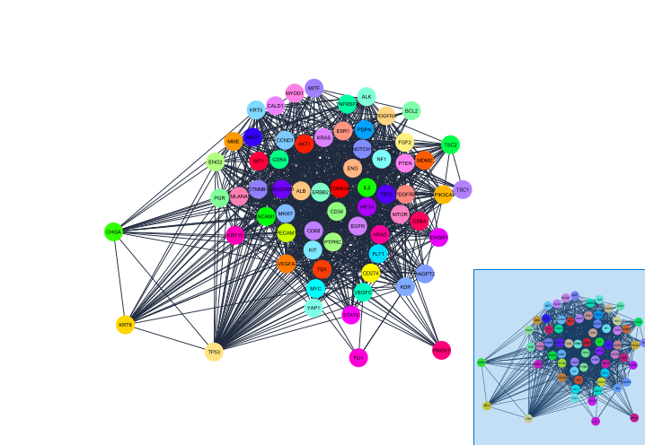
1% top connected nodes with the mirnas (no mirnas)
66 nodes
1119 edges

Slide 14
Let’s practice

Slide 15
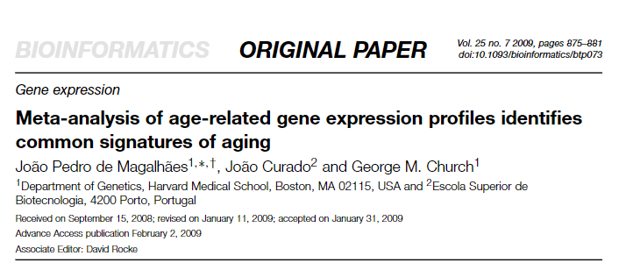
De Magalhaes 2009

Slide 16
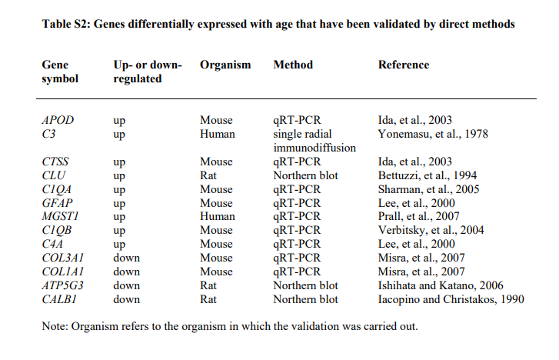

Slide 17
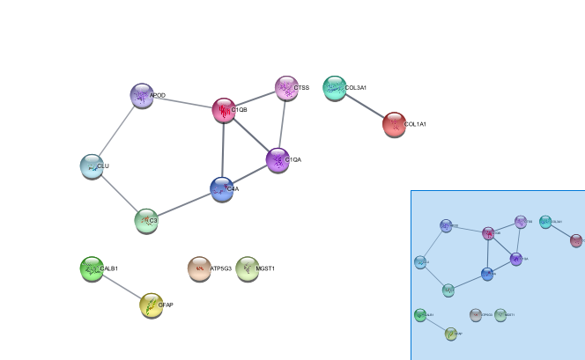
Original String network

Slide 18
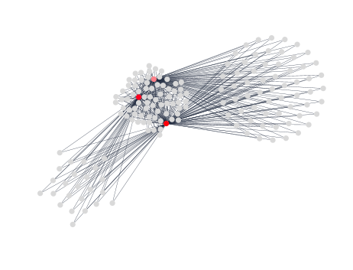
10% top connected nodes
161 nodes
390 edges

Slide 19
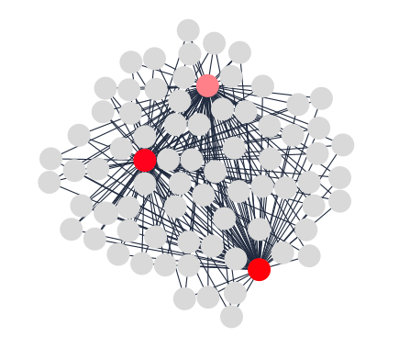
Degree > 3
76 nodes
390 edges

Slide 20
Proteins
MGST1:
Microsomal Glutathione S-Transferase 1
Involved in the production of leukotrienes and prostaglandin E, important mediators of inflammation.
C1QB and C1QA
Complement C1q B chain ; complement C1q A chain
protein complex involved in the complement system, which is part of the innate immune system

Slide 21
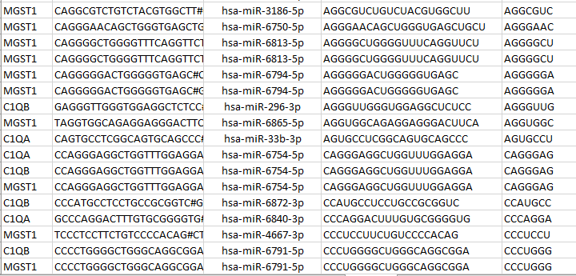
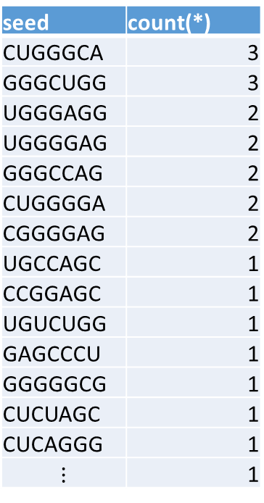
Mirna seeds
143 different seeds
seed | count(*)
CUGGGCA | 3
GGGCUGG | 3
UGGGAGG | 2
UGGGGAG | 2
GGGCCAG | 2
CUGGGGA | 2
CGGGGAG | 2
UGCCAGC | 1
CCGGAGC | 1
UGUCUGG | 1
GAGCCCU | 1
GGGGGCG | 1
CUCUAGC | 1
CUCAGGG | 1
$$⋮$$ | 1

Slide 22
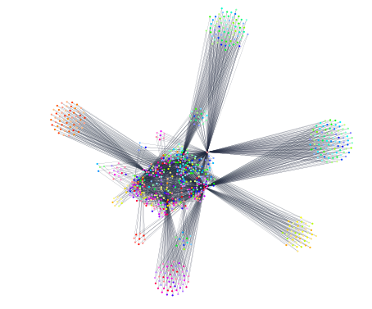
50% top connectivity

Slide 23
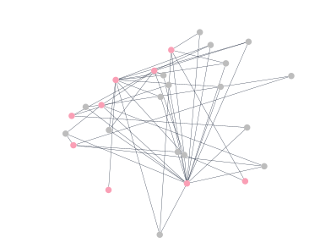
Mirnas with target to 5 or more genes
26 nodes
17 mirnas
2066 edges

Slide 24
Genes
Mirnas
APOD
C3
C4A
CALB1
CLU
COL1A1
COL3A1
CTSS
GFAP
hsa-miR-10400-5p
hsa-miR-1233-3p
hsa-miR-3150a-3p
hsa-miR-365a-5p
hsa-miR-3714
hsa-miR-423-5p
hsa-miR-4446-3p
hsa-miR-4508
hsa-miR-4537
hsa-miR-4746-3p
hsa-miR-6746-3p
hsa-miR-6751-5p
hsa-miR-6754-5p
hsa-miR-6763-5p
hsa-miR-6794-5p
hsa-miR-6856-5p
hsa-miR-8089

Slide 25
miRNA | Target selected genes | Seed | Occurrences
hsa-miR-10400-5p | 2 | AAGGCAG | 1
hsa-miR-1233-3p | 2 | AGAGAGG | 1
hsa-miR-3150a-3p | 2 | AGCCGCC | 1
hsa-miR-365a-5p | 3 | AGGGCUG | 1
hsa-miR-3714 | 3 | AGGGGGA | 1
hsa-miR-423-5p | 3 | CAGGGAG | 1
hsa-miR-4446-3p | 2 | CGGGGCU | 1
hsa-miR-4508 | 2 | CUGGGGA | 1
hsa-miR-4537 | 2 | GAGCCCU | 1
hsa-miR-4746-3p | 2 | GAGCCGA | 1
hsa-miR-6746-3p | 3 | GAGGGGC | 1
hsa-miR-6751-5p | 3 | GCGGUGC | 1
hsa-miR-6754-5p | 2 | GGGACUU | 1
hsa-miR-6763-5p | 4 | UGGGGAG | 2
hsa-miR-6794-5p | 3 | UGGGGGU | 1
hsa-miR-6856-5p | 3
hsa-miR-8089 | 3
https://www.mirbase.org/cgi-bin/mirna_entry.pl?acc=MI0022608

Slide 26
Genes that hsa-miR-6763-5p binds
APOD
C1QB
C3
CALB1
COL1A1
MGST1
PMID:22955976"Discovery of hundreds of mirtrons in mouse and human small RNA data"Ladewig E, Okamura K, Flynt AS, Westholm JO, Lai ECGenome Res. 22:1634-1645(2012).

Slide 27
Genes that hsa-miR-3150a-3p binds
APOD
C1QA
C1QB
C4A
MGST1
PMID:20300190"Characterization of the Melanoma miRNAome by Deep Sequencing"Stark MS, Tyagi S, Nancarrow DJ, Boyle GM, Cook AL, Whiteman DC, Parsons PG, Schmidt C, Sturm RA, Hayward NKPLoS One. 5:e9685(2010).
PMID:21199797"Identification of new microRNAs in paired normal and tumor breast tissue suggests a dual role for the ERBB2/Her2 gene"Persson H, Kvist A, Rego N, Staaf J, Vallon-Christersson J, Luts L, Loman N, Jonsson G, Naya H, Hoglund M, Borg A, Rovira CCancer Res. 71:78-86(2011).

Slide 28
APOD
Encodes a component of high density lipoprotein.
Homology to plasma retinol-binding protein and other lipocalins.
This glycoprotein is closely associated with an enzyme involved in lipoprotein metabolism. [provided by RefSeq, Aug 2008]
C3
Central role in the activation of complement system
The C3a peptide, also known as the C3a anaphylatoxin, modulates inflammation and possesses antimicrobial activity.
Mutations in this gene are associated with atypical hemolytic uremic syndrome and age-related macular degeneration in human patients. [provided by RefSeq, Nov 2015]
CALB1
Calcium binding capability.
Depletion of this protein was noted in patients with Huntington disease. [provided by RefSeq, Jan 2015]
COL1A1
Encodes the pro-alpha1 chains of type I collagen.
Associated with dermatofibrosarcoma protuberans, resulting from unregulated expression of the growth factor [provided by R. Dalgleish, Feb 2008]

