Slide 1
Asylum Trends
Jean Thompson, Ian Morris, Trevor Kahl

Slide 2
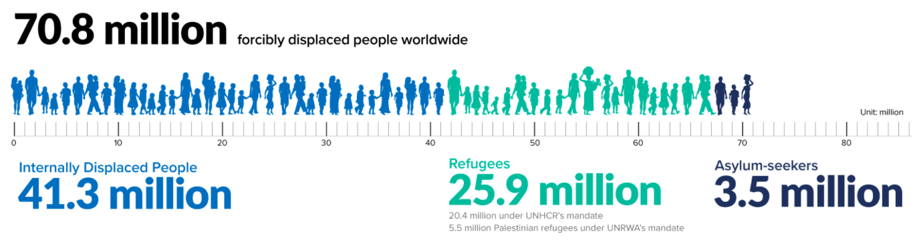
Introduction
The global refugee crisis presents continuing challenges for both developed and developing countries
Natural and man-made disasters have produced millions of refugees living in austere conditions
Nongovernmental and international aid organizations are overwhelmed and must effectively prioritize their efforts and response

Slide 3
Motivation and Problem Statement
Problem Statement
How can the team advise future humanitarian assistance operations by predicting or modeling future refugee migration trends and minimizing global societal impacts?
Motivation
An exacerbated refugee crisis is global security concern
Regional stability supports global prosperity
Reduced forced migration can stop the spread of contagious disease

Slide 4
About the Data
The first set of data is focused on trends for 2014.
Tables 1 and 2 includes asylum requests for destination countries.
Tables 3, 4 and 5 includes origin countries.
Notes:
This dataset comes with many different tables with the raw counts of asylum applications by year for 2010-2014. It includes additional attributes for annual change, rank (in high number of applications), and various weighted measures on asylum requests per 1000 inhabitants versus per 1 USD/GDP.
Table 1: Europe and select other countries
Table 2: Eastern Europe countries

Slide 5
Types of Variables
Country Name | (Years) Listed as individual attributes from 2010-2014, counts of asylum applications per country each year | Annual Change 10-14 Pre-calculated percentage in change of applications from 2010-2014 | Rank 2014 Ordinal ranking by top # of requests by country for 2014 | Rank ‘10-’14 Ordinal ranking by top # of requests by country for all years
Per 1000 Inhabitants Total 2014 Weighted number of requests divided by country population per 1000 inhabitants for 2014 | Per 1000 Inhabitants Total All Weighted number of requests divided by country population per 1000 inhabitants for 2014 | Per 1000 Inhabitants Rank 2014 Ordinal ranking by top # of weighted 1000 inhabitants for 2014 | Per 1000 Inhabitants Rank All Ordinal ranking by top # of weighted 1000 inhabitants for 2014 | Per 1 USD/GDP Per Capita Total 2014 Weighted number of requests divided by 1 USD/GDP for each country for 2014
 | Per 1 USD/GDP Per Capita Total All Weighted number of requests divided by 1 USD/GDP for each country for 2014 | Per 1 USD/GDP Per Capita Rank 2014 Ordinal ranking by top # of weighted USD/GDP per capita for 2014 | Per 1 USD/GDP Per Capita Rank All Ordinal ranking by top # of weighted USD/GDP per capita for 2014
Notes:
This dataset comes with many different tables with the raw counts of asylum applications by year for 2010-2014. It includes additional attributes for annual change, rank (in high number of applications), and various weighted measures on asylum requests per 1000 inhabitants versus per 1 USD/GDP.

Slide 6
Freedom Indices
Region | Governance | Expression | Electoral | PoliticalPluralism
 | IndividualRights | RuleofLaw | Organization | PolRights
 | Liberties | PoliticalRights | CiviLiberties | Free
Notes:
This includes rankings from Freedom House…

Slide 7
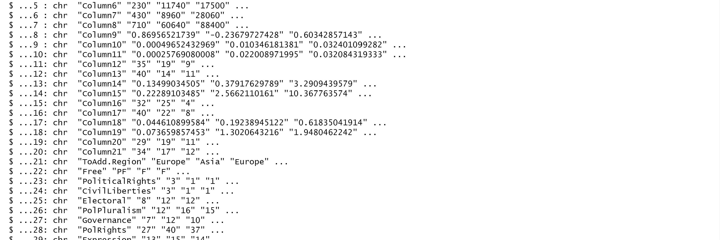
Data Transformation

Slide 8
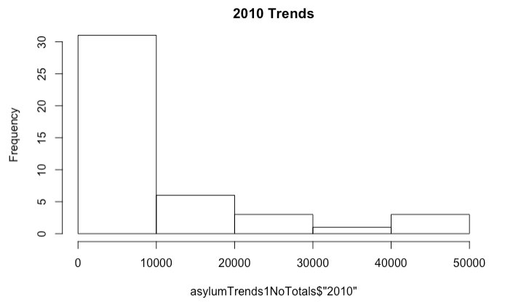
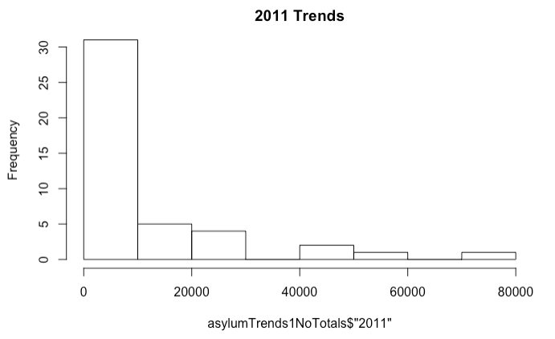
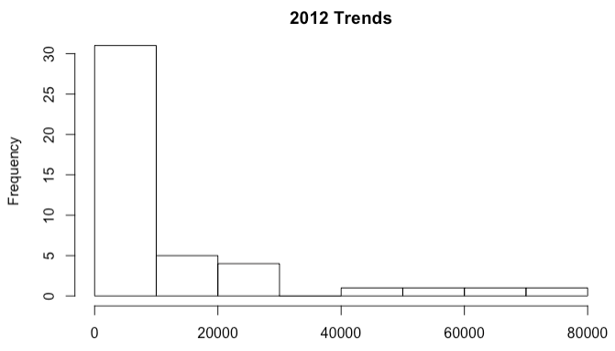
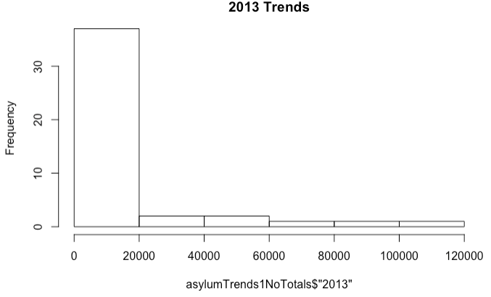
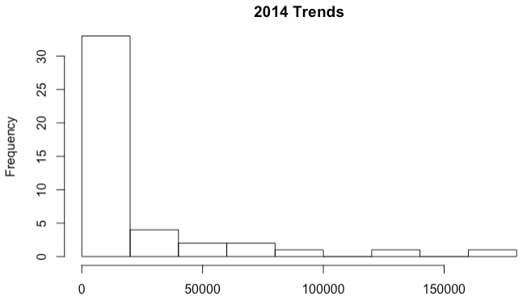
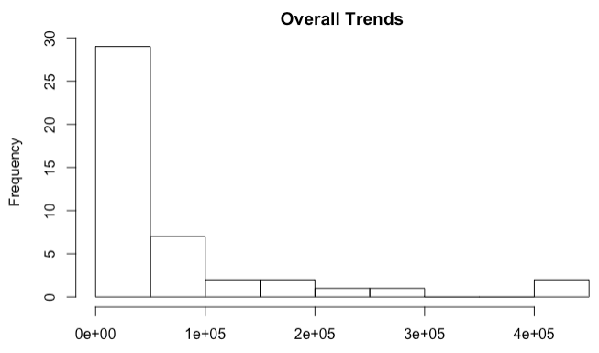
Notes:
Histograms by year for aggregate total #s of request. This

Slide 9
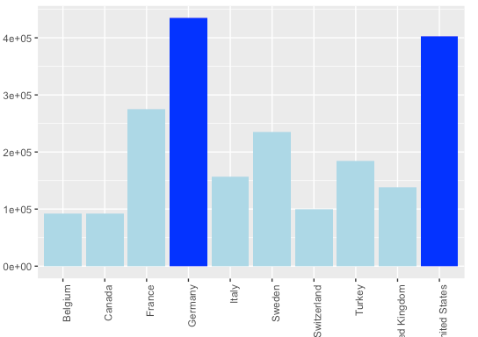
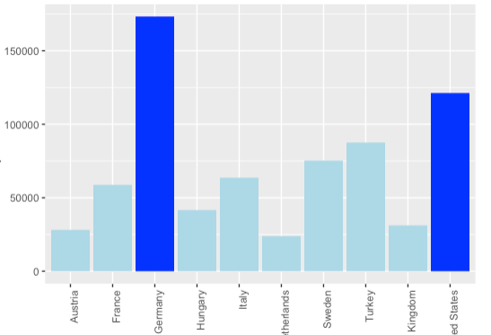
Top Countries – Aggregate
2010-2014
2014

Slide 10
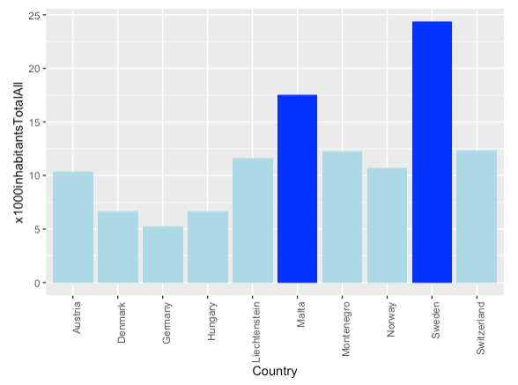
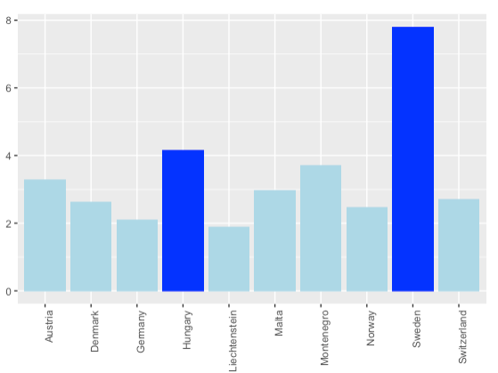
Top Countries – Per 1000 Inhabitants
2010-2014
2014

Slide 11
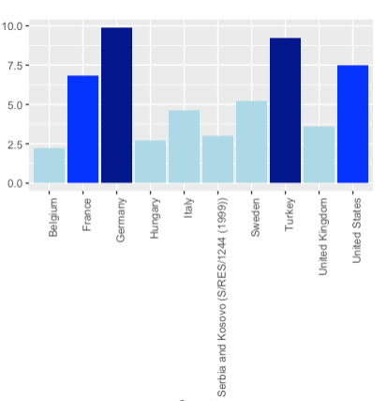
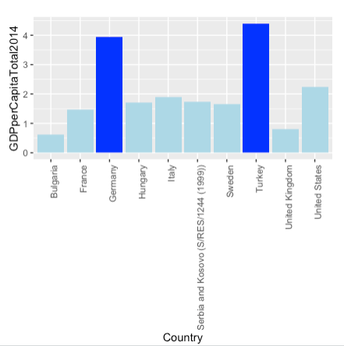
Top Countries – Per 1 USD/GDP
2010-2014
2014

Slide 12
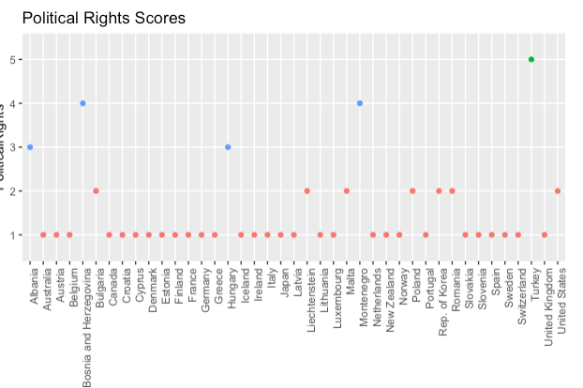
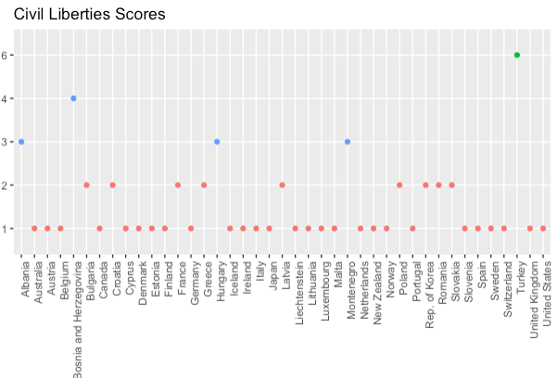

Slide 13
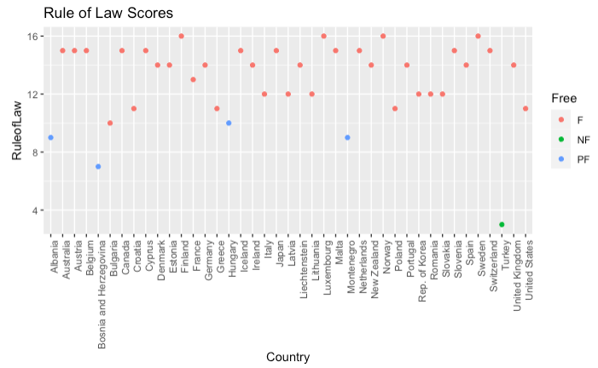
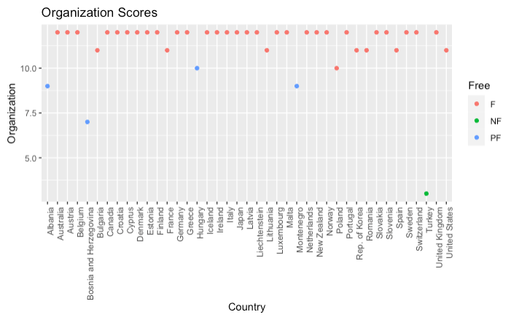
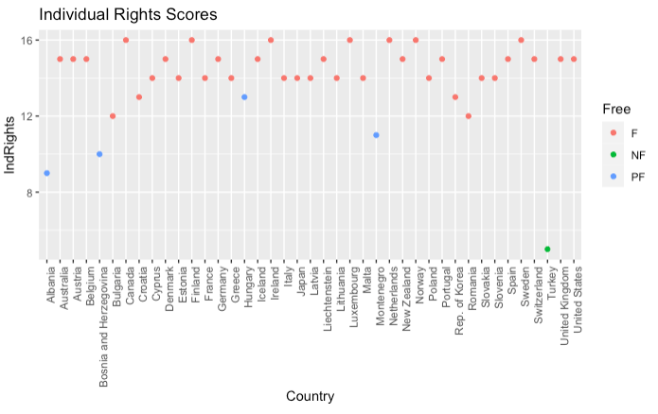
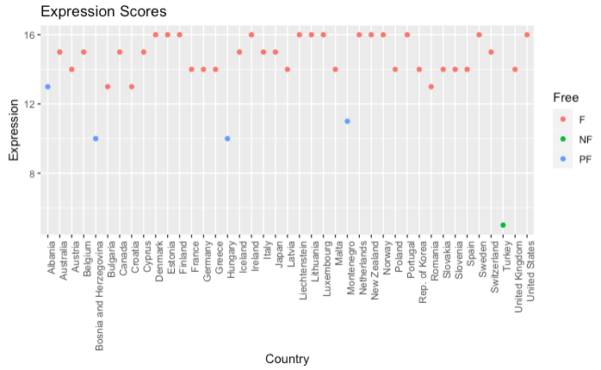
Notes:
Destination EDA for freedom indices

Slide 14
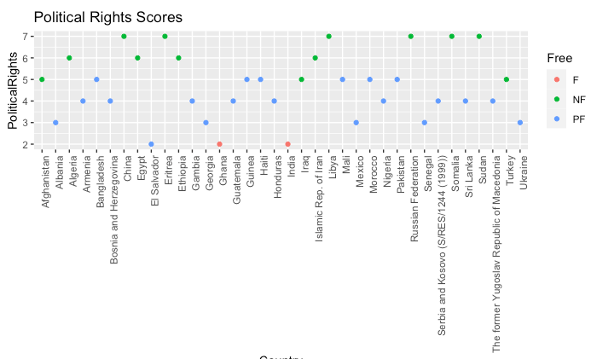
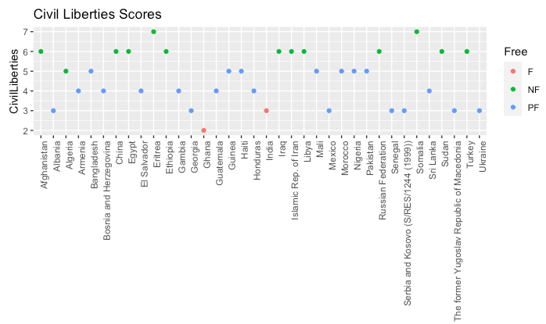
Notes:
Origin countries freedom indices

Slide 15
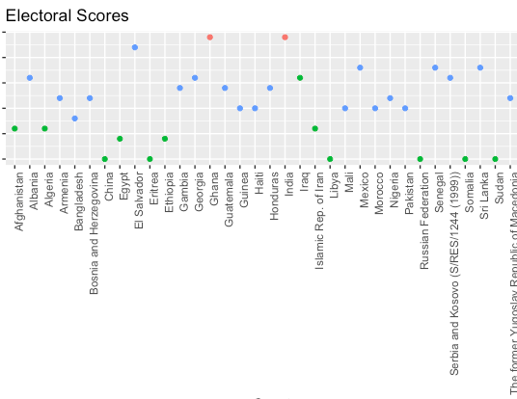
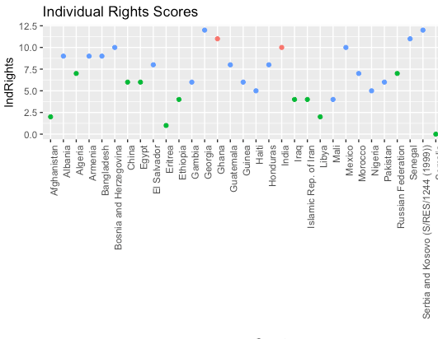

Slide 16
Association Rule Mining for Submitted Applicants
lhs rhs support conf lift
{2010=small, Rule of Law=mid-low} => {2013=small} 0.2 0.8 1.07
{2010=small, Rule of Law=mid-low} => {2014=small} 0.2 0.8 1.10
{Free=F,Governance=mid-high} => {2013=small} 0.3 0.8 1.07
{Civil Liberties=1,Rule of Law=high} => {2010=small} 0.3 0.8 0.97
{Political Rights=1,Governance=mid-high} => {2012=small} 0.2 0.8 1.14
{Governance=mid-high,Organization=high} => {2012=small} 0.3 0.8 1.14
{2013=small-high,Liberties Score=F} => {2012=small-high} 0.1 1 5

Slide 17
ARM for Origin of Applicants
lhs rhs support conf lift
{2013=highest,PolPluralism=mid} => {PolRights=mid-low} 0.36 0.8 1.9
{Governance=low,Liberties Score=NF} => {Rule of Law=low} 0.36 0.8 2.2
{2013=highest,2014=highest,Civil Liberties=mid,Liberties Score=NF} => {Organization=low} 0.52 0.85 1.6
{2014=highest,Expression=low} => {Free=NF} 0.36 0.86 2.2
{Expression=low,Liberties Score=NF} => {Governance=low} 0.36 0.86 1.9
{Organization=mid,Liberties Score=PF} => {2013=highest} 0.27 0.9 0.96

Slide 18
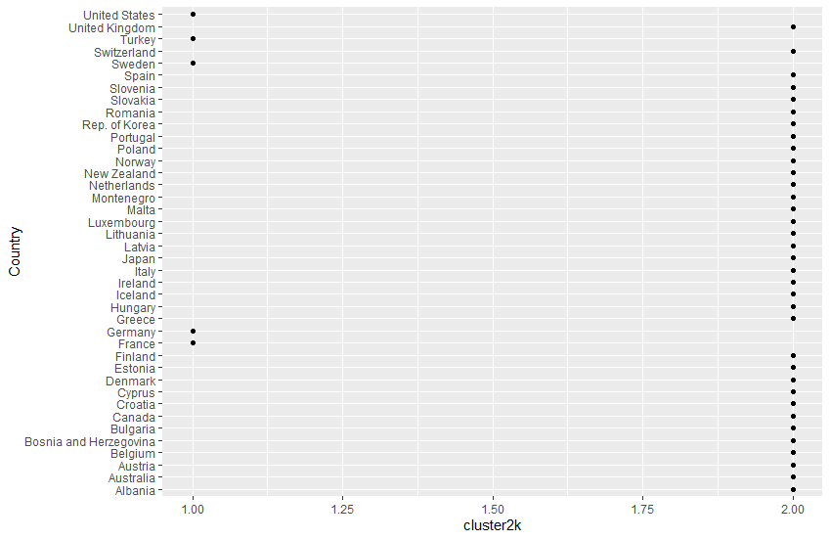
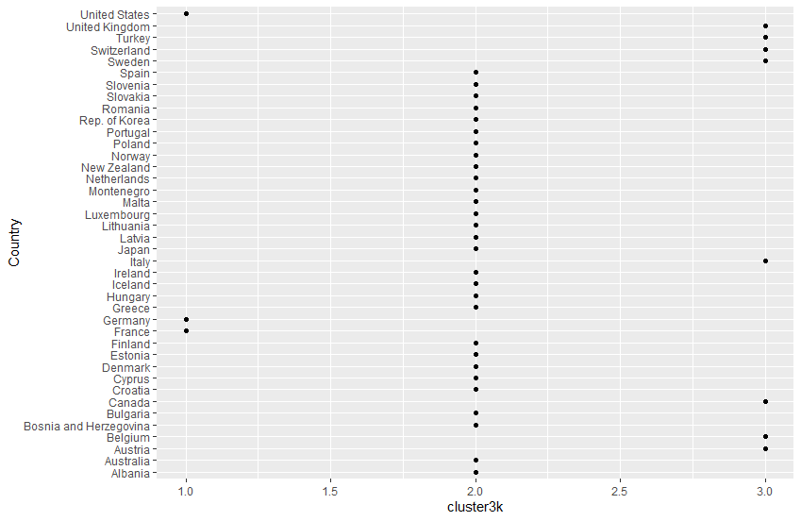
K-means, 2 or 3 Clusters for Destination Countries (European + Selected Others)
2 Centroids
3 Centroids

Slide 19
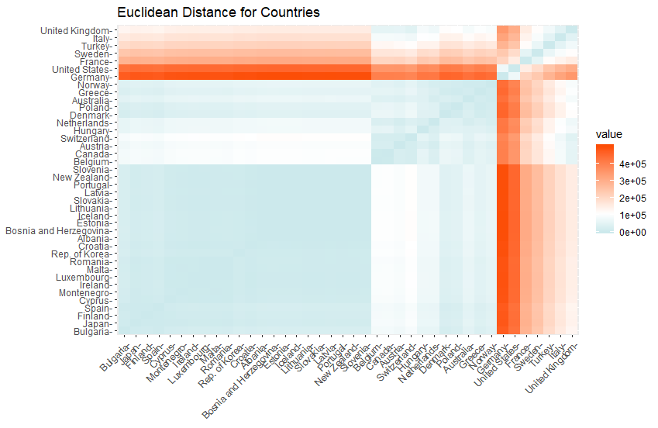
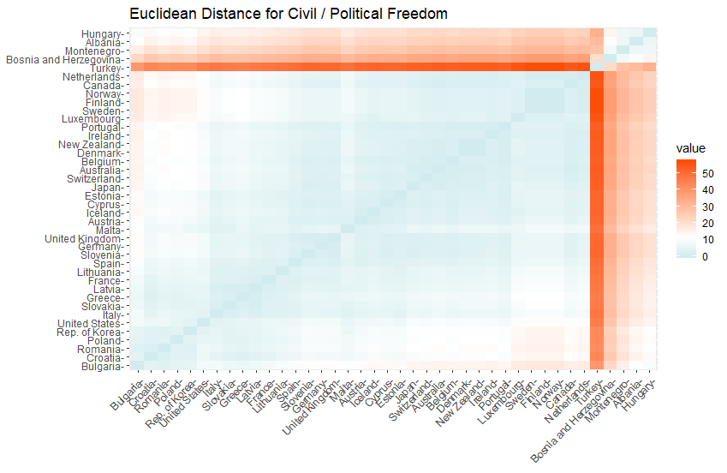
Euclidean Distance for Destination Countries (European + Selected Others)
All Variables
Freedom Index Only

Slide 20
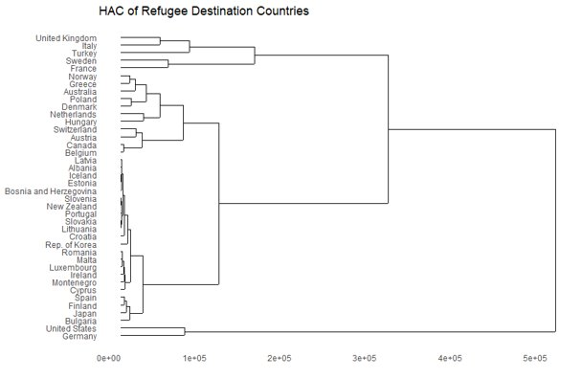
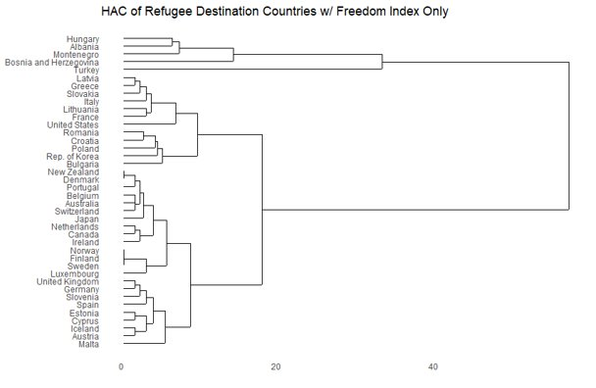
HAC for Destination Countries (European + Selected Others)
All Variables
Freedom Index Only

Slide 21
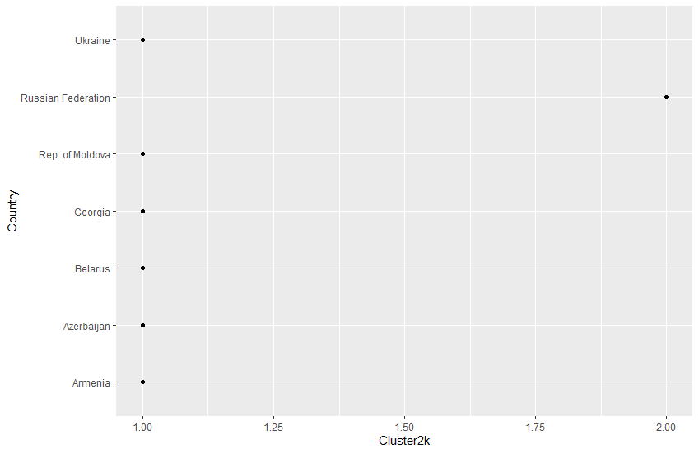

K-means, 2 or 3 Clusters for Destination Countries (Eastern Europe)
2 Centroids
3 Centroids

Slide 22
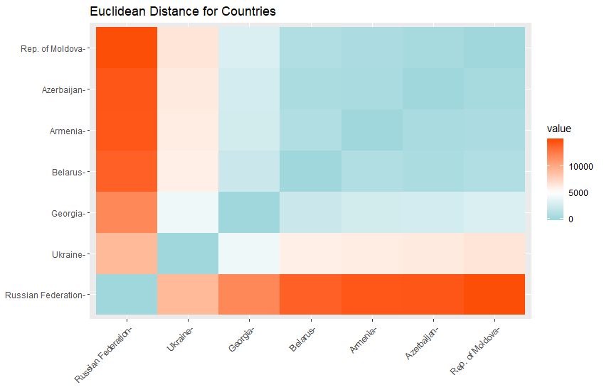
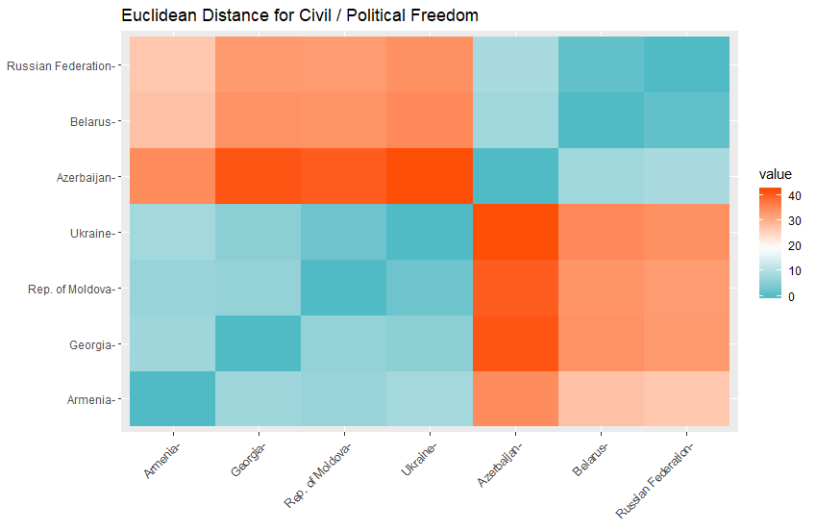
Euclidean Distance for Destination Countries (Eastern Europe)
All Variables
Freedom Index Only

Slide 23
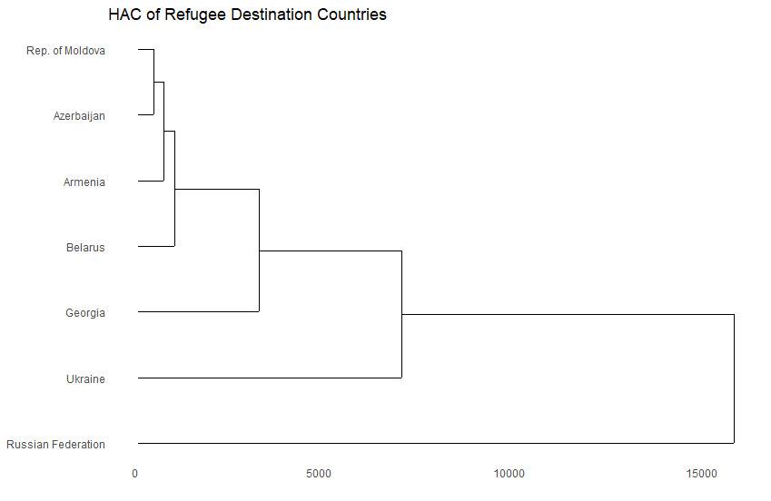
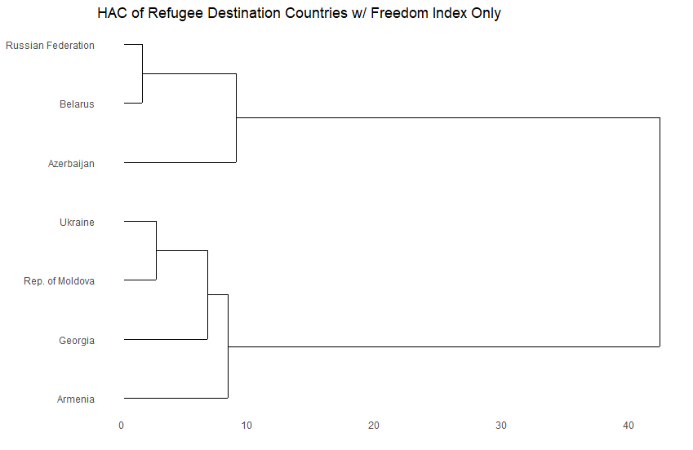
HAC for Destination Countries (Eastern Europe)
All Variables
Freedom Index Only

Slide 24
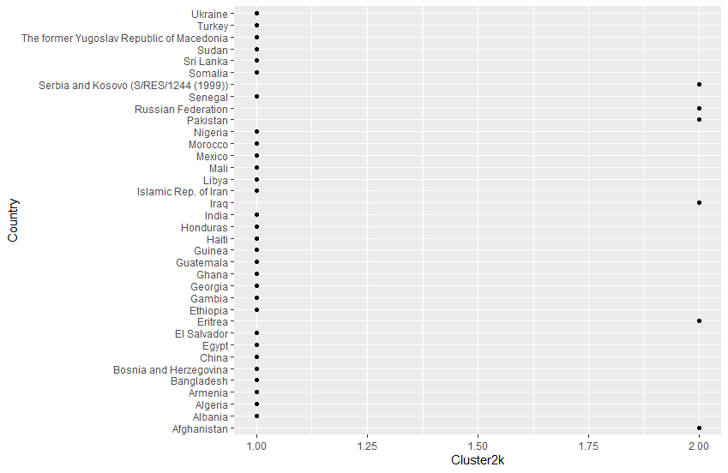
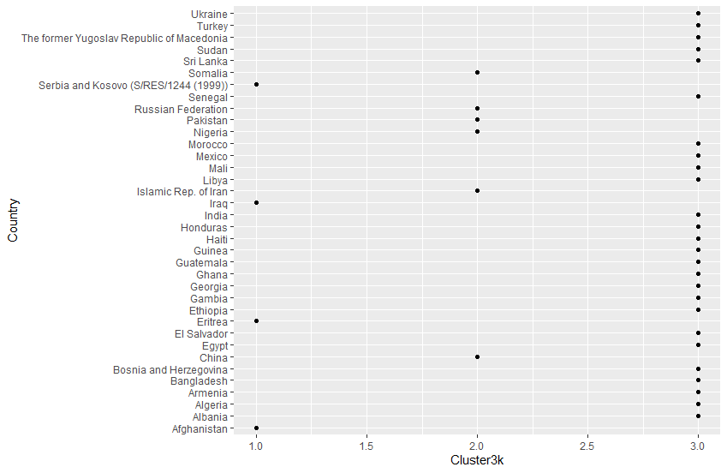
K-means, 2 or 3 Clusters for Origin Countries (Submitted in Industrialized Countries)
2 Centroids
3 Centroids

Slide 25
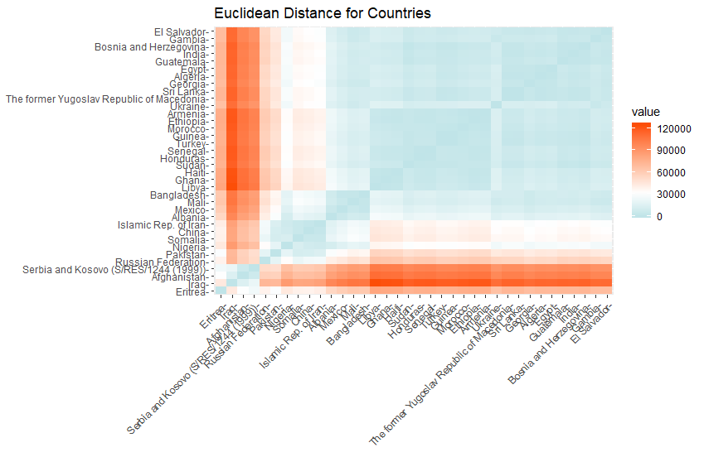
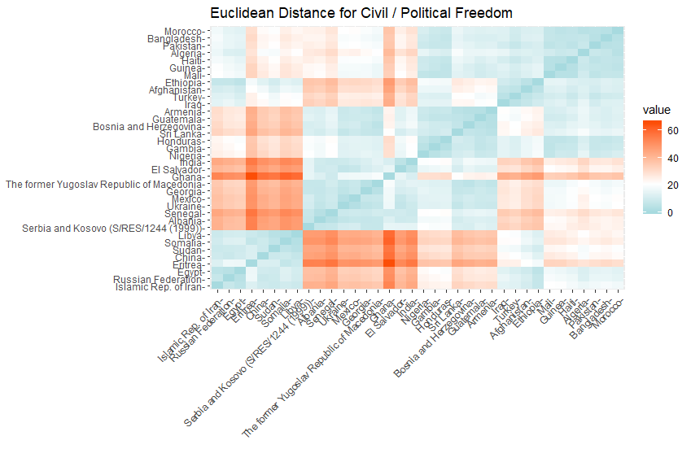
Euclidean Distance for Origin Countries (Submitted in Industrialized Countries)
All Variables
Freedom Index Only

Slide 26
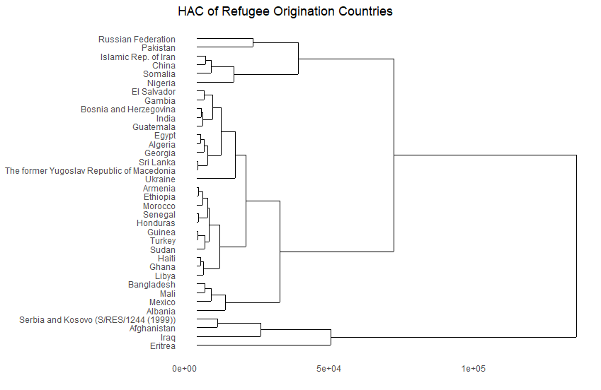
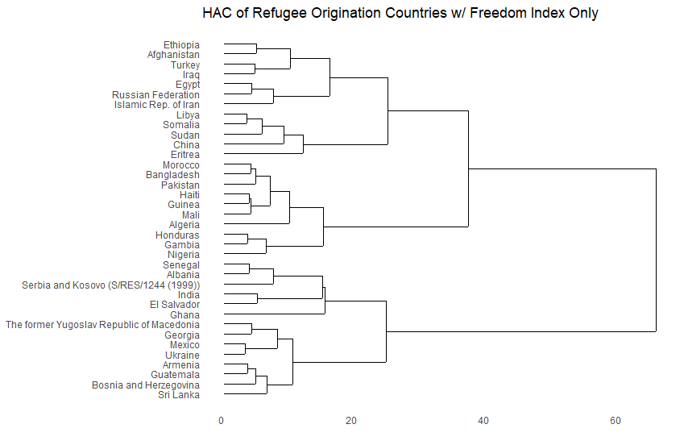
HAC for Origin Countries (Submitted in Industrialized Countries)
All Variables
Freedom Index Only

Slide 27
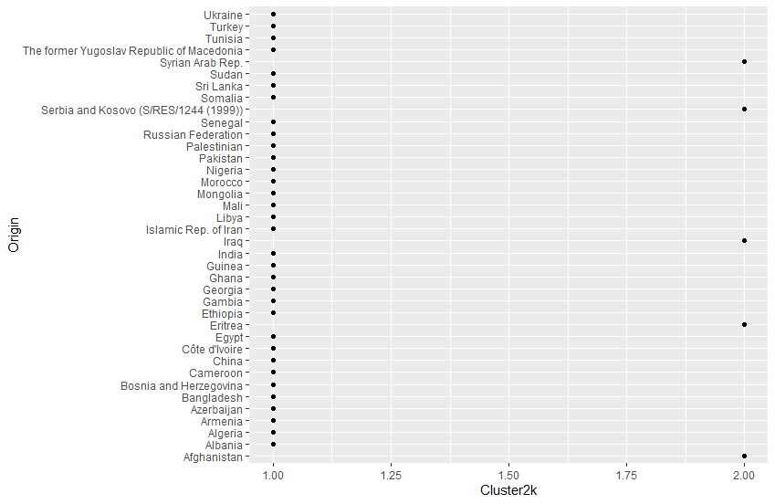
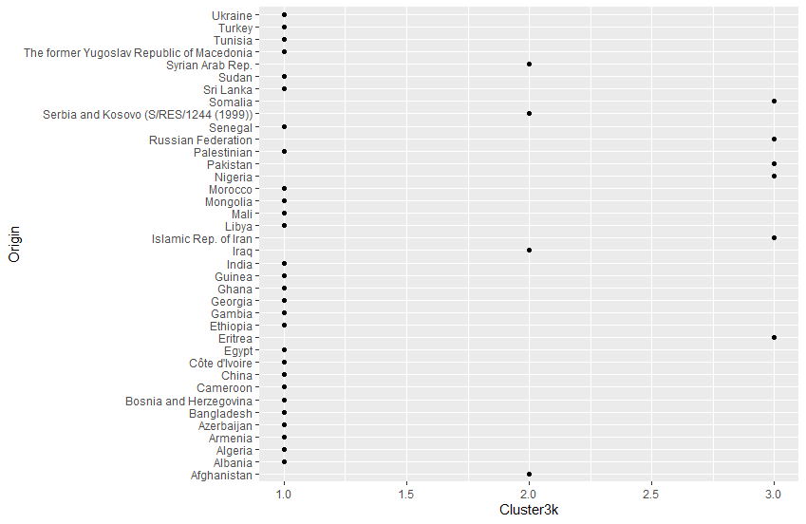
K-means, 2 or 3 Clusters for Origin Countries (Submitted in Europe)
2 Centroids
3 Centroids

Slide 28
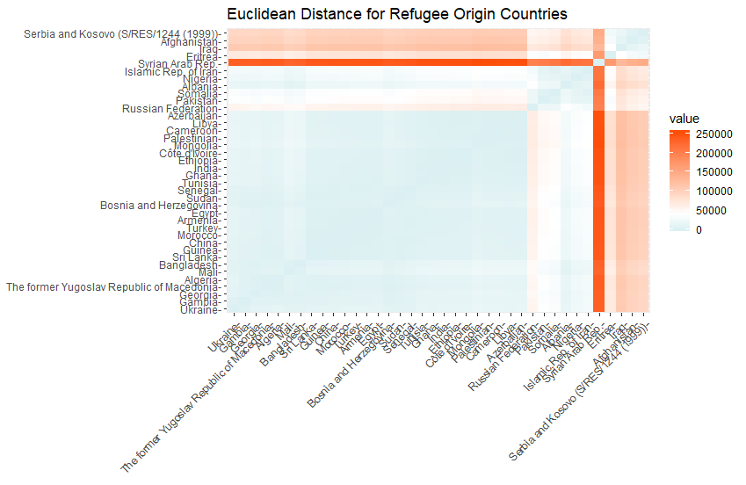
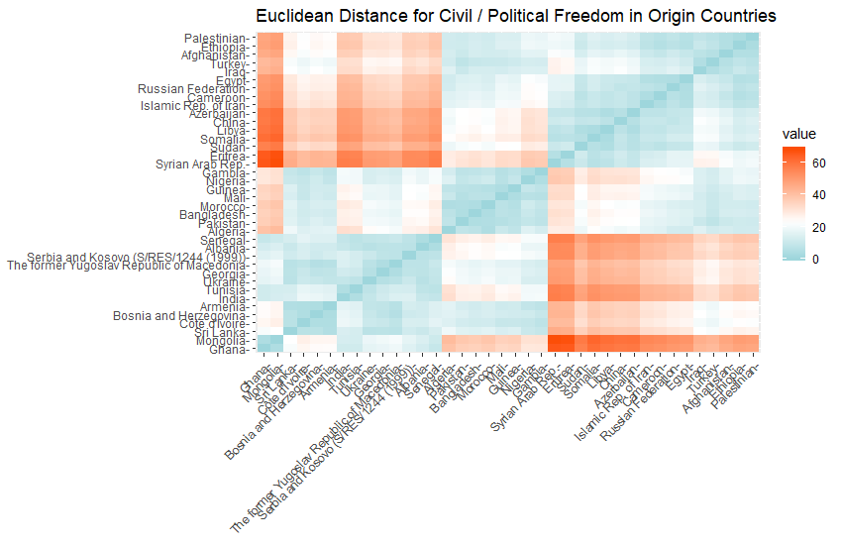
Euclidean Distance for Origin Countries (Submitted in Europe)
All Variables
Freedom Index Only

Slide 29
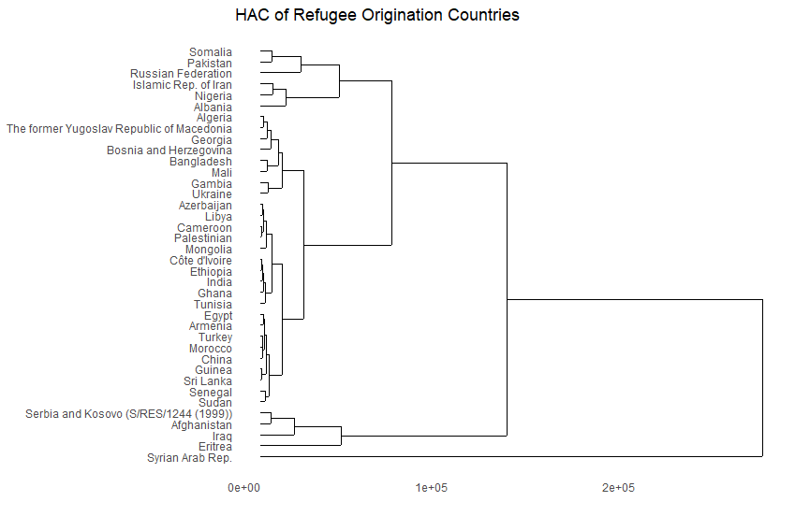
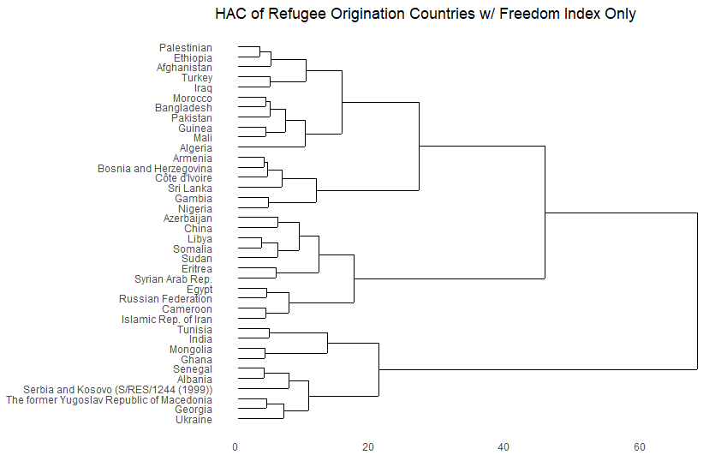
HAC for Origin Countries (Submitted in Europe)
All Variables
Freedom Index Only

Slide 30

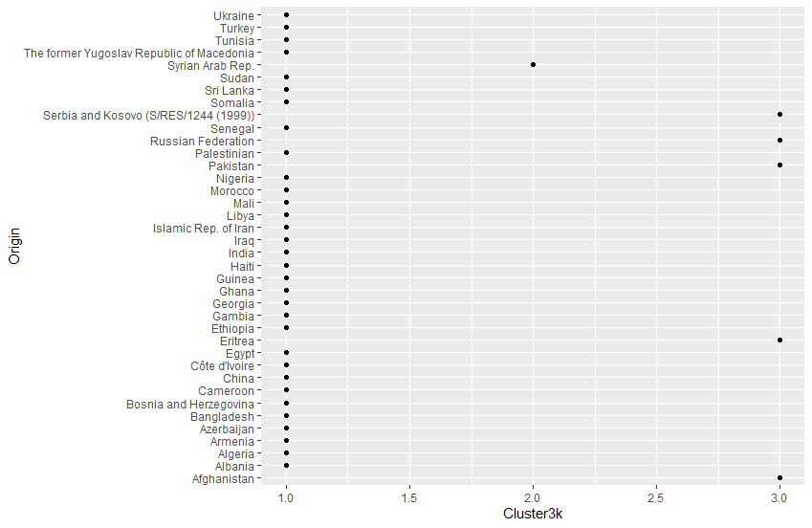
K-means, 2 or 3 Clusters for Origin Countries (Submitted in EU)
2 Centroids
3 Centroids

Slide 31
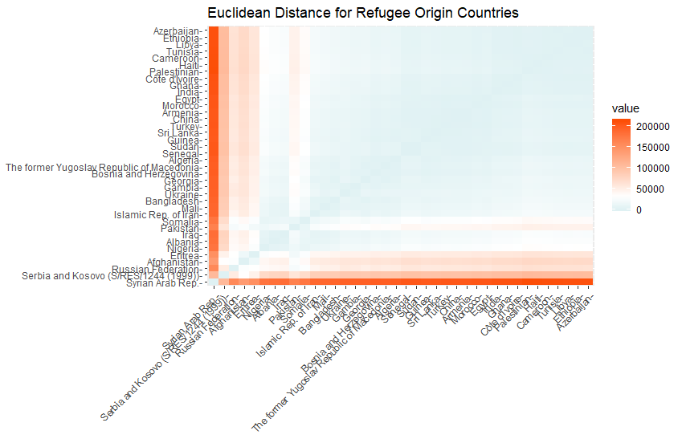
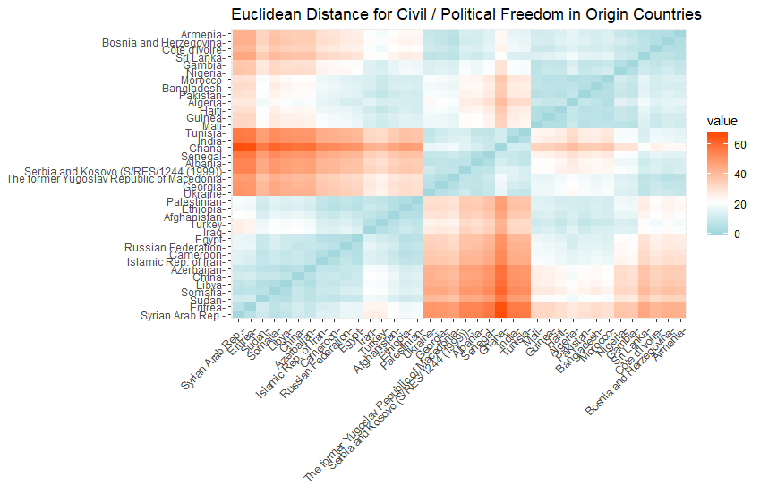
Euclidean Distance for Origin Countries (Submitted in EU)
All Variables
Freedom Index Only

Slide 32


HAC for Origin Countries (Submitted in EU)
All Variables
Freedom Index Only

Slide 33


DT: Destination Europe + Others
Accuracy = 39/42 = 95%
Accuracy = 5/7 = 71%
DT: Destination Eastern Europe

Slide 34


DT: Origin, Submitted in Industrialized
Accuracy = 28/36 = 77%
Accuracy = 32/38 = 84%
DT: Origin, submitted in Europe

Slide 35

DT: Origin, Submitted in EU
Accuracy = 30/38 = 79%

Slide 36
Random Forest for Submitted Applicants
OOB estimate of error rate: 20%
MeanDecreaseGini
X2010 1.0915894
X2011 1.2608147
X2012 0.8049224
X2013 0.3155774
X2014 0.4065228
Total 0.3499946
X1000inhabitantsTotal2014 0.7522369
X1000inhabitantsTotal10.14 0.4099153
X1000inhabitantsRank2014 0.7664522
X1000inhabitantsRank10.14 0.4380965
X1GDPperCapitaTotal2014 0.6991164
X1GDPperCapitaTotal10.14 0.3636240
X1GDPperCapitaRank2014 0.7515188
X1GDPperCapitaRank10.14 0.3339185

Slide 37
RF for Origin of Applicants
OOB estimate of error rate: 9.09%
MeanDecreaseGini
X2013 1.712059
X2014 1.173942
Total 1.740612
Political.Rights 5.704979
Civil.Liberties 6.886104

Slide 38
Conclusions
As with any data project, this research is best coupled with tacit knowledge of the data and would require a heavy qualitative lift in order to best make use of the findings.
Proximity and Violence are driving factors for refugee application
Region data of Countries
More variation of Country data

