Slide 1

SANGGUNIANG KABATAAN OF
BARANGAY BUGAY
KATIPUNAN NG KABATAAN
ASSEMBLY
May 17, 2026, 3PM at Brgy. Bugay, Gymnasium

Slide 2
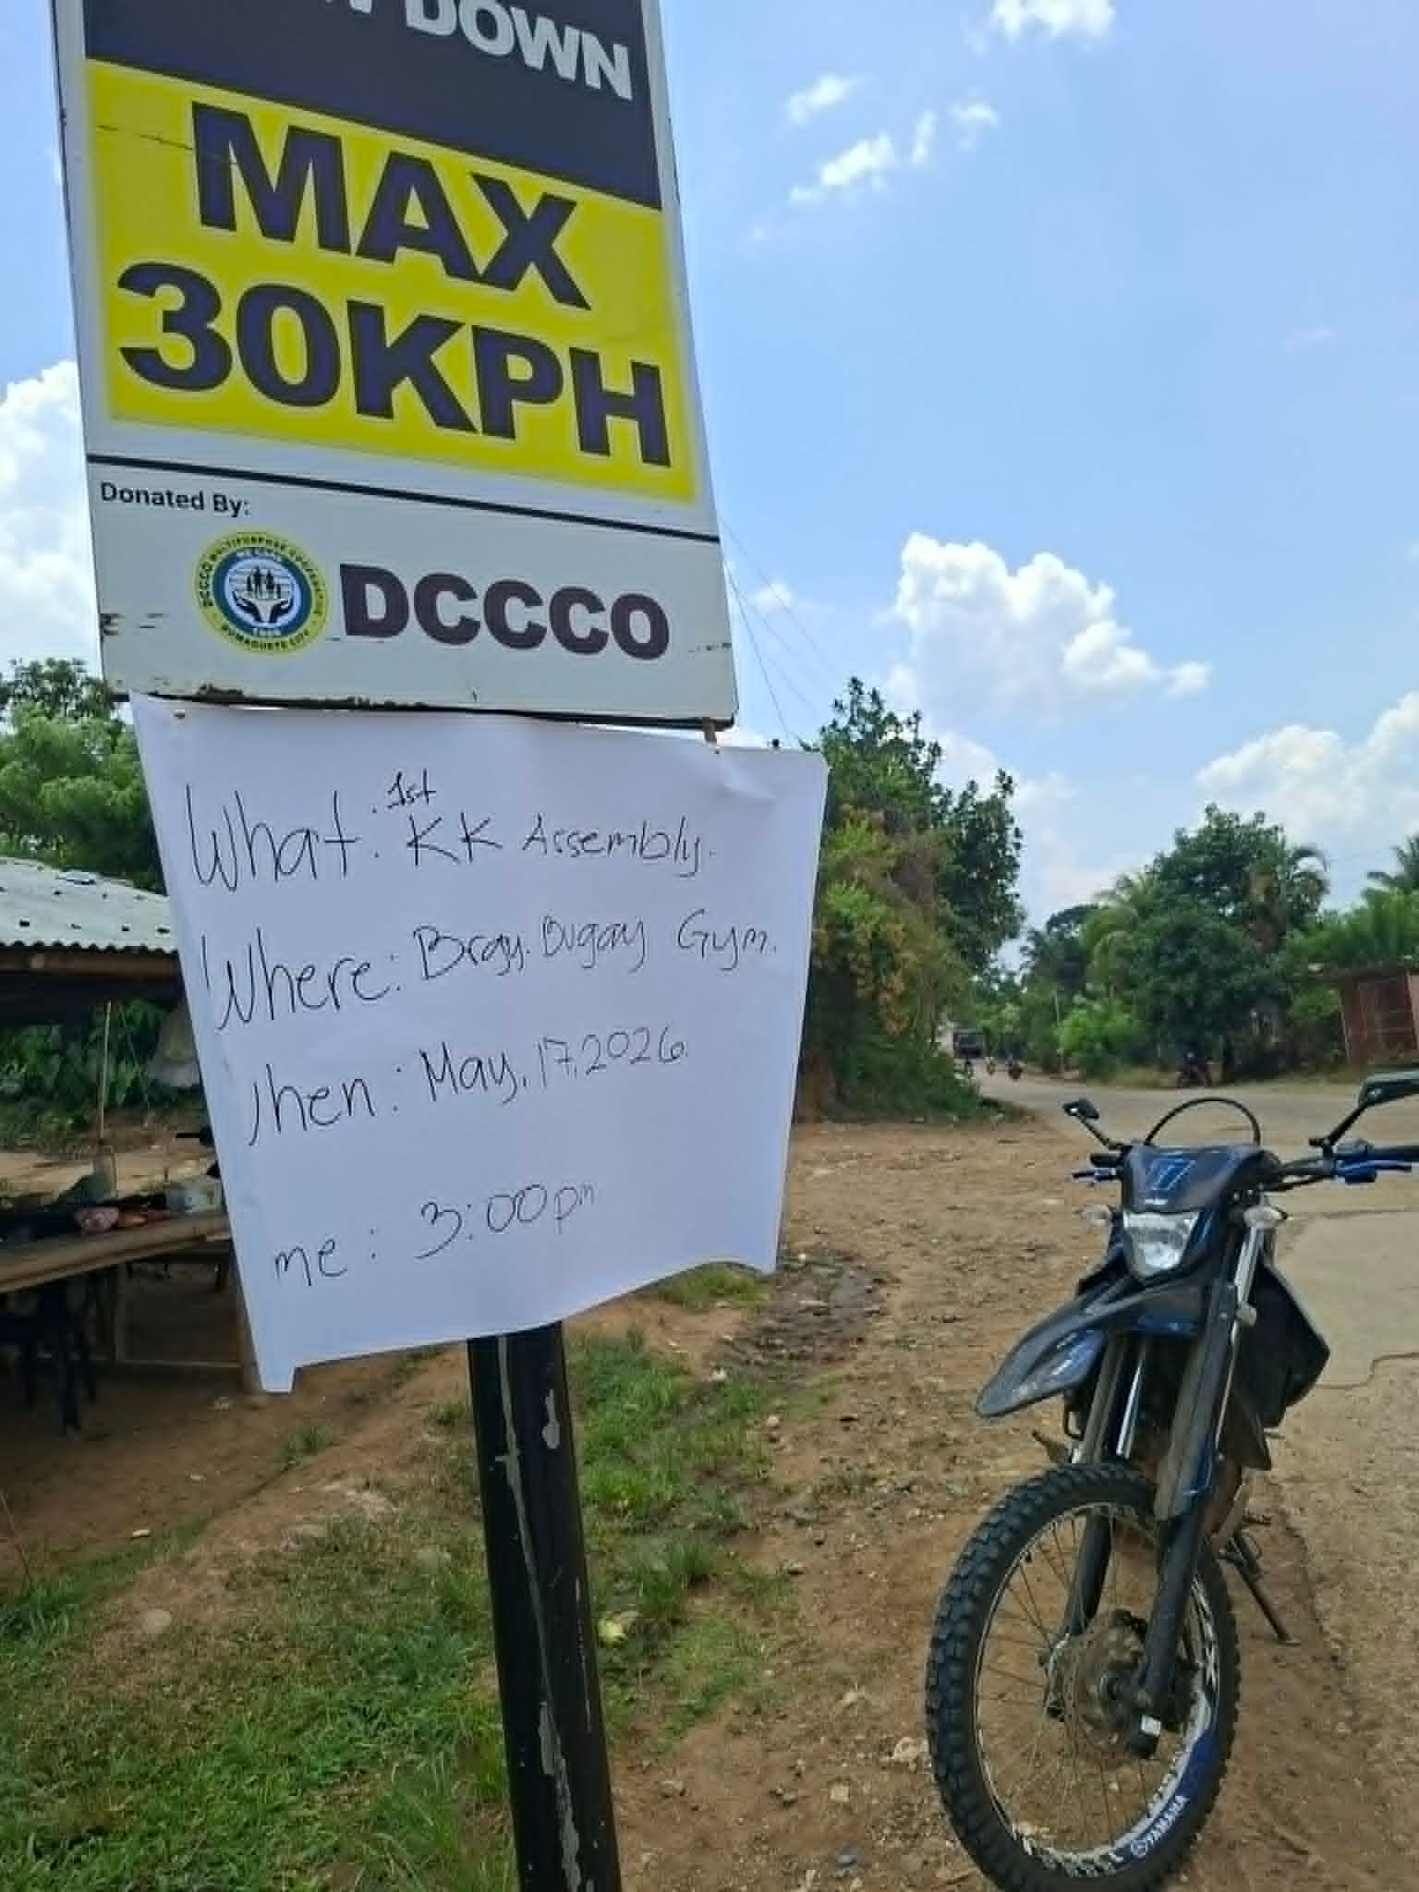
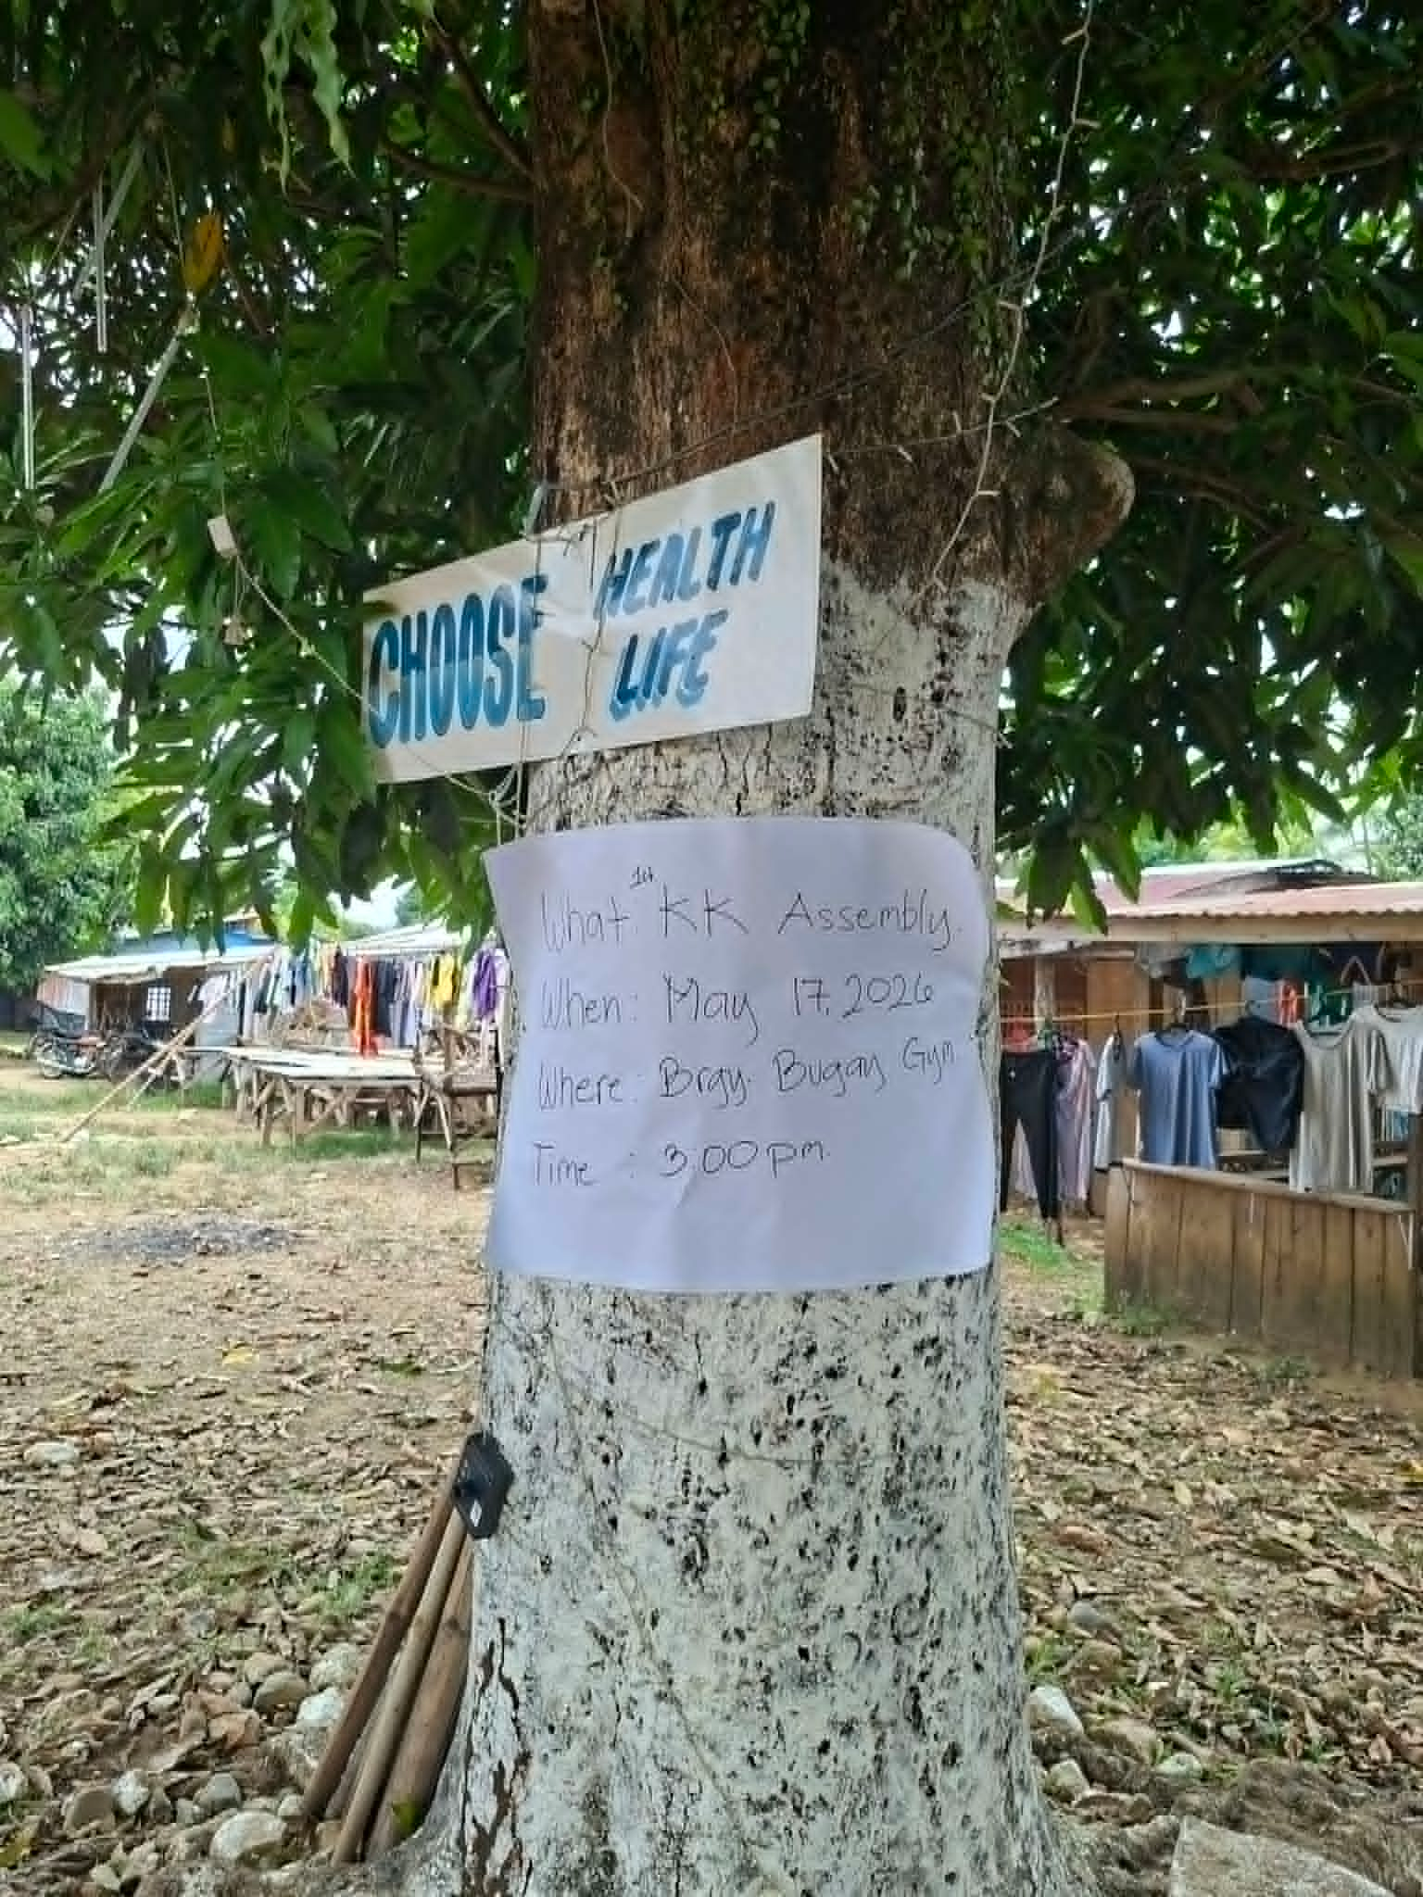
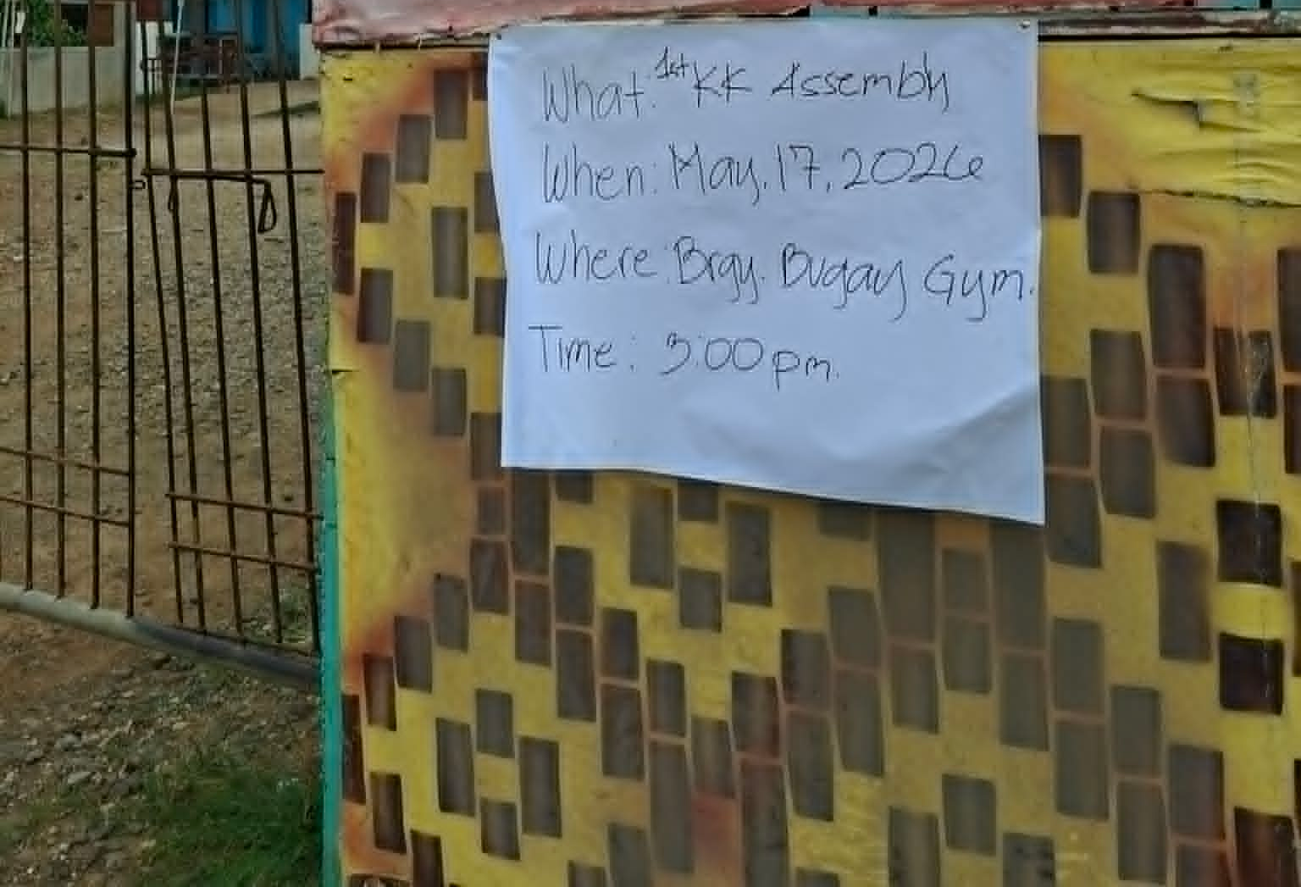
ANOUNCEMENT

Slide 3
PRESENTATION OF AGENDA:
READING OF MINUTES OF THE PREVIOUS MEETING
2026 ACCOMPLISHMENT REPORT
ANNUAL BUDGET / FINANCIAL REPORT
OTHER MATTERS / OPEN FORUM
ADJOURNMENT

Slide 4
READING OF THE MINUTES OF THE PREVIOUS KK ASSEMBLY

Slide 5
2026 ACCOMPLISHMENT REPORT

Slide 6
Programs/Projects and activities implemented

Slide 7
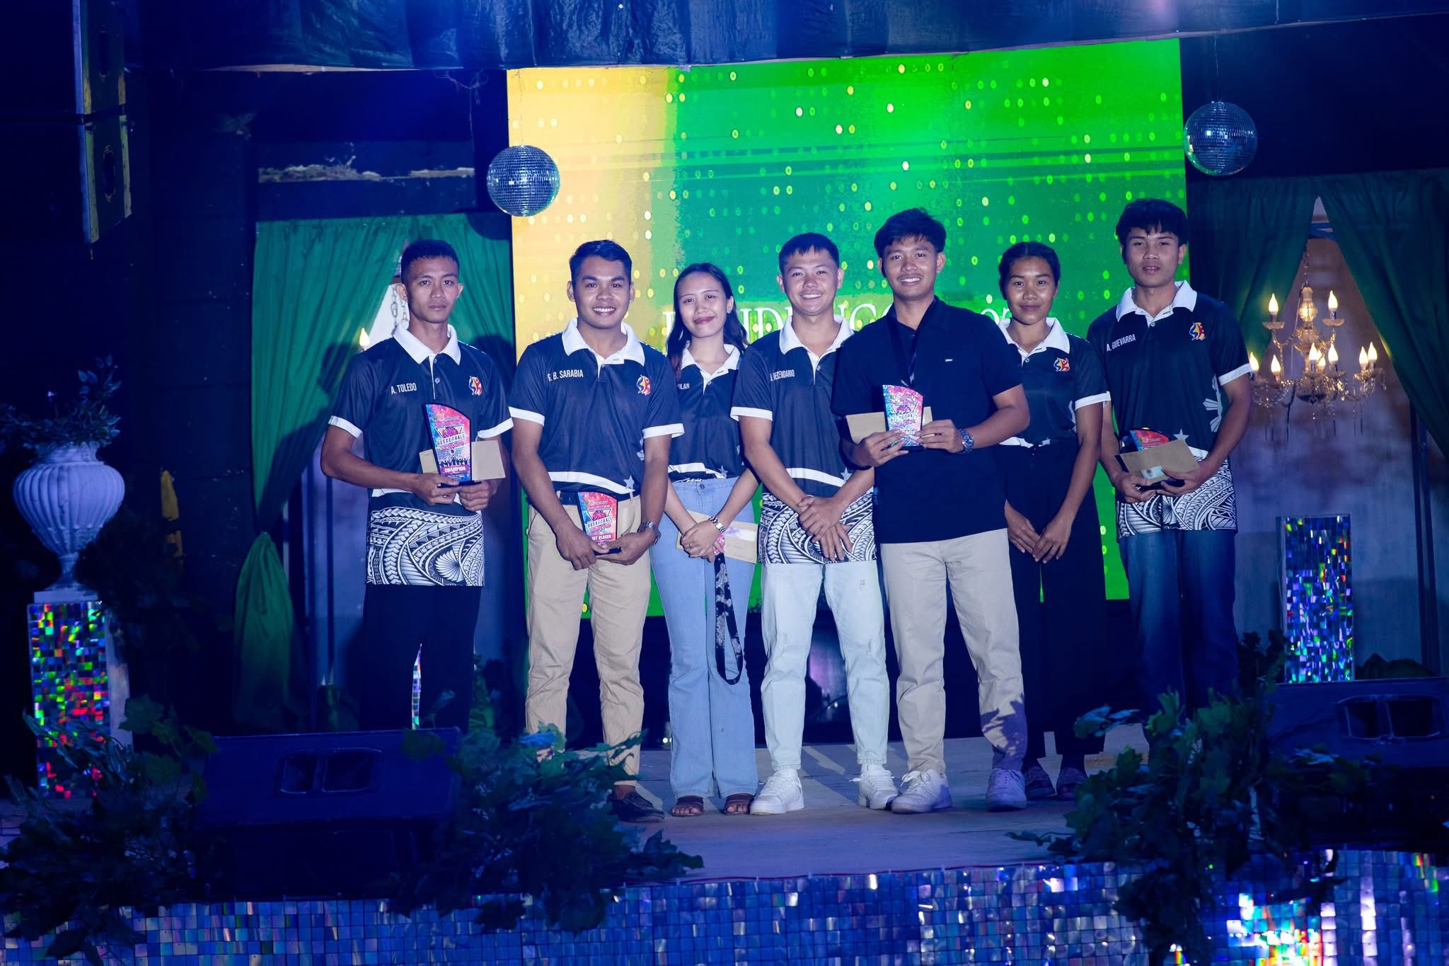
Sports Development Program
BASKETBALL TOURNAMENT
February 1 to March 11, 2026

Slide 8
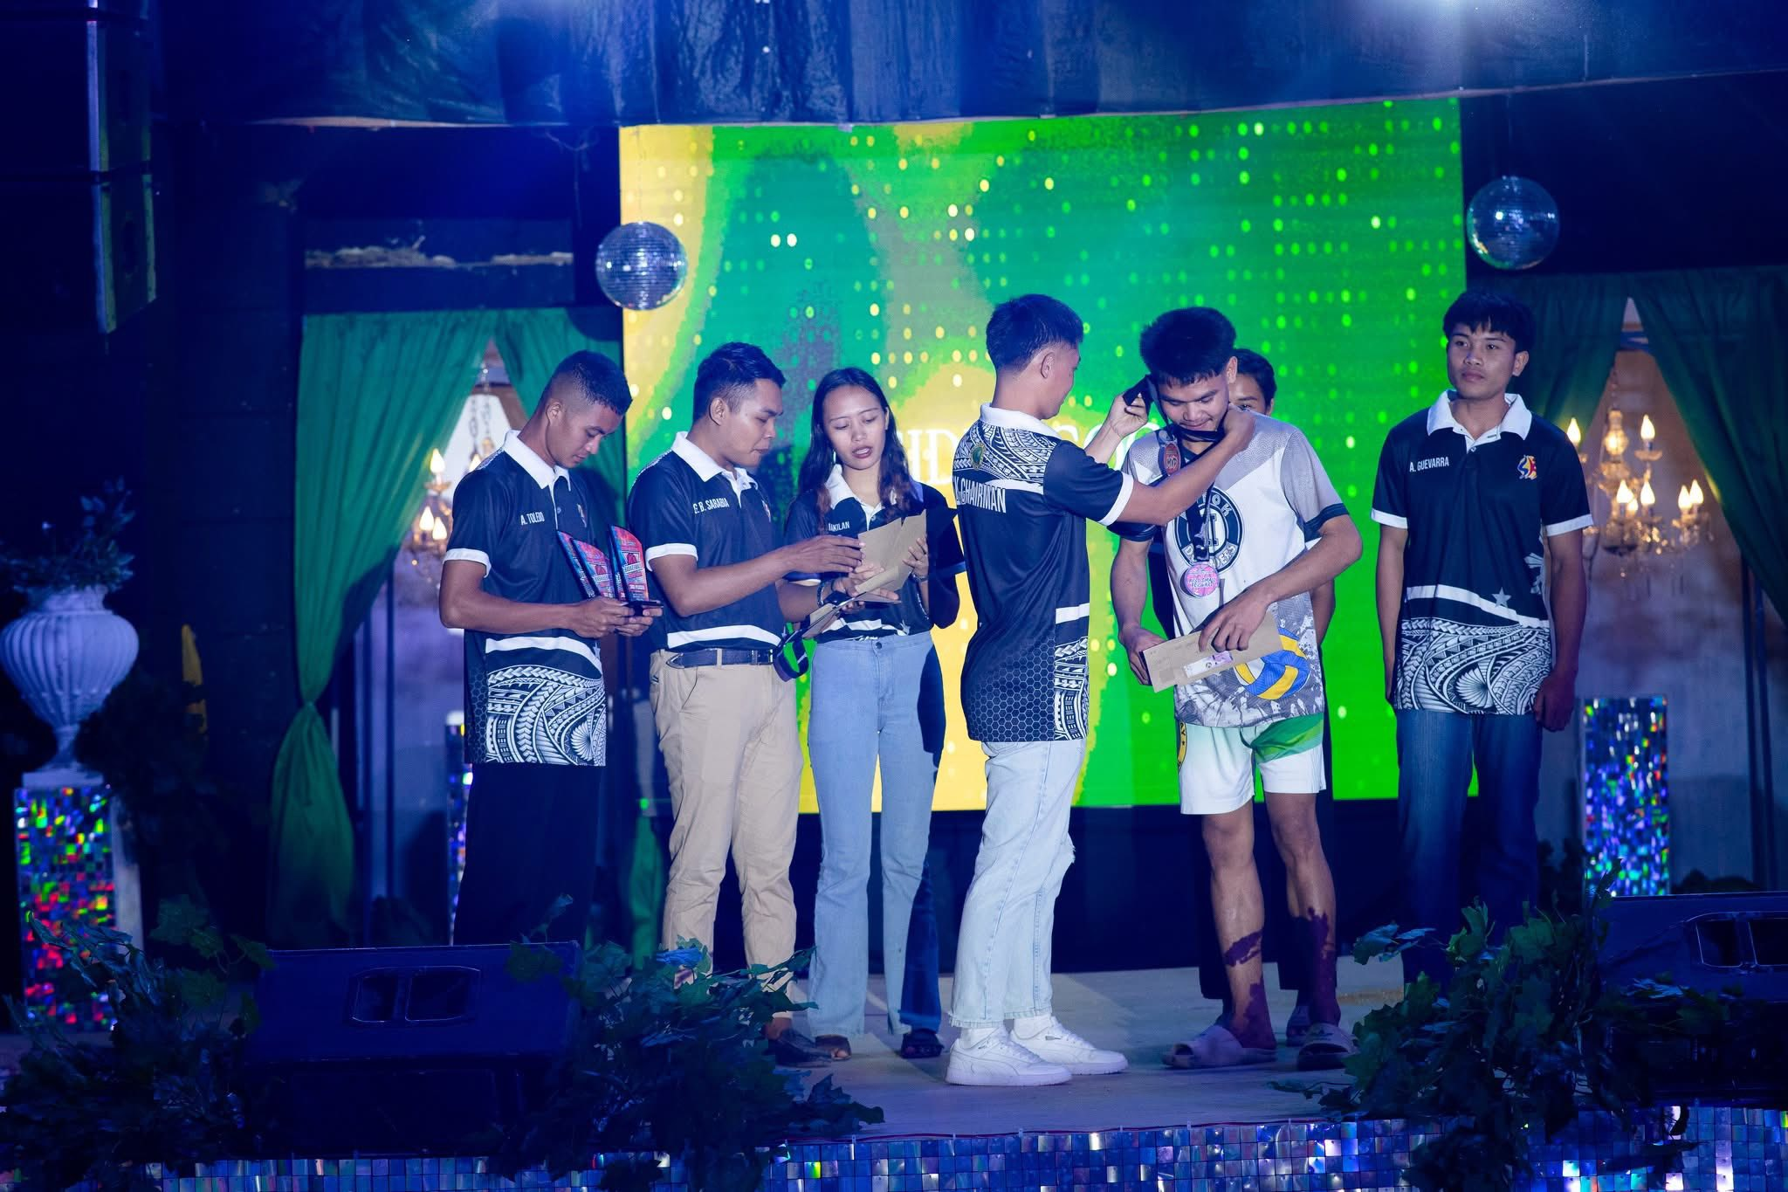

Slide 9
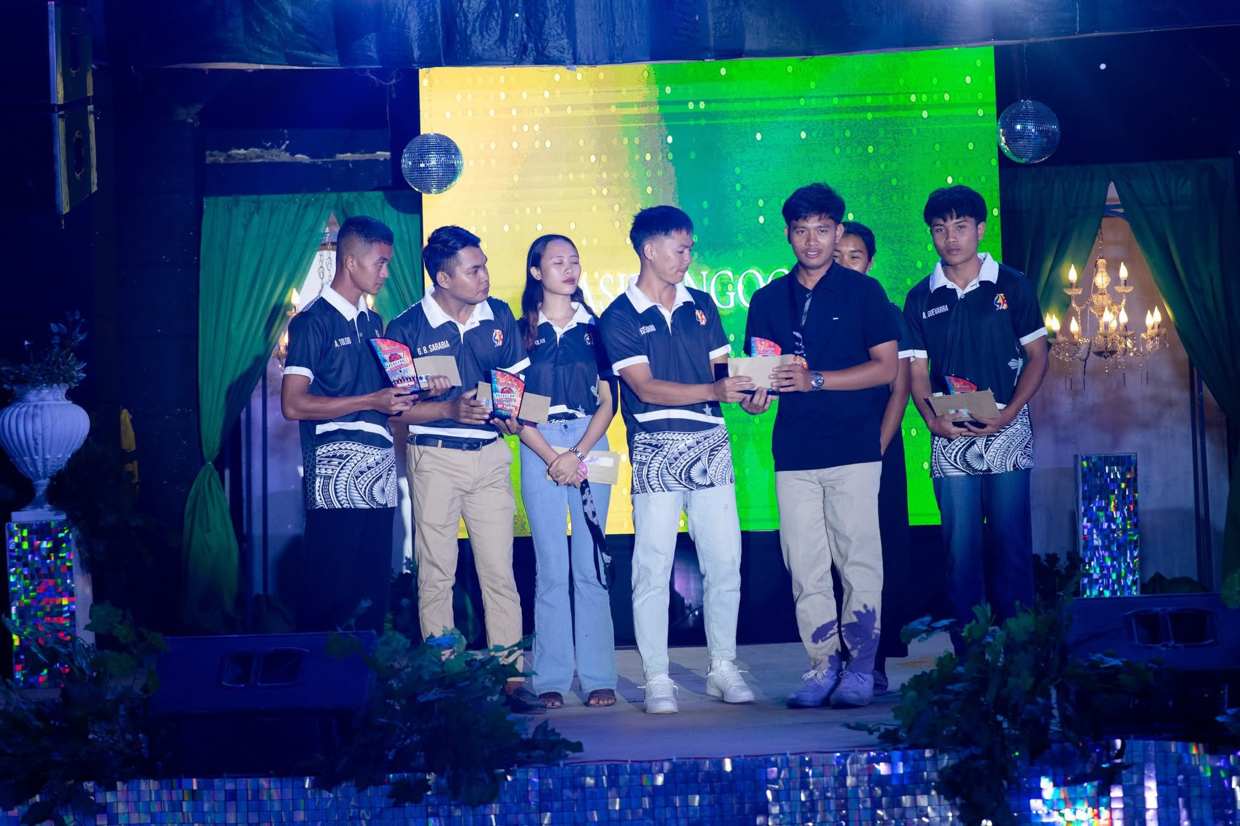

Slide 10
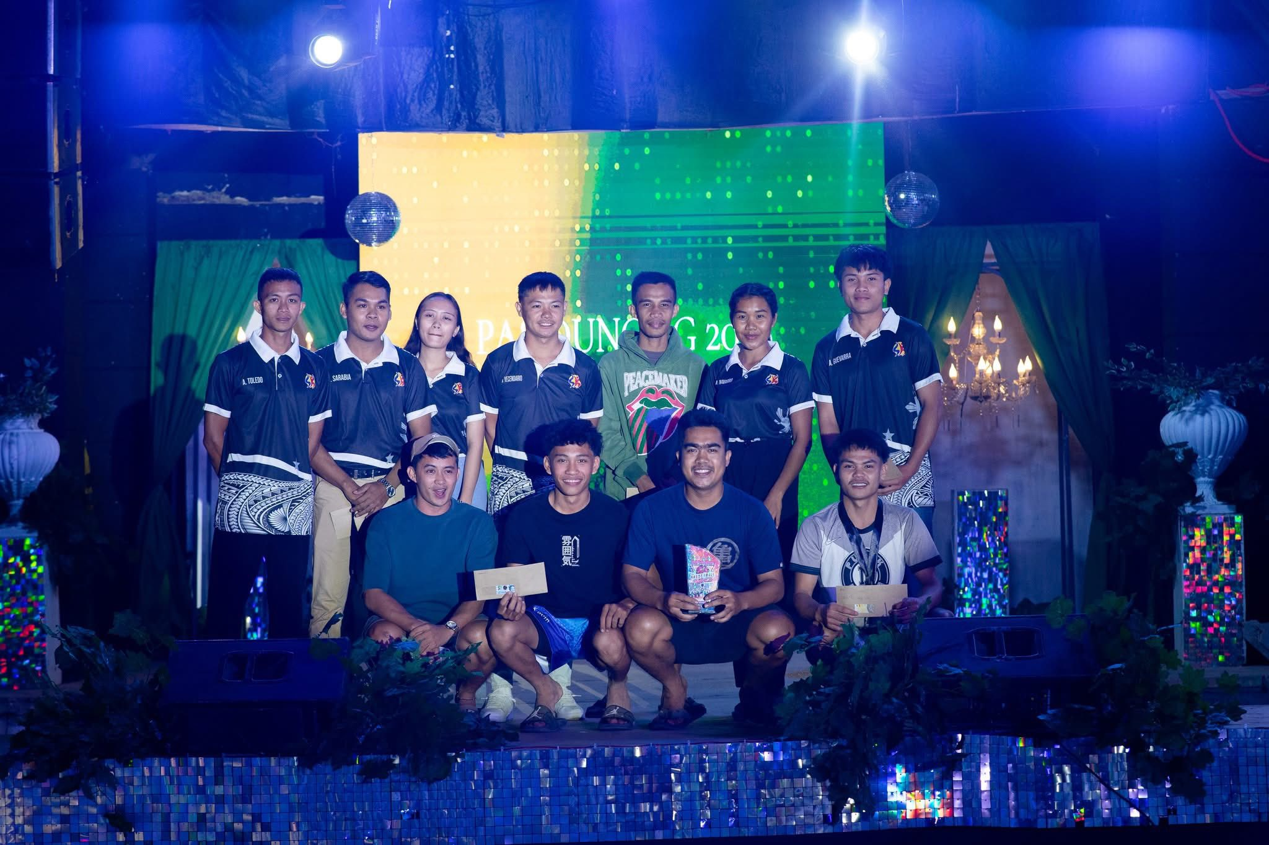

Slide 11
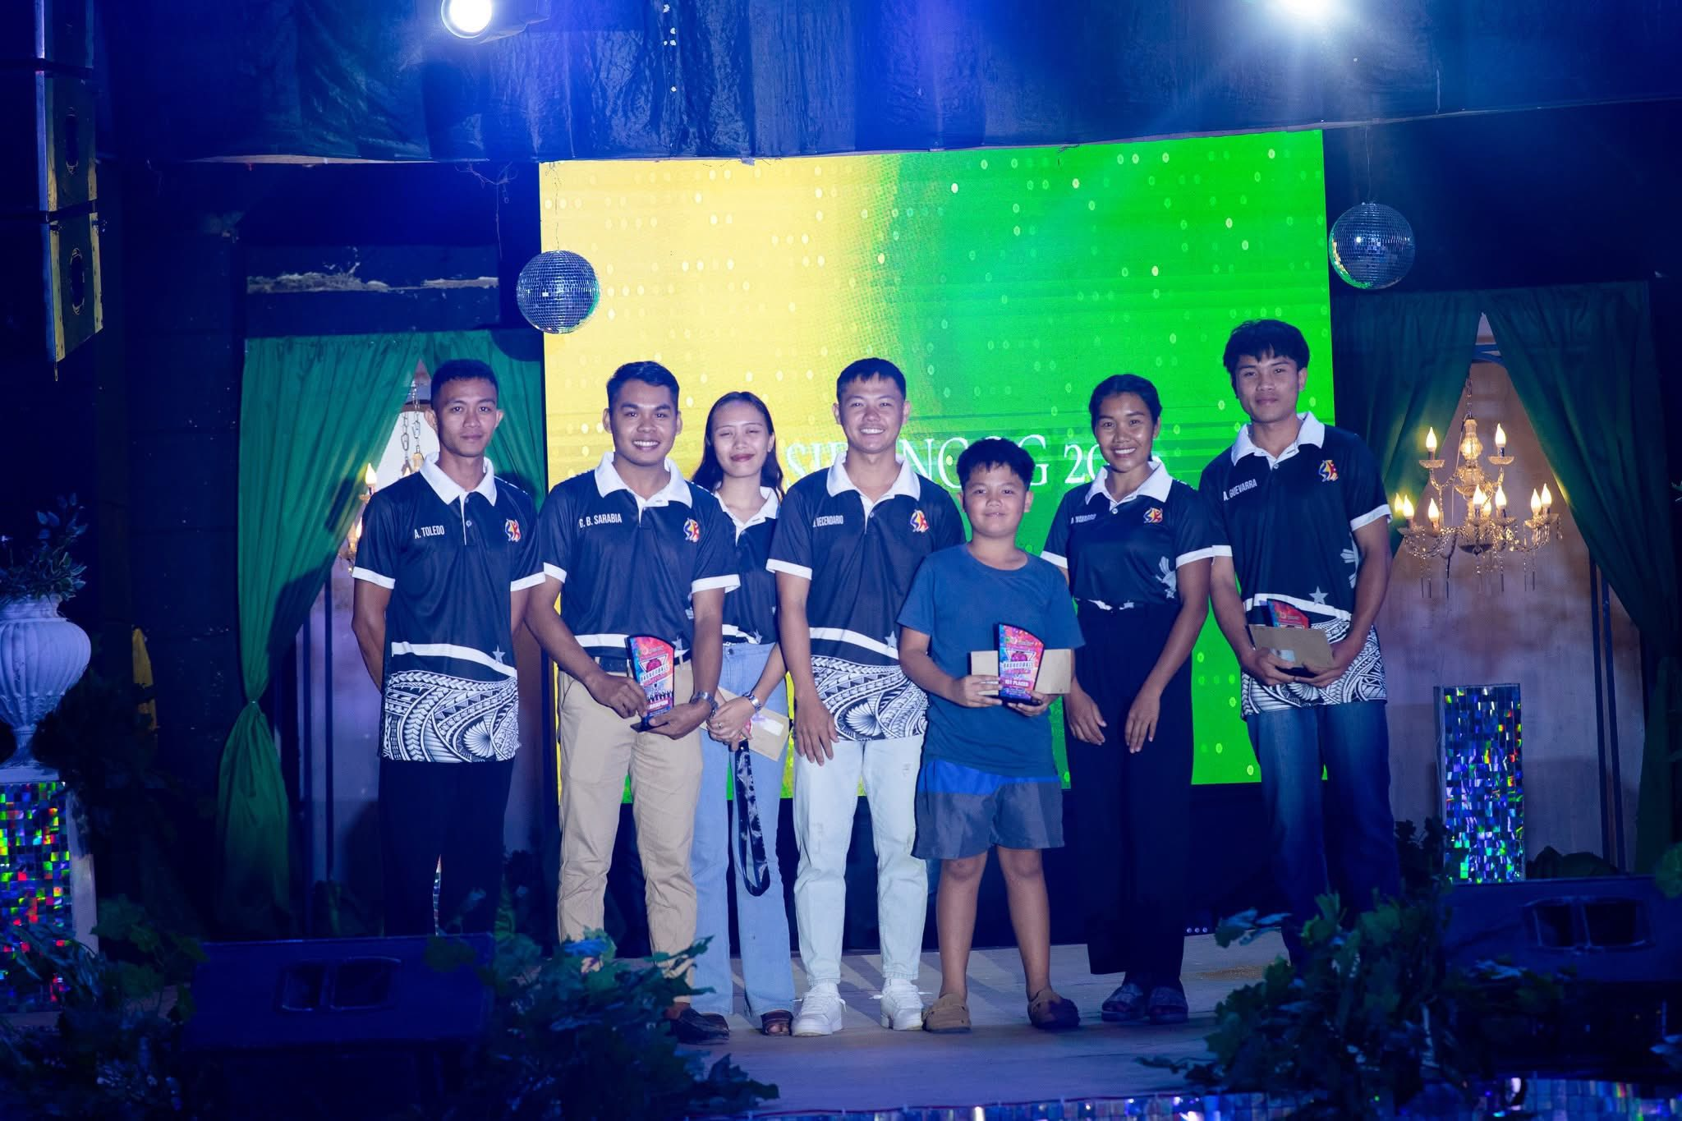

Slide 12
ANNUAL BUDGET

Slide 13
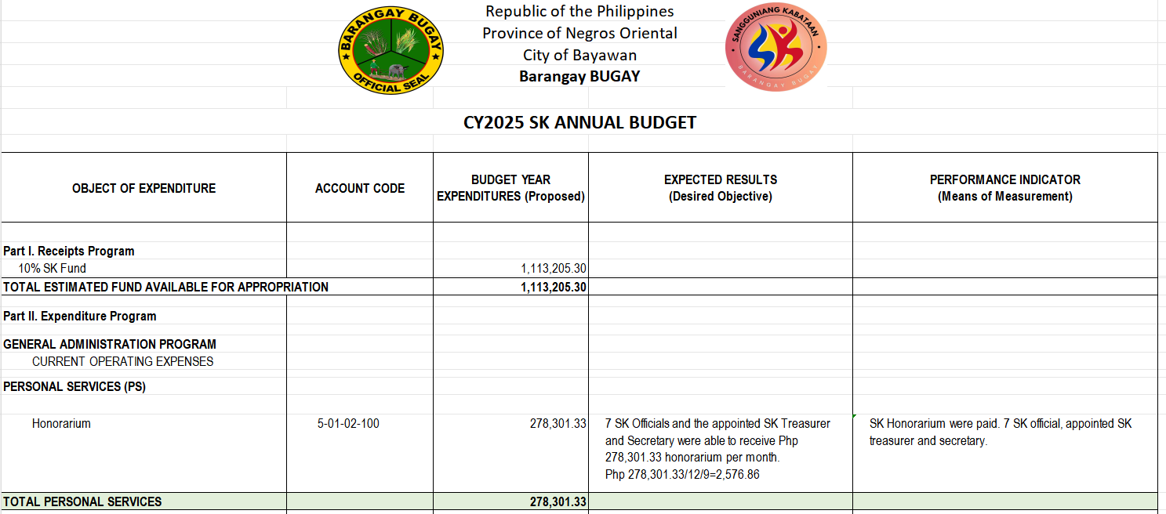

Slide 14
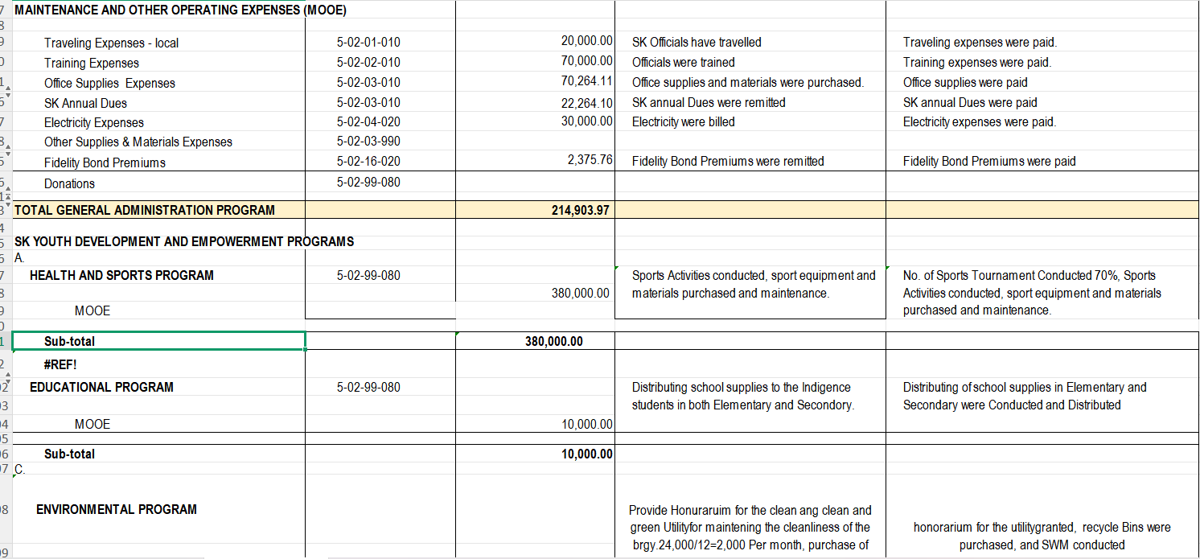

Slide 15
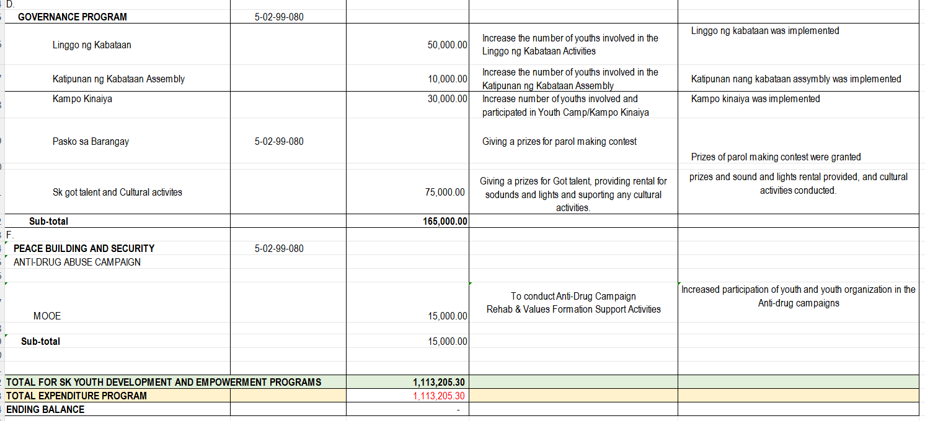

Slide 16
OTHER MATTERS / OPEN FORUM

Slide 17
ADJOURNMENT

Slide 18

THANK YOU!

