Slide 1
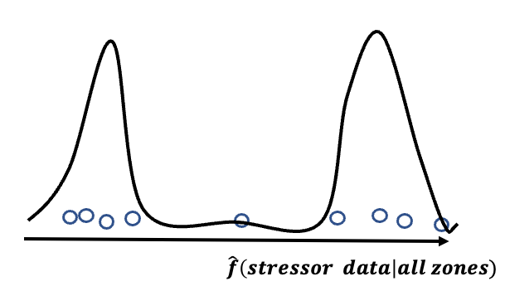
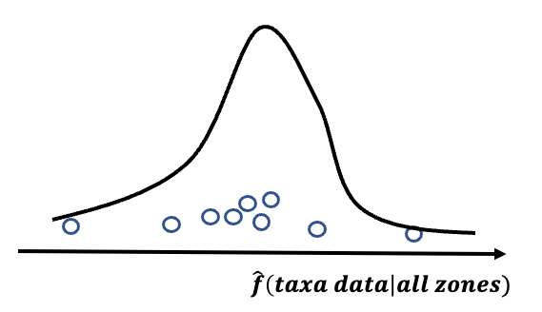
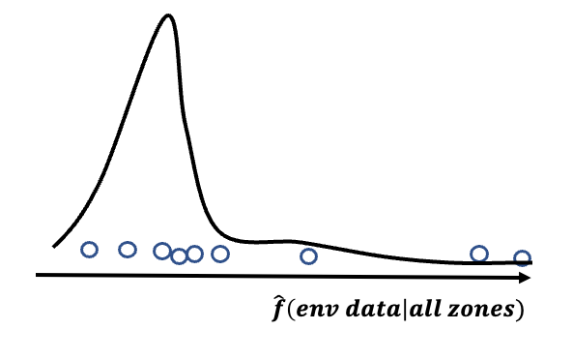

Collected data/
collected region
Detroit River
St. Clair Reiver
Lake St. Clair
Taxa data(311)
Environmental data(289)
Stressor data(104)
Infer the integrities of other stations
Stress level | environmental condition = $k$
condition on entire zone(three),
not only in Detroit River
Taxonomic composition

Slide 2
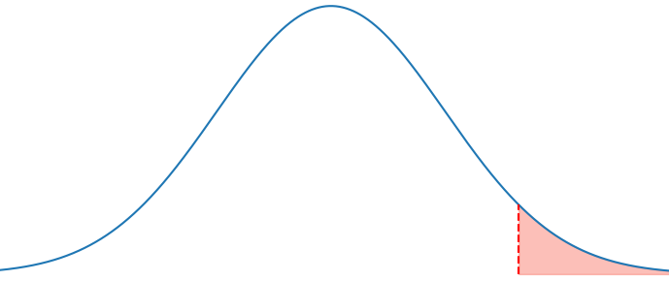
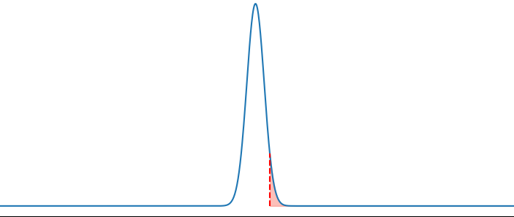
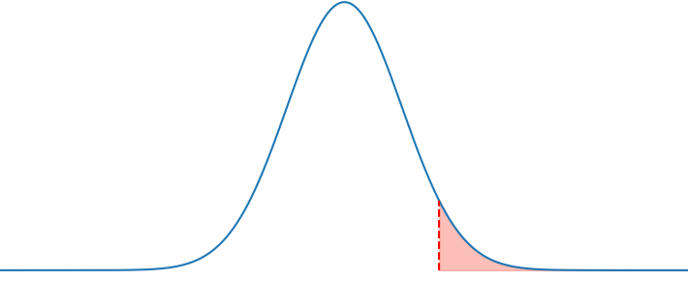





Taxonomic factor 2| reference sites
$$k=2$$
Probability density
$$k=1$$
$$k=3$$
Taxonomic factor 1| reference sites
Sediment contamination level
Probability density
Stress level | taxa group $K=k$
Probability of degraded
Sediment contamination level
Taxonomic distance | taxa group $K=k$
Taxonomic structure measurement

Slide 3
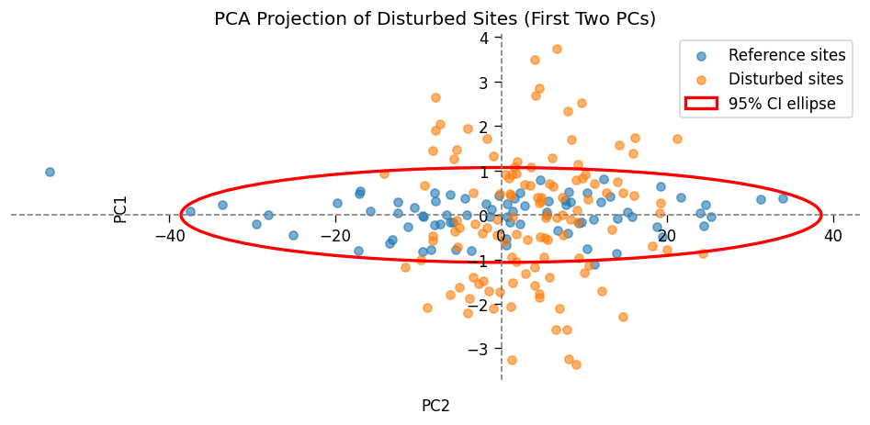






Probability density | $d=d_{3}$
Sediment contamination level
$$d=d_{3}$$
$$d=d_{2}$$
Probability density | $d=d_{1}$
$$d=d_{1}$$
Probability density | $d=d_{2}$
Sediment contamination level
Sediment contamination level

Slide 4


Taxonomic composition
Taxonomic composition
With control of other minor variables
Stress level | environmental condition = $k$
Taxonomic composition
Stress level |environmental condition = K
Environmental condition| stress level = $p$

Slide 5
Aquatic ecosystem
Human activities
Ecological reactions
Agricultural runoff
Bioaccumulation & toxicity
Industrial discharges
(cause sediment pollutants)
Zoobenthic community changes (responses of sediment organisms)
Urban storm water
Habitat degradation
More sources of pollutants
More ecological reactions

Slide 6
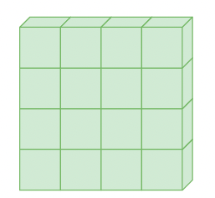













$$m (observations)$$
$$3 raw metrices$$
$$m (observations)$$
$$k_{1}$$
$$k_{2}$$
$$⋯$$
$$k_{n}$$
$$New results$$
$p$ (specific cols)
$p×K$ (specific cols)
$k$(types of information)
Flatten the tensor into a matrix
$$m × p × K$$
$$m × (p × K)$$

Slide 7
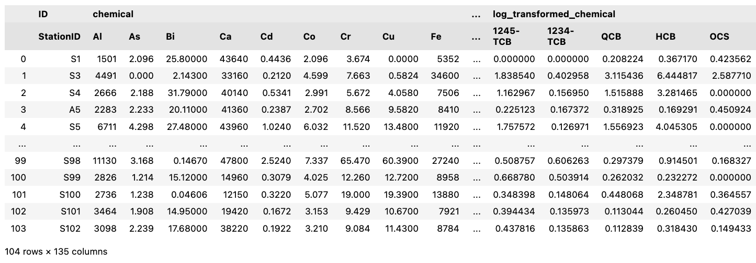







$$m (observations)$$
$$k_{1}$$
$$k_{2}$$
$$⋯$$
$$k_{n}$$
$$p_{j|{k=k}_{2}}$$
More columns
$p×K$ (specific cols)

Slide 8
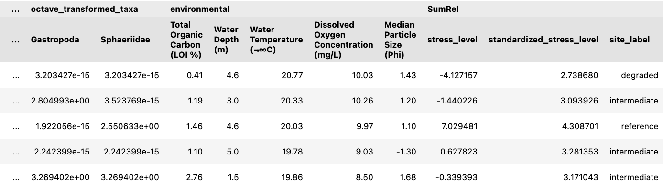

$$k_{n+1}$$

Slide 9







Fit
Apply
Other sites
Taxonomic factor 2| reference sites
Taxonomic factor 2| all sites
$$k=2$$
$$k=2$$
$$k=1$$
$$k=1$$
$$k=3$$
$$k=3$$
Taxonomic factor 1| reference sites
Taxonomic factor 1| all sites

Slide 10


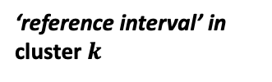


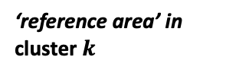

For$k=1, ⋯, K$
Taxonomic factor 2|cluster $k$
‘reference area’ in cluster $k$
‘reference interval’ in cluster $k$
$$⋯$$
Difference in taxa composition
Difference in taxa composition
Taxonomic factor | cluster $k$
Taxonomic factor 1| cluster $k$
One-dimentional measurement of taxa composition
Two-dimentional
higher-dimentional

Slide 11




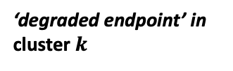
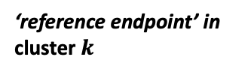

Probability density
$×:$ a fixed degraded threshold,
which will connect to quntile regression later
$$×$$
Stress level
‘degraded endpoint’ in cluster $k$
‘reference endpoint’ in cluster $k$
Distance - $d_{deg}$
Distance - $d_{ref}$
ZCI | cluster $k$
Details in one-dimentional measurement of taxa composition

Slide 12



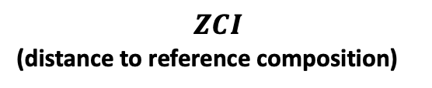

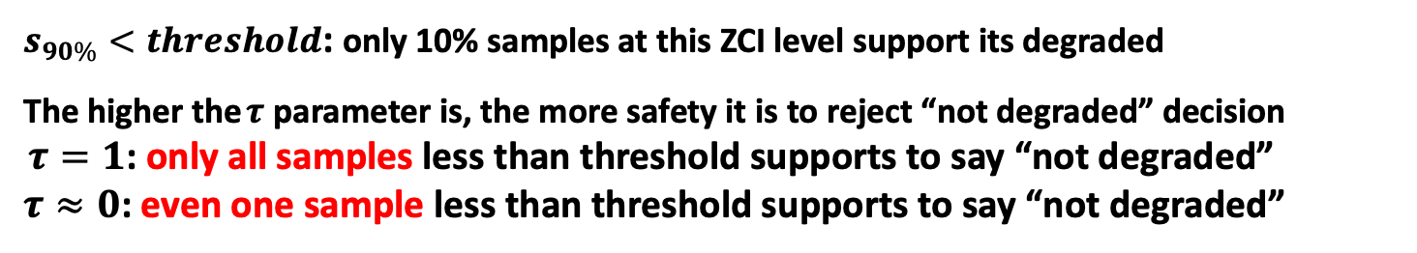


The true distribution would never be known, and may not be necessary to know
Probability density|$ZCI=x$
$τ$ th quantile of Stress level
$$s_{τ}$$
$$×$$
Stress level
$$ZCI=x$$
$$ZCI$$
(distance to reference composition)
$×:$ a fixed degraded threshold
$s_{90\%}<threshold$: only 10% samples at this ZCI level support its degraded
The higher the $τ$ parameter is, the more safety it is to reject “not degraded” decision
$τ=1$: only all samples less than threshold supports to say “not degraded”
$τ≈0$: even one sample less than threshold supports to say “not degraded”

Slide 13
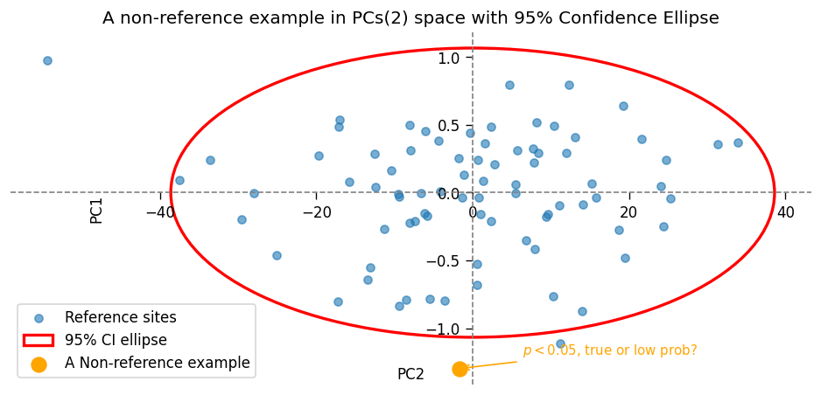
Taxa composition measured in two-dimensional space | Reference sites

Slide 14
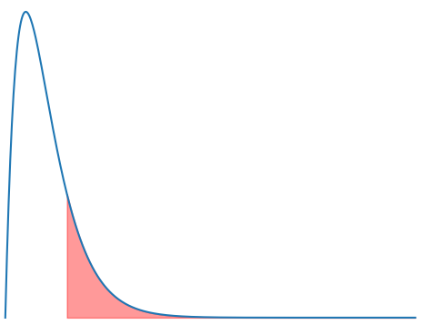
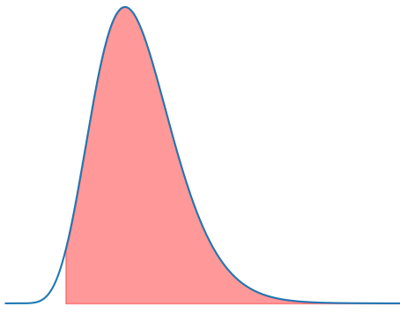









Taxa composition measured in two-dimensional space | All sites
Probability density | $d=d_{3}$
$$p<0.05:$$
$$Yes, it is not degraded$$
$$×$$
Sediment contamination level
$$d=d_{3}$$
$$d=d_{2}$$
Probability density | $d=d_{1}$
$$d=d_{1}$$
Probability density | $d=d_{2}$
$$p>0.05:$$
$$No, it is degraded$$
$$×$$
$$p≈0.05:$$
$$emm, it is interesting$$
$$×$$
Sediment contamination level
Sediment contamination level

Slide 15
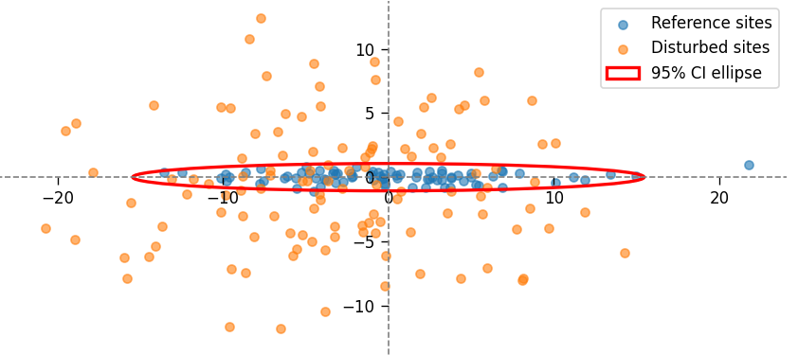
Taxa composition measured in two-dimensional space | All sites

Slide 16
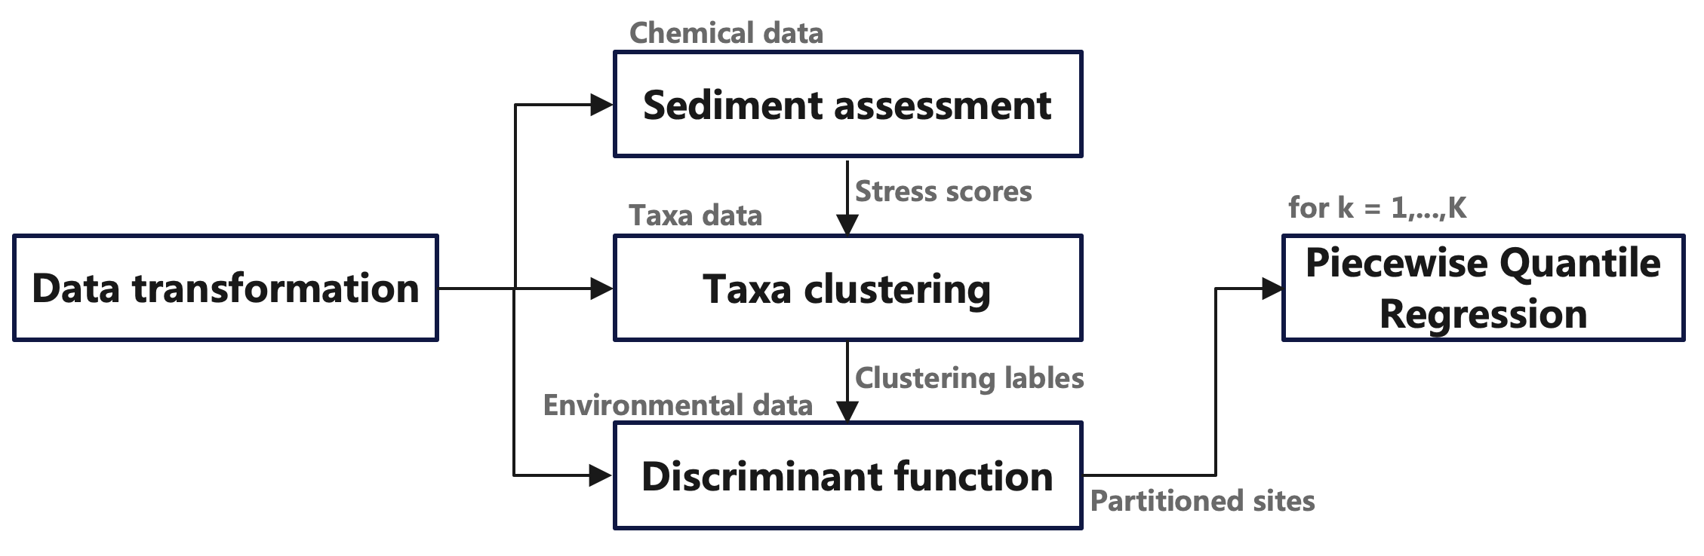








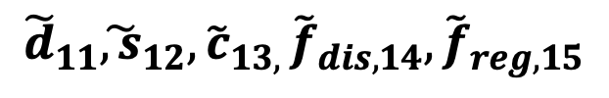



$$\tilde{S}$$
$$\tilde{D}$$
$$\tilde{C}$$
$${\tilde{F}}_{reg}$$
$${\tilde{F}}_{discr}$$
$${\tilde{d}}_{11}{\tilde{, s}}_{12},{\tilde{c}}_{13, }{\tilde{f}}_{dis,14},{\tilde{f}}_{reg,15}$$
1$× 5$
Grid search
$$\tilde{D},\tilde{S},\tilde{C},{\tilde{F}}_{discr},{\tilde{F}}_{reg}$$
$$⋯$$
$$Z × 5$$
$${\tilde{d}}_{Z1}{\tilde{, s}}_{Z2},{\tilde{c}}_{Z3, }{\tilde{f}}_{dis,Z4},{\tilde{f}}_{reg,Z5}$$
1$× 5$

