Slide 1

IILM UNIVERSITY, GREATER NOIDA
DATA SCIENCE MASTER VIRTUAL INTERNSHIP
Industry-oriented learning in Data Engineering, Machine Learning and AI Applications
Student
GUFRAN ALI
Enrollment / Student ID
Engineering/2024/20837
Program & Semester
B.Tech CSE • Semester V
Organization
Siemens
Delivery Platform
EduSkills Foundation
Internship Period
April – June 2026 • 8 Weeks
Supported by Siemens • AICTE / National Internship Portal ecosystem • EduSkills

Slide 2
Internship at a Glance
01 / Overview
• Eight-week virtual internship completed during April–June 2026.
• Focus: practical understanding of the data science lifecycle from data preparation to model evaluation.
• Learning environment: structured online content, assessments and visual data-science workflows.
• Primary industry support: Siemens; internship delivery platform: EduSkills Foundation.
• Completion certificate records Grade O (Outstanding), within the 90–100 range shown on the certificate.
IILM University • B.Tech CSE • Data Science Master Virtual Internship 2

Slide 3
Organization & Delivery Ecosystem
02 / Context
IILM University
EduSkills Foundation
Siemens
Academic setting B.Tech CSE Greater Noida
Virtual internship delivery Industry-oriented skilling Academia–industry bridge
Industry support Technology, digitalisation and data-driven transformation
The certificate supplied with the report records the participation of the Ministry of Education, AICTE, National Internship Portal, EduSkills and Siemens.
IILM University • B.Tech CSE • Data Science Master Virtual Internship 3

Slide 4
Problem Statement
03 / Problem
• The main challenge addressed by the internship was the gap between learning isolated data-science concepts and applying them as one connected workflow.
• A useful analytical result depends on data quality, preparation, feature selection, model choice and validation—not only on the algorithm.
• The internship therefore emphasised a repeatable process for moving from a dataset to an interpretable analytical or predictive result.
• This approach is especially relevant to a B.Tech CSE student because it connects programming, databases, statistics, machine learning and software workflow design.
IILM University • B.Tech CSE • Data Science Master Virtual Internship 4

Slide 5
Objectives & Scope
04 / Objectives
• Understand the end-to-end data science lifecycle.
• Practise data inspection, filtering, transformation, selection and aggregation.
• Build familiarity with classification, regression, feature engineering and model validation.
• Interpret model outputs and compare alternative analytical approaches.
• Document workflows clearly enough to reproduce or explain them.
• Keep the work within an academic / training scope; no proprietary Siemens production data is claimed.
IILM University • B.Tech CSE • Data Science Master Virtual Internship 5

Slide 6
Technologies & Learning Areas
05 / Technical
Python
RapidMiner / Altair AI Studio
Programming and data-science concepts
Visual workflow design and applied analytics
Data Preparation
Machine Learning
Filtering, transformation, selection, aggregation
Classification, regression, feature engineering
Validation & Evaluation
Visualisation
Cross-validation, performance views, model comparison
Patterns, trends and interpretation
IILM University • B.Tech CSE • Data Science Master Virtual Internship 6

Slide 7
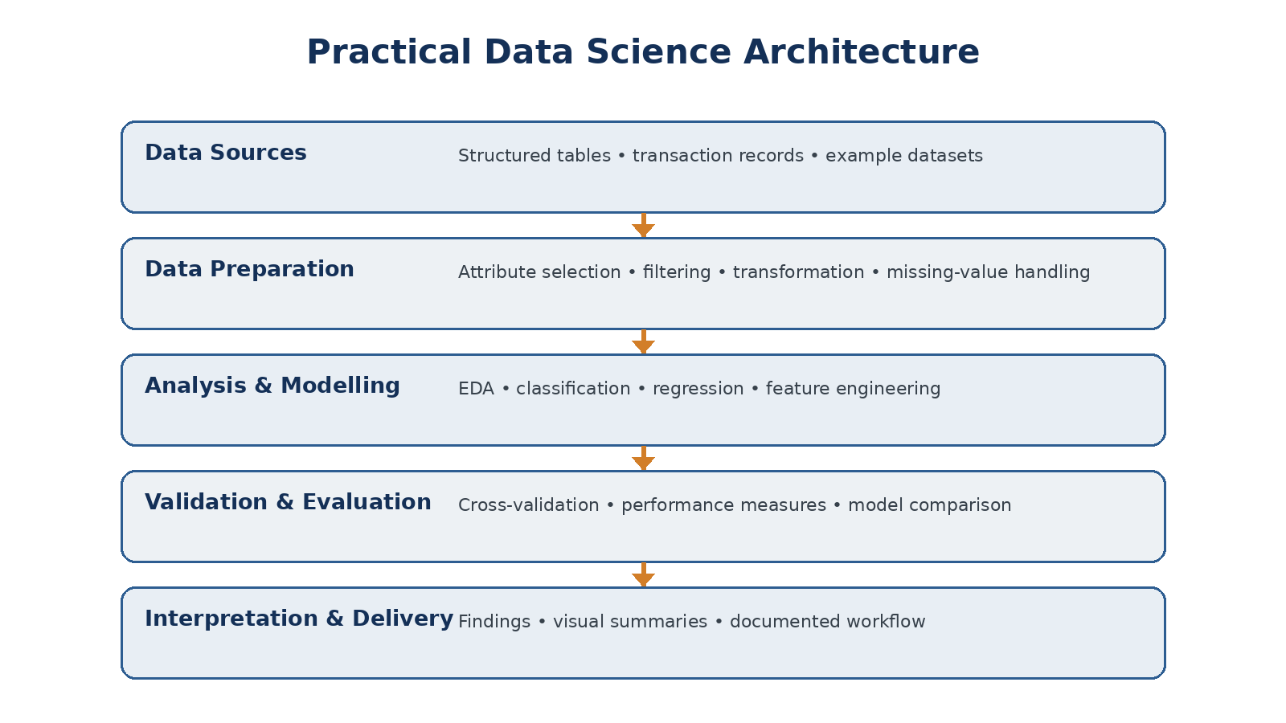
System Architecture
06 / Workflow
IILM University • B.Tech CSE • Data Science Master Virtual Internship 7

Slide 8
Methodology
07 / Method
1
2
3
4
5
6
Understand
Inspect
Prepare
Model
Validate
Interpret
Define the question and
expected output
Review attributes, types
and data quality
Filter, transform, select
and reshape
Apply an appropriate
analytical method
Measure and compare
model behaviour
Explain findings and
limitations
IILM University • B.Tech CSE • Data Science Master Virtual Internship 8

Slide 9
Practical Learning Highlights
08 / Practice
• Visual data-processing exercises: attribute selection, filtering, transformation and aggregation.
• Model-building activities covering classification and regression workflows.
• Validation and comparison activities using performance measures and model-result views.
• Exposure to feature handling and the effect of preparation choices on downstream analysis.
• Process-organisation exercises that emphasised readable, modular analytical workflows.
• These activities were treated as training exercises rather than as claims about confidential industrial systems.
IILM University • B.Tech CSE • Data Science Master Virtual Internship 9

Slide 10
Outcomes & Skills Developed
09 / Outcomes
Data handling
More confident with the preparation stage before modelling.
ML workflow
Clearer understanding of training, validation and evaluation.
Analytical reasoning
Better habit of checking whether outputs answer the original question.
Workflow thinking
Understands data science as a sequence of connected operations.
Technical communication
Able to document a workflow and explain its purpose.
IILM University • B.Tech CSE • Data Science Master Virtual Internship 10

Slide 11
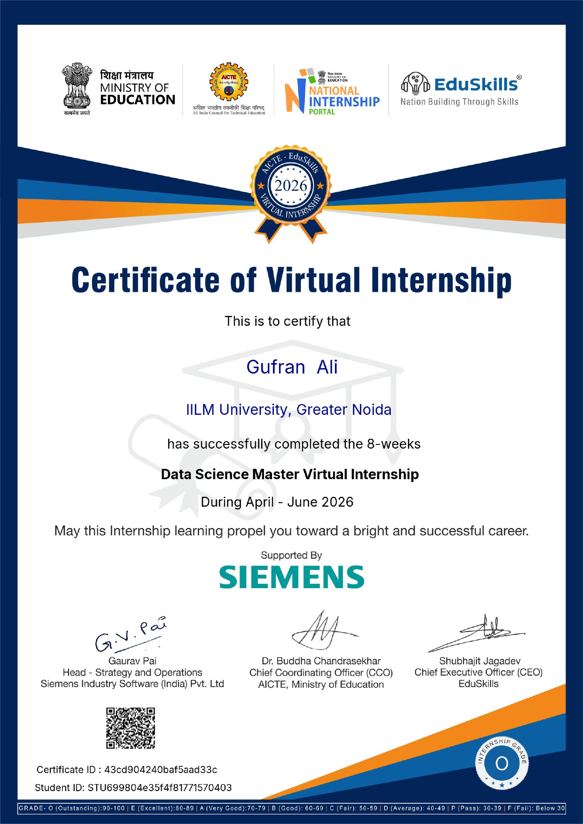
Completion Certificate
10 / Evidence
Completion evidence • 8-week Data Science Master Virtual Internship • April–June 2026 • Grade O (Outstanding)
IILM University • B.Tech CSE • Data Science Master Virtual Internship 11

Slide 12
Conclusion
11 / Closing
The internship converted data-science concepts into a connected practical workflow.
• It strengthened the link between data preparation, modelling and evaluation.
• It provided exposure to industry-aligned visual analytics and machine-learning workflows.
• The experience complements the B.Tech CSE curriculum and provides a foundation for deeper work in
machine learning and data-driven software systems.
Thank you
IILM University • B.Tech CSE • Data Science Master Virtual Internship 12

Slide 13
Selected References
12 / References
• IILM University — Internship Report Format updated 26–27.
• Internship completion certificate — Data Science Master Virtual Internship, April–June 2026.
• EduSkills Foundation — About / Virtual Internship ecosystem.
• Siemens — India business profile and Digital Industries.
• Altair RapidMiner Academy / AI Studio documentation.
Detailed bibliography is included in the accompanying report.
IILM University • B.Tech CSE • Data Science Master Virtual Internship 13

