Slide 2
Use constant sigma(v) = sigma0

Slide 3
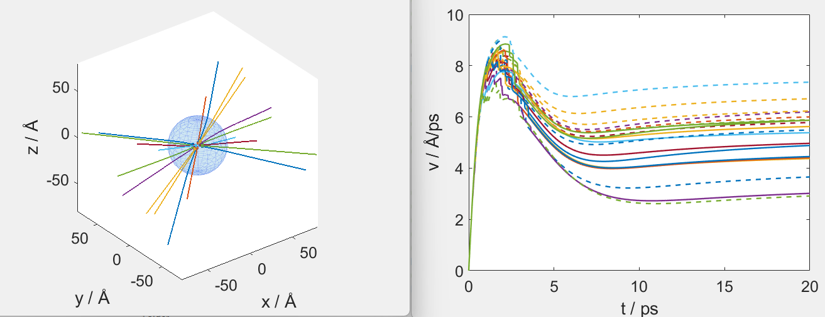
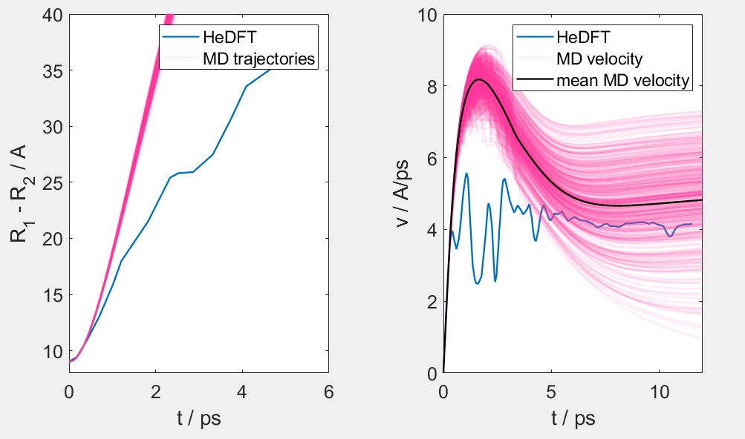
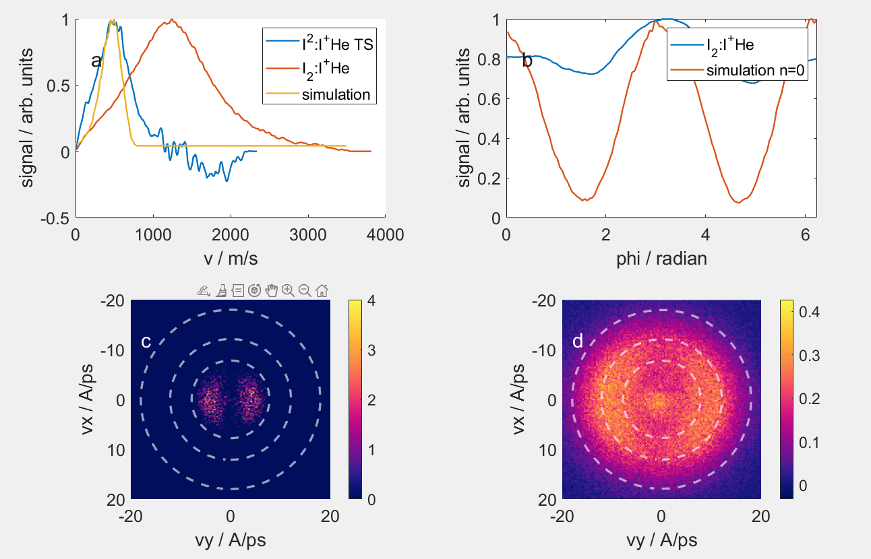
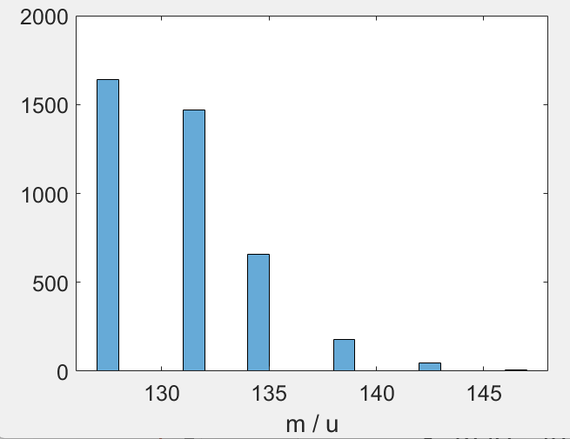
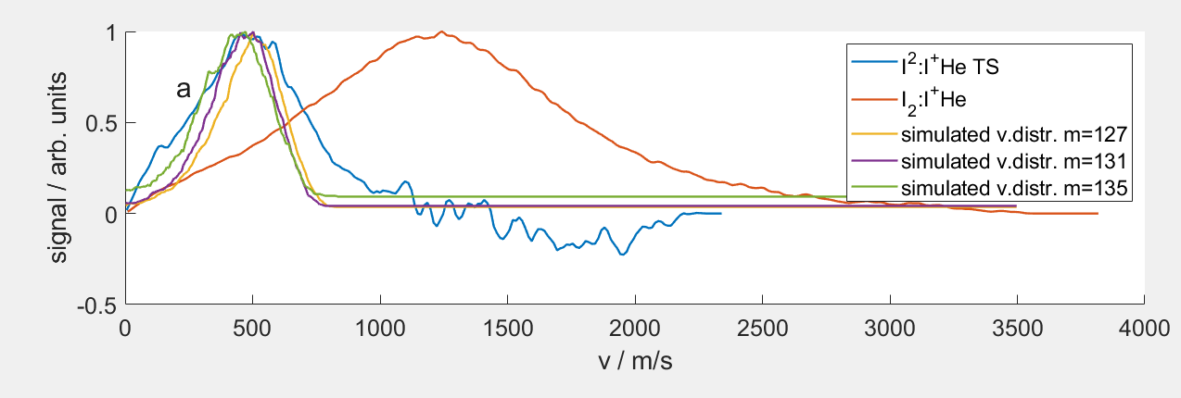
Adjusting MD to fit DFT |v|
R0 = 9 Angström
N = 2000 (R_droplet = 27 Angström)
geometric_scattering_crosssection_Iplus = 22
binding_energy_I_ion = 0.4;
mass_attach_probability = 0.1;
Simulation VD: 131 u

Slide 4
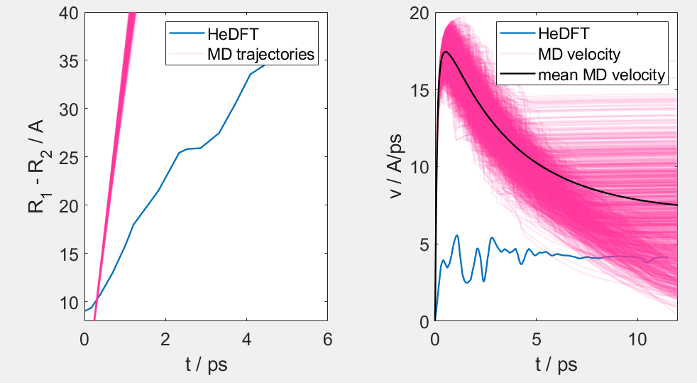
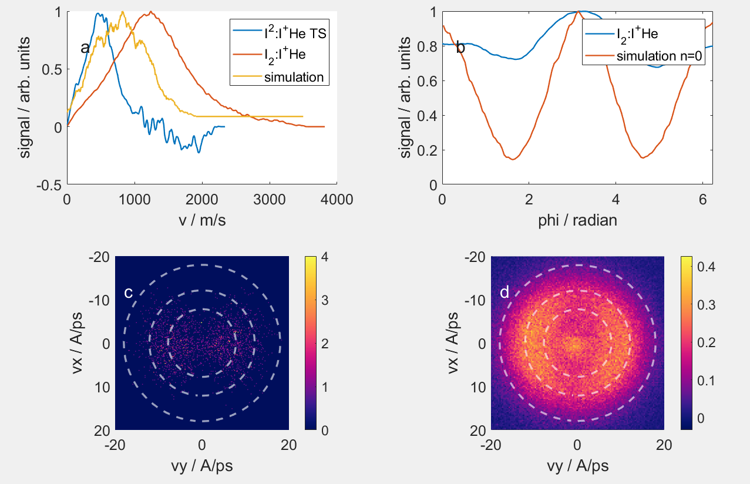
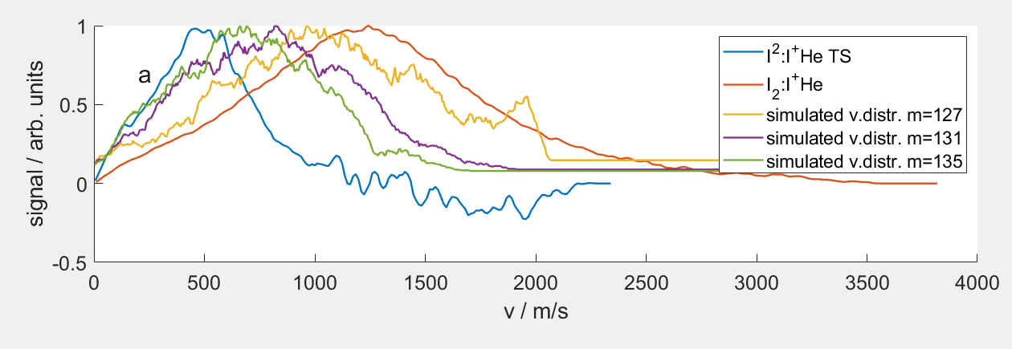
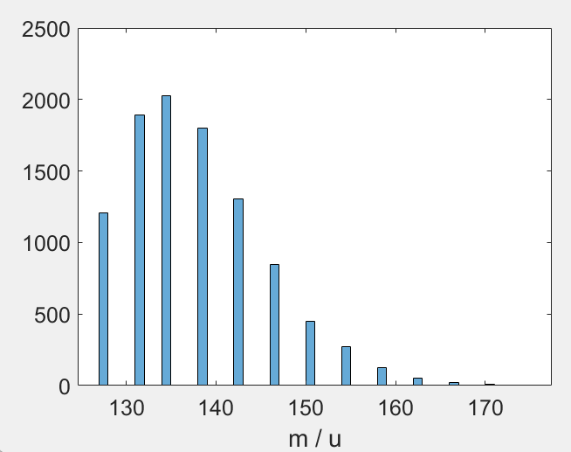
Checking 2.666 Angström result
R0 = 2.666 Angström
N = ensemble (14 K, 40 bar)
geometric_scattering_crosssection_Iplus = 22
binding_energy_I_ion = 0.4;
mass_attach_probability = 0.1;
Simulation VD: 131 u

Slide 5
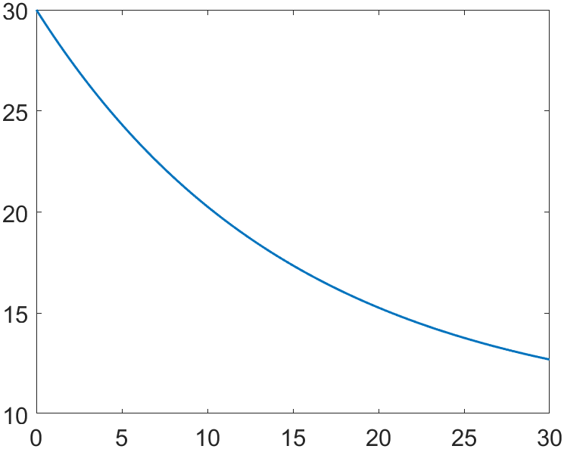
Use artificial sigma(v)
v_debug = 0:0.1:30;
sigma_debug = (sigma0*3 - sigma0)* exp(-v_debug/15) + sigma0;

Slide 6
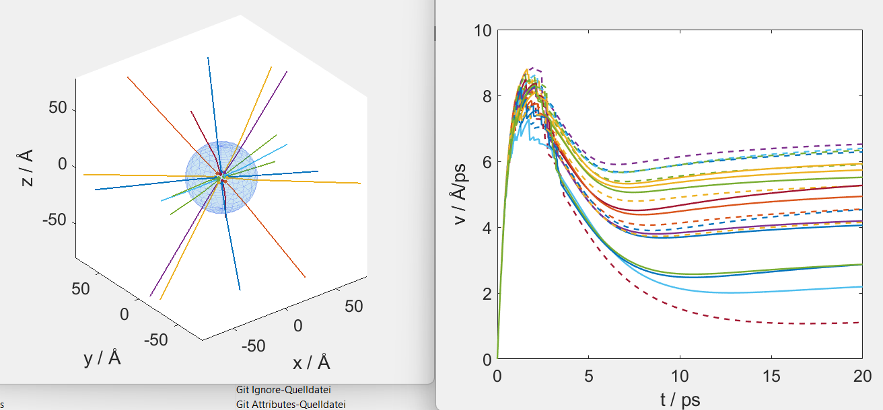
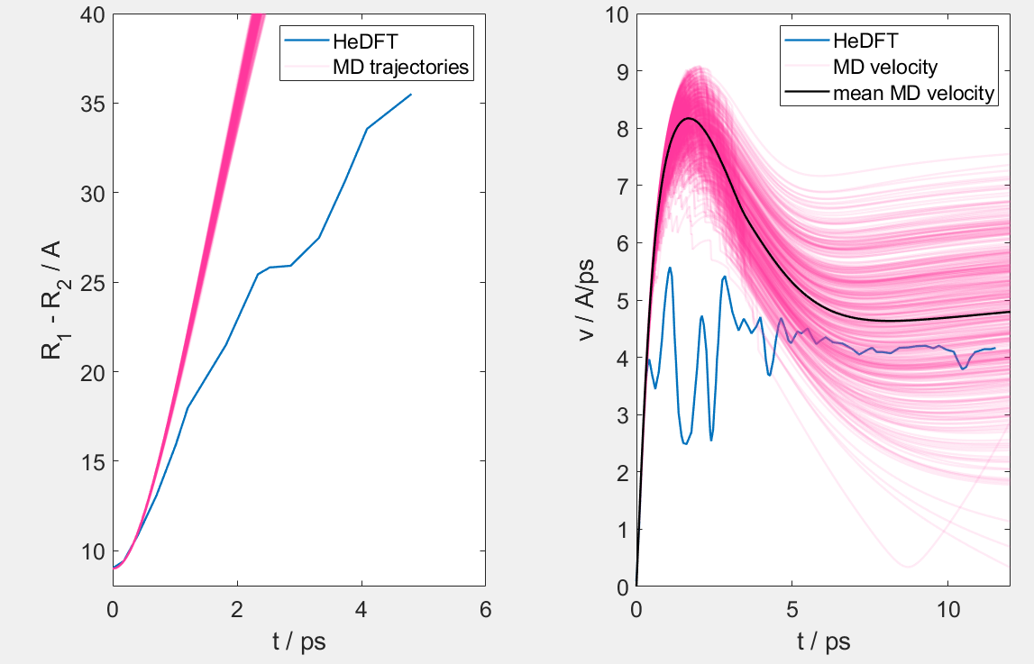
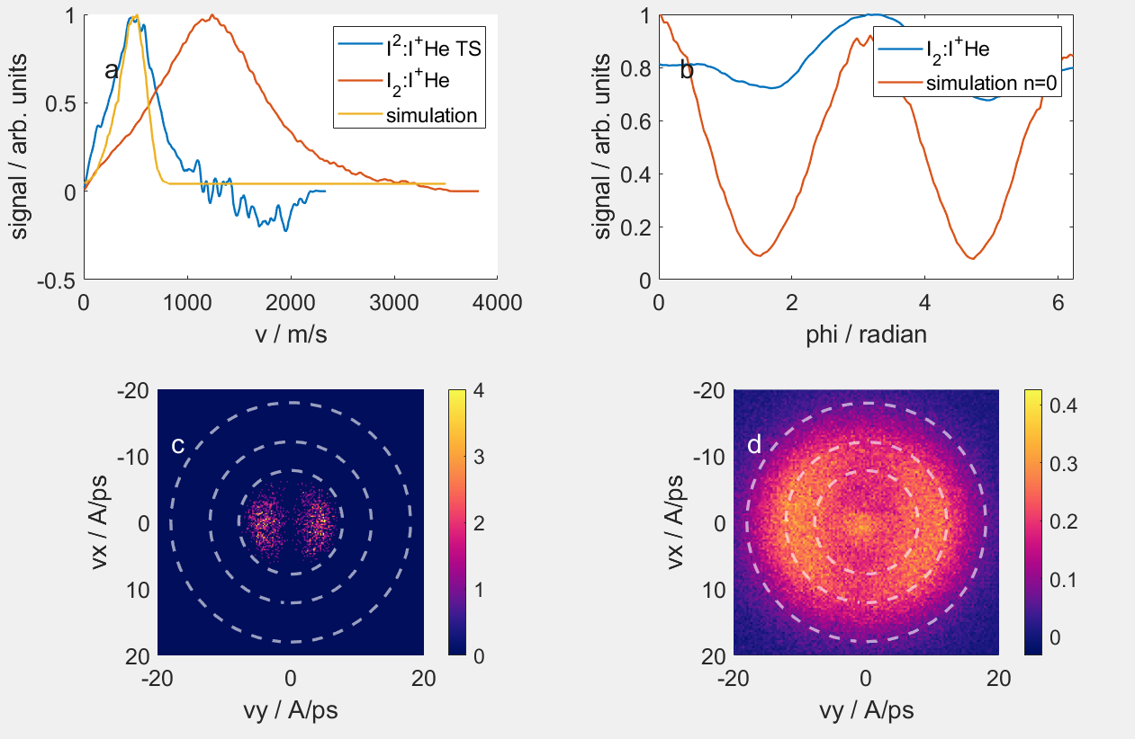
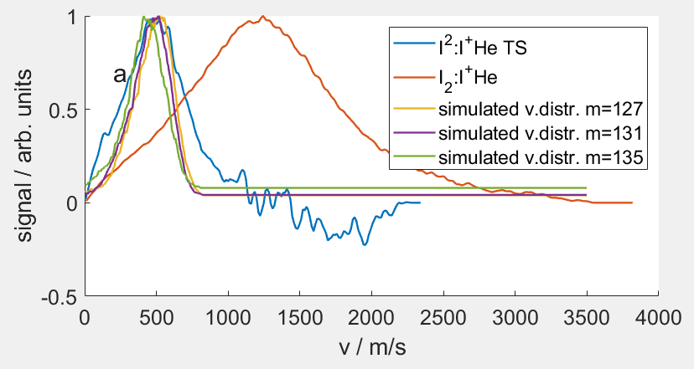
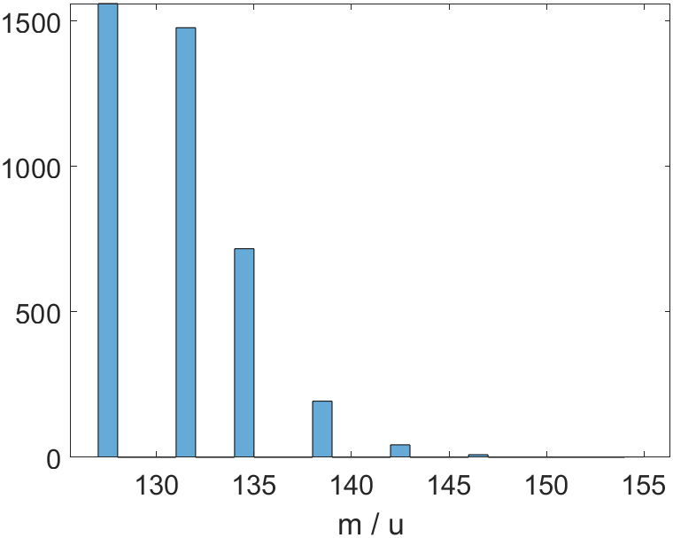
Adjusting MD to fit DFT |v|
R0 = 9 Angström
N = 2000 (R_droplet = 27 Angström)
geometric_scattering_crosssection_Iplus = 10
binding_energy_I_ion = 0.4;
mass_attach_probability = 0.1;
Simulation VD: 131 u

Slide 7
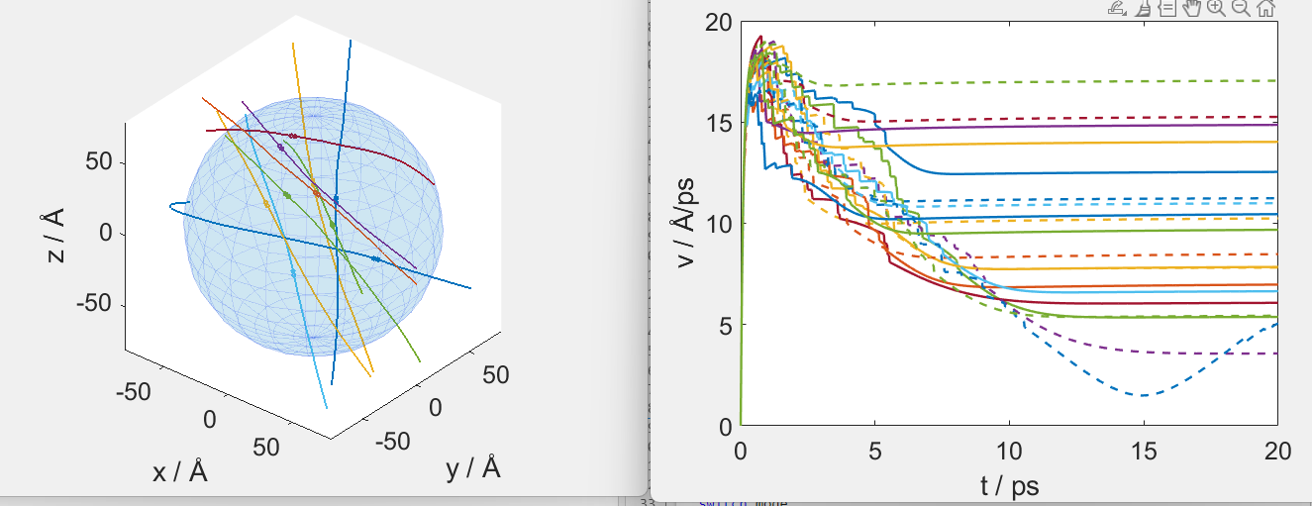
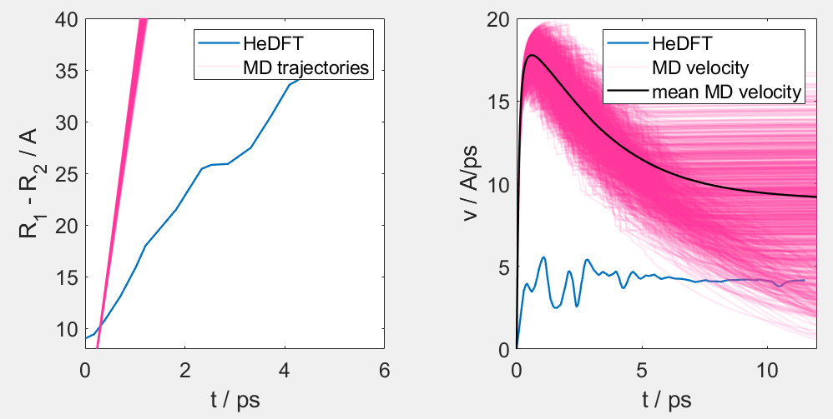
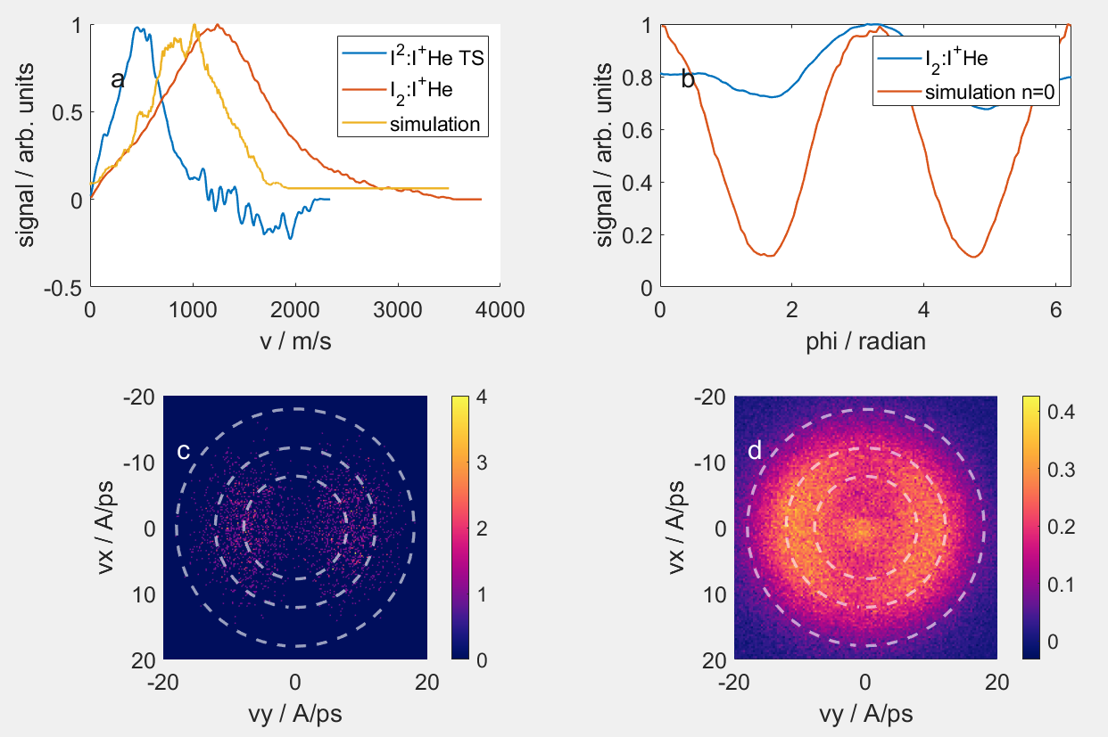
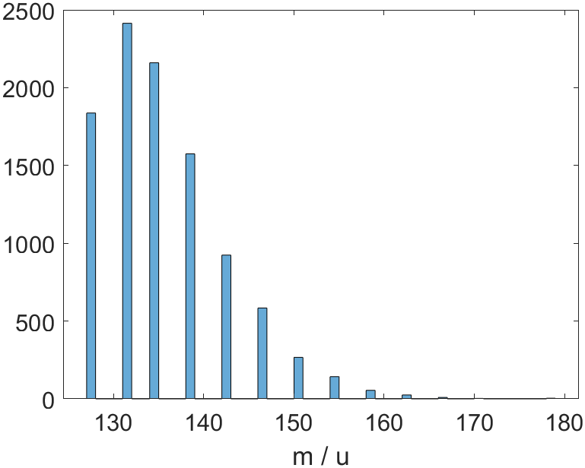
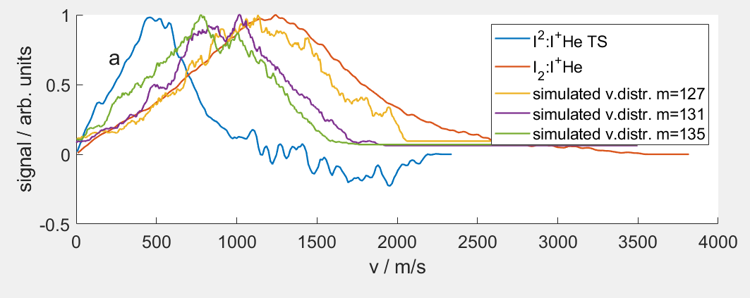
Checking 2.666 Angström result
R0 = 2.666 Angström
N = ensemble (14 K, 40 bar)
geometric_scattering_crosssection_Iplus = 10
binding_energy_I_ion = 0.4;
mass_attach_probability = 0.1;
Simulation VD: 131 u

Slide 8
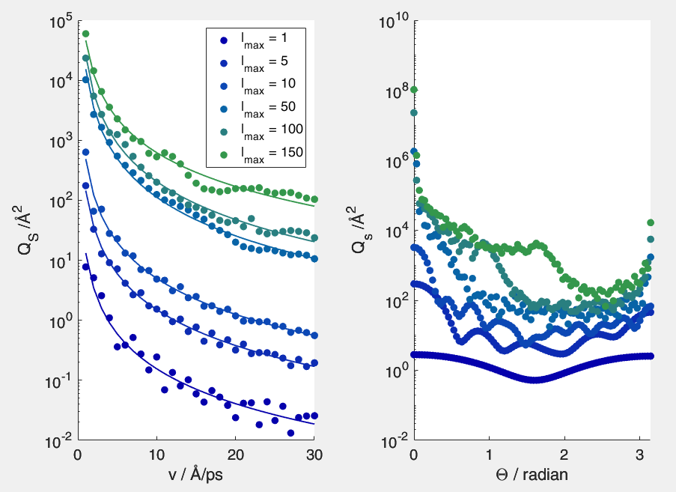
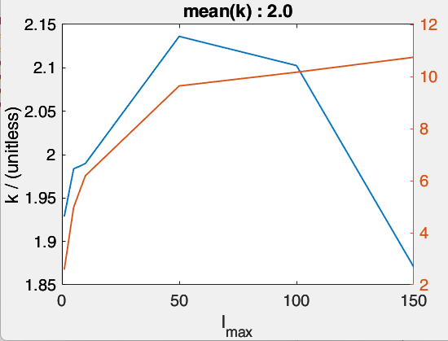
Fit calculated crosssection
Q_S = sigma(v) = sigma0 v^-2
Log(sigma(v)) = -k log(v) + d
The mean value of k for different lmax is about 2
The d value is not important, since it is contained by sigma0: sigma(v) = exp(-k log(v) + d) = sigma0 * exp(- k log(v))

Slide 9
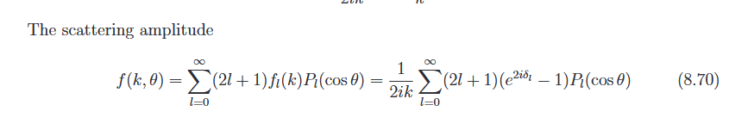
Why v^-2 ??
Comes directly
This means in my calculation the sum is rougly independent of k why should this be the case? Delta_l is implicitely dependent on k
Hbar k = m v ➔ k =m v/hbar
Qs = |f|^2 ➔ proportional to v^-2

Slide 10
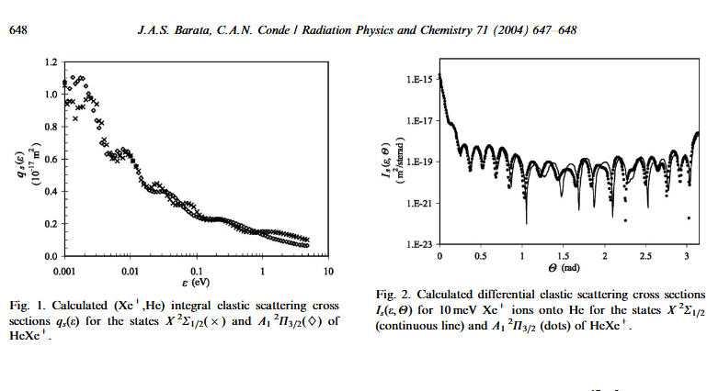
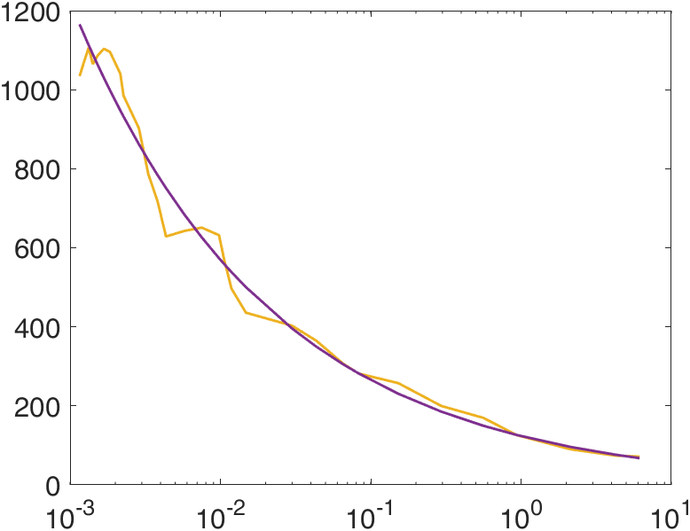
He Ne+ (and others)
10.1016/j.radphyschem.2004.04.038
Qs (E) = Qs(0) E^-0.332;
This is the same group again. I think they published the same stuff 5 times…

Slide 11
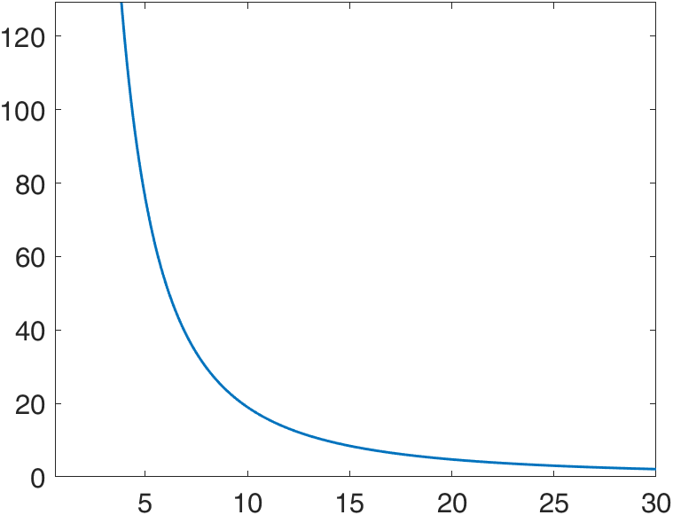
Sigma(v), (sigma0 = 1900 Angström^2)
Explodes at small v

Slide 12
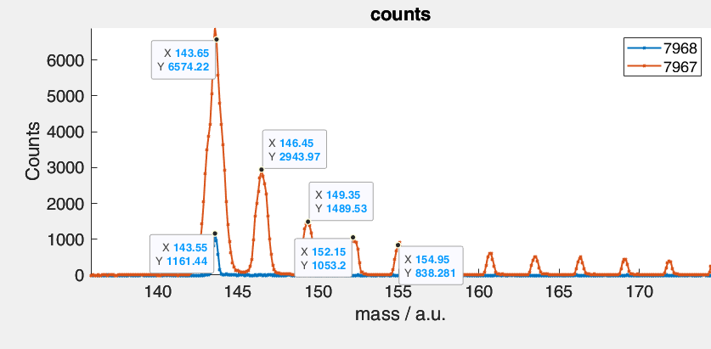
Check tof (50 mW probe)
Adjust mass attachment probability so that resulting ions are similar
I+: 6574 – 1161 = 5400 | 1
I+He: 2900 | 0.53
I+He2: 1500 | 0.27
I+He3: 1000 | 0.2

Slide 13
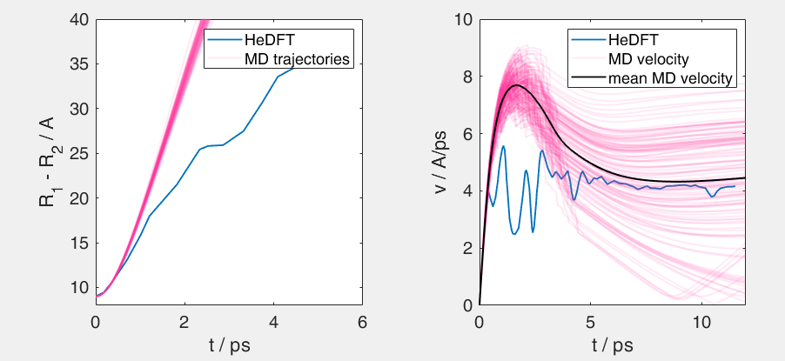
Adjusting MD to fit DFT |v|
R0 = 9 Angström
N = 2000 (R_droplet = 27 Angström)
geometric_scattering_crosssection_Iplus (sigma0 ) = 1900
binding_energy_I_ion = 0.3;
mass_attach_probability = 0.09;

Slide 14
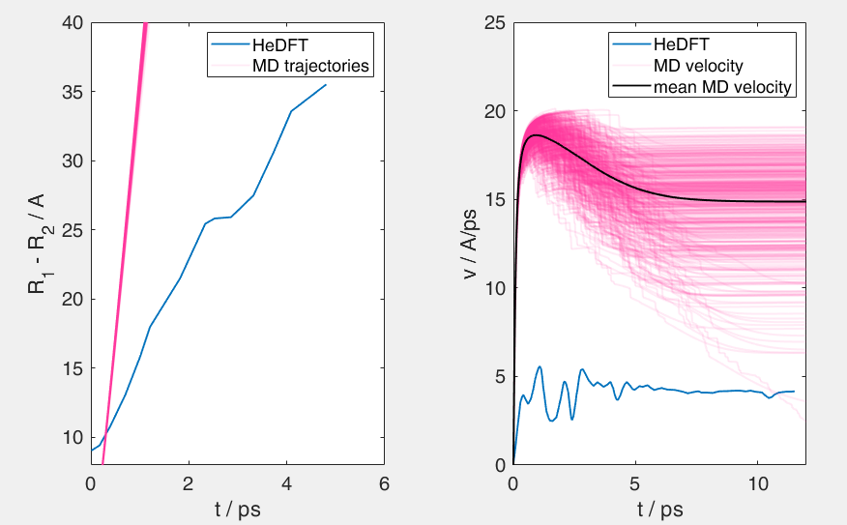
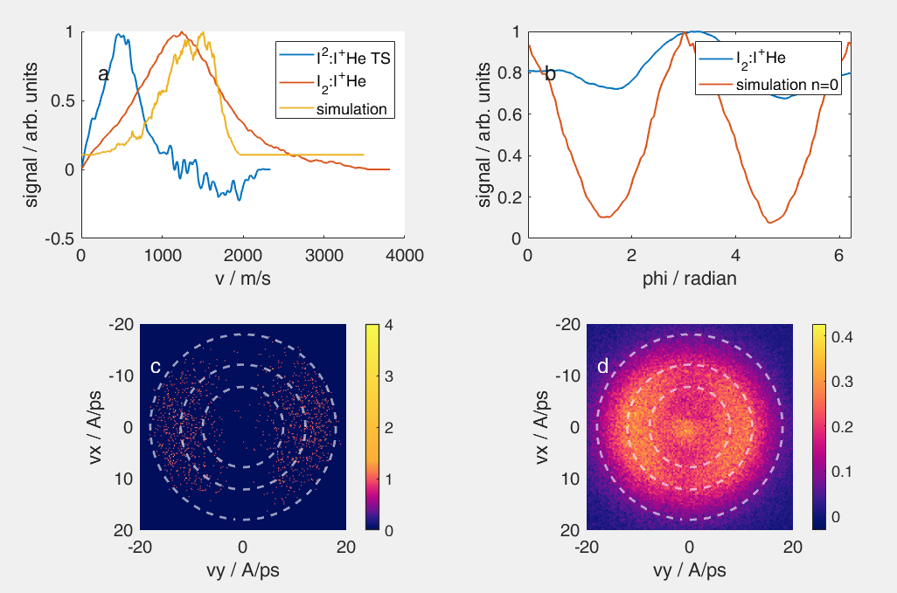
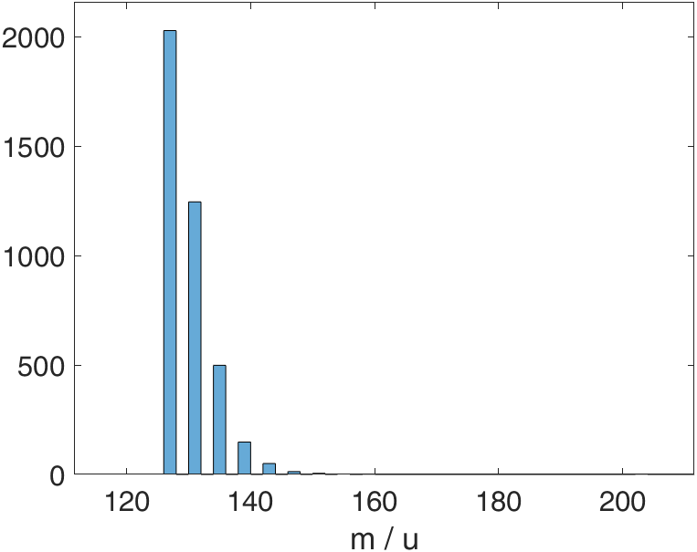
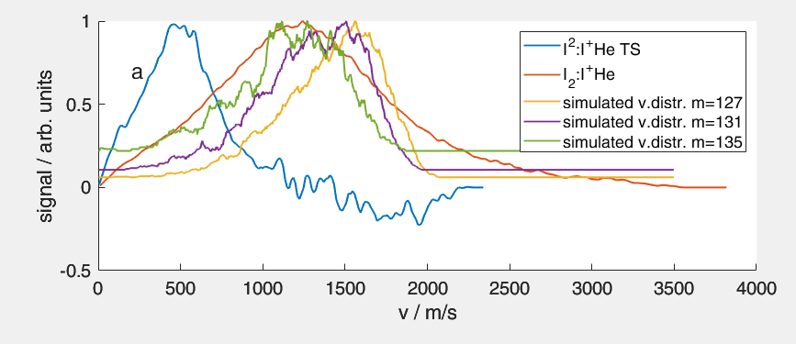
Checking 2.666 Angström result
R0 = 2.666 Angström
N = ensemble (14 K, 40 bar)
geometric_scattering_crosssection_Iplus = 1900
binding_energy_I_ion = 0.3;
mass_attach_probability = 0.09;

Slide 15
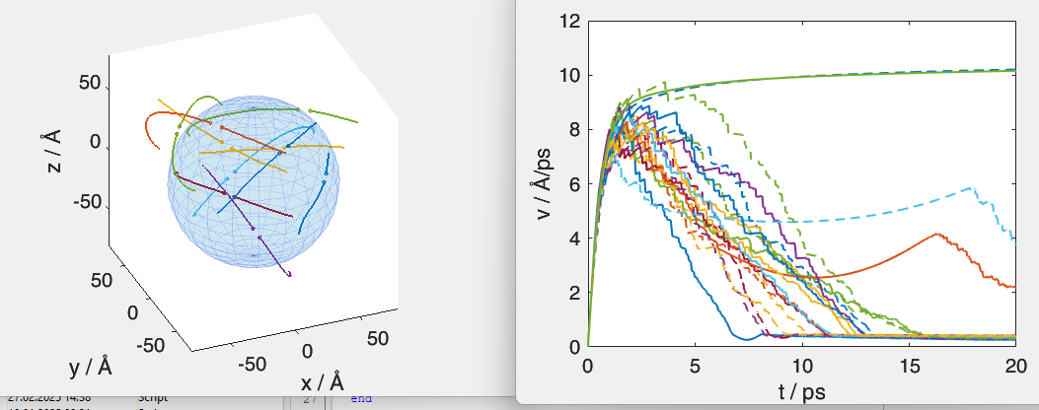
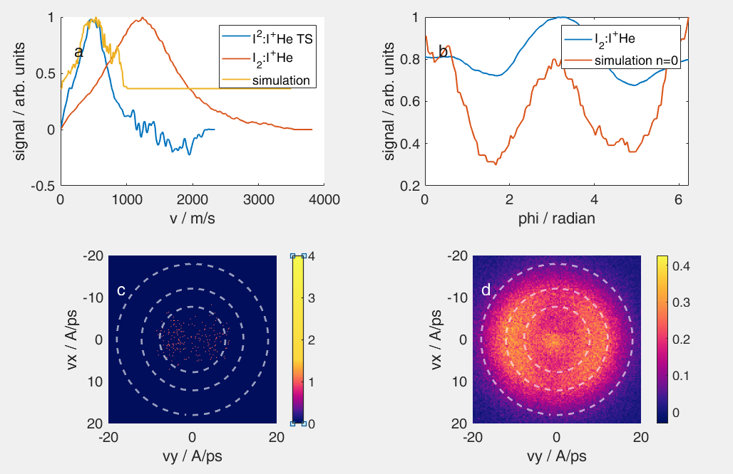
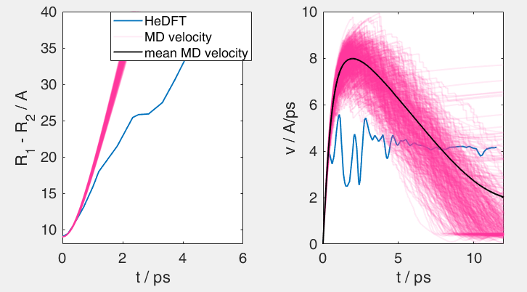
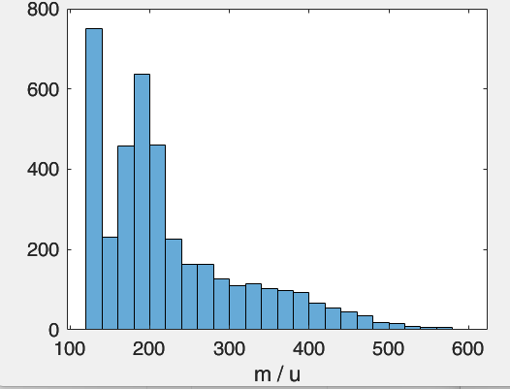
Checking 9 Angström result (ensemble)
R0 = 9 Angström
N = ensemble (14 K, 40 bar)
geometric_scattering_crosssection_Iplus = 1900
binding_energy_I_ion = 0.3;
mass_attach_probability = 0.09;
T_particle = 12.7 K

Slide 16
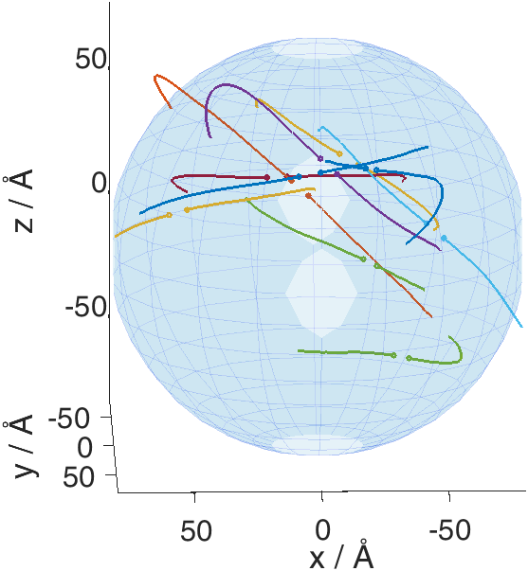
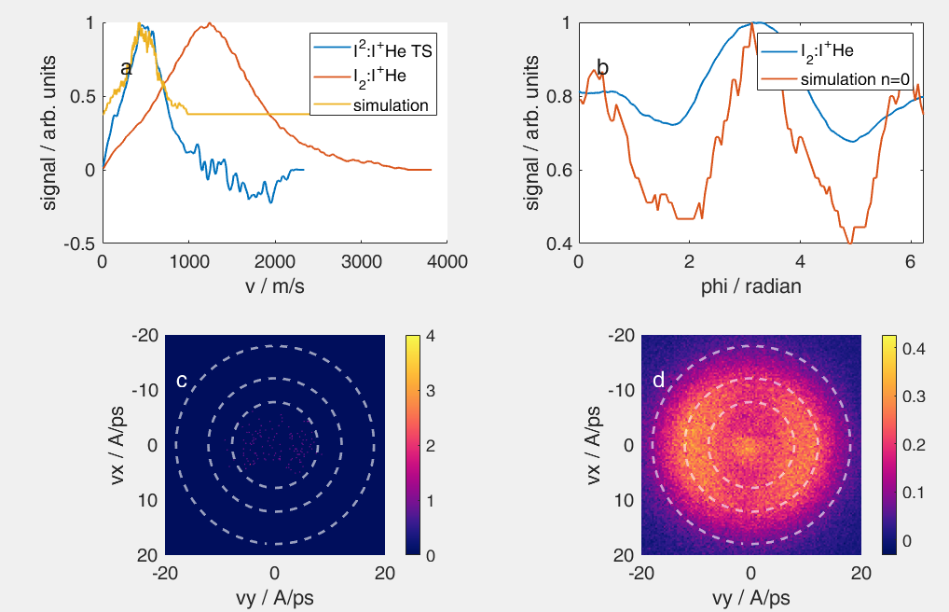
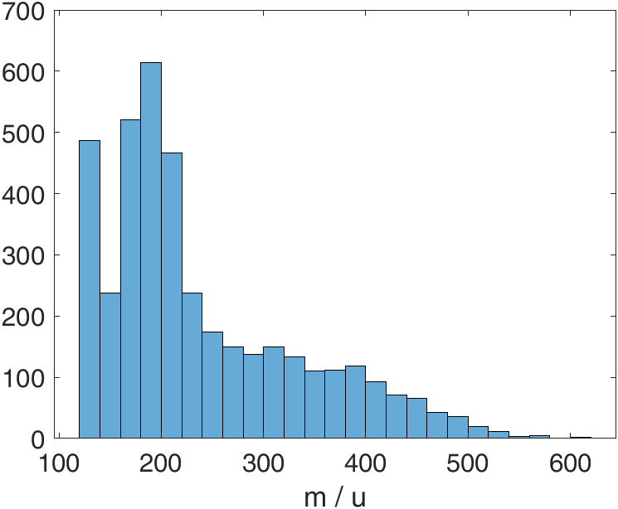
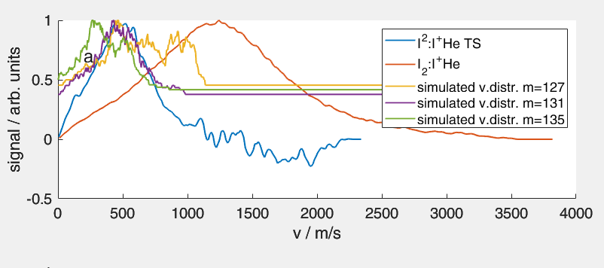
Checking 9 Angström result (ensemble)
R0 = 9 Angström
N = ensemble (14 K, 40 bar)
geometric_scattering_crosssection_Iplus = 1900
binding_energy_I_ion = 0.3;
mass_attach_probability = 0.09;
T_particle = 0.6 K (check if there is a difference)

