Slide 1
Progress MD simulation
10.3.25

Slide 2
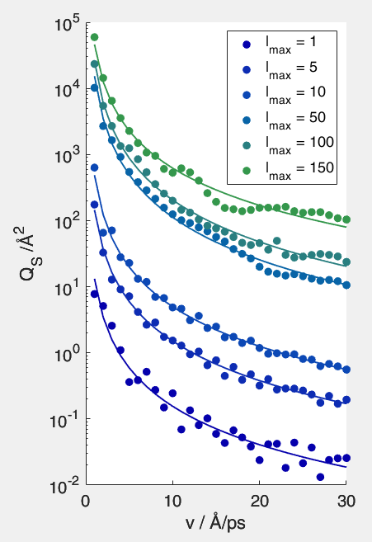
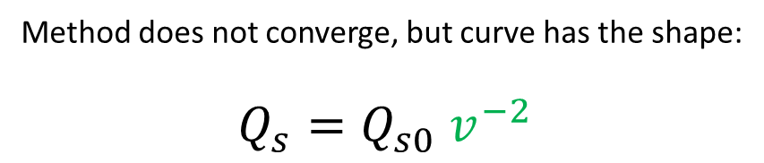
Velocity dependent crosssection
Calculate total elastic collision crosssection
I⁺He potential from: J. Chem. Phys. 122, 194311 (2005)
Method from: 10.1109/NSSMIC.2004.1462242
Method does not converge, but curve has the shape: $$Q_{s}=Q_{s0} v^{−2}$$

Slide 3
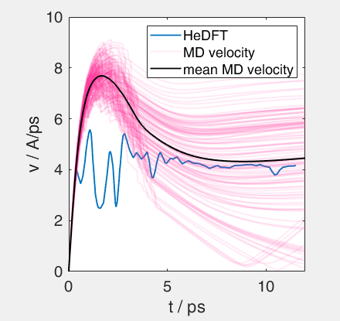
Adjusting MD to fit DFT |v|
R0 = 9 Angström
N = 2000 (R_droplet = 27 Angström)
Q_{s0} = 1900 Angström^2 (fit value)
binding_energy_I_ion = 0.3 eV;

Slide 4
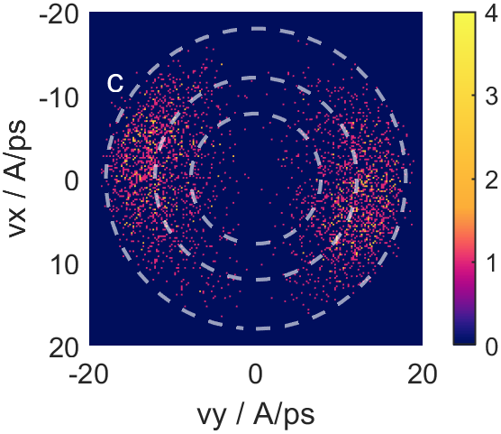
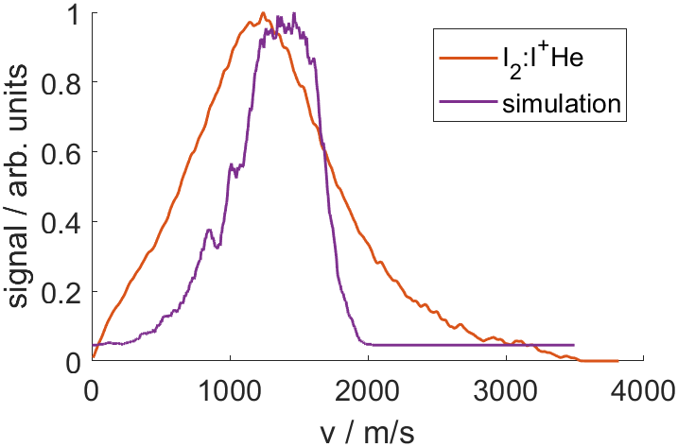
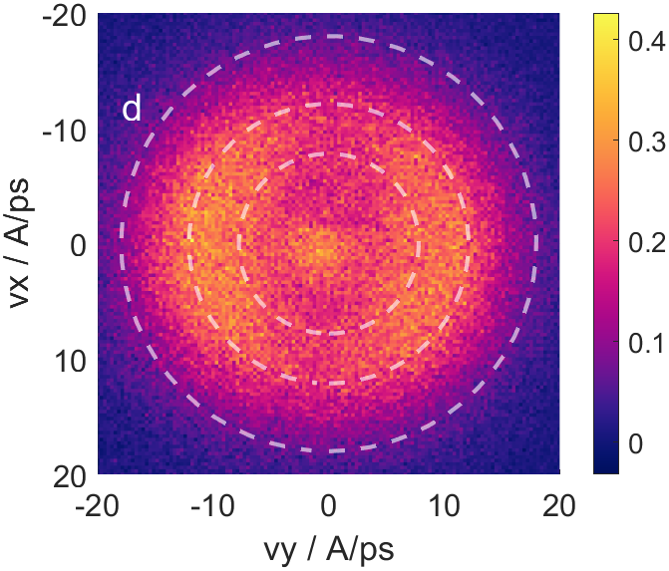
Ground state I₂ in droplet
R0 = 2.666 Angström
N = ensemble (14 K, 40 bar)
T_molecule = 0.4 K (determines distribution in droplet)
I+He distributions

Slide 5
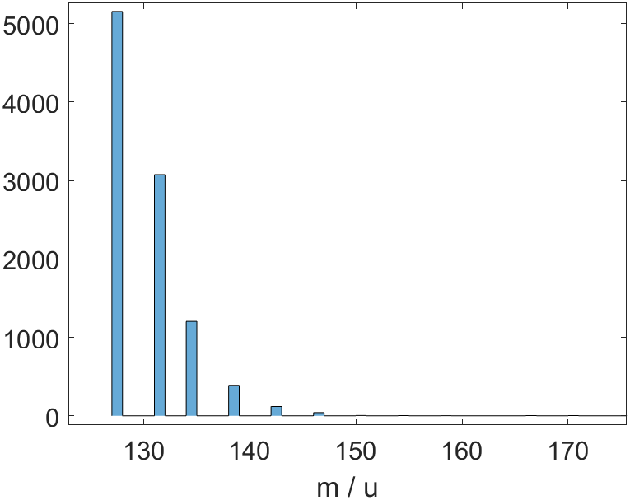
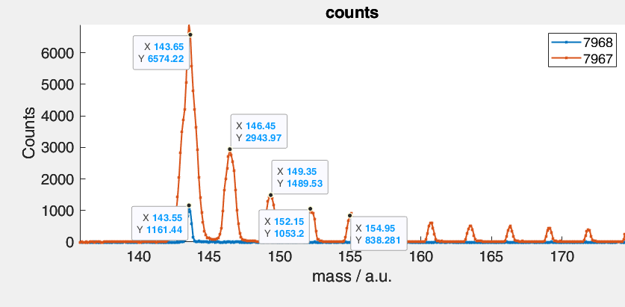
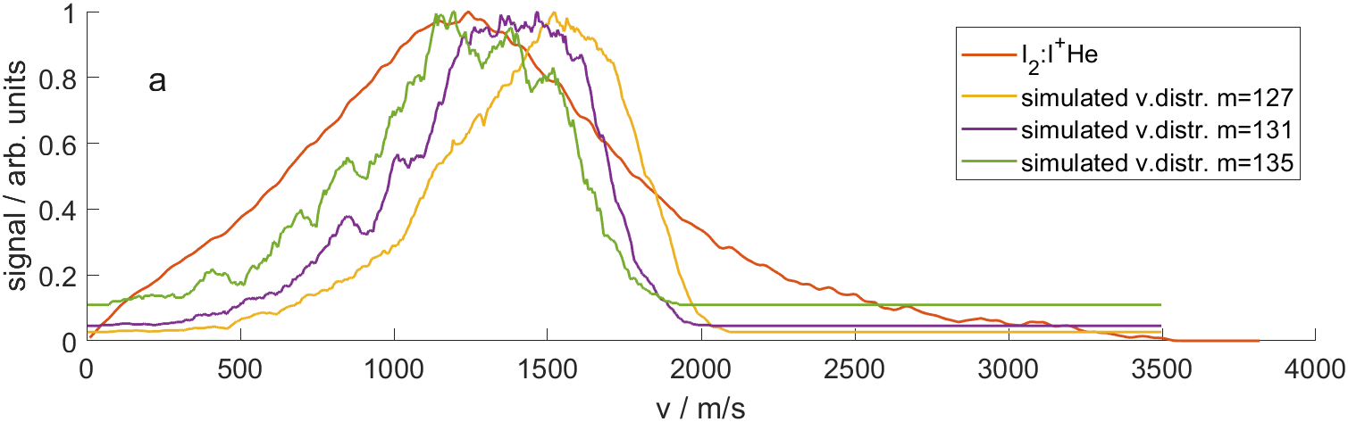
Mass distribution of ions
mass_attach_probability = 0.09 at each collision of ions with He
Simulated histogram
Measured data

Slide 6
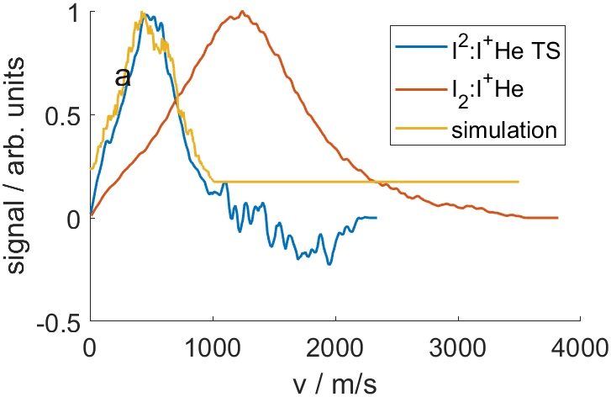
I₂ with 9 Angström interatomic distance
R0 = 2.666 Angström
N = ensemble (14 K, 40 bar)
T_molecule = 12.7 K

Slide 7

Why 12.7 K?
$$m\frac{v_{landau}^{2}}{2}=\frac{3}{2}k_{B}T$$
$T=\frac{1}{3k_{B}}m v_{landau}^{2}$
Using m = 127 u and $v_{landau}=50\frac{m}{s}$
T = 12.7 K

