Slide 1
Comprehensive Digital Marketing Project Work

Slide 2
Team ID : LTVIP2023TMID09301 Team Leader : Guggilapu Akhil Team member : Andukuri GangadharSharma Team member : Boddu VindhyaSree Team member : Bheemavarapu BhavyaPrasad Team member : Jaldi Ramchander

Slide 3

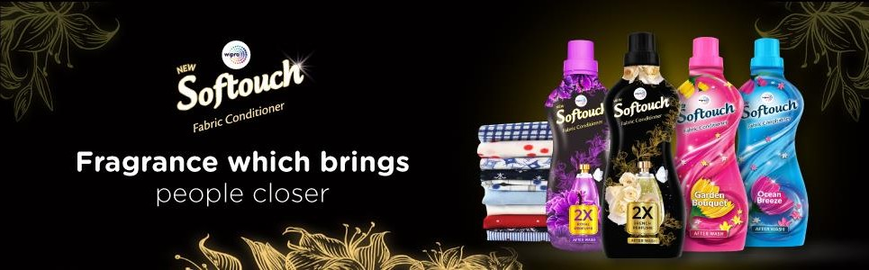









Slide 4






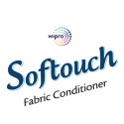



Part 1: Brand study, Competitor Analysis & Buyer’s/Audience’s Persona
Research Brand Identity: Study the brand's mission, values, vision, and unique selling propositions (USPs).
COMPANY / TOPIC : SOFT TOUCH
Logo:
Mission/Values: The mission of Softouch is to provide affordable health care products while ensuring the required quality standards. With the help of our Innovation and development team, we are relentlessly working towards making our products affordable to the mass alongside maintaining the highest quality standards.
Soft Touch Corporation is an Eco-Friendly
manufacturer and distributor of
-High-End, Natural, and Organic Turkish Cotton Products, including Towels, Bathrobes, and Linen
-Luxury Hotel Bathroom Amenities and Room Accessories
-Made in USA Custom Mattresses
-Custom Hotel Furniture

Slide 5
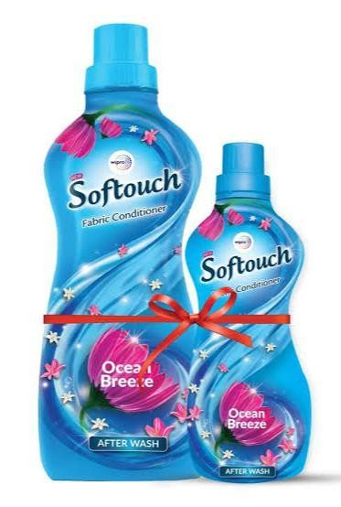
At Soft Touch®, our values are ^{V}the^{A}fo^{L}u^{U}nda^{E}t^{S}ion ^{O}of o^{F}ur ^{SOFT TOUCH}
employee and company culture. Soft Touch Corporation invests in people and protects its workers rights in full according to the laws. They define the manner in which we do business, engage our customers and conduct our work and processes
Integrity Honesty Discipline Creativity
Effectiveness and Efficiency
USP: The USP for Soft touch is providing content That guides for customers to make the right selection For their true beauty and fragrance.
TAG LINE : Soft touch makes the World go Around.

Slide 6
Part 1: Brand study, Competitor Analysis & Buyer’s/Audience’s Persona
Analyze Brand Messaging:
Analyzing brand messaging is crucial for Soft Touch brand to achieve its goals. It helps the brand to understand how its messages are perceived by its target audience and how they can be improved to better resonate with them.
By analyzing brand messaging, Soft Touch brand can also identify any gaps or inconsistencies in its communication strategy. This allows the brand to make necessary adjustments to ensure that its messages are consistent across all channels and effectively communicate its values and mission.One example of the Soft Touch tagline in action is a print advertisement featuring a close-up shot of a person’s hand holding a Soft Touch product, with the tagline ‘Feel the difference’ prominently displayed

Slide 7
SOFT TOUCH BRAND TAGLINE :
Applying Thought’, represents the company’s commitment to innovation and problem-solving. It reflects Wipro’s approach to business, which is centered around understanding the needs of their clients and applying their expertise to create innovative solutions that drive growth and success.

Slide 8
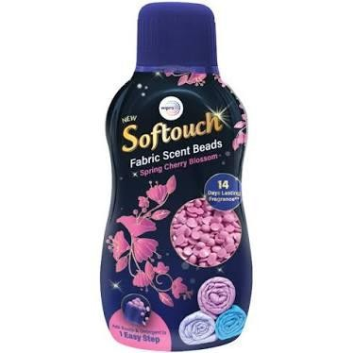
Part 1: Brand study, Competitor Analysis & Buyer’s/Audience’s Persona
Competitor Analysis: Select three competitors operating in the same industry or niche as the chosen brand, examine their USPs and online communication.
Competitor 1:
Competitor 1: Fresh & Soft
Fresh & Soft is a well-established brand in the fabric conditioner market, known for its refreshing fragrances and softening properties. One of its unique selling points (USPs) is its long-lasting scent, which keeps clothes smelling fresh for days after washing.
Additionally, Fresh & Soft has a strong online presence, with active social media accounts and a user-friendly website that offers product information and online purchasing options.

Slide 9
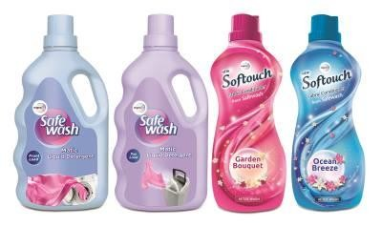
COMPETITOR 2: SOFTCARE
SoftCare is a major player in the soft touch fabric conditioner market, offering a range of products that cater to different consumer needs. One of their unique selling points is their emphasis on using natural ingredients, which appeals to consumers who prioritize eco-friendliness and sustainability. Their products also come in a variety of scents, from floral to fruity, giving customers plenty of options to choose from.

Slide 10
COMPETITOR 3: SILKY SMOOTH :
Silky Smooth is a soft touch fabric conditioner that prides itself on its ability to provide long-lasting freshness and softness to clothes. Their unique selling point is their use of natural ingredients, such as aloe vera and lavender, which are known for their soothing properties. In addition, Silky Smooth claims to be eco-friendly, using biodegradable materials in their packaging and production process.

Slide 11
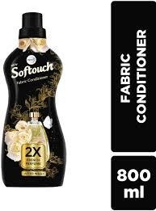
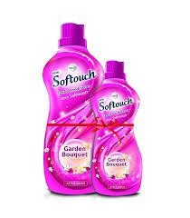
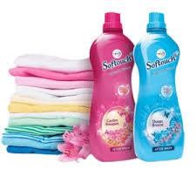
TYPES OF SOFT TOUCH PRODUCTS

Slide 12
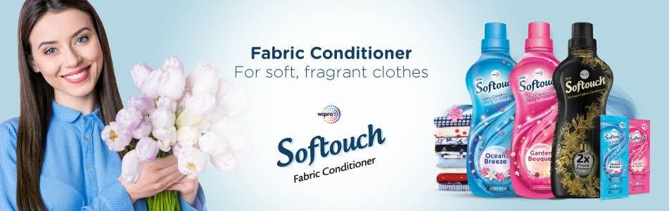
Part 1: Brand study, Competitor Analysis & Buyer’s/Audience’s Persona
Buyer's/Audience's Persona: Clearly define the target audience for the chosen brand. Consider demographics, psychographics, behaviors, and interests.
Soft touch fabric condisitoner 25-45
Men and primarily females Yes
Married/ unmarried
Metro cities like Mumbai, Delhi and vskp etc. Tier 2 and tier 3 cities
Not Remote villages
With a Median household income of ₹ 60,000.
They are Typically college- educated and reside in Urban Or suburban area. While the product is used by both Genders, females are the primary purchasers. Social status: Tv ads, social media.
Brand quality: priceless and long lasting.

Slide 13
Part 2: SEO & Keyword Research
SEO Audit: Do an SEO audit of the brands website
Keyword Research: Define Research Objectives, Brainstorm Seed Keywords, Utilize Keyword Research Tools (SEMrush or Moz Keyword Explorer),Analyze Competitor Keywords, Long-tail Keyword Exploration (specific, longer phrases) that align with the research objectives and have lower competition but higher conversion potential.
On page Optimization: Meta Tag optimization & content optimization
Reflect on the process of conducting keyword research and the SEO
recommendations provided.
Document the challenges faced during the research and analysis phase, as well as the key insights gained from the keyword research process.

Slide 14
SEO AUDIT:
SEO Audit : https://wiproconsumercare.com/softouch-anti-germ/
Soft Touch Fabric Conditioner of SEO is not just any ordinary fabric conditioner. It’s a product that stands out from the rest because of its eco-friendliness and affordability. Unlike other fabric conditioners in the market, Soft Touch Fabric Conditioner of SEO is made with natural ingredients that are gentle on the environment and your clothes. This means you can enjoy softer and more comfortable clothes without harming the planet.In conclusion, Soft Touch Fabric Conditioner of SEO is the perfect solution for anyone looking to keep their clothes soft and comfortable while also extending the life of their garments. By using Soft Touch Fabric Conditioner, you can say goodbye to static cling and hello to longer-lasting fabrics that look and feel great.

Slide 15
KEYWORD RESEARCH:
The research objectives for soft touch fabric conditioner are multi-faceted. First and foremost, we aim to identify the target market for this product. This will involve analyzing demographic data, as well as surveying potential customers to determine their laundry habits and preferences.
In addition to identifying the target market, we also seek to understand consumer preferences when it comes to fabric softeners. This will involve conducting focus groups and surveys to gather feedback on factors such as scent, texture, and packaging.
Finally, we aim to evaluate the effectiveness of soft touch fabric conditioner in comparison to other fabric softeners on the market. This will involve conducting product testing and analyzing the results to determine the strengths and weaknesses of the product.

Slide 16
OPTIMIZING SOFT TOUCH FABRIC CONDITIONER USAGE
Optimizing Soft Touch Fabric Conditioner Usage
To ensure that you get the most out of your soft touch fabric conditioner, it’s important to use the right amount. Adding too little may not give you the desired softness, while adding too much can leave a residue on your clothes. Check the label for instructions on how much to use based on the load size and water hardness.
Market Research : Market Research
Market research is a crucial component of the analysis phase in the development of soft touch fabric conditioner. It helps to identify consumer needs and preferences, as well as market trends and competition. By conducting market research, we can gather valuable insights that inform the development of our product.

Slide 17
Part 3: Content Ideas and Marketing Strategies
Content Idea Generation & Strategy: Create a content calendar for the remaining month of July by brainstorming content themes, exploring various formats like blog posts, videos, infographics, podcasts, and interactive quizzes, and scheduling publication dates mainly on Facebook & Instagram.
And include the strategy, aim and the idea behind these posts and story
Content Calendar Example (Try creating a table for the month of July)
Content Calender of July : https://1drv.ms/w/s!AnWaS2qkkcROgQbEWNNeaZSbqawQ

Slide 18
Part 3: Content Ideas and Marketing Strategies
Reflect on the content ideas and marketing strategies process, discussing the challenges encountered and lessons learned.
Soft Touch Marketing Ideas: Educational content:Fabric care tips: Create blog posts or videos that offer tips on how to care for different types of fabrics, highlighting the role of soft touch fabric conditioner in maintaining their
softness and texture.
Social media engagement:Before and after visuals: Encourage customers to share before and after images of their laundry results after using soft touch fabric conditioner, creating a social media campaign with a dedicated hashtag.
Targeted advertising : Partner with influencers: Collaborate with lifestyle influencers or parenting bloggers who can showcase the benefits of soft touch fabric conditioner in their everyday routines.

Slide 19
THE MARKETING STRATEGY FOR SOFT TOUCH FABRIC CONDITIONER COULD INCLUDE THE FOLLOWING ELEMENTS:
1. Target Audience: Identify the target audience for the product, such as individuals who value soft and smooth fabrics, those who prioritize comfort in their clothing, or those who have sensitive skin and need a gentle fabric conditioner.
●
2. Unique Selling Proposition: Highlight the unique features and benefits of Soft Touch Fabric Conditioner, such as its advanced formula that provides long- lasting softness, its ability to reduce wrinkles and static cling, or its hypoallergenic properties.
●
3. Branding and Packaging: Develop a visually appealing and recognizable brand identity for Soft Touch Fabric Conditioner, with a focus on conveying a sense of luxury, comfort, and quality. Design packaging that stands out on store shelves and clearly communicates the product’s benefits.
●
4. Product Placement: Ensure that Soft Touch Fabric Conditioner is available in a wide range of retail outlets, including supermarkets, department stores,
and online platforms. Consider partnering with clothing brands or retailers to offer bundled promotions or exclusive deals.
●
5. Advertising and Promotion: Utilize various advertising channels to reach the target audience, such as television commercials, online ads, social media campaigns, and print advertisements in relevant magazines or newspapers. Highlight the product’s benefits and showcase before-and-after visuals of fabrics treated with Soft Touch.
●
6. Influencer Marketing: Collaborate with influencers or bloggers who have a strong presence in the fashion, home, or lifestyle niche. Encourage them to
share their positive experiences with Soft Touch Fabric Conditioner and provide discount codes or giveaways to their followers.

Slide 20
Part 4: Content Creation and Curation (Post creations, Designs/Video Editing, Ad Campaigns over Social Media and Email Ideation and Creation)
Post Creation:
Select Content Categories: Identify three different content formats relevant to the chosen topic or industry. Research and Brainstorm: Research trending topics, industry news, or audience interests within each category. Brainstorm ideas for social media posts that align with each category. Do note that 1 content format has to be video and additionally 3 stories/status are to be created.
Format 1: Blog Article
Format 2: Video
Format 3: Creative

Slide 21
FORMAT 1: BLOG ARTICLE
AIM:The aim of soft touch fabric conditioner is to provide several benefits to fabric when used in the laundry process. Fabric conditioners are used in addition to laundry detergent to improve the overall feel and quality of the fabric.
DATE: 26th July 2023
IDEA: The idea behind “Soft Touch” fabric conditioner would likely revolve around providing a laundry product that delivers an exceptionally soft and gentle feel to the fabric, along with other beneficial properties.
Topic: Softness: One of the primary aims of fabric conditioners is to make clothes and fabrics feel softer and more comfortable against the skin. This is
especially important for items like towels, bed linens, and undergarments that come into direct contact with the body.
Static Reduction: Fabric conditioners help reduce static electricity in fabrics, which can prevent clothes from sticking together or clinging to the body during wear.
Wrinkle Reduction: By softening the fibers, fabric conditioners can reduce wrinkles and creases in clothes, making ironing easier and quicker.
Fresh Fragrance: Many fabric conditioners come with pleasant fragrances that leave clothes smelling fresh and clean after washing.
Fabric Protection: Fabric conditioners may contain ingredients that help protect the fibers from wear and tear, extending the lifespan of clothing and other fabrics.

Slide 22
FORMAT 2: VIDEO
AIM : To promote Soft touch fabric condisitoner.
DATE: 20th July 2023
https://www.canva.com/design/DAFQnr5qyDA/cJ4tRABkN3As0MOHSagXNQ/watch?utm_content=DAFQnr5qyDA&utm_campaign=designshare&utm_medium=link&utm_source=publishsharelink

Slide 23


FORMAT 3: CREATIVE
AIM: Brand awareness & Reach
Date:26July 2023
IDEA: To create a brand awareness
I believe you are referring to a “fabric conditioner” rather than “condsitioner.” Fabric conditioner, also known as fabric softener, is a liquid product used in laundry to soften and freshen clothes, towels, and other fabrics. It is typically used in combination with laundry detergent during the rinse cycle.
●
Fabric conditioners work by depositing a thin layer of lubricating chemicals on the fibers of the fabric. This helps reduce friction between the fibers, making the fabric feel softer and smoother to the touch. Additionally, fabric conditioners can help reduce static cling and make clothes easier to iron.
●
The term “soft touch fabric conditioner” might be a specific brand or product name in the market. There
are various brands that offer fabric conditioners with different scents and formulations, each claiming to provide a soft and gentle touch to your clothes.
●
When using fabric conditioners, it’s essential to follow the instructions on the product label to ensure
proper usage. Some fabrics may not be suitable for fabric softeners, and excessive use might lead to
reduced absorbency in towels or certain types of fabrics.

Slide 24
Part 4: Content Creation and Curation (Post creations, Designs/Video Editing, Ad
Campaigns over Social Media and Email Ideation and Creation)
Instagram Story
Utilize the Stories feature on Instagram for three consecutive days. Share behind-the-scenes glimpses, polls, quizzes, or sneak peeks etc to encourage audience participation. Once uploaded use the story highlight feature on Instagram and save the 3 story with an appropriate name for each.
Note:
Once done monitor the performance of the posts and Stories using the insight tool and analyze the engagement metrics (likes,
comments, shares, impressions, etc.). Based on the analysis, mention the strategies and areas for improvement.

Slide 25
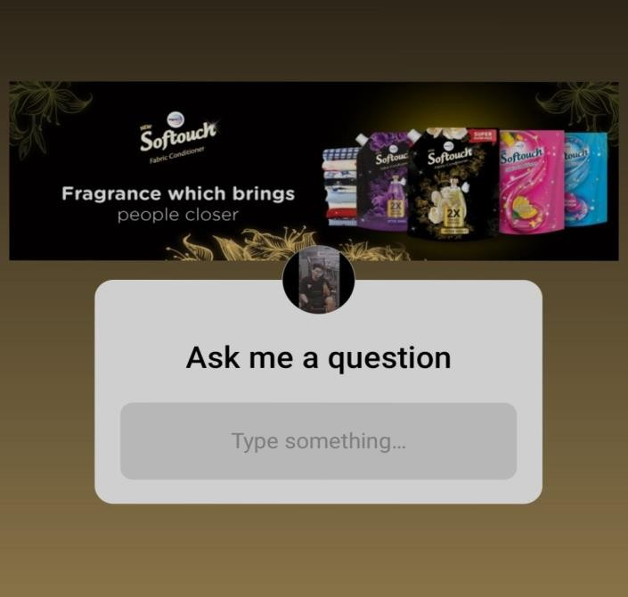
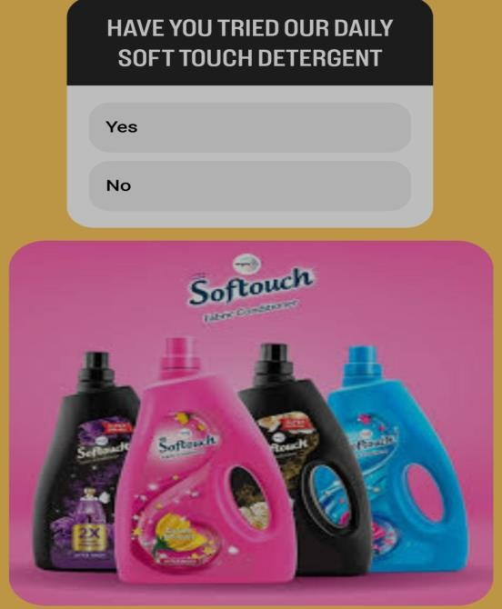
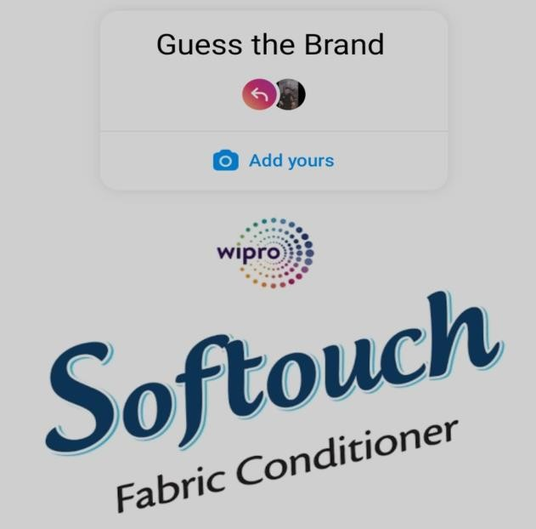
INSTAGRAM STORY

Slide 26
Part 4: Content Creation and Curation (Post creations, Designs/Video Editing, Ad Campaigns over Social Media and Email Ideation and Creation)
Designs/Video Editing
Design Tools Familiarization (use Canva for creating visually appealing graphics)
Video Creation: Utilize VN or any video editor of your choice to create videos related to the chosen topic.

Slide 27


Part 4: Content Creation and Curation (Post creations, Designs/Video Editing, Ad Campaigns over Social Media and Email Ideation and Creation)
Social Media Ad Campaigns
Ad Campaigns over Social Media:
Come up with 3 ad campaigns each covering one of the mentioned goals: brand
awareness, driving website traffic, or generating leads

Slide 28
Part 4: Content Creation and Curation (Post creations, Designs/Video Editing, Ad Campaigns over Social Media and Email Ideation and Creation)
For every campaign clearly define:
Advertising Goals: Soft touch fabric can evoke feelings of comfort, coziness, and well-being. The advertising campaign could try to create an emotional connection with the audience, associating the fabric with positive emotions and experiences.
Audience Targeting : To effectively target these audiences, the advertising and marketing messages should focus on the benefits of soft touch fabric, such as its comfort, coziness, and luxurious feel. Additionally, the marketing channels should be chosen strategically to reach these specific groups, such as social media platforms, lifestyle magazines, home
decor blogs, or fashion influencers’ collaborations
Ad creation: Select the appropriate advertising channels to reach the target audience effectively. Digital platforms like social media, websites, and online marketplaces can be highly relevant for reaching tech-savvy consumers. Traditional media, such as magazines and TV, might be suitable for broader audiences.

Slide 29
Part 4: Content Creation and Curation (Post creations, Designs/Video Editing, Ad Campaigns over Social Media and Email Ideation and Creation)
Email Ad Campaigns
Ad Campaigns for email marketing:
Come up with 2 email ad campaigns with the mentioned goals: brand awareness &
generating leads

Slide 30
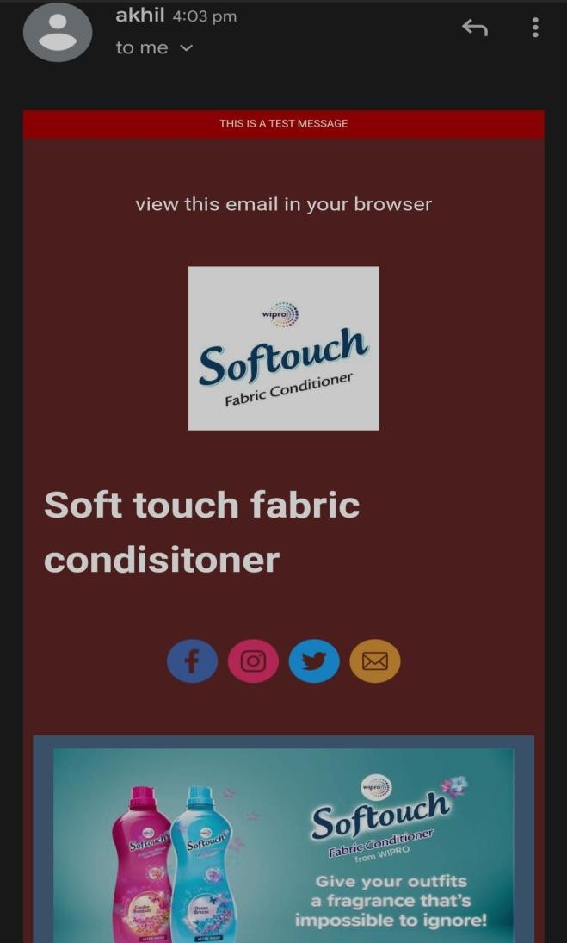
Email Ad Campaign 1 - Brand Awareness
(insert emailer image)

Slide 31
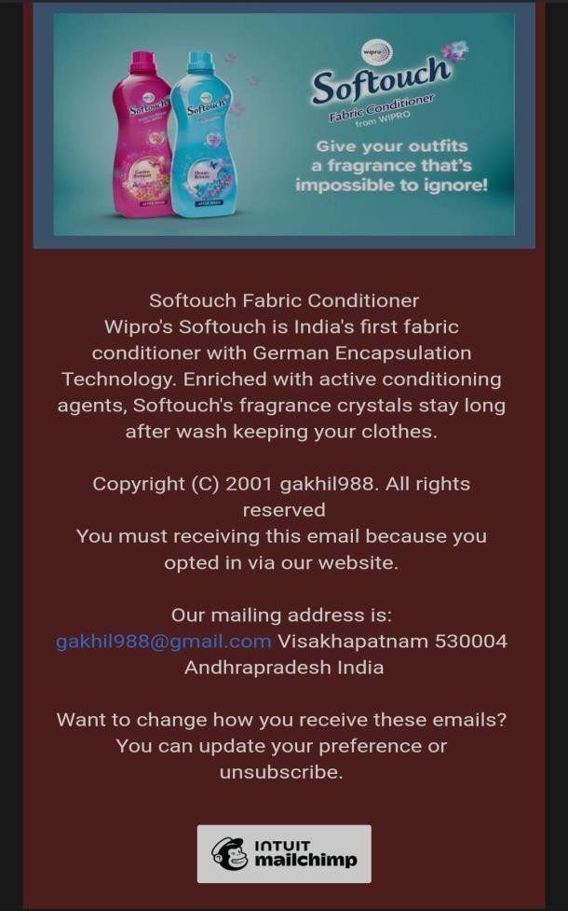
Email Ad Campaign 2 - Lead Generation
(insert emailer image)

Slide 32
Part 4: Content Creation and Curation (Post creations, Designs/Video
Editing, Ad Campaigns over Social Media and Email Ideation and Creation)
CHALLENGES FACED
Challenges:
•
Competition: The fabric care industry is highly competitive, with numerous established brands and new entrants. Standing out and gaining market share can be challenging.
•
Brand Awareness: Building brand awareness and recognition is essential to attract customers, especially when competing against
well-known brands.
•
Consumer Education: Educating consumers about the benefits and proper usage of fabric conditioners can be a hurdle, especially if they are not familiar with the product category.
•
Product Differentiation: Creating a unique selling proposition and differentiating Soft Touch Fabric Conditioner from other similar products is crucial to capture a distinct market segment.
•
Ingredient Safety and Sustainability: Consumers are becoming more conscious of the environmental impact and safety of products
they use. Ensuring that the fabric conditioner’s ingredients are safe and eco-friendly can be a challenge.

Slide 33
LESSONS LEARNED
Lessons Learned:
Market Research: Thoroughly researching the target market’s needs, preferences, and pain points can help tailor the product and marketing strategy accordingly.
Effective Marketing: Crafting compelling marketing messages and campaigns that resonate with the target audience can enhance brand awareness and attract potential customers.
Quality and Innovation: Investing in product quality and continuous innovation can set Soft Touch Fabric Conditioner apart from competitors and garner customer loyalty.
Transparency and Sustainability: Being transparent about the product's ingredients and manufacturing processes, as well as adopting sustainable
practices, can build trust with environmentally conscious consumers.
Customer Feedback and Engagement: Actively seeking and listening to customer feedback can provide valuable insights for product improvements and help build a loyal customer base.

Slide 34


