Slide 1

SMART INDIA HACKATHON 2026
GramIntel
Before you borrow, understand what you're building.
• Problem Statement ID – 26091
• Problem Statement Title – AI-Driven Hyper-Local Business Advisory and Financial Structuring Assistant for Rural Micro-Entrepreneurs
• Ministry / Agency – Ministry of Social Justice & Empowerment (MoSJE)
• Theme – Agriculture, FoodTech & Rural Development
• PS Category – Software
• Team ID – TBD
• Team Name – ADAPT

Slide 2
GramIntel — AI Advisor for Rural Micro-Entrepreneurs
Team ADAPT
1. Detailed Explanation (Prototype & Core Modules)
• Input Parameters: Village/Block/District location + Available Margin Capital + Proposed Category (Dairy, Retail, Poultry, Food Processing, Textiles, Services, Livestock).
• Module 1 — Hyper-Local Feasibility: Evaluates 6 signals (5–10 km market reach, niche opportunity analysis, competitor density, SWOT, threats, and Agmarknet product market value).
• Module 2 — Smart Scheme Calculator: 10% margin → 90% loan, auto-routes Micro Finance (≤ ₹1.40L @ 6.5%) vs. Term Loan (≤ ₹50L @ 8%), quarterly EMI/moratorium schedule & 3-mo opex reserve.
2. Addressing the Problem (MoSJE Mandate)
• Data Over Anecdote: Replaces hearsay with authentic Census 2011 demographics, Mission Antyodaya infrastructure, and Agmarknet mandi feeds before borrowing.
3. Innovation & Uniqueness
• Dual-Tier Pipeline & Full Loop: Multi-tiered fallback (OSM + Census/Antyodaya + Calibrated Baseline) with end-to-end applicant submission to SCA officer appraisal queue.
INPUTS
Village · margin · category
MODULE 1
6-signal feasibility
MODULE 2
Scheme + EMI math
DECISION
Officer approves
▶
▶
▶

Slide 3
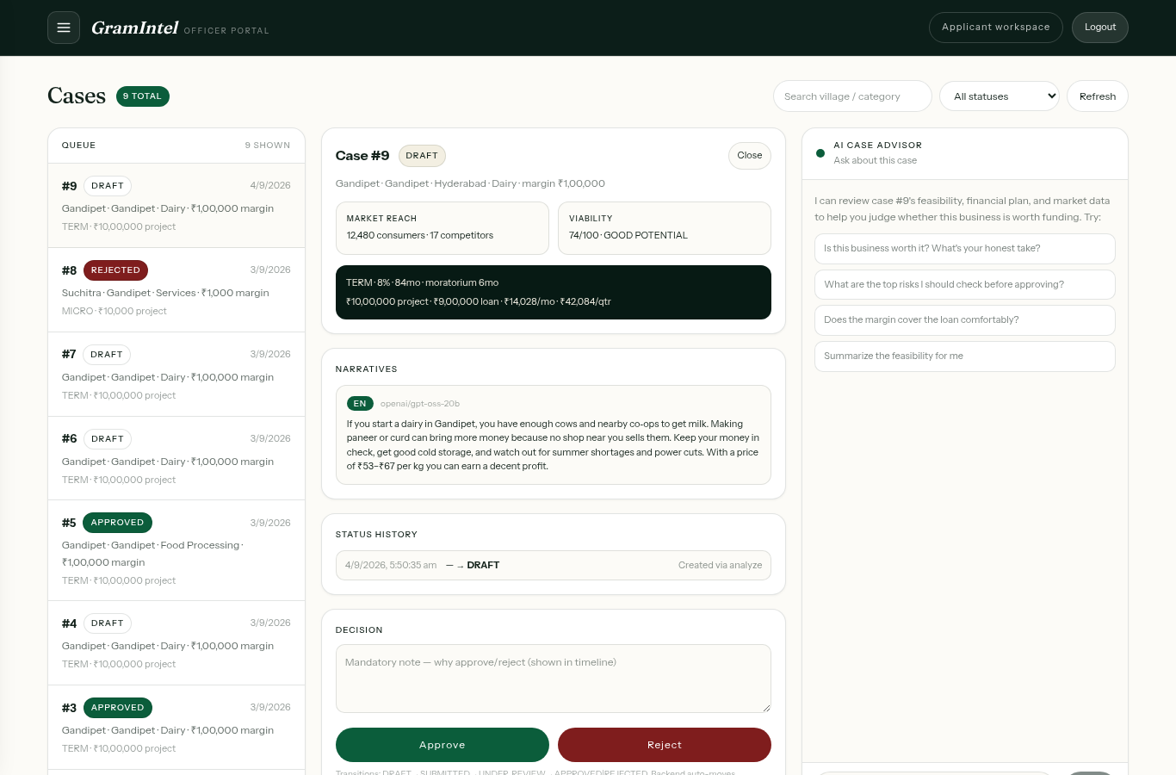
TECHNICAL APPROACH
Team ADAPT
Technologies Used (4-Layer Modular Stack)
• Client Layer: Next.js 14 App Router, React 18, TypeScript 5.7, Tailwind CSS, MapLibre GL 5.6 (pinned), Framer Motion, Lenis.
• Gateway & Services: Next.js Proxy, FastAPI, SQLModel/SQLite (zero-ops sync), JWT OTP + Google OAuth with server-side allowlist RBAC.
• AI & Spatial Pipeline: Groq LPU (openai/gpt-oss-20b for trilingual narratives & SSE advisor), Overpass API (OSM live shops) with dual-endpoint retries.
• Data Foundation: Integrated Census 2011 PCA, Mission Antyodaya 2020 rural infrastructure, and Agmarknet commodity pricing datasets.
Methodology & Implementation Process
• 1. Zero-Hallucination Engine: Deterministic financial & feasibility math strictly verified with 56 automated pytest unit/integration tests.
• 2. Ground-Truth Ingestion: Directly computes consumer volume and monthly demand from village household counts and category spend benchmarks.
• 3. Multi-Tier Resilience: Guaranteed 100% uptime with pre-seeded regional fallbacks; zero blank screens under low rural bandwidth.
56 tests green · next build green · Verified Gov Datasets + PS math
GOV DATASETS & OSM
Census · Antyodaya · Agmarknet
FASTAPI ENGINE
Groq EN/हिं/తె + EMI math
APPS
/assistant + /portal
▶
▶

Slide 4
FEASIBILITY AND VIABILITY
Team ADAPT
Analysis of Feasibility (Technical, Operational & Financial)
• Technical Feasibility: Lightweight commodity stack (Next.js 14 + FastAPI + SQLite), single-image deployment (Vercel + Render), zero-ops maintenance.
• Operational Feasibility: Trilingual vernacular interface (EN/हिं/తె) with simple OTP auth, removing digital and language literacy hurdles for rural beneficiaries.
• Financial Viability: Aligned with MoSJE/NBCFDC/NSFDC scheme rules; computes 3-mo opex reserve + 10% contingency to safeguard borrower liquidity.
Potential Challenges, Risks & Mitigation Strategies
Risk / Challenge | Mitigation strategy | Status
Unreliable rural connectivity / venue WiFi | Dual-endpoint Overpass retries, localStorage caching, pre-seeded demographic fallbacks; zero blank UI | Built ✓
Data sparsity in remote unsurveyed villages | Grounded in Census 2011 PCA & Mission Antyodaya village infrastructure (co-ops, banks, haats, power) | Built ✓
Groq / External AI service outage | Template narrative fallbacks (EN/हिं/తె) + offline case chat advisor; portal never blocks | Built ✓
Working capital depletion & gestation lag | Built-in financial safety buffer: computes 3-month operating expenses + 10% contingency into project cost | Built ✓

Slide 5
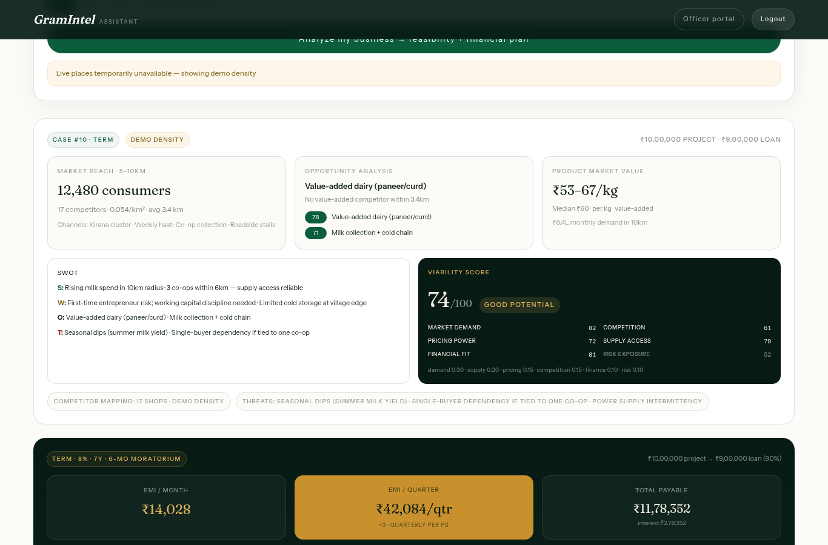
IMPACT AND BENEFITS
Team ADAPT
Potential Impact on Target Audience
• Transparent Financial Structuring: ₹1,00,000 margin → ₹10,00,000 project → ₹9,00,000 loan (TERM @ 8%, ₹14,028/mo EMI) clearly structured before borrowing.
• Reduces Enterprise Failure Rate: Entrepreneurs choose viable ventures backed by Census population & Agmarknet demand (e.g. 14,230 pop & ₹53.5L/mo demand in Chevella).
Social, Economic & Governance Benefits
• Economic (SCA Default Reduction): Drastically lowers non-performing assets (NPAs) for State Channelising Agencies by directing credit to underserved niches.
• Social Inclusion & Empowerment: Empowers rural youth, women artisans (Mahila Samriddhi & Swarnima schemes), and grassroots SHGs through vernacular guidance.
• Governance Acceleration: Shrinks appraisal turnaround from weeks of paperwork to 4 minutes with streaming AI case advisor & audit history.
Automated Scheme Router (PS-Verbatim Rules):
MICRO ≤ ₹1.40L
6.5% · 3 yr · 3-mo moratorium
TERM ₹1.40–50L
8% · 7 yr · 6-mo moratorium
Live analysis: Census verified · viability 78/100 · quarterly EMI & working capital

Slide 6
RESEARCH AND REFERENCES
Team ADAPT
• Scheme Directives (PS-verbatim): MoSJE, NBCFDC & NSFDC Concessional Loan Guidelines — Micro Finance (≤ ₹1.40L @ 6.5%) & Term Loan (≤ ₹50L @ 8%) — nsfdc.nic.in/scheme · nbcfdc.gov.in.
• Rural Infrastructure & Demographics: Ministry of Rural Development (MoRD) — Mission Antyodaya Survey (2020) & Census of India 2011 Primary Census Abstract (PCA) — missionantyodaya.nic.in · censusindia.gov.in.
• Mandi Pricing & Livestock Benchmarks: Directorate of Marketing & Inspection (DMI) — Agmarknet Daily Mandi Price Feeds & 20th Livestock Census, DAHD — agmarknet.gov.in · dahd.nic.in.
• Hyper-Local Spatial Data: OpenStreetMap Foundation & Overpass API for real-time shop density mapping & dual failover — overpass-api.de · openstreetmap.org.
• AI Language & Reasoning: Groq LPU Inference Engine (openai/gpt-oss-20b / llama-3.1-8b) for structured trilingual narratives & SSE streaming advisor — docs.groq.com.
• Engineering & Verified TDD: Next.js 14 App Router, FastAPI, SQLModel/SQLite; 56-test pytest suite with golden validation for PS lending boundaries & dataset grounding — github.com/GramIntel.

