Slide 1
OPTIMIZATION OF THE GANTRY LAYOUT USING A MACHINE LEARNING APPROACH
Guglielmo Frisella
Vittorio Bencini

Slide 2
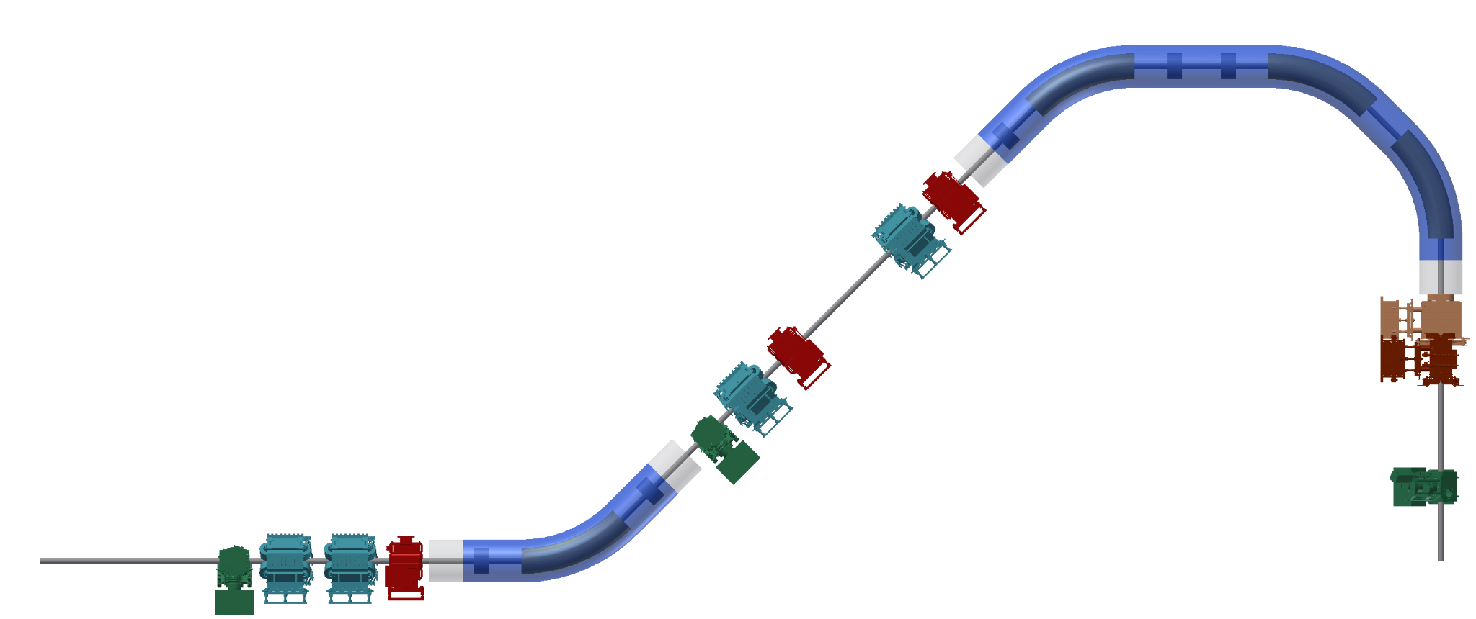
STARTING CONFIGURATION
Free parameters
Var Type | Min | Max | N° of Pars
K_{wq} | -10 T/m | 10 T/m | 4
K_{cq} | -50 T/m | 50 T/m | 5
K_{dip} | -5 T/m | 5 T/m | 1*
l_{i} | 0.5 m | 1.5 m | 3
SC 4T Dipole
Not taken into account in this version
50 cm
Warm Quadrupole (K_{wq})
Kicker
52 cm
3.09 m
2 m
Not in scale
65 cm
Monitor
Cold Quadrupole (K_{cq})
*To simplify the implementation of these magnets, we have opted to uniformly set the quadrupole intensity across all the dipoles.

Slide 3
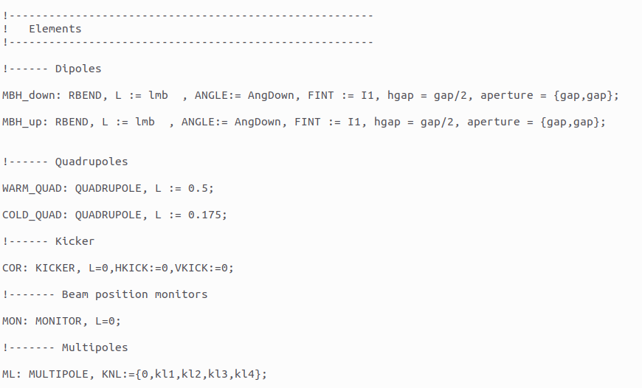
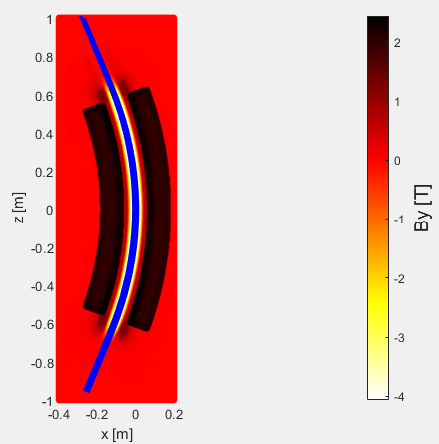
STARTING CONFIGURATION

Slide 4
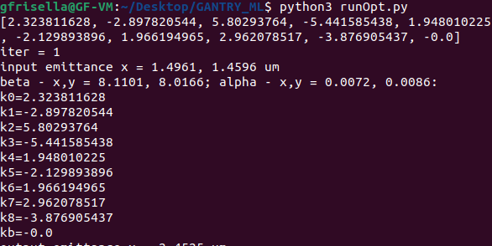
STARTING CONFIGURATION
kb
kb
k7
k8
kb
k6
k5
k4
3.09 m
2 m
k3
Not in scale
k0
k1
k2
kb

Slide 5
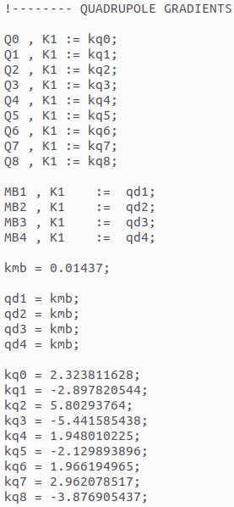
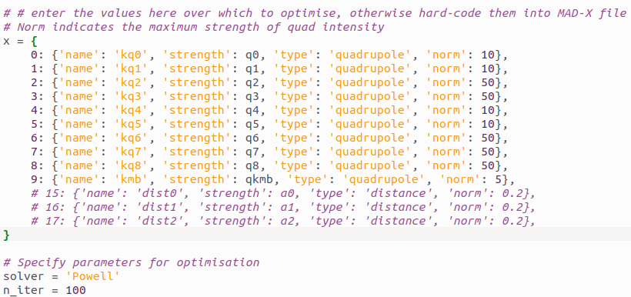
QUADRUPOLE INITIALIZATION

Slide 6
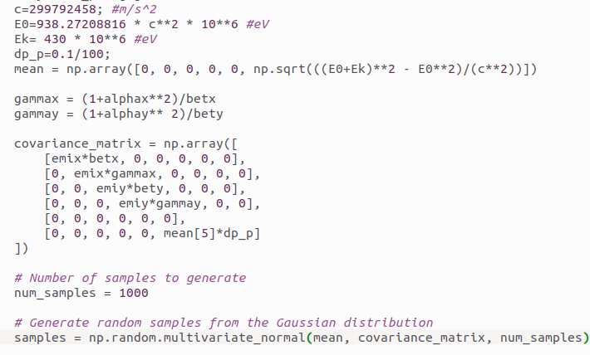
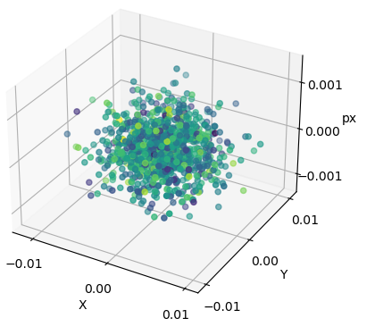
BEAM DISTRIBUTION

Slide 7
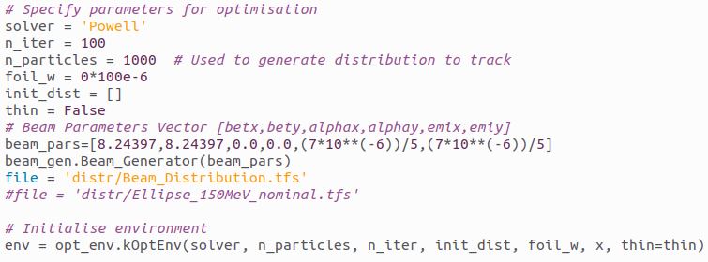
BEAM INITIALIZATION

Slide 8
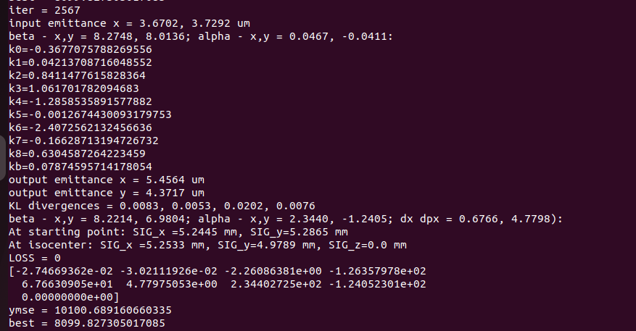
POWELL OPTIMIZATION

Slide 9
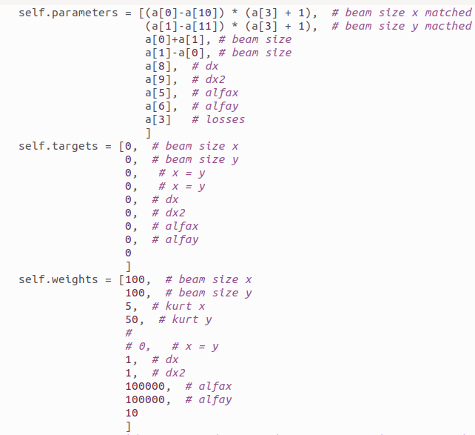

OPTIMIZATION TARGETS

Slide 10
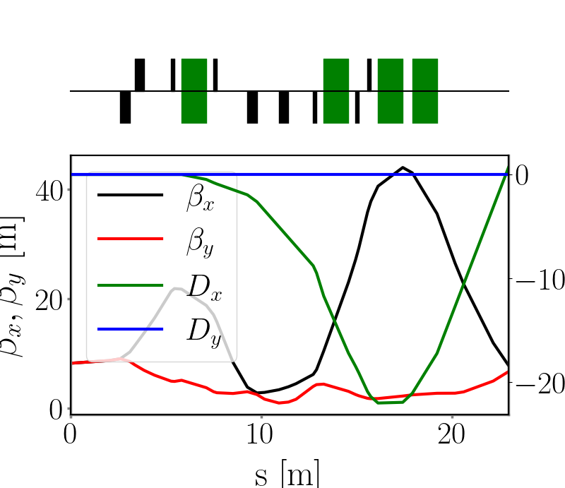
TWISS

Slide 11
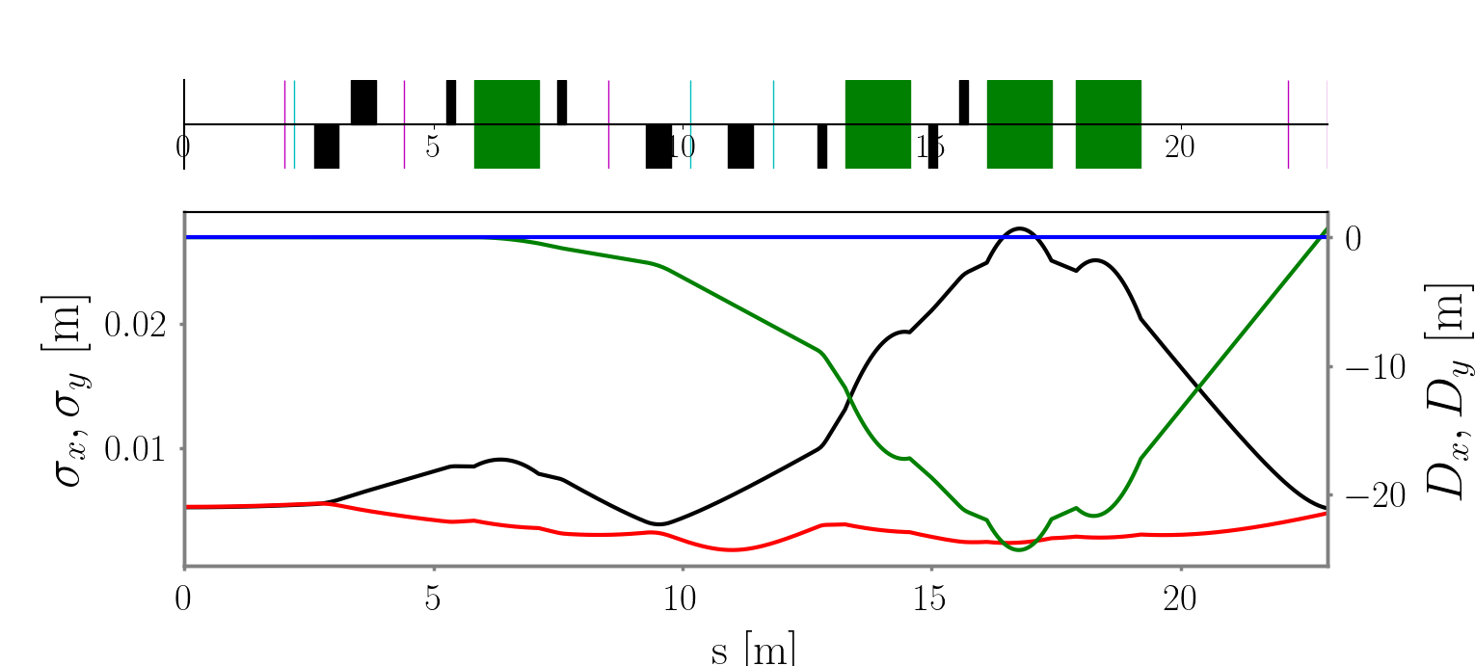
BEAM ENVELOPE

Slide 12
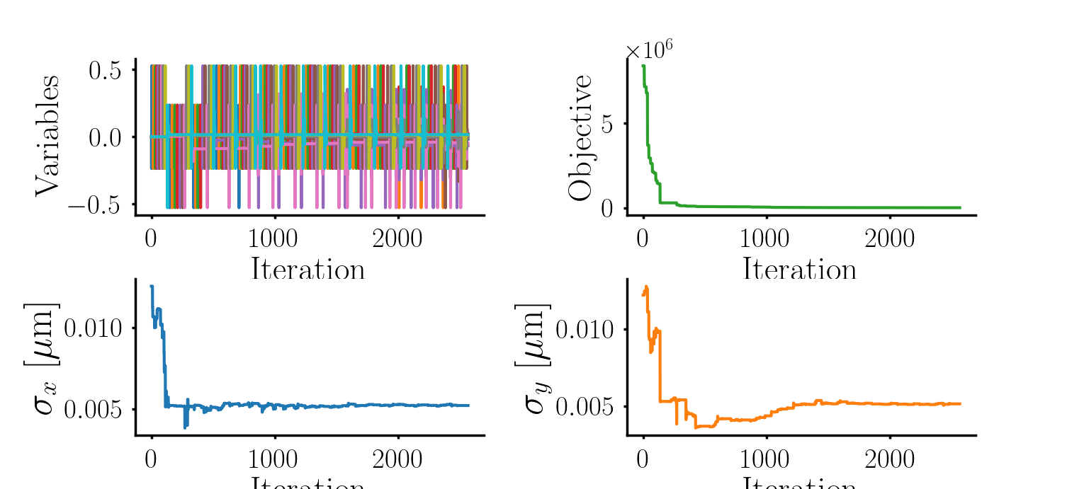
OPTIMIZATION PARS

Slide 13
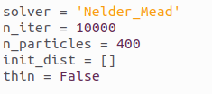
NM OPTIMIZATION

Slide 14
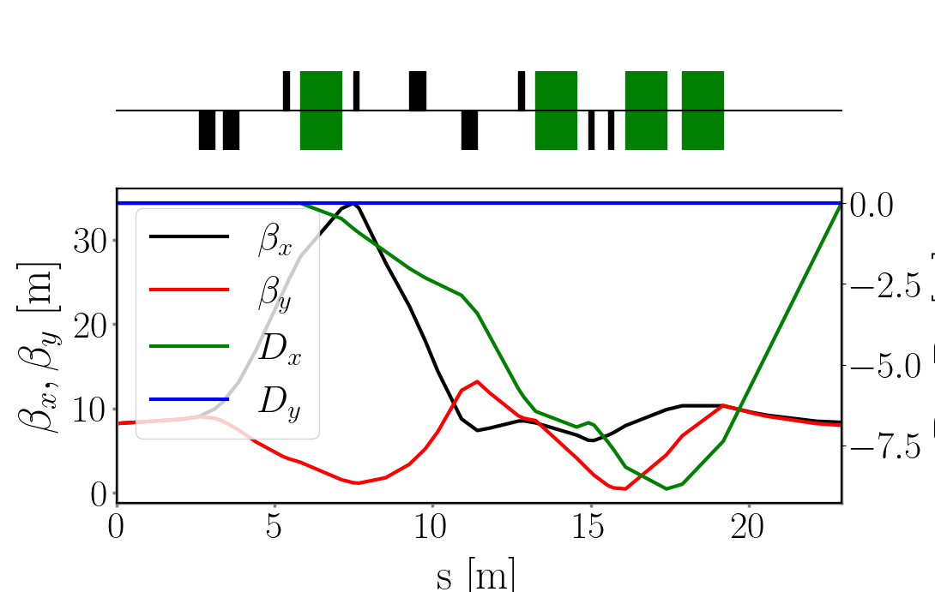
TWISS

Slide 15
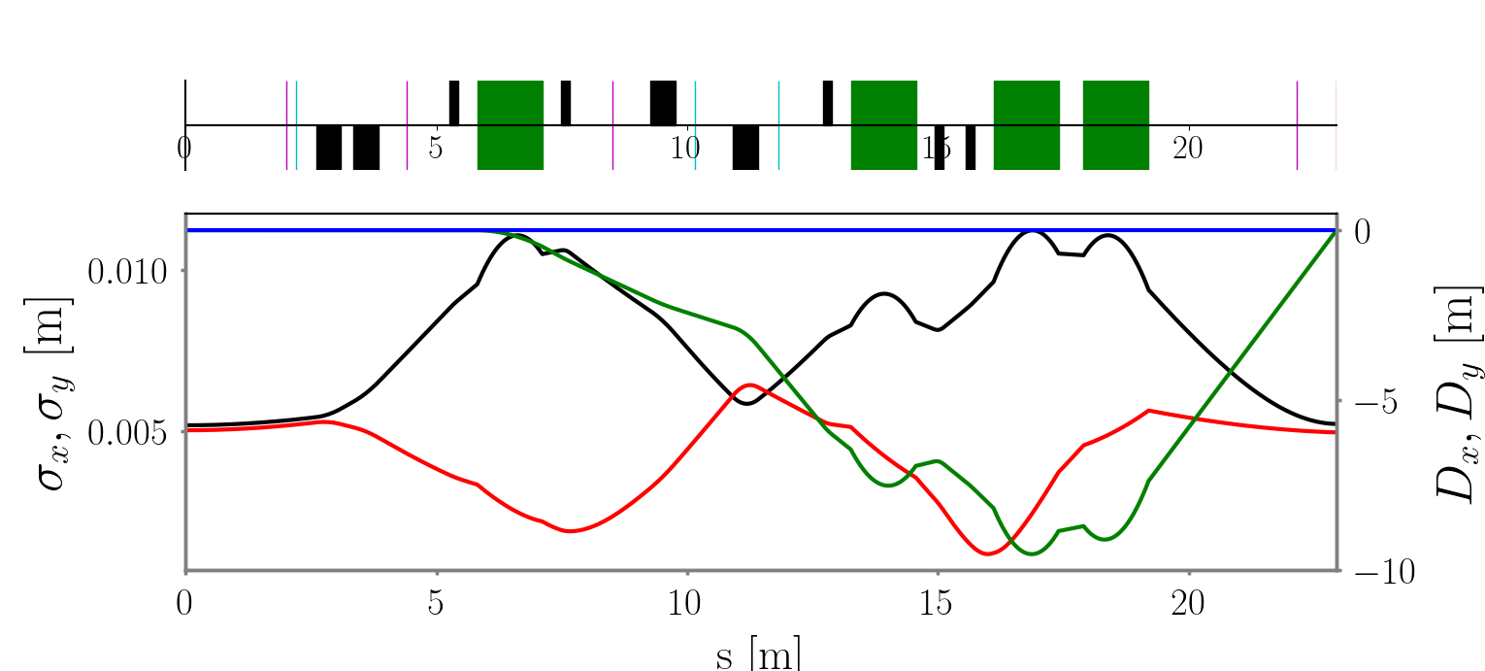
BEAM ENVELOPE

Slide 16
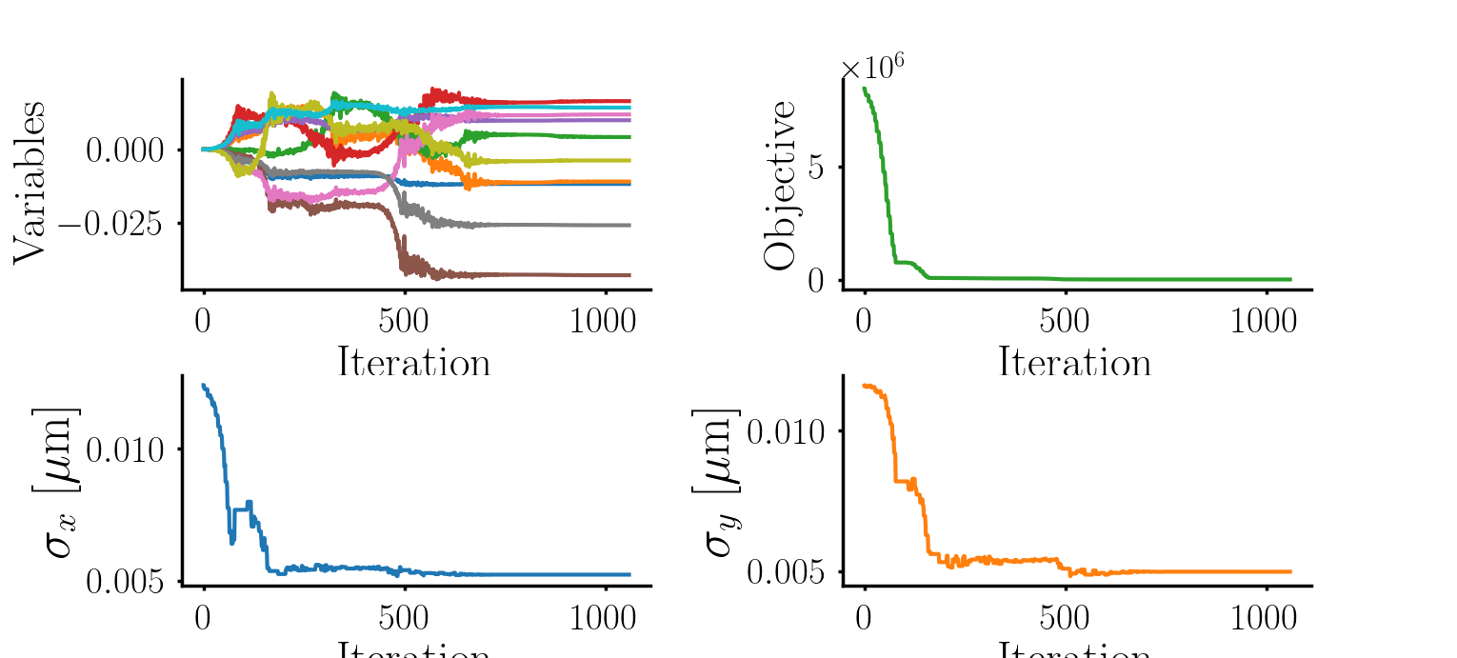
OPTIMIZATION PARS

Slide 19
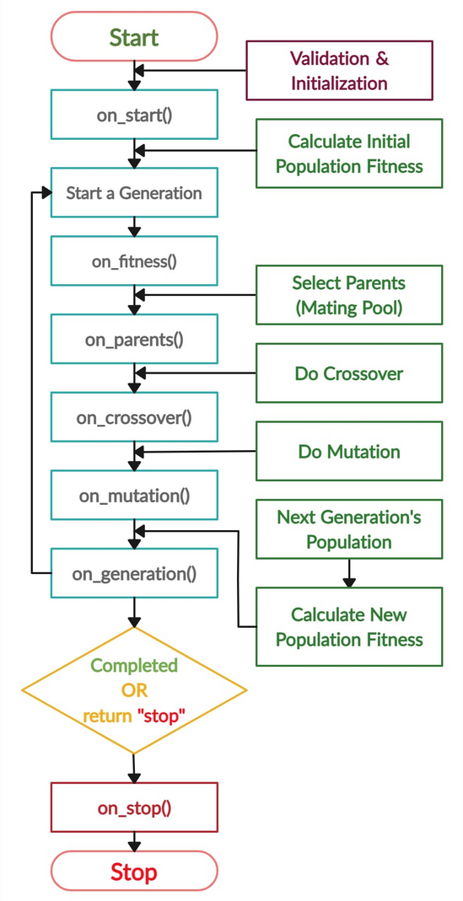
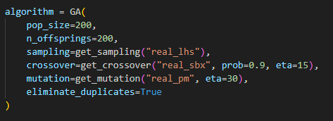
GENETIC ALGORITHM

