Slide 1
🍐
Kulpio
Waste less food. Save money. In any language.
A privacy-first Progressive Web App that tracks your fridge, tells you what expires first, and helps you cook it before it's wasted — offline, on any phone, in 33 languages.
FIRSTEP × INFOMATRIX 2026
Daniil Bejenari
Notes:
Kulpio — a food-freshness tracker PWA. Waste less food, save money, in any of 33 languages. Built for firSTep and Infomatrix 2026.

Slide 2
WHY I BUILT THIS
It started in my own fridge
🍐
The idea in one line
“Don't let me forget the food I already own.”
I kept watching good food go bad — bought with the best intentions, pushed to the back of the shelf, forgotten, then thrown out. That bothered me twice over: it's money in the bin, and wasted food is a real climate problem. So I built the tool I wanted — one that just tells me what to use next, before it's too late.
Notes:
Personal interest: I built Kulpio because I kept wasting food in my own kitchen — money and a climate cost. I wanted a tool that tells me what to use first.

Slide 3
THE PROBLEM
A third of our food is wasted — mostly at home
~1/3
#1
Forget
of all food produced is lost or wasted (FAO)
households are among the largest single contributors
the main cause at home: bought, forgotten, expired
It's an information & attention problem — not a preservation problem. That's exactly what an app can fix.
💡
Notes:
A third of food is wasted; households are a huge share; the cause at home is forgetting. It's an information problem — solvable with software.

Slide 4
UN GLOBAL GOALS
Built for the Sustainable Development Goals
SDG
PRIMARY
SDG
SDG
12
2
13
Responsible Consumption & Production
Zero Hunger
Climate Action
Kulpio's core mission — cut the food households throw away.
Use more of the food we buy; value it instead of binning it.
Less wasted food means fewer needless food-related emissions.
UN Target 12.3: halve per-capita global food waste by 2030. Kulpio goes straight at household waste — the largest, most-forgettable slice.
🎯
Notes:
Kulpio aligns with SDG 12 (Responsible Consumption — primary), SDG 2 (Zero Hunger) and SDG 13 (Climate Action). It directly serves UN Target 12.3: halve food waste by 2030.

Slide 5
THE IDEA
Track it, know what's going off, cook it first
01
📥
02
⏳
03
🍳
Add in seconds
Know what expires
Use it in time
Scan a barcode, read a label or receipt with AI, or paste a list — no typing marathon.
Printed dates beat estimates. Live freshness colours and a 'week-ahead' strip.
Cook what's going off first; mark Used / Wasted / Froze and watch the money you save.
Notes:
A three-step loop: add with almost no effort, see what's expiring, use it in time — with money-saved feedback that keeps you coming back.

Slide 6
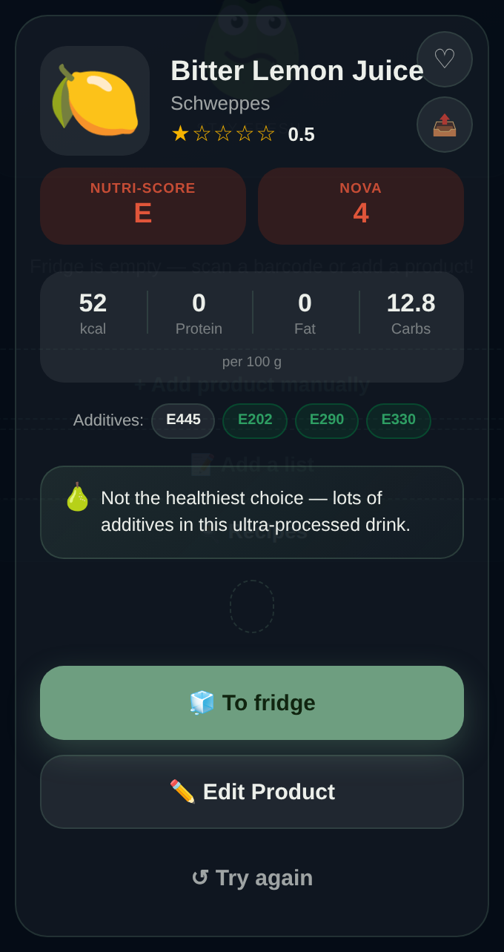
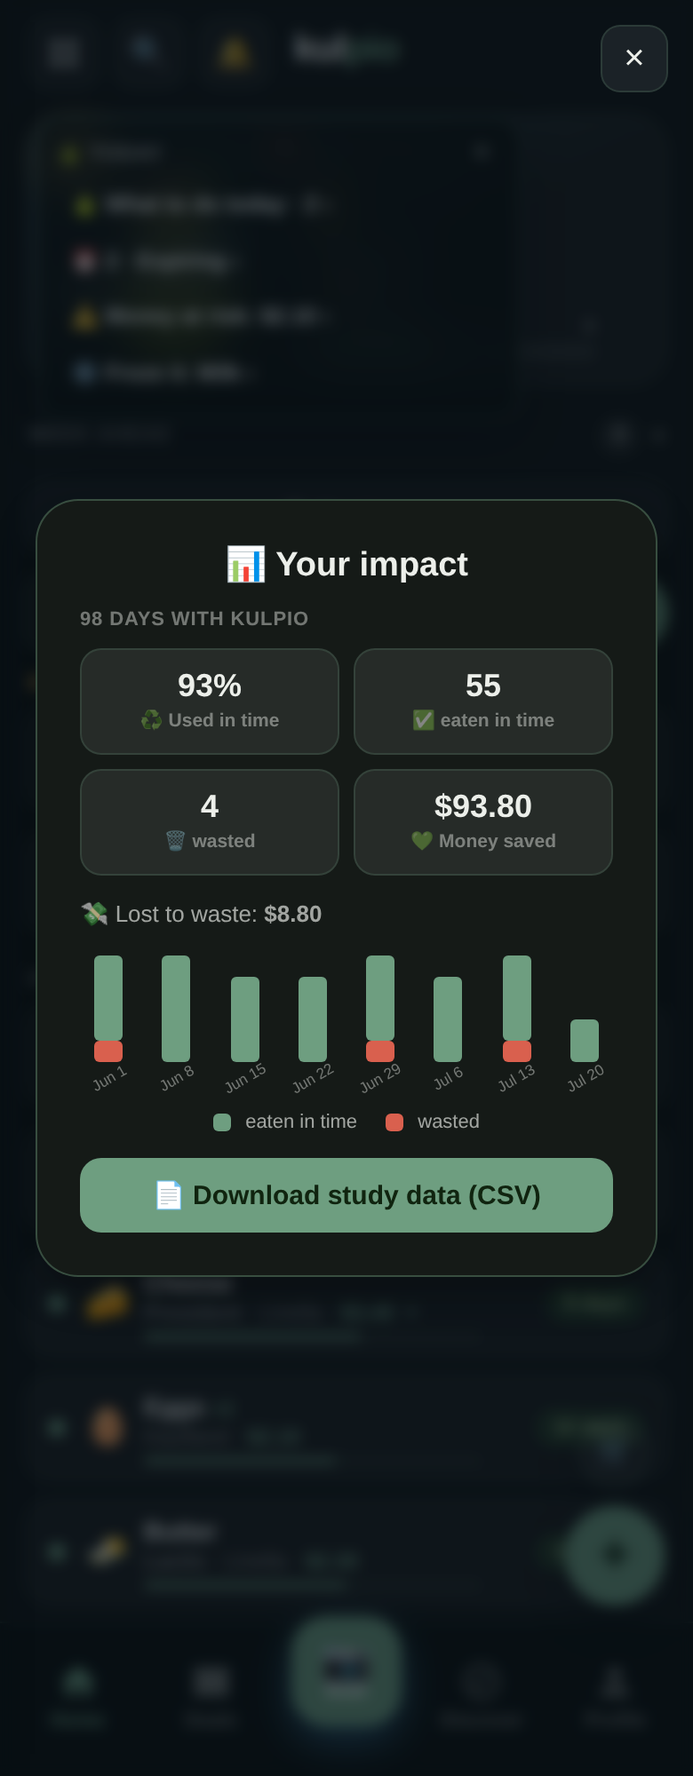
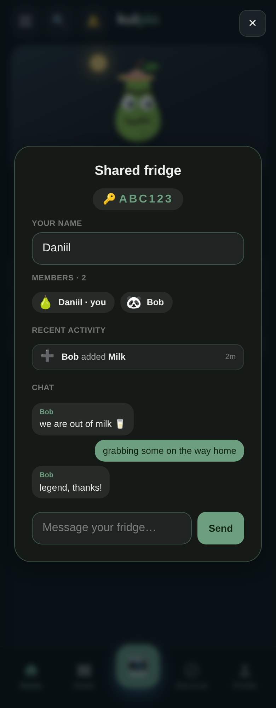
SEE IT
One app, offline, on any phone
Scan → product card additives, Nutri-Score, verdict
Your impact waste cut & money saved
Shared fridge members, activity & chat
Notes:
Real screenshots: the scanned product card, the impact screen, and the shared-fridge chat. Everything runs offline from a single HTML file.

Slide 7
FEATURES
What Kulpio does
📷
🧊
🍅
Effortless input
Storage sections
Recipes
Barcode, AI label & receipt scan, or paste a list
Fridge, freezer & pantry with live freshness
Cook from your ingredients, with nutrition estimates
👥
🏆
🌍
Shared fridge
Motivation
33 languages
One code links a household + activity feed & chat
Achievements, XP levels, monthly recap & impact
Full RTL support; installs to the home screen
Notes:
Six pillars: effortless input, storage sections, recipes, the shared fridge, motivation, and 33-language reach.

Slide 8
METHODOLOGY
How Kulpio decides when food expires
Printed dates are ground truth — Kulpio only estimates when there's no date to read.
1
Printed date wins
Read from the pack (OCR + model) or typed by you. Always takes priority.
AI degrades gracefully
Anthropic Claude (best)
▼
2
Offline shelf-life table
Built-in per-food estimate, adjusted for storage (freezer +~90 d; opened shortens).
↓
Cloudflare Workers AI — Llama (free)
▼
↓
AI refine
When online, the model refines the estimate from the product name.
Clean JSON error — never blocks
3
Notes:
Scientific method: printed date beats an offline shelf-life estimate beats an AI refinement. The AI itself degrades gracefully — Claude, then free Llama, then a clean error — so the app never blocks.

Slide 9
UNDER THE HOOD
Built as one offline file + one worker
📱 Client
☁️ Backend
•
Single static HTML — ~1.3 MB — markup, CSS, JS, 33 langs
•
Cloudflare Worker — serves the app AND the API
•
No build step — no framework, no bundler
•
D1 (SQLite) — accounts, sync, households, community
•
Service worker — precache → fully offline
•
Web Push (VAPID) — daily expiry reminders
•
Web Crypto — hashing & secure tokens
•
Rate-limited auth — PBKDF2 · 5 tries / 15 min
Deploy: one Cloudflare Worker serves static assets + API on a single origin — installs from static hosting, runs offline.
Notes:
Hardware/software: the client is one static HTML file with a service worker; the backend is a single Cloudflare Worker plus D1 (SQLite), Web Push and Web Crypto. No build step, deploys to static hosting.

Slide 10
VS. EXISTING APPS
Why Kulpio is different
Offline, no install
AI label/receipt
Shared fridge + chat
33 languages
Privacy-first
Kulpio
✓
✓
✓
✓
✓
Inventory apps (NoWaste…)
✗
partial
✗
few
varies
Too Good To Go
✗
✗
✗
some
account
Whisk / Samsung Food
✗
partial
✗
some
cloud-first
The combination — offline single-file PWA + AI input + a social shared fridge + privacy — is the edge.
Notes:
No competitor combines offline-first, AI input, a social shared fridge, 33 languages and privacy. The combination is the differentiator.

Slide 11
PRIVACY & SECURITY
Private by design, hardened by default
Local-first
GDPR export
🔒
📤
Your fridge stays in the browser — nothing leaves unless you choose a networked feature.
One tap downloads everything the app holds about you as JSON.
Real deletion
Hardened auth
🗑️
🛡️
Delete account wipes the server account, sessions & synced data.
PBKDF2 hashing, opaque tokens, and login rate-limiting (5 / 15 min).
Notes:
Local-first storage, GDPR export and true account deletion, plus hardened, rate-limited auth — a credible privacy posture that judges and users can trust.

Slide 12
IMPACT
Projected savings — and how we'll measure it
PROJECTION · MODEL, NOT A STUDY
At a mid-range 30% reminder effectiveness:
≈ 30% fewer wasted items ≈ €10–11 saved / household / month ≈ €128 / household / year
Measured for real by a pilot: a within-subject micro-study (baseline vs. Kulpio week, N = 3–15) using the app's built-in CSV export.
Notes:
Honest framing: the chart is a transparent projection from one stated assumption (reminder effectiveness) — NOT measured data. Real numbers come from a within-subject micro-study measured via the app's CSV export. The two are kept separate.

Slide 13
THE JOURNEY
How it evolved — and what I had to solve
01
02
03
04
Offline core
Trustworthy dates
Kill the friction
Social & safe
Single-file PWA + shelf-life table.
AI label reading + estimates.
Barcode, receipt scan, paste-a-list.
Shared fridge, accounts, GDPR, 33 langs.
Challenge solved Had to run with no network → service-worker precache.
Challenge solved Estimates felt unreliable → printed dates always win.
Challenge solved Typing was tedious → four fast input paths.
Challenge solved Two phones clobbered data → server-side merge.
Notes:
Iterations and the problems I solved at each: offline (service worker), trustworthy dates (printed beats estimate), low-friction input (four paths), and safe multi-device sync (server-side merge).

Slide 14
NEXT & SUSTAINABLE
Where it goes — and how it stays alive
⚖️
Open & sustainable
🚀
Roadmap
Free under GNU AGPL v3 for open use. Paid commercial licence for closed-source use — per product:
→
Run the real user pilot & publish results
→
Validate the offline shelf-life table
Indie €250 · Business €1,500 · Enterprise €5,000+
→
Email verification (add an email provider)
→
Field-level merge for multi-device edits
Keeps the project open while funding its future.
→
Shareable monthly impact report
Notes:
Future improvements: run the real pilot, validate the shelf-life table, add email verification, field-level merge, and a shareable impact report. Sustained by a dual-license model.

Slide 15
🍐
Waste less. Save more. Together.
Kulpio — a food-freshness tracker that fits in your pocket, in your language.
SDG 12
SDG 2
SDG 13
Daniil Bejenari · github.com/Gugster777/kulpio · firSTep × Infomatrix 2026
Notes:
Thank you. Kulpio: waste less, save money, in any language — built for the Global Goals. Questions welcome.

