Slide 1
🍐
Kulpio
Waste less food. Save money. In any language.
A single-file offline PWA + one Cloudflare Worker that helps households waste less food — AI input, trustworthy expiry, a shared fridge, 33 languages.
INFOMATRIX 2026
PROGRAMMING
Daniil Bejenari T.L. Orizont · Ceadîr-Lunga
Notes:
Title — Kulpio for Infomatrix, Programming category. Introduce yourself and the school (T.L. Orizont, Ceadîr-Lunga), then the project and its technical scope.

Slide 2
THE PROBLEM
A third of our food is wasted — mostly at home
~1/3
#1
Forget
of all food produced is lost or wasted (FAO)
households are among the largest single contributors
the main cause at home: bought, forgotten, expired
It's an information & attention problem — not a preservation problem. That's exactly what an app can fix.
💡
Sources: FAO — Global Food Losses & Food Waste · UNEP — Food Waste Index Report.
Kulpio · food-freshness tracker
02
Notes:
A third of food is wasted; households are a huge share; the cause at home is forgetting — an information problem, solvable with software.

Slide 3
UN GLOBAL GOALS
Built for the Sustainable Development Goals
SDG
PRIMARY
SDG
SDG
12
2
13
Responsible Consumption & Production
Zero Hunger
Climate Action
Kulpio's core mission — cut the food households throw away.
Use more of the food we buy; value it instead of binning it.
Less wasted food means fewer needless food-related emissions.
UN Target 12.3: halve per-capita global food waste by 2030. Kulpio goes straight at household waste — the largest, most-forgettable slice.
🎯
Kulpio · food-freshness tracker
03
Notes:
Kulpio aligns with SDG 12 (Responsible Consumption — primary), SDG 2 (Zero Hunger) and SDG 13 (Climate Action), and directly serves UN Target 12.3: halve food waste by 2030.

Slide 4
THE IDEA
Track it, know what's going off, cook it first
01
📥
02
⏳
03
🍳
Add in seconds
Know what expires
Use it in time
Scan a barcode, read a label or receipt with AI, or paste a list — no typing marathon.
Printed dates beat estimates. Live freshness colours and a 'week-ahead' strip.
Cook what's going off first; mark Used / Wasted / Froze and watch the money you save.
Kulpio · food-freshness tracker
04
Notes:
A three-step loop: add with almost no effort, see what's expiring, use it in time — with money-saved feedback that keeps you coming back.

Slide 5
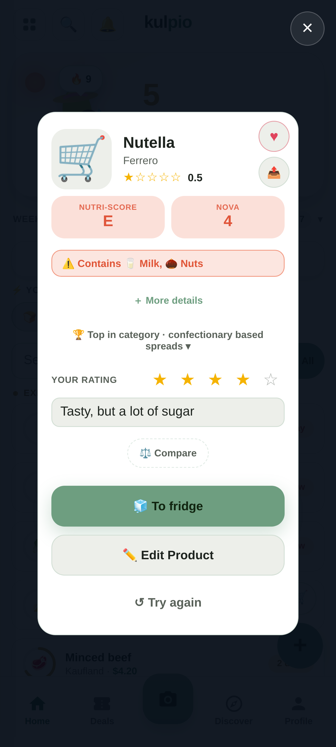
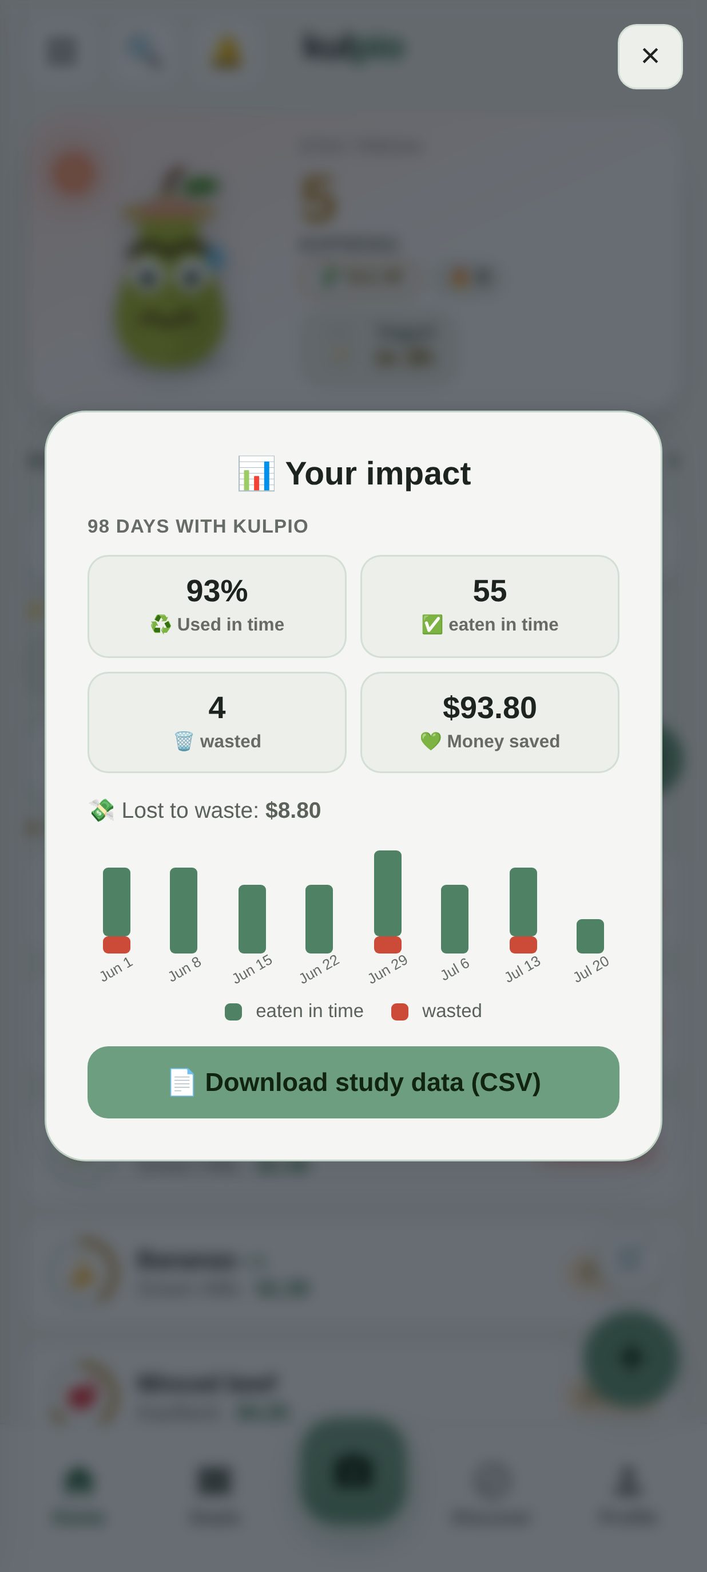
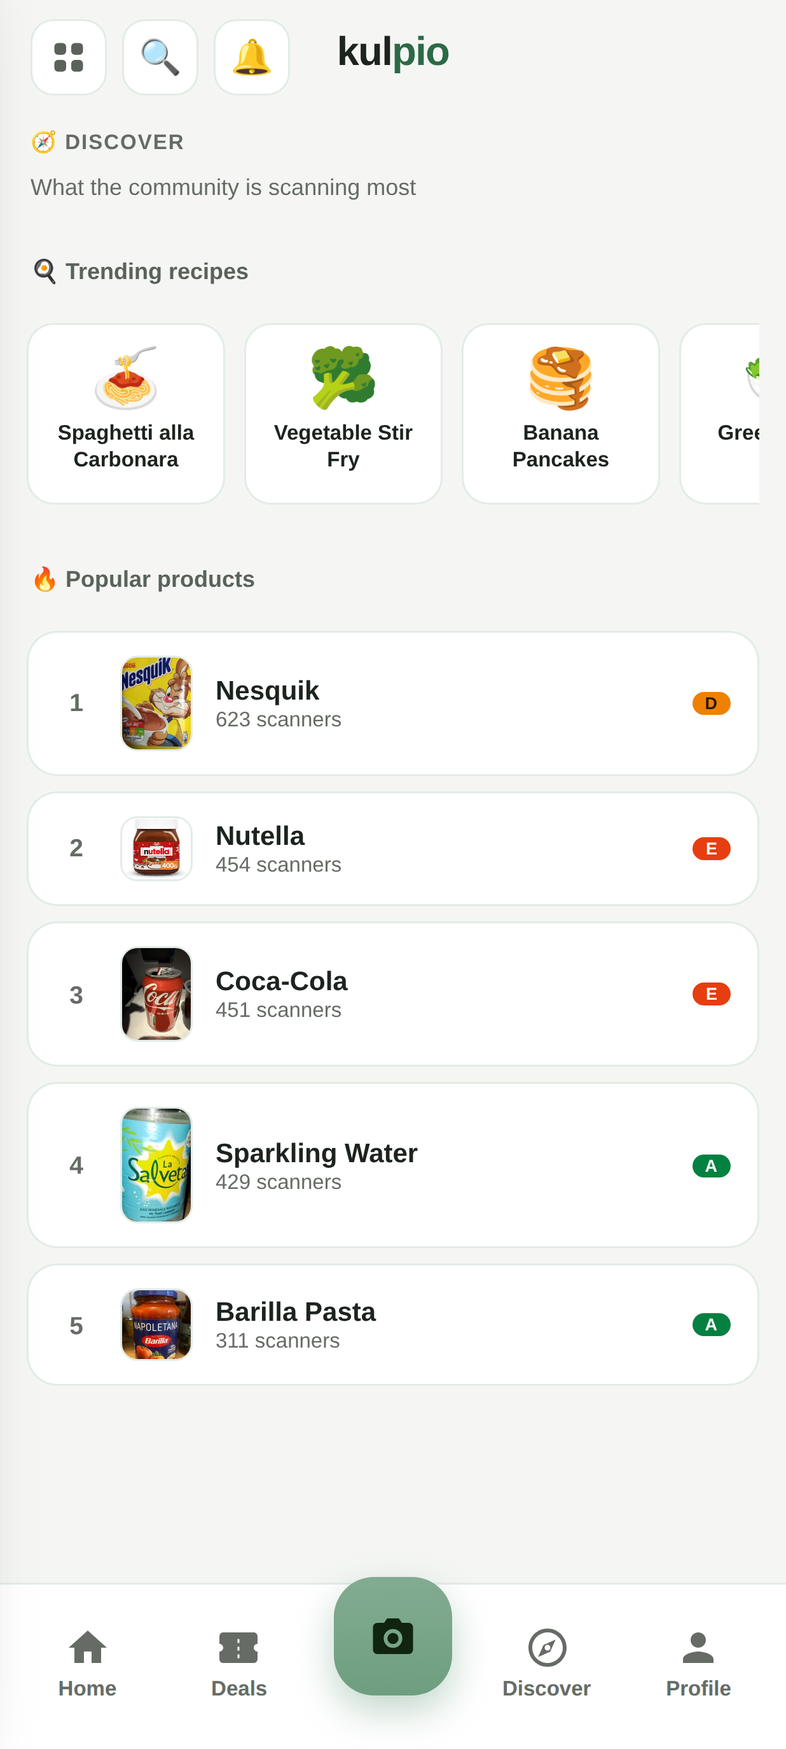
SEE IT
One app, offline, on any phone
Scan → product card Nutri-Score, allergens, verdict
Your impact waste cut & money saved
Discover what the community scans
Kulpio · food-freshness tracker
05
Notes:
Real screenshots: the scanned product card with an allergen warning, the impact screen, and the community Discover leaderboard. Everything runs offline from a single HTML file.

Slide 6
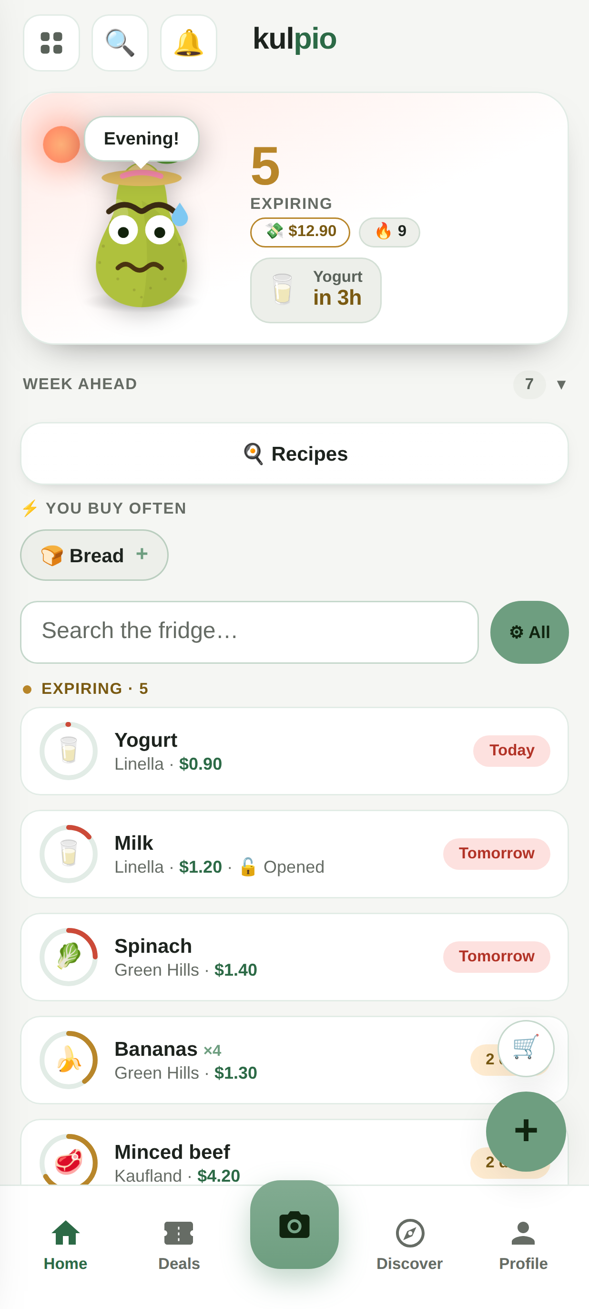
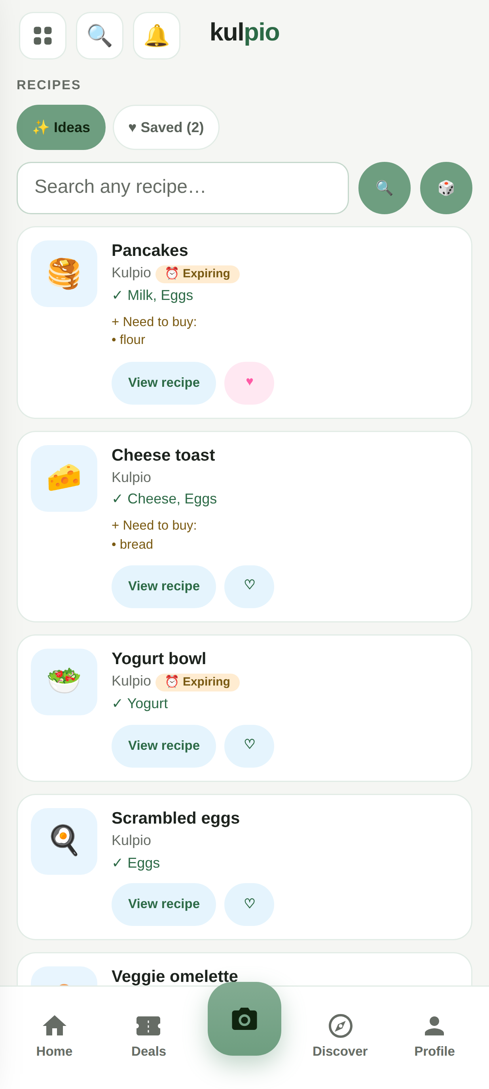
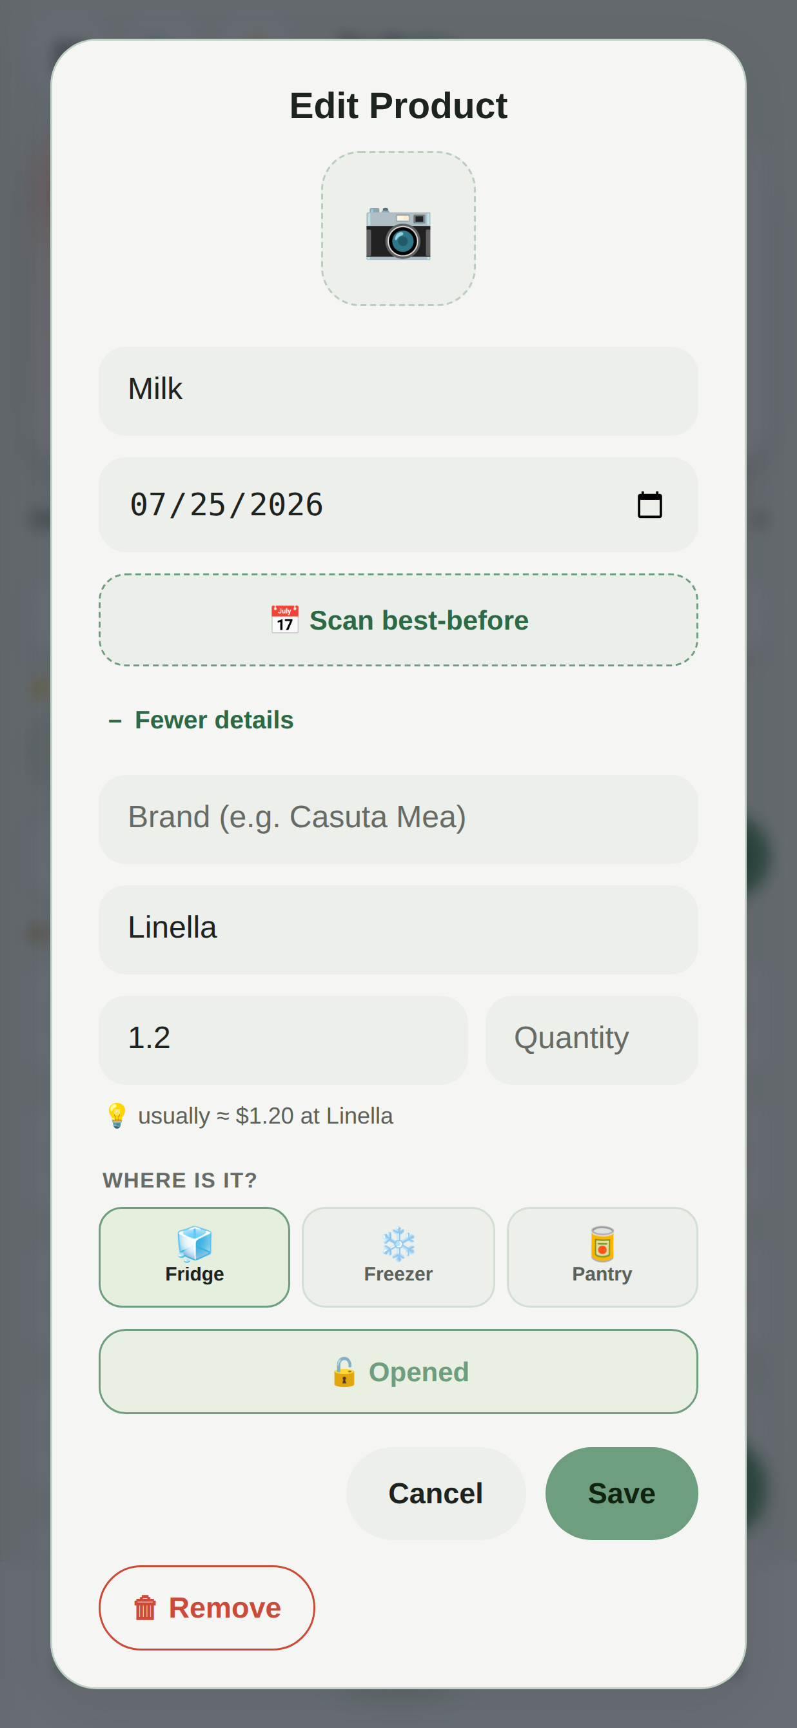
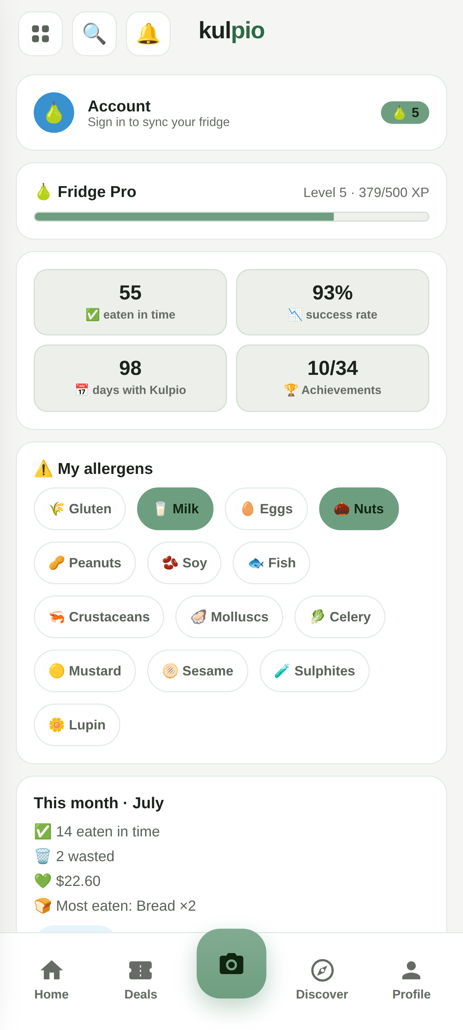
A CLOSER LOOK
A quick tour of the app
Home dashboard today, week-ahead & fridge
Recipes cook from what you have
Every item, one tap edit, price history, storage
Profile & levels achievements, XP & impact
Kulpio · food-freshness tracker
06
Notes:
A quick product tour: the home dashboard, recipes from your ingredients, the per-item edit with price history, and the profile with levels and impact.

Slide 7
FEATURES
What Kulpio does
📷
🧊
🍅
Effortless input
Storage sections
Recipes
Barcode, AI label & receipt scan, or paste a list
Fridge, freezer & pantry with live freshness
Cook from your ingredients, with nutrition estimates
👥
🏆
🌍
Shared fridge
Motivation
33 languages
One code links a household + activity feed & chat
Achievements, XP levels, monthly recap & impact
Full RTL support; installs to the home screen
Kulpio · food-freshness tracker
07
Notes:
Six pillars: effortless input, storage sections, recipes, the shared fridge, motivation, and 33-language reach.

Slide 8
METHODOLOGY
How Kulpio decides when food expires
Printed dates are ground truth — Kulpio only estimates when there's no date to read.
1
Printed date wins
Read from the pack (OCR + model) or typed by you. Always takes priority.
AI degrades gracefully
Best cloud AI model (top quality)
▼
2
Offline shelf-life table
Built-in per-food estimate, adjusted for storage (freezer +~90 d; opened shortens).
↓
Cloudflare Workers AI — Llama (free)
▼
↓
3
AI refine
When online, the model refines the estimate from the product name.
Clean error — never blocks
Kulpio · food-freshness tracker
08
Notes:
Scientific method: printed date beats an offline shelf-life estimate beats an AI refinement. The AI itself degrades gracefully — best model, then a free Llama fallback, then a clean error — so the app never blocks.

Slide 9
UNDER THE HOOD
Built as one offline file + one worker
📱 Client
☁️ Backend
•
Single static HTML — ~1.3 MB — markup, CSS, JS, 33 langs
•
Cloudflare Worker — serves the app AND the API
•
No build step — no framework, no bundler
•
D1 (SQLite) — accounts, sync, households, community
•
Service worker — precache → fully offline
•
Web Push (VAPID) — daily expiry reminders
•
Web Crypto — hashing & secure tokens
•
Rate-limited auth — PBKDF2 · 5 tries / 15 min
Deploy: one Cloudflare Worker serves static assets + API on a single origin — installs from static hosting, runs offline.
Kulpio · food-freshness tracker
09
Notes:
Hardware/software: the client is one static HTML file with a service worker; the backend is a single Cloudflare Worker plus D1 (SQLite), Web Push and Web Crypto. No build step; deploys to static hosting.

Slide 10
VS. EXISTING APPS
Why Kulpio is different
Offline, no install
AI label/receipt
Shared fridge + chat
33 languages
Privacy-first
Kulpio
✓
✓
✓
✓
✓
Inventory apps (NoWaste…)
✗
partial
✗
few
varies
Too Good To Go
✗
✗
✗
some
account
Whisk / Samsung Food
✗
partial
✗
some
cloud-first
The combination — offline single-file PWA + AI input + a social shared fridge + privacy — is the edge.
Kulpio · food-freshness tracker
10
Notes:
No competitor combines offline-first, AI input, a social shared fridge, 33 languages and privacy. The combination is the innovation.

Slide 11
PRIVACY & SECURITY
Private by design, hardened by default
Local-first
GDPR export
🔒
📤
Your fridge stays in the browser — nothing leaves unless you choose a networked feature.
One tap downloads everything the app holds about you as JSON.
Real deletion
Hardened auth
🗑️
🛡️
Delete account wipes the server account, sessions & synced data.
PBKDF2 hashing, opaque tokens, and login rate-limiting (5 / 15 min).
Kulpio · food-freshness tracker
11
Notes:
Local-first storage, GDPR export and true account deletion, plus hardened, rate-limited auth — a credible privacy posture users and judges can trust.

Slide 12
QUALITY
Built to last — and tested
1
33
300+
4
static HTML file — no build step, no framework
languages, with full right-to-left support
automated checks run offline on every push
test suites: structure, smoke, worker auth & sync
Every push runs the full suite in CI — text guard-rails, a 300+-check headless Playwright smoke test that runs the app fully offline, and Node tests for auth, push/cron and household-merge.
AI degrades gracefully: best cloud model → free Cloudflare Workers AI (Llama) → clean error. The app never blocks on AI.
Kulpio · food-freshness tracker
12
Notes:
One file, 33 languages, 300+ offline checks across 4 suites, all in CI on every push. The AI path degrades gracefully so it never blocks the app.

Slide 13
THE JOURNEY
How it evolved — and what I had to solve
01
02
03
04
Offline core
Trustworthy dates
Kill the friction
Social & safe
Single-file PWA + shelf-life table.
AI label reading + estimates.
Barcode, receipt scan, paste-a-list.
Shared fridge, accounts, GDPR, 33 langs.
Challenge solved Had to run with no network → service-worker precache.
Challenge solved Estimates felt unreliable → printed dates always win.
Challenge solved Typing was tedious → four fast input paths.
Challenge solved Two phones clobbered data → server-side merge.
Kulpio · food-freshness tracker
13
Notes:
Iterations and the problem solved at each: offline (service worker), trustworthy dates (printed beats estimate), low-friction input (four paths), and safe multi-device sync (server-side merge).

Slide 14
WHAT'S NEXT
Where Kulpio goes from here
🚀
Roadmap
🌍
Free & open-source
→
Native Android app on the Play Store
Released under the GNU AGPL v3 — free for anyone to use, study and build on. The vision: help households everywhere waste less food and save money — in their own language.
→
Run the real user pilot & publish measured results
→
Validate the offline shelf-life table against reference data
→
Email verification (add an email provider)
→
Field-level merge for multi-device offline edits
→
A shareable monthly impact report
Kulpio · food-freshness tracker
14
Notes:
Future improvements: a native Android app, the real pilot, validate the shelf-life table, add email verification, field-level merge and a shareable impact report. Kulpio is free and open-source under the AGPL v3.

Slide 15
🍐
Waste less. Save more. Together.
Kulpio — a food-freshness tracker that fits in your pocket, in your language.
SDG 12
SDG 2
SDG 13
Daniil Bejenari · T.L. Orizont · Ceadîr-Lunga github.com/Gugster777/kulpio · Infomatrix 2026
Notes:
Thank you. Kulpio: waste less, save money, in any language — built for the Global Goals. Questions welcome.

