Slide 1
TV
BrightTv Viewership Analytics
Gugulethu Mabena

Slide 2
01
02
The View
03
04
Overview
Top 5 viewed channels
Viewership Demographics
Recommendations

Slide 3
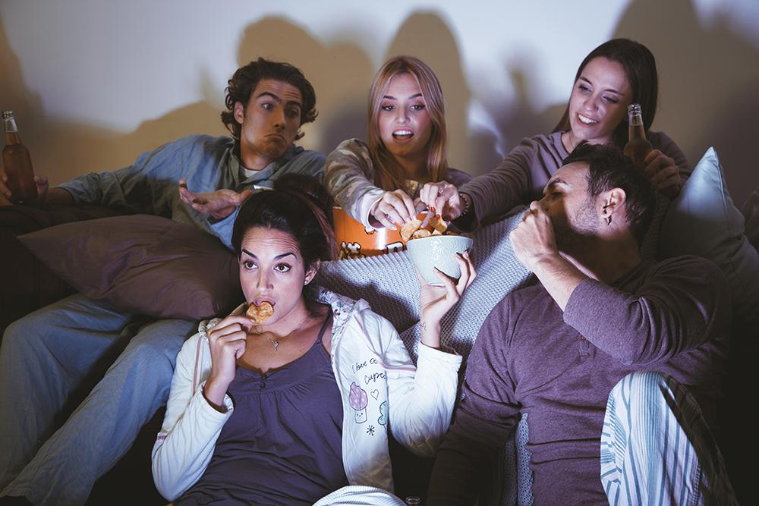
01
Overview

Slide 4
Overview
To grow the company’s subscription base some insights have been provided.
Various viewing aspects were taken into consideration to account for this.
The 4-month viewing period was accounted for, for this analysis: Jan 2016 – April 2016.
The following viewer demographics were accounted for: gender, rage, age
Recommendations have been tailored to ground this analysis further

Slide 5
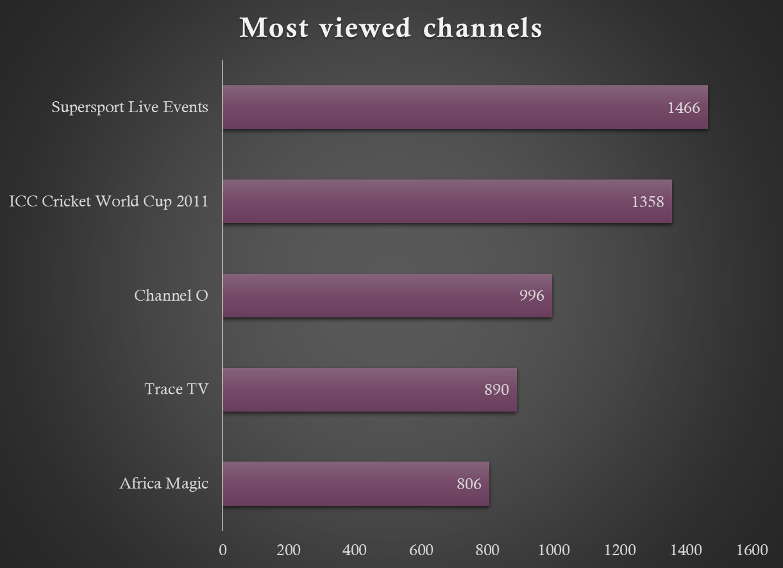
You could use three columns, why not?
Most viewed channels
For the period 01/01/2016 – 01/04/2016, SuperSport Live Events was the leading channel with a total of 1466 views.
ICC Cricket World Cup 2011, comes in at second place
2 music channels (Trace TV & Channel O), fetched 3rd and 4th place in viewing

Slide 6

What female viewers watched
The top show viewed by females was Africa Magic with 155 views.
Interestingly, cartoon channels show up in the top 5 pick for females.

Slide 7
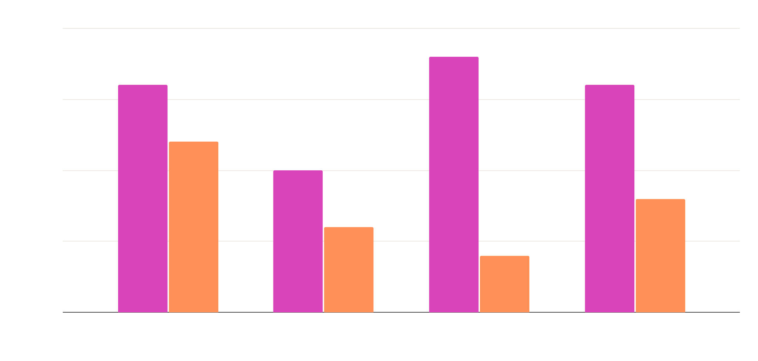
What male viewers watched
By contrast, males viewing habits is dominated by sporting channels
SuperSport Live Events comes out top with 1362 males glued to their screens

Slide 8

Viewing times
4pm – 8pm
Is the most popular viewing slot
12am – 4am
Viewing has slowed at this time

Slide 9

02
Demographics

Slide 10
What about four columns?
March 2016
Saw the most views in the period under review
Rival time slots
12pm – 4pm and 4pm – 8pm are the times racking in the most views

Slide 11
Viewership by province & gender
01
02
210 Females in Gauteng scaled the viewing charts
1704 Males in Gauteng dominated the charts

Slide 12
Infographics make your idea understandable…
Gauteng
The province with most viewership
Provinces with least viewership
Northern Cape, Free State, and North West each have under just 5% viewership

Slide 13
7,498,300
Big numbers catch your audience’s attention

Slide 14
Here are some percentages
37%
59%
85%
Mars
Mercury
Saturn
Even if it’s red, but Mars is a cold place
Mercury is the closest planet to the Sun
Saturn is the ringed one and a gas giant

Slide 15
Who watches what, where?
Gauteng, the viewership is dominated by black, indian-asian, and white viewers
N. Cape, the viewership is dominated by coloured viewers

Slide 16
March 2016
Sporting came out tops across the board.
This particular month recorded the most views for these events

Slide 17

Mobile web
Mars
It’s red, but Mars is actually a cold place
Mercury
You can replace the image with your own work. Delete this one, add yours and send it to the back
It’s the closest planet to the Sun
Saturn
Saturn is the ringed one and a gas giant

Slide 18
Recommendations
Let’s offer content bundles that speak directly to different audiences based on where they live and what they love to watch.
A fun, rewarding referral program can turn our current viewers into our best promoters.
We should make the most of our peak viewing hours by running special subscription offers when people are most engaged.
By partnering with local voices and offering region-specific deals, we can grow our presence in areas where we’re not yet strong.
Thank you!

Slide 19
Thank you!

