Slide 1

AMAZON SALES ANALYSIS
Task 4 – Data Storytelling & Statistical Validation
Presented By
G Bhanupriya
Data Analytics Internship
ApexPlanet Software Pvt. Ltd.
July 2026

Slide 2
PROJECT OVERVIEW
Amazon Sales Dataset & Business Objectives
🎯 Project Objective
Analyze the Amazon Sales dataset to identify revenue trends, customer purchasing behavior, product performance, and payment preferences. The goal is to transform raw sales data into actionable business insights through data analysis, visualization, and storytelling.
🛠 Tools Used
🐍 Python
🐼 Pandas
🗄 SQL
📊 Power BI
📈 Matplotlib
📂 Dataset Summary
Attribute | Value
Dataset | Amazon Sales
Orders | 250
Revenue | $247,000
Products | 10
Payment Methods | 5
Analysis Period | Feb– Apr 2025
🔄 Workflow
Data Collection → Data Cleaning → EDA→ Dashboard → Insights

Slide 3
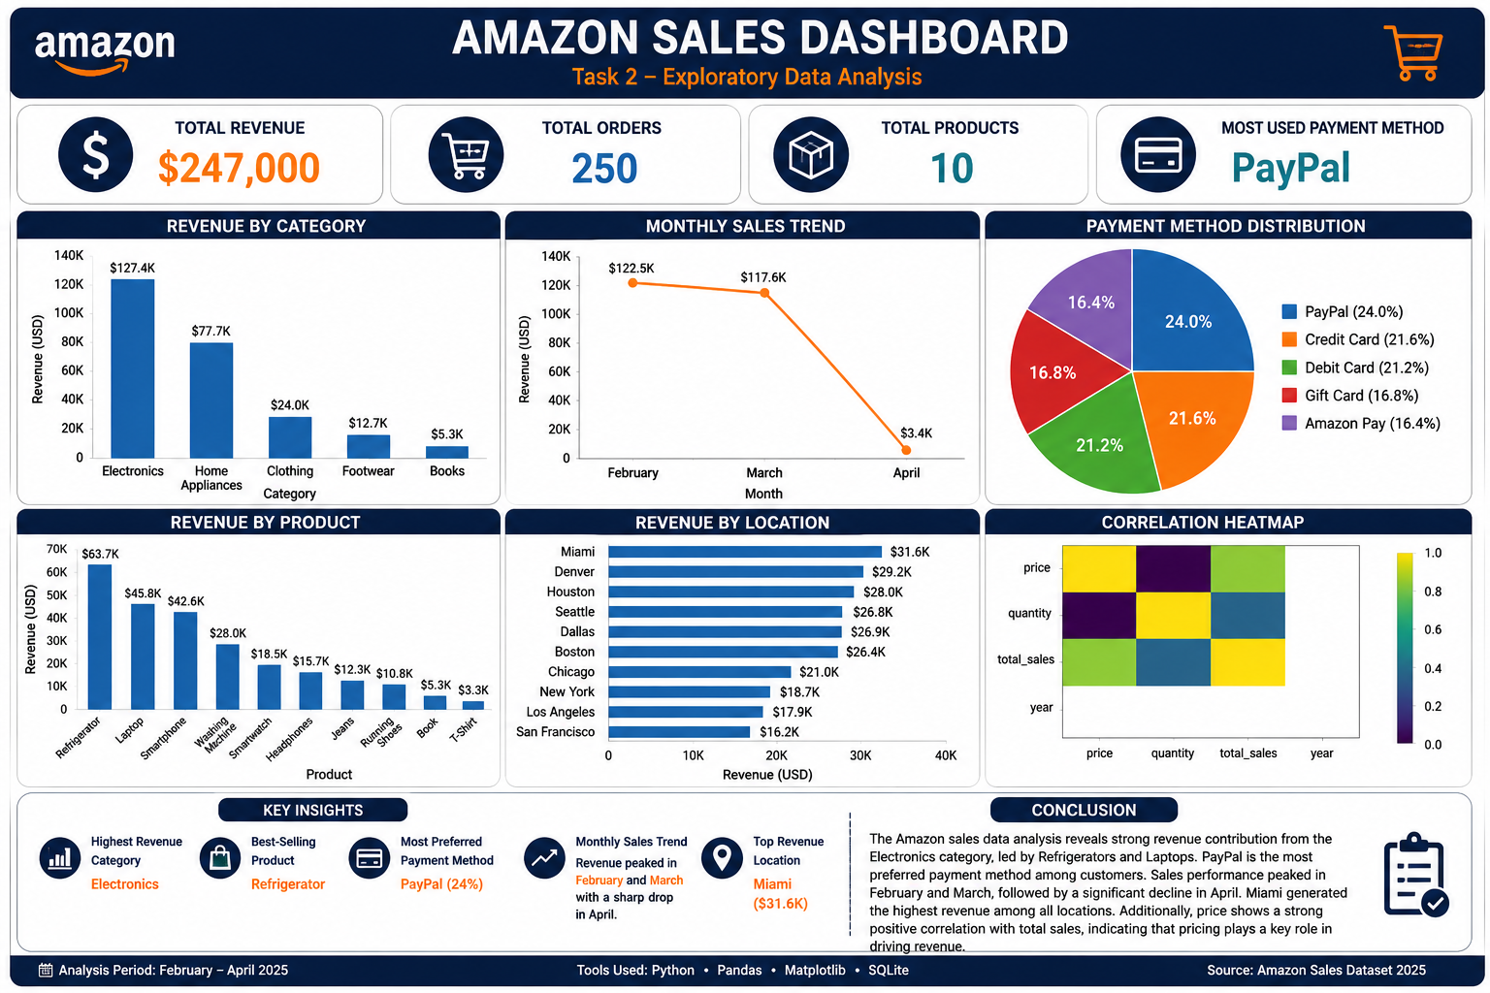
DASHBOARD OVERVIEW
The interactive dashboard provides a comprehensive view of Amazon sales performance, revenue trends, product categories, payment methods, and business insights.

Slide 4
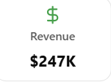
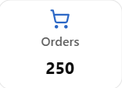
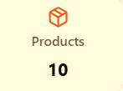
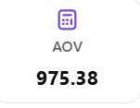
KPI ANALYSIS
Key Performance Indicators
Key Insights
Electronics generated the highest revenue.
Refrigerator was the best-selling product.
PayPal was the preferred payment method.
Miami recorded the highest sales.
February and March achieved peak revenue

Slide 5
DATA STORY
Business Insights from Amazon Sales
📈 Sales Performance
The Amazon sales analysis reveals strong business performance with a total revenue of $247K generated from 250 customer orders. Electronics emerged as the highest revenue-generating category, with Refrigerator being the best-selling product. Customers preferred PayPal as their primary payment method, highlighting the popularity of secure digital payments.
Business Story
📈 Electronics drove overall business growth.
🛒 Refrigerator contributed the highest product revenue.
💳 PayPal was the most preferred payment method.
📍 Miami emerged as the highest-performing city.
📅 Sales peaked in February and March before declining in April.
💡 Pricing showed a positive relationship with total sales.
📊 Sales Trend
Monthly sales peaked during February and March, followed by a noticeable decline in April. This suggests that seasonal demand or promotional campaigns may have influenced customer purchasing behavior. Miami recorded the highest revenue among all locations, indicating a strong regional market.

Slide 6
STATISTICAL VALIDATION
Hypothesis Testing & Business Validation
📈 Statistical Method
Correlation Analysis
Descriptive Statistics
Dashboard Trend Analysis
🎯 Objective
To validate whether the observed sales patterns are supported by statistical analysis and can be used for business decision-making.
📊 Result
Positive correlation observed between Price and Total Sales.
Higher-priced products generated greater revenue.
Sales trends support the business findings.
🧪 Hypothesis
Null Hypothesis (H₀)
There is no significant relationship between product price and total sales revenue.
Alternative Hypothesis (H₁)
There is a positive relationship between product price and total sales revenue.
💼 Business Conclusion
The statistical analysis supports the conclusion that pricing influences total revenue. Products with higher prices contributed more to overall sales, making pricing strategy an important factor for business growth.

Slide 7
BUSINESS RECOMMENDATIONS
Actionable Insights for Business Growth
📈 Recommendations
💻 Increase Focus on Electronics
Electronics generated the highest revenue. Expanding product variety and running targeted promotions can further increase sales.
🛒 Promote Best-Selling Products
Refrigerator was the best-selling product. Bundle offers and seasonal discounts can improve customer purchases.
💳 Strengthen Digital Payments
PayPal was the most preferred payment method. Offering cashback and exclusive online payment discounts can enhance customer experience.
📍 Expand High-Performing Markets
Miami recorded the highest sales. Similar marketing strategies can be implemented in other cities to boost revenue.
📅 Improve Low-Sales Months
Sales declined in April. Running promotional campaigns, festive offers, and loyalty programs can help maintain consistent monthly sales.
📌 Expected Business Impact
✔ Higher Revenue
✔ Increased Customer Satisfaction
✔ Better Sales Performance
✔ Improved Marketing Strategy
✔ Sustainable Business Growth

Slide 8
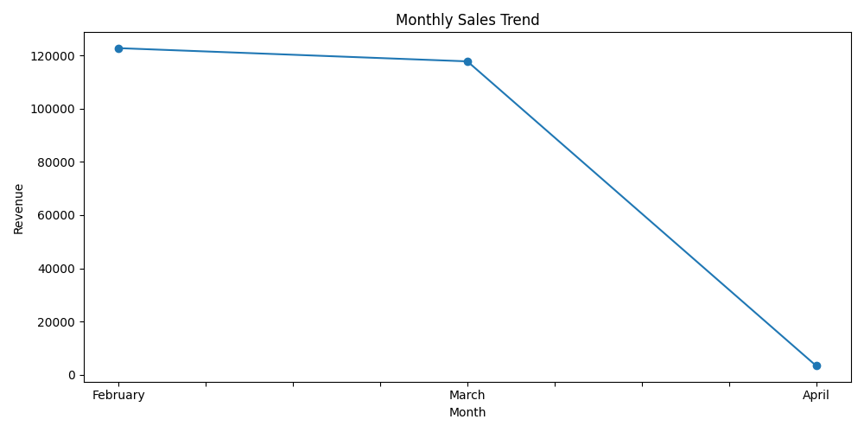
MONTHLY SALES TREND
Revenue Performance Across Months
📈 Analysis
Sales increased steadily during the initial months.
Revenue peaked in February and March.
A decline was observed in April, indicating possible seasonal effects or reduced customer demand.
Stable monthly monitoring can help improve future sales forecasting.
🎯 Key Insight
Peak sales occurred during February and March, making them the strongest-performing months.

Slide 9
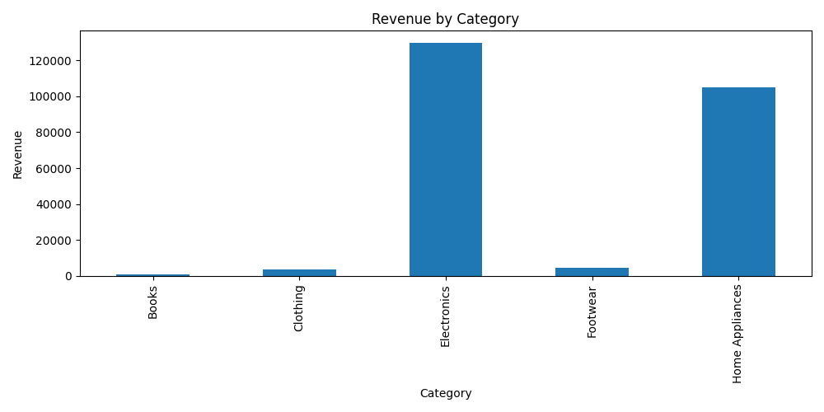
PRODUCT PERFORMANCE
Category & Product Insights
📊 Analysis
Electronics generated the highest overall revenue.
Refrigerator emerged as the best-selling product.
High-performing products significantly contributed to total sales.
Expanding successful product categories can increase future revenue.
💡 Key Insight
Electronics remained the primary revenue driver throughout the analysis period.

Slide 10
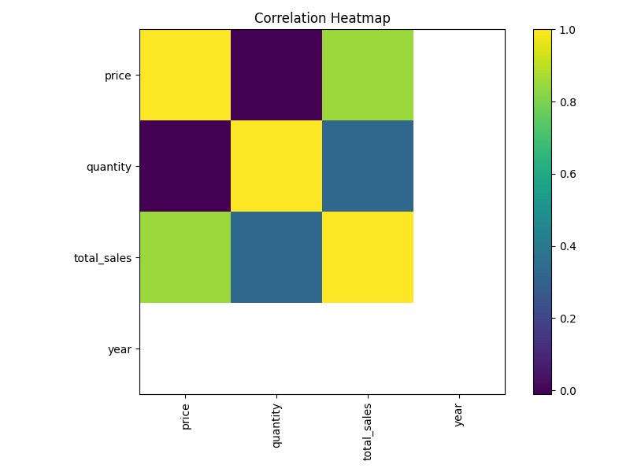
CORRELATION ANALYSIS
Statistical Relationship Between Variables
📈 Observation
A positive relationship exists between Price and Total Sales.
Higher-priced products generated higher revenue.
Strong positive correlations support the business insights obtained from the dashboard.
✅ Validation
The correlation analysis confirms that pricing has a measurable impact on overall revenue, supporting the conclusions drawn from the dashboard.

Slide 11
CONCLUSION
Project Summary & Final Insights
📌 Project Summary
The Amazon Sales Analysis project successfully transformed raw sales data into meaningful business insights using Python, SQL, and Power BI. Through interactive dashboards, KPI analysis, data storytelling, and statistical validation, the project identified key trends in revenue, customer behavior, product performance, and regional sales. These insights provide valuable support for data-driven business decisions.
🎯 Key Achievements
🏆 Revenue Analyzed: $247K
📦 Orders Evaluated: 250
📈 Top Category: Electronics
🛒 Best-Selling Product: Refrigerator
💳 Most Preferred Payment Method: PayPal
📍 Top Performing City: Miami
📊 Validated Through: Correlation Analysis & Dashboard Insights
💡 Final Takeaway
Data becomes valuable only when it is transformed into actionable insights. This project demonstrates how analytics can support smarter decisions, optimize business performance, and drive sustainable growth.

Slide 12
THANK YOU!
Amazon Sales Analysis
Turning Data into Meaningful Business Insights
Thank You for Your Time & Consideration

