Slide 1
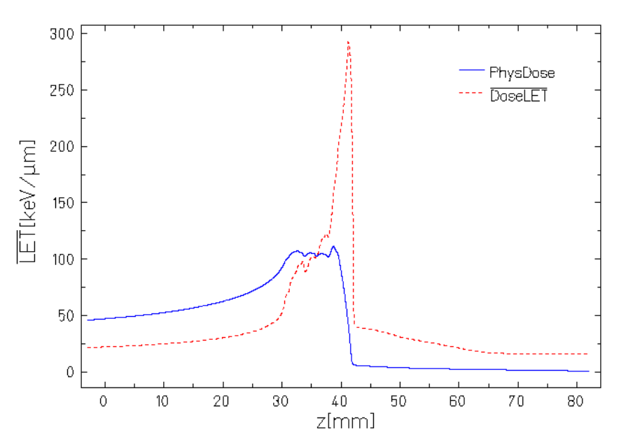
A
Entrance
SOBP
B
C
D
Entrance
SOBP
E
F
G
Notes:
Figure 1

Slide 2
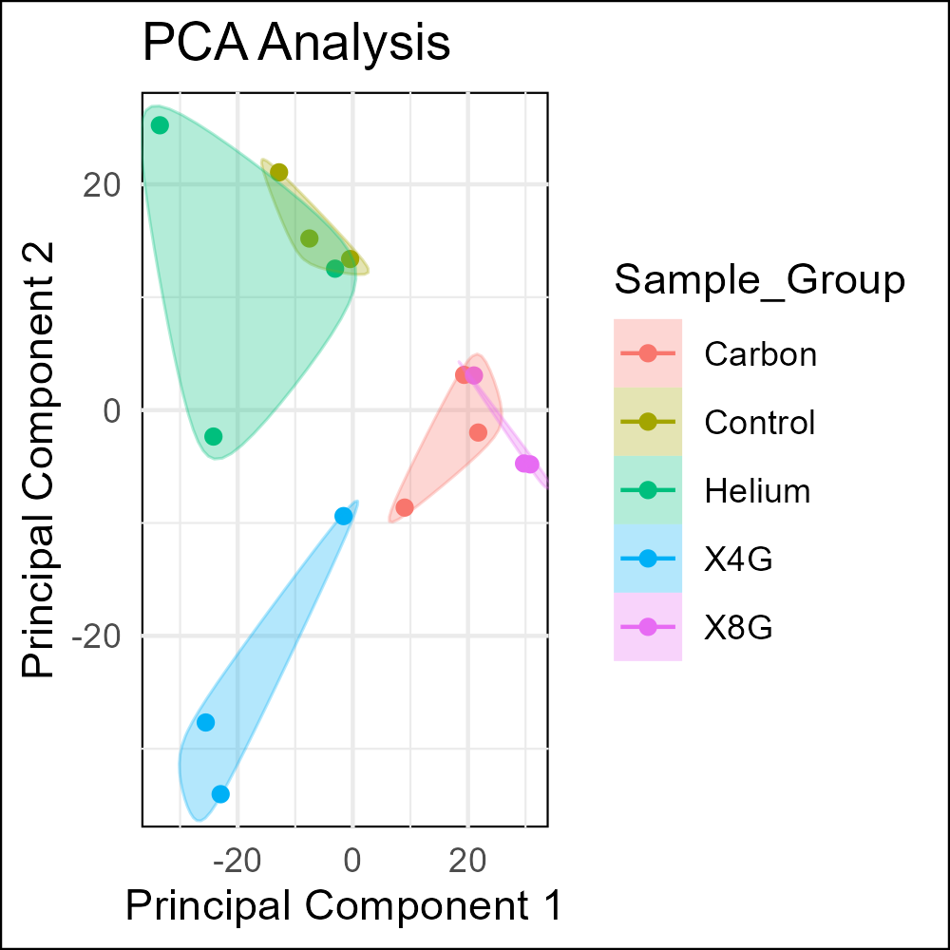
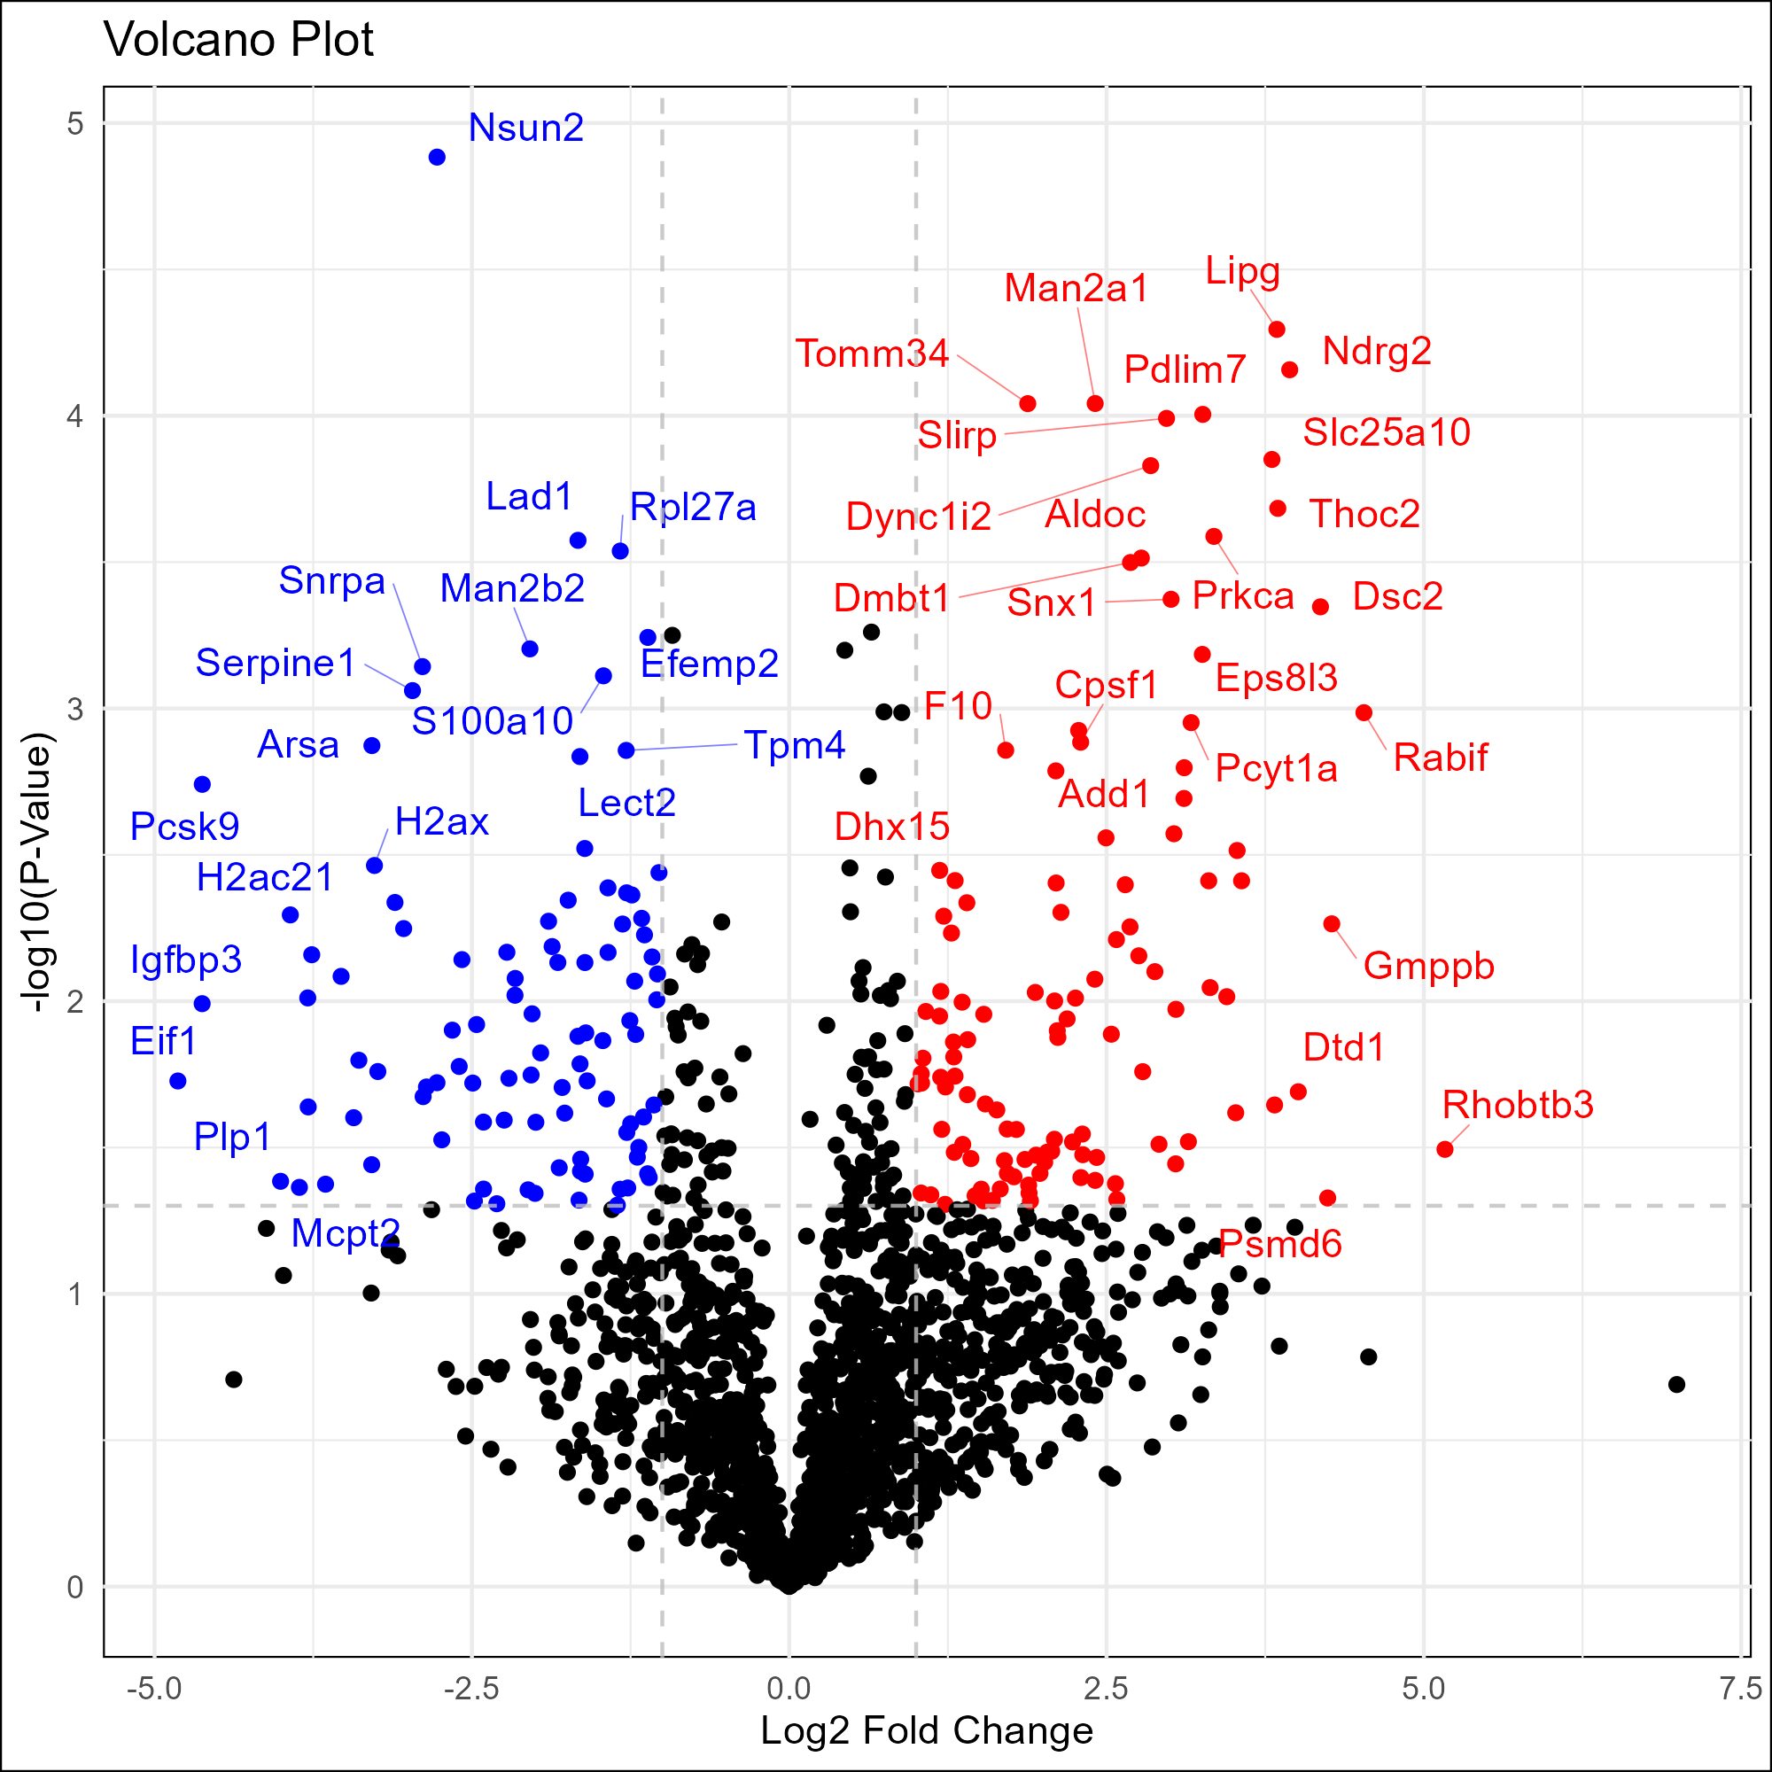
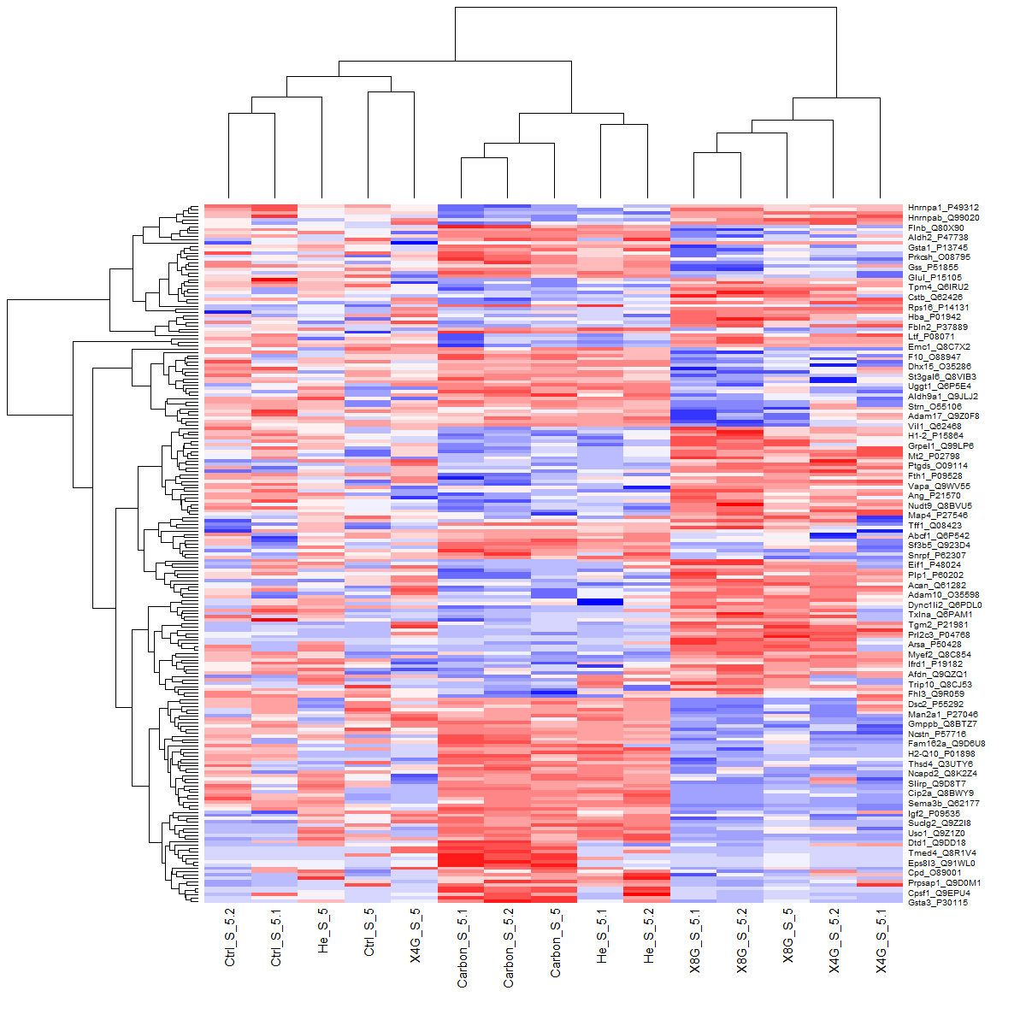
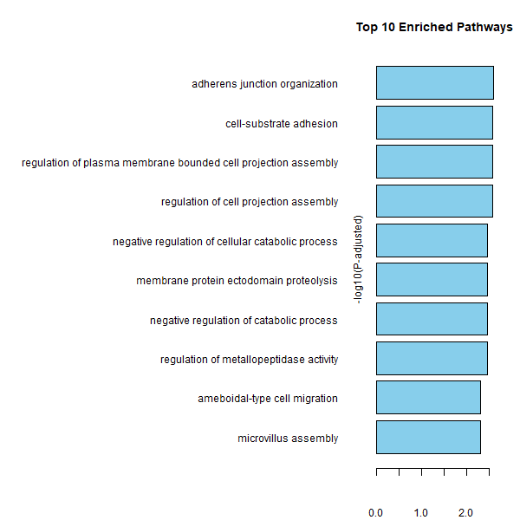
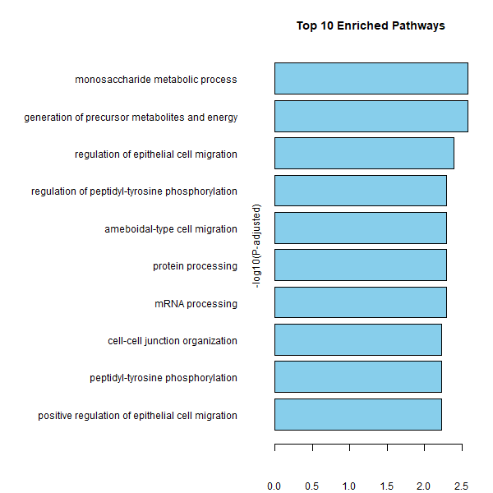
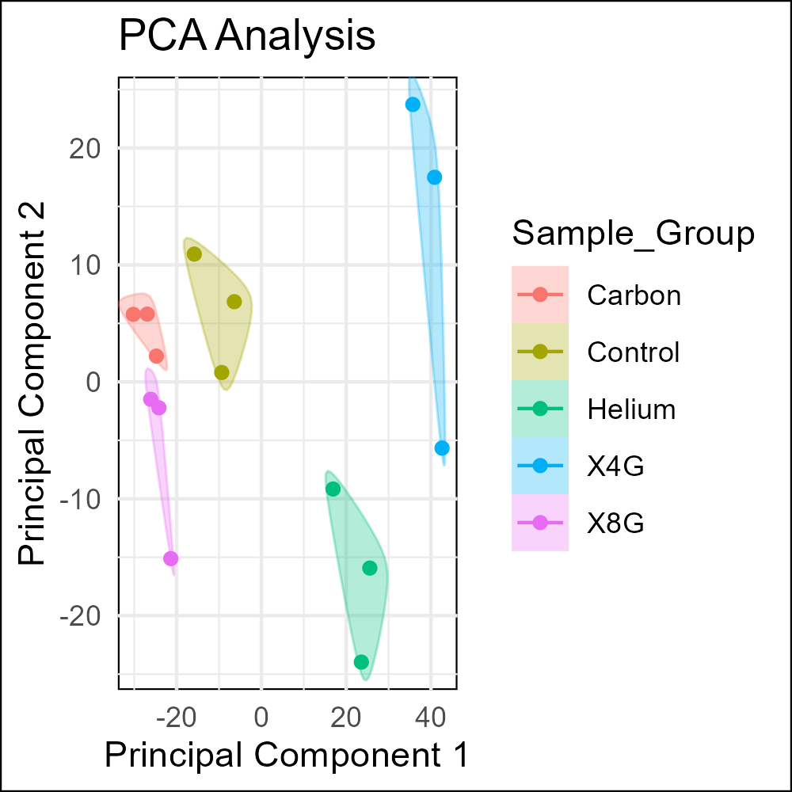
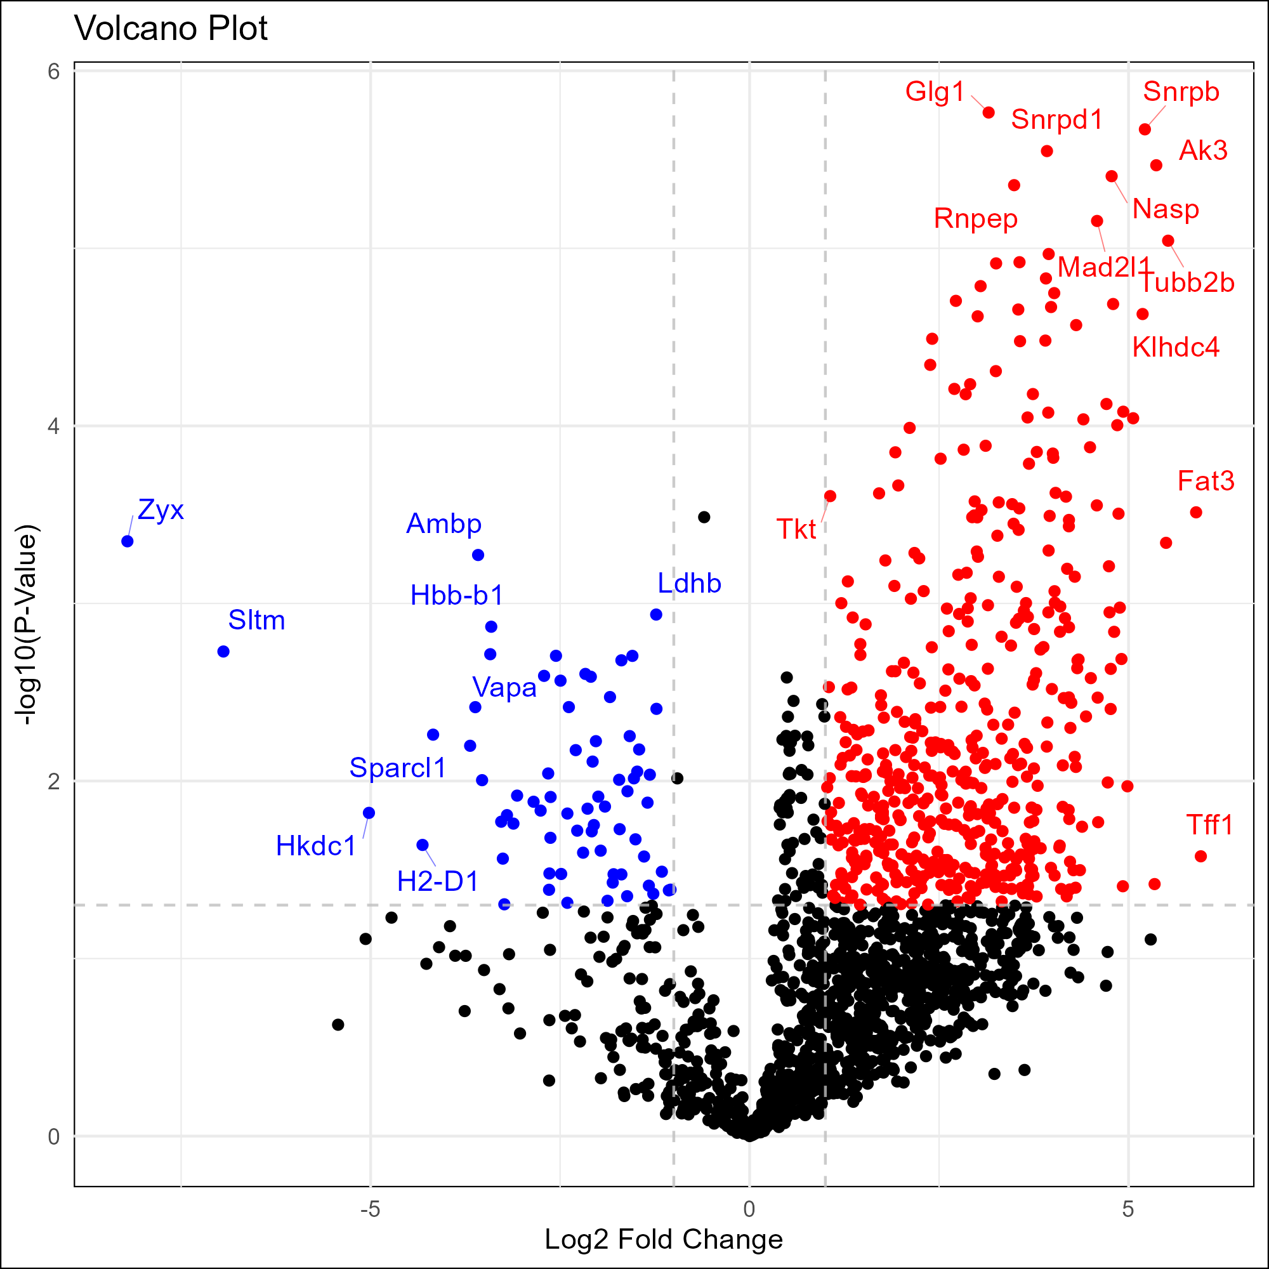
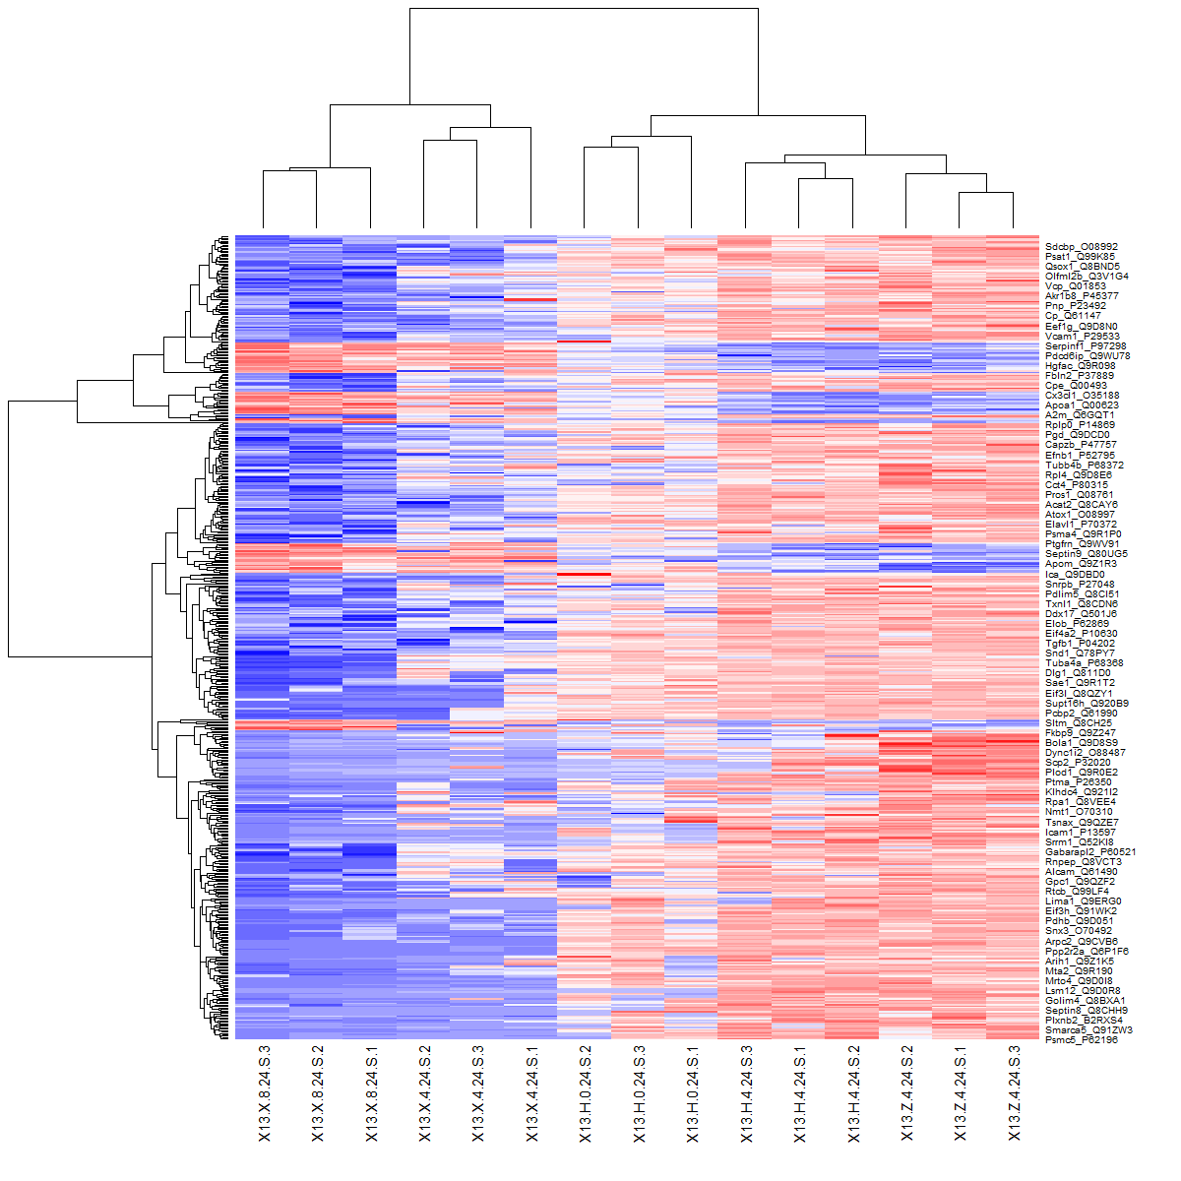
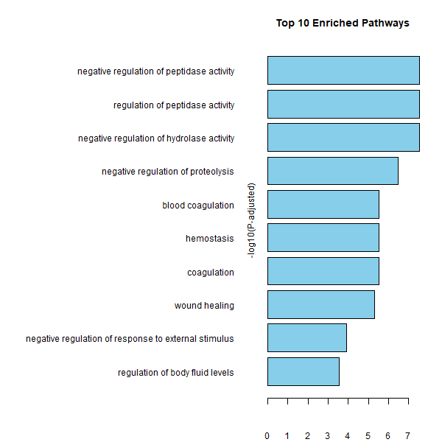
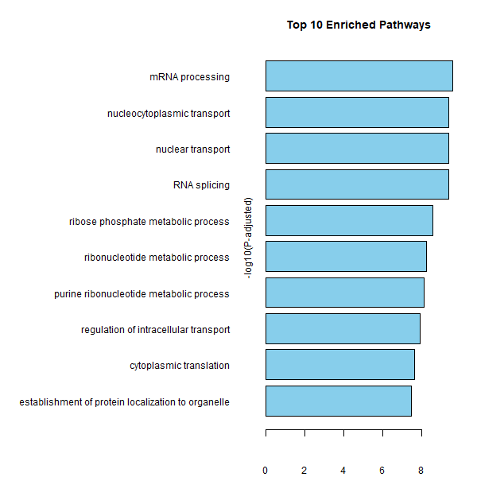
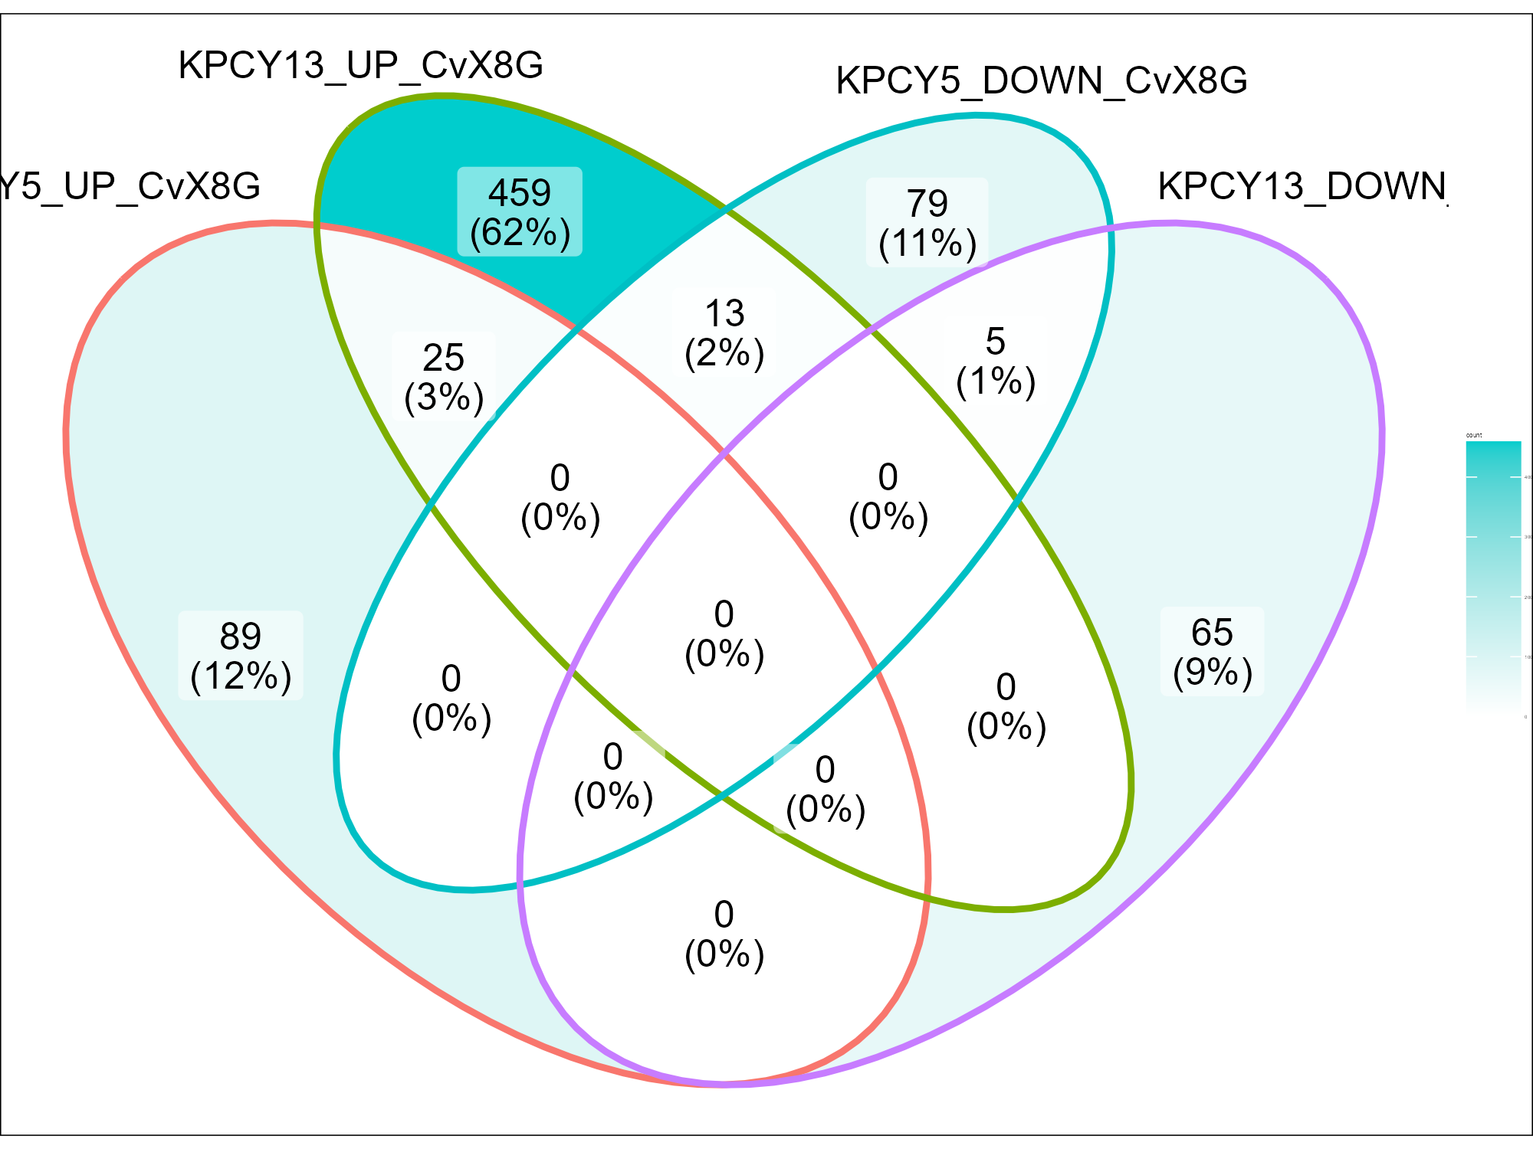
A
B
6419c5 Secretome
E
6419c5 Secretome
Increased by X-Ray 8 Gy
Increased by Carbon 4 Gy
Carbon
Control
Helium
X-Ray 4 Gy
X-Ray 8 Gy
C
Top 10 Pathways Enriched in X-Ray 8 Gy
D
Top 10 Pathways Enriched in Carbon 4 Gy
X-Ray 8 Gy
Control
Carbon 4 Gy
X-Ray 8 Gy
X-Ray 4 Gy
Control
X-Ray 4 Gy
Control
X-Ray 4 Gy
Helium 4 Gy
Carbon 4 Gy
Carbon 4 Gy
X-Ray 8 Gy
Helium 4 Gy
Helium 4 Gy
F
G
2838c3 Secretome
J
2838c3 Secretome
Increased by X-Ray 8 Gy
Increased by Carbon 4 Gy
Carbon
Control
Helium
X-Ray 4 Gy
X-Ray 8 Gy
H
Top 10 Pathways Enriched in X-Ray 8 Gy
I
Top 10 Pathways Enriched in Carbon 4 Gy
Control
X-Ray 4 Gy
Control
Control
X-Ray 8 Gy
X-Ray 4 Gy
X-Ray 4 Gy
Helium 4 Gy
X-Ray 8 Gy
X-Ray 8 Gy
Helium 4 Gy
Carbon 4 Gy
Helium 4 Gy
Carbon 4 Gy
Carbon 4 Gy
K
2838c3_UP
6419c5_UP
6419c5_DOWN
2838c3_DOWN

Slide 3
A
B

