Slide 1
Matrix-Chain Multiplication

Slide 2
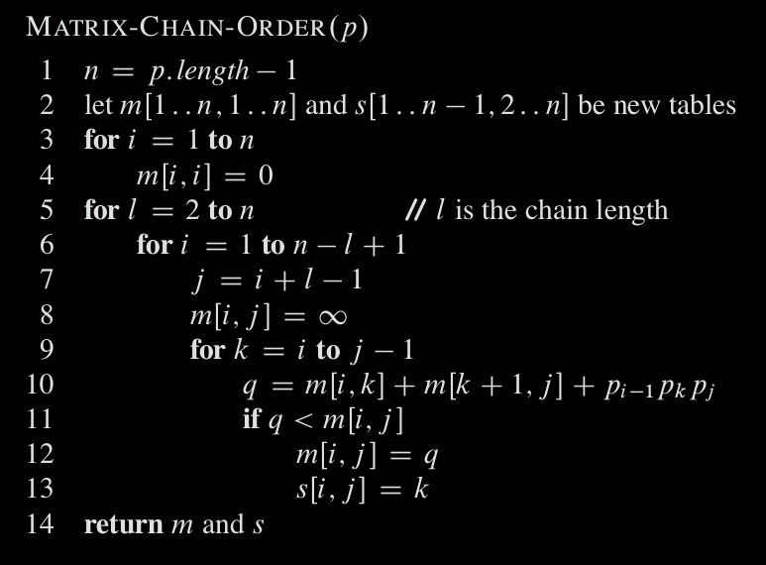
Bottom-up DP

Slide 3
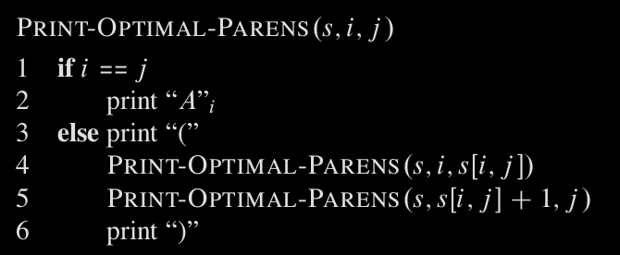
Step 4: Constructing an optimal solution
the call PRINT-OPTIMAL-PARENS (s, 1, 6) prints the parenthesization ((A₁(A₂A₃))((A₄ A₅) A₆))

Slide 4
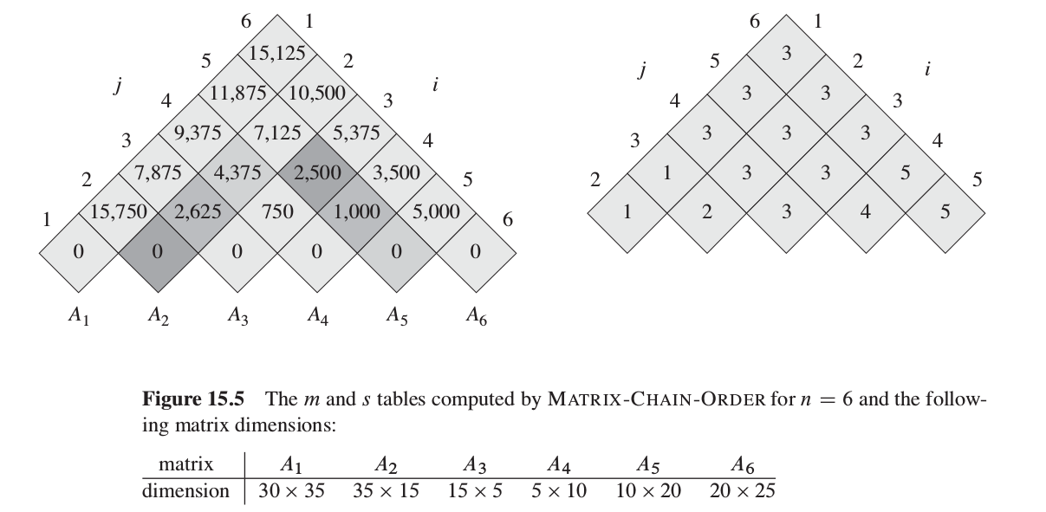
Bottom-up DP

Slide 5
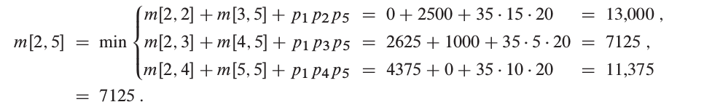
Bottom-up DP
((A1(A2A3))((A4 A5) A6))

