Slide 1
Task
A task is nothing but a function with an independent asynchronous thread of execution
A schedule-able entity that competes for the processor time
Has its own stack
A well-defined priority
Task ID and name
Task Control Block (TCB) – describes the state of the task
TCB
Task Stack
Task State
Task ID/Name
MyTask()
While{ (1)
{
..
}
}
Highest
System Tasks
Initialization and startup
Default idle task – low power mode
Logging task
Exception handling
Debug
Application Tasks
Depends on the system design
Task Priority
Lowest
Task Routine

Slide 2
Scheduling
A mechanism to share the CPU among different applications
Each task thinks that it has the entire CPU for itself
Control given from one task to another with/without task’s knowledge
Operating system “schedules” task i.e., scheduler decides which task to run “now”
Scheduling Algorithms
First come first serve
Round robin
Preemptive priority based scheduling

Slide 3
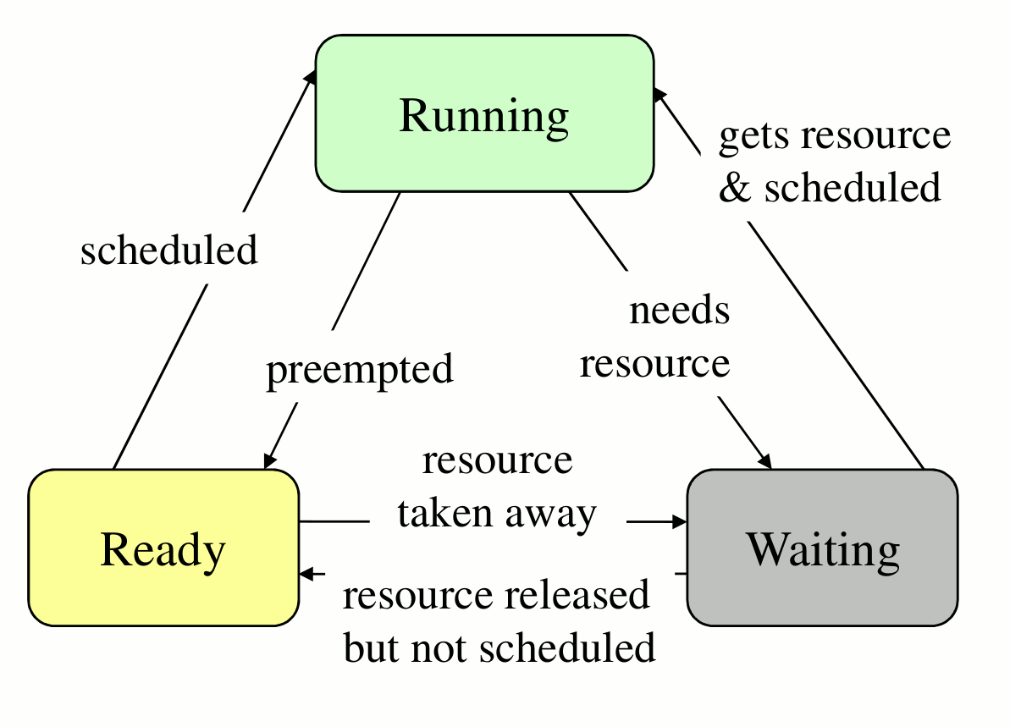
Task states
Running
CPU is currently executing the task
Ready
Needs CPU time but higher priority task is running
Eligible to compete with other Ready tasks for CPU time
Waiting/Blocked
Can not continue, waiting for resource data/event/communication
Task requests for the resource that is not available. OS blocks it so that other tasks can run
Waiting for other task to fill up the buffer
Waiting for button press/timer or DMA interrupt

Slide 4
Assignment-1
Arrange tasks in a queue
TCB structure will have
task_id
task_pri
ptr_context
task_state [Running/Waiting/Ready]
event_id [id of event task is waiting for]
ptr_next_task
Implement ready_queue and waiting_queue
Ready queue is sorted according to priority
Lower the number higher the priority
Waiting queue tasks are waiting for event_id. As soon as the event occurs the task is removed from waiting queue and added to ready_queue
Read initial state of the machine from init_tasks.txt file
Console:
n task_id– Add/create new task
d task_id– Delete task from the Ready/Waiting queue
w task_id event_id – Move task from Ready to Waiting queue
e event_id – Trigger the event of event_id
s event_id – Suspend running task with event_id

