Slide 1
TRIGNOMETRIC FUNCTION GENERATION USING CORDIC
Guhan Rajasekar (22410) , Hari Vignesh (23409)

Slide 2
Aim:
To generate trigonometric functions using CORDIC .
Main focus is on hardware friendly implementation to get results with decent accuracy (Trade off between hardware resources and accuracy).
Trigonometric Functions Implemented Using CORDIC
Sin
Cos
Tan
Tan Inverse
Tan Hyberbolic (Sin Hyperbolic and Cos Hyperbolic are implicitly used here)
Tan Hyberbolic Inverse

Slide 3
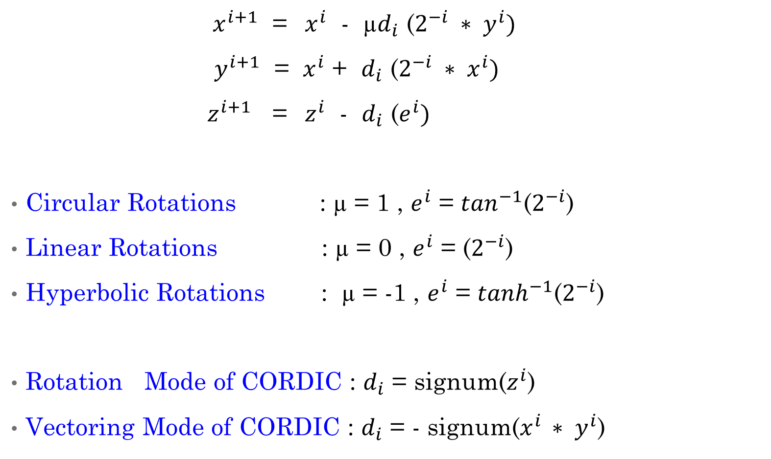
Generalized Equations Of CORDIC
${ x}^{i+1}$ = ${ x}^{i}$ - µ$d_{i}$ ($2^{−i} ∗ y^{i})$
${ y}^{i+1}$ = $x^{i}$ + $d_{i}$ ($2^{−i} ∗ x^{i})$
${ z}^{i+1}$ = $z^{i}$ - $d_{i}$ ($e^{i})$
Circular Rotations : µ = 1 , $e^{i}$ = $\tan^{−1}$($2^{−i}$)
Linear Rotations : µ = 0 , $e^{i}$ = ($2^{−i}$)
Hyperbolic Rotations : µ = -1 , $e^{i}$ = $\tanh^{−1}$($2^{−i}$)
Rotation Mode of CORDIC : $d_{i}$ = signum($z^{i}$)
Vectoring Mode of CORDIC : $d_{i}$ = - signum($x^{i }∗ y^{i}$)

Slide 4
Sin And Cos Function Generation
Both Sin and Cos Functions are generated using Circular Rotations in Rotation Mode .
These waveforms are also displayed on the Oscilloscope using PMOD DA2 DAC.
User can control the frequency using the slide switches present in the FPGA.
Range of Frequencies for which distortion less waveform was observed is 800Hz to 50KHz.
As we move to higher frequencies, conversion time of DAC and computing sin and cos for widely spaced angles(high slide switch values) results in waveform being distorted

Slide 5
Slide Switch Value and Frequency pf Waveform
Slide Switch Value | Frequency (KHz)
0 | 0.814
1 | 1.626
2 | 2.44
3 | 3.257
4 | 4.032
5 | 4.85
7 | 6.55
15 | 12.98
31 | 25.92
63 | 51.75
127 | 104.166 ( Distortion Occurs beyond this point)

Slide 6
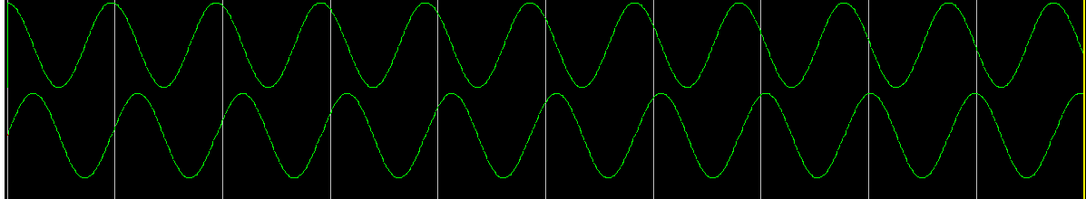
Sin and Cos Simulation Waveforms

Slide 7
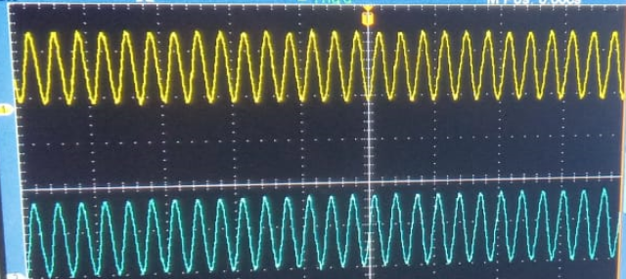
Sin and Cos Functions on Oscilloscope

Slide 8
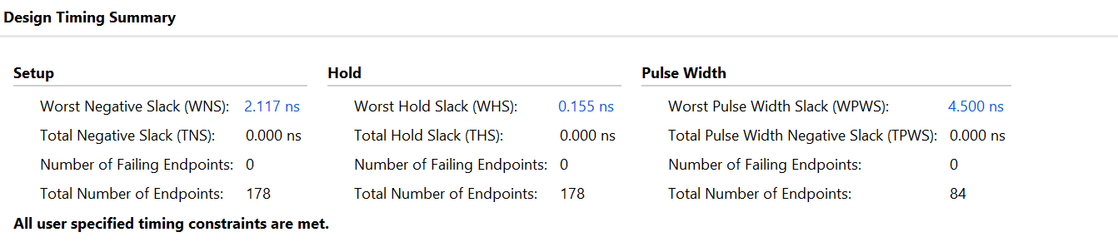
Timing Results
Angles were generated at a lower frequency to feed the results to the DAC. The original clock of 100MHz frequency was used only to generate the slower clock signal clk2. Hence we get positive slack in the timing results.
Max Frequency of Operation : 1 / (10n – 2.117n) = 126.855MHz

Slide 9
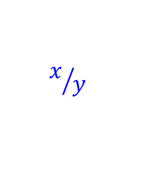
Tan Function Generation
It is not possible to generate tan function directly using CORDIC. But we can perform Division using CORDIC in Vectoring Mode using Linear Rotations.
Since we already have Cos and Sin functions, we pass those results into the Divider block to get tan waveform.
x
tanx
cosx
$$x/y$$
CORDIC cos and sine generator
CORDIC Divider Block
Target Angle
sinx
y

Slide 10
Limitations Of CORDIC Division

