Slide 1
Flask CRUD API

Slide 2
Contents
Creating app module
Installing flask
Importing flask
Route
Running application
Debug Mode

Slide 3
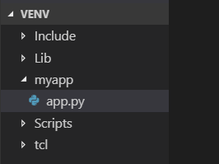
Create Applications
After installing virtual environtment
Create new setup ( virtualenv venv)
Create new app folder(myapp) inside the venv
Create app.py module inside the myapp folder

Slide 4

Installing Flask
Command: pip install flask
After installing the flask, import the flask in app module
Next create an object of Flask Application with constructor

Slide 5
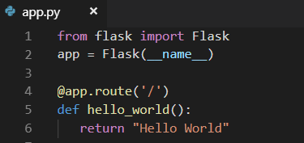
Route
The route() function of the Flask class is a decorator, which tells the application which URL should call the associated function
‘/’ URL is bound with hello_world() function. Hence, when the home page of web server is opened in browser, the output of this function will be rendered.

Slide 6
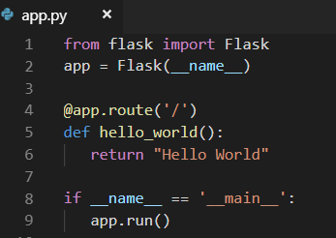
How to run applications
Importing flask module in the project is mandatory. An object of Flask class is our WSGI application.
Flask constructor takes the name of current module (__name__) as argument.
To run the app, we must assign the arguments as __main__

Slide 7

Cont…
Run you app module: python app.py in cmd
To check in browser: http://127.0.0.1:5000/
To change IP Address: python -m flask run --host=172.16.3.64

Slide 8
Debug mode
The Debug mode is enabled by setting the debug property of the application object to True before running or passing the debug parameter to the run() method.
A Flask application is started by calling the run() method. However, while the application is under development, it should be restarted manually for each change in the code. To avoid this inconvenience, enable debug support. The server will then reload itself if the code changes. It will also provide a useful debugger to track the errors if any, in the application.

Slide 9
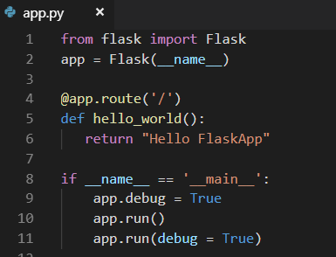
Cont..

Slide 10
THANK YOU

