Slide 1
HTTP METHODS

Slide 2
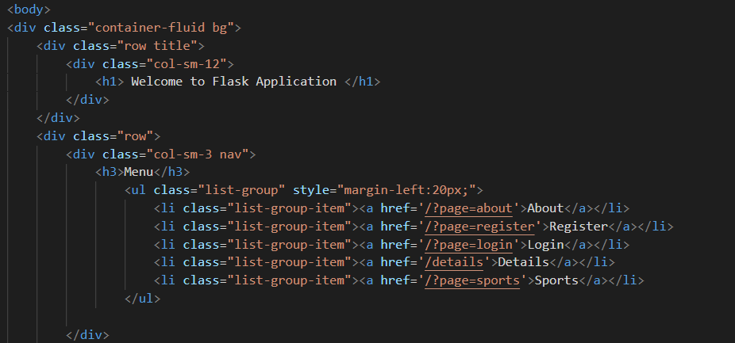
Templates
Create templates folder inside your app
Create Index.html file inside your app folder
The index file has a nav bar to access other files

Slide 3
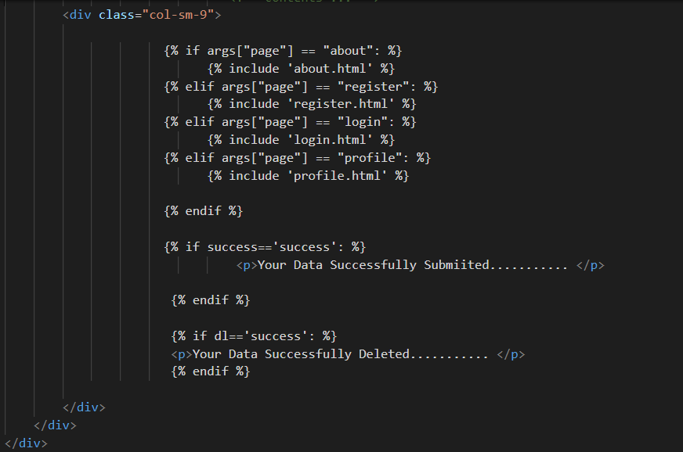
Including Templates
We can include more than one templates in index file

Slide 4


Redirecting the Templates
Import Flask module and routing the templates based on the arguments are provided in the url

Slide 5
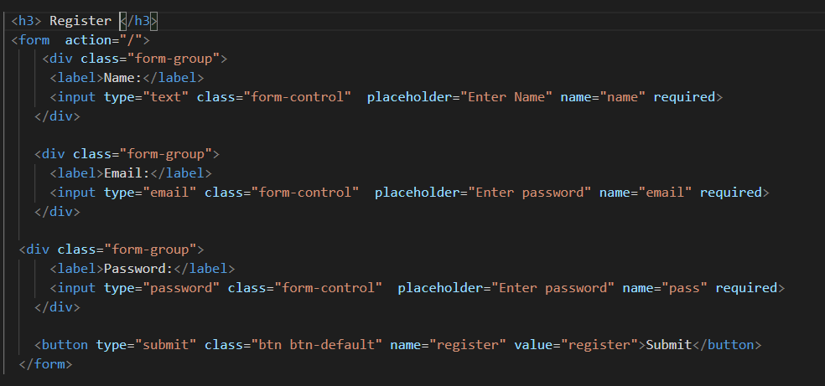
Register Data
Design an application form to submit a data into database in Register.html

Slide 6
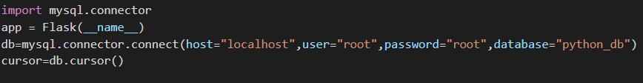
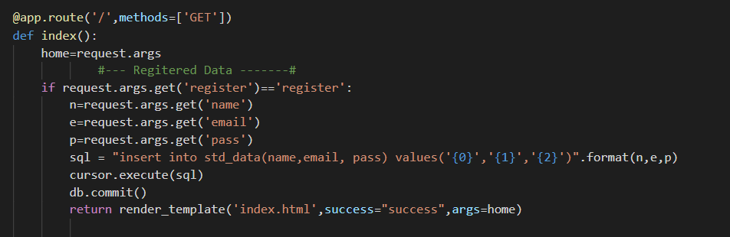
Sent Data into Database
In app module we are using http get method to access the submitted data from html form
Then we will write import python mysql connector module database connectivity
create table std_data(id int auto_increment, primary key(id), name varchar(30), email varchar(30),pass varchar(30));

Slide 7
Thank you

