Slide 1
Login in Flask App API

Slide 2
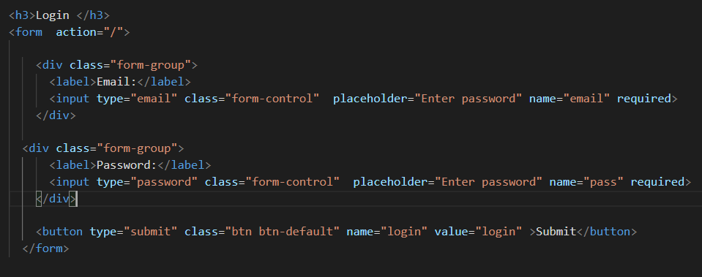
Flask Login Functionalities
Create a login form in login.html

Slide 3
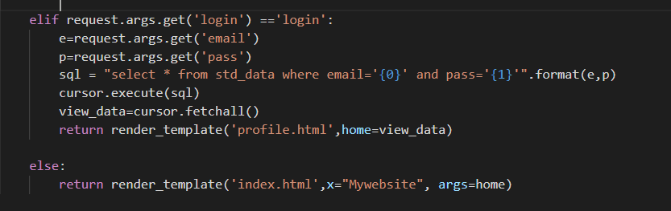
Validate with MySQL Database
The app module has validations code to checks the user login details with mysql database to view their registered details

Slide 4
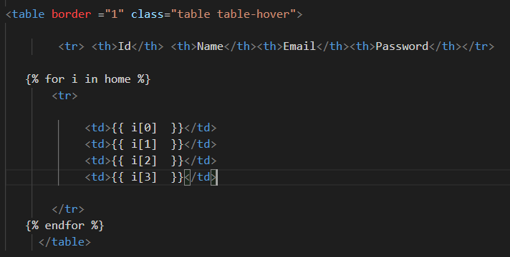
View Registered Data
The app module returns the all data into profile templates
There we can display the data in tabular form

Slide 5
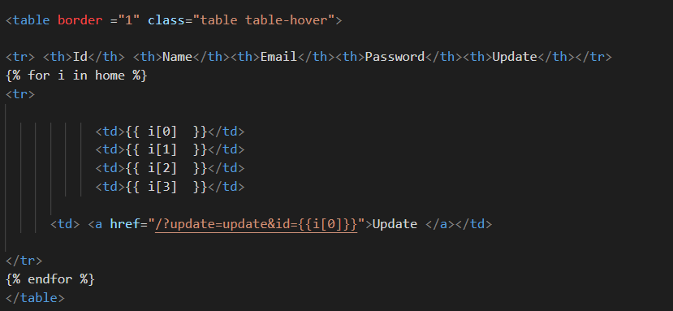
Update Data
The profile templates shows the corresponding data that has verified with mysql database there we have to add hyperlink or form action to retrieve data to update

Slide 6
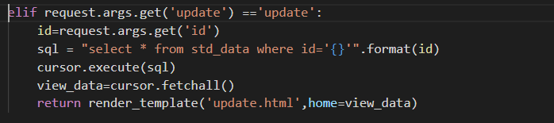
Retrieve data…
First we have to retrieve data then we have redirect into update template to edit the data to update

Slide 7
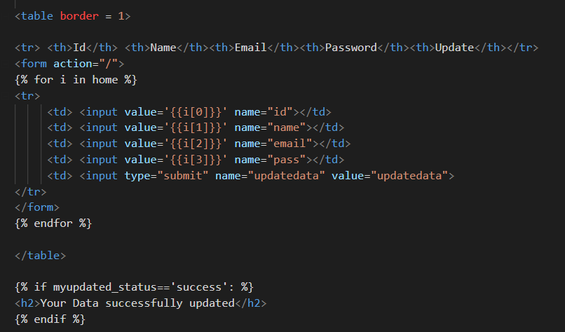
Edit Data
The update template has a form to submit the updated data into mysql database

Slide 8
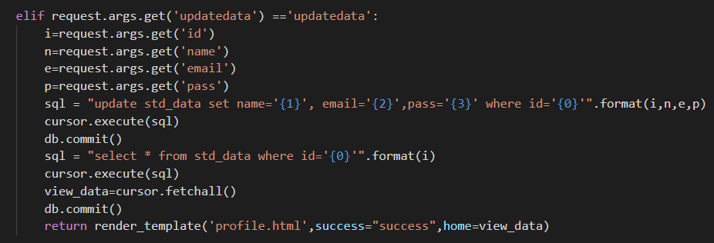
View Updated Data
In app module, the submitted updated details are updated in mysql database
Then retrieves the updated data to display in update templates

Slide 9
Thank you

