Slide 1
Delete and Filters Details

Slide 2
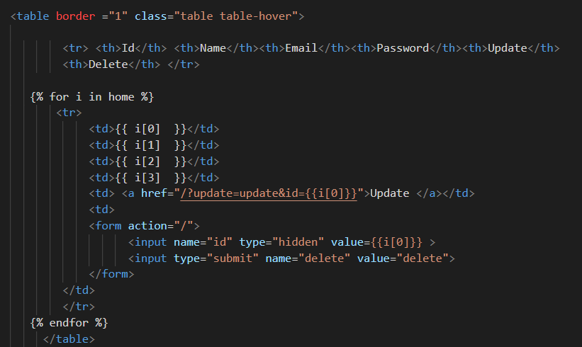
Delete Request
Update the profile templates to send the delete request

Slide 3
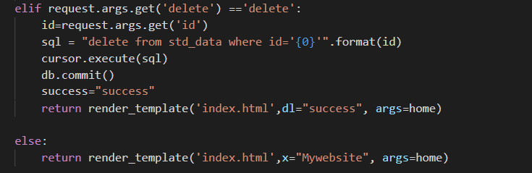
Delete using unique values
The delete request is extracted for remove registered data in mysql database

Slide 4
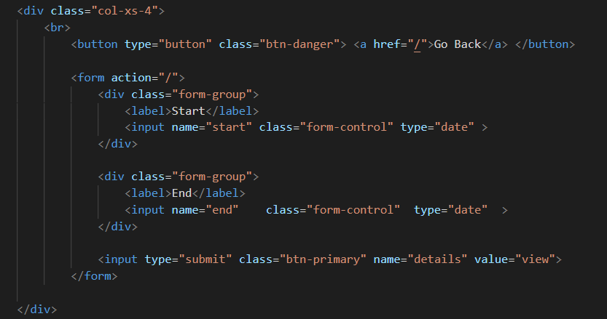
Filter By Date
Create Table in MySQL Database: create table login_details(id int, email varchar(30), pass varchar(30), timing timestamp default current_timestamp, counting varchar(30) default 1, foreign key(id) references std_data(id));
In details template has a form for filtering the data by date

Slide 5
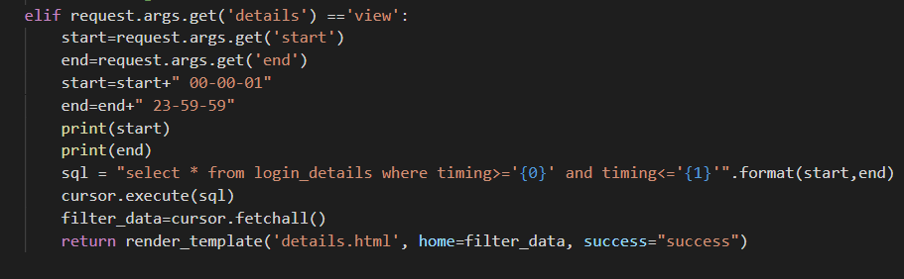
Cont..
We need to extract date from url to filters the data from mysql database

Slide 6
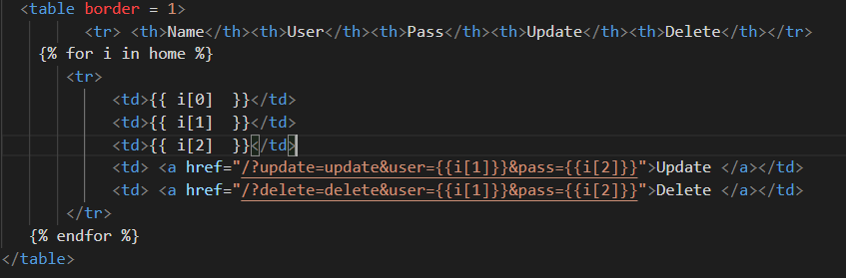
Delete Records
In profile.html we have to include one more option to delete a records in database
Once the delete button is pressed, the request will be sent via url

Slide 7
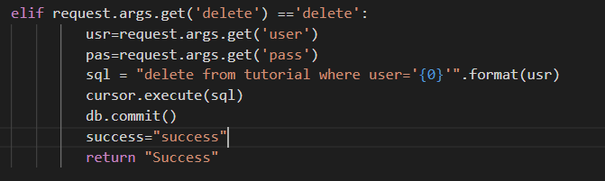
Cont..
In app module, we are using delete query to remove the records from database once the corresponding username has verified

Slide 8
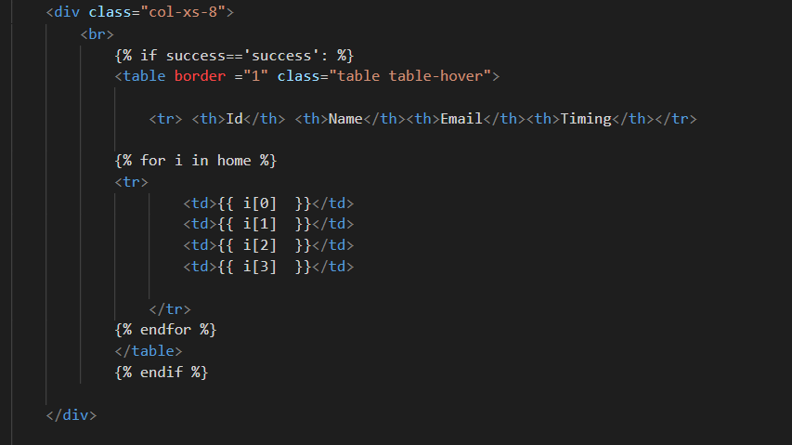
Display the filtered data
In details template we have designed template for filtering the data from database that will be displayed in html table

Slide 9
Thank You

