Slide 1
Hardware Programming

Slide 2
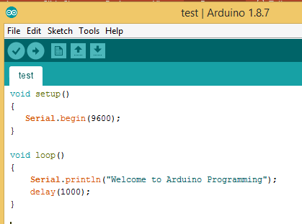
Structure of Arduino Programming
The program has two main scope one is declaration(setup) part and another one is execution part(loop).
The variable declarations and initialization of the serial communications within this part(setup). It executes only one time.
The executions parts(loop) executes code continuously
This scope used to read the sensor input and triggers the outputs

Slide 3
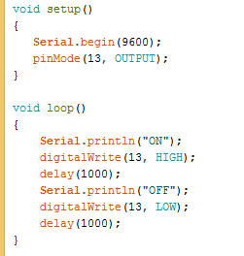
LED Blinking
In setup function, we are initialize the LED pin 13 to blink built-in LED of Arduino board

Slide 4
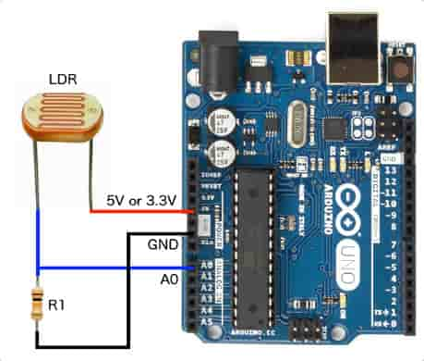
Read the sensor input
Choose any one of the pins of LDR to 5v of Arduino board
The LDR other pin connected to 1K Resistor to limit the current flow inside the LDR
The other terminal of resistor connected to ground. The sensor output is taken from in-between the resistor and LDR

Slide 5
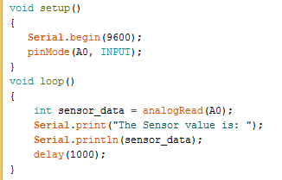
Display the sensor value
Initialize the analog pin(A0) in setup function
Store the sensor value is integer to display in serial monitor

Slide 6
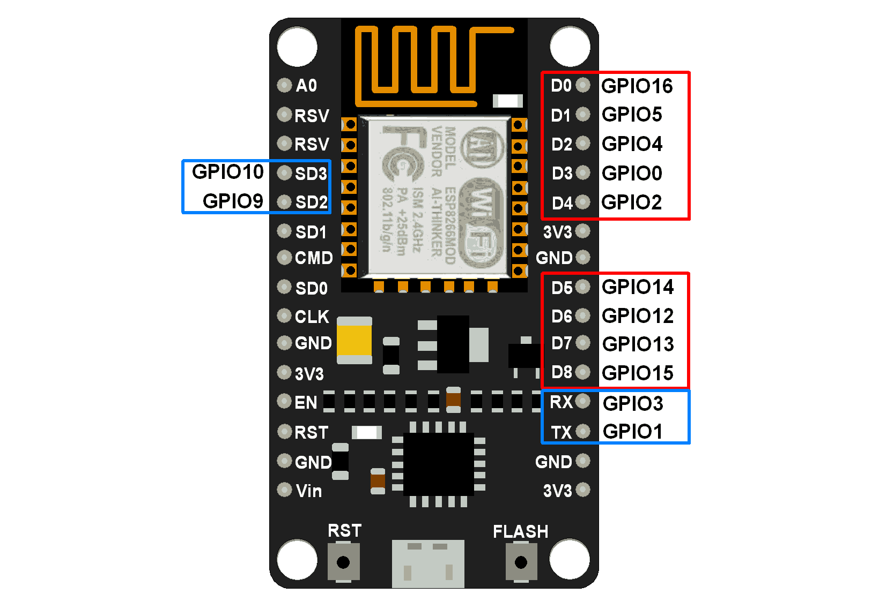
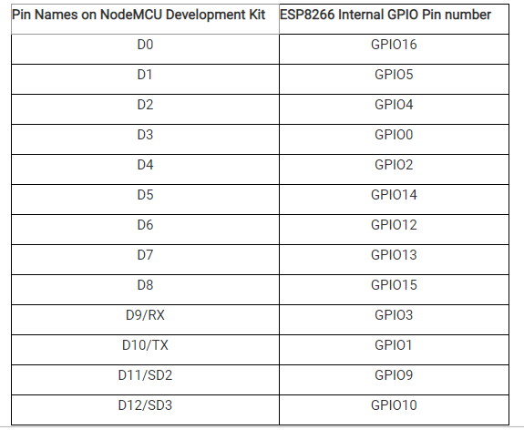
Pin Configurations
General-purpose input/output (GPIO) is a pin on an IC (Integrated Circuit).
It can be either input pin or output pin, whose behavior can be controlled at the run time.

Slide 7
Setup a NodeMcu Board
In Arduino IDE, Go to file and select preferences the add
http://arduino.esp8266.com/stable/package_esp8266com_index.json for additional board manager
Go to tools and visit manage libraries install the ESP8266 nodemcu libraries if it is not available in your libraries
Select the NodeMcu ESP(0.9) 12E module in Arduino IDE Tools to upload the programs into microcontroller

Slide 8
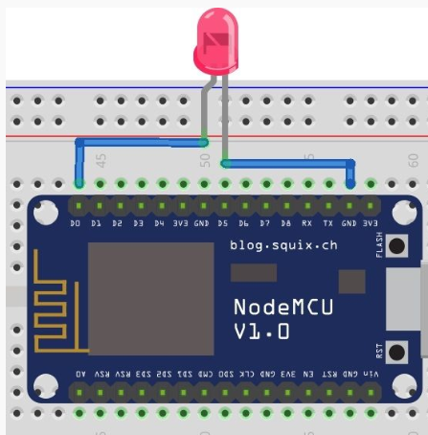
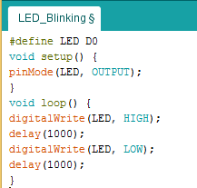
LED Blinking
Connect LED +ve terminal to NodeMcu D0 pin
Connect LED –ve pin to NodeMcu Ground pin

Slide 9
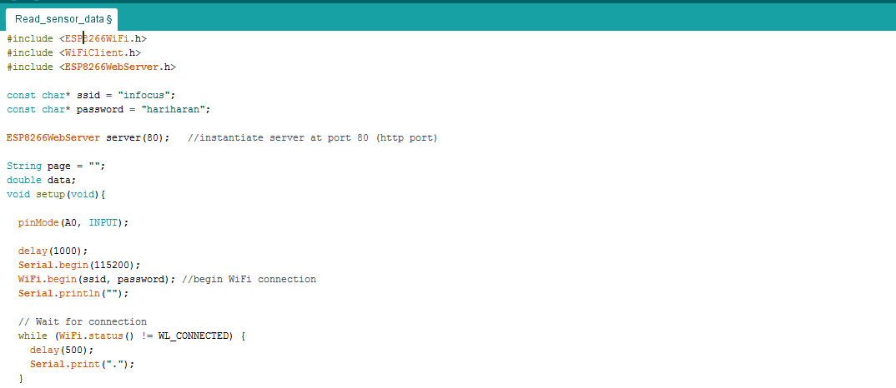
Read the sensor details using NodeMcu

Slide 10
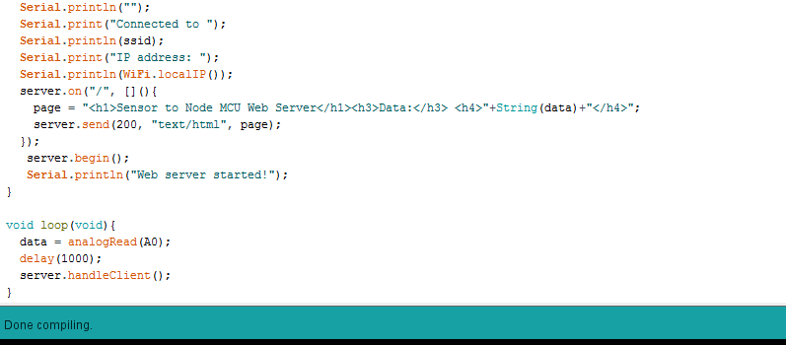
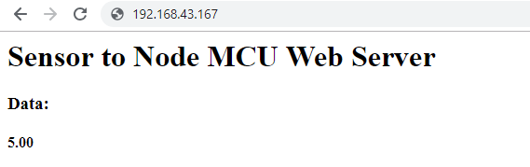
Cont..

Slide 11
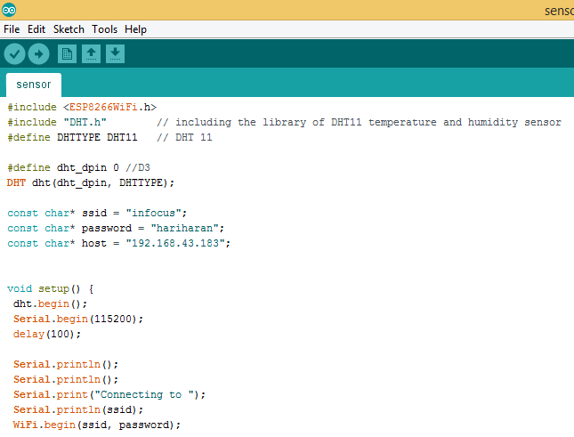
Store sensor data in mysql database

Slide 12
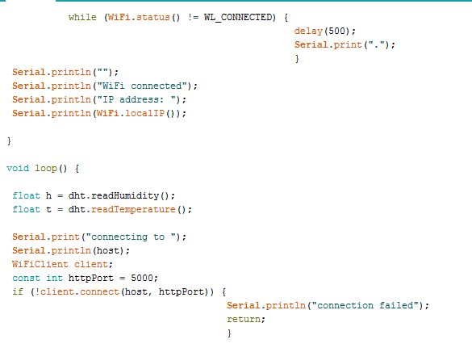
Cont..

Slide 13
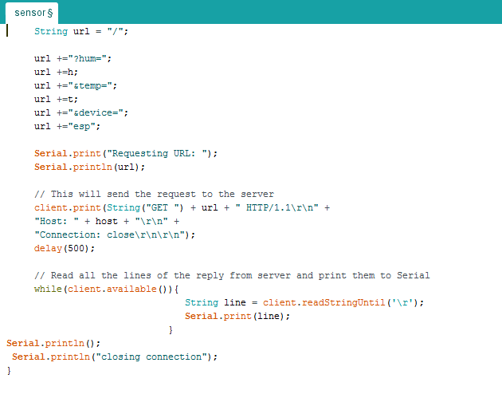
Cont..

Slide 14
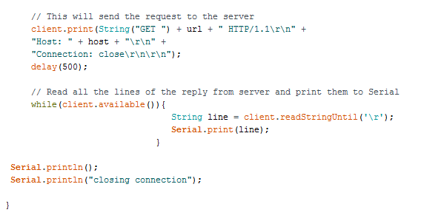
Cont..

Slide 15
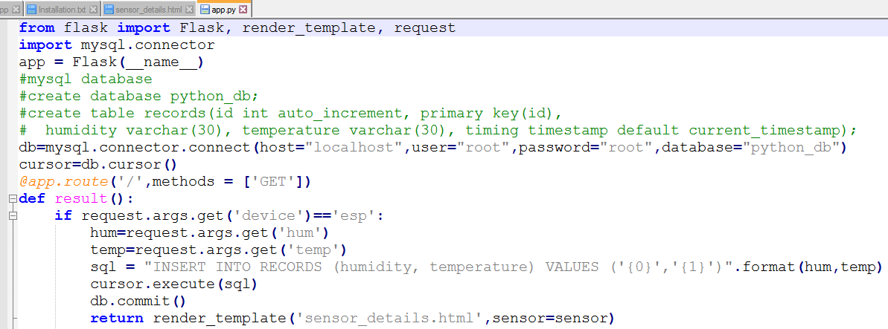
Flask Applications
Install Flask Application and Create Python_db and records table in mysql server

Slide 16
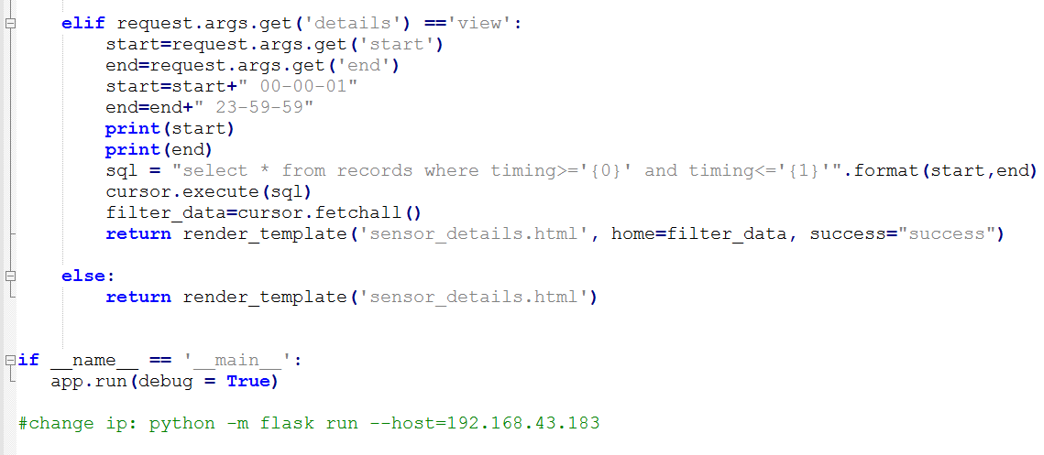
Cont…

Slide 17
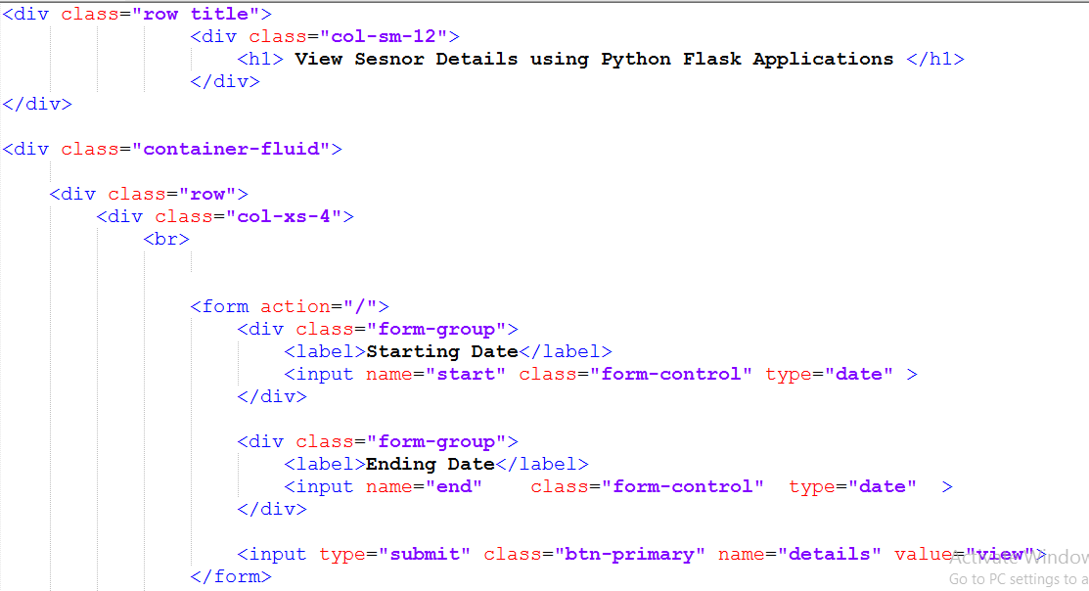
Template for filtering the data

Slide 18
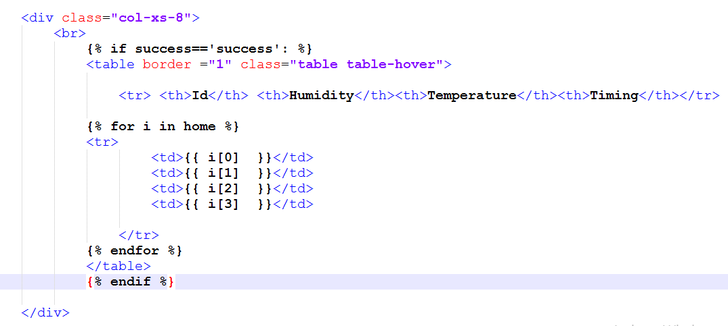
View the sensor data

Slide 19
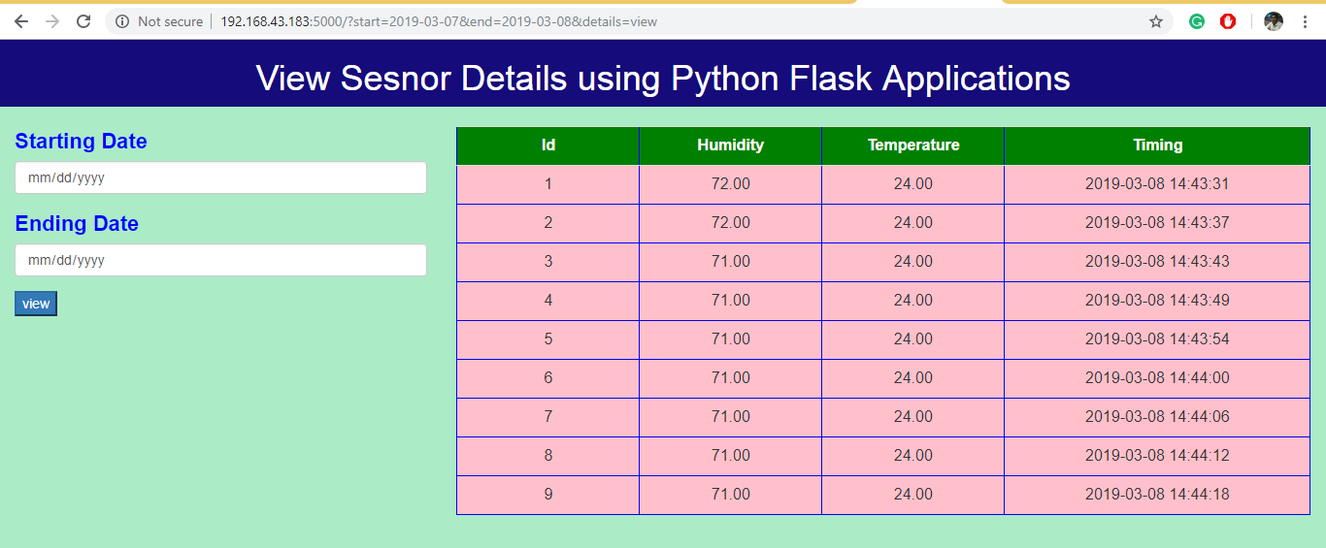
Application View

Slide 20
Thank You…

