Slide 1
BASIC OPERATIONS

Slide 2
Table of Contents
Operators
Looping
Counters

Slide 3
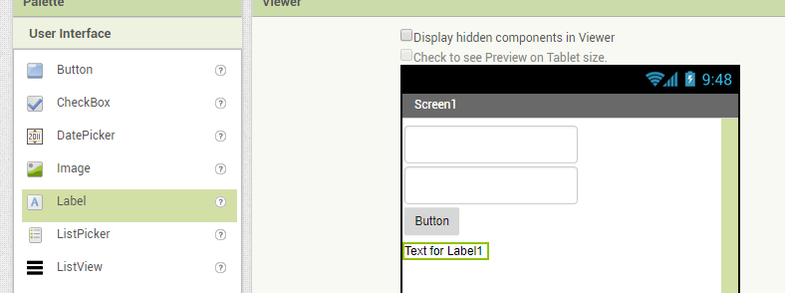
Operators
The operators deals with basic arithmetic operations
In this applications we are using simple addition operations
First Login with your account.
Go to user interface select 2 input box, 1 label and 1 Button
Here we are choosing input box for getting user values and label for display the result and button for submission of input data

Slide 4
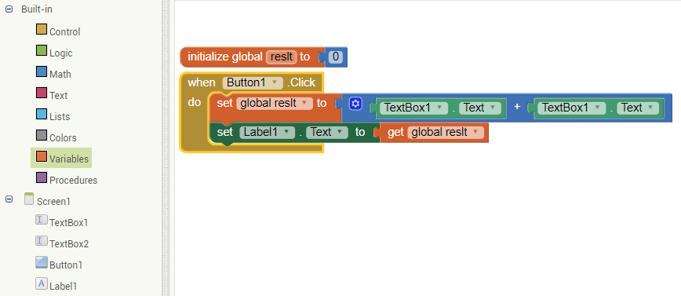
Block for Addition of two numbers
First select the variable and initialize the global variable(result) is zero (that is selected from math)
Select the button to get user input display the result
There we are choosing input box and label for get user values and display the result

Slide 5
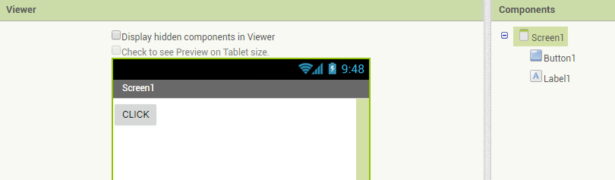
For Loop
Select a button and label for using for loop operations

Slide 6
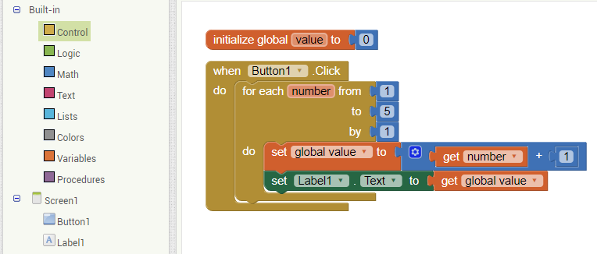
Blocks for Looping Operations
Select the variable to initialize the global variable
Select the button for using click functions
Select the control to use the for each functions to iterate the range of numbers

Slide 7
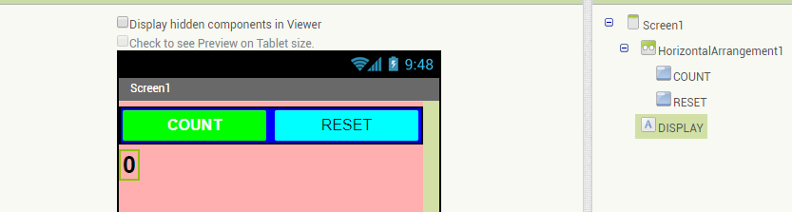
Counter
Add two buttons in Horizontal Arrangements and use 1 label for display the results
Assign initial value as zero in the label text

Slide 8
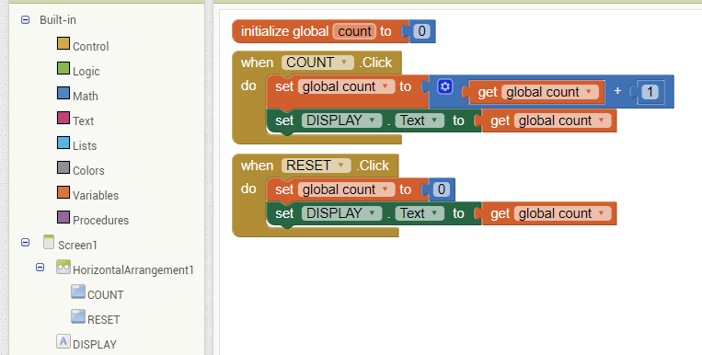
Blocks for Counting Numbers(Counter)
Initialize the global variable as zero
Select the button to count the value
Select the reset button to reset value as zero

Slide 9
THANK YOU

