Slide 1
Menu and Form Designing

Slide 2
Table of Contents
Toggle Image
Switching the screens
Menu Designing
Form Designing

Slide 3
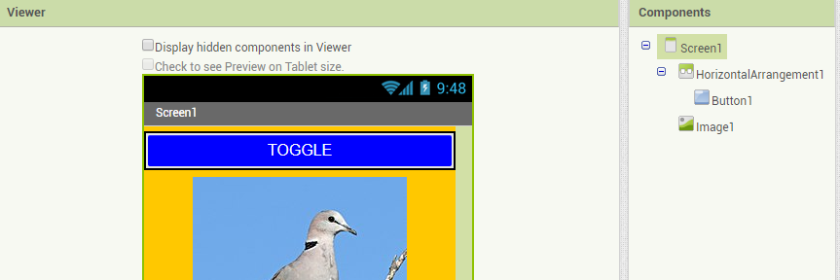
Toggle Image
Select a layout of Horizontal Arrangement
Add button inside the layout
Select image from User Interface and upload the image file

Slide 4
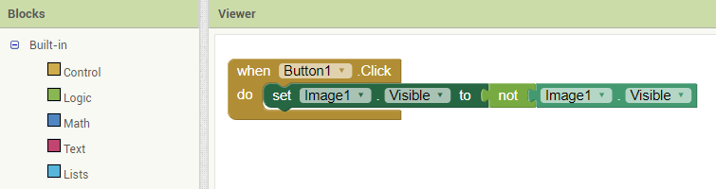
Block for Toggle Image
Select a button for click function
Set a image as visible from image options
Choose a logic operation as not for invisible

Slide 5
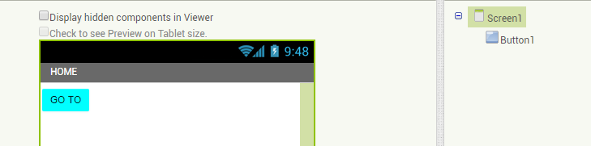
Switching the Screens
Create two screen (using add buttons) and provide the title as home and profile
Change the title as visible

Slide 6
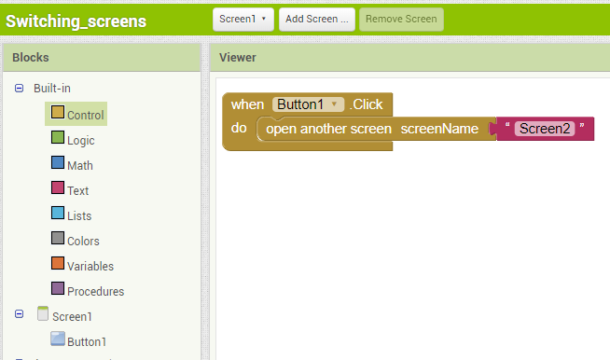
Blocks for screen switching
Select a button for submit options
Choose another screen option from control (built-in) for opening new screens

Slide 7
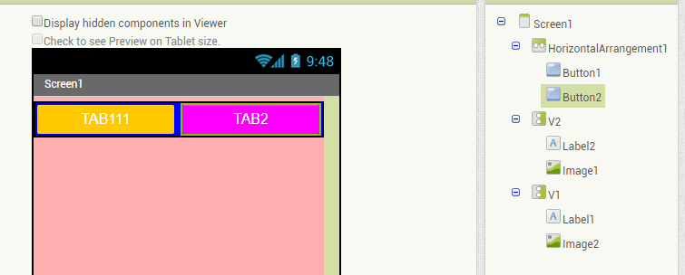
Tab Menu
Select 1 horizontal Arrangement from layout and add two buttons for switching (navigations)
Select two vertical arrangements and add two labels and images from user interface to check menu functionalities

Slide 8
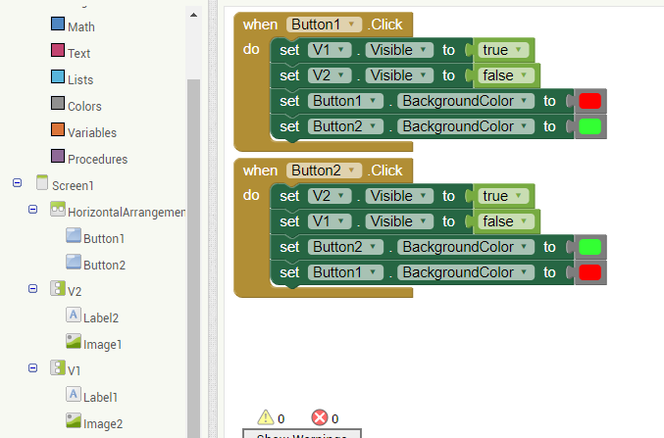
Blocks Tab Menu
Select button 1 and set vertical arrangements are true and false for hide and show while navigating the vertical arrangements
Repeat the above procedure for button 2

Slide 9
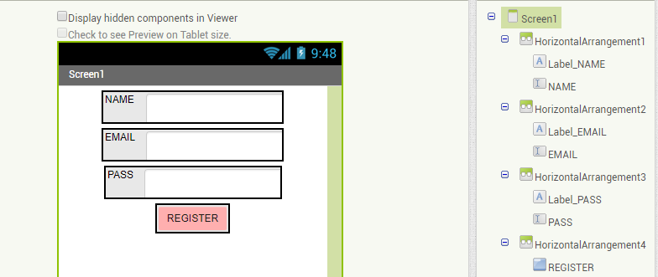
Form Designing
Select three horizontal arrangements
Add three inputs and label inside the horizontal arrangements
Add a button to submit details

Slide 10
THANK YOU

