Slide 1
Lesson 21 NumPy
Python Mini-Course
University of Oklahoma
Department of Psychology

Slide 2
Lesson objectives
Use the NumPy package

Slide 3
What is NumPy?
NumPy is the fundamental package needed for scientific computing with Python. It contains:
a powerful N-dimensional array object
basic linear algebra functions
basic Fourier transforms
sophisticated random number capabilities
tools for integrating Fortran code
tools for integrating C/C++ code

Slide 4
NumPy documentation
Official documentation
http://docs.scipy.org/doc/
The NumPy book
http://www.tramy.us/numpybook.pdf
Example list
http://www.scipy.org/Numpy_Example_List_With_Doc

Slide 5
The ndarray data structure
NumPy adds a new data structure to Python – the ndarray
An N-dimensional array is a homogeneous collection of “items” indexed using N integers
Defined by:
the shape of the array, and
the kind of item the array is composed of

Slide 6
Array shape
ndarrays are rectangular
The shape of the array is a tuple of N integers (one for each dimension)

Slide 7
Array item types
Every ndarray is a homogeneous collection of exactly the same data-type
every item takes up the same size block of memory
each block of memory in the array is interpreted in exactly the same way

Slide 8
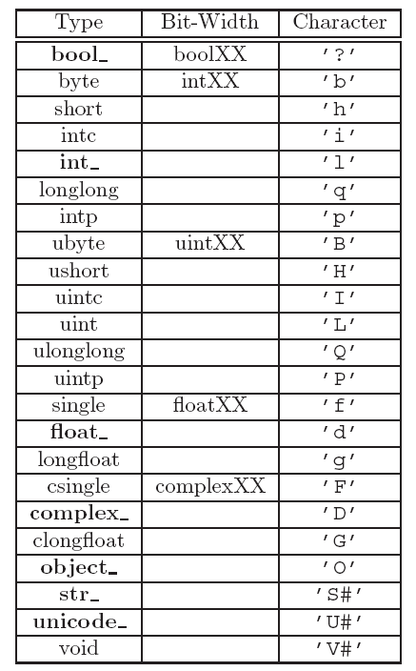

Slide 10
Example: creating an array
import numpy
a = array([[1,2,3],
[4,5,6],
[7,8,9]])
a.shape
a.dtype

Slide 11
Indexing arrays
Use a tuple to index multi-dimensional arrays
Example:
a[1,2]

Slide 12
Slicing arrays
Slicing arrays is almost the same as slicing lists, except you can specify multiple dimensions

Slide 13
Examples: Slicing arrays
a[1]
a[1,:]
a[1,1:]
a[:1,1:]

Slide 14
Some ndarray methods
ndarray. tolist ()
The contents of self as a nested list
ndarray. copy ()
Return a copy of the array
ndarray. fill (scalar)
Fill an array with the scalar value

Slide 15
Some NumPy functions
abs()
add()
binomial()
cumprod()
cumsum()
floor()
histogram()
min()
max()
multipy()
polyfit()
randint()
shuffle()
transpose()

Slide 16
Suggested exercise
Complete the desc_stat_calc.py program

