Slide 1
Machine Learning
Presented By Guhan Ganesan M.E.,

Slide 2
What is NumPy?
NumPy is a module for Python. The name is an acronym for "Numeric Python" or "Numerical Python".
It is pronounced /ˈnʌmpaɪ/ (NUM-py) or less often /ˈnʌmpi (NUM-pee)).
It is an extension module for Python, mostly written in C.
This makes sure that the precompiled mathematical and numerical functions and functionalities of Numpy guarantee great execution speed.

Slide 3
Cont..
NumPy is the fundamental package needed for scientific computing with Python. It contains:
A powerful N-dimensional array object
A basic linear algebra functions
A basic Fourier transforms
A sophisticated random number capabilities
A tools for integrating Fortran code
Atools for integrating C/C++ code

Slide 4
History of Numpy
The Python programming language was not initially designed for numerical computing.
A special interest group called matrix-sig was founded in 1995 with the aim of defining an array computing package.
Among its members was Python designer and maintainer Guido van Rossum, who implemented extensions to Python's syntax (in particular the indexing syntax) to make array computing easier.
An implementation of a matrix package was completed by Jim Fulton, then generalized by Jim Hugunin to become Numeric,also variously called Numerical Python extensions or NumPy.

Slide 5
How to install?
Standard Python distribution doesn't come bundled with NumPy module.
A lightweight alternative is to install NumPy using popular Python package installer, pip
pip install numpy

Slide 6
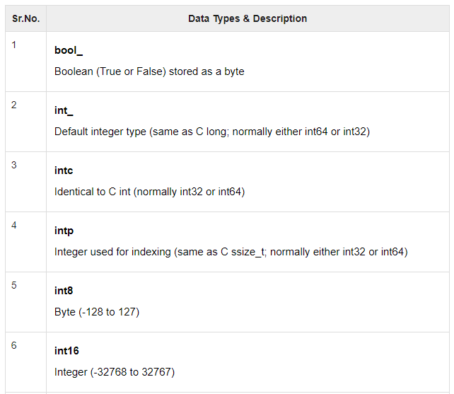
Data Types

Slide 7
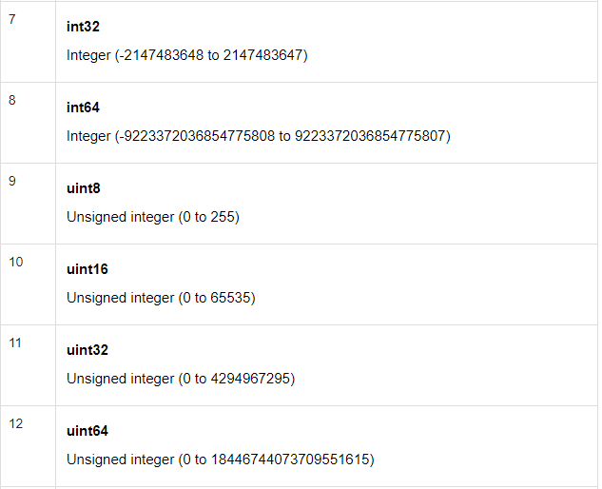
Cont..

Slide 8

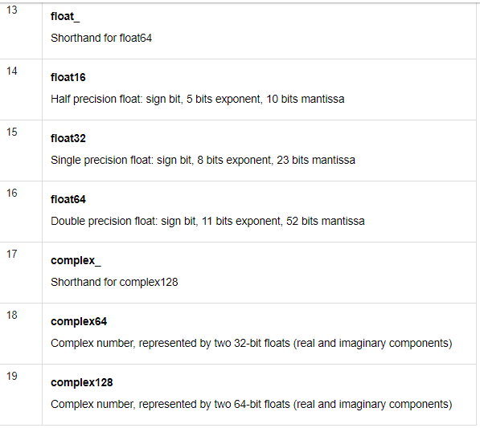
Cont..

Slide 9
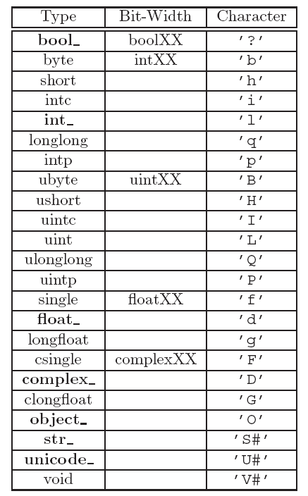

Slide 11
Thank You

