Slide 1
Mathematical and Statistical functions

Slide 2
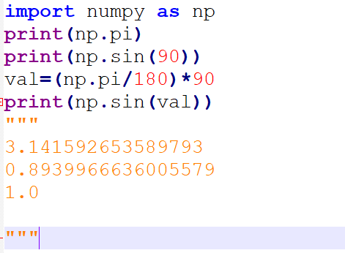
Mathematical functions
Most frequently needed mathematical functions

Slide 3
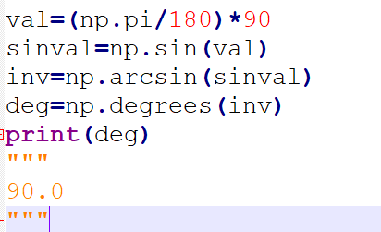
Cont..

Slide 4
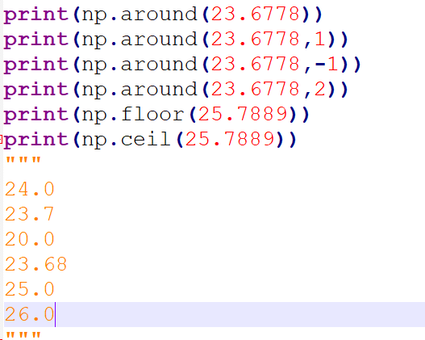
Cont..

Slide 5
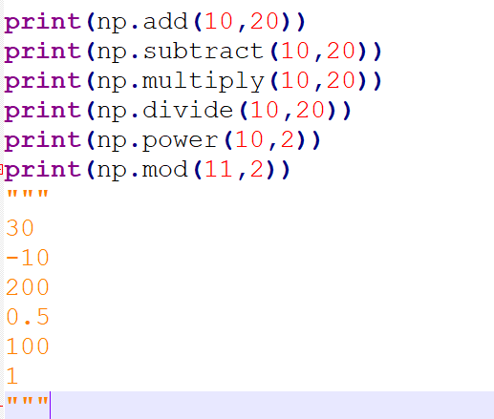
Cont..

Slide 6
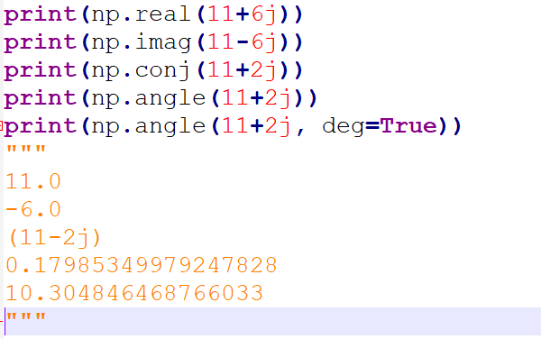
Cont..

Slide 7
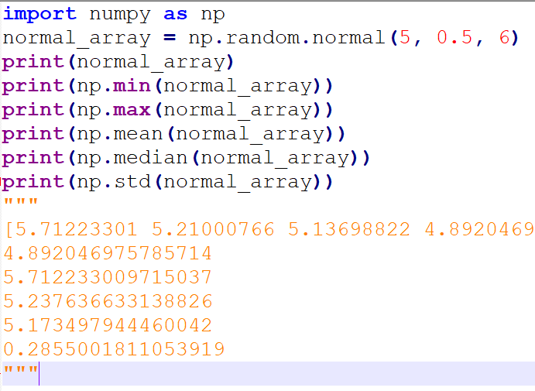
Statistical functions

