Slide 1
DATAFRAMES

Slide 2
What is Dataframes?
Pandas DataFrame is two-dimensional size-mutable, potentially heterogeneous tabular data structure with labeled axes (rows and columns).
A Data frame is a two-dimensional data structure, i.e., data is aligned in a tabular fashion in rows and columns.
Pandas DataFrame consists of three principal components, the data, rows, and columns.

Slide 3
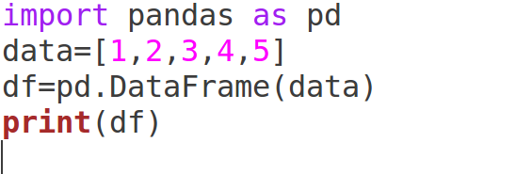
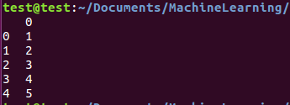
Example

Slide 4
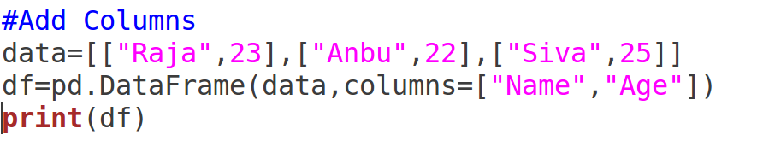

Add Column Details

Slide 5
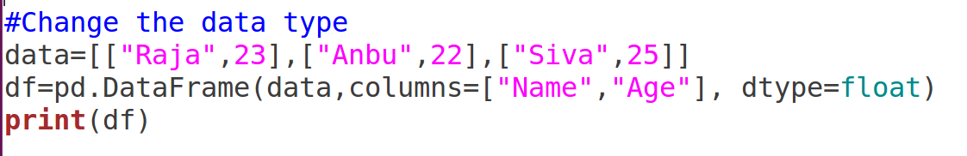

Changing the data types

Slide 6
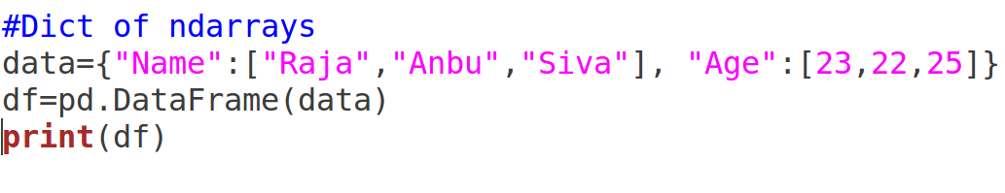

Dictionary of ndarray

Slide 7
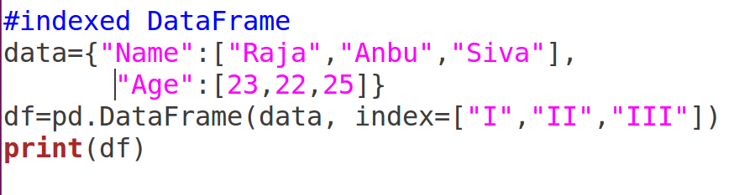

Indexed Dataframe

Slide 8
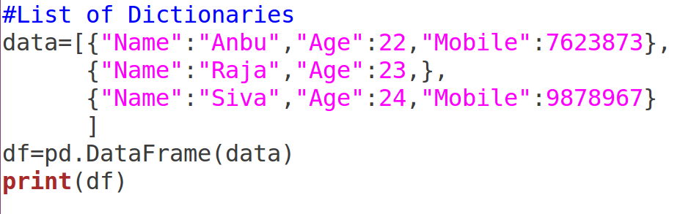
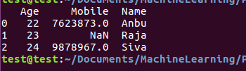
List of Dictionaries

Slide 9
Not a number
NaN, standing for not a number, is a member of a numeric data type that can be interpreted as
a value that is undefined or unrepresentable, especially in floating-point arithmetic.

Slide 10
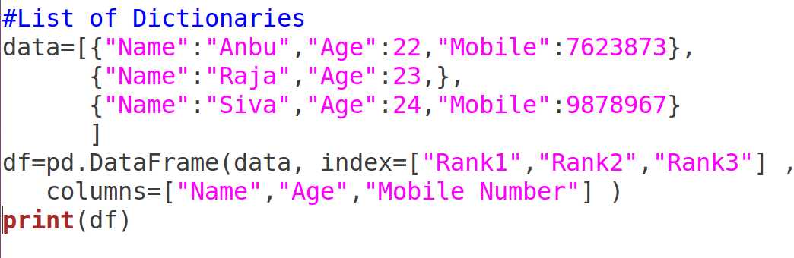

List of Dictionaries with index

Slide 11
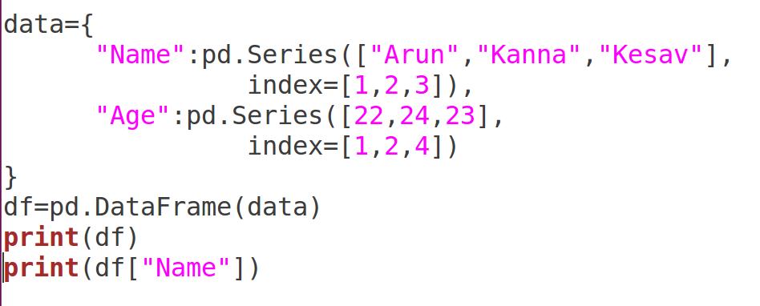
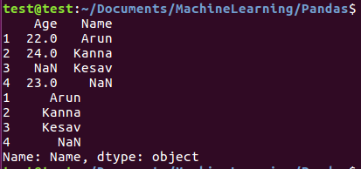
Cont..

Slide 12
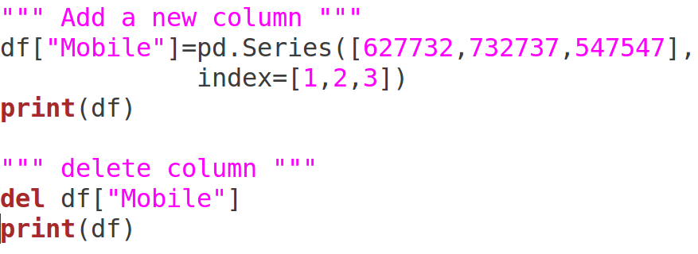
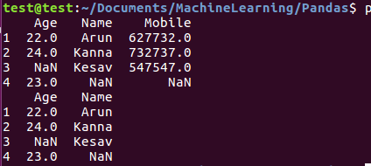
Add and Delete Columns

Slide 13
Thank You

